Slide 1
Demonstrating the impact of modelling coupled irrigation over regional and global domains
Heather Rumbold, Adrian Lock, Martin Best
3rd Pan-GASS Meeting, Friday 29th July 2022

Slide 2
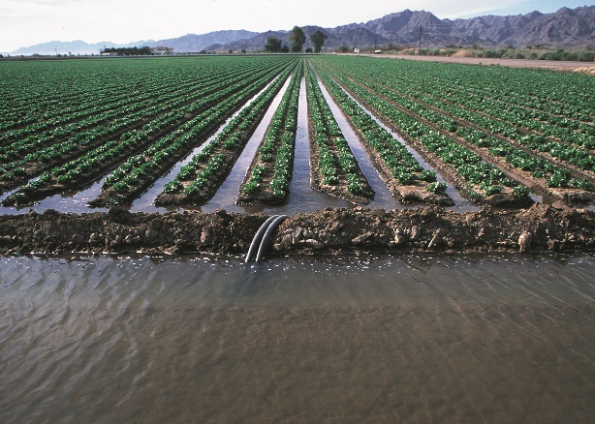
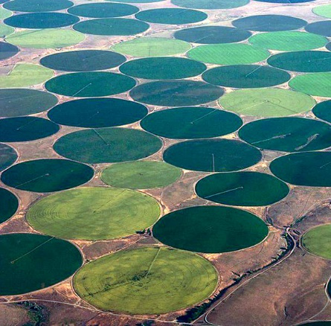
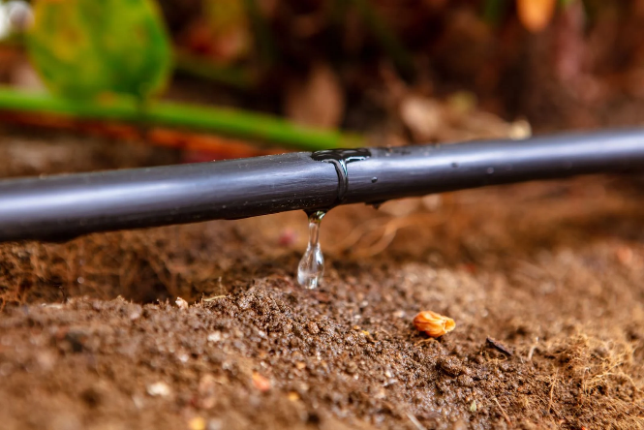
Irrigation
Huge spatial and temporal variability in application of irrigation
Many different methods used:
Bringing in water via pipes from rivers, canals and reservoirs
Flood irrigation systems
Sprinkler systems
Drip irrigation
(Credit: Jeff Vanuga, USDA Natural Resources Conservation Service)
https://phys.org/news/2014-01-effects-earth.html

Slide 3
Coupled JULES Irrigation
JULES (Joint UK Land Environment Simulator) irrigation code has been coupled to the Unified Model (UM)
Ancillaries of irrigated fraction of grid box have been developed from two sources¹ ²
Irrigation here adds water to keep the top two soil layers (10+25cm depths) at the critical point
removing any moisture stress for the vegetation.
Irrigate grid boxes where irrigated fraction > 0
Irrigate C3 and C4 grass tiles only
Irrigate all year round on every timestep
No limitation on water availability

Slide 4
Impacts of irrigation in regional forecasts

Slide 5
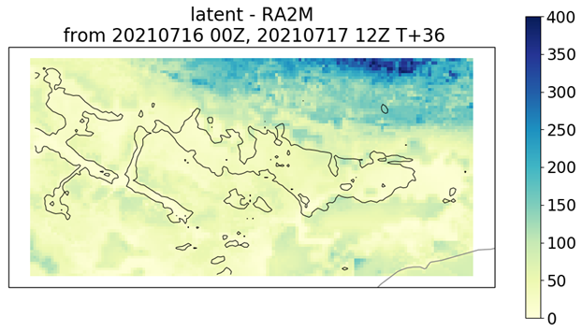
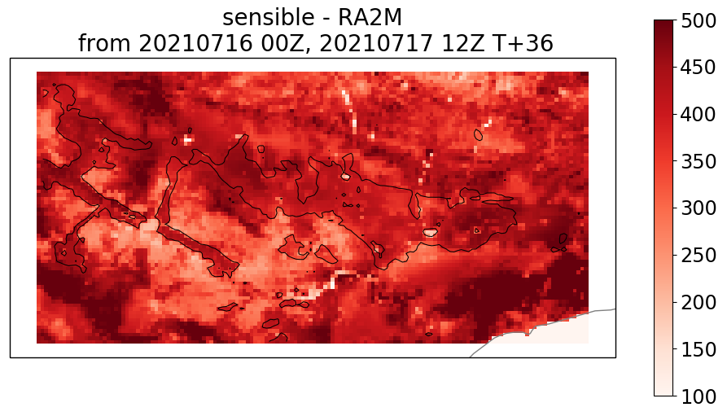
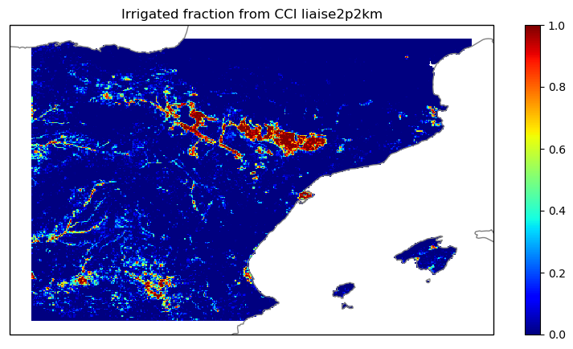
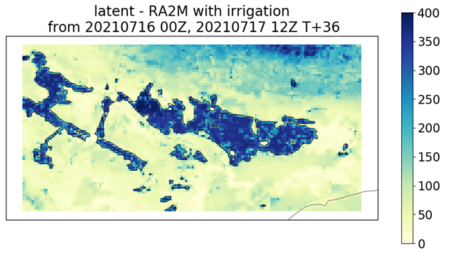
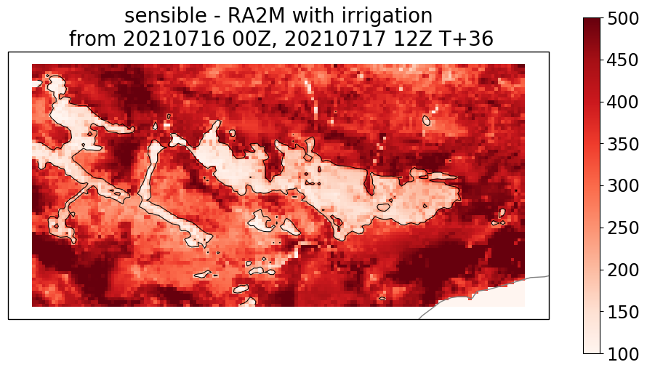
Impacts of irrigation in LIAISE simulations
The LIAISE international observational campaign was targeted to improve the understanding of land-atmosphere-hydrology interactions in a semi-arid region of NE Spain
strong surface heterogeneity between the natural, rainfed landscape and irrigated agriculture
2.2km resolution forecasts from Met Office global analyses at 0z on 16th July 2021 to T+36
Control is RAL2-M
Latent heat flux (Wm⁻²) no irrigation
Sensible heat flux (Wm⁻²) no irrigation
Irrigated fraction for LIAISE domain
Latent heat flux with irrigation
Sensible heat flux with irrigation
Ancillary derived from ESA Climate Change Initiative (CCI) land cover dataset

Slide 6
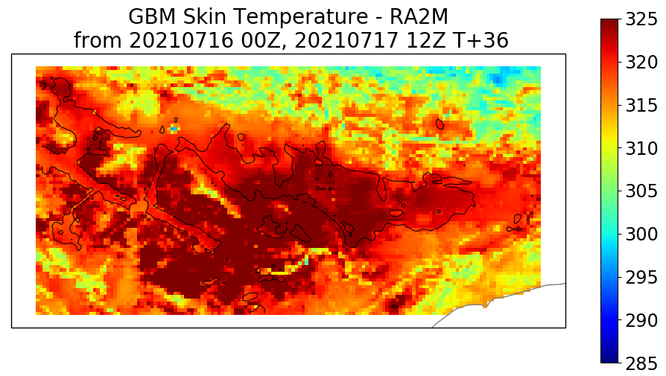
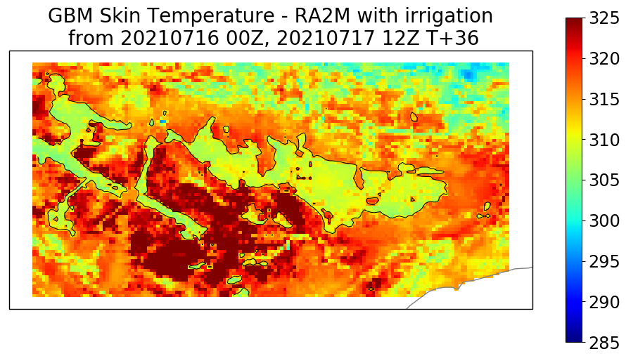
Land Surface (Skin) Temperatures T+36 12z 16th July 2021
Skin temperature without irrigation
Observed daytime LST from Terra/Modis (20210717)
Skin temperature with irrigation
Observations from https://worldview.earthdata.nasa.gov

Slide 7
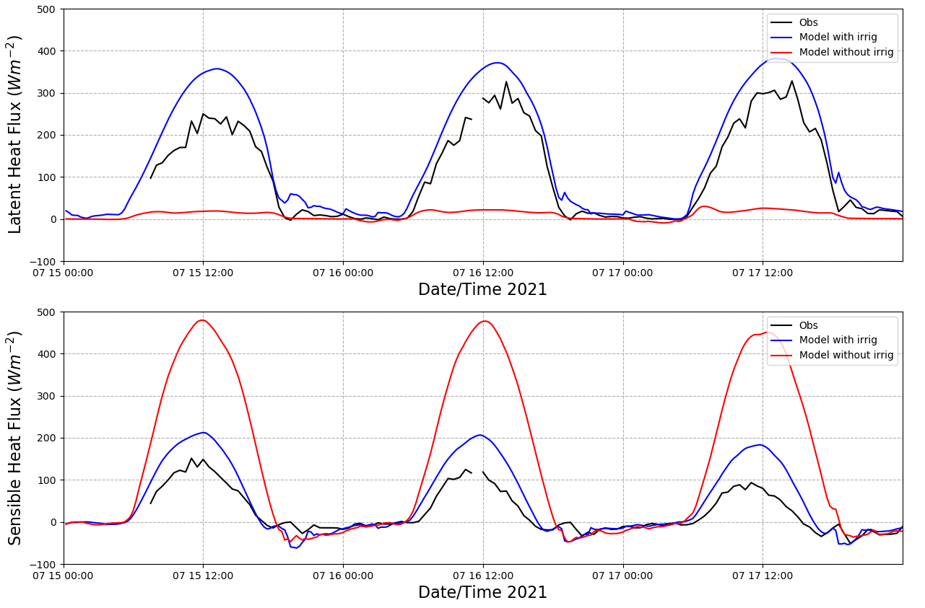
Surface fluxes at irrigated site, La Cendrosa
500
Latent heat flux
With irrigation
Observed
Irrigated site of fast growing Alfalfa crop
Subjected to flood irrigation on 10th July
IOP days 15th-17th July
0
Without irrigation
500
Sensible heat flux
Without irrigation
With irrigation
Observed
0
0 UTC
15th July
0 UTC
16th July
0 UTC
17th July

Slide 8
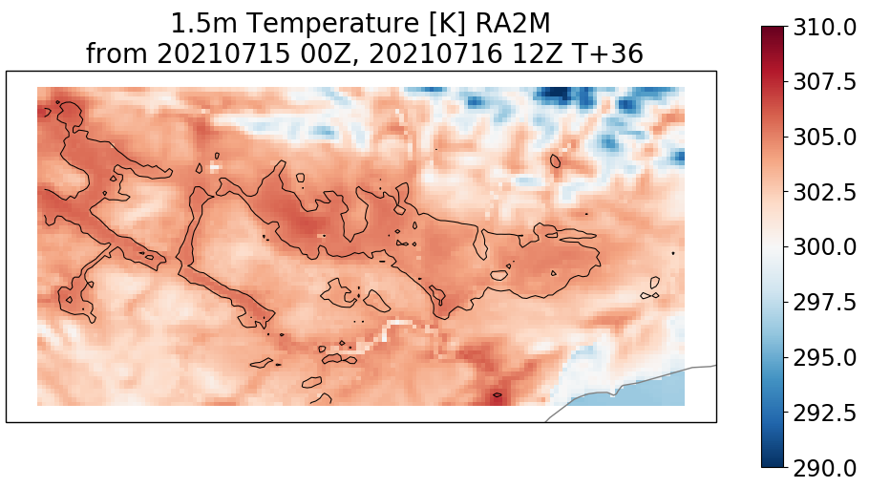
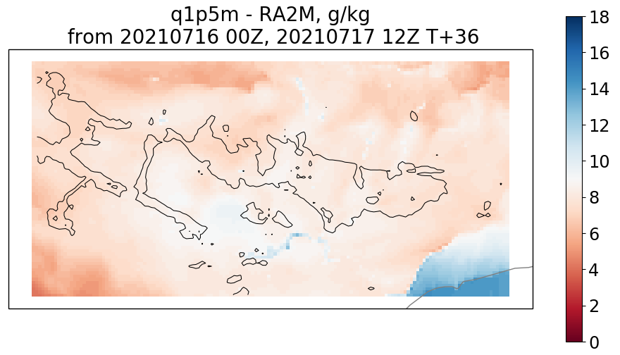
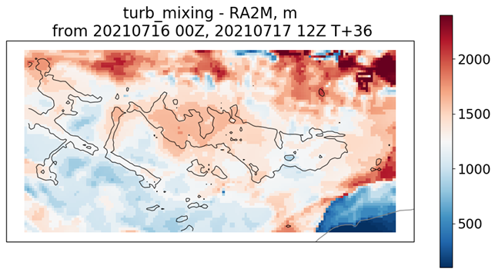
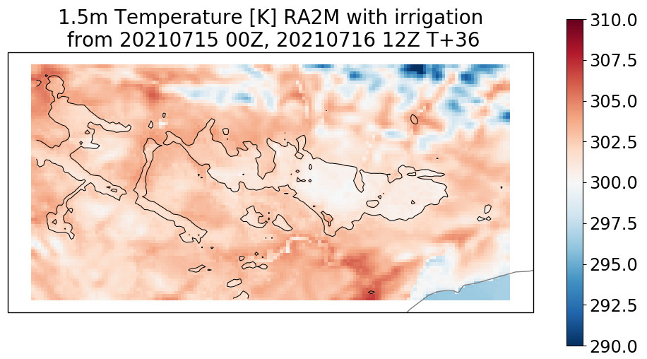
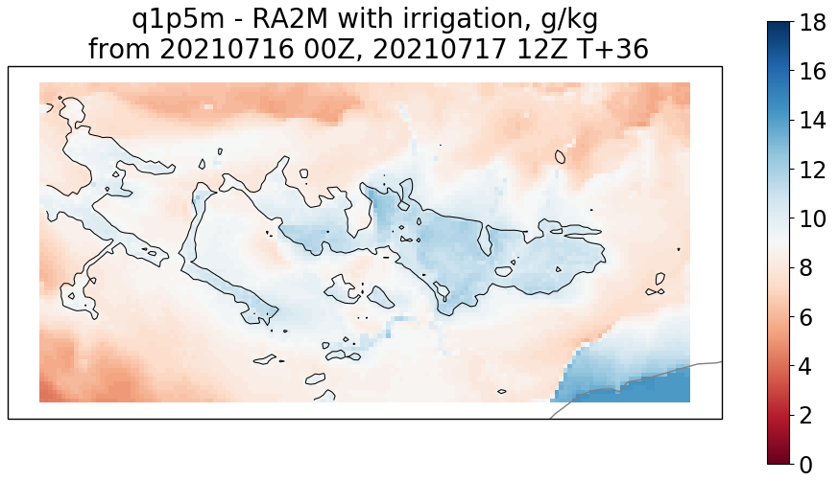
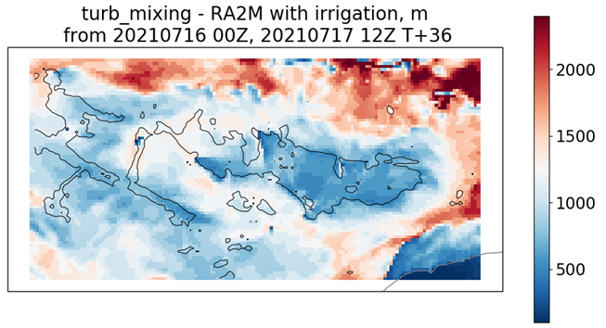
Screen level temperature and humidity
T+36 12z 16th July 2021
1.5m temperature (K) no irrigation
1.5m humidity (g/kg) no irrigation
Boundary layer depth (m) no irrigation
1.5m temperature with irrigation
1.5m humidity with irrigation
Boundary layer depth with irrigation

Slide 9
Screen level temperature and humidity
T+36 12z 16th July 2021
1.5m temperature (K) no irrigation
1.5m humidity (g/kg) no irrigation
Boundary layer depth (m) no irrigation
Warmer Air
Cooler Air
Boundary layer top
1.5m humidity with irrigation
1.5m temperature with irrigation
Boundary layer depth with irrigation
Wetter & Cooler
Drier & Warmer
Irrigated
Non-irrigated

Slide 10
Impacts of irrigation in global NWP forecasts
Global NWP case studies at N320 L70 resolution (~30km grid)
24 forecasts from ECMWF analyses to T+120
control configuration is GAL8

Slide 11
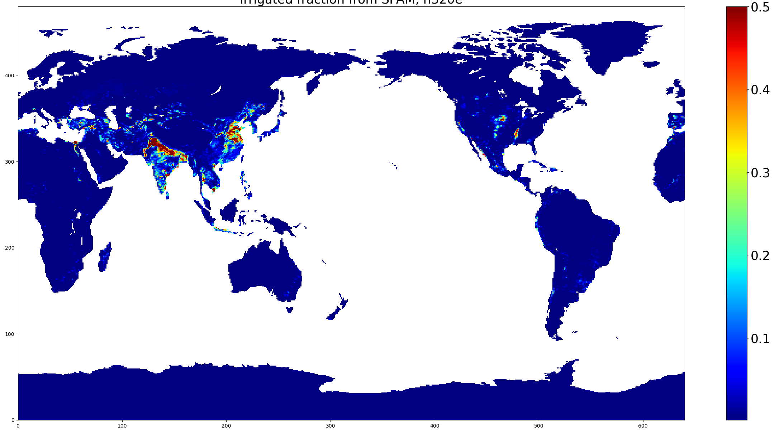
Irrigated fraction ancillary at N320 from SPAM

Slide 12
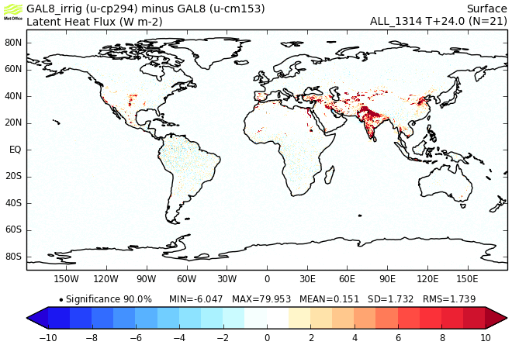
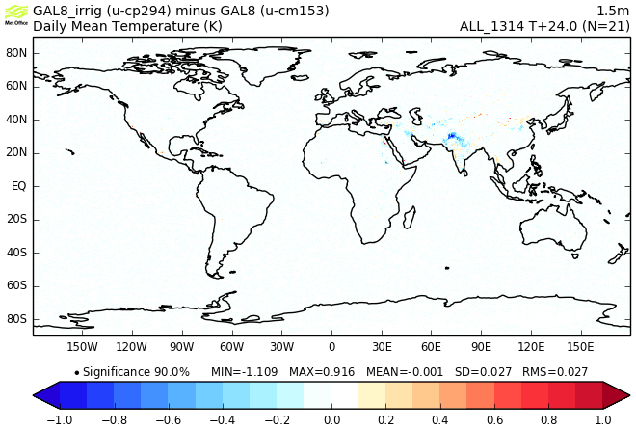
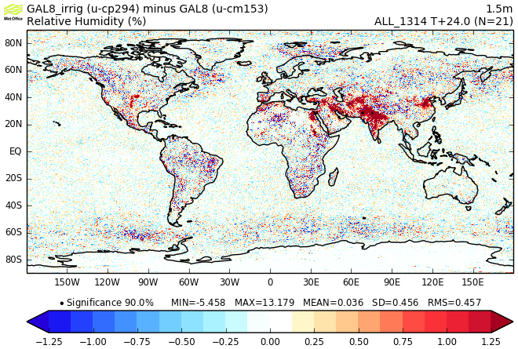
Average case study results Day 1 average
Latent Heat Flux
1.5m Temperature
Irrigation minus control
1.5m Relative Humidity
Sensible Heat Flux

Slide 13
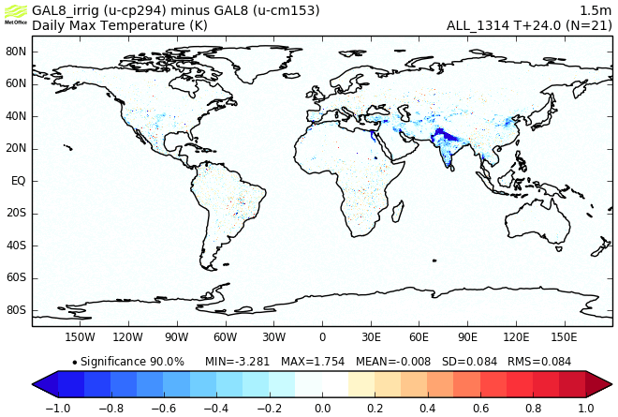
Average Case Study Results, T+24
Daily Max Temperature
Daily Min Temperature

Slide 14
Hydrological cycle impacts over India T+24
Irrigated fraction
Change in evaporation
Change in PBL depth
Change in precipitation
kg/m2/day
kg/m2/day

Slide 15
Conclusions and Further Work
First results show that irrigation gives a significant increase (reduction) in latent (sensible) heat flux and a beneficial cooling of daytime land surface and screen temperatures
The colder/wetter irrigated surfaces suppress boundary layer growth, setting up local circulations
also found to significantly improve (delay) the arrival of the sea breeze
to what extent can these gradients and circulations promote triggering of convection?
Continue more detailed evaluation of the impact of patchy irrigation on the land surface and boundary layer using the LIAISE observations
Investigate sensitivity to how the “irrigation” is done
currently like a continuous “drip” irrigation but will test “flood” irrigation (irrigate to saturation but ~weekly)
Make improvements to the parametrization
e.g., limit irrigation using available water from river flow model
.

