Slide 1



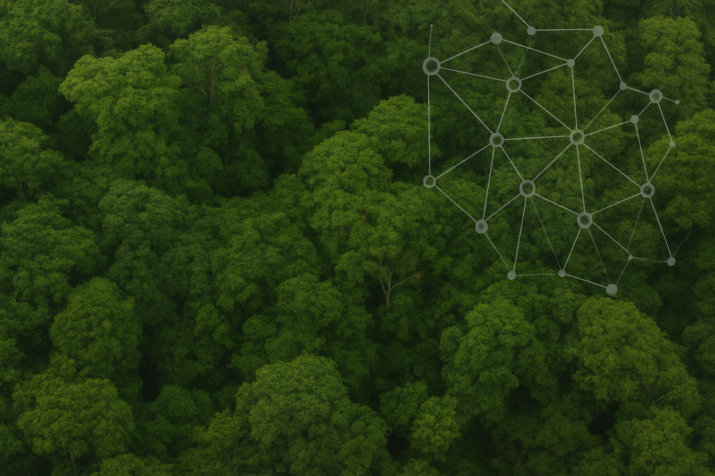
Life inside a grid cell… in a Virtual Ecosystem
Vivienne Groner
PanGLASS Conference | July 2026 | Stuttgart

Slide 2
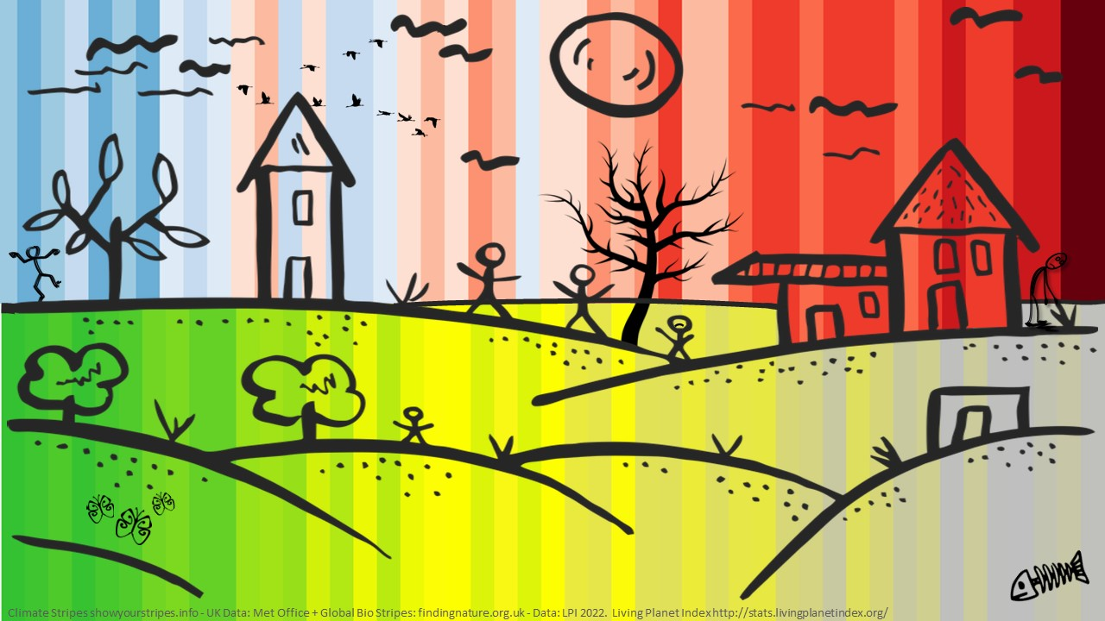
Ecosystems are more complex than the space station
- and we barely have a map
Notes:
Both the climate system and ecosystems are very complex and very hard to predict.
Non-linear feedbacks, emergent phenomena, multiple stable states
Urgent need: drought, floods, and unprecedented warming demand process-based predictive tools
At the end of the day, we have been modelling the same crisis from different ends, but there is still a gap to fully understand how systems might respond to climate change and other disturbances and how we can manage them to sustain a healthy planet in the future

Slide 3
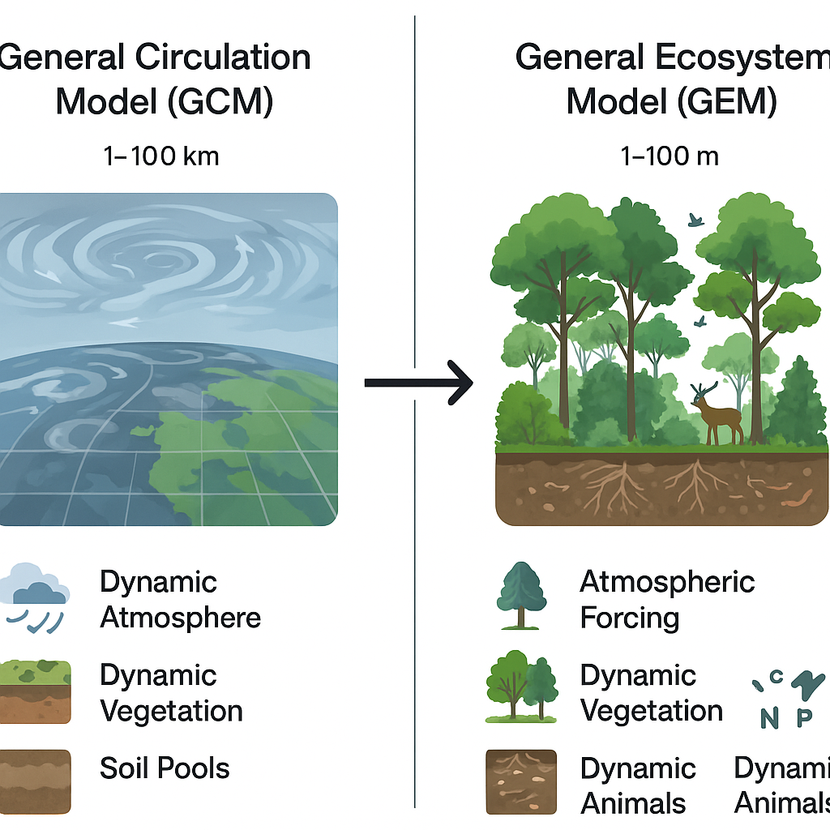
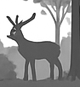
We have powerful models - but they look at different things
Land surface models
1-100 km
Ecosystem
models
1m-10 km
Coupled
atmosphere
Atmospheric
Forcing microclimate
Complex
hydrology
Simple or
no hydrology
Simple vegetation
Complex vegetation
Complex soils
Simple soil C
Typically no animals
Complex animals
Notes:
LSMs: get the physics right, miss the biology
EMs: add some biology, but coarsely and often just subcomponents
Gap: neither captures the full ecosystem - plants, animals, microbes, abiotic environment together
"What if we started from scatch?"

Slide 4
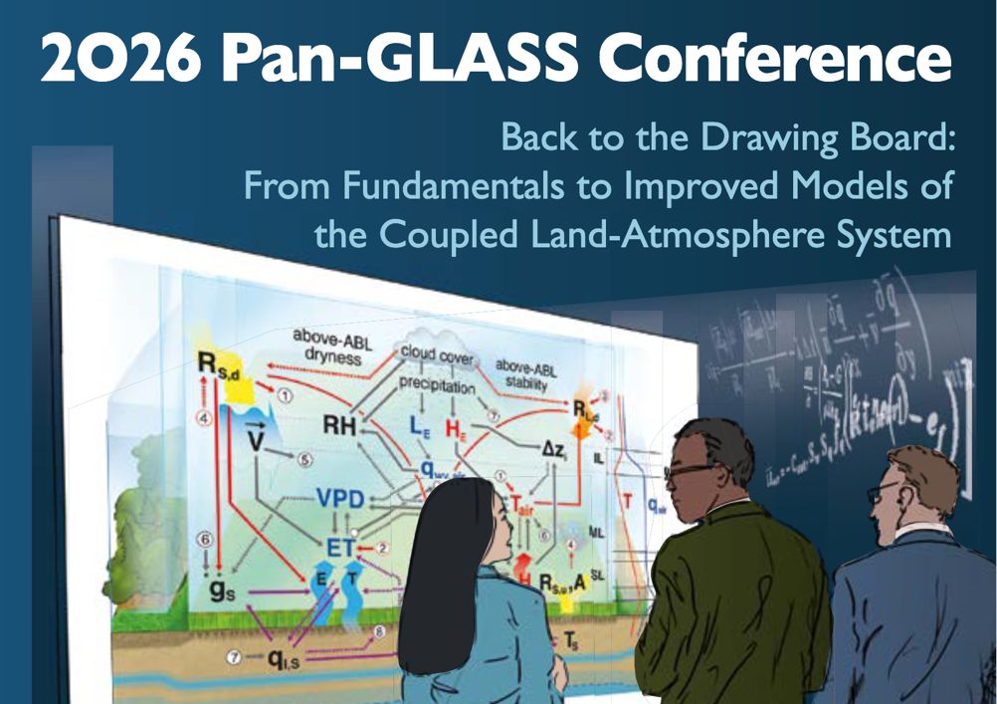
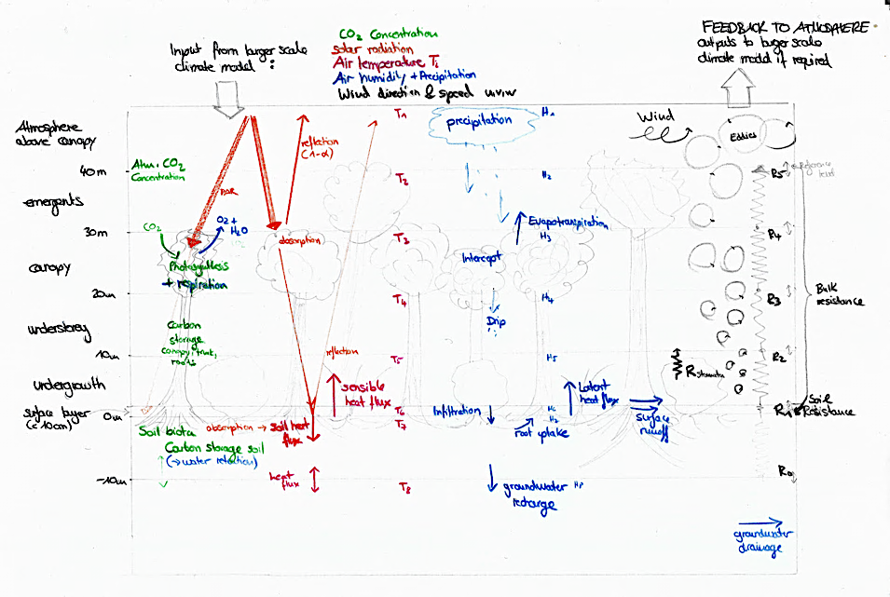


Back to the drawing board…
4
ImperialCollegeLondon / virtual_ecosystem
Notes:
Our attempt to embrace complexity

Slide 5
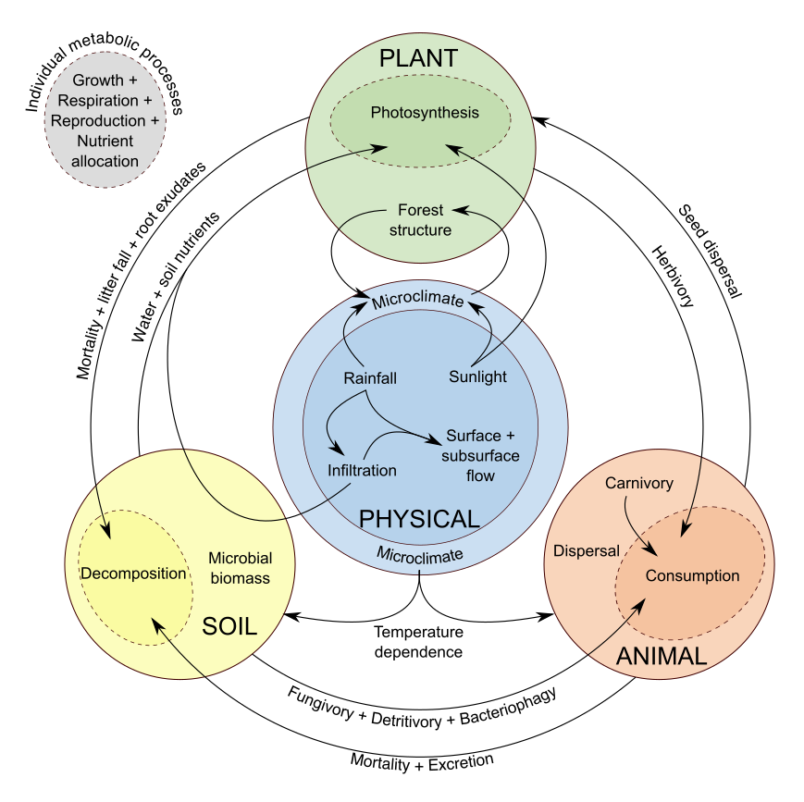
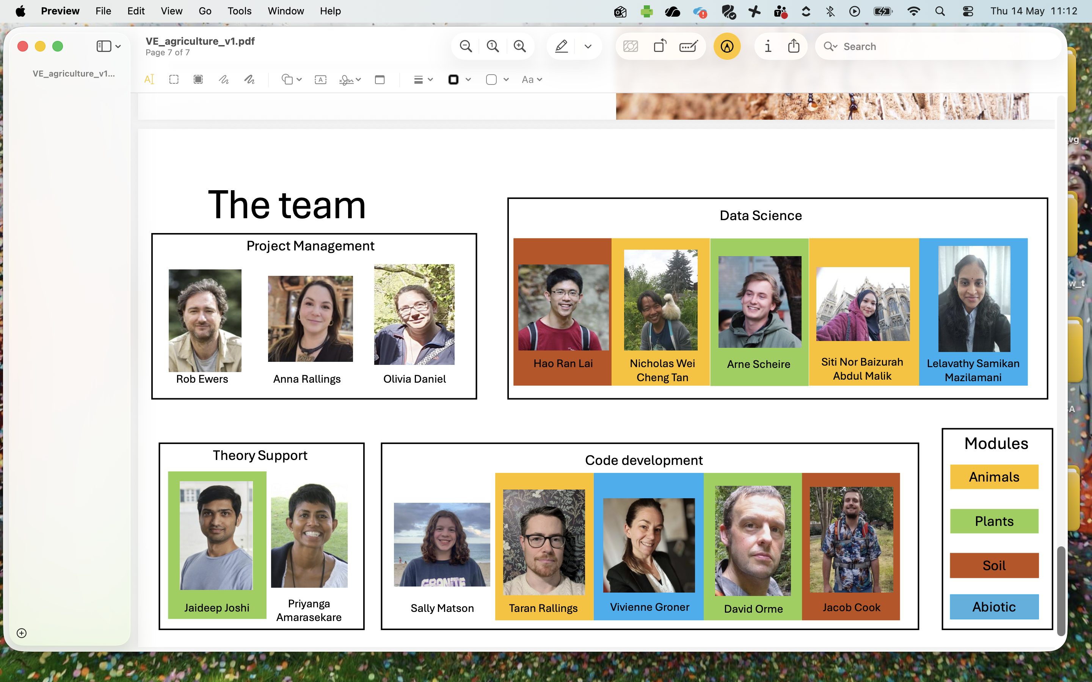
What is the Virtual Ecosystem?
A holistic, process-based terrestrial ecosystem model
Ewers et al. 2024
Ecological Modelling
5
Notes:
Four coupled domains: Plants · Animals · Soil Microbes · Abiotic
Environment Simultaneously balances budgets for energy, water, carbon, nitrogen, and phosphorus

Slide 6
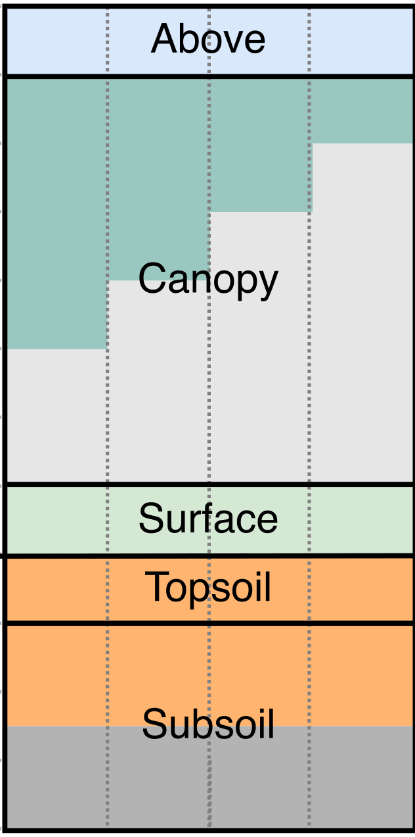
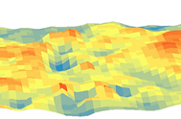
What is the Virtual Ecosystem?
A holistic, process-based terrestrial ecosystem model
Native resolution:
1hectare, 1month
Makinde et al. (2017) 10.4236/gep.2017.512012
Ewers et al. 2024
Ecological Modelling
6
Notes:
Native resolution: 1 hectare / 1 month; 3D vertical layers from canopy to deep soil

Slide 7
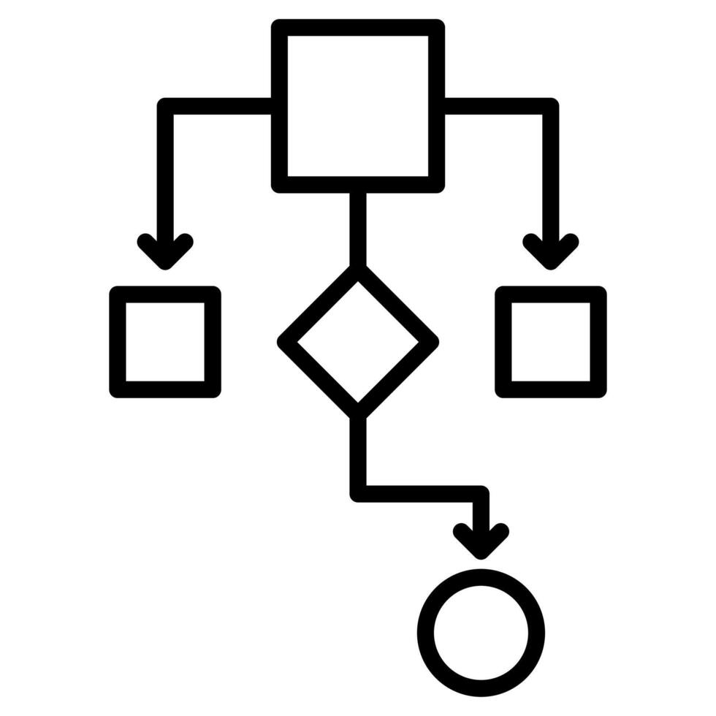
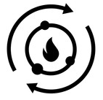
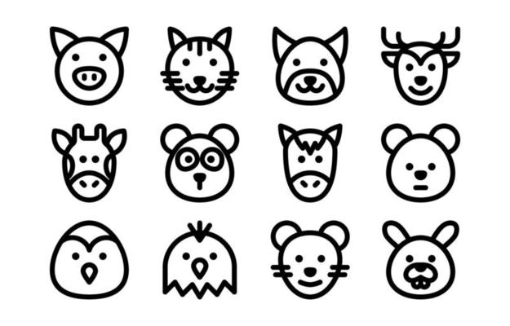
What is the Virtual Ecosystem?
A holistic, process-based terrestrial ecosystem model
Based on:
Generalizable
principles &
processes
Metabolism & stoichiometry
Functional groups
Ewers et al. 2024
Ecological Modelling

Slide 8


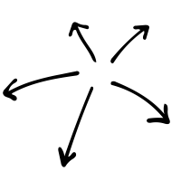
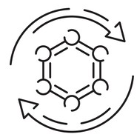


What is the Virtual Ecosystem?
A holistic, process-based terrestrial ecosystem model
Based on:
Generalizable
principles &
processes
Metabolism & stoichiometry
Functional groups
Predictions & emergent dynamics:
Plant, animal, & microbial demography
Movement and
dispersal patterns
Biogeochemical cycles
Ewers et al. 2024
Ecological Modelling
8

Slide 9
What is the Virtual Ecosystem?
A holistic, process-based terrestrial ecosystem model
Based on:
DISTURBANCE
Logging
Fire
Hunting
Generalizable
principles &
processes
Metabolism & stoichiometry
Functional groups
Predictions & emergent dynamics:
Plant, animal, & microbial demography
Movement and
dispersal patterns
Biogeochemical cycles
Ewers et al. 2024
Ecological Modelling

Slide 10
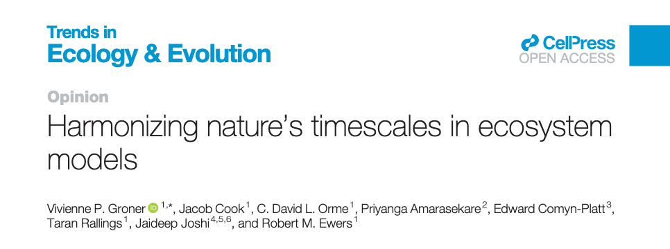
What time is it?
Full model: 1 month
Hydrology: 1 day (30 days per month)
Microclimate: 1 hour (mean monthly day)

Slide 11
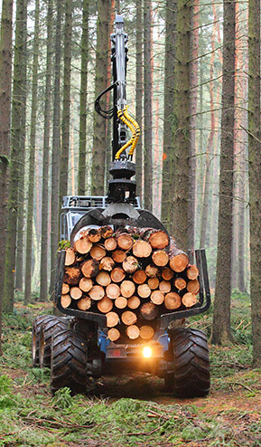
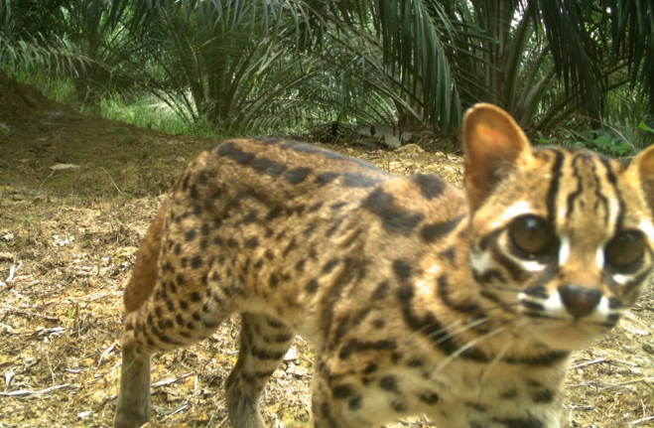
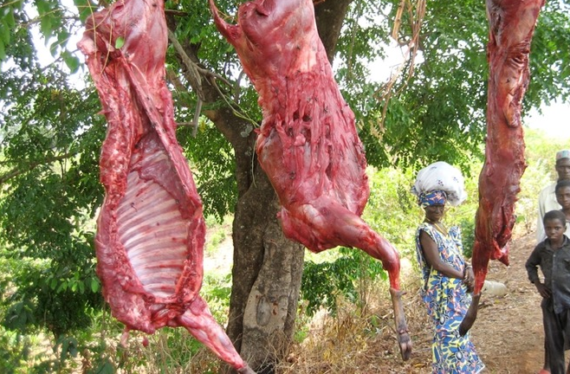
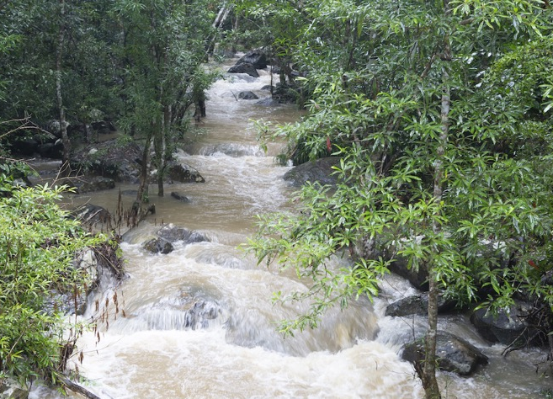
Almost unlimited applications

Slide 12

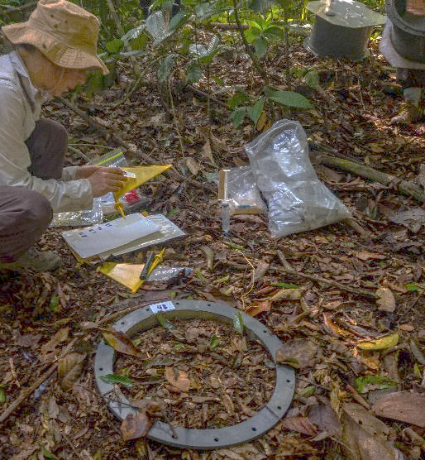
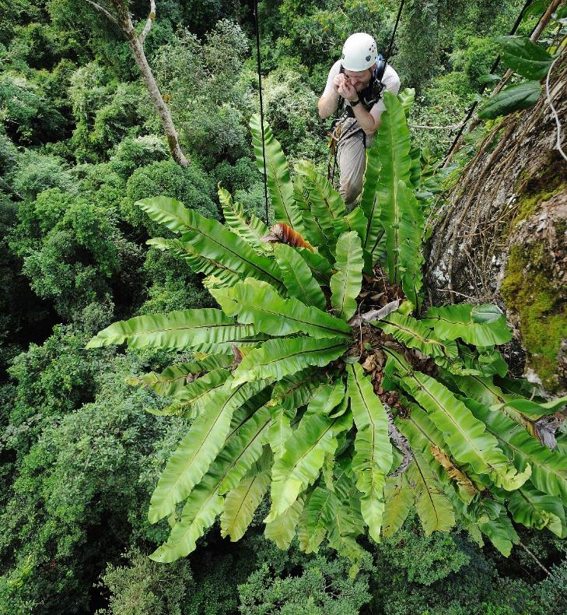
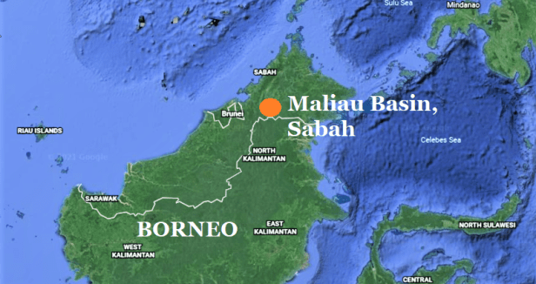
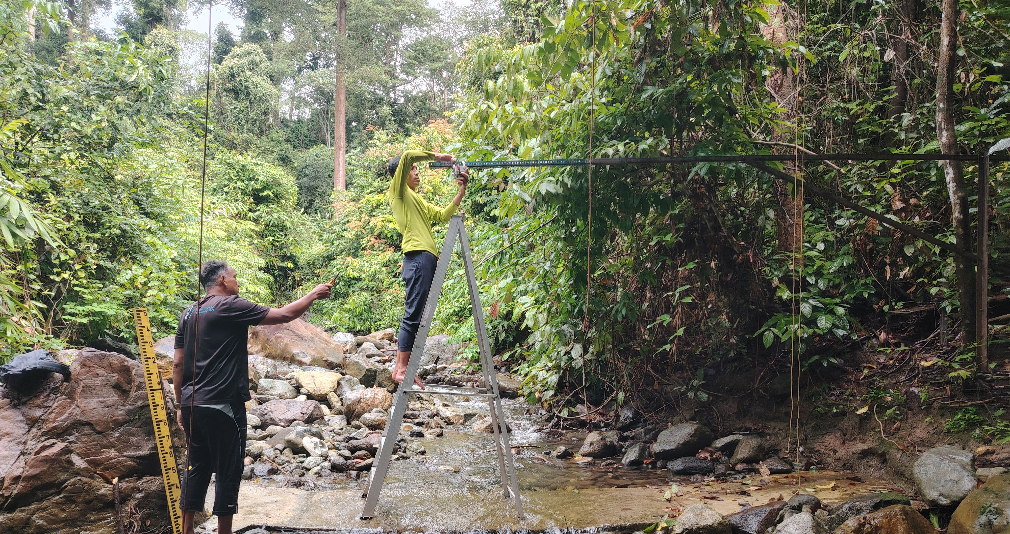
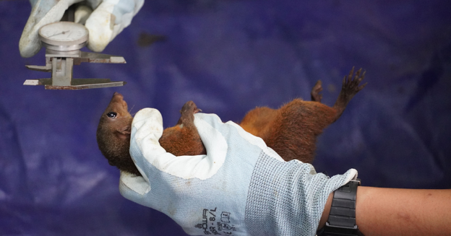
HMTF Lombok
Rob Ewers
Case study:
Maliau Basin,
Borneo
Lela Mazilamani
Rob Ewers

Slide 13
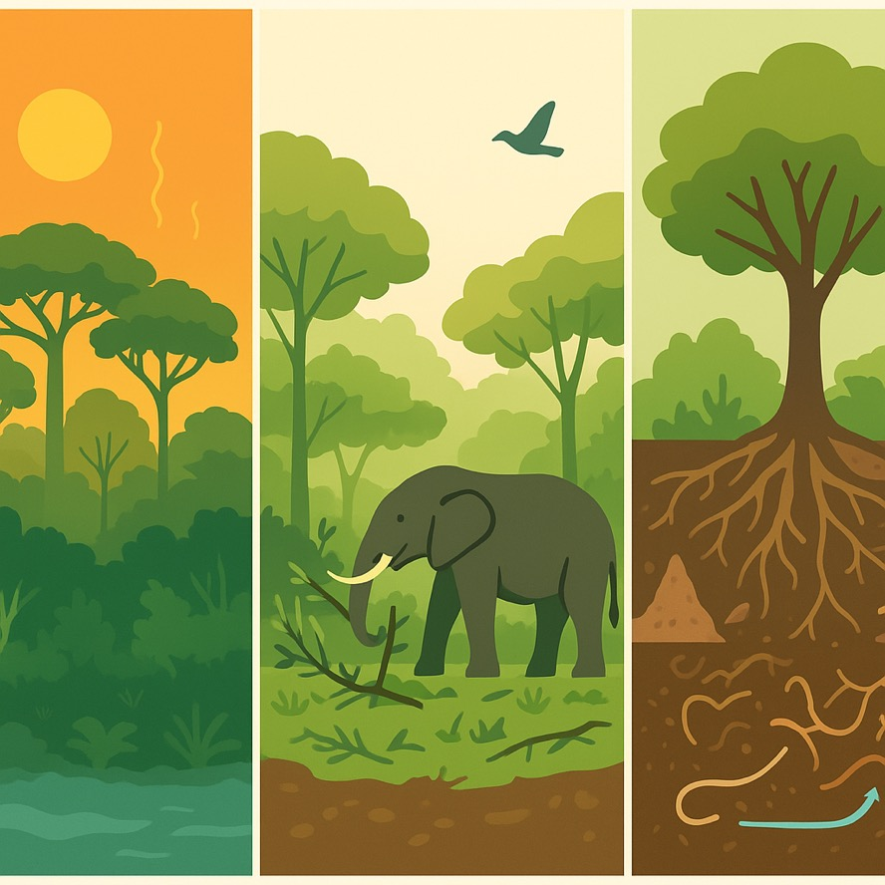
Cross-scale and cross-domain feedbacks
Physical buffering
Canopies cool up to 5ºC
  Affects soil-plant-animal metabolic rates
Biological modification
Animals consume up to 50% of NPP
  Affects microclimate buffering
Biogeochemical consequences
Recycling and redistribution of nutrients
  Affects plant growth

Slide 14
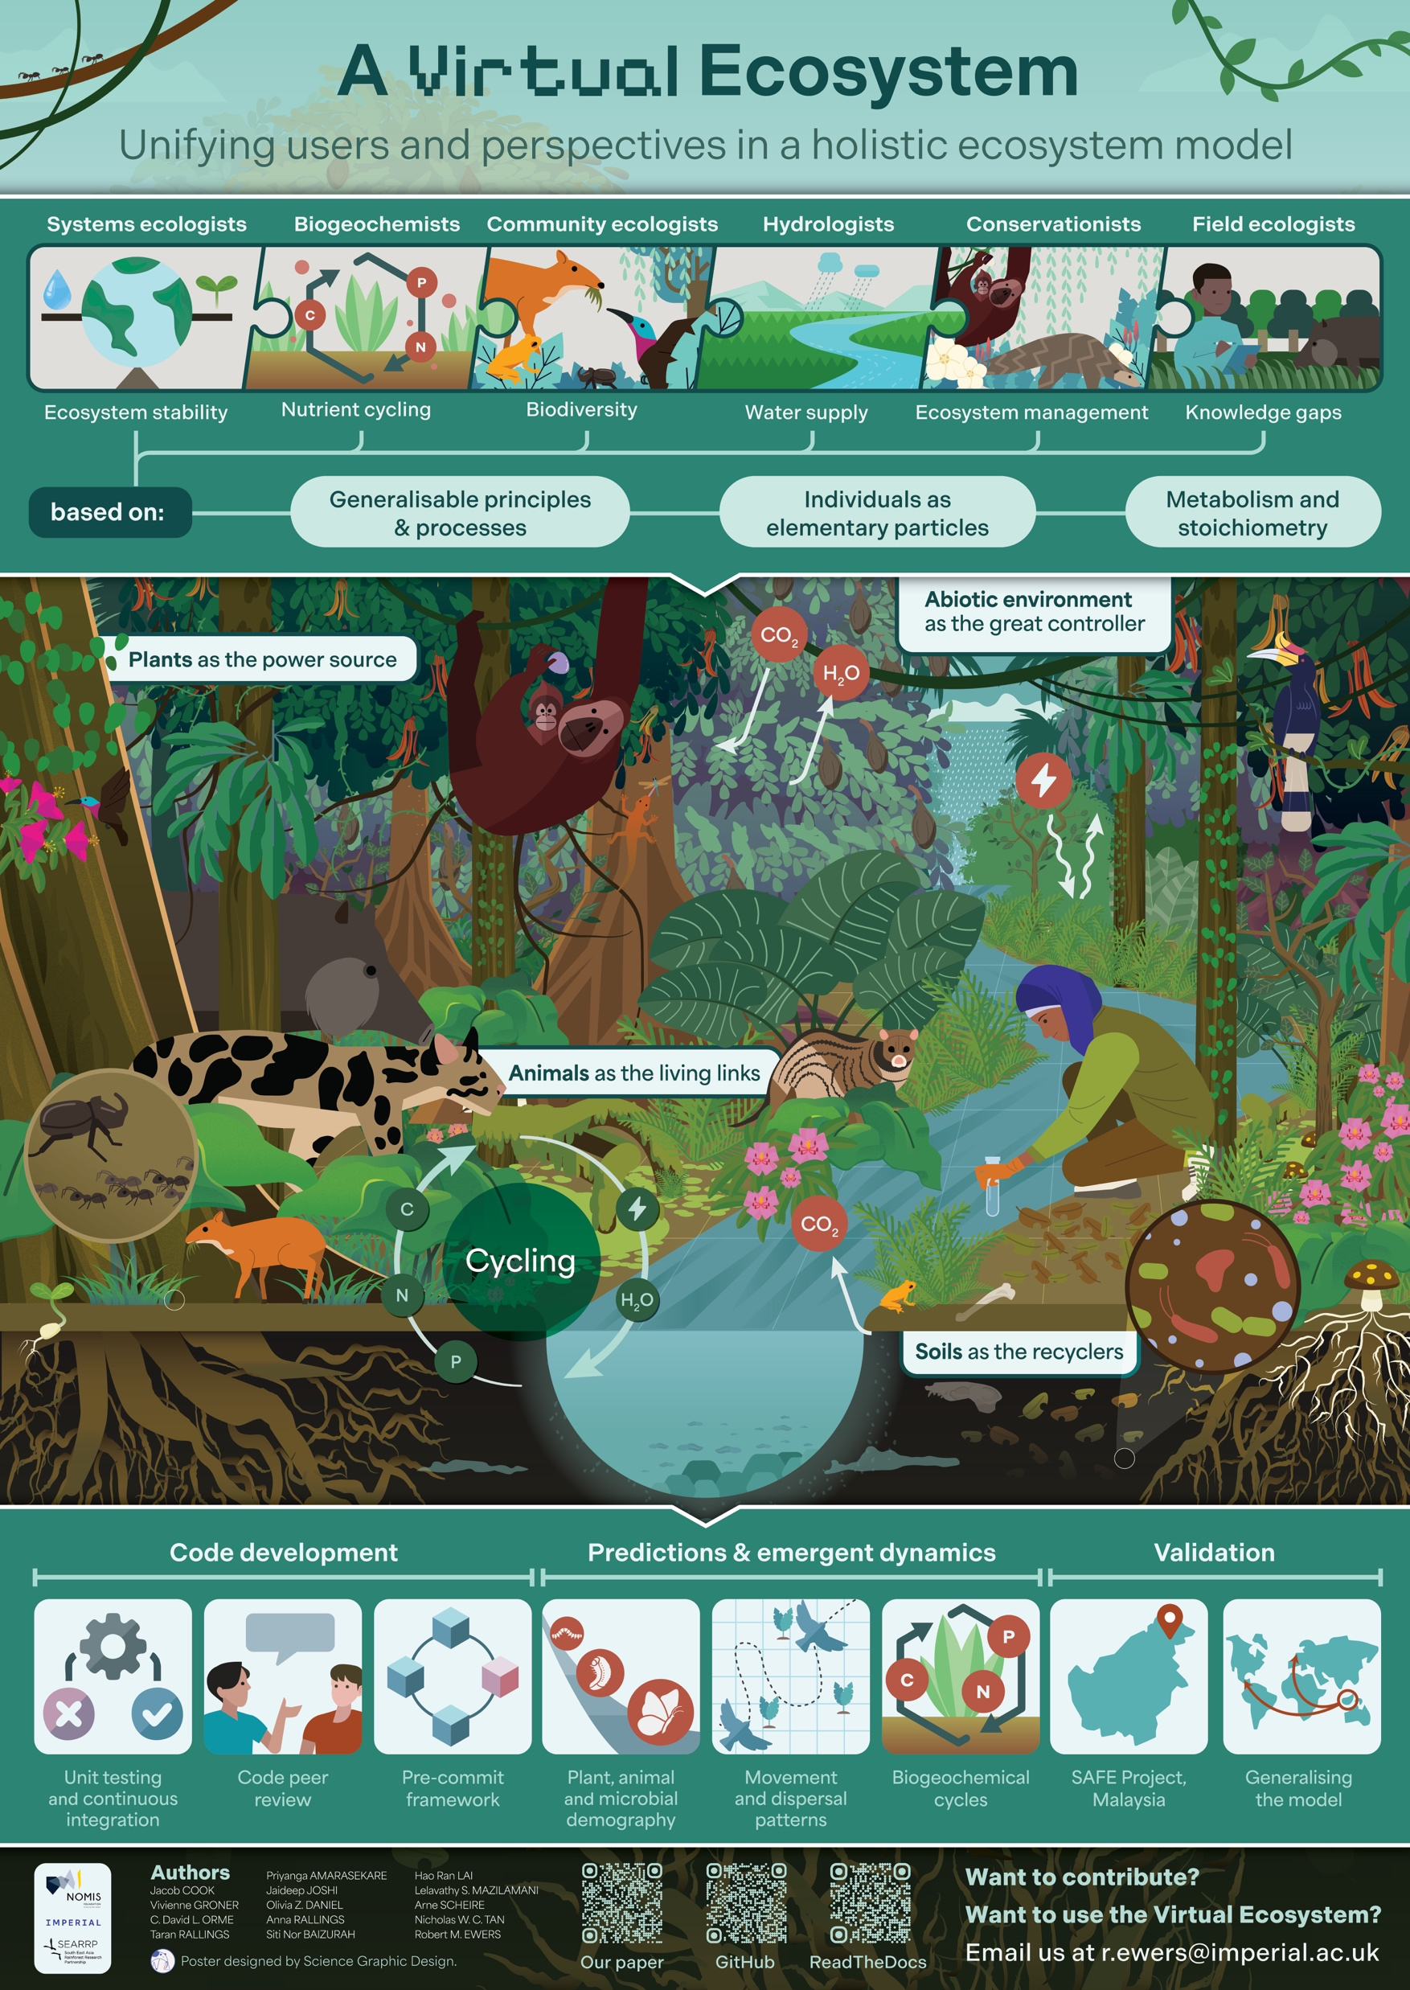
Next steps
1. Bug fixing & calibration
2. SAFE project, Malaysia
3. Generalizing the model
Notes:
continue calibration and bug fixing
expand across the SAFE deforestation gradient
interested in input on:
calibration strategies
Snow and ice

Slide 15


Take home
Climate- and Ecosystems are complex, non-linear, hard to predict. The Virtual Ecosystem is our attempt to embrace that complexity.
We sit in ecology, but we need the physics - in return, we offer realistic ecosystem processes.
We are building in public - your feedback, data, and critique will make this stronger.
Want to contribute?
Want to use the Virtual Ecosystem?
Email us at v.groner@ic.ac.uk
GitHub page
Our paper

