Slide 1


Flux-Driven Surface Temperature
Responses to Forest-Cropland Transitions in India Using the ICON Model
Jyoti Sharma^{1,2}, Pankaj Kumar¹, and Alexander J. Winkler²
¹Indian Institute of Science Education and Research, Bhopal, Bhopal, India
²Max Planck Institute for Biogeochemistry, Jena, Germany

Slide 2
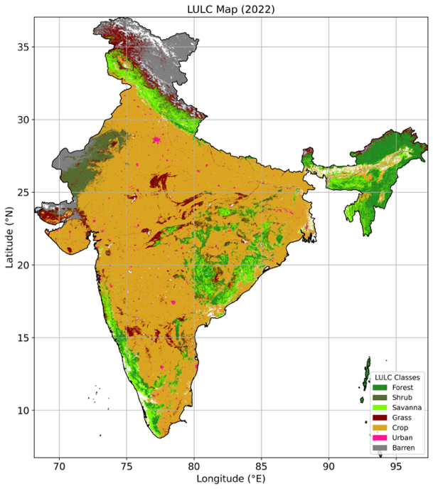
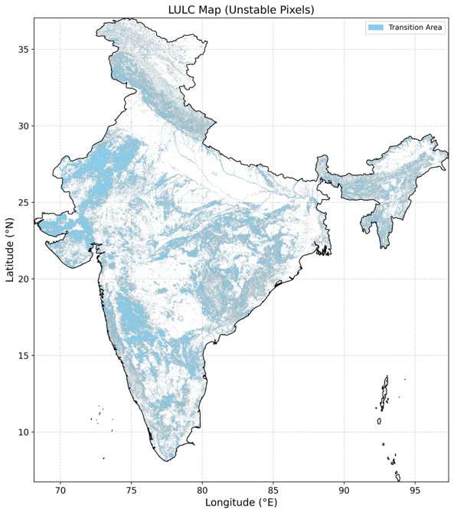
Motivation
Rapid land-cover transformation over India
Need for process-based climate sensitivity analysis
We propose, for the first time, an ICON-ESM AMIP experiment over India.
Nearly 70% cropland and 20% Forest (FSI Report)
Huge Transitions over last 2 decades
Objective: To quantify temperature responses to land-cover change and identify key biogeophysical drivers using process-based climate modelling.

Slide 3
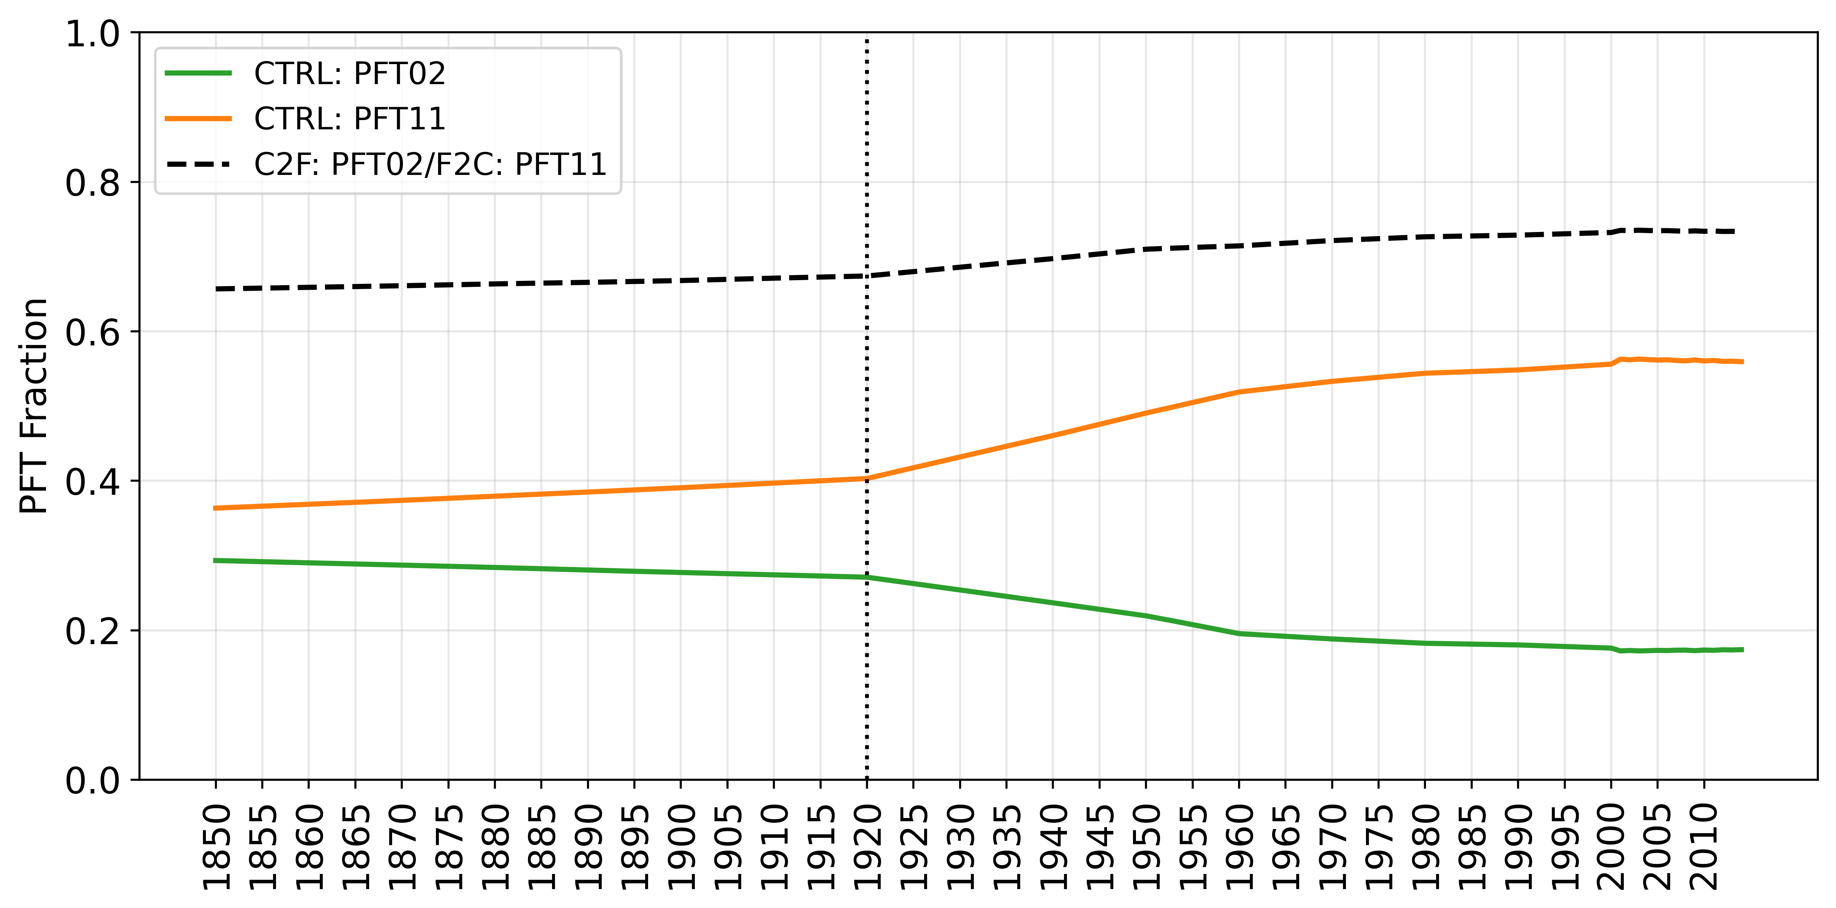
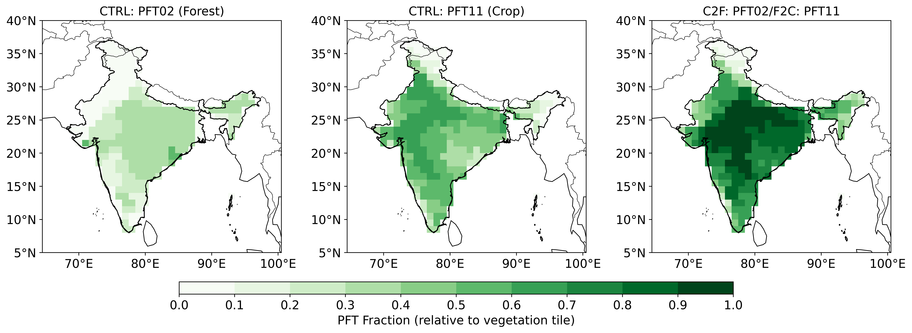
Experiment Design
Three Historical Simulations (1850-2014):
1. CTRL: Default PFT fractions (PFT01, PFT02 ….PFT11)
2. F2C (Agricultural Expansion Case)
3. C2F (Afforestation Case)
Study period: 1980-2014

Slide 4
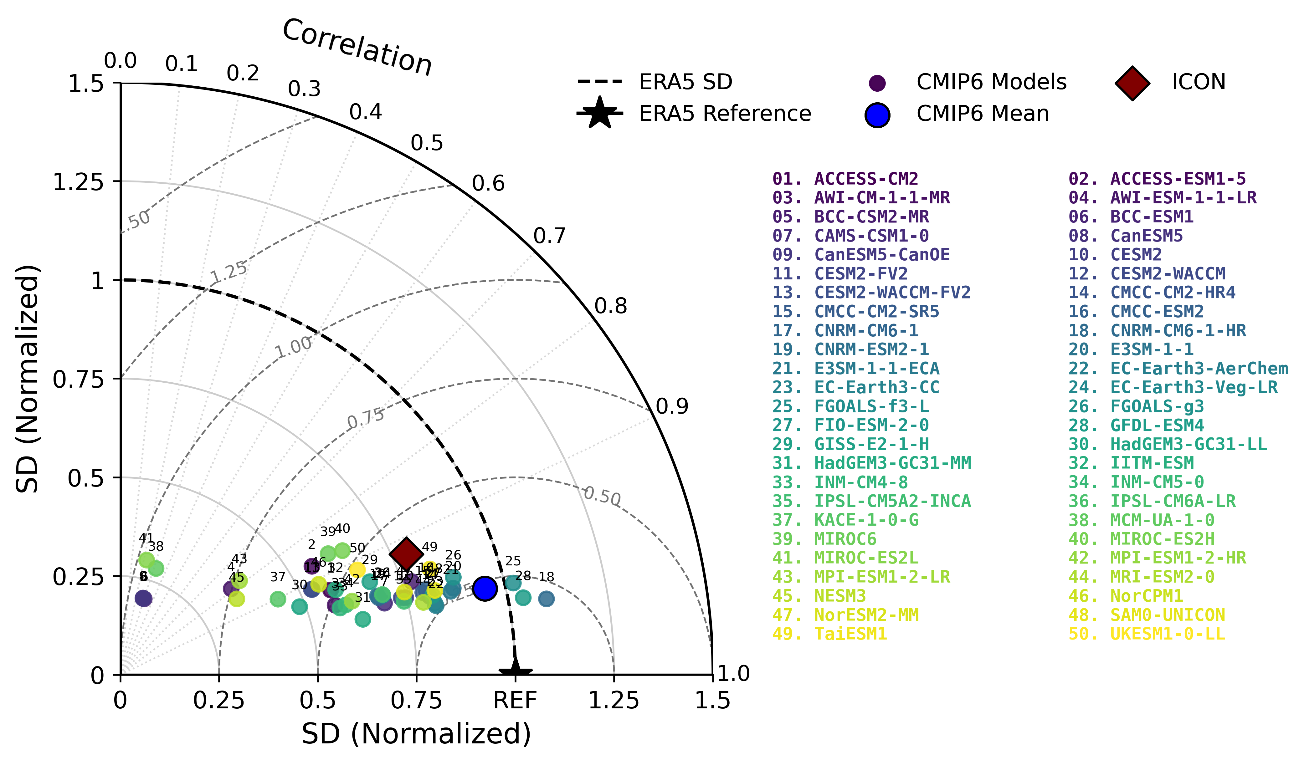
Model Validation (Surface Temp.)
Key Points:
Reasonable agreement with ERA5, however slightly away from the reference point, suggesting some remaining bias.
ICON performs within the CMIP6 model spread, indicating comparable skill to many CMIP6 models.

Slide 5
Key Points:
ICON captures temperature well, closely following CMIP6, ERA5, and IMD.
The model reproduces the monsoon precipitation peak, though some differences remain in magnitude.
Surface energy fluxes show reasonable seasonal agreement, but biases are stronger for radiation and turbulent heat fluxes.

Slide 6
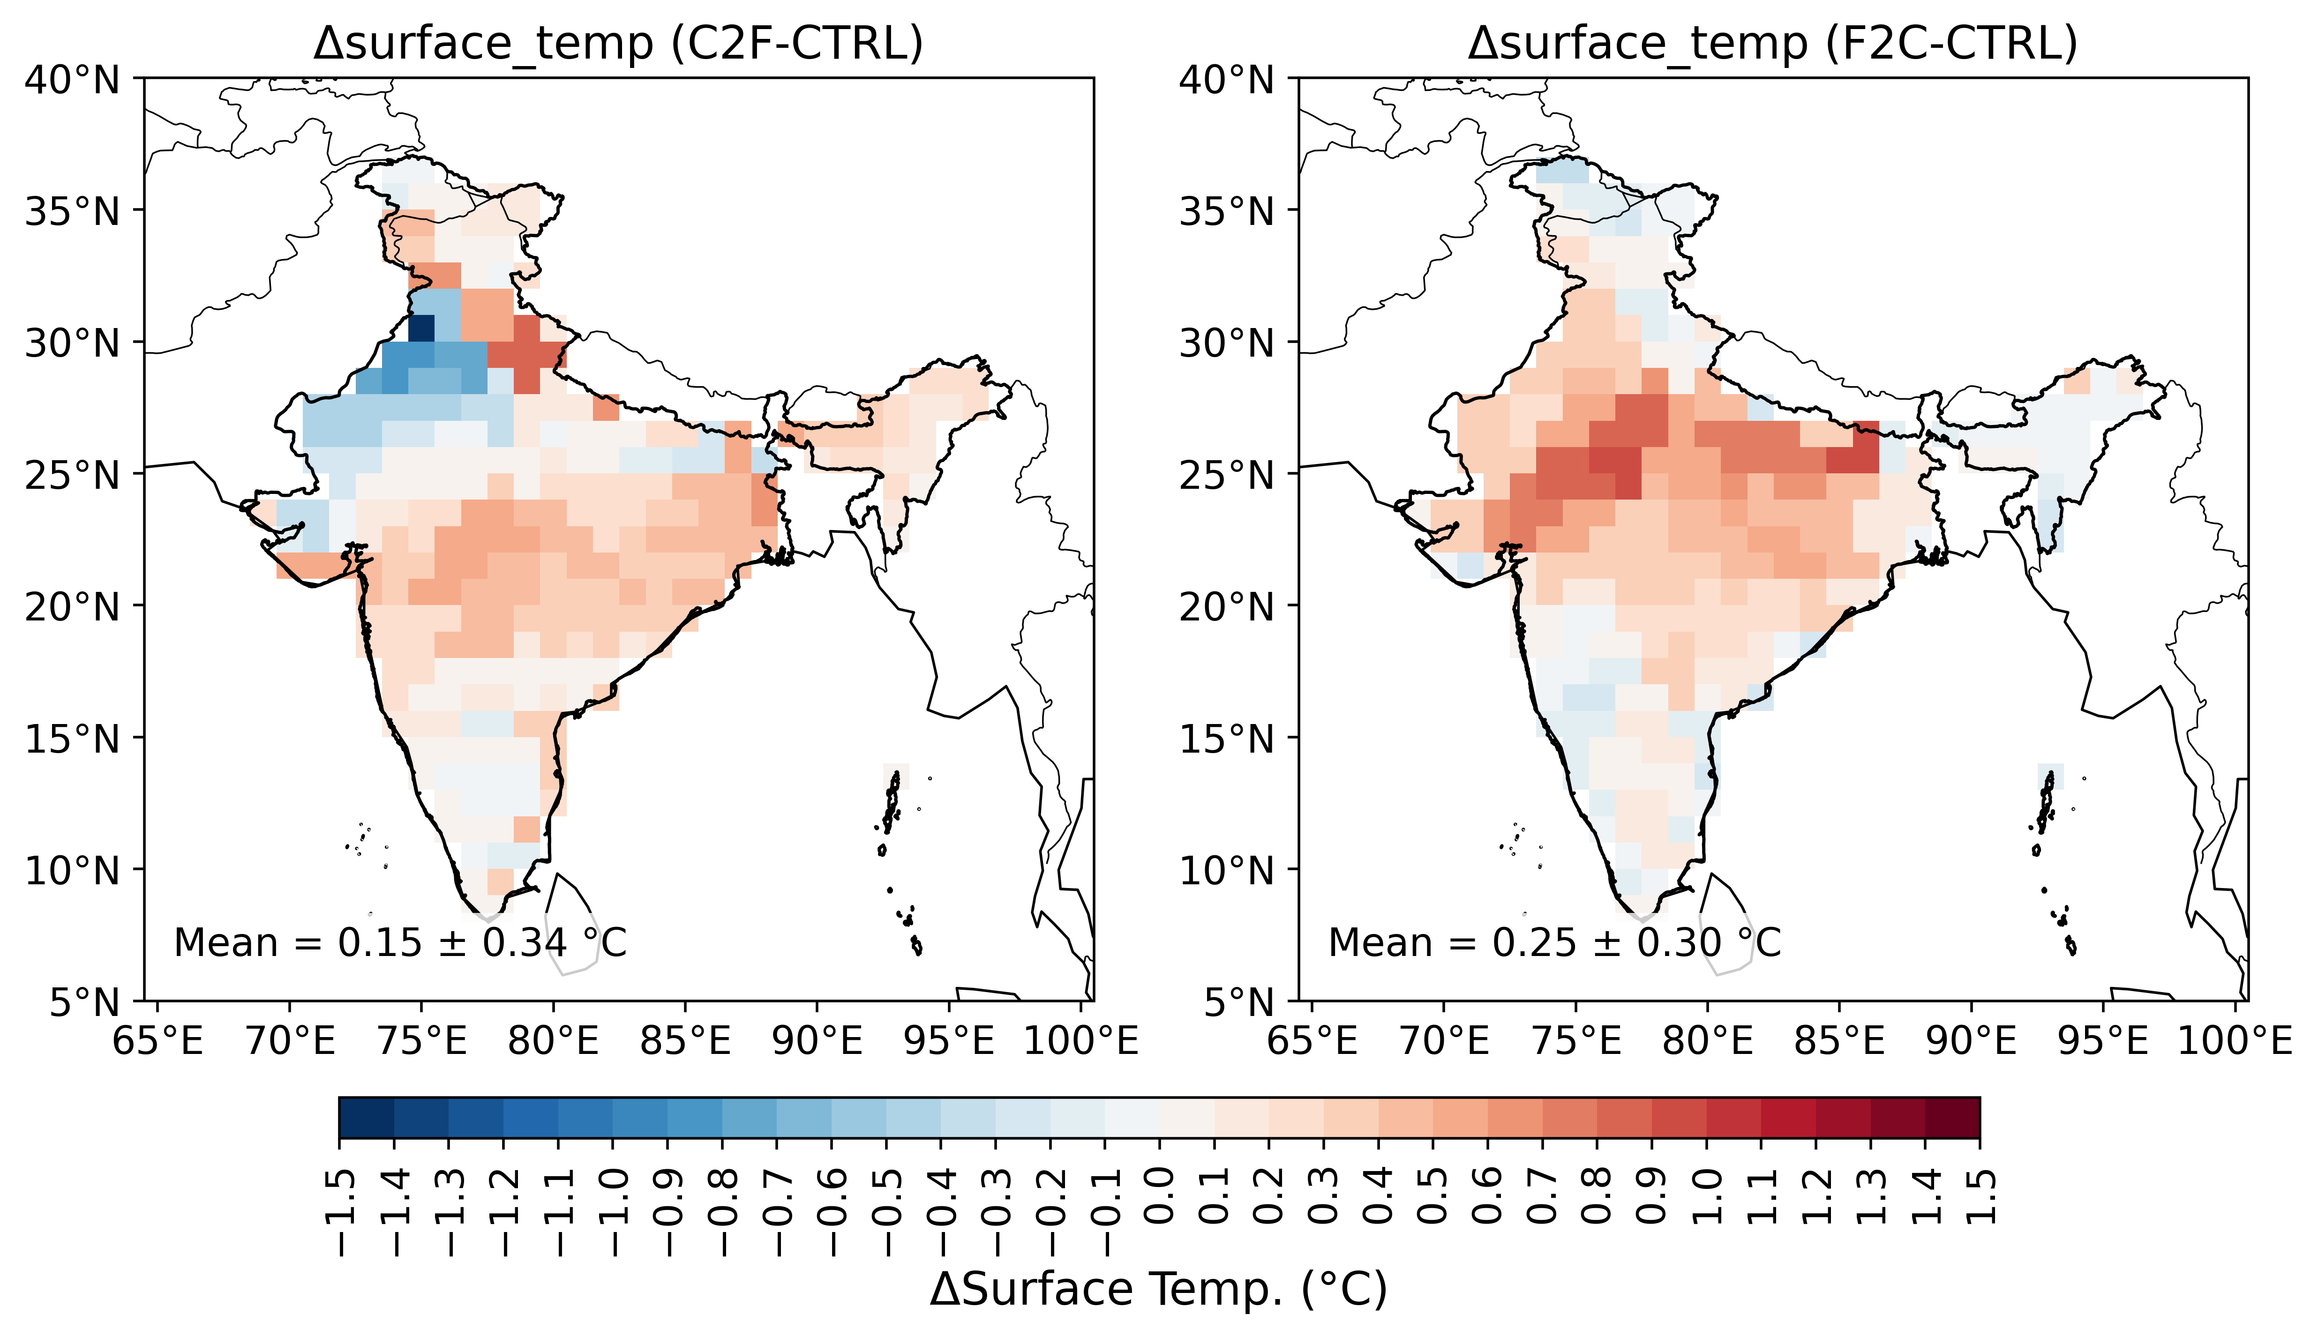
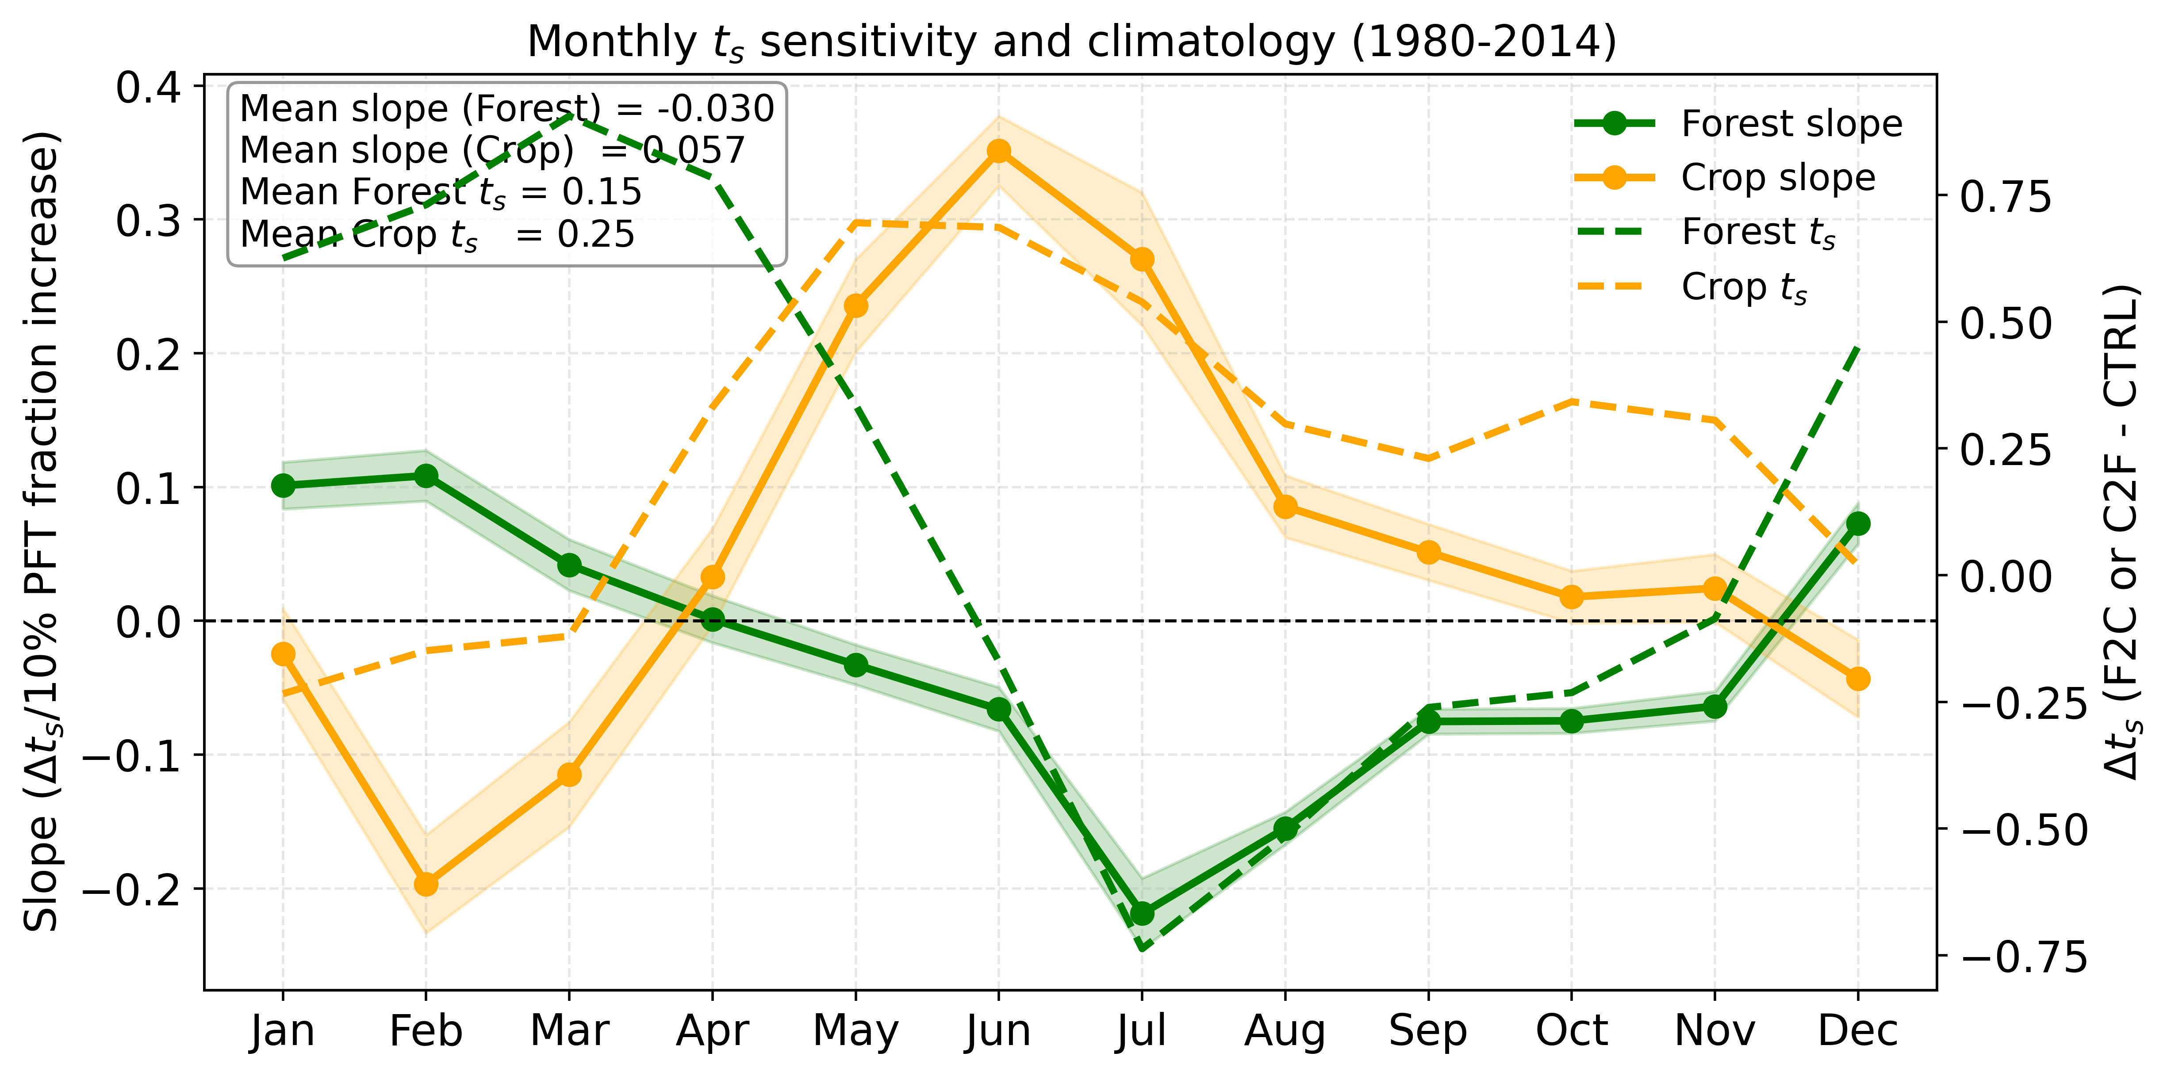
Results (Surface Temperature)
Warming: Crop>Forest
Forest winter warming & Crop summer warming decide the overall temperature sensitivity

Slide 7
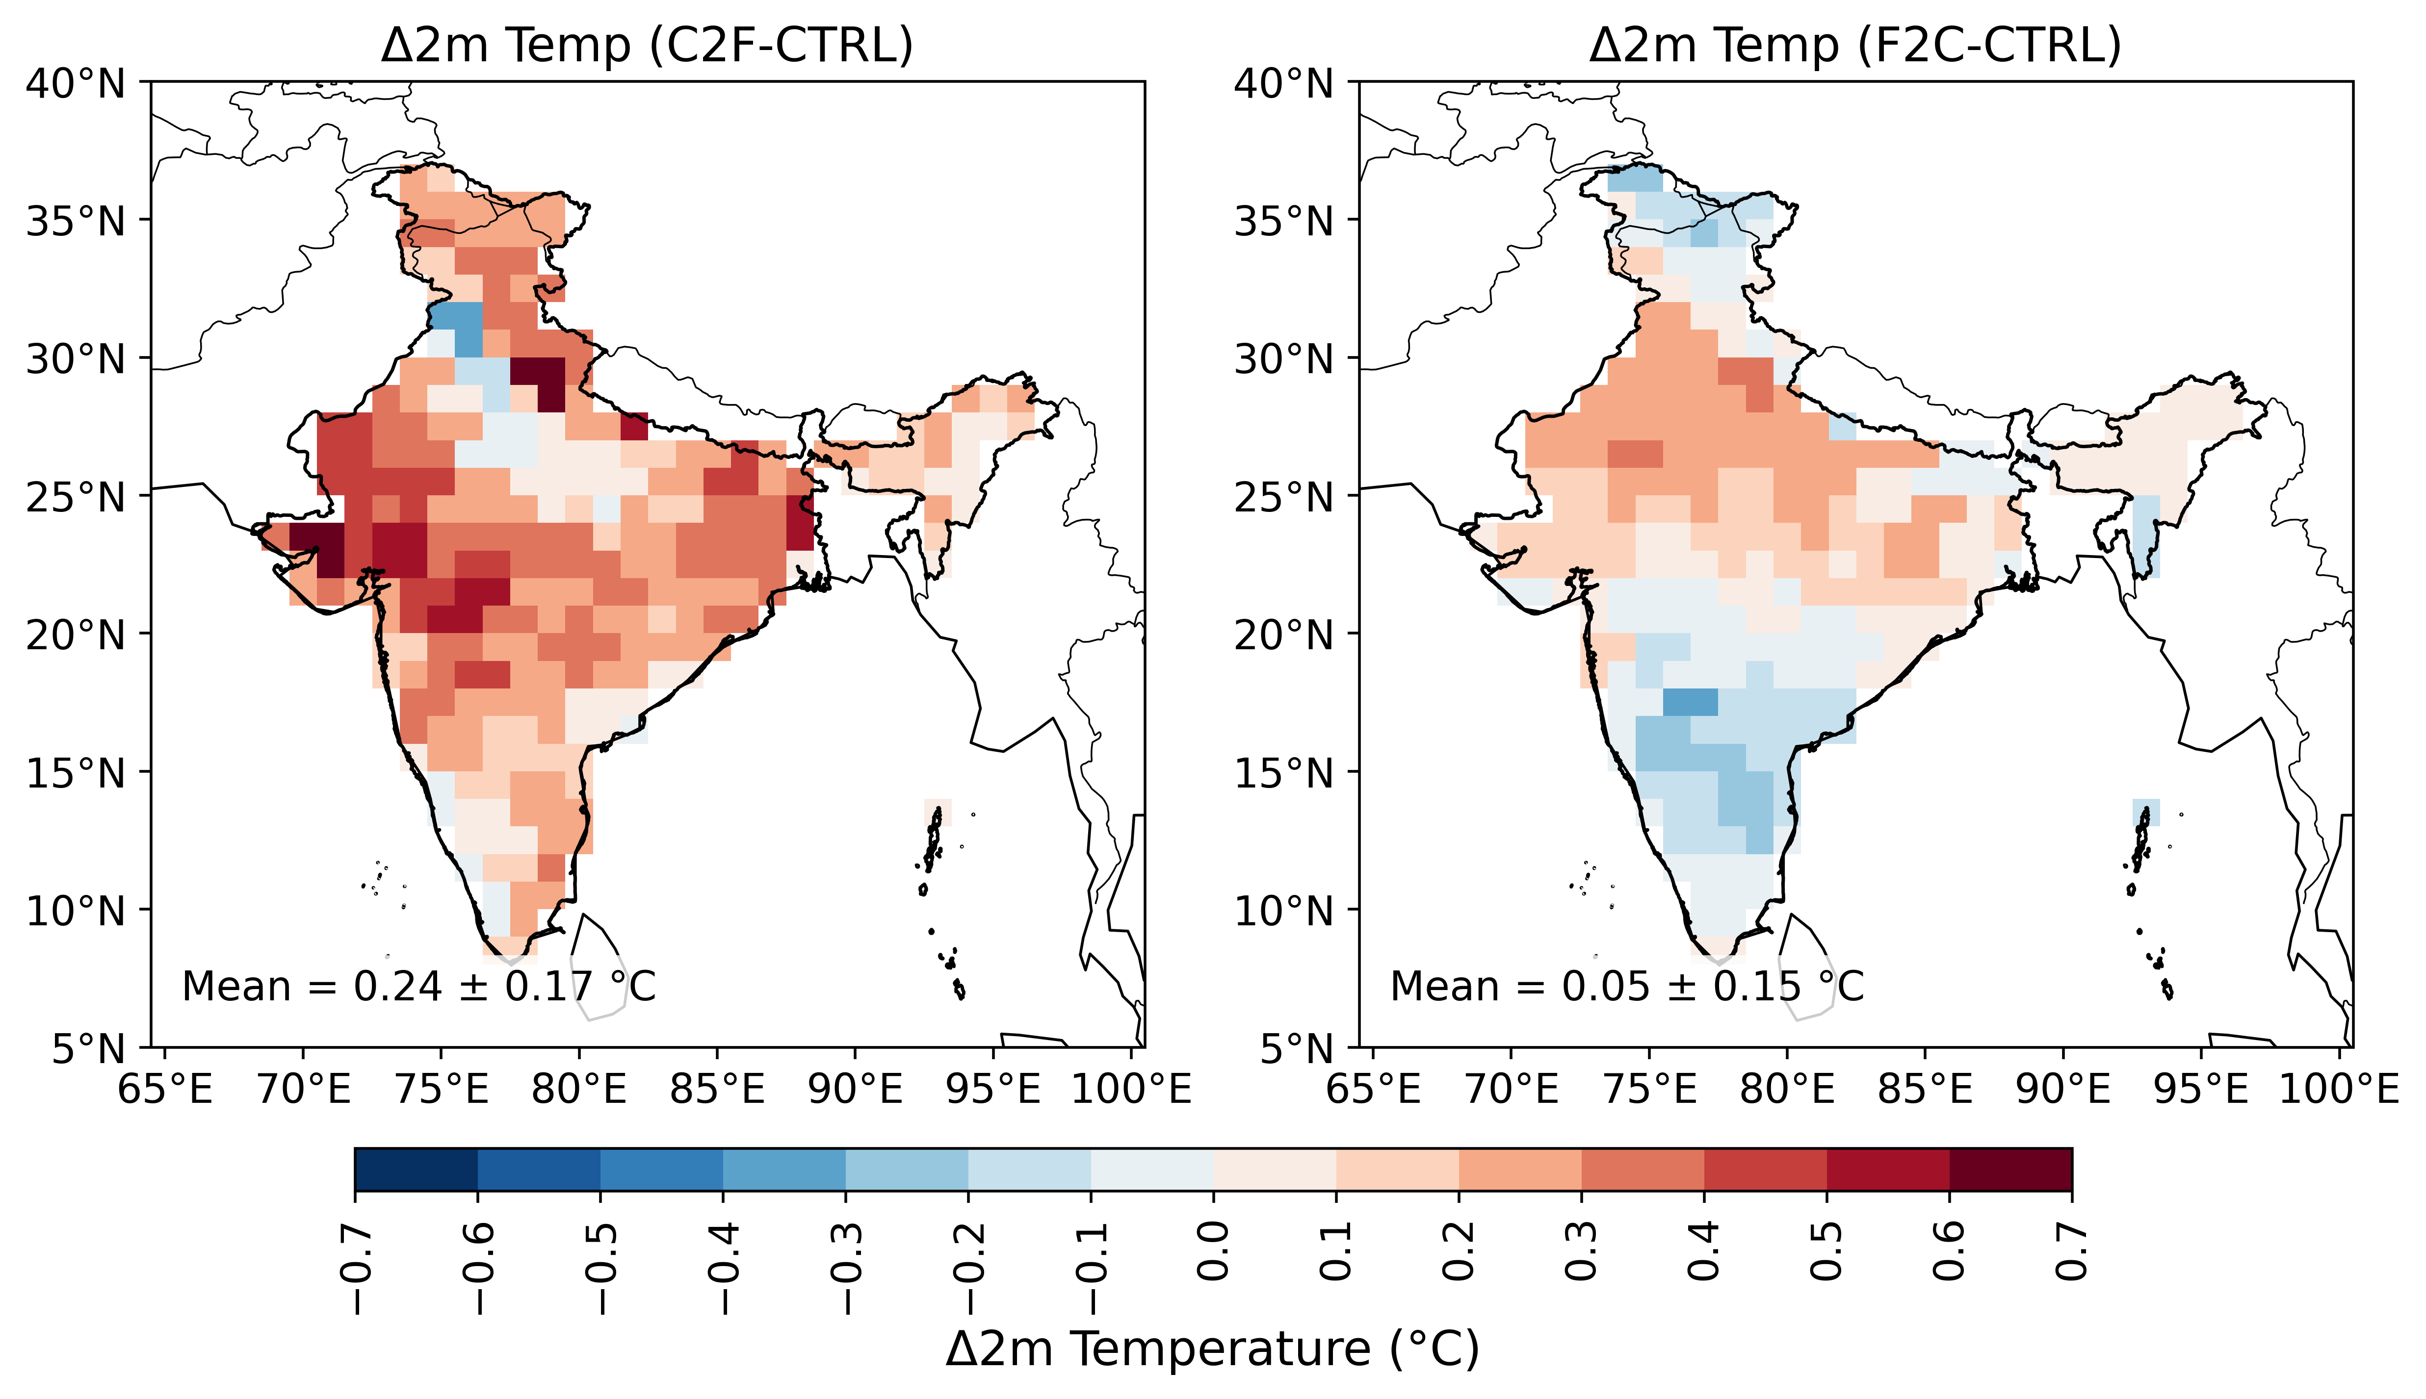
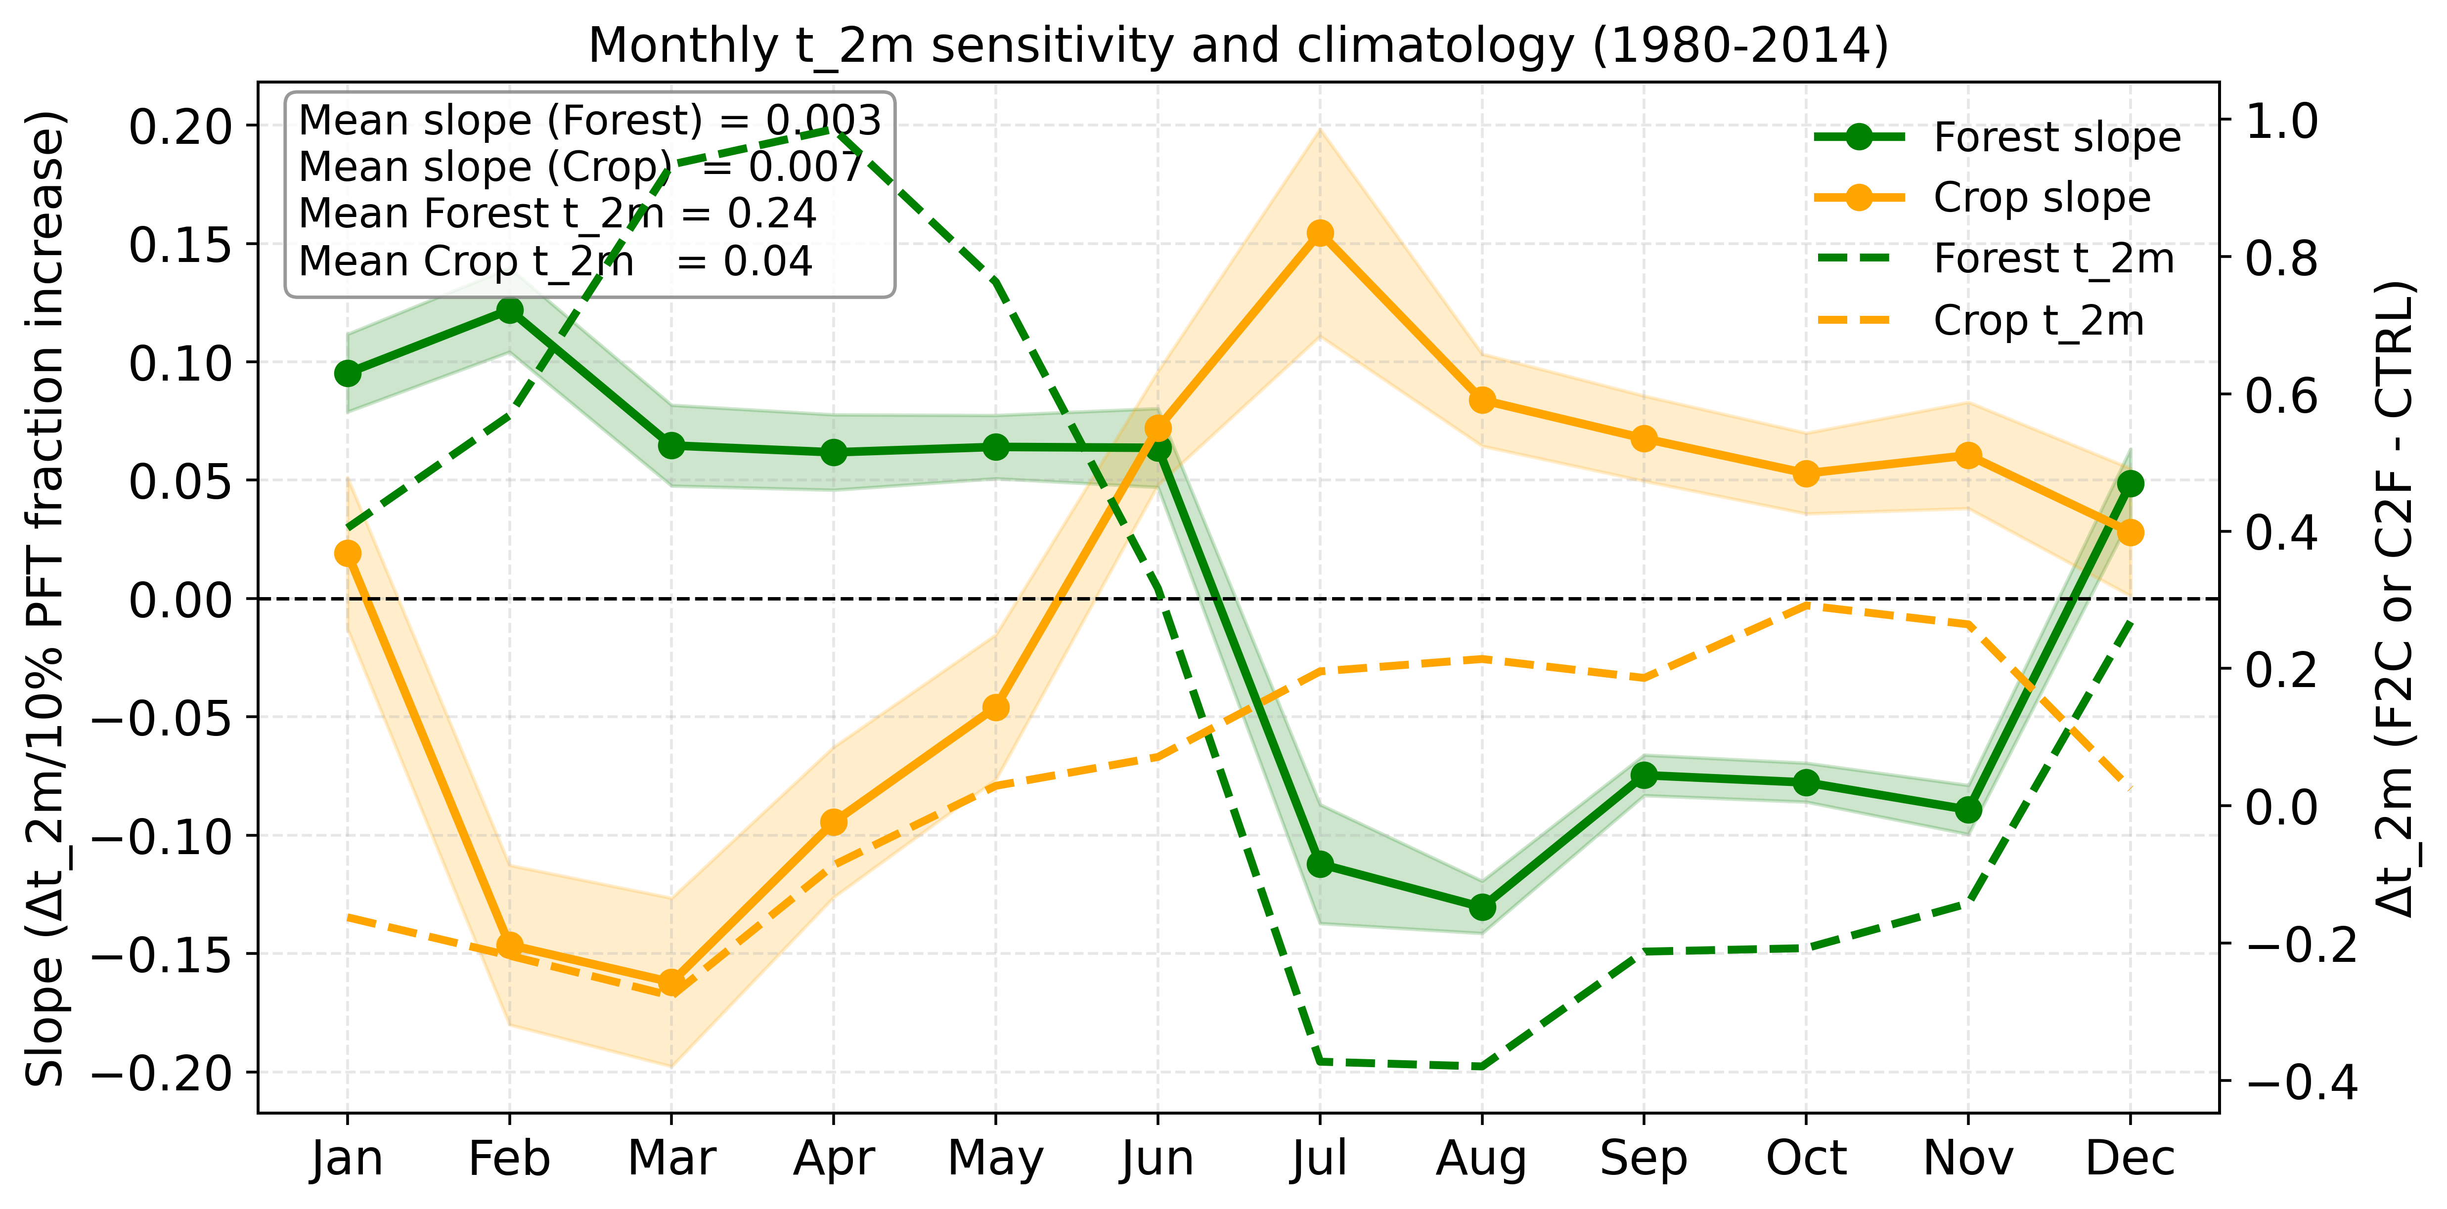
Results (2m Temperature)
Warming: Forest > Crop
Same seasonal variations as surface temperature

Slide 8
Biogeophysical Controls
Forest gains more SW energy in winter, summer reduction linked to cloud cover and albedo.
Forests show enhanced winter SHF, indicating stronger dry heat transfer.
Higher forest LWnet due to greater humidity/cloudiness and reduced outgoing LW from cooler surface.
Forests enhance LHF cooling, strongest during warm/monsoon months.
Forests have lower NIR albedo than crops.
Key Points:
Clear seasonal contrasts are evident across all fluxes.
Forests exhibit cooling through enhanced latent heat flux (LHF), while radiative processes contribute to warming.

Slide 9
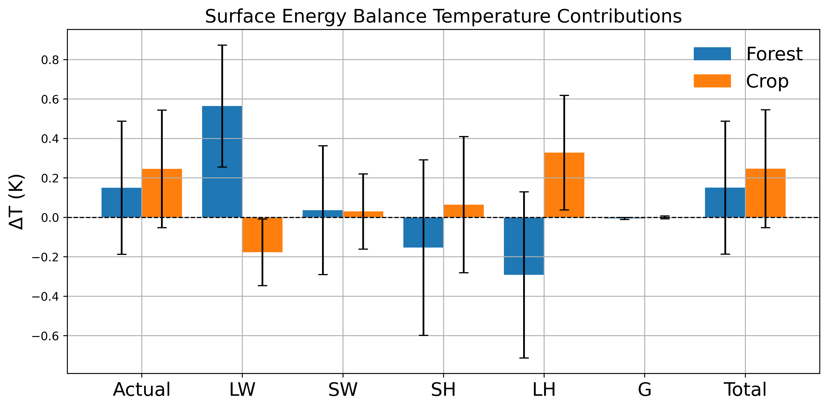
Surface Energy Balance Decomposition
Key Points:
Forest: More LWdown majorly warms the surface
Crop: Less Latent Heat Flux warms the surface

Slide 10
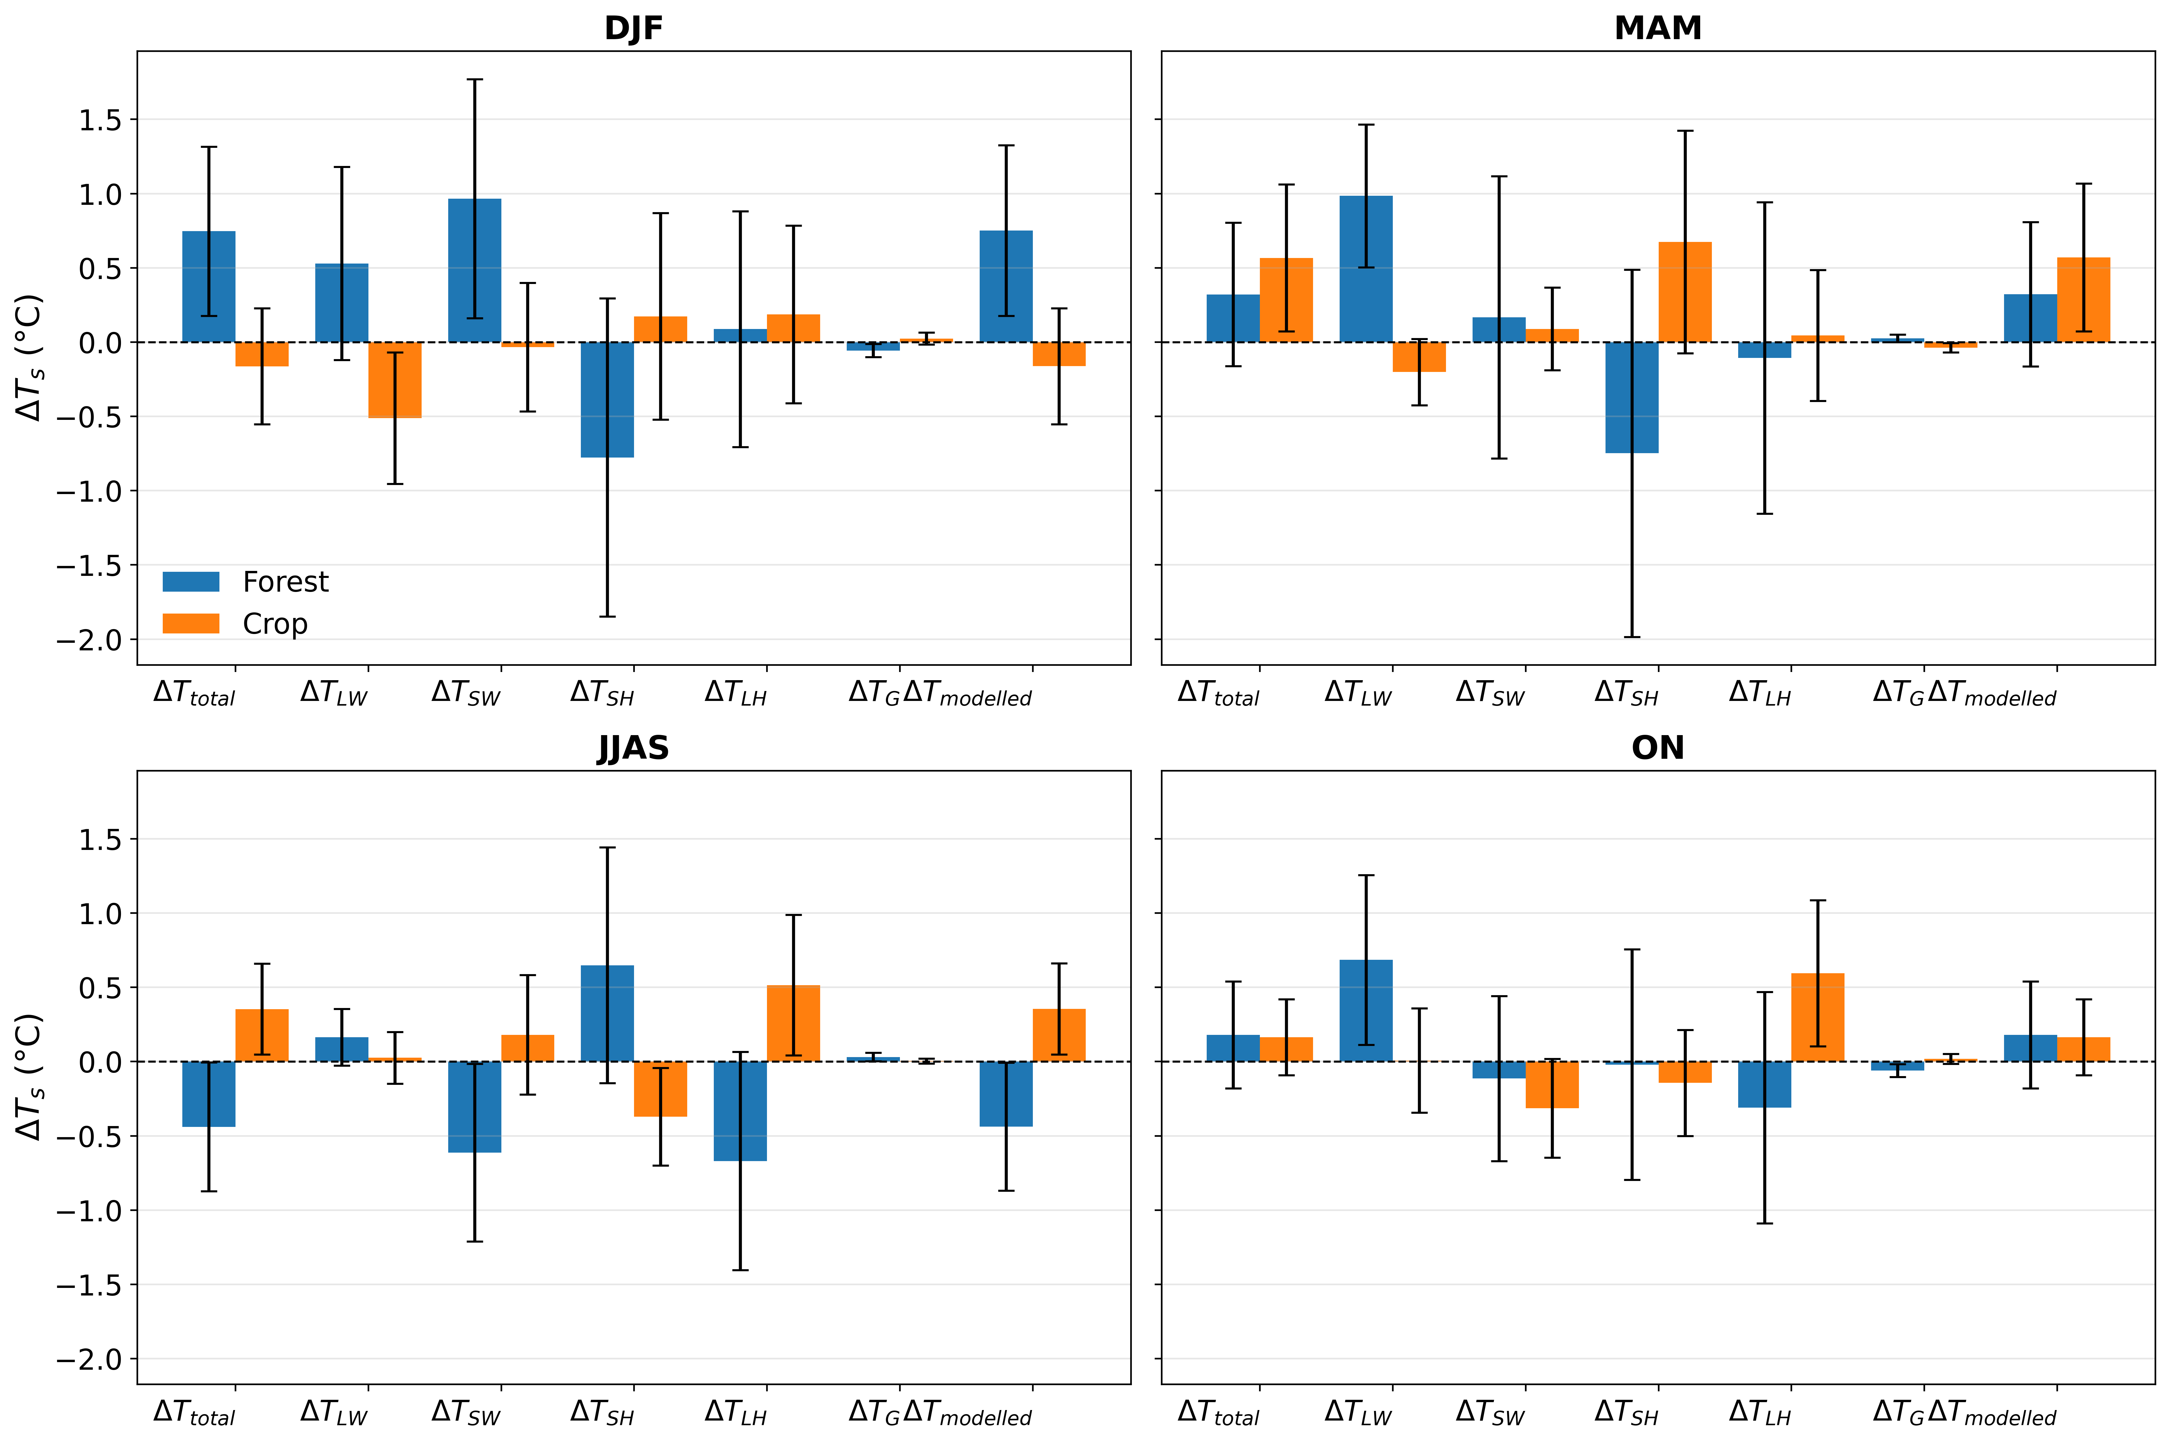
Surface Energy Balance Decomposition- Seasonal
Key Points:
Forest shows seasonal contrast: warming in DJF, MAM and ON, but cooling during JJAS.
Crop shows strongest warming during MAM and JJAS, while DJF response is weak or slightly cooling.
Longwave radiation contributes mainly to warming, especially for forests in DJF, MAM and ON.
Turbulent fluxes differ by season: sensible and latent heat partly offset radiative effects, especially during JJAS.

Slide 11
Conclusion
Both agricultural expansion and afforestation warms the surface and T_{2m}.
Forest: warming in non-monsoon seasons, Crop: warming in monsoon season
Forest: Net Longwave radiation and Latent Heat Flux acts opposite to each other but large magnitude of LWdown warms the surface.
Crop: Less Latent Heat Flux warms the surface.
Further improvement in ICON’s surface-flux representation and additional process-based studies are needed to increase confidence in the simulated land-atmosphere energy balance responses.

Slide 12









Thank you ☺
Kind Suggestion/Query please…..

