Slide 1






Introduction to the K-POP and a plan for understanding Western North Pacific Subtropical High (WNPSH)
The 9th GEWEX Open Science Conference, Jul 8 ~ 13, 2024, Sapporo, Japan
Hyun-Suk Kang¹, S. Shin¹ , G. Lee², S.-W. Son³, E. Chang⁴, M. Park¹, and H. Do¹
¹National Institute of Meteorological Sciences, KMA
²Kyungbook National University, ³Seoul National University, ⁴Kongju National University

Slide 2
Contents
Backgrounds
K-POP, Korean Precipitation Observation Program
Variability and Uncertainty of the WNPSH
A plan for a new IOP and some suggestions

Slide 3
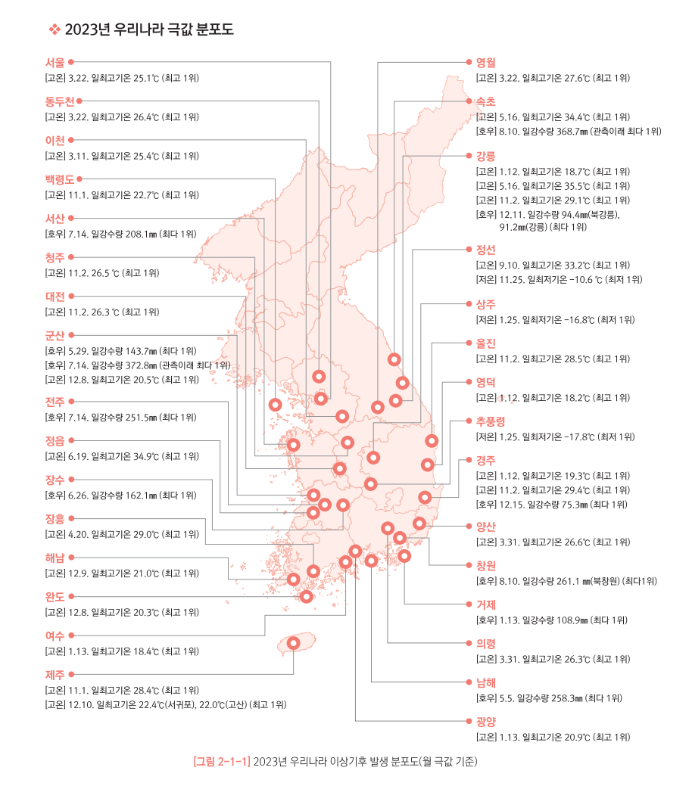
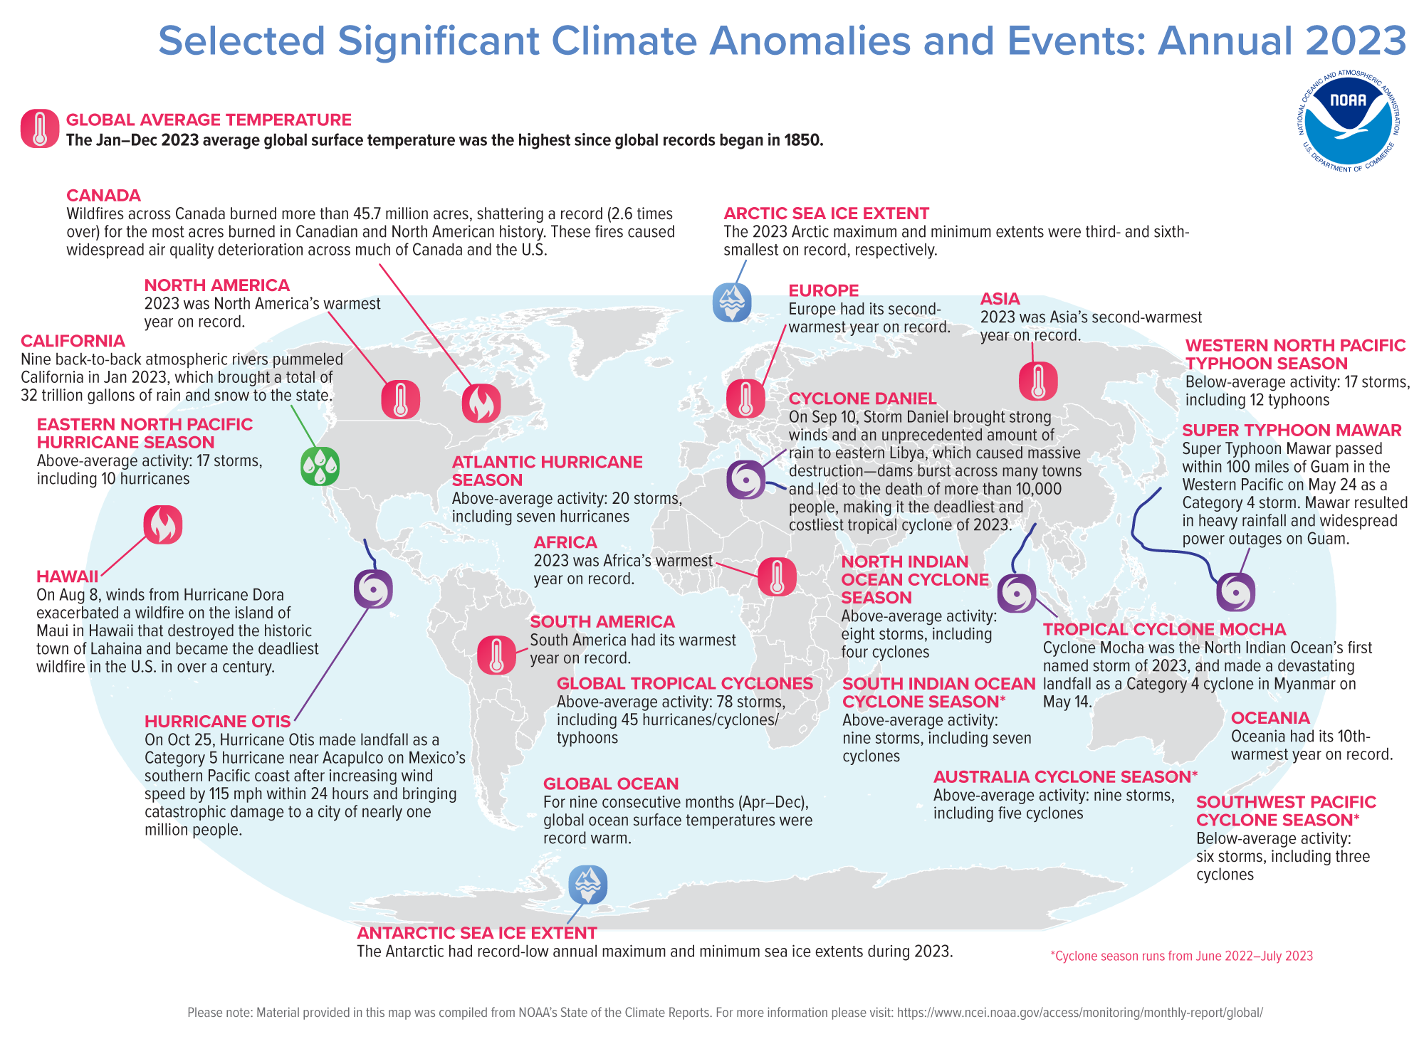
Backgrounds

Slide 4
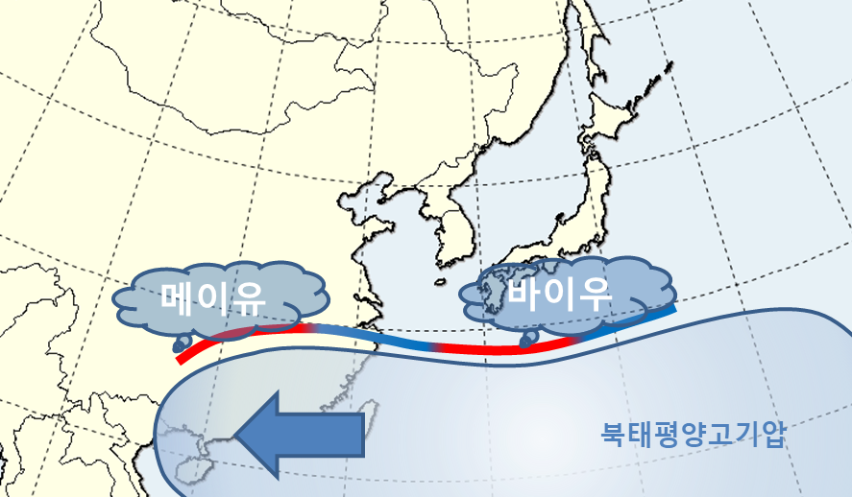
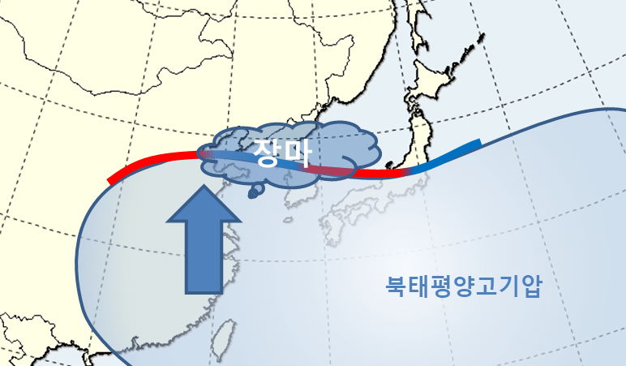
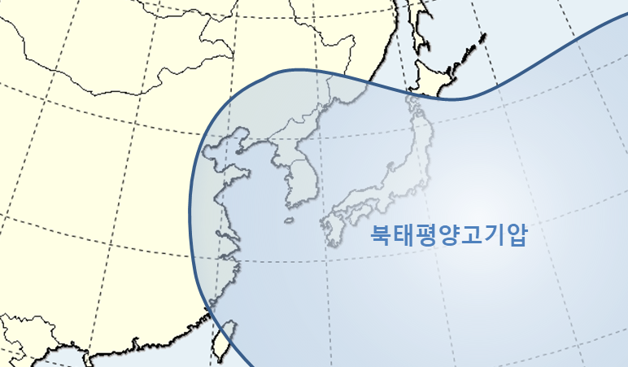
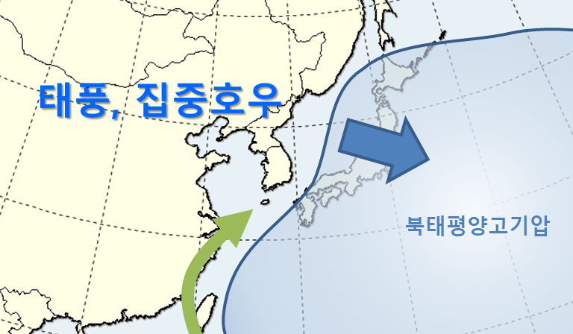
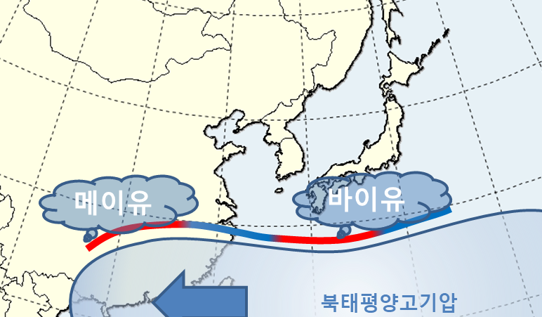
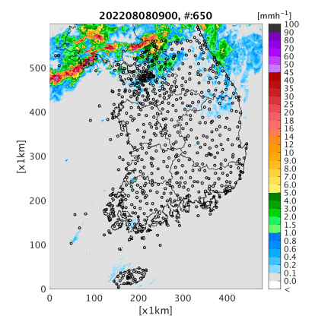
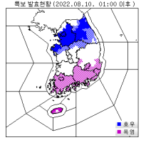
Backgrounds
May-June
June-July
August
August-September
Typhoon, Heavy Rainfall
Chang-ma
Mei-Yu
Baiu
Heat Waves
H
H
H
H
Early warning message
Torrential rainfall
Record breaking event on August 9, 2022. Daily (381.5 mm/d) and hourly (141.5 mm/h) rainfall amounts in Seoul.
Simultaneous torrential rainfall and heat wave in the middle and southern Korean peninsula, respectively.
Heat Wave

Slide 5
K-POP, the Korean Precipitation Observation Program
To understand dynamical/physical processes and improve weather forecasts predictability through real-time monitoring and operational NWP modeling for mesoscale convective system (KPOP-MS) and typhoon (KPOP-TY) in moisture-rich environment.
To advance cloud microphysical processes and their parameterization schemes of mesoscale convective systems.

Slide 6
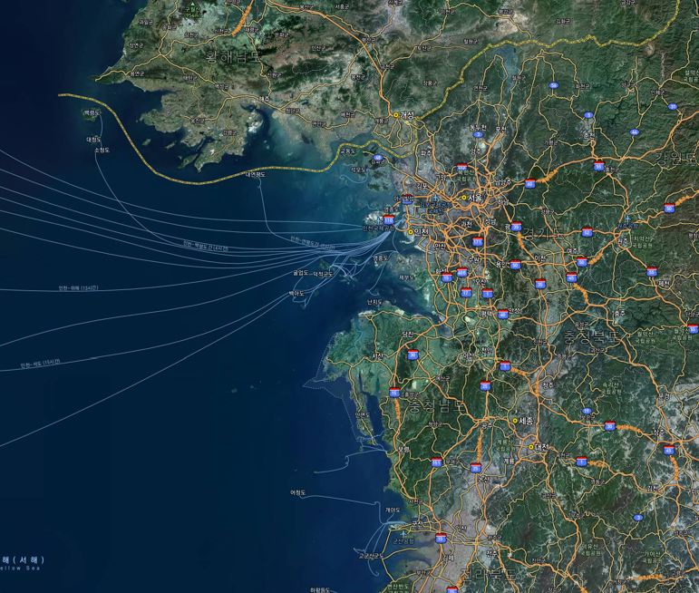
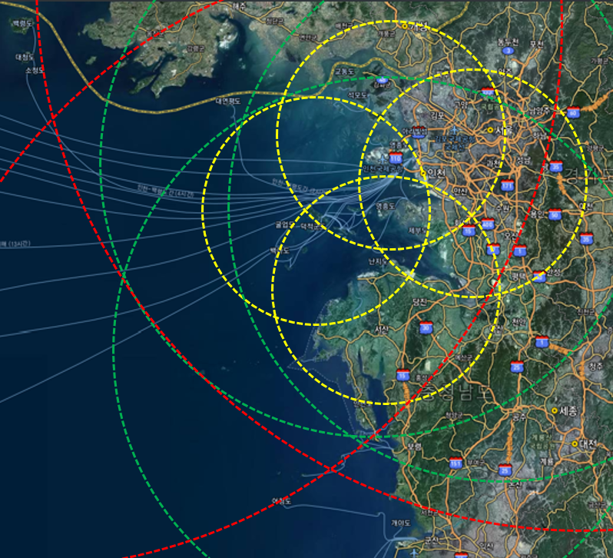
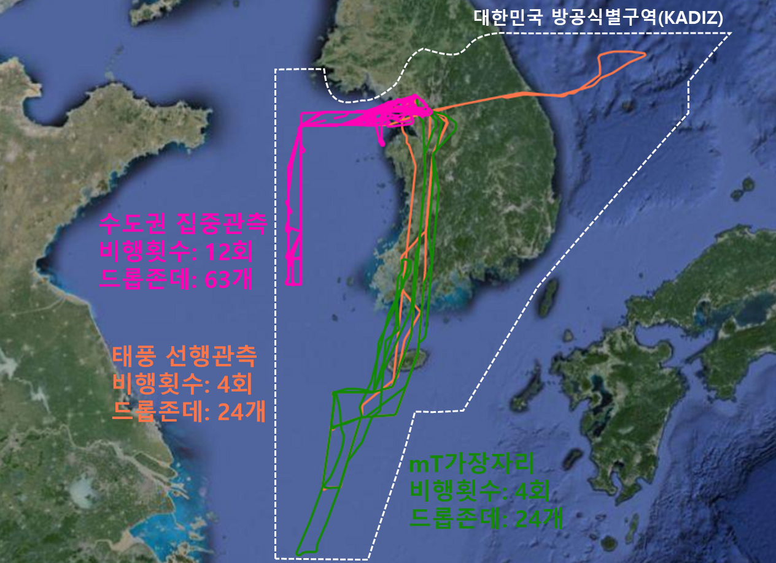
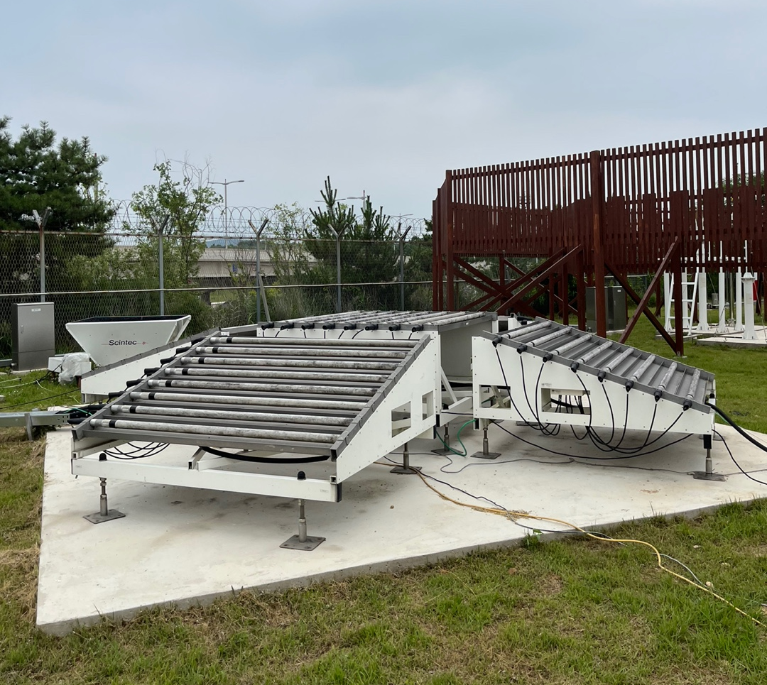
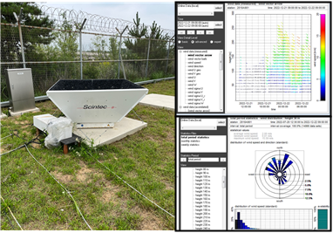
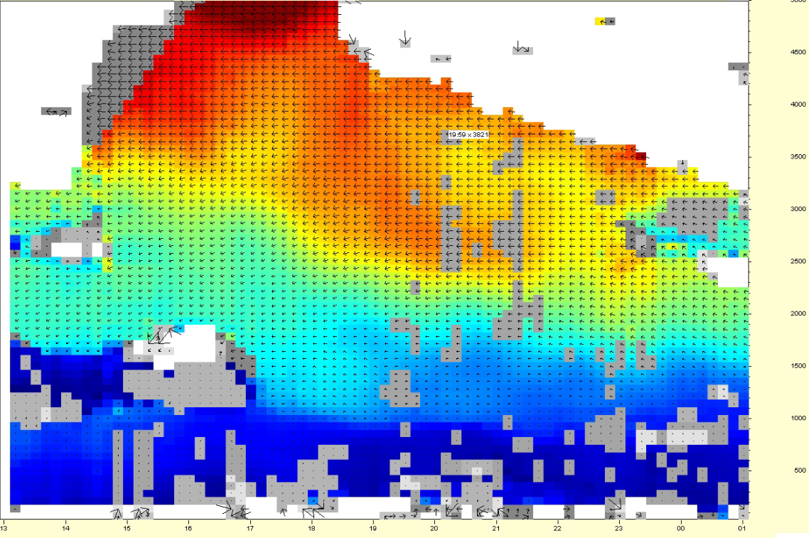
Observation Network of KPOP-MS and TY
Surface Observation
Aircraft Flights
Supersites(1st Site, ICO)
1st site : Lidar, WXT530, PARSIVEL(2), PLUVIO(2),
Wind prof., MRR2, POSS, SODAR, 2DVD, TREX
ICO : VERTIX, MRRpro, POSS, MPS, PARSIVEL,
PLUVIO, Gauge, USA-1, 2DVD
S-band X-band(O) X-band(R) C-band
Doppler lidar
Wind profiler
  Microphysics sites
  Microphysics sites (NIMS)
  KMA/KAF operational sites
Storm tracker sites(TBD)
NMC special obs.
  ECCC lidar sites
  Ship obs.
  LMA sites
Super sites on Incheon International Airport

Slide 7
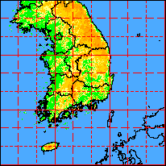
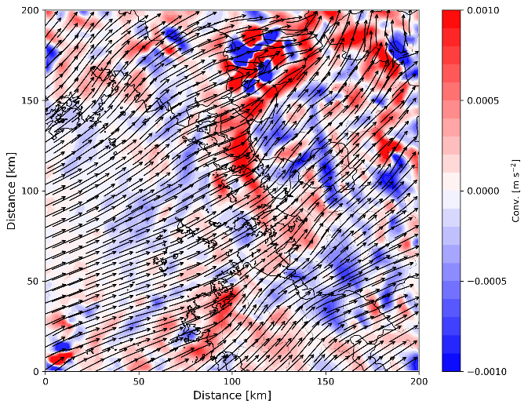
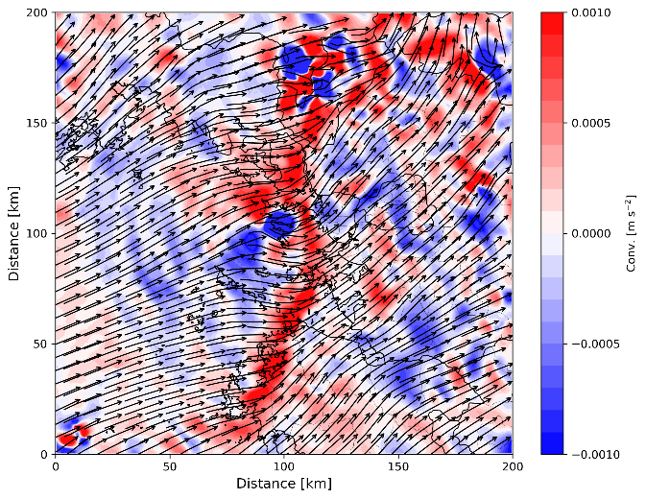
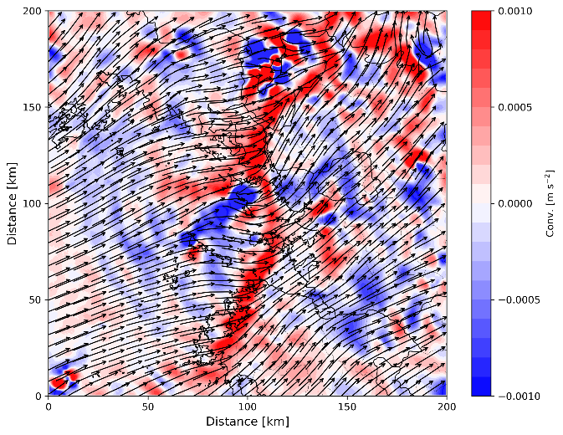
An Example of KPOP-MS Results
(Observation-based analysis data from Radar)
S-band only
S + C band
S + C + X band
1.5km conv.

Slide 8
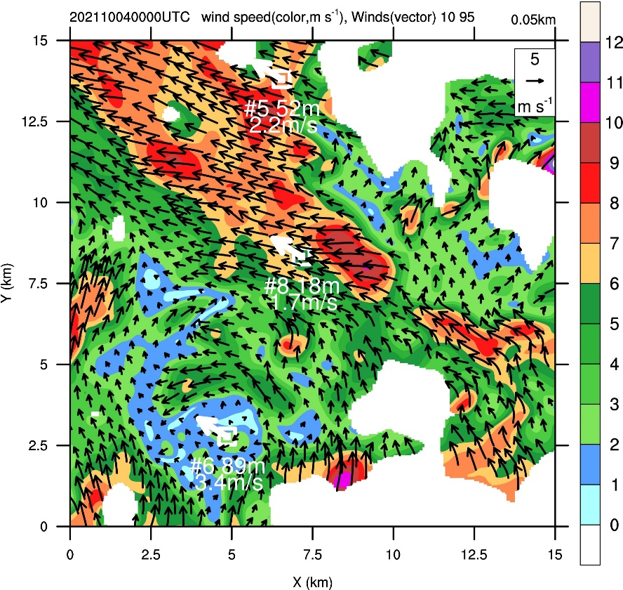
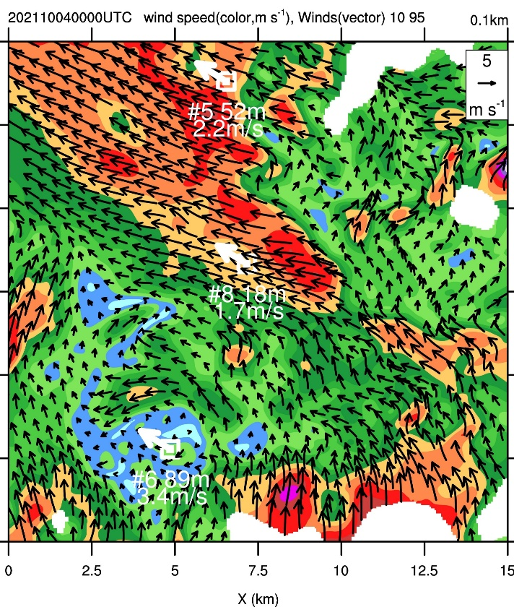
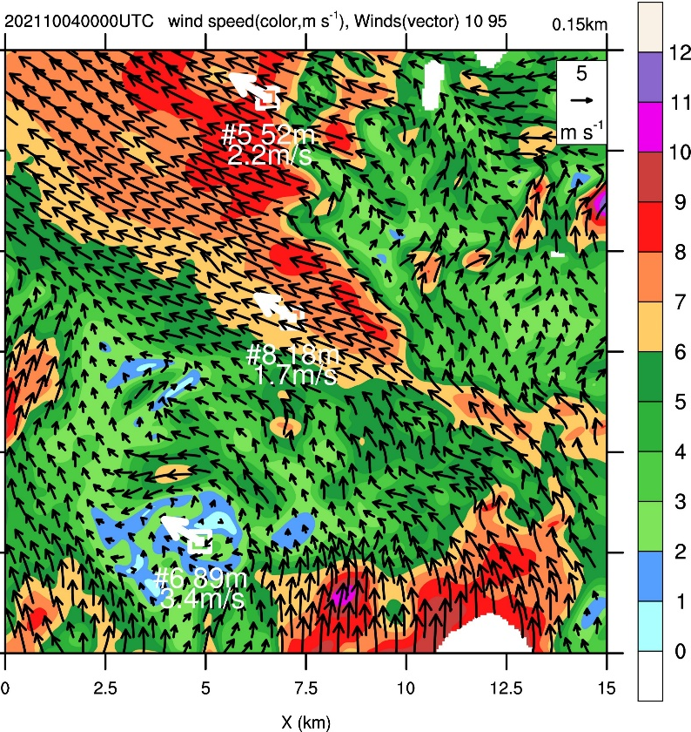
An Example of KPOP-MS Results
(Observation-based analysis data from Lidar)
00:00UTC 4 Oct 2021
H=50m
H=100m
H=150m

Slide 9
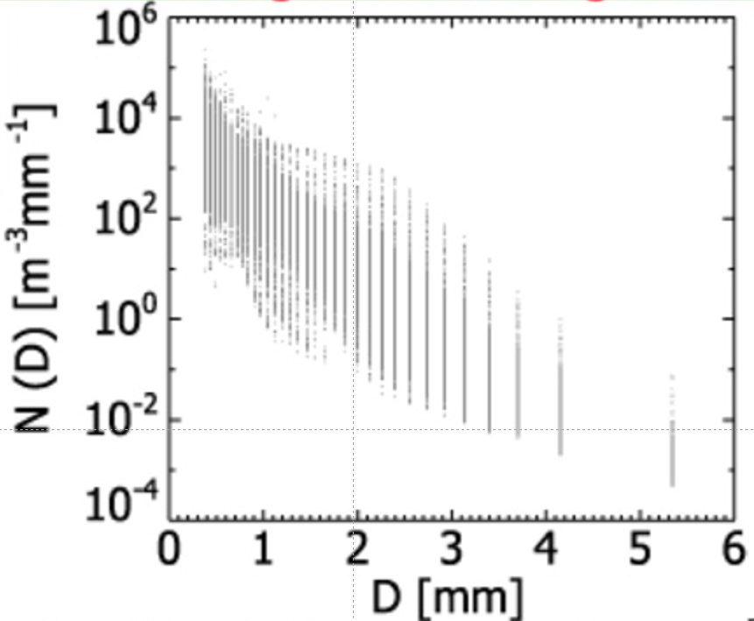
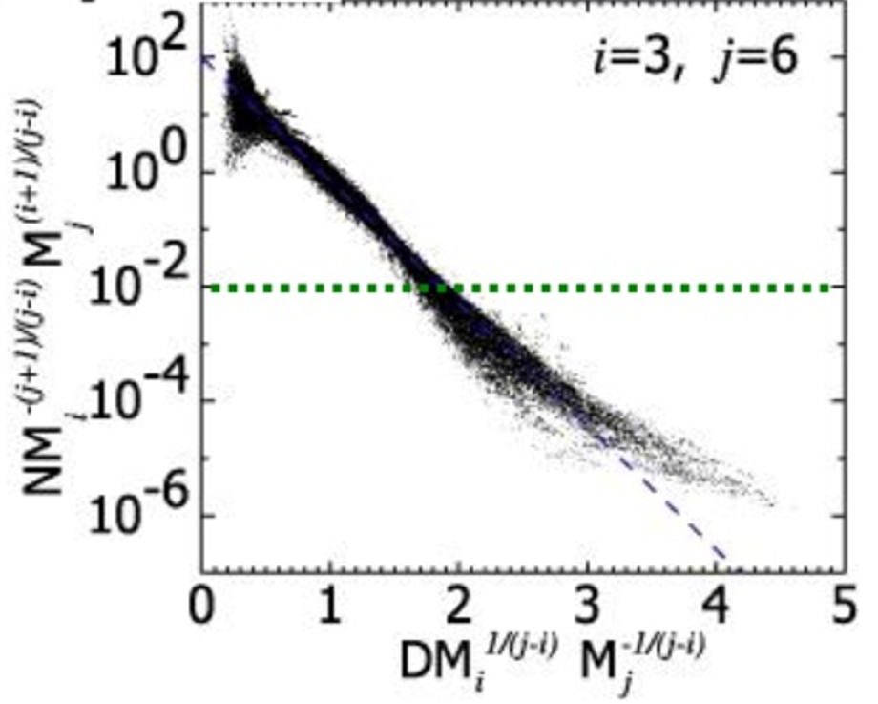
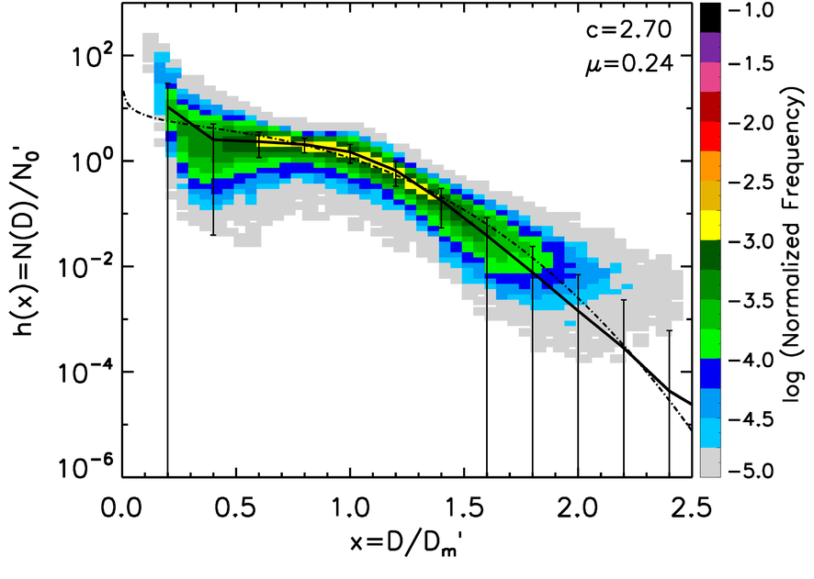
An Example of KPOP-MS Results
(WDM6 Parameterization Scheme in the WRF)
Original Scheme
(large variance in N(D))
Normalized
double moment distribution
Parameters from in-situ measurements
# of drops: 12,025,359

Slide 10
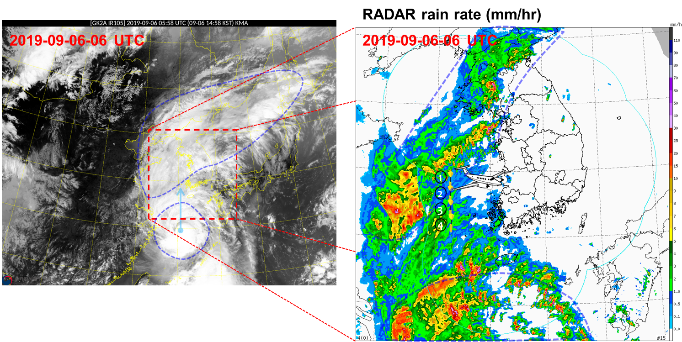
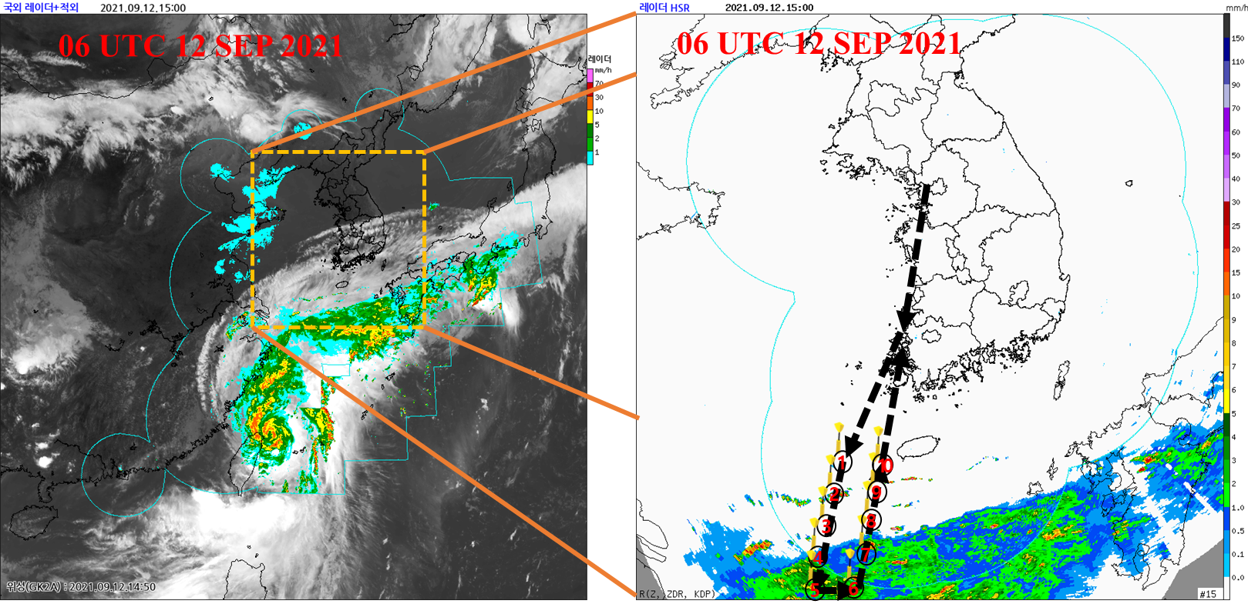
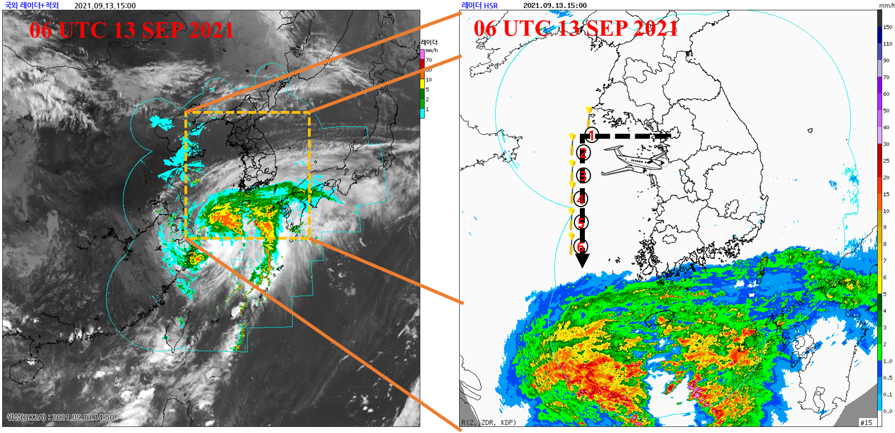
An Example of KPOP-TY Results
(Aircraft Dropsonde Observation)
13th LINGLING in 2019
Dropsonde observation using Aircraft
  Precipitation band or dry area in front of the Typhoon
  12hr before Typhoon landfall
  Used for data assimilation for operational NWP model
14th CHANTU in 2021

Slide 11
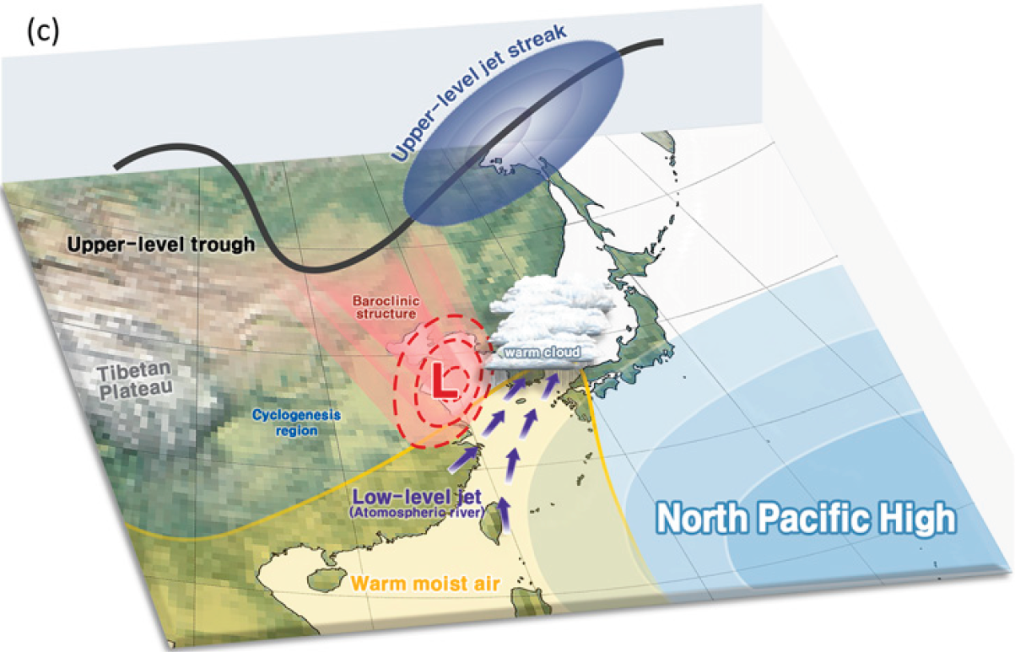
Impacts of WNPSH on extreme weather in East Asia
Summertime extreme weather events over East Asia including the Korean peninsular are highly related with the WNPSH. However, it is not well known why the WNPSH acts such a way.
Extreme weathers are highly associated with WNPSH’s location, intensity, and variability.
Nevertheless, it’s fundamental dynamics and variability are poorly understood in spite of its importance.
It is essential to know uncertainty and variability in WNPSH’s activity for extreme weather forecasts.
Park et al.(2021), Diverse synoptic weather patterns of warm-season heavy rainfall events in South Korea

Slide 12
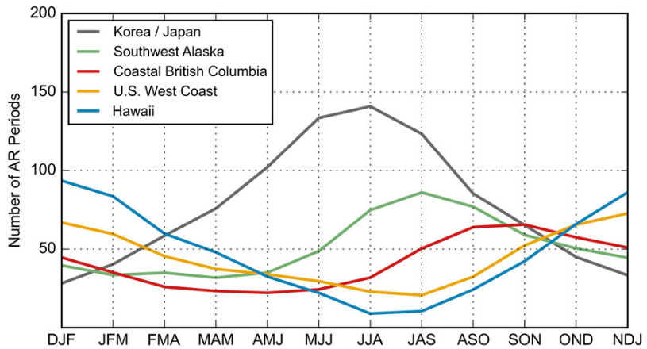
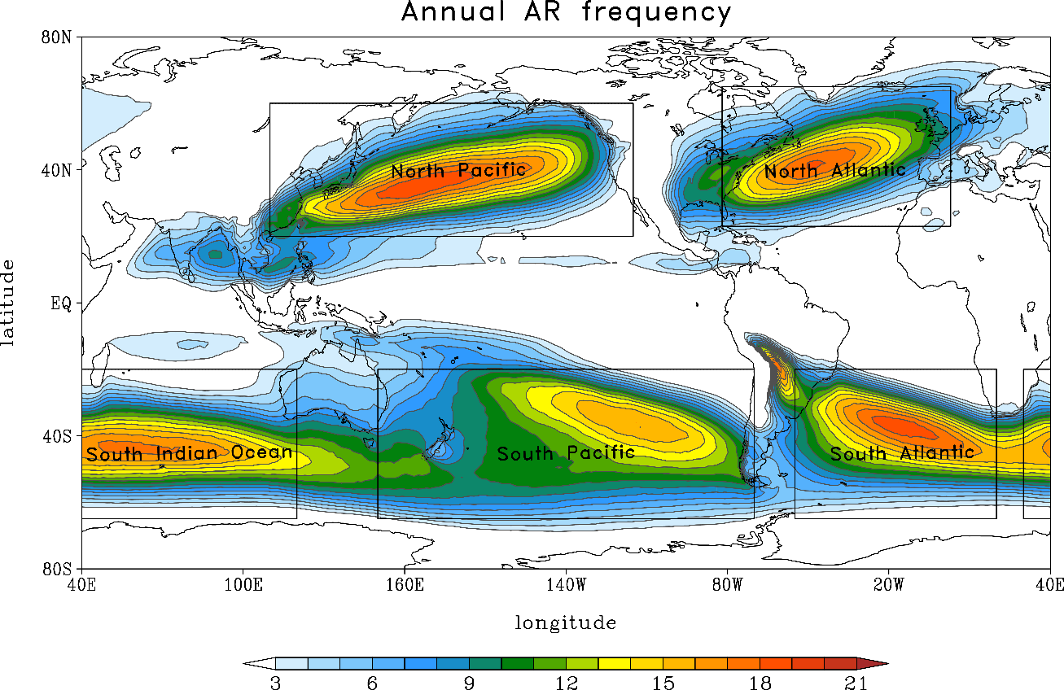
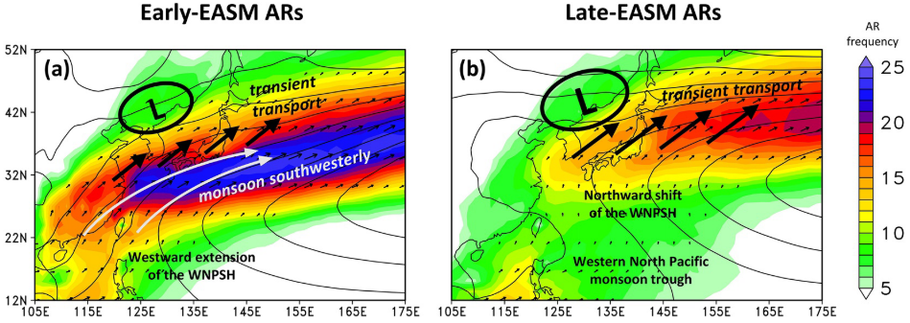
Atmospheric River
Mundhenk et al. (2016)
Park et al. (2023)
AR is one of the good indicator for water vapor amount in East Asia, but it is not good enough for rainfall amount due to the lack of triggering mechanism (Courtesy of Prof. Son).
Park et al. (2021)
Shading: AR frequency (%)
Contours: 850-hPa GPH (gpm)
Vectors: AR-IVT (kg m⁻¹ s⁻¹)

Slide 13
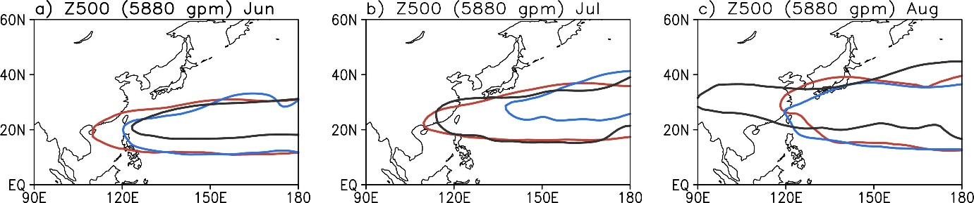
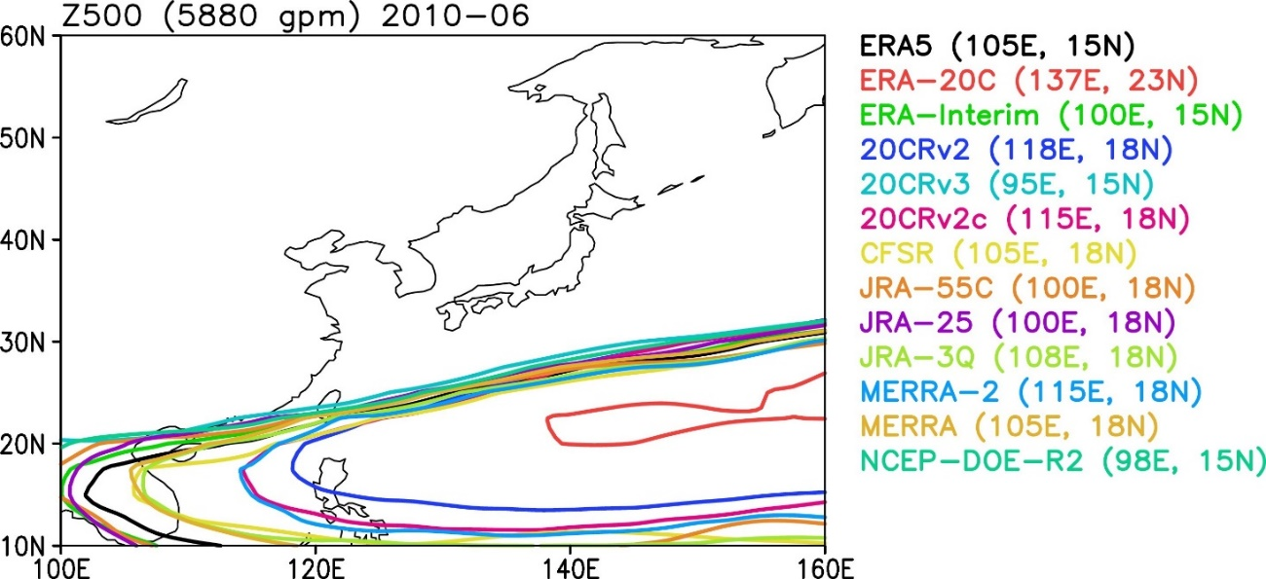
Variability and Uncertainties of the WNPSH
`21
`20
`20
`21
`22
`20
`22
`22
`21
5880 gpm lines in 13 reanalysis data show significant differences to each other (even though it is a monthly average),
That means…..

Slide 14
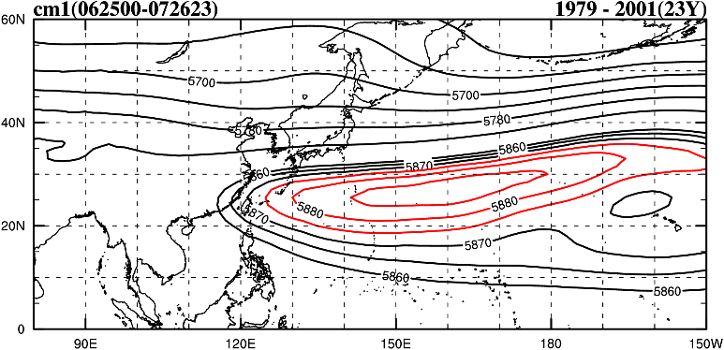
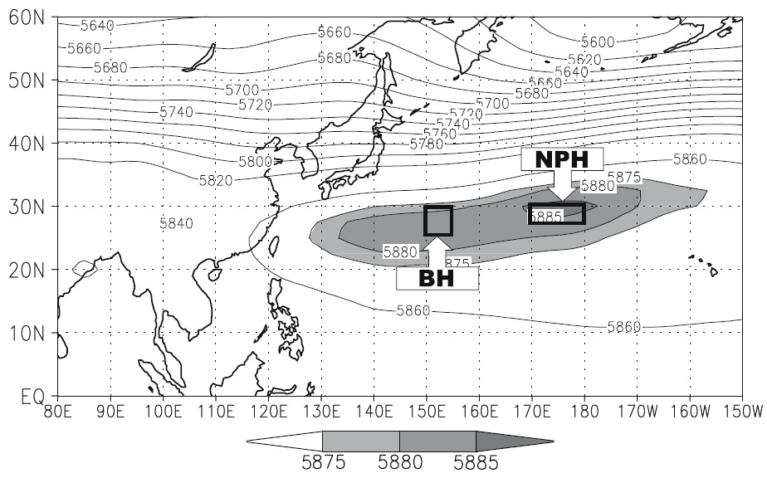
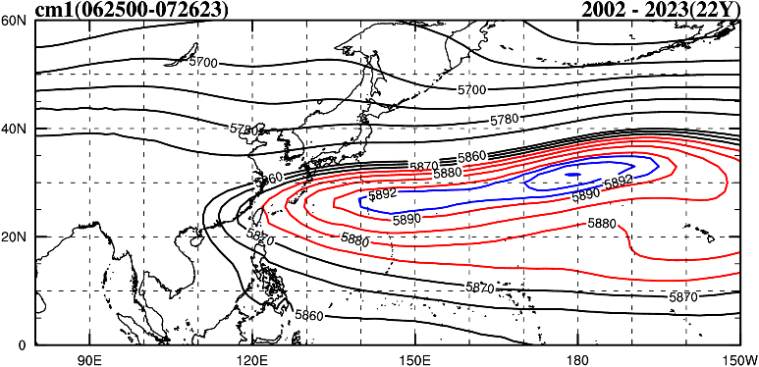
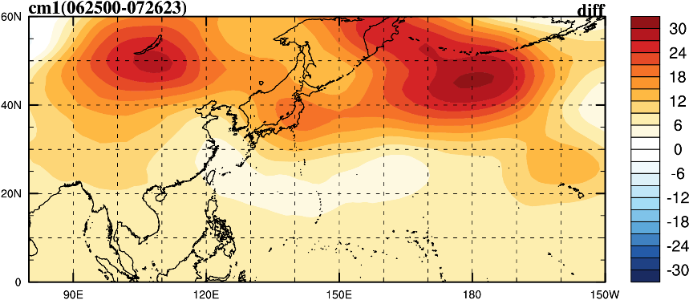
Preliminary Study on the WNPSH’s variability
Ha and Lee, 2007: On the interannual variability of the Bonin high associated with the East Asian summer monsoon, Clim. Dyn., 28, 67-83.
KOR
Fig. 3. The climatological mean position at 500 hPa (late June–late July) of the Bonin high (BH) and the north Pacific high (NPH) from NCEP/NCAR reanalysis data for the period from 1948 to 2001

Slide 15
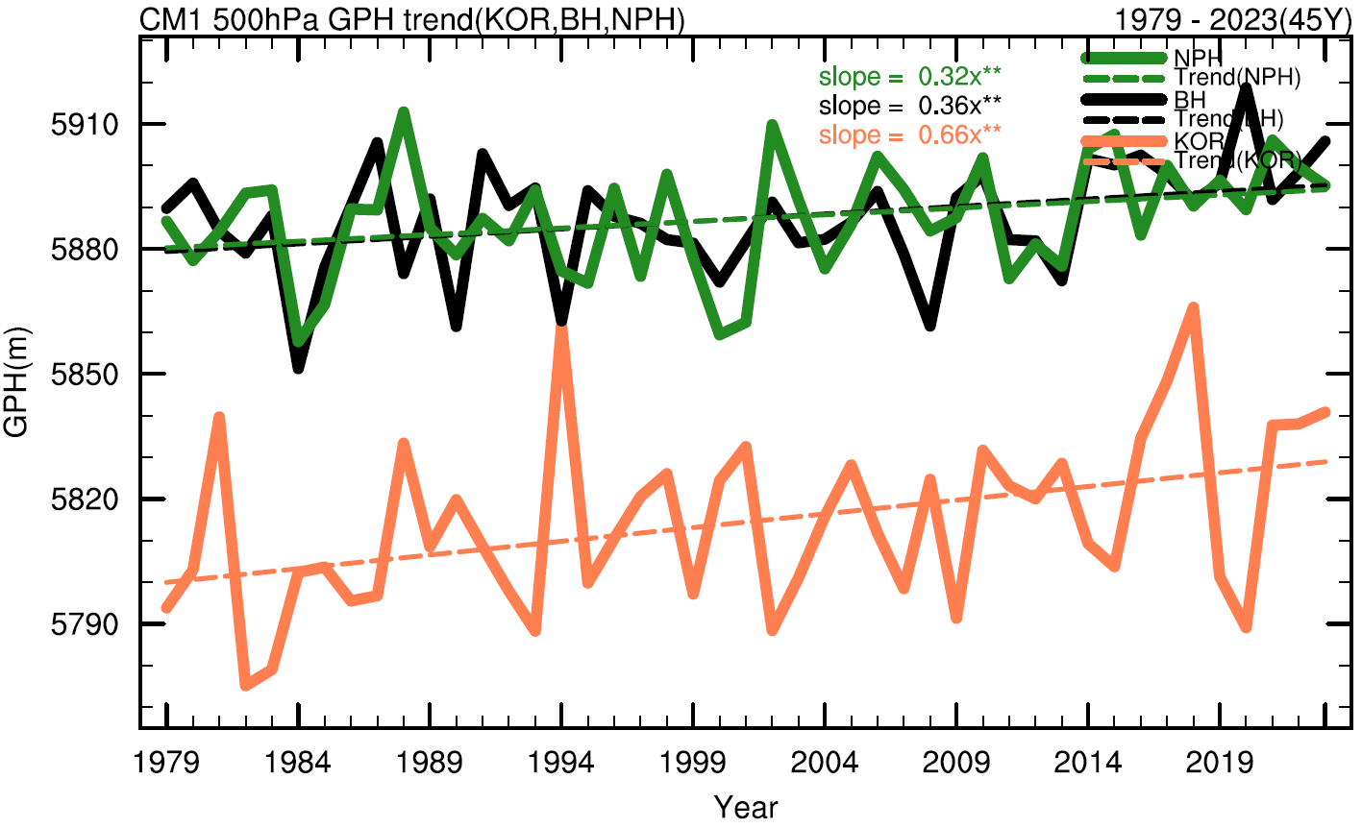
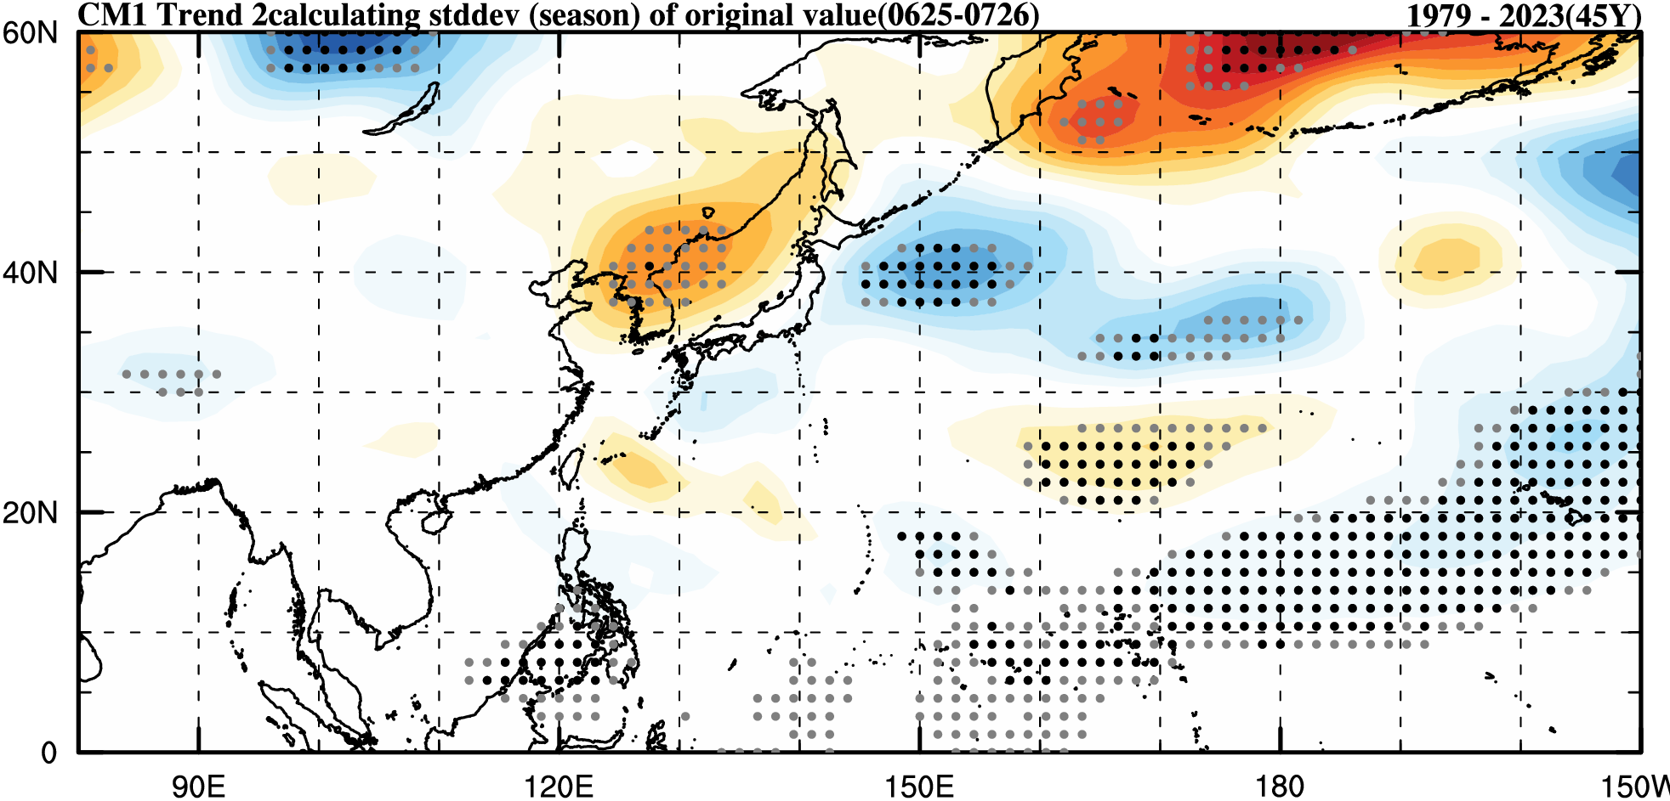
Long-term trend & STD of the 500 Height

Slide 16
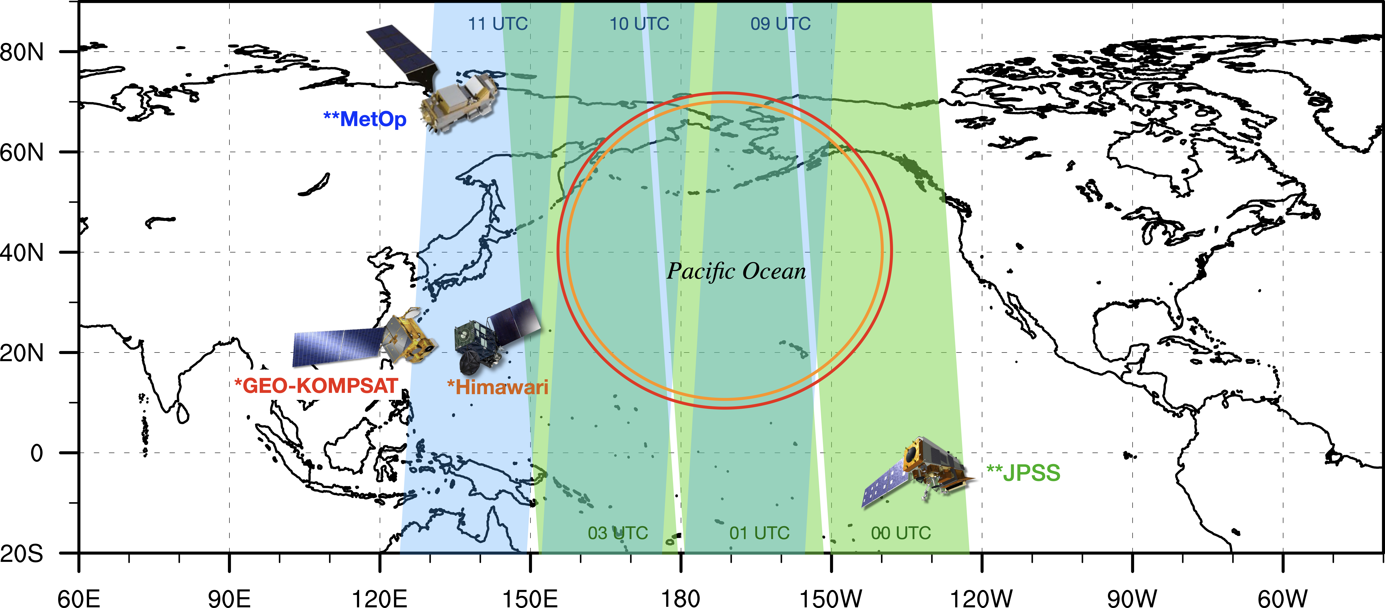
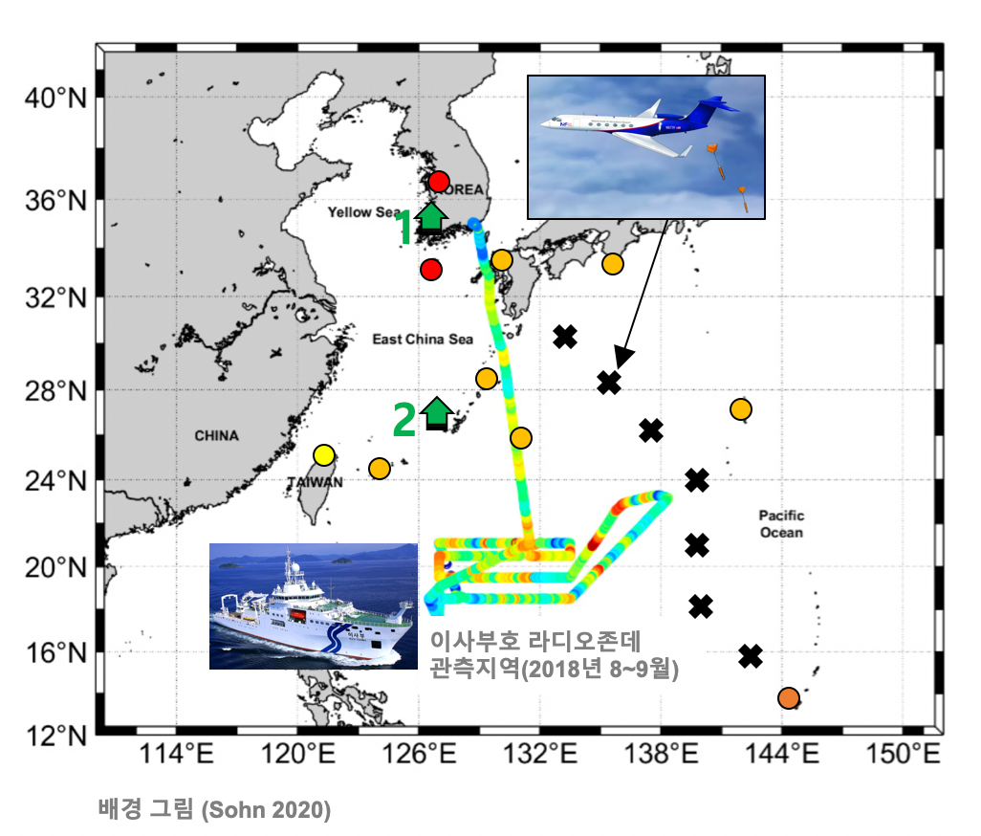
Tentative Plan for a New IOP and Suggestions
Through the WNPSH IOP, we can calibrate satellite measurements that is available 365day/24hrs for monitoring extreme weather events.
Real-time operation for extreme weather forecast
Development of calibration method and/or retrieval algorithm of satellite products by robust analysis & diagnosis
Step 1. Pilot Study (`25~`27)
Step 2. IOP (`28~`30)
Step 3. Diagnosis/Analysis (`31~`32)
Step 4. R2O in real-time (`33~`34)
Field campaign with all available equipments (in-situ & remote sensing) based on international partnership
Find the target area for IOP, which is the most sensitive to extreme weather
Pilot study with given observation & reanalysis data

Slide 17
Thanks for your attention!
Questions?

