Slide 1
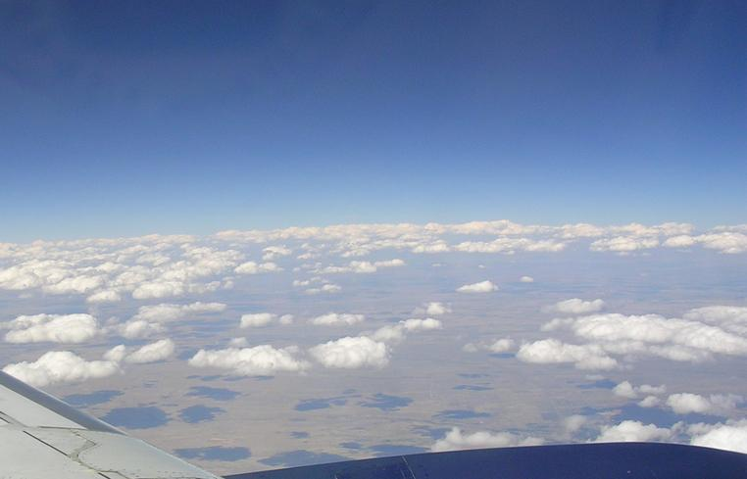


Local Land-Atmosphere Coupling:
Will Clouds Form?
Michael Ek, NCAR Scientist (retired)
…working with many researchers worldwide!
Research Applications Laboratory (RAL)
NSF National Center for Atmospheric Research (NCAR)
Boulder, Colorado USA

Slide 2


Land-Atmosphere Interactions
Land & atmosphere are intimately coupled: short to long time scales.
However, historically land models and atmospheric models have been developed separately, and then plugged together. Not so good for simulating coupled land-atmosphere processes…
Land-atmosphere interactions remain a weak link in Earth system prediction models for Numerical Weather Prediction (NWP) & Climate.
Coupling strength affects surface fluxes and boundary-layer evolution (with downstream influences), so important for weather and climate; develop/use land-atmosphere coupling metrics: Is the coupling correct?
Need to understand many land & atmospheric processes and interactions, with proper representation in weather/climate models...
...e.g. soil moisture/evaporative flux to the atmosphere (boundary-layer development, clouds/convection), hydrology/river-flow & connection to oceans, dust/suspension and surface chemistry interactions, plants, etc.
Coupling begins locally!
Nature
Models
Paul Dirmeyer (George Mason Univ.)

Slide 3
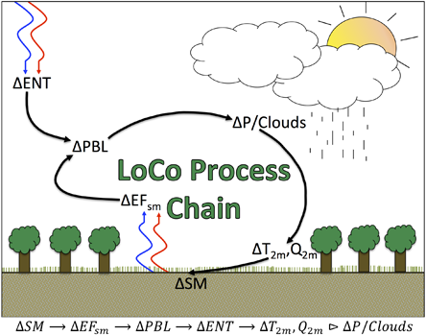
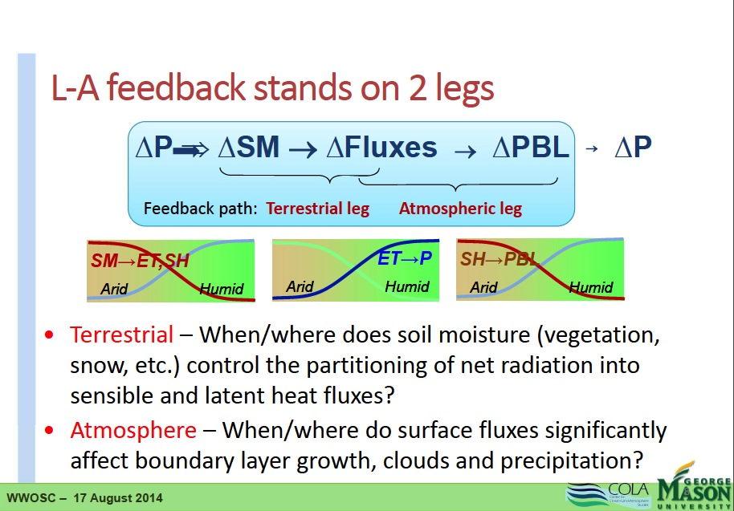

Local Land-Atmosphere Interactions
Feedback Path:
Terrestrial Leg
Atmospheric Leg
GLASS Local Land-Atmos. Coupling (LoCo) project
Land-Atmosphere Coupling &
Feedbacks “Stand on 2 Legs”
Terrestrial Leg – How does soil moisture (& vegetation, soil, snow) control the surface energy budget partition (ET, SH, G, Rnet)?
Atmospheric Leg – How do surface fluxes affect boundary-layer development?
Figures from Joe Santanello (NASA/GSFC) & Paul Dirmeyer (George Mason Univ.)

Slide 4
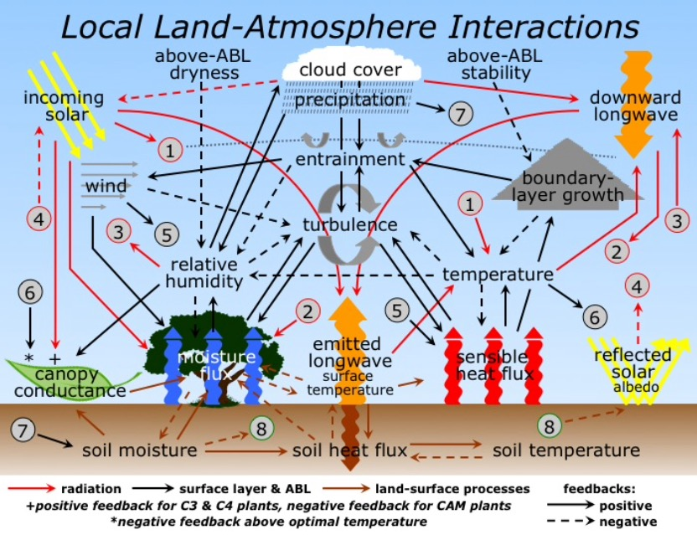




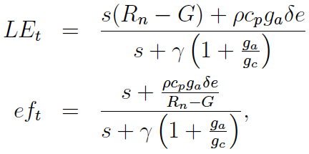

Many Processes!
What’s “Under the Hood”?! Many processes, all interacting!
We need to get Earth system processes & their interactions right for the right reasons.
Explore Relative Humidity (RH) tendency at ABL top.
Relevant Equations…
ABL-top dry-air entrain.
boundary-layer growth
direct evaporation
surface-layer turb exchange
surface energy budget
transpiration
canopy conductance

Slide 5


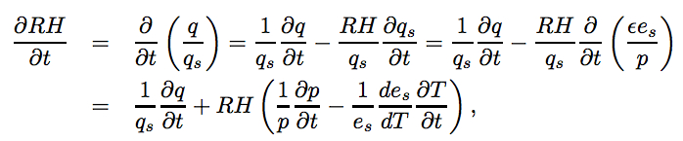
Relative Humidity Tendency
How does land surface impact onset of fair-weather cumulus?
What is the role of soil moisture, surface fluxes & atmospheric processes?
How to quantify?
Evolution of Relative humidity at ABL top expected to control cloud initiation. RH tendency dRH/dt:
RH tendency
Largest RH tendency and potential for ABL cloud init.
available
energy term+
“normalized”
tendency term
RH tendency with decreasing ef
Non-evaporative terms:
“normalized” RH tendency term
phase diagram
non-evaporative terms (ne)
dry-air
entrainment-
ABL
growth+
ABL
warming-
RH tendency with increasing ef
ABL-growth regime (weaker above-ABL stability and Δq small)
q=specific humidity (g/kg)
qs=saturation specific humidity (g/kg)
RH = q/qs
Surface moistening regime (stronger above-ABL stability and/or Δq large)
evaporative fraction (ef)
Ek & Holtslag 2004

Slide 6
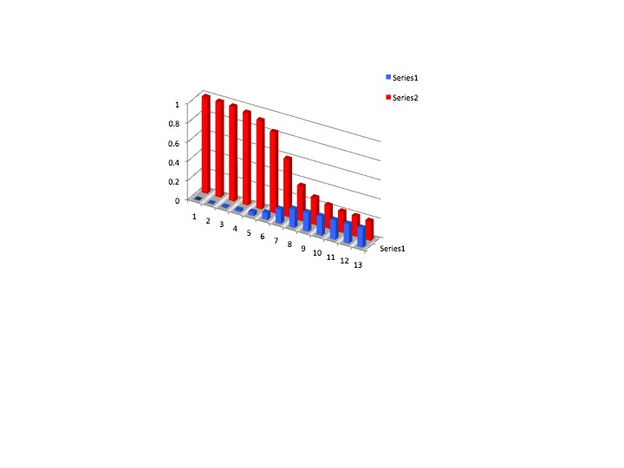
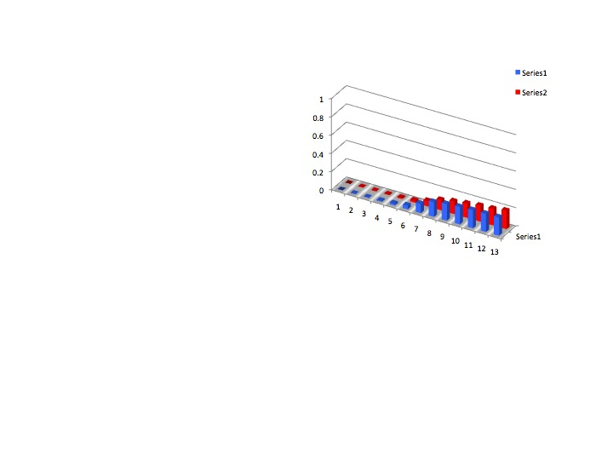
Single Column Model (SCM) Testing
Sensitivity tests: SCM with interactive land & ABL with fair weather cumulus for different conditions (starting with an intial Cabauw, NL data set).
• dry soil/strong inversion --> shallow ABL, no clouds.
• dry soil/weak inversion --> deeper ABL, more clouds.
• moist soil --> shallow ABL, cloud cover similar, regardless of inversion strength.
• dry aloft (Δq large) --> fewer clouds regardless of inversion strength; dry air “wins”!
Δq small
(Δq<Δqcrit)
Δq large
(Δq>Δqcrit)
cloud cover
dry
soil moisture
wet
weak
inversion
strength
strong

Slide 7
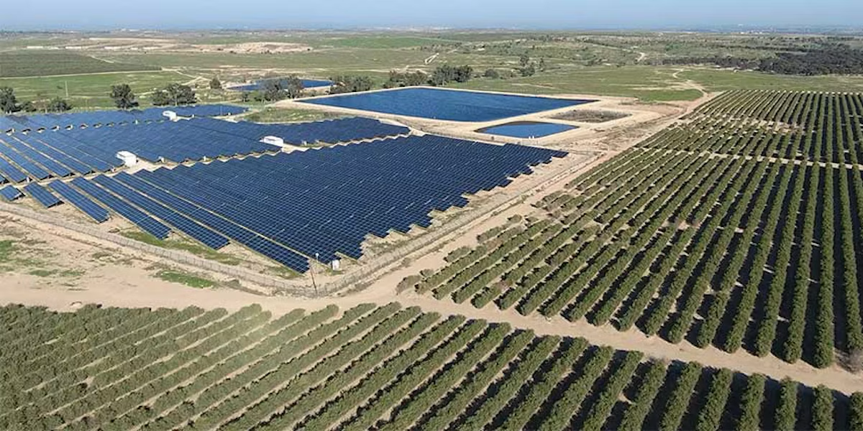

Observations from Field Programs
Observed mid-afternoon ABL cloud formation (fair-weather Cumulus) <~20% cloud cover.
AMMA, West Africa: June. Tropical mixed agriculture & semi-arid. Westra et al (2012).
HAPEX-MOBILHY, SW France: June. Mixed agriculture & forest. Ek & Mahrt (1994).
Cabauw, Netherlands: May. Grassland, agriculture. Ek & Holtslag (2004).
Need to evaluate more data sets from field programs & observational networks focused on land-atmosphere interactions (with clouds possibly observed), e.g.:
Hu & Islam, BLM, 1997, FIFE/Oklahoma.
Kustas & Albertson, 2003, WWR, Monsoon 90 field exp., AZ.
Lenderink et al, 2004, QJRMS, SCM study, S. Great Plains.
Bertoldi et al, 2007, WWR. Remote sensing, SGP.
Huang & Mergulis, WWR, 2010, LES study, SMACESX/SMEX02, Great Plains.
Qiu & Williams, 2020, GRL, SGP.
Also work by Dirmeyer, Findell, Santanello, among others.
Study dRH/dt with GEWEX Land-Atmos. Feedback Observatories (GLAFOs)!
Concept behind the Cloud and Precipitation Reactor (CPR) – “Intelligent land use change to enhance precipitation in arid regions.”
Optimal conditions: strong surface heating (small ef), optimal initial RH in ABL, small Δq, weak inversion.
Branch, Wulfmeyer, et al.
non-evaporative terms (ne)
Jojoba plantation & solar farm
evaporative fraction (ef)

Slide 8
Summary & Future
Land-atmosphere interactions involves:
Terrestrial Leg: land processes/characteristics effect surface fluxes.
Atmospheric Leg: surface fluxes affect boundary-layer development, including cloud initiation.
Evaluate many land-atmosphere data sets.
Increase understanding of land-atmosphere interactions, and transfer this knowledge to Earth system models for weather and climate.
In fully-coupled multi-component Earth System Models, we have less degrees of freedom, so a greater need to get the right answers for the right reasons, i.e. properly represent land & ABL processes and land-atmosphere interaction, including clouds.
This effort is helped by activities and projects on land-atmosphere interaction under (WCRP GEWEX) GLASS, LoCo, GABLS, GLAFO.

Slide 9


Thank you!

