Slide 1

JAXA EO Program and
Opportunities for GEWEX - 2022
Tadahiro HAYASAKA,
Riko OKI, Misako KACHI
Japan Aerospace Exploration Agency (JAXA)
GEWEX SSG-34b, 26-27 July 2022

Slide 2
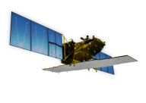





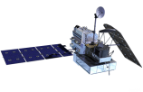
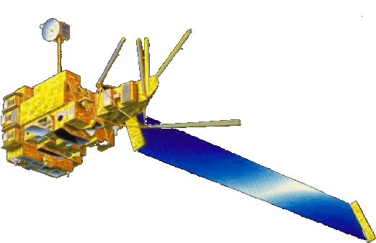




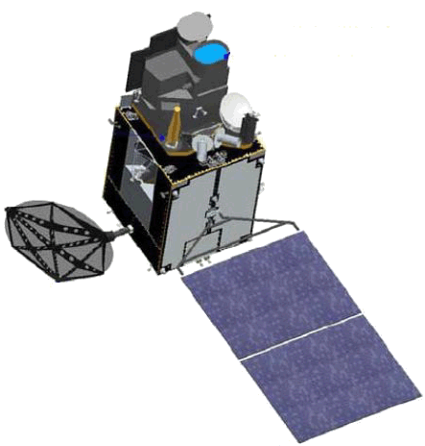
Japanese Earth Observation Satellites/Sensors
Targets (JFY: Apr-Mar) |  | 2014 | 2015 | 2016 | 2017 | 2018 | 2019 | 2020 | 2021 | 2022 | 2023 | 2024 | 2025
Disasters Management & Land Monitoring JERS1/OPS, SAR (1992-1998) ADEOS-I/AVNIR ALOS/AVNIR2, PALSAR (2006-2011)
Climate System Climate change ADEOS-I/OCTS (1996-1997) ADEOS-II/GLI (2003)
Water Cycle ADEOS-II/AMSR (2003) Aqua/AMSR-E (2002-2011)
Greenhouse gases
[Land and disaster monitoring]
[Land and disaster monitoring]
ALOS-2 / PALSAR-2
ALOS-4/Advanced SAR
[Land and disaster monitoring]
ALOS-3/Advanced Optical
[Vegetation, aerosol, cloud, SST, ocean color]
GCOM-C / SGLI
[Cloud and aerosol 3D structure]
EarthCARE / CPR
with ESA
TRMM / PR
[Precipitation 3D structure]
ACCP Pre-phase A
PMM(TBD) Phase A
with NASA
GPM / DPR
with NASA
[Wind, SST , water vapor, precipitation]
[Wind, SST , water vapor, rainfall]
GCOM-W / AMSR2
GOSAT-GW/AMSR3
[CO_{2,} CH₄]
GOSAT-GW/TANSO-3
GOSAT / FTS, CAI
[CO_{2,} CH₄, NO₂]
MOE
with MOE
[CO_{2,} CH₄, CO]
with MOE
GOSAT-2
MTSAT-1R
(Himawari-6)
Himawari-10/11 planning
JMA geostationary meteorological satellites
[Cloud, aerosol, SST]
MTSAT-2 (Himawari-7)
Himawari-8
Himawari-8 (standby)
Himawari-9 (standby)
Himawari-9
Mission status
Completed
On orbit
Development
Pre-phase-A
Phase-A

Slide 3
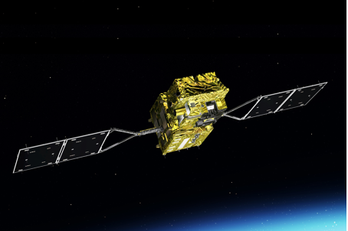
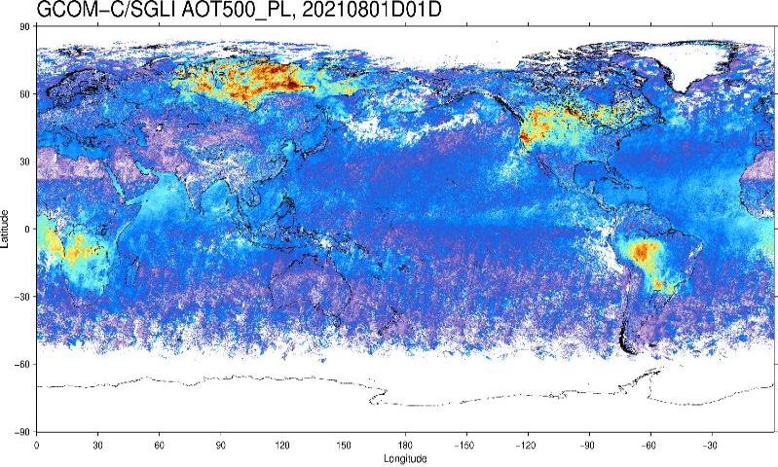
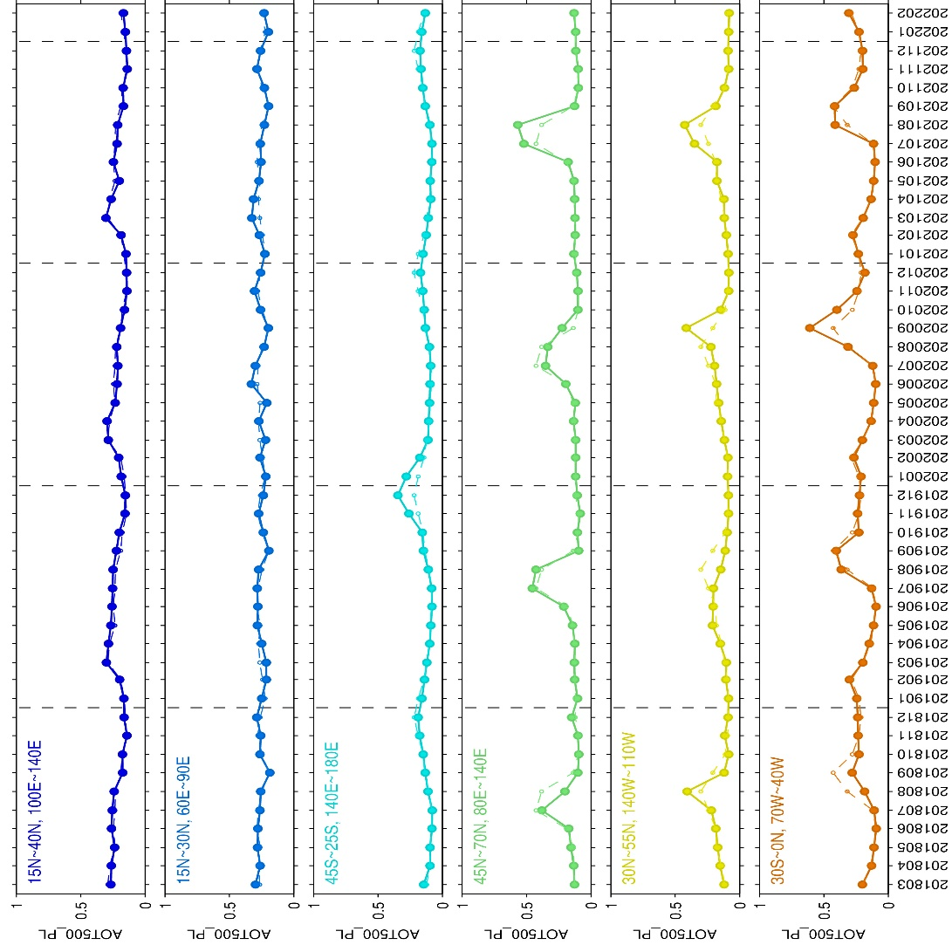

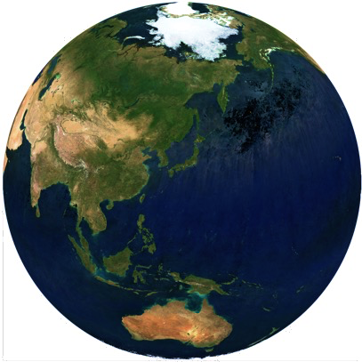
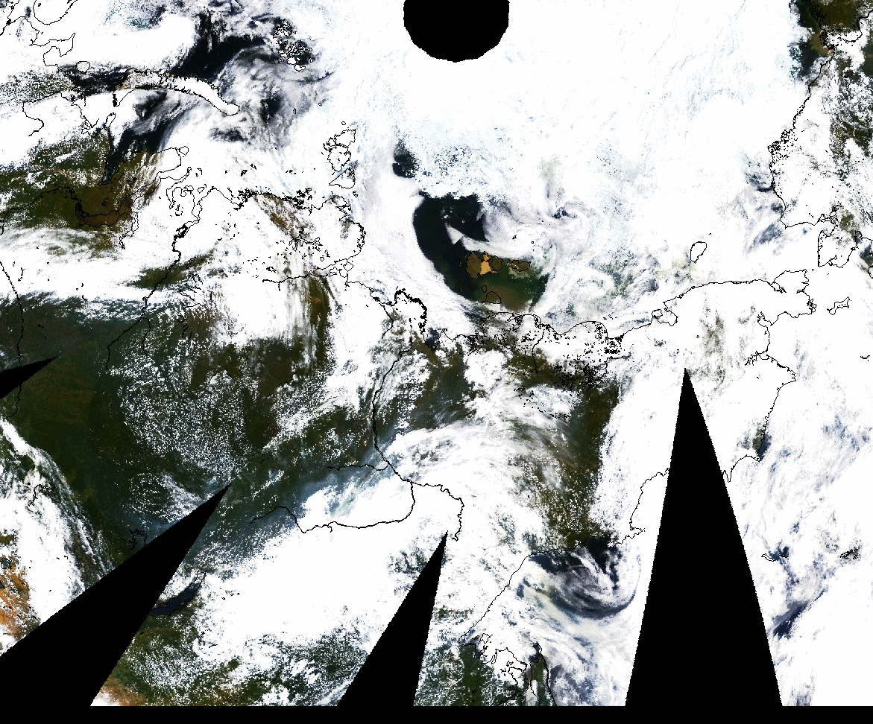
Climate Monitoring by GCOM-C
Global Change Observation Mission - Climate (GCOM-C)
GCOM-C
Energy Budget
Observation started since Jan. 1, 2018
250-m resolution, 19 channels in NUV-TIR including 2-ch polarization with 1150-1400km swath
Version 3 products released Nov. 2021: https://gportal.jaxa.jp/gpr/
Research products (land cover, albedo, primary production, evapotranspiration, shortwave and longwave radiation, etc.) are under development
Carbon
& Material Cycle
Global ecosystem change
Land vegetation ,Leaf area index
Land surface temperature,
BRDF reflectance, Land cover, …
Aug. 2021 monthly AOT 500nm (fine mode) by SGLI polarimetry
Atmosphere
aerosol and clouds,
shortwave and longwave radiation
…
2018
2019
2020
2021
North pole
Model-observation comparison
→ Improvement of the ESM
Improvement of future prediction
Alaska
Earth system model
(ESM)
Collaboration with
JAMSTEC, Tokyo Univ.
Siberia
Ocean Chlorophyll-a
Total suspended matter
Sea surface temperature,
…
Snow Ice distribution
Snow properties, albedo, …
Monthly fine-mode AOT@500nm by GCOM-C/SGLI POL
RGB image of SGLI R-G-NUV, 2021/07/24-8/10
Two kinds of aerosols (light-gray and yellow: small and large absorption in NUV) from the wildfires
SGLI polarimetry could monitor the temporal change of aerosol from wildfires with small influence of land/cloud/snow contamination

Slide 4
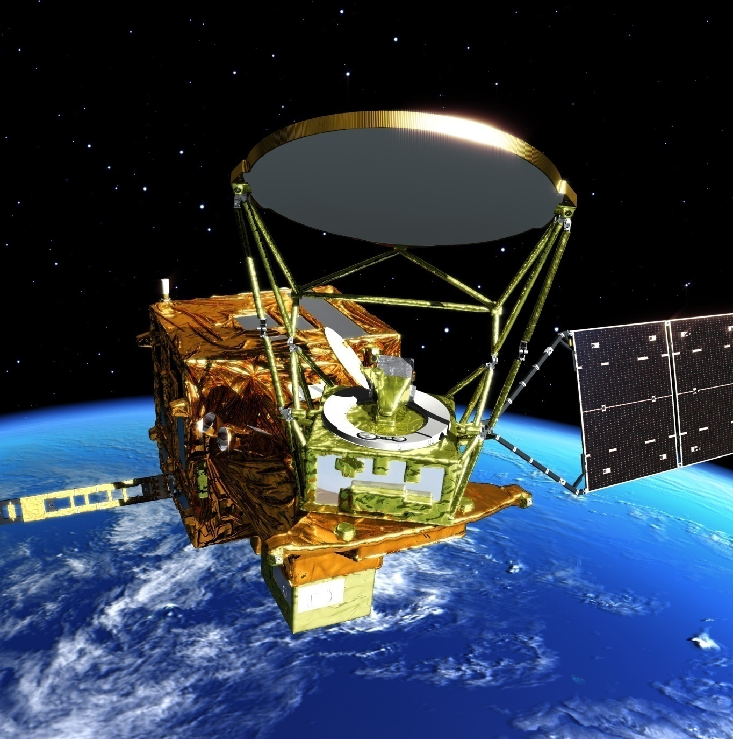
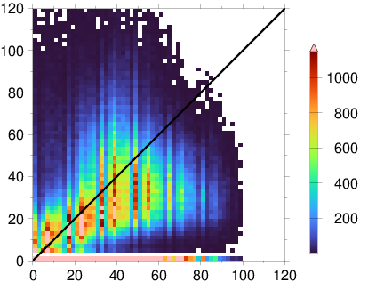
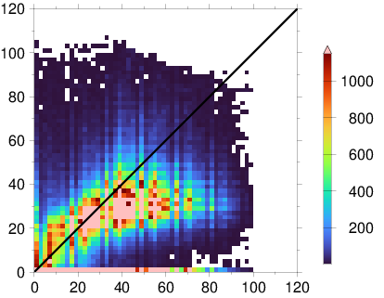
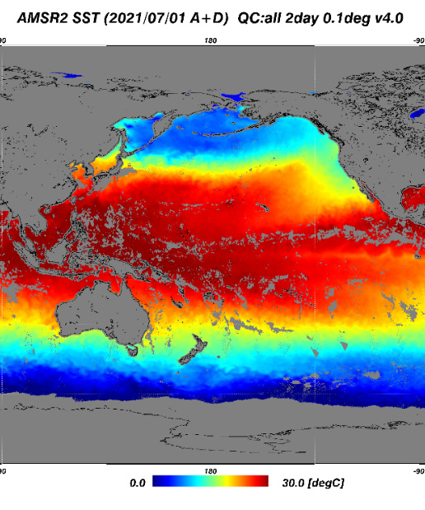

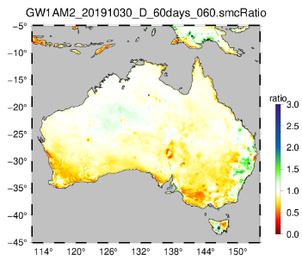
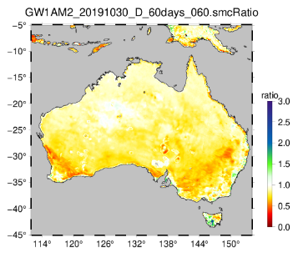
New GCOM-W/AMSR2 Products
Global Change Observation Mission - Water (GCOM-W)
Start observation since Jul. 3, 2012
Finest spatial resolution among PMWs
Sea Ice Motion Vector V1 in Mar. 2022
Precipitation V3 & SST V4.1 is planned in summer 2022
Improved Snow depth V3 & Soil Moisture Content will be released as research product in summer 2022
Standard product: https://gportal.jaxa.jp/gpr/
Research product: https://suzaku.eorc.jaxa.jp/GCOM_W/research/resdist.html
AMSR2 Snow Depth Ver.3 (Research)
Water Cycle
Standard
Research
AMSR2 Snow Depth [cm]
AMSR2 Snow Depth [cm]
AMSR2 SST Ver.4.1
sin-situ snow depth [cm]
sin-situ snow depth [cm]
Improved version of Snow Depth (SND) and Soil Moisture Content (SMC) products, which are developed for AMSR3 will be released to public as research product.
V4
V4.1
Will be released in summer 2022
Will be released in summer 2022
AMSR2 Soil Moisture Content (Research)
Standard
Research
Missing due
to rain and/or
strong wind
Retrieve
rainy/windy
pixels
SMC ratio of Sep.-Oct. 2019 versus normal year
Notes:
積雪深と土壌水分量は、どちらもAMSR2の標準プロダクトであるが、AMSR3用に開発している積雪深アルゴリズムの改良版(SMSA v3.0)と、土壌水分アルゴリズムの改良版がGCOM-Wミッション運用システム(MOS)の仕様に一致しないことから、EORCの高次処理システムで定常的に生産し、研究プロダクトして公開する。
積雪深は放射伝達モデル、積雪成長モデル、品質管理などを向上。土壌水分量は土地被覆率データベースについて、標準プロダクトでは平年値を使用していたのを、研究プロダクトではMODIS植生被覆率を利用してdynamicに変化。

Slide 5
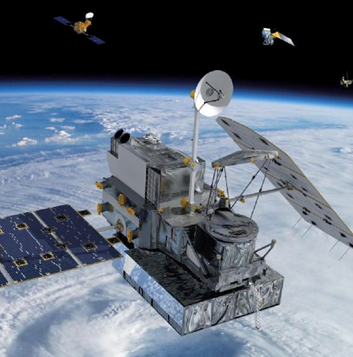
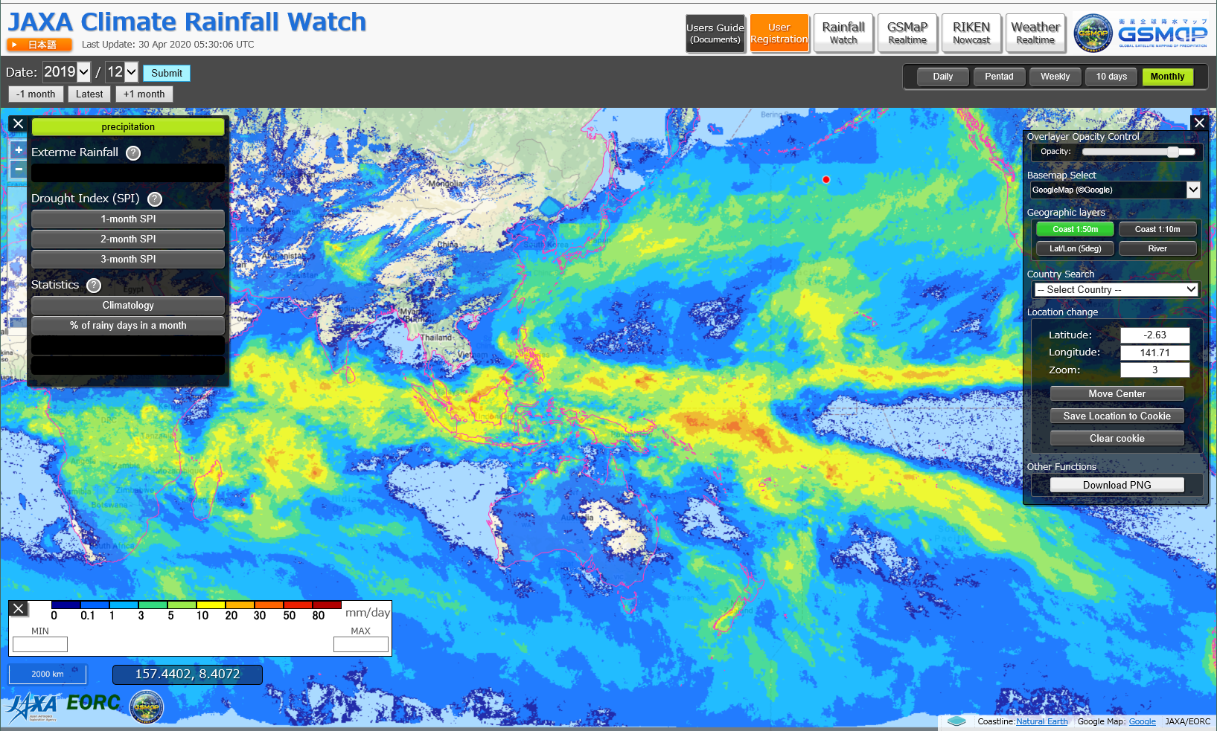
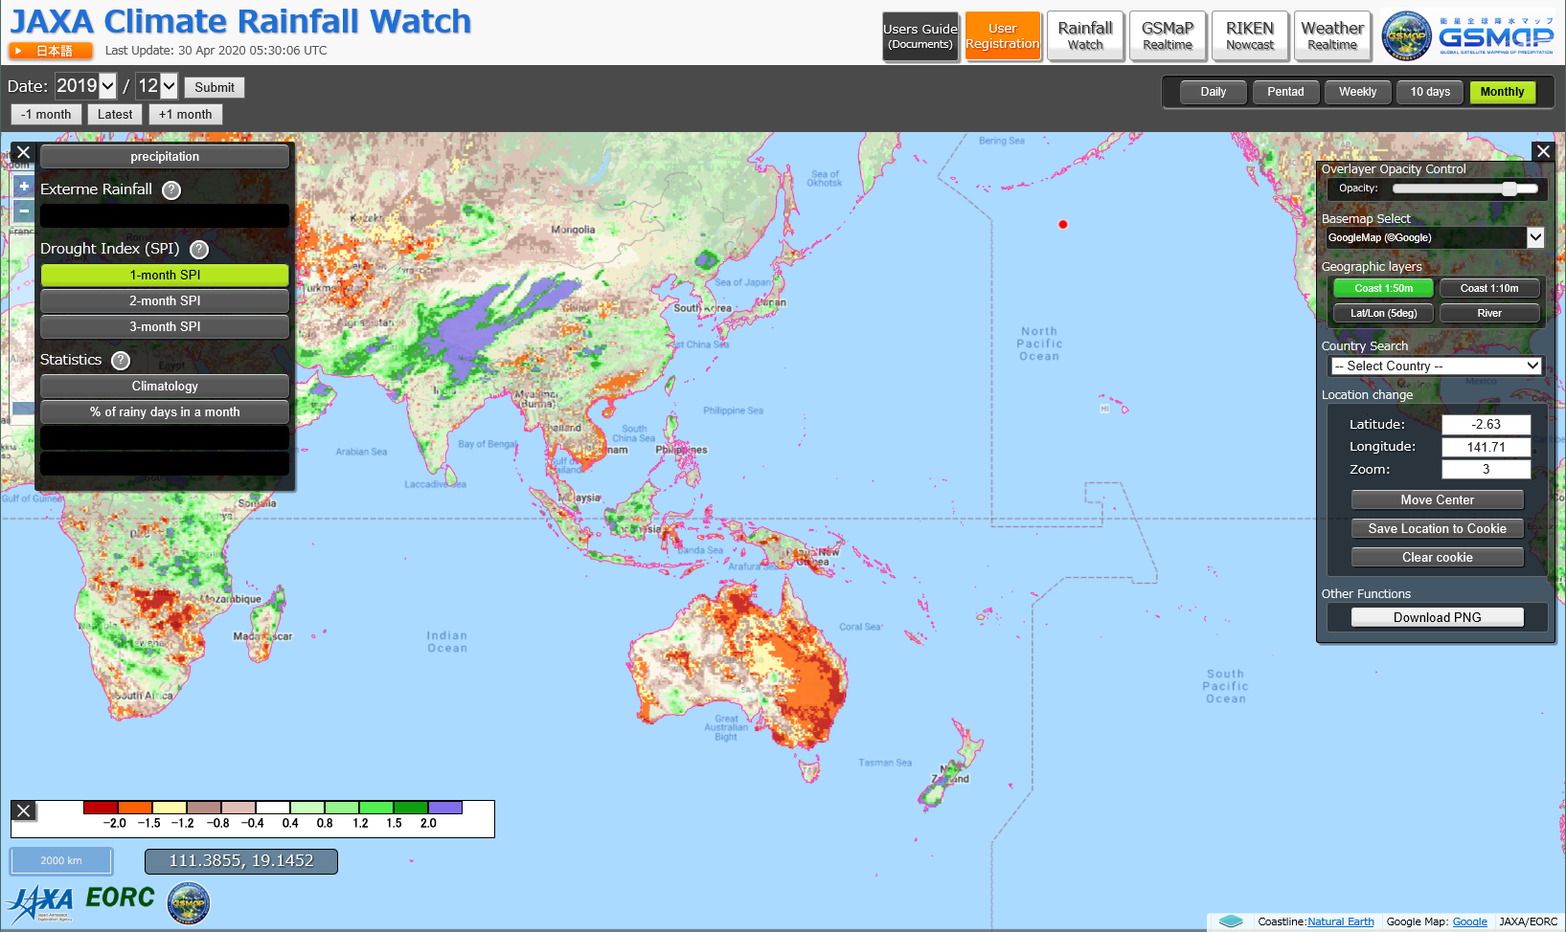
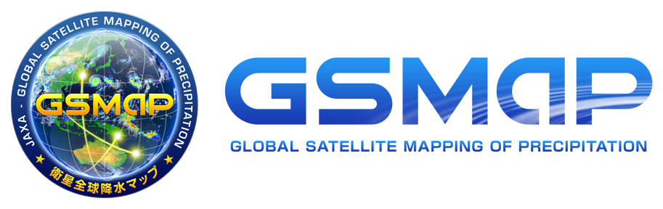
Monitoring of Extreme Heavy Rainfall and Drought based upon 21-yr Statistics of the GSMaP Precipitation Data
JAXA has developed the Global Satellite Mapping of Precipitation (GSMaP) in the Global Precipitation Measurement (GPM) mission (Kubota et al. 2020, https://doi.org/10.1007/978-3-030-24568-9_20).
"JAXA Climate Rainfall Watch", which provides information about
extreme heavy rainfall and drought over the world, is now available.
  Calculated based upon 22-yr statistics with Standardized Precipitation Index (SPI)
  (21-yr statistics are reported in Tashima et al. 2020, https://doi.org/10.1109/JSTARS.2020.3014881)
GPM/DPR
GCOM-W
/AMSR2
Monthly Rainfall by GSMaP in Dec. 2019
Drought index in Dec. 2019
Drought in Australia
in Dec. 2019
https://sharaku.eorc.jaxa.jp/GSMaP_CLM/
Notes:
Here is precipitation applications related to water cycle monitoring under the GPM mission.
JAXA recently released the web site, called “JAXA Climate Rainfall Watch”.
This website provides information of extreme-heavy rainfalls and droughts in worldwide.
JAXA’s multi-satellite precipitation products, GSMaP, is used as inputs/ and calculate indices related to extreme heavy rainfall and droughts.
This product is developed in the WMO space-based weather and climate extremes monitoring project.
Lower panels are monthly mean rainfall (in mm/day) and drought index in Dec. 2019.
Strong drought was identified in eastern Australia in red color.
The case study results in Australia were reported in the WMO bulletin and also WMO annual statement on the State of the Global climate in 2019.

Slide 6
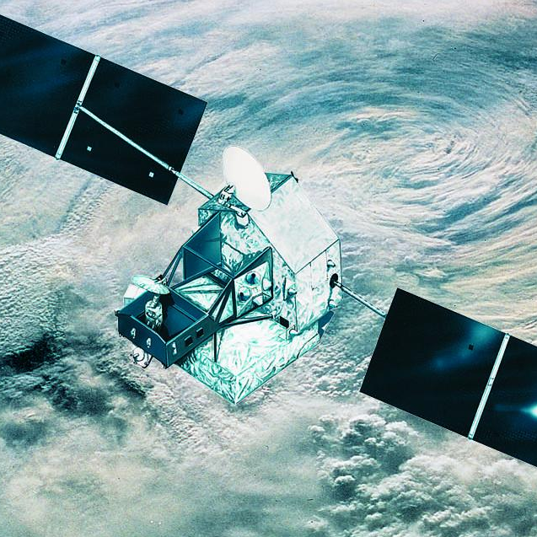
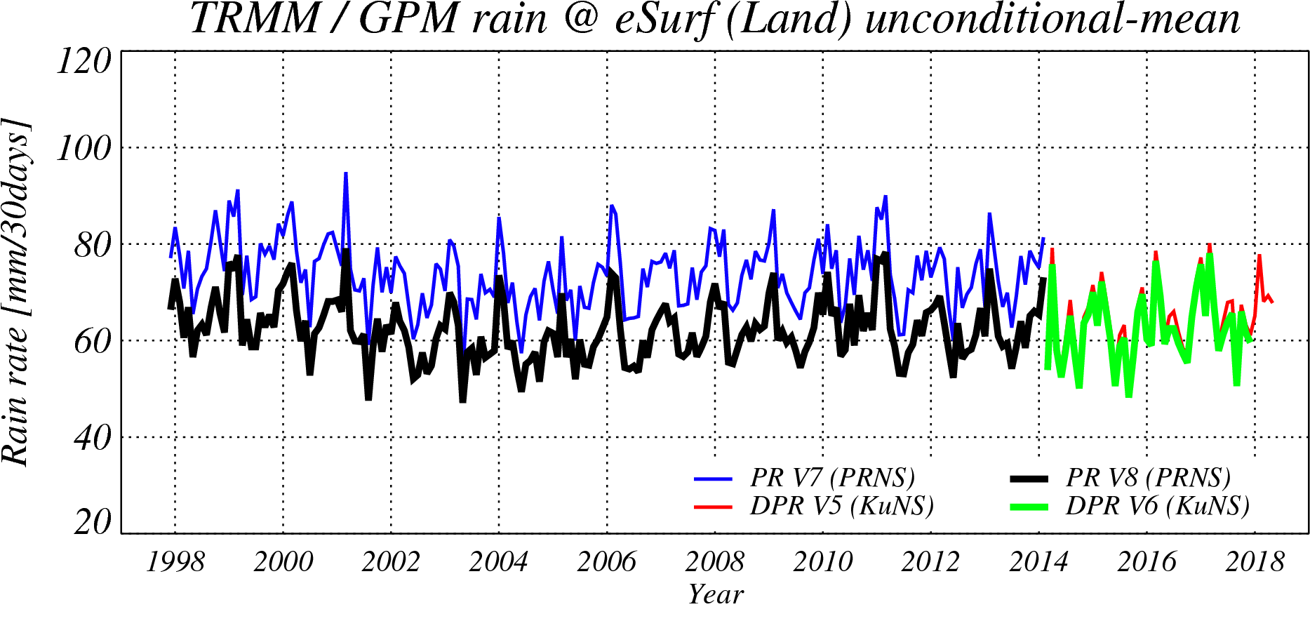
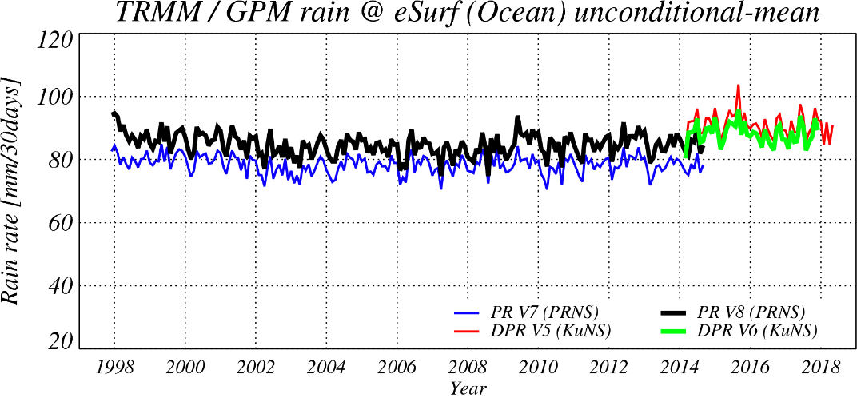
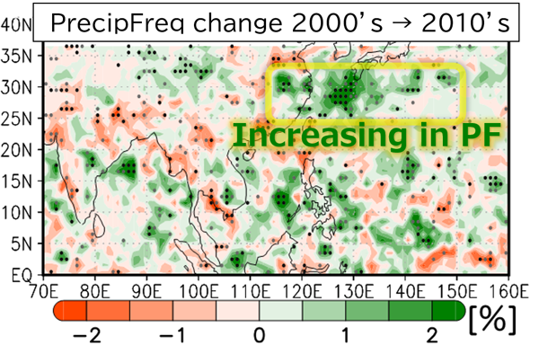
Constructing long-term precipitation radar datasets by TRMM/PR (1997-2015) and the GPM/DPR (2014-)
TRMM/PR
Constructing long-term precipitation radar datasets by TRMM/PR (1997-2015) and the GPM/DPR (2014-)
  Better continuity was realized in the TRMM/PR and the GPM/KuPR, by using well-considered calibration coefficients and common precipitation estimation algorithms between the TRMM/PR and the GPM/KuPR.
GPM/DPR
Over-land surface precipitation rates averaged in 35S-35N.
Over-ocean surface precipitation rates averaged in 35S-35N.
Takahashi and Fujinami (2021) showed recent decadal enhancement of Meiyu-Baiu heavy rainfall over the East Asia using the TRMM/PR & GPM/DPR dataset.
KuPR V5
KuPR V5
PR V8
PR V7
PR V7
KuPR V6
PR V8
KuPR V6
1998
2018
1998
2018
→These dataset was used long-term precipitation analyses.
Takahashi, H.G., Fujinami, H. Recent decadal enhancement of Meiyu–Baiu heavy rainfall over East Asia. Sci. Rep. 11, 13665 (2021). https://doi.org/10.1038/s41598-021-93006-0
https://earth.jaxa.jp/en/earthview/2021/08/02/5584/index.html
Notes:
The last topic of precipitation radar is about developing long period radar precipitation record from TRMM/PR to GPM/DPR.
The first big task we had to overcome was calibration of DPR and PR.
The sigma0 level of early version of GPM’s Ku radar, that is V04 was here.
But we reconsidered the method of calibration itself and updated as V05, here.
Then we also applying the same method to the TRMM/PR’s level 1 data.
As the result, better continuity was realized between GPM/Ku V05 and the TRMM/PR V8 and also looks reasonable comparing the other independent instruments.
We already released their level 1 data, last year.

Slide 7
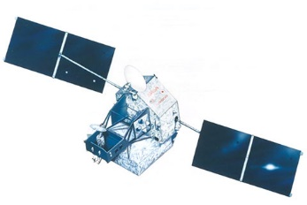
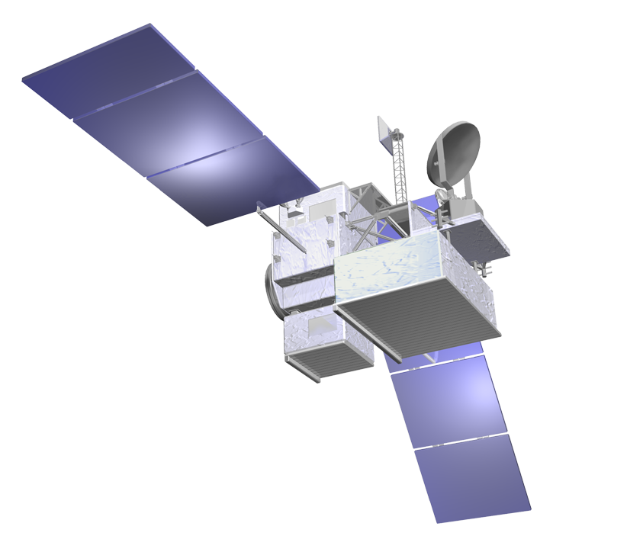

Long-term precipitation observations by Spaceborne Precipitation Radar
1995
2000
2005
2010
2015
2020
2025
2030
Overlap
-> calibrate
TRMM/PR
Ku-band (13.8GHz)
1997 - 2015
GPM/DPR
Ku-band (13.6GHz)
Ka-band (35.5GHz)
2014-
PMM/KuDPR (TBC)
Ku-band (13.6GHz) With Doppler obs.
Precipitation Measuring Mission carrying Ku-band Doppler Precipitation Radar (PMM/KuDPR)
In January 2022, PMM Pre-Project Team was organized in JAXA, and in July 2022, System Requirement Review (SRR) was completed in JAXA. We plan System Definition Review (SDR) in winter 2022-2023.
Better sensitivities in the PMM/KuDPR
→Better understanding for cloud-precipitation process
Challenges in measuring doppler velocities by the PMM/KuDPR
→Better understanding for convection in precipitating clouds
Notes:
JAXA Mission Definition Review (MDR) for the next generation Precipitation Radar satellite was completed in August 2021.
The review board confirmed that the JAXA mission with a spacecraft carrying Ku-band Doppler radar is valuable as a successor of GPM/DPR.
The IPWG report and the letter by CGMS, supported by CGMS members last year, was well received as requirements from international precipitation communities in the MDR.
JAXA appreciates the efforts by CGMS and IPWG to support the new mission.
In December 2021, Implementation Plan of the “Basic Plan on Space Policy” noted the Precipitation Radar Satellite Phase A activity.
In January 2022, Precipitation Measuring Mission (PMM) Pre-Project Team was established on for the JAXA Spacecraft carrying the Ku-band Doppler Precipitation Radar.
Currently, JAXA is conducting conceptual study, and the System Requirements Review (SRR) is now scheduled in June 2022.
We are also studying this mission with NASA and other international agencies in the Atmosphere Observing System mission.
3D structure of precipitation by JAXA radar and vertical air velocity in convection by Doppler capability can synergize with aerosols and clouds to be observed by sensors in other agencies.

Slide 8
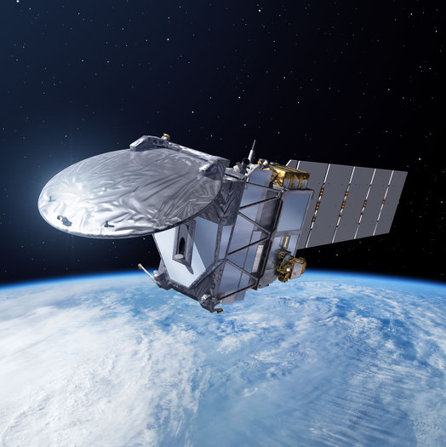
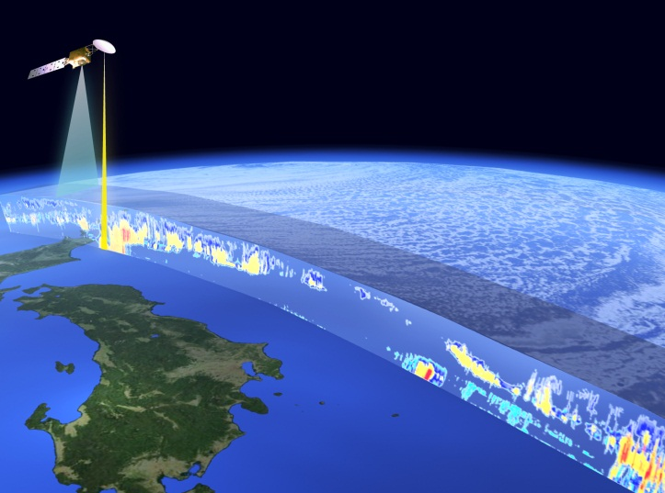
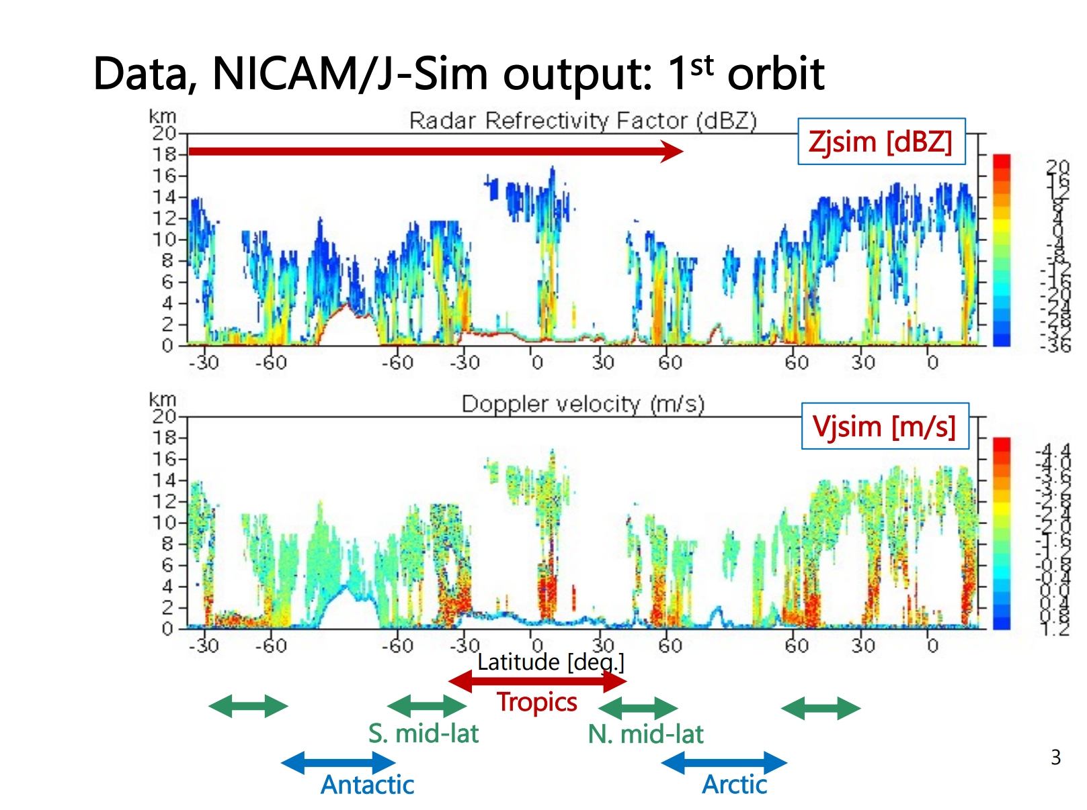
Future Missions for Climate & Water:
EarthCARE (JFY2023)
To be launched
in JFY2023
Europe-Japan joint mission
3 dimensional global distributions of cloud and aerosol to contribute to precise understanding of climate change
JAXA and NICT provides world's first satellite-based cloud vertical motion by the Clod Profiling Radar (CPR) with 94 GHz with Doppler Capability at 0.8 km spatial resolution.
Clouds continue to contribute the largest sources of uncertainty in current climate predictions.
Measuring Doppler velocities from space is very challenging (Illingworth et al. 2015), but it is expected to advance climate modeling.
EarthCARE
Cloud/
Aerosol
Radiation
Budget
Doppler simulation of global clouds
estimated the satellite-observed Doppler velocity by using a combined approach of global cloud resolving model “NICAM” and a satellite data simulator “Joint-Simulator” (Hagihara et al. 2022).
Orbit | Sun-synchronous sub-recurrent orbit Altitude: approx. 400km Inclination angle: 97.05° Local Sun Time at Desc.: 14:00 Revisit time: 25 days
Instruments | - Cloud Profiling Radar (CPR) by NICT & JAXA - Atmospheric Lidar (ATLID) by ESA - Multi-Spectral Imager (MSI) by ESA) - Broad-Band Radiometer (BBR) by ESA
Mass | Approx. 2.2 tons at launch
Designed lifetime | 3 years
Notes:
The left-hand side shows the EarthCARE mission, jointly with ESA, planned to be launched in JFY 2023.
JAXA and NICT have developed Cloud Profiling Radar (CPR), which is the world’s first spaceborne cloud profiling radar with Doppler capability.
In the right, we explain GOSAT-GW planned to be launched in JFY 2023 as well.
It will carry the GCOM-W/AMSR2 follow-on microwave radiometer called AMSR3, and GOSAT-2 follow-on instrument called TANSO-3, to continue and improve water cycle and GHG observations.
These mission in the near future will also contribute to climate and water relevant to the CGMS community.
Next slide please.

Slide 9
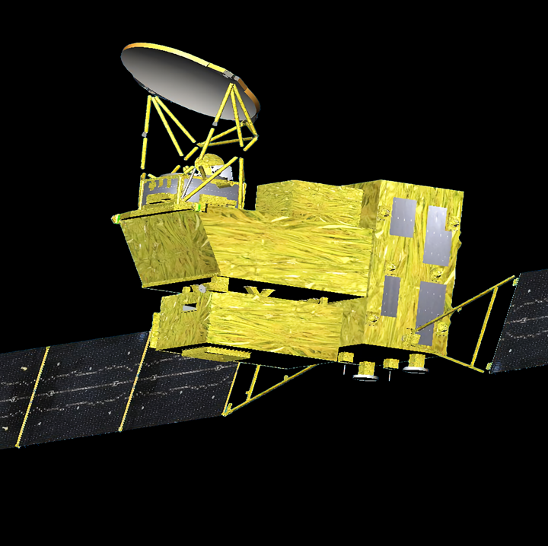
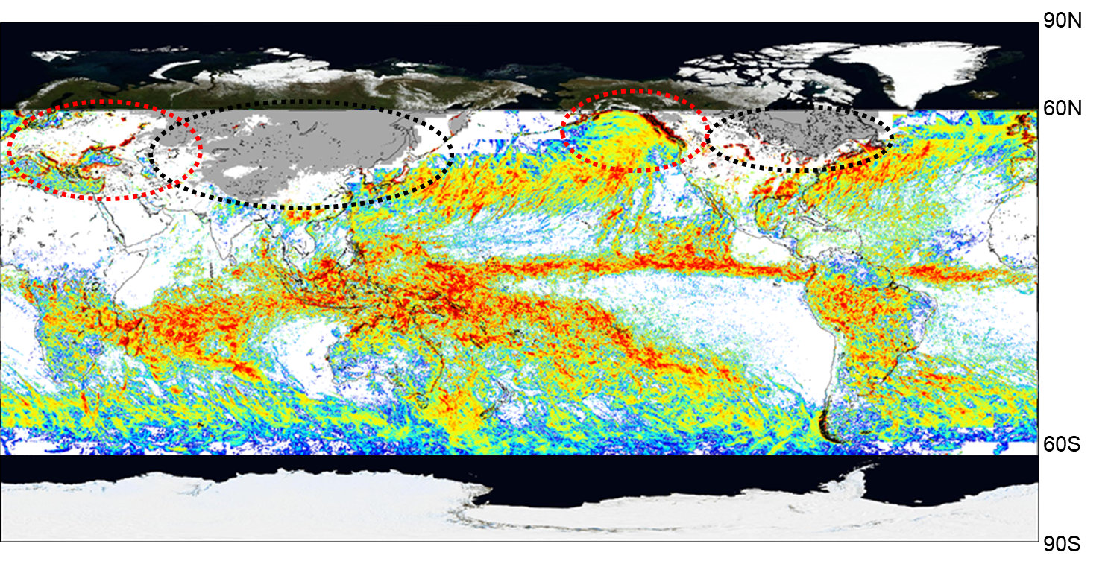
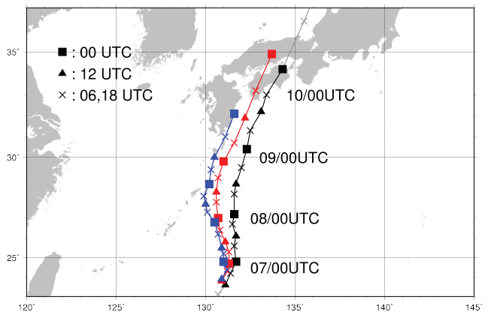
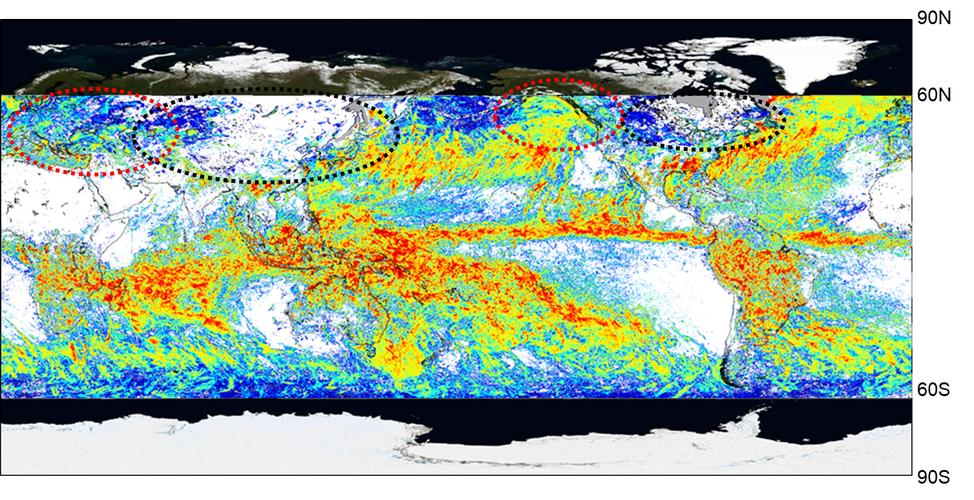
Future Missions for Climate & Water:
GOSAT-GW (JFY2023)
To be launched
in JFY2023
Carrying two instruments, AMSR3 and TANSO-3.
  AMSR3 (JAXA) will succeed AMSR series observations with adding new high frequency channels (166 & 183 GHz) for snowfall retrievals and water vapor analysis for numerical weather prediction.
  TANSO-3 (led by Ministry of Environment in Japan) uses imaging spectrometer technology to measure CO2, CH4 and NO2 globally with medium and locally with high spatial resolution.
Orbit | Sun-synchronous sub-recurrent orbit Altitude: approx. 666km Inclination angle: 98.06° Local Sun Time at Desc.: 1:30 +/- 15 min Revisit time: 3 days
Instruments | - Advanced Microwave Scanning Radiometer 3 (AMSR3) - Total Anthropogenic and Natural emissions mapping SpectrOmeter-3 (TANSO-3) (for Ministry of Environment in Japan (MOE))
Mass | Approx. 2.6 tons at launch
Designed lifetime | 7 years
GOSAT-GW
Water Cycle
Green-house gases
Without high-freq. channels
Impact of High-freq. channels to Precipitation retrievals
Impact of 183 GHz channels to Typhoon forecast
Forecast of Typhoon #11 storm track with initial time of 12Z Aug. 6, 2014
Blue: Forecast by JMA operational system
Red: Forecast with 183 GHz brightness temperature by Megha-Tropiques
Black: Best track
With high-freq. channels
Gray: missing due to snowfall
White: No rainfall
Improve accuracy of storm track forecast by assimilating TB of 183GHz channels
（Monthly GSMaP precipitation of Jan. 2015 using GMI)
（Image provided by JMA）
Notes:
GOSAT-GW planned to be launched in JFY 2023 as well.
It will carry the GCOM-W/AMSR2 follow-on microwave radiometer called AMSR3, and GOSAT-2 follow-on instrument called TANSO-3, to continue and improve water cycle and GHG observations.
These mission in the near future will also contribute to climate and water relevant to the CGMS community.
Next slide please.

Slide 10
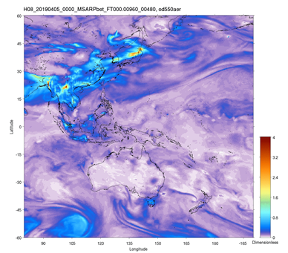
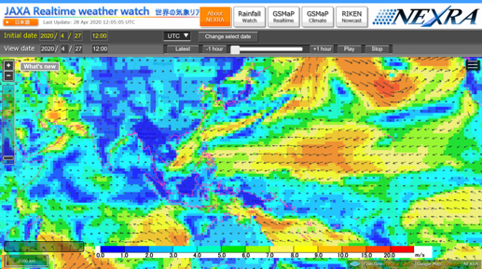

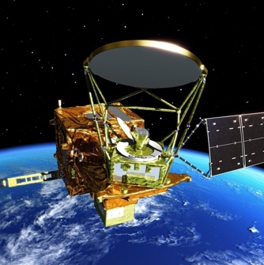
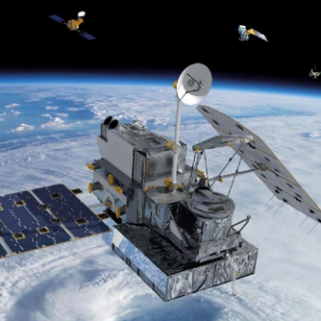
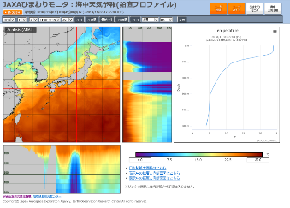

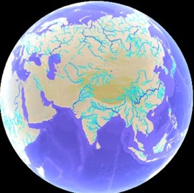
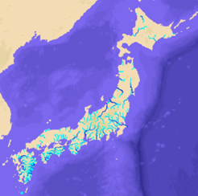

Satellite and Model Collaborations toward Earth Environment Predictions
Alert for
Public Health
with JMA, MRI, NIES, Kyushu Univ.
with U. Tokyo, RIKEN
Severe Weather
Heavy Rainfall,
Flood
Aerosol
GSMaP
Aerosol Model
Atmospheric Model
Satellite Data
Ocean Model
Interaction
Land/River Model
Interaction
SST
Fisheries,
Ocean Transport,
Climate
GSMaP
Down SW
Drought, Flood,
Water-related
Hazard
ECVs
with JAMSTEC, RIKEN
with U. Tokyo
Climate Model &
Earth System Model
with U. Tokyo, JAMSTEC, etc.
Notes:
We collaborate with various model communities to utilize satellite data in their models to enhance future predictions and contribute to science and society.
For Aerosol Model, JAXA has collaborative study with JMA and some research institues for satellite aerosol assimilation.
Next slide please.

Slide 11

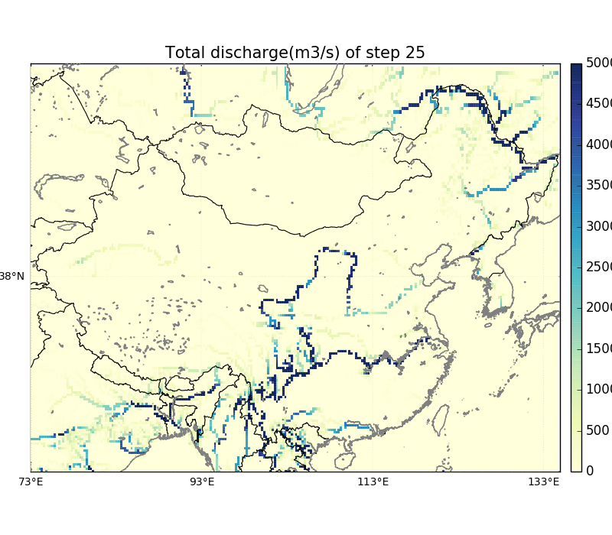
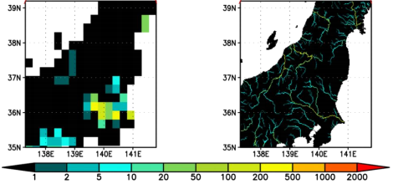
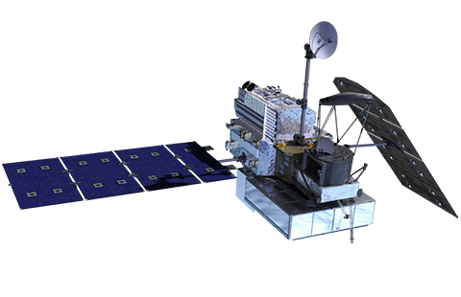
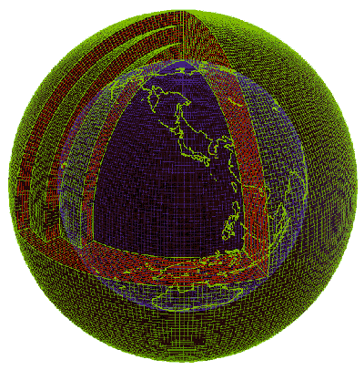
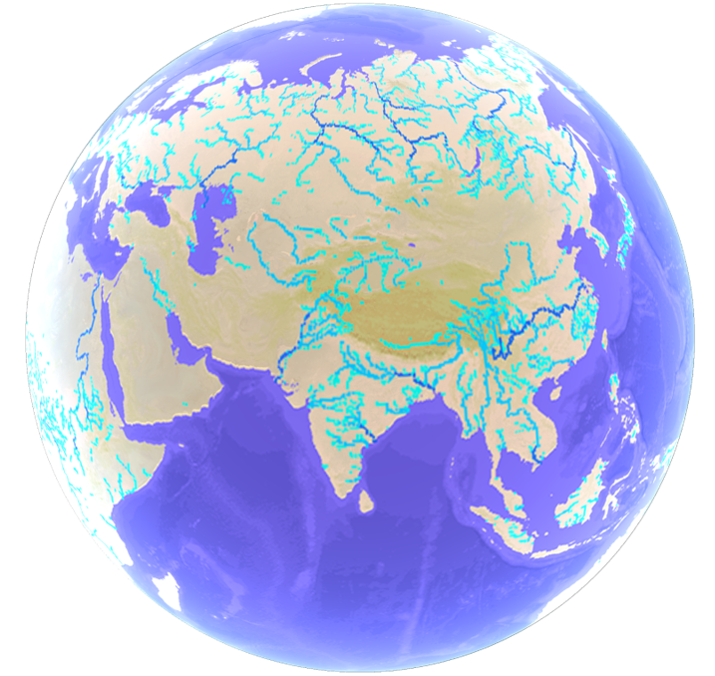
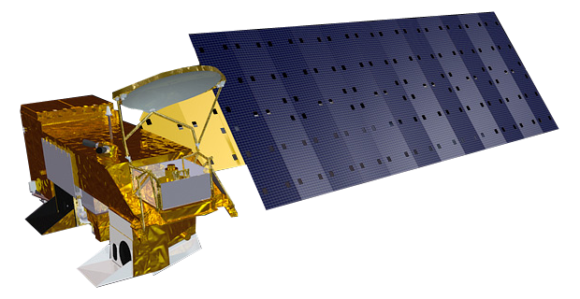
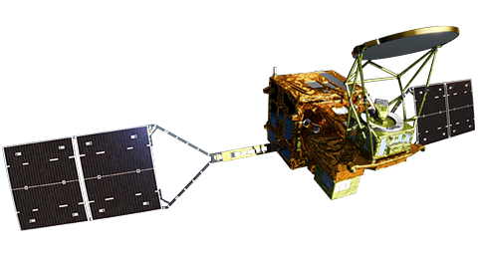

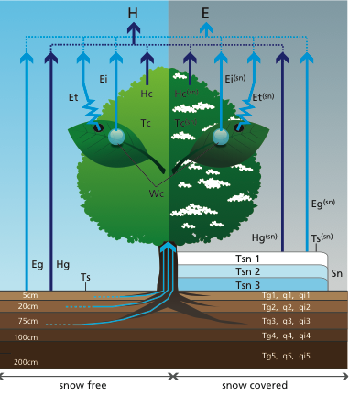
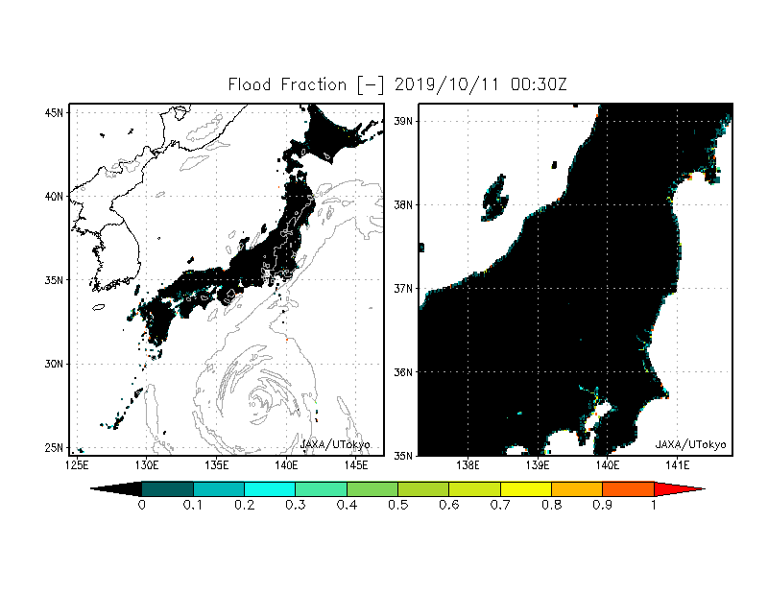
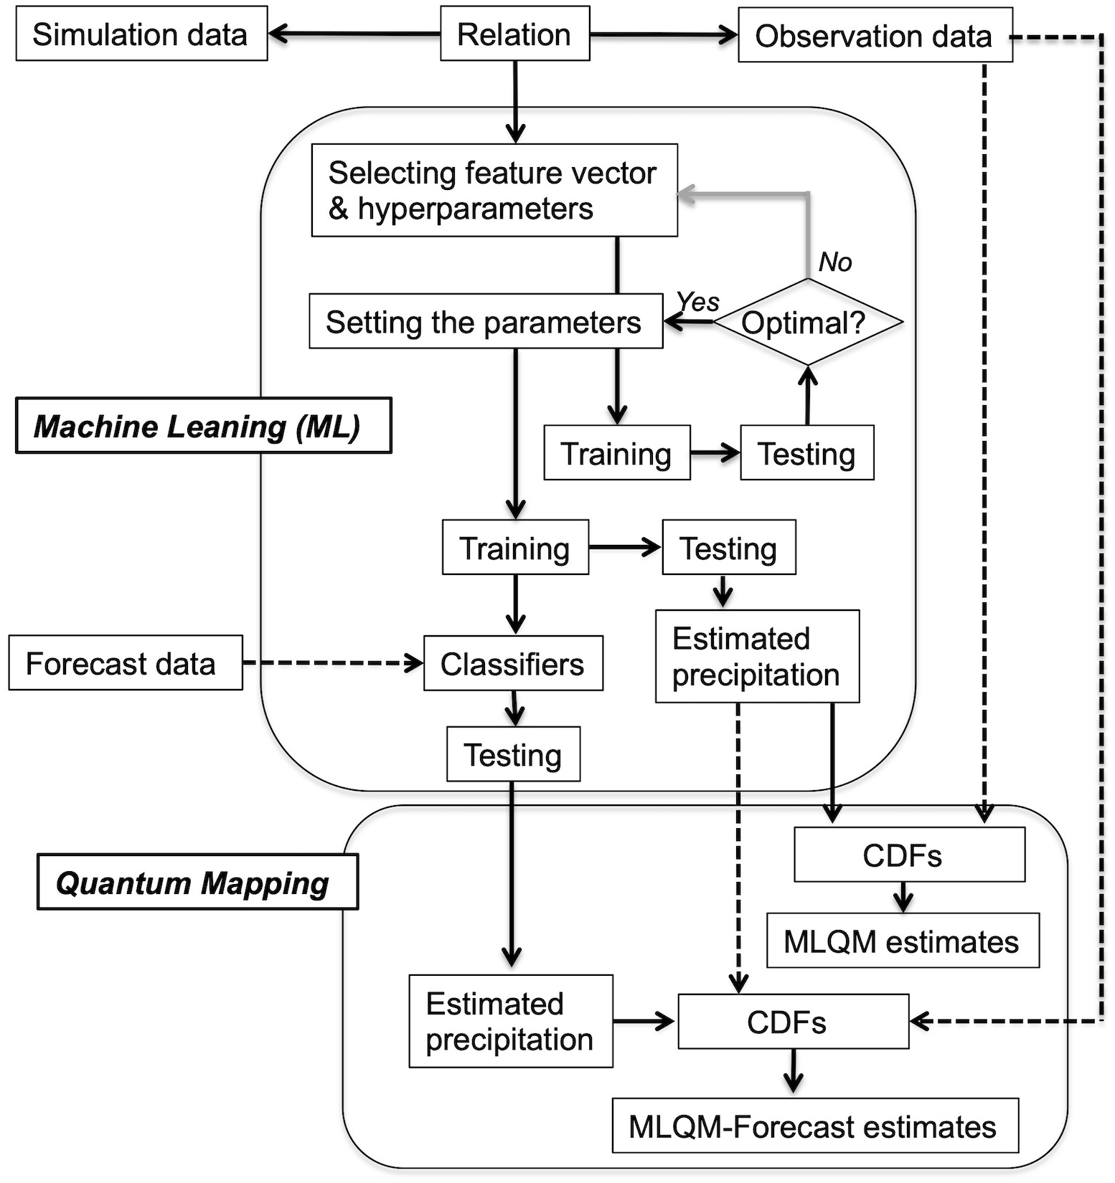
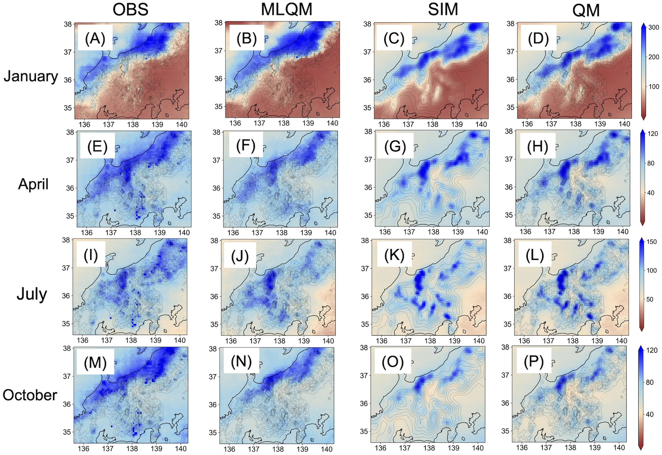


Global Terrestrial Hydrological Simulation System:
Today’s Earth
Development of Regional ver. (Japan)
Ensemble Approach
Forcing Data Preparation：
Satellite obs. and JMA reanalysis/forecast data
25km
→1km
Validation
Model Simulation：
LSM + River Routing Model
River Dis.[m³/s]
2008
2014
2015
2019
2021
Super High- Resolution model(1km)
Global
100km
50/25km
Japan
10km development
1km
Typhoon Hagibis Forecast
Machine Learning for Bias Correction
Accuracy
Improvement
Yoshikane and Yoshimura., 2022
Data Provision：
Various hydrological parameters with risk indices
91.6% of the flooded locations are predicted!
Ma et al., 2021
Notes:
JAXA has developed the “Today’s Earth”, the satellite merged global terrestrial hydrological simulation system, under the joint research with the University of Tokyo.

Slide 12




“JAXA Realtime Weather Watch” GSMaP Assimilation in
JAXA Supercomputer System (NEXRA)
JAXA, Univ. Tokyo and RIKEN installed the NICAM-LETKF data assimilation system using the GSMaP at JAXA supercomputer system generation 3 (JSS3) and has experimentally operated it in near-real time (Kotsuki et al. 2019, SOLA).
Monitoring home page of the NEXRA is now available as “JAXA realtime weather watch”.
https://www.eorc.jaxa.jp/theme/NEXRA/
NICAM-LETKF at JAXA Research Analysis = NEXRA
Collaboration with Today’s Earth
Kotsuki et al., 2019: Predictability of Record-Breaking Rainfall in Japan in July 2018: Ensemble Forecast Experiments with the Near-real-time Global Atmospheric Data Assimilation System NEXRA. SOLA, 15A,
https://doi.org/10.2151/sola.15A-001.
5-day weather prediction data with 14km horizontal resolution have been computed since July 2021!
Visualization of ensemble hydrological simulation is now open internally
(will be in public in this FY!)

Slide 13
Summary
最後に修正
JAXA Satellites/Sensors
  Nominal Operation: GCOM-C, GOSAT-2
  Extended Operation: GOSAT, GCOM-W, GPM/DPR, ALOS-2
  Future: ALOS-3 (TBC), ALOS-4 (TBC), EarthCARE/CPR (JFY2023), and GOSAT-GW (JFY2023)
  Phase A Study: Precipitation Measuring Mission (PMM) with Ku Doppler Radar
Data Release/Researches related to GEWEX
  GCOM-C/SGLI Ver.3 release - aerosol, ecosystem change, sea ice, wildfire, etc.
  GCOM-W/AMSR new products - sea ice motion vector, precipitation (Ver.3 update) and SST (Ver.4.1 update)
  Calibration of TRMM/PR and GPM/DPR for long-term dataset
  GSMaP Climate Rainfall Watch web site
  Collaboration with model communities
    Today’s Earth - global terrestrial hydrological simulation system
    NEXRA - GSMaP assimilated atmospheric model
  Collaborations with WMO, JMA and other agency/institute/private company are ongoing

