Slide 1




Earth Observation in the Age of AI and Big Data
Min Feng ( mfeng@itpcas.ac.cn )
Institute of Tibetan Plateau Research, Chinese Academy of Sciences
Notes:
Good morning, thanks the chair for the introduction. Sorry for the long title, today, my presentation is about mapping of periglacial landforms, especially rock glaciers using remote sensing.

Slide 2


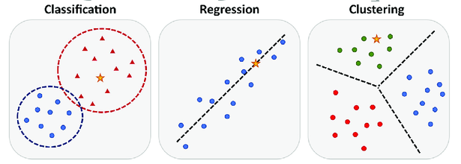
Big Earth data
Build models to recognize the spatial, spectral, or temporal patterns from big Earth data
Models
Machine learning
Notes:
Machine learning algorithms can be applied to build models for detect the conditions and changes of land surface by recognizing the spatial, spectral, or temporal patterns recorded in Earth observation data

Slide 3
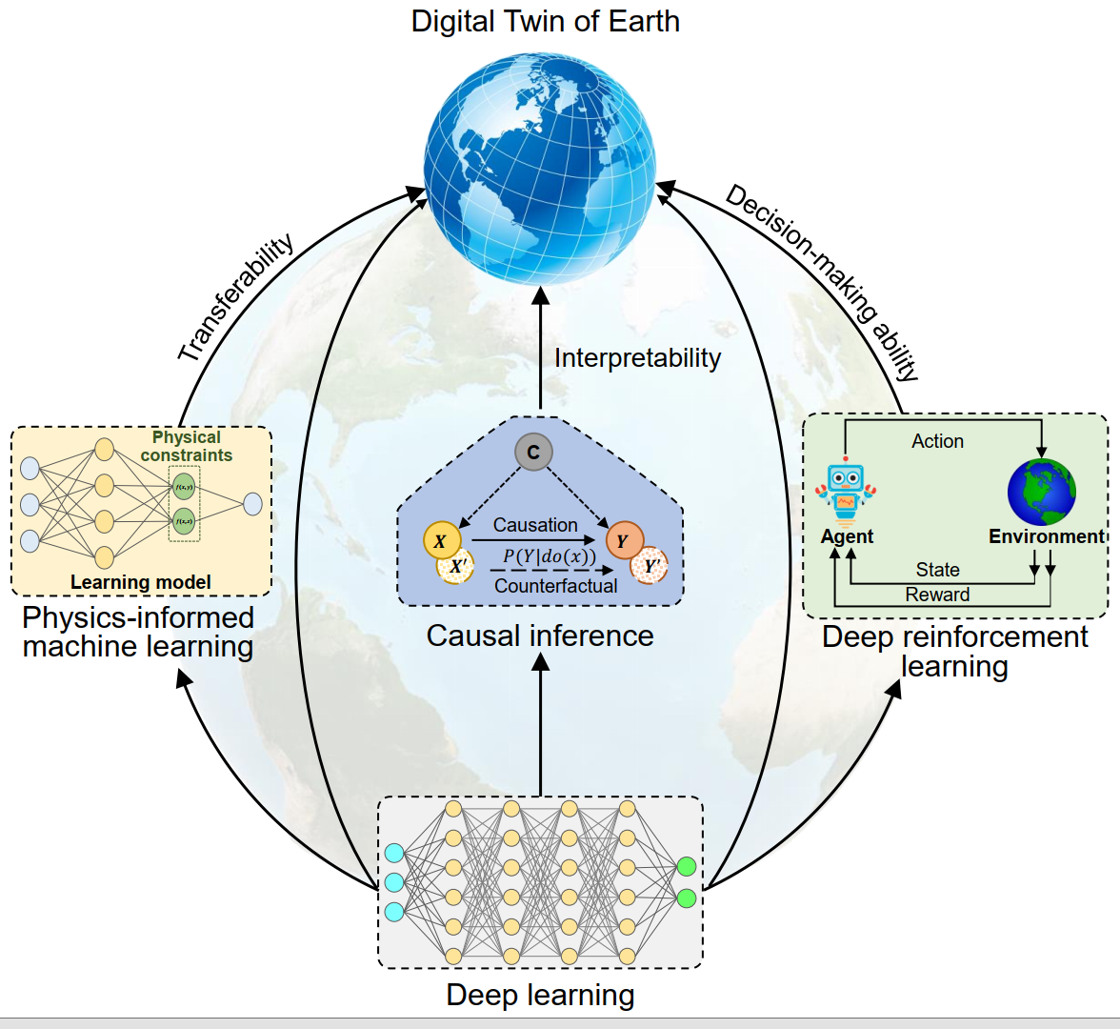
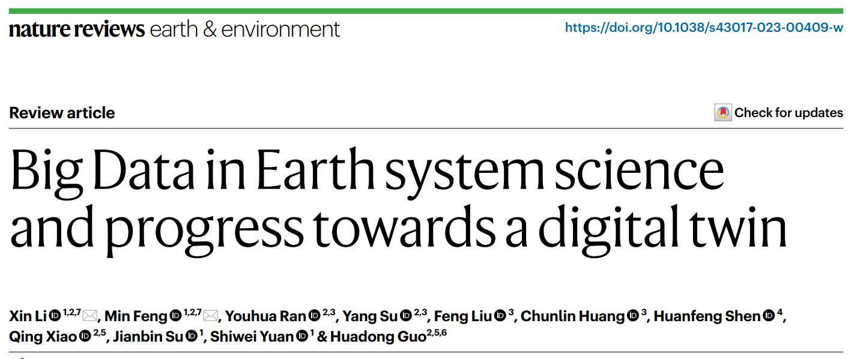
Frontier big data analysis
Deep learning improves the learning ability
Machine learning with physical knowledge improves the transferability and interpretability of the model
Causal inference improves the interpretability
Deep reinforcement learning improves the application of Earth system models in decision-making
Li X*, Feng M*, Ran YH, Su Y, Liu F, Huang CL, Shen HF, Xiao Q, Su JB, Yuan SW, Guo HD. Big data in Earth system science and progress towards a digital twin. Nature Reviews Earth & Environment, 2023, 4, 319–332, doi:10.1038/s43017-023-00409-w
Notes:
接下来介绍两个比较新的概念：Causal inference、Deep reinforcement learning

Slide 4
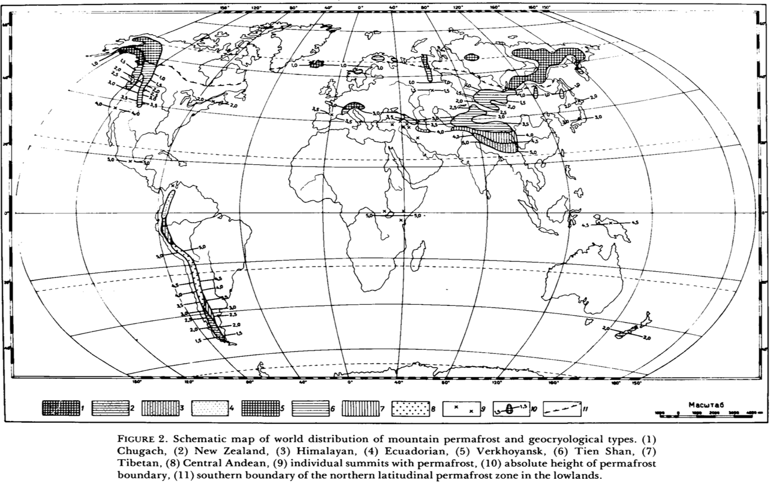
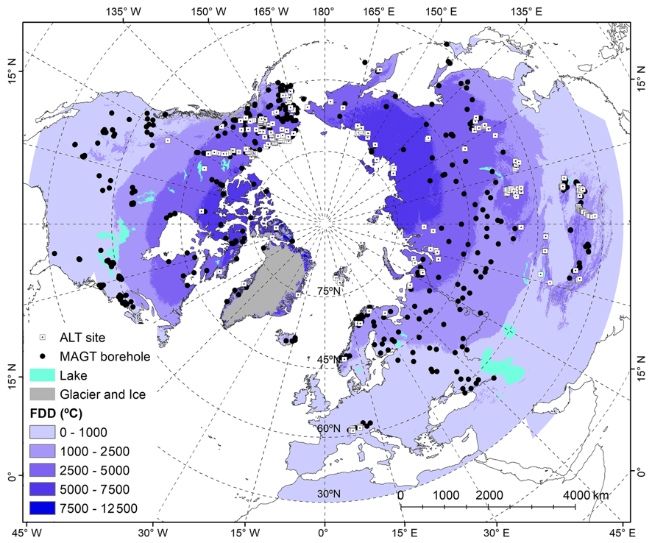
Mountain permafrost
Mountain permafrost is broadly distributed and even more sensitive to the climate change, but our understanding of the mountain permafrost is very limited due to the complex terrain and climate as well as the lack of in-situ data
(Gorbunov, 1978)
(Ran et al. 2022 ESSD)
Notes:
冻土消融还将：
产生大量热融塌陷、热融湖等冰缘地貌
影响区域水循环
改变生态群落
导致灾害和破坏工程设施
Ice and periglacial soils contain unexpectedly diverse and rich assemblages of Bacteria and Eukarya indicating that there may be high rates of dispersal to the top of this tropical mountain and/or that the habitat is more conducive to microbial life than was previously thought.

Slide 5
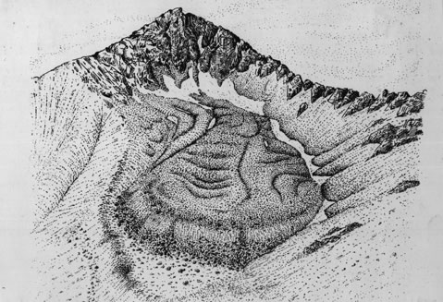
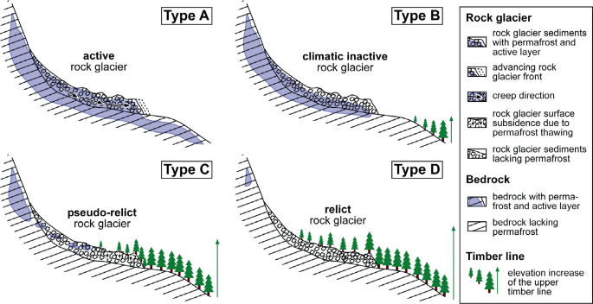
Rock glacier and permafrost
Rock glaciers could be an effective indicator for the existence of mountainous permafrost.
Rock glaciers are distinctive geomorphological landforms normally found in high altitudes, extending downslope from talus cones, glaciers, or terminal moraines of glaciers
Pen and Ink sketch of the Spruce Creek Rock Glacier by Steve Wood
(Kellerer-Pirklbauer et al. 2022)

Slide 6
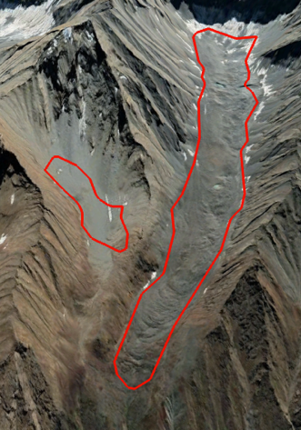
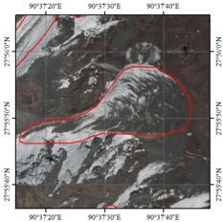
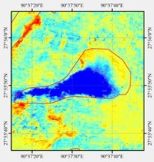
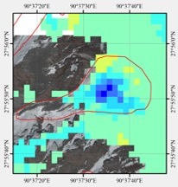
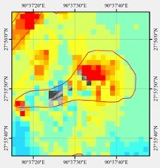
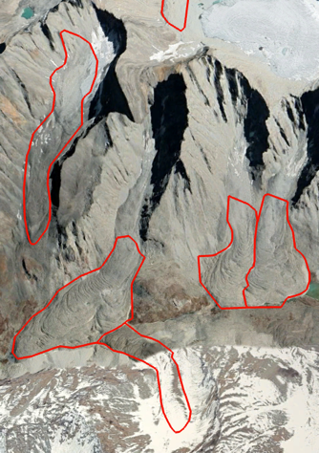
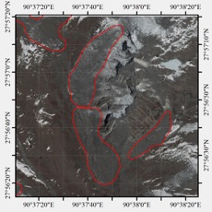
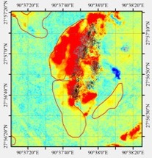
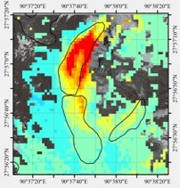
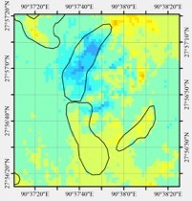
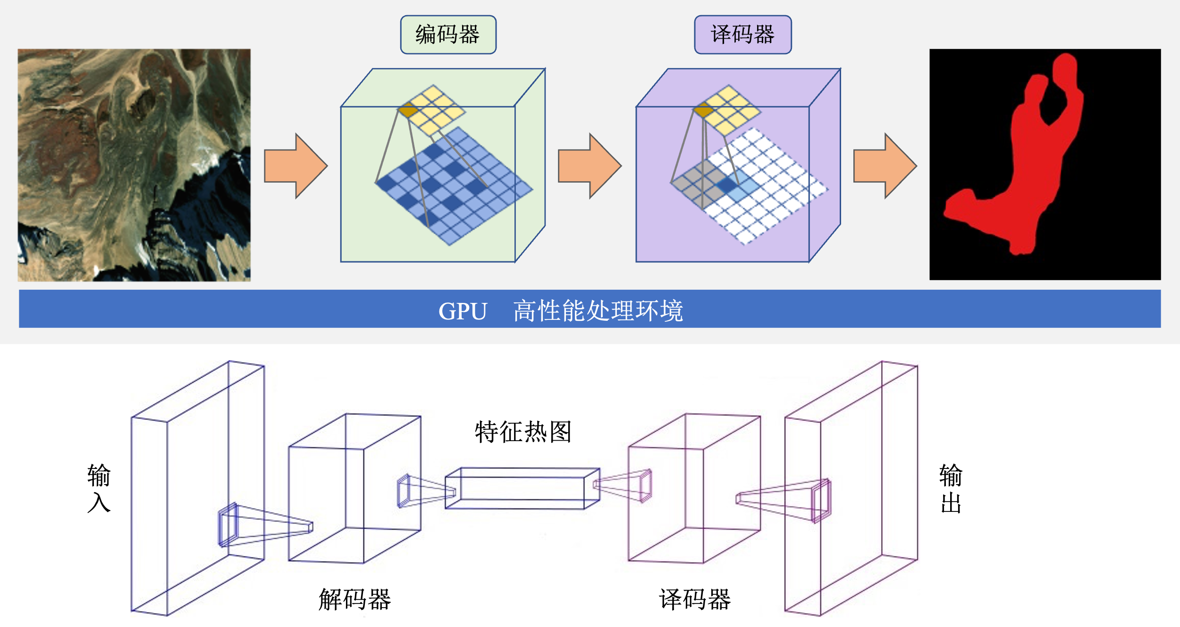
Rock glacier identification
Develop a deep-learning and MT-InSAR based rock glacier identification method
Deep-learning based RG recognition
MT-InSAR based RG kinematic detection
Build training database with millions of labels
Build RG model with deep-learning networks
Resolve the impact from terrain, snow, frozen/thawing
Utilize multi-sourced satellite observations
Satellite images
Radarsat-2 (Descending)
Sentinel-1 (Descending)
Sentinel-1 (Ascending)
Deep-learning RG model
(Xu, Feng* et al., 2020)
(Zhang, Feng et al., 2021 RS; Zhang, Feng* et al., 2023 IJDE)

Slide 7
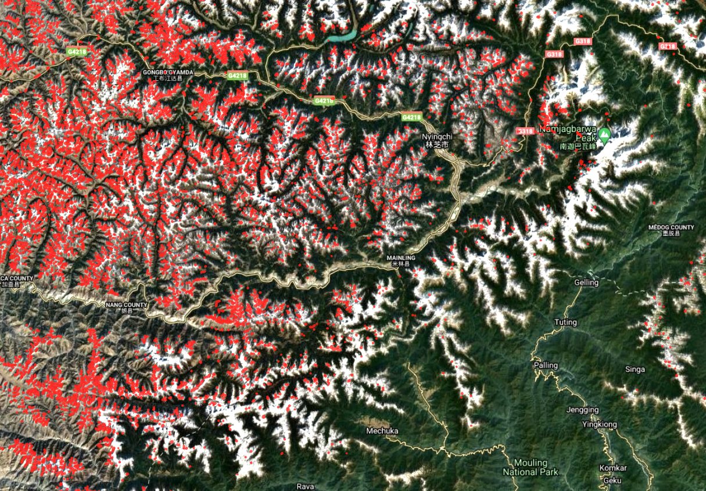
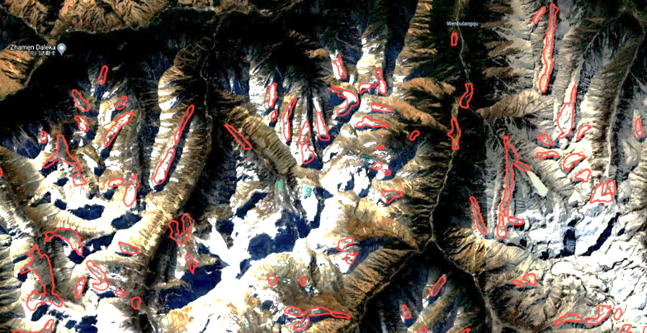
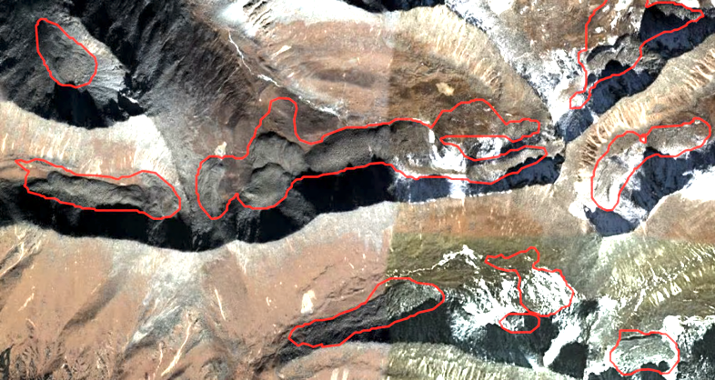
TP rock glacier inventory
Eastern Himalayas (middle-downstream of Yarlung Tsangpo)
A
A
林芝市
墨脱县
雅鲁藏布江
B
B
雅鲁藏布江

Slide 8
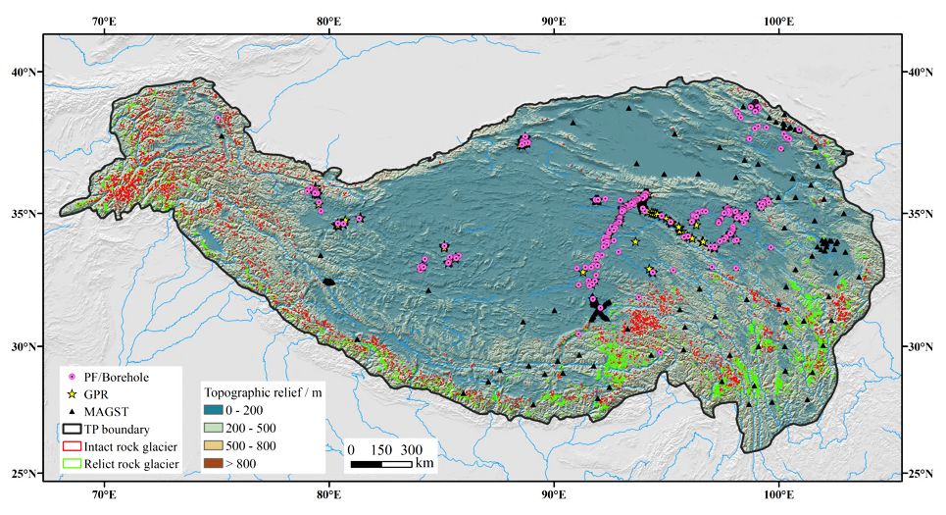
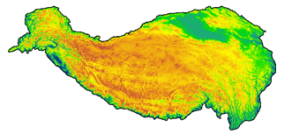
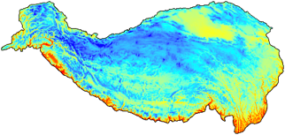
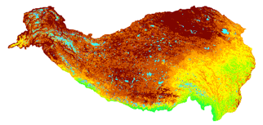
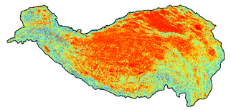
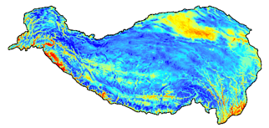
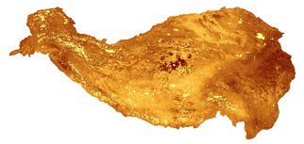
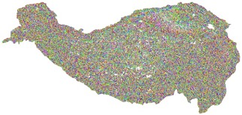
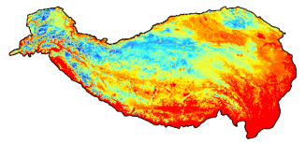
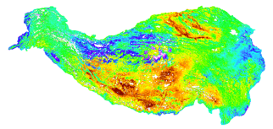
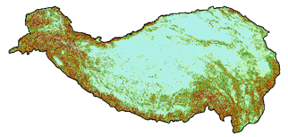
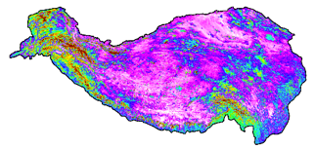
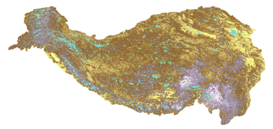
TP permafrost mapping
We are working on expanding the effort to the entire Tibetan Plateau and beyond
Dem
MAAT
Soil bd
Slope
DDT
Soil silt
Data sources:
Dem: ALOS
MAAT: WorldClim 2
DDF/T: MODIS
Soil: Soilgrids
NDWI: Landsat 8
Aspect
DDF
Soil coarse
Borehole | 1141
Soil pit | 6
Surface temperature | 184
Ground penetrating radar | 144
Rock glacier inventory | >100000
Relief
NDWI
Soil sand

Slide 9
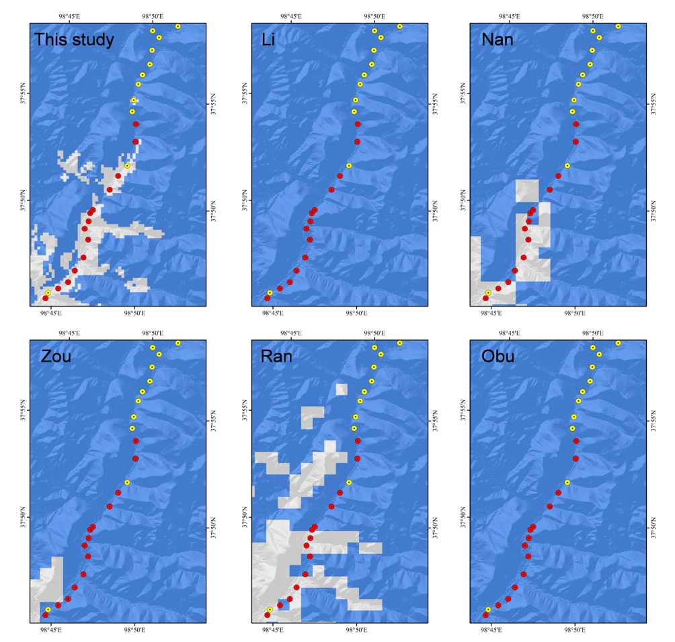
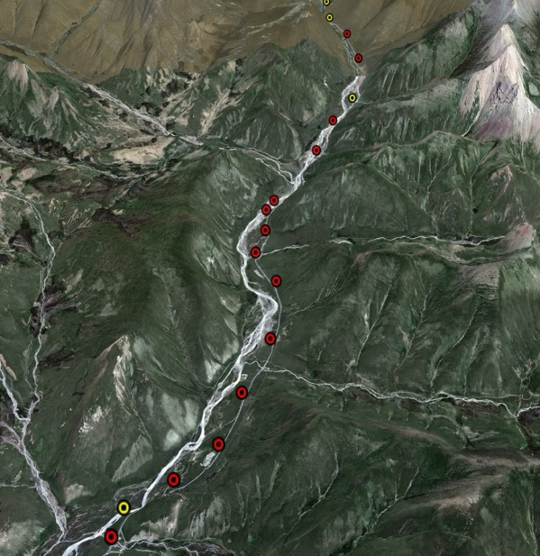
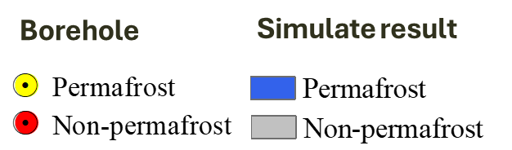
TP permafrost mapping
98°54′40″E, 38°06′20″N
Li, 1996; Nan et al., 2002 Glacier and permafrost
Zou et al., 2017 TC
Obu et al., 2019 ESR
Ran et al., 2020 Science China Earth Sciences

Slide 10
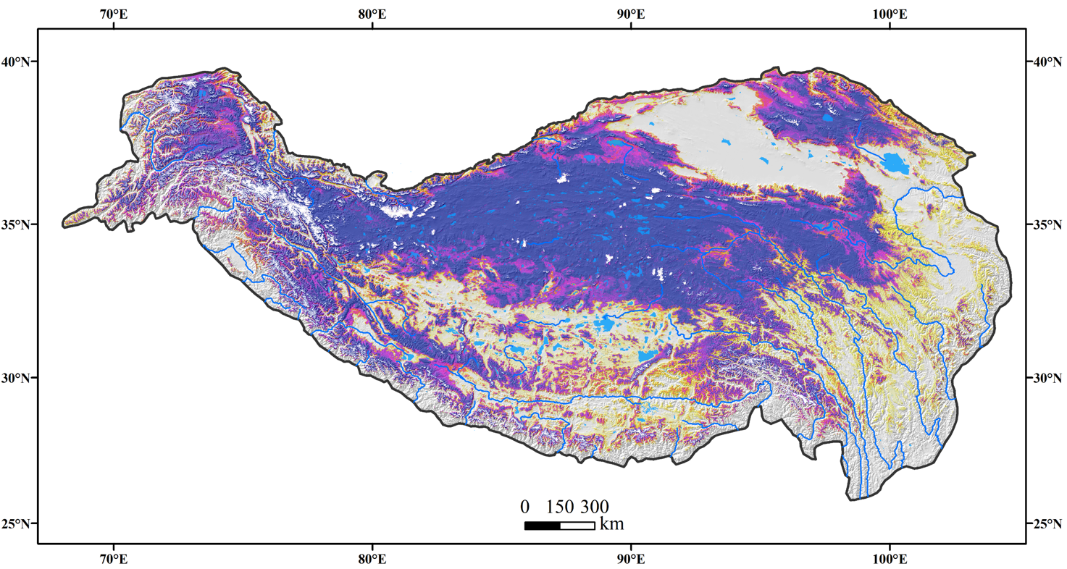
TP permafrost mapping
Our preliminary result shows that the total area of permafrost on the Tibetan Plateau is 1.18 × 10⁶ km² (38.1%)
(Hu, Z., Yan, D., Feng, M.*, et al. 2024, IJDE; Yan, Feng*, et al. PPP, under review)

Slide 11

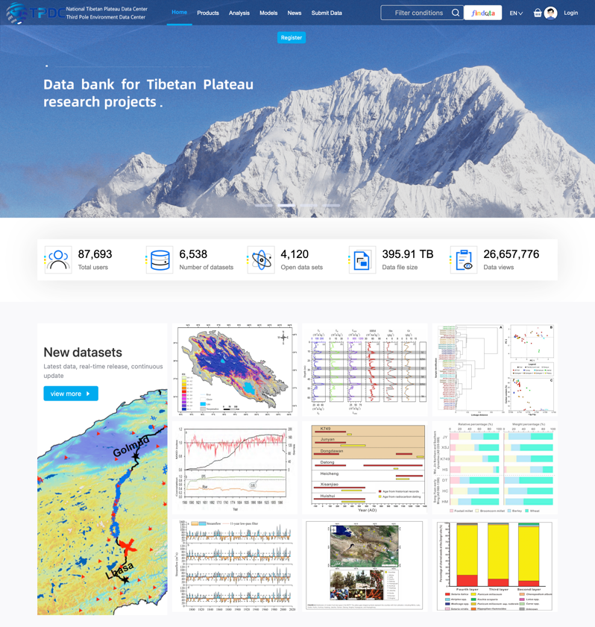
TPDC
National Tibetan Plateau/Third Pole Data Center (TPDC)
(https://data.tpdc.ac.cn)
The only data center in China dedicated to promoting scientific data for the Tibetan Plateau and its surrounding regions
One of the first 20 national data centers approved by the Ministry of Science and Technology of China in 2019
Notes:
国家青藏高原科学数据中心是我们中心承担的重要任务，是全国首批成立的国家级数据中心，自2019年6月成立以来，已经拥有超过7万名注册用户，发布了涵盖……等多个学科的近6000个数据集，总量超过300TB，数据中心还遵从FAIR原则，超过65%位开放获取数据集

