Slide 1


The Role of GEWEX in Moving the Needle
on the Resiliency of Society to
Flooding in a Climate Context
GEWEX Flood Initiative
Presentation for 1st GEWEX Online Flood Workshop
GEWEX introduction by Peter J van Oevelen
Vidya Samadi, Joshua Roundy, Andrea Prein, Qingyun Duan

Slide 2
What is GEWEX
GEWEX is the Global Energy and Water Exchanges project of the World Climate Research Programme
Goal: facilitate international research collaboration to advance biogeophysical climate and weather research
Around since 1990: more than 3 decades of experience in supporting the international research community

Slide 3
https://www.gewex.org/about/science/gewex-science-goals/
https://www.gewex.org/gewex-content/uploads/2022/05/GEWEX-science-plan-v8.pdf

Slide 4
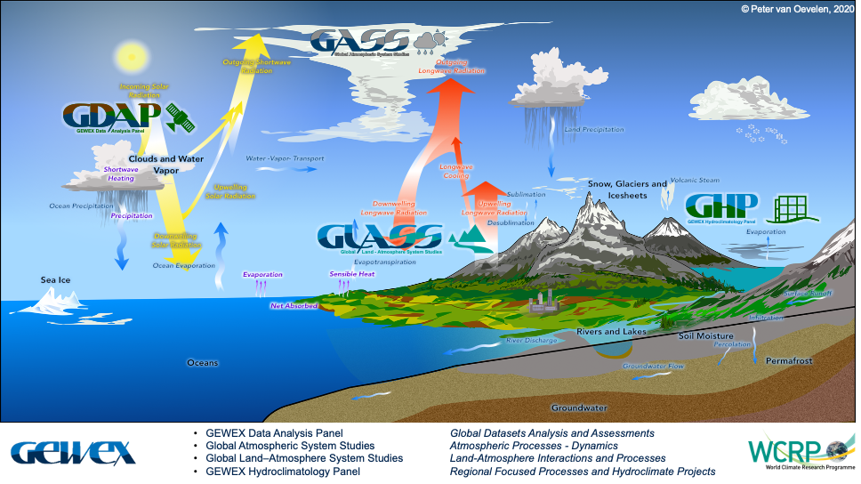

Slide 5
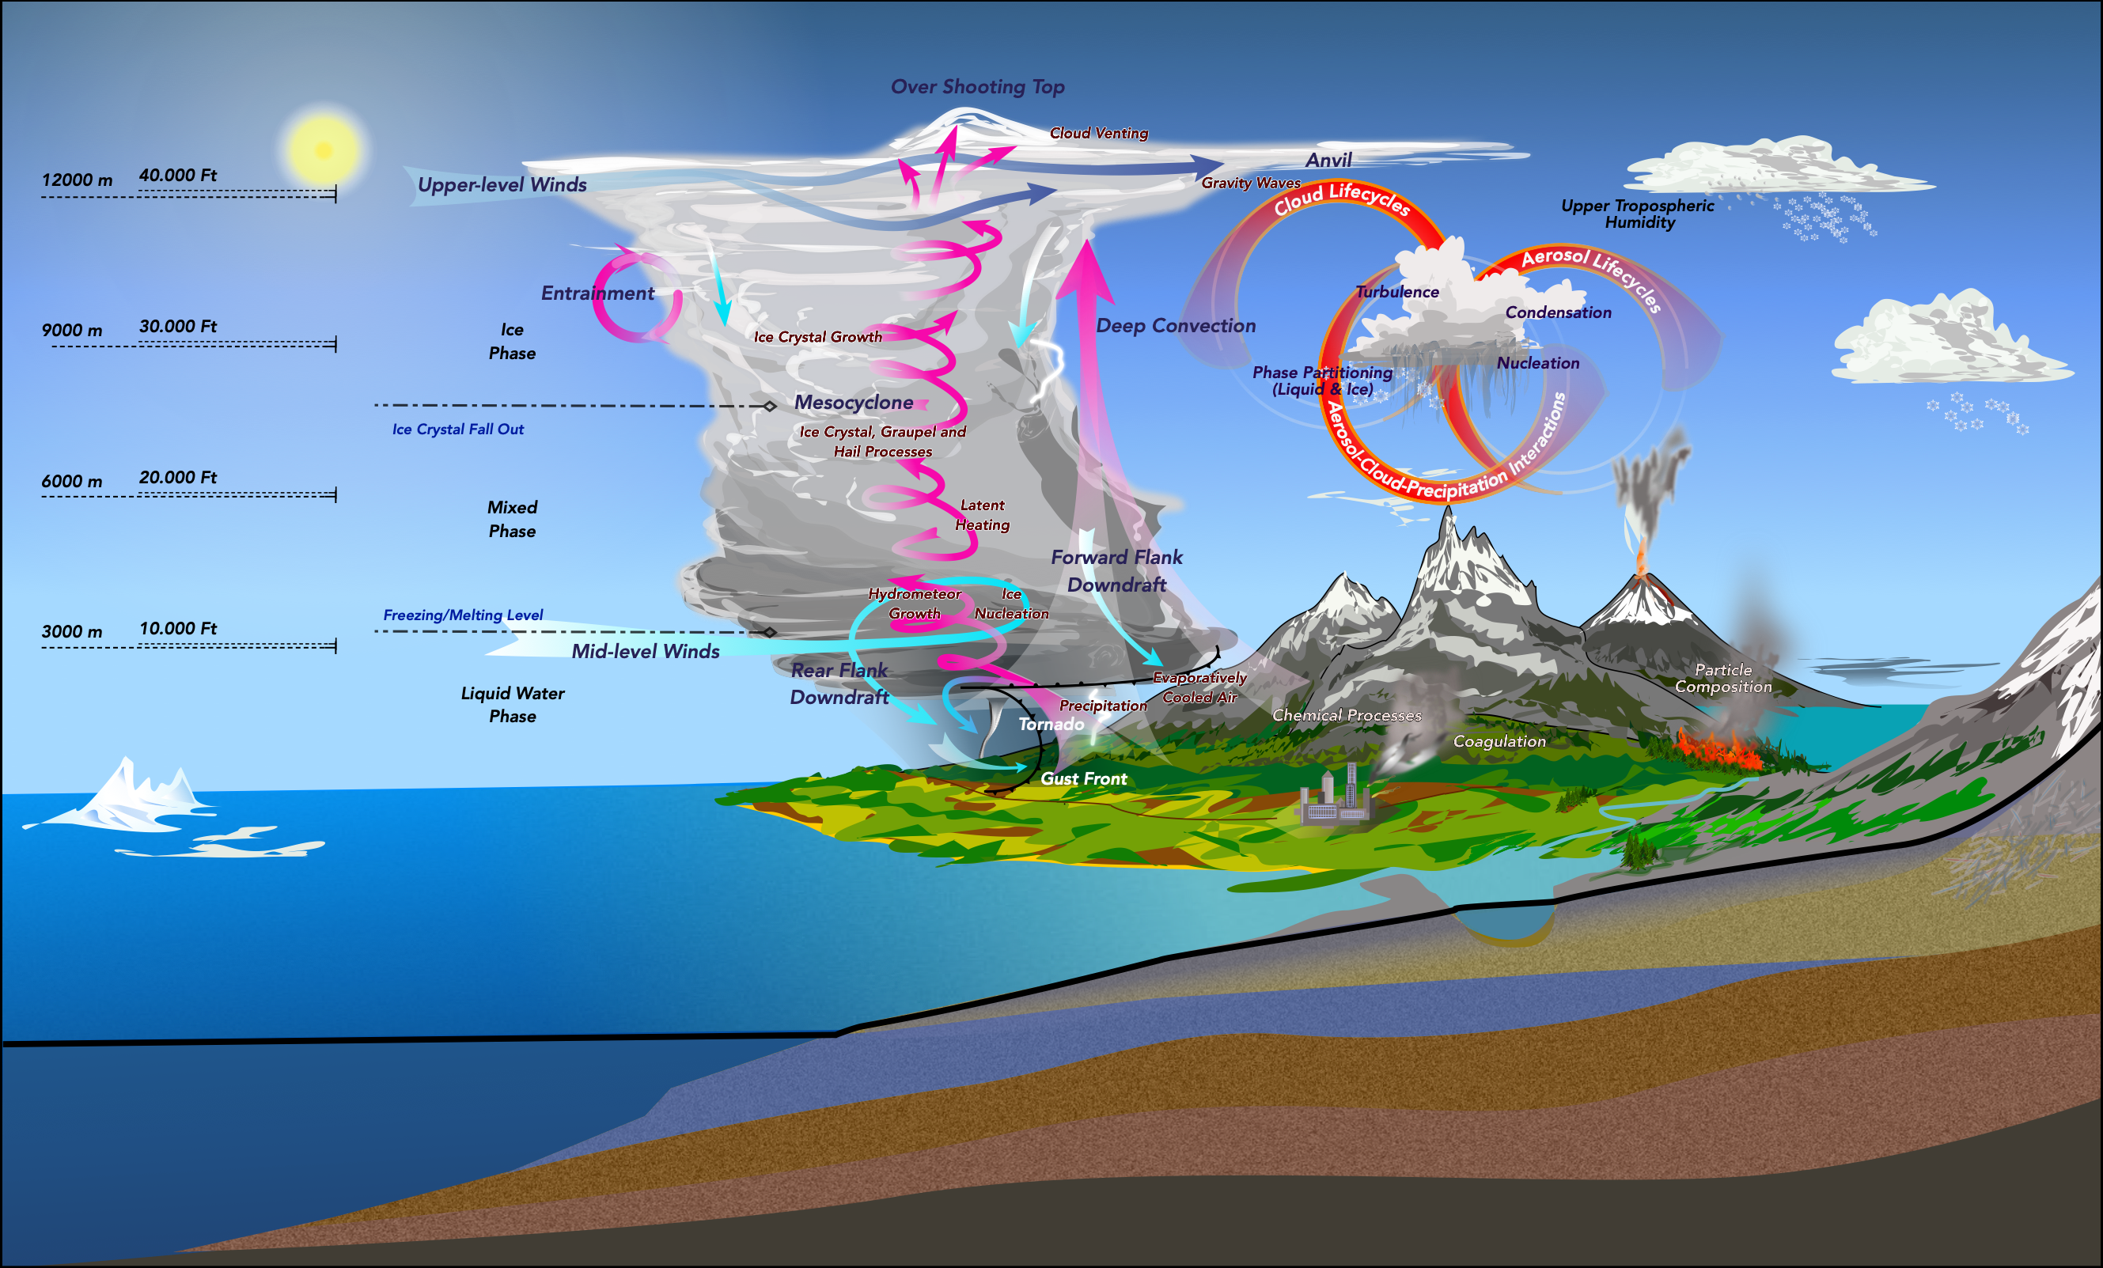



GEWEX Data Analysis Panel Global Datasets Analysis and Assessments
Global Atmospheric System Studies Atmospheric Processes - Dynamics
Global Land–Atmosphere System Studies Land-Atmosphere Interactions and Processes
GEWEX Hydroclimatology Panel Regional Focused Processes and Hydroclimate Projects
The GEWEX Panels:

Slide 6
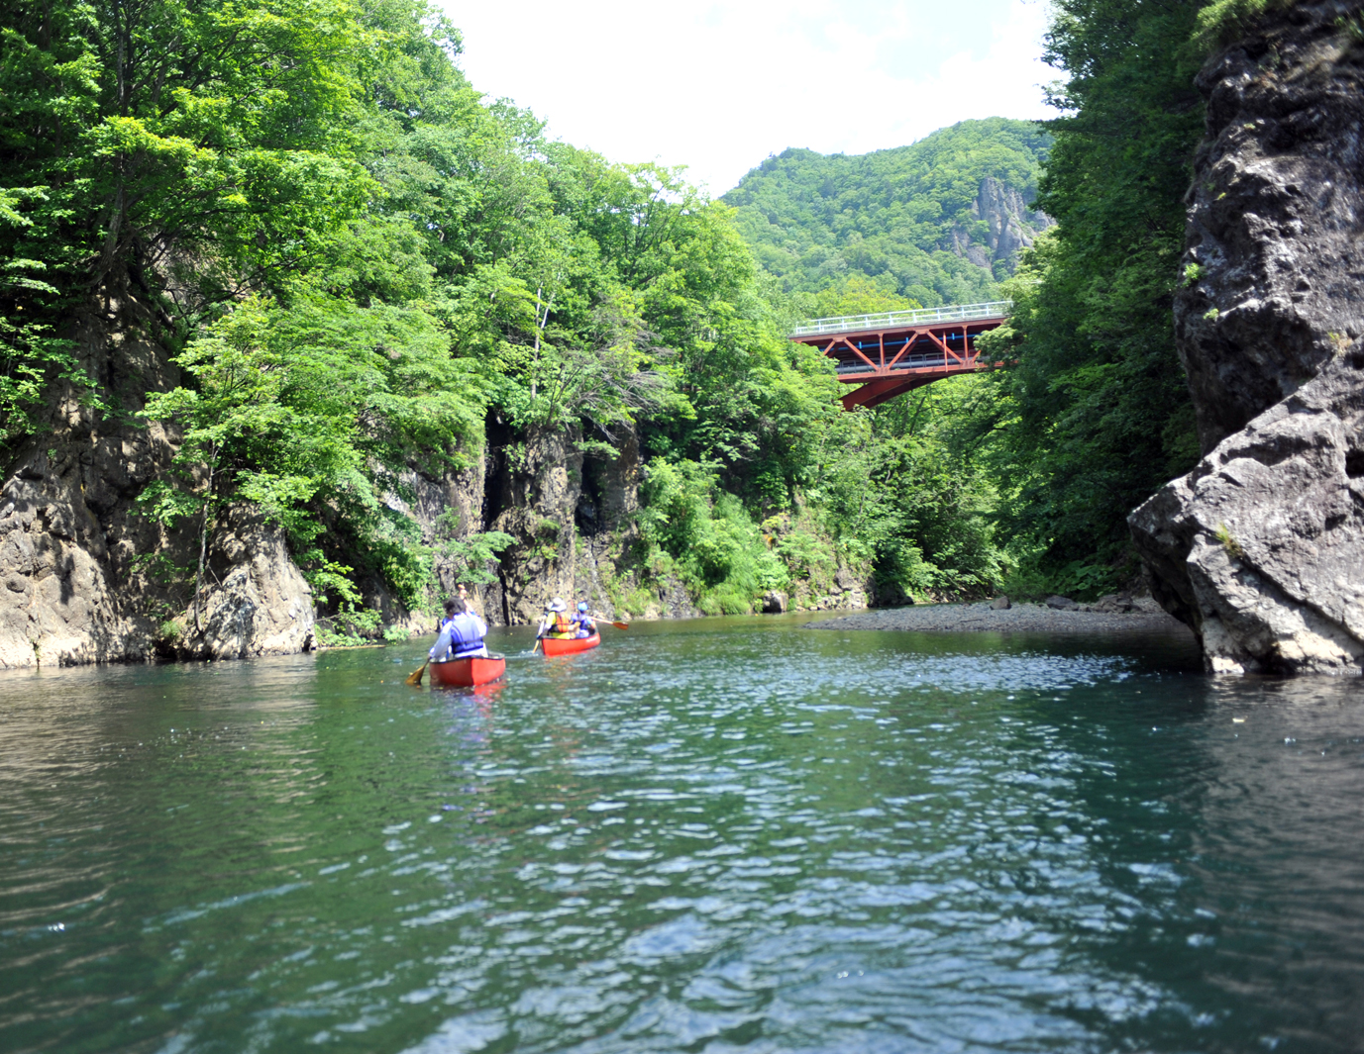
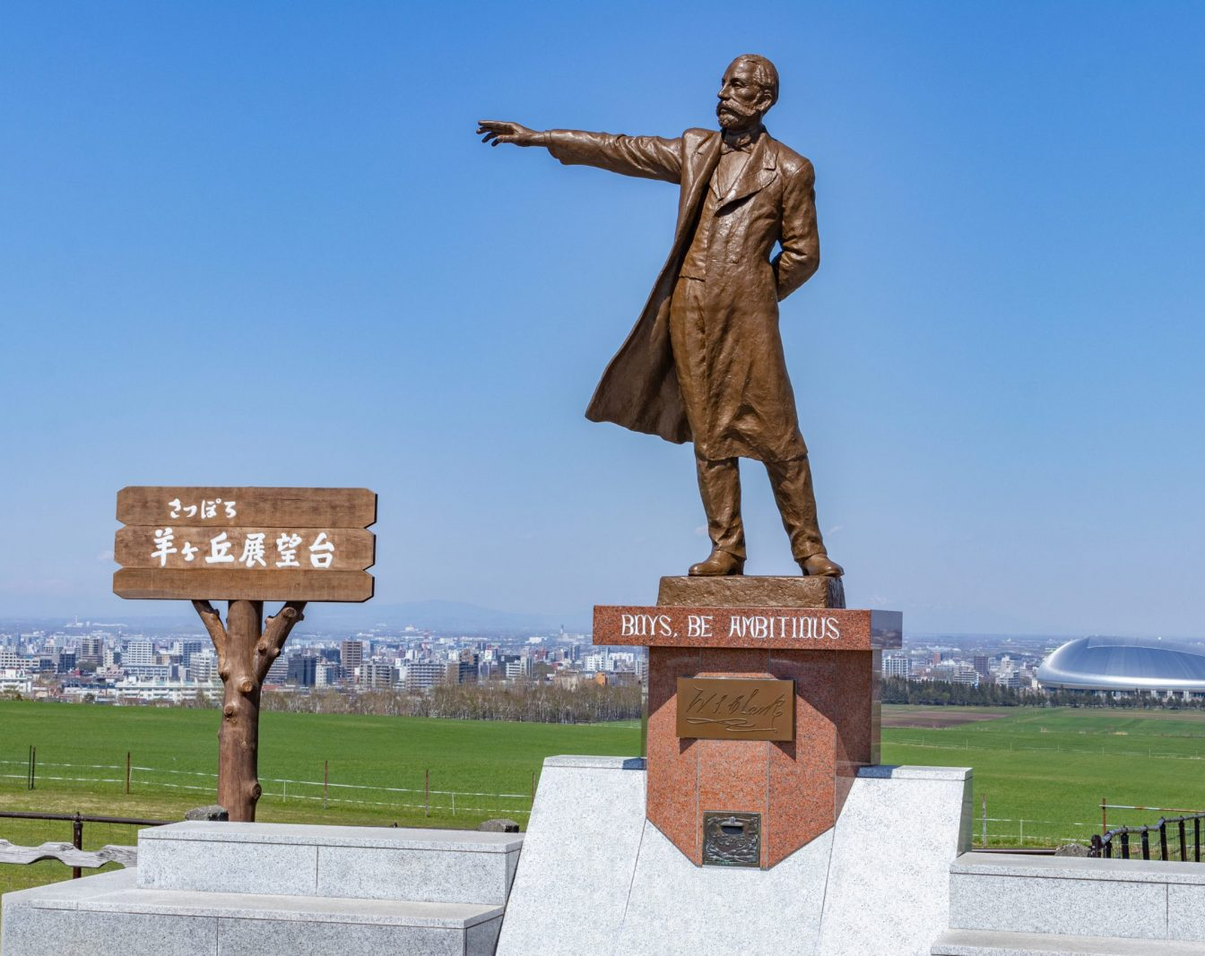
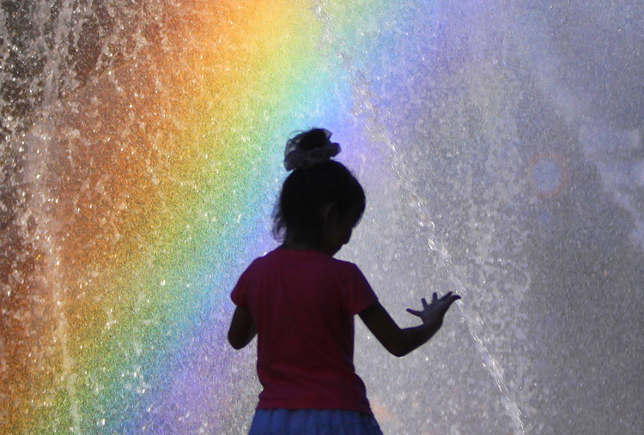





9th The Global Energy and Water Exchanges
Open Scientific Conference
|
Water
・
Climate
水
・
気 候
7–12 July 2024
Sapporo, Japan
Keio Plaza Hotel
Join us in beautiful Sapporo, Japan, to address the challenges facing humanity in terms of freshwater availability and associated disaster risk reduction and the sustainable development in the context of climate change and human activities.
https://www.gewexevents.org/meetings/gewex-osc2024/

Slide 7
Thank You
pvanoevelen@gewex.org
www.gewex.org
www.gewexevents.org
www.wcrp-climate.org

