Slide 1
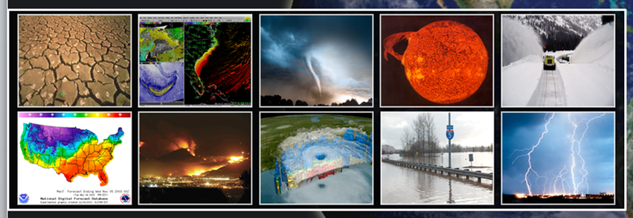
Enhancing Community UFS Land Model Development using Hierarchical Testing
3rd PAN-GASS Meeting, July 28, 2022
National Weather Service
Michael Barlage, NOAA Environmental Modeling Center
Weizhong Zheng and Helin Wei, IMSG at NCEP/EMC
Acknowledgements: EMC Model Evaluation Group

Slide 2
Unified Forecast System
The Unified Forecast System (UFS) is a community-based, coupled, comprehensive Earth modeling system. It is designed to support the NOAA Weather Enterprise and to be the source system for NOAA‘s operational numerical weather prediction applications.
The UFS is organized around applications (SRW, MRW, etc.). Each application has a forecast target. The UFS numerical applications span local to global domains and predictive time scales from sub-hourly analyses to seasonal.
The UFS is freely-available in a public GitHub repo:
https://github.com/ufs-community/ufs-weather-model
More information on UFS: https://ufscommunity.org including documentation and Graduate Student Tests
Embracing a Hierarchical Testing Capability (see Ek, Kalina, Zhang posters)

Slide 3
Common Community Physics Package
Common Community Physics Package (CCPP) contains the physics parameterizations used in UFS – interfaced through the atm model
Designed to facilitate the implementation of physics innovations in state-of-the-art atmospheric models
Accelerate transition of physics innovations to operational NOAA models
Find out more about CCPP framework and concepts:
https://dtcenter.org/community-code/common-community-physics-package-ccpp
Check out the code in the public repository:
https://github.com/NCAR/ccpp-physics

Slide 4
Unified Forecast System - Land
Current Infrastructure
Future Infrastructure
UFS Atmosphere
UFS Atmosphere
CCPP Layer
CCPP Layer
Land
Other Physics
Land
Other Physics
CCPP Layer
inline option
Land
CMEPS
CMEPS
component option
Land Comp1
MOM
CICE
MOM
CICE
Land Comp2
Land
= CCPP land models
Land
= component land models, including lakes, routing, etc.

Slide 5
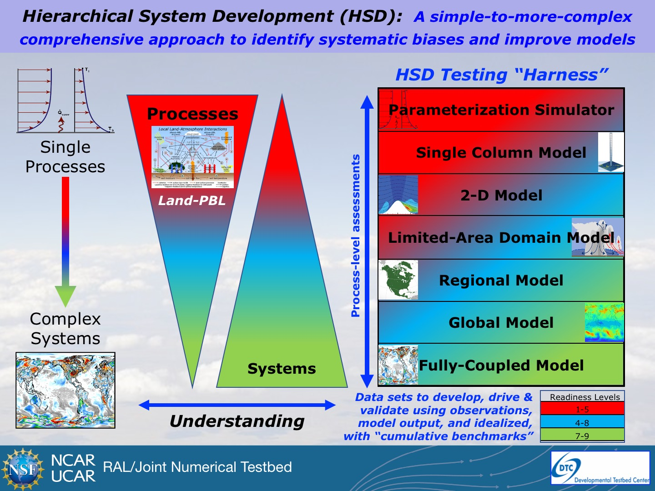
Hierarchical Testing/Evaluation Framework
Goals:
remove the barriers to participation in the development and advancement of UFS [Land]
plug into the process with simpler (but relevant) models that have fewer dependencies and can run with minimal resources
Source: Michael Ek, NCAR

Slide 6
Hierarchical Testing/Evaluation Framework
Land model testing and evaluation
  Essentially land model drivers: GLDAS, NLDAS, HRLDAS, LIS
  These are more useful if connected directly to code used in UFS/ops repositories

Slide 7
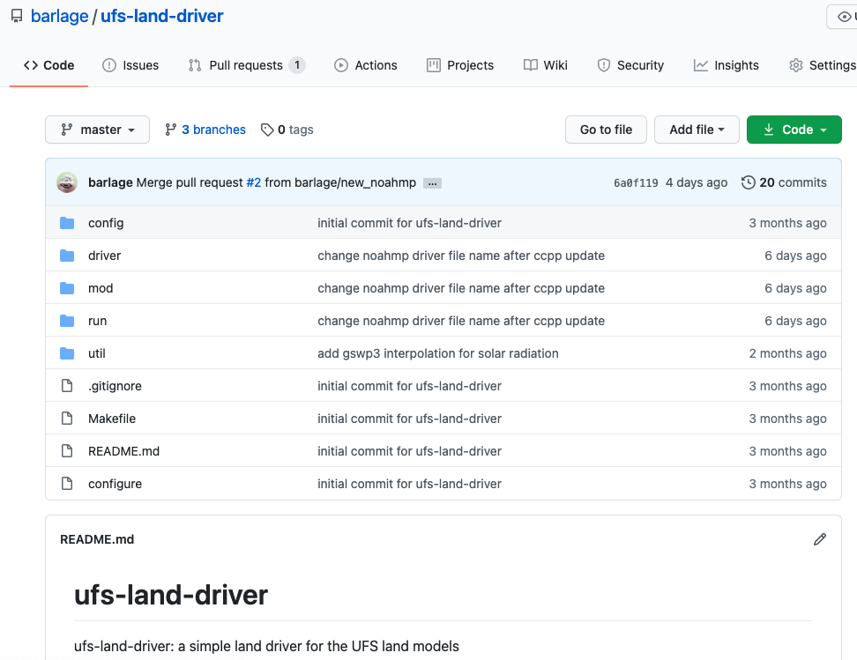
Hierarchical Testing/Evaluation Framework
UFS land driver that plugs directly into CCPP Physics repository
Designed for ease-of-use
Graduate/ Undergraduate student laptop capability
Two dependencies: Fortran compiler and NetCDF library
github.com/barlage/ufs-land-driver

Slide 8
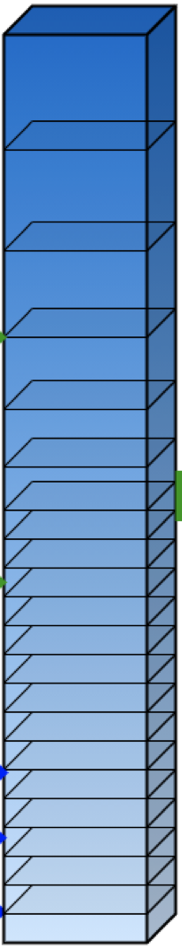
Hierarchical Testing/Evaluation Framework
Land model testing and evaluation
  Essentially land model drivers: GLDAS, NLDAS, HRLDAS, LIS
  These are more useful if connected directly to code used in UFS/ops repositories
Single column model (CCPP-SCM)
  Very useful for efficient testing of land-atmosphere coupling
  Rapid L-A sensitivity tests of land model parameters and physics
  Run with pre-packaged observed or LES cases
  Extract columns out of the UFS simulations to run test cases
  Check out the code in the public repository (along with documentation
  and test cases):
  https://github.com/NCAR/ccpp-scm

Slide 9
Hierarchical Testing/Evaluation Framework
Land model testing and evaluation
  Essentially land model drivers: GLDAS, NLDAS, HRLDAS, LIS
  These are more useful if connected directly to code used in UFS/ops repositories
Single column model (CCPP-SCM)
  Very useful for efficient testing of land-atmosphere coupling
  Rapid L-A sensitivity tests of land model parameters and physics
Global land-atmosphere – SRW or MRW App cases
Global coupled cases

Slide 10


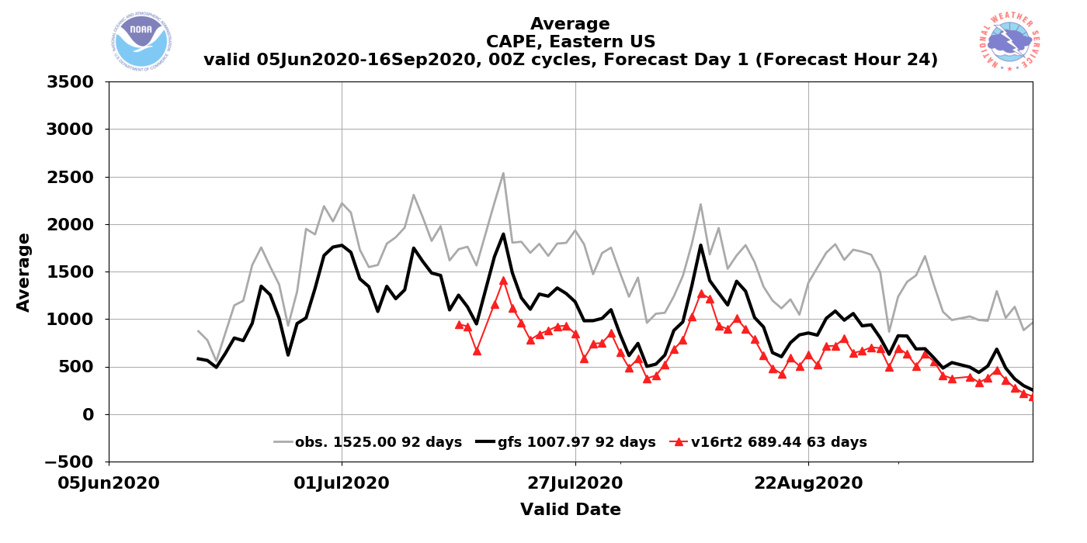
NATIONAL OCEANIC AND ATMOSPHERIC ADMINISTRATION
CAPE Magnitudes Are Reduced in GFSv16
GFSv15
GFSv16
Obs
Operational GFSv15 CAPE analyses/forecasts are consistently lower than obs
CAPE magnitudes in GFSv16 analyses/forecasts are consistently lower than those from GFSv15

Slide 11
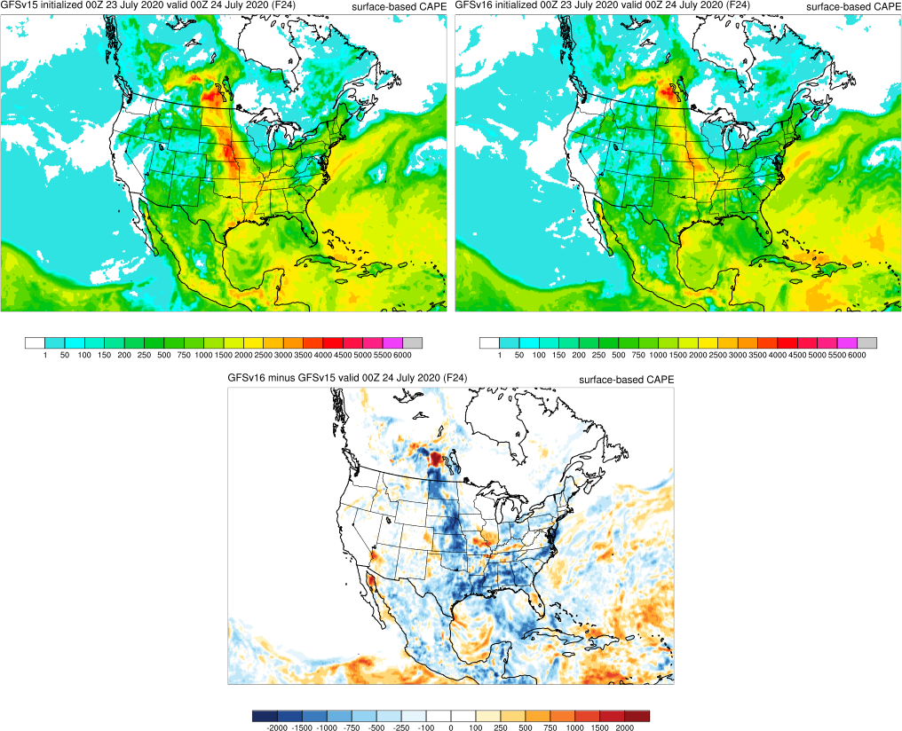
NATIONAL OCEANIC AND ATMOSPHERIC ADMINISTRATION
CAPE Magnitudes Are Reduced in GFSv16
GFSv15
GFSv16
v16 - v15
F024
F024
F024
Surface-Based CAPE Forecasts (left and middle) and Forecast Differences (right)
Init: 00Z 23 July 2020 Valid: 00Z 24 July 2020 (F024)
GFSv16 CAPE was notably lower across the Northern and Central Plains, as well as over the Gulf Coast region and southeast; smaller reductions over the northeast, Ohio Valley, and Mexico

Slide 12
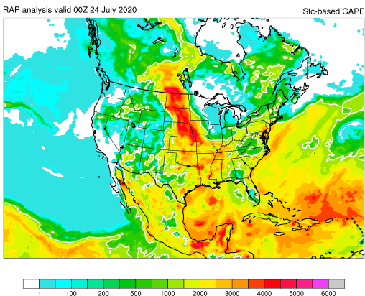
NATIONAL OCEANIC AND ATMOSPHERIC ADMINISTRATION
CAPE Magnitudes Are Reduced in GFSv16
GFSv15
GFSv16
RAP ANL
F024
F024
Surface-Based CAPE Forecasts (left and middle) and Analysis (right)
Init: 00Z 23 July 2020 Valid: 00Z 24 July 2020 (F024)
The higher CAPE values in GFSv15 are almost always better, and even those are too low

Slide 13
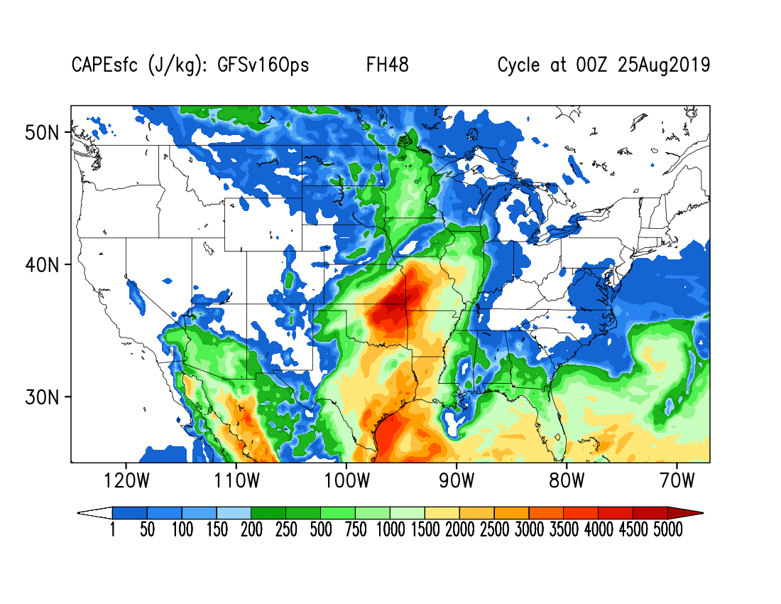
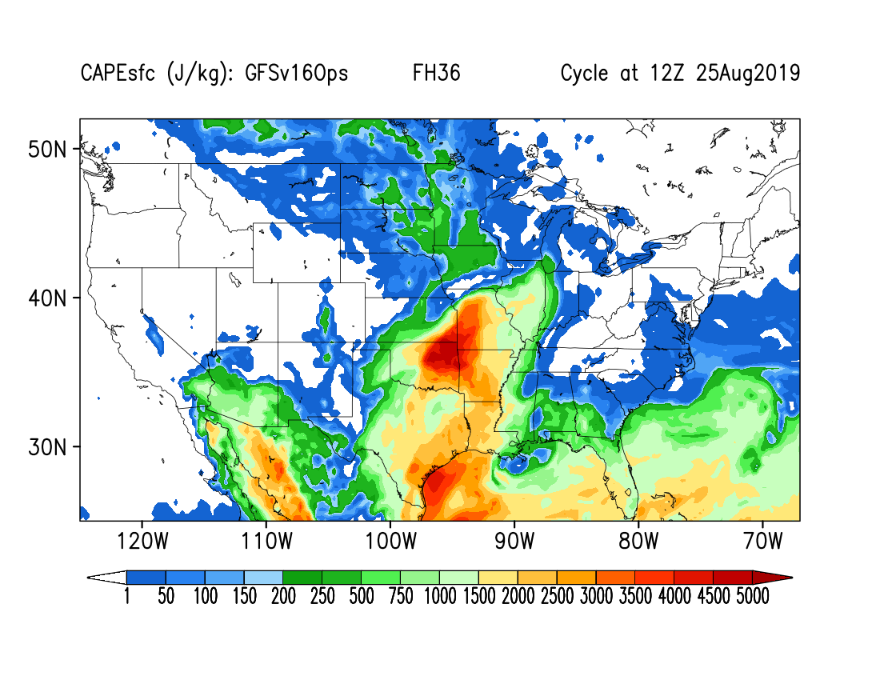
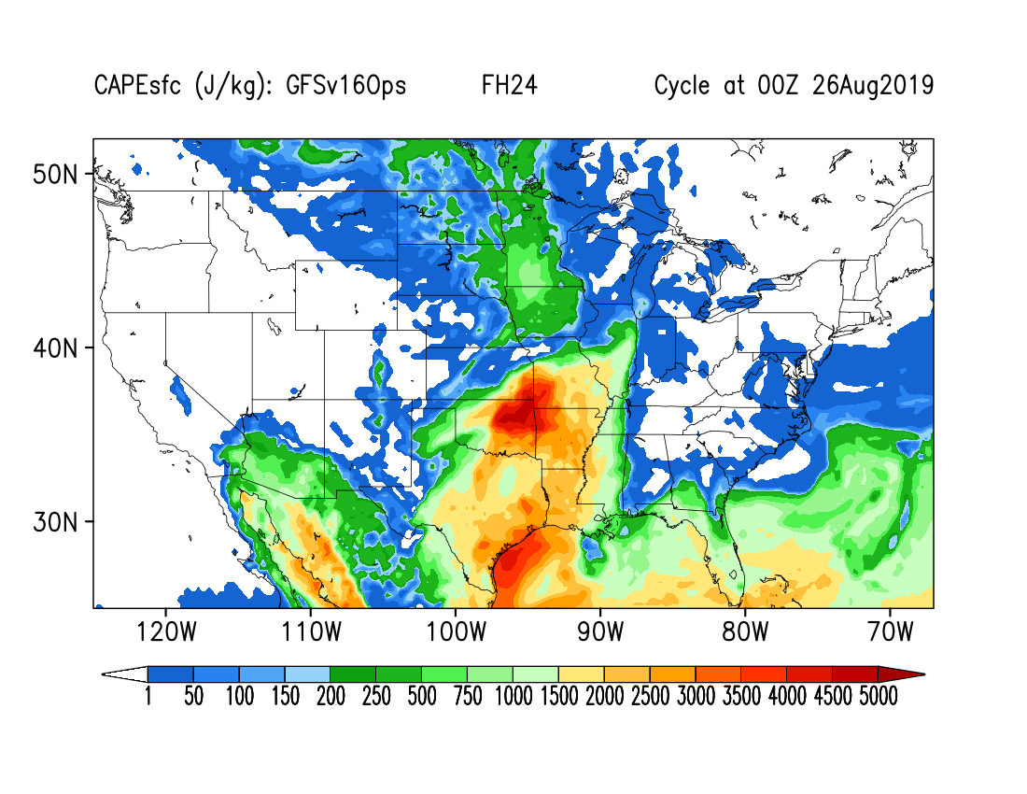
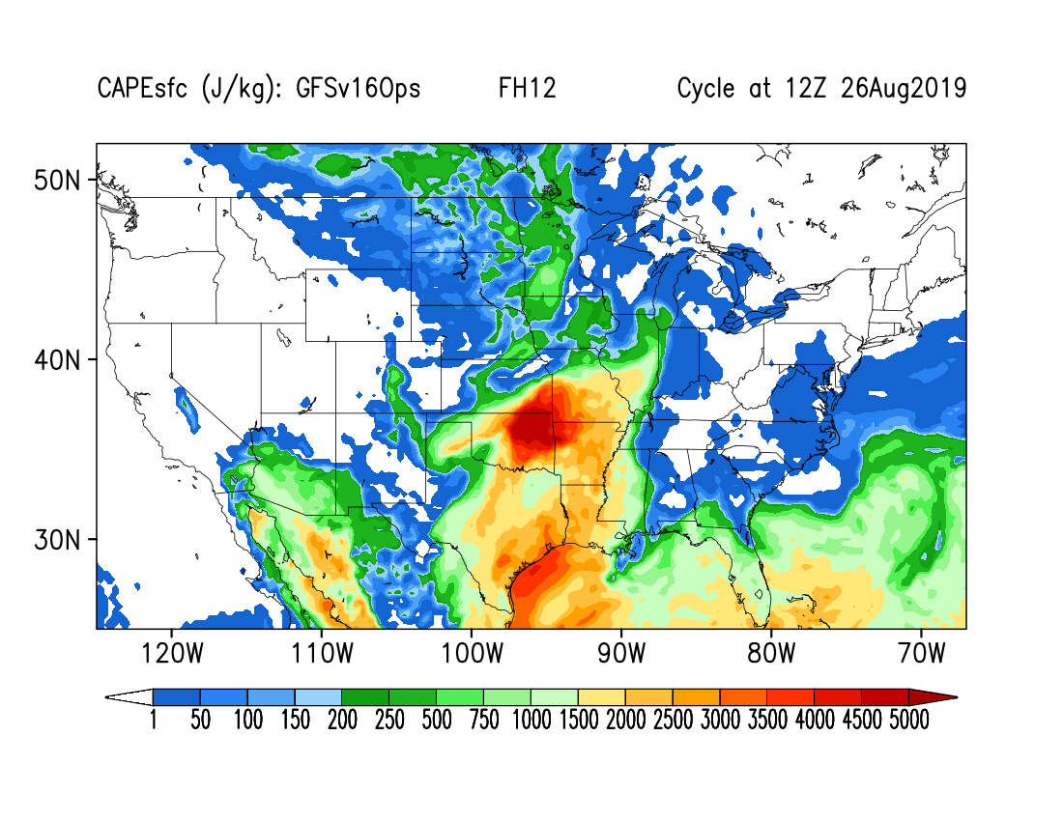
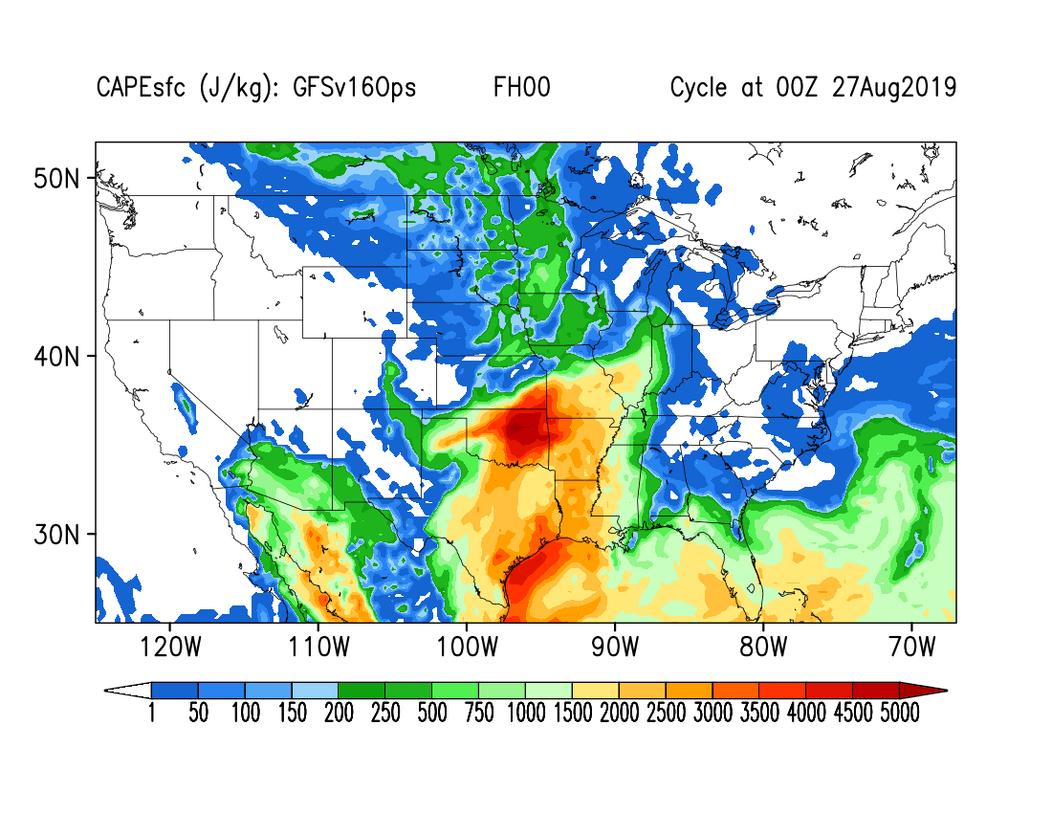
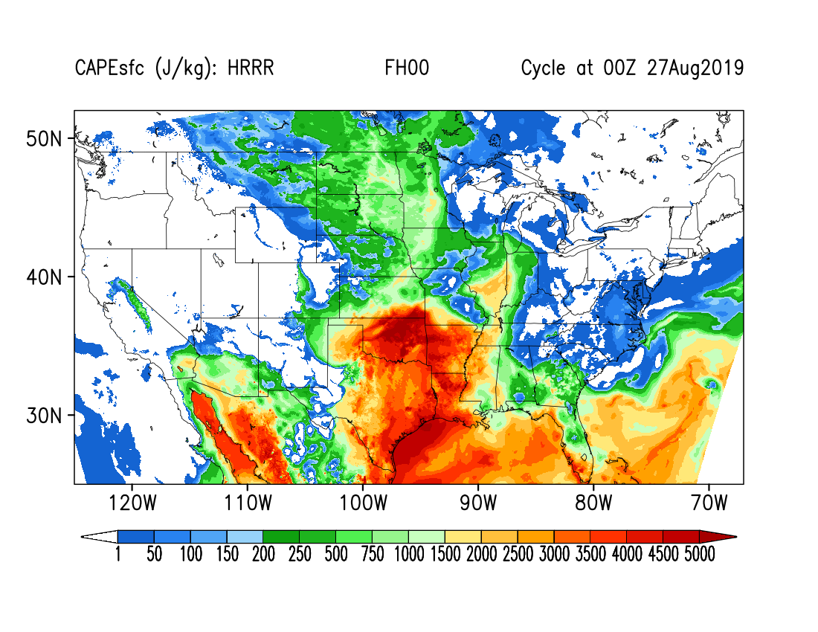
Observed Soundings
FH48
FH36
FH24
FH12
FH00
HRRR
CAPE (J/kg): GFSv16Ops Valid: 00Z, 27 Aug 2019

Slide 14
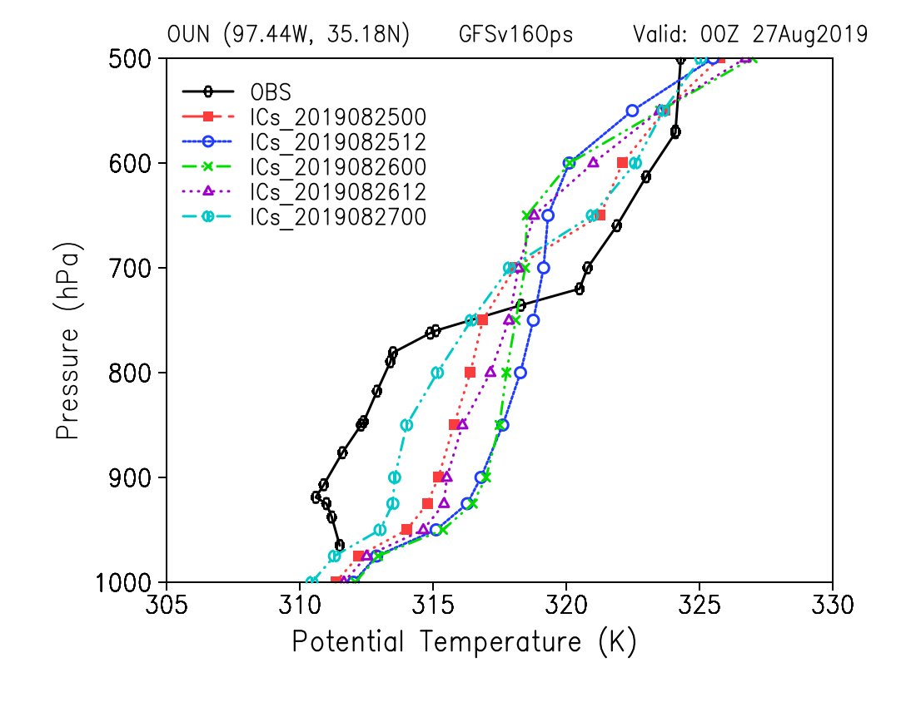
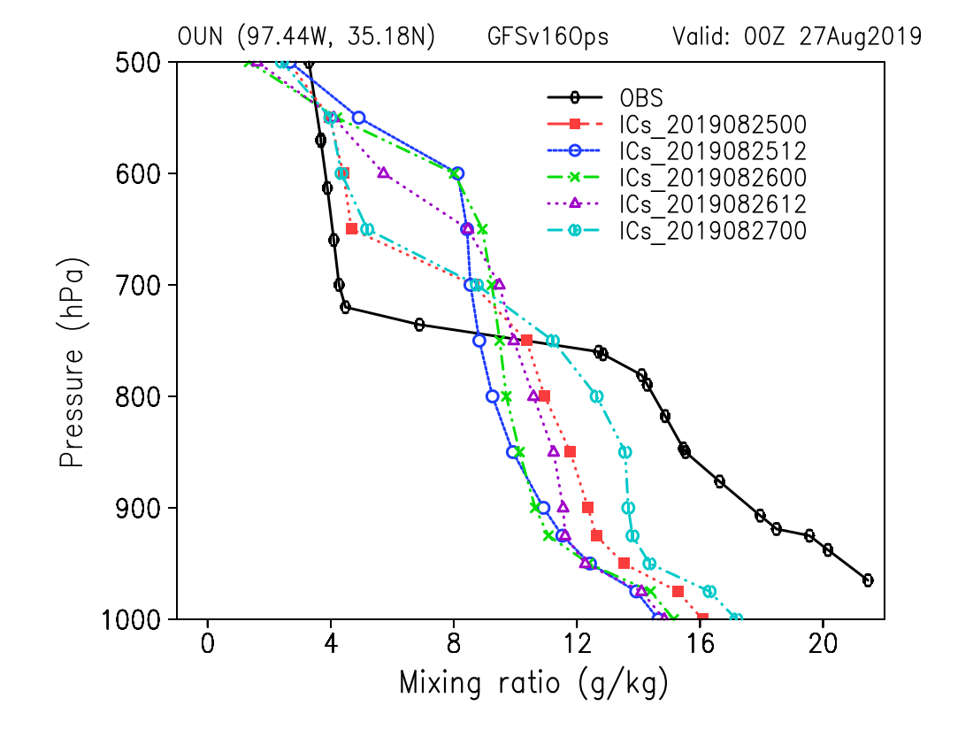
Observed Soundings
Observed and multiple model simulations soundings at Norman, OK show too warm PBL
Observed and multiple model simulations soundings at Norman, OK show too dry PBL
Potential Temperature (K): OUN Valid: 27 Aug 2019

Slide 15
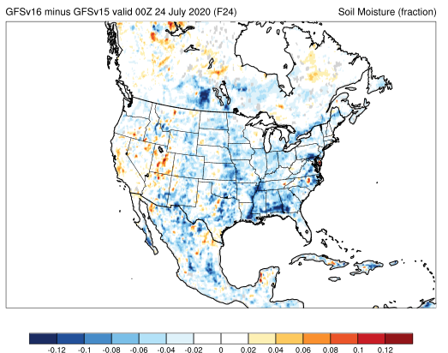
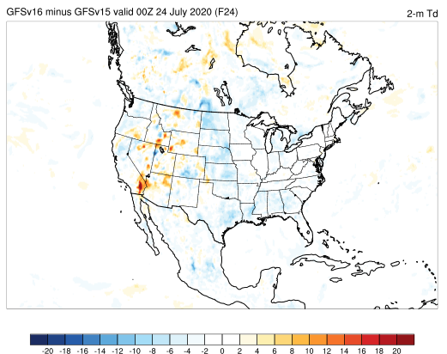
NATIONAL OCEANIC AND ATMOSPHERIC ADMINISTRATION
Drier Soil Reduces Boundary Layer Moisture
v16 - v15 Differences
F024
Top Level Soil Moisture
F024
2-m Dew Point
F024
Sfc-Based CAPE
F024
Init: 00Z 23 July 2020 Valid: 00Z 24 July 2020 (F024)
GFSv16 top level soil moisture is considerably drier than in v15
Good alignment between lower 2-m dew points and largest areas of reduced CAPE

Slide 16
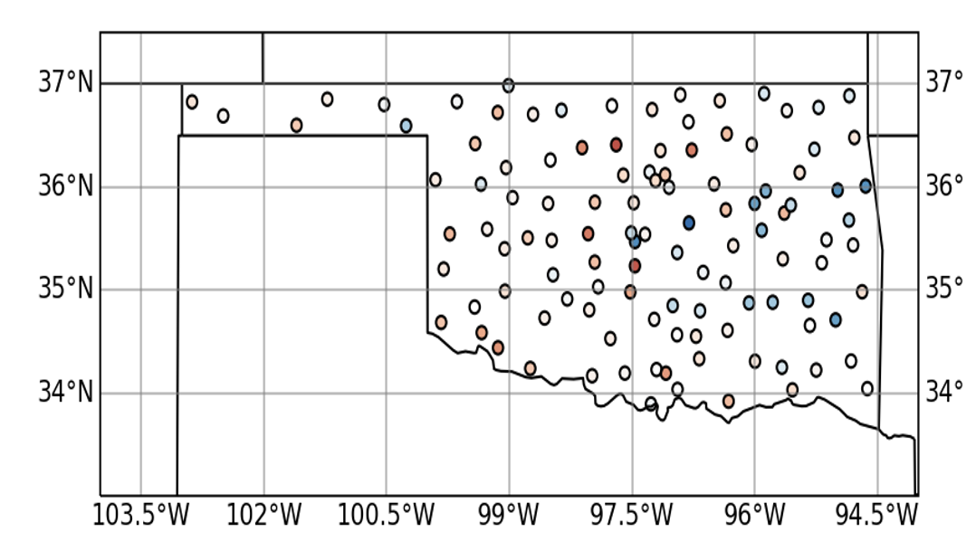
Observations
Observation focus on State of Oklahoma
Norman, OK sounding (OUN)
ARM-SGP Stations
Oklahoma Mesonet Soil Moisture
13
OUN
24

Slide 17
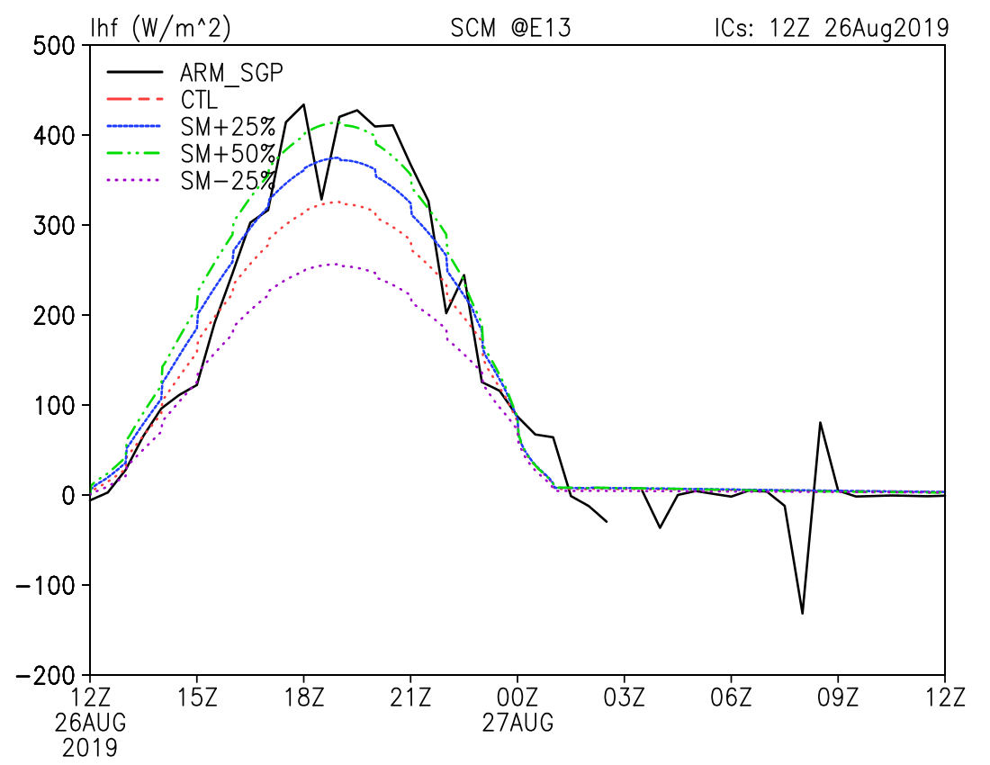
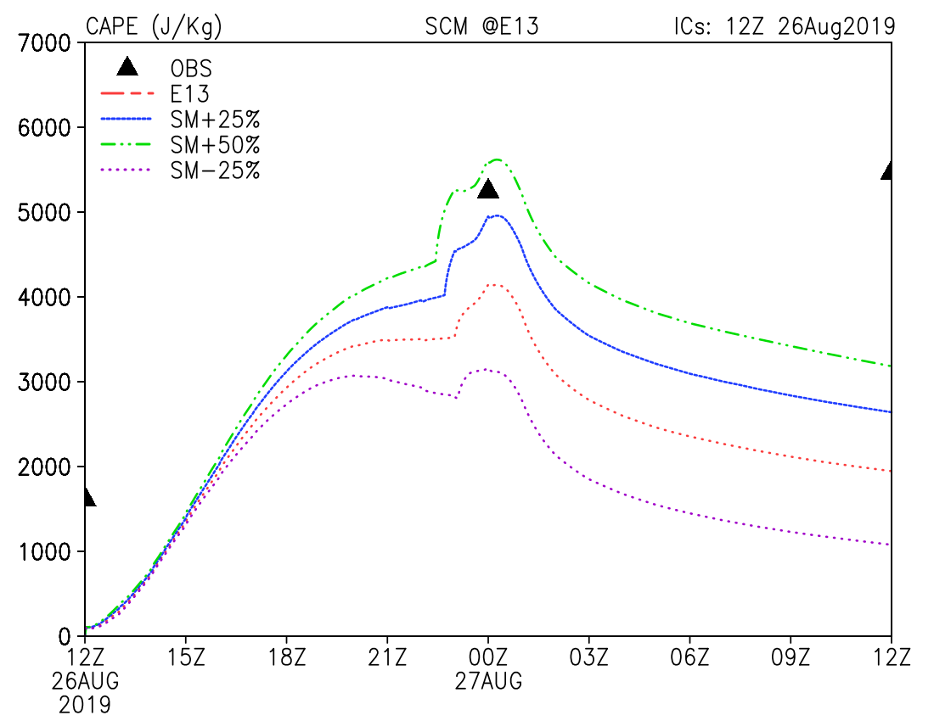
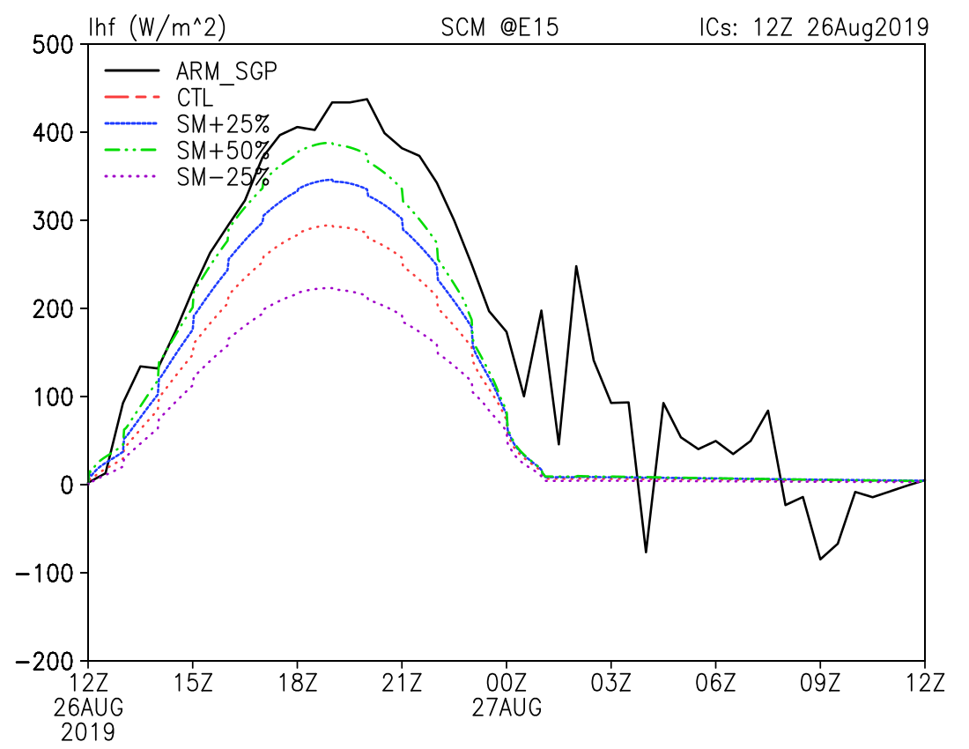
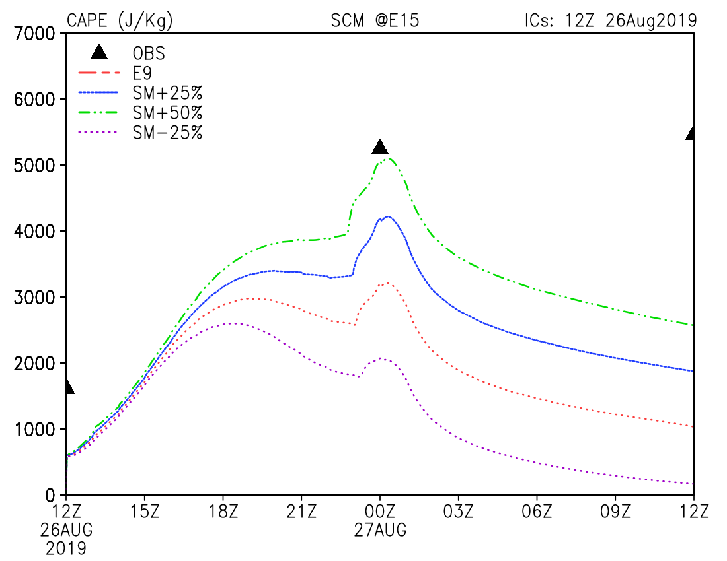
Single Column Model Simulations
Observed CAPE at Norman, OK and LH at ARM-SGP sites
Extracted initialization produces low LH and low CAPE
Perturbed SM produces increased LH and CAPE

Slide 18
Soil State Initialization in Coupled Model
Observed precipitation is used to run land-only simulations to update soil states
observed precip
observed precip
observed precip
observed precip
00UTC
06UTC
12UTC
18UTC
00UTC
Land-Model-Only Simulations
Soil states are then replaced in coupled model restart files
soil
states
soil
states
soil
states
soil
states
00UTC
06UTC
12UTC
18UTC
00UTC
Coupled Model Forecasts

Slide 19
Land-only Simulations
Precipitation
GFSv15 > GFSv16 > observations
Several changes made to the land model in operations to deal with excessive precipitation and need for increase latent heat flux
Can we quantify the effect this has on parallel land-only soil states?
Return to the land-only system
          Run multi-year simulation with model not as tuned to coupled biases

Slide 20
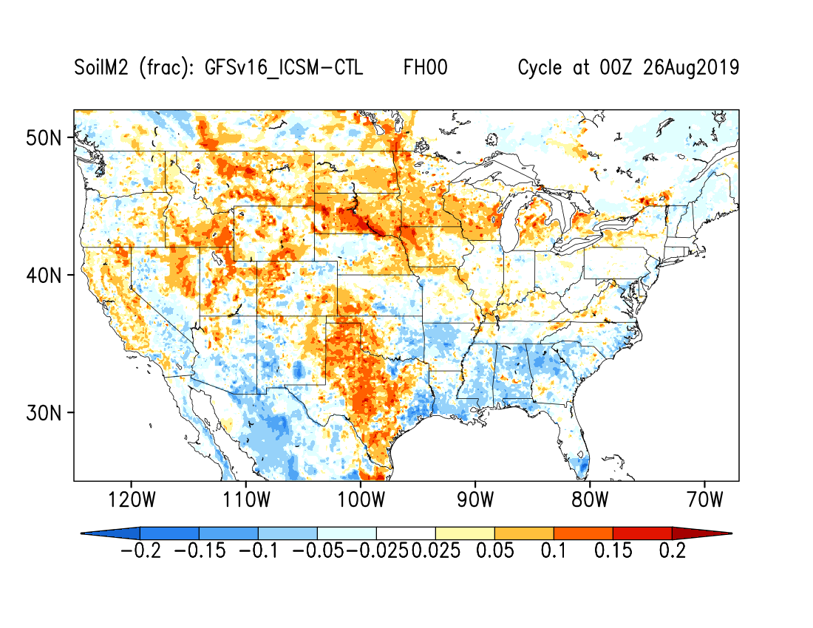
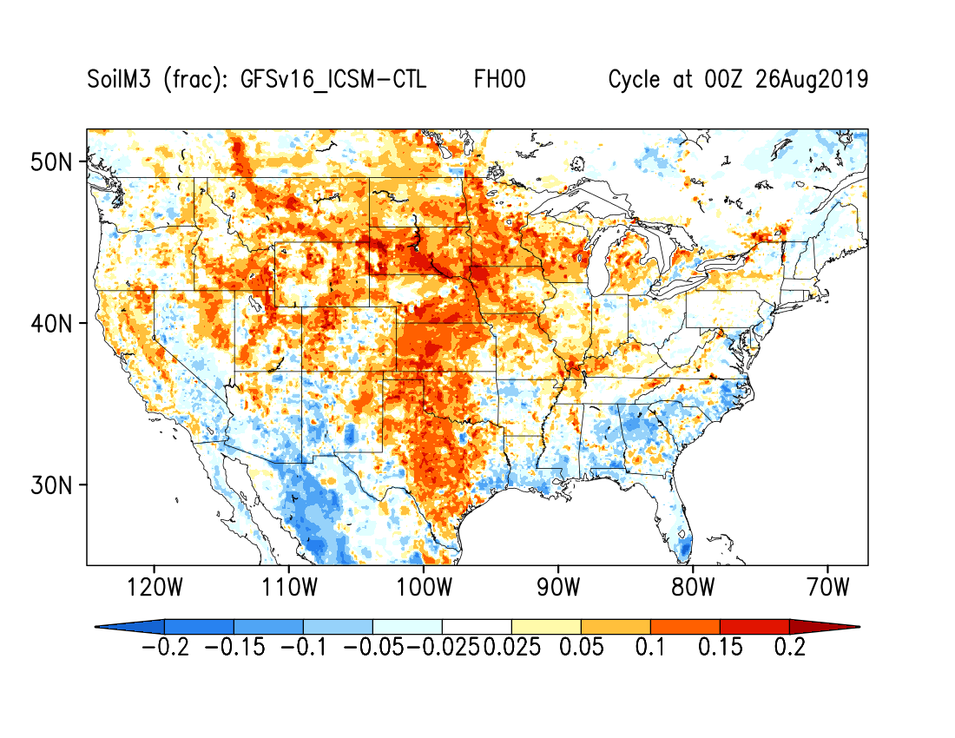
Land-only Simulations
Largest positive differences in soil moisture are coincident with regions of poor CAPE prediction
25 cm Soil Moisture
70 cm Soil Moisture

Slide 21
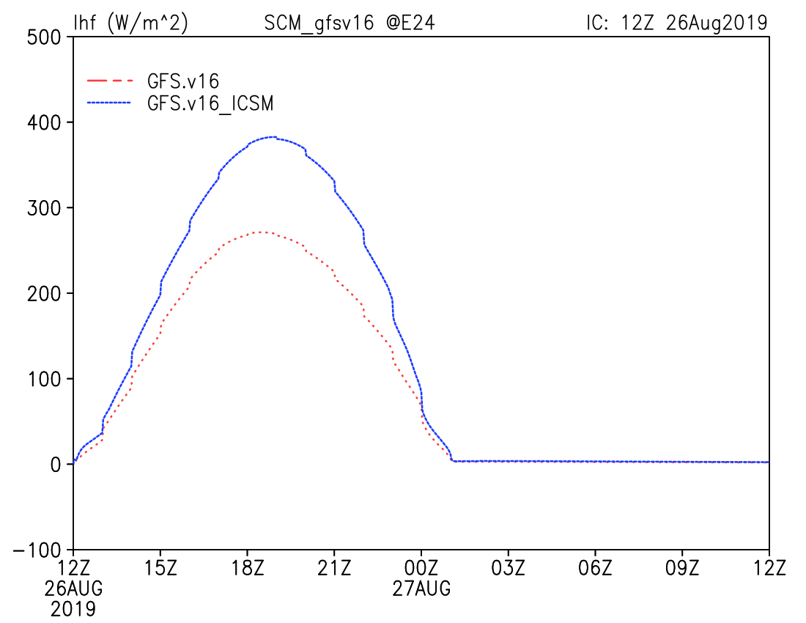
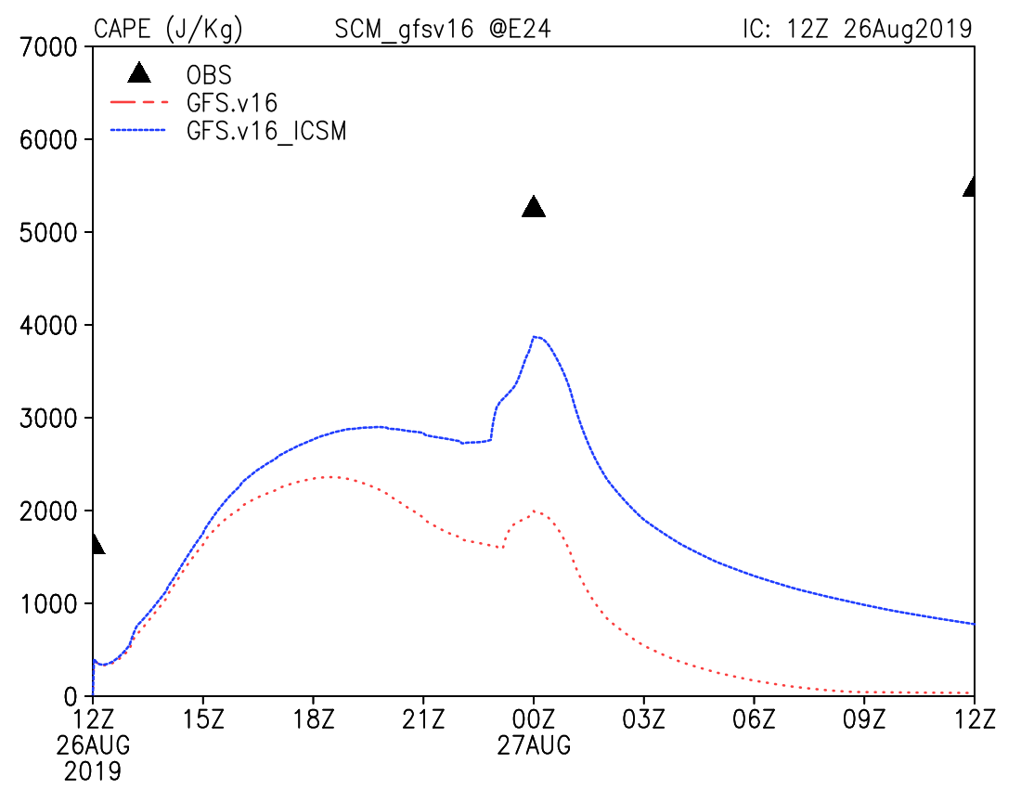
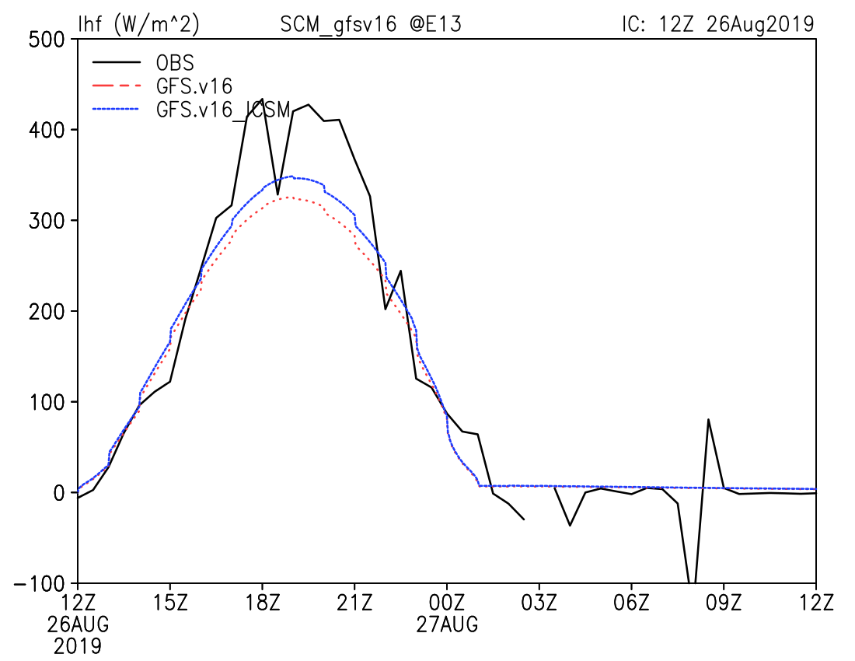
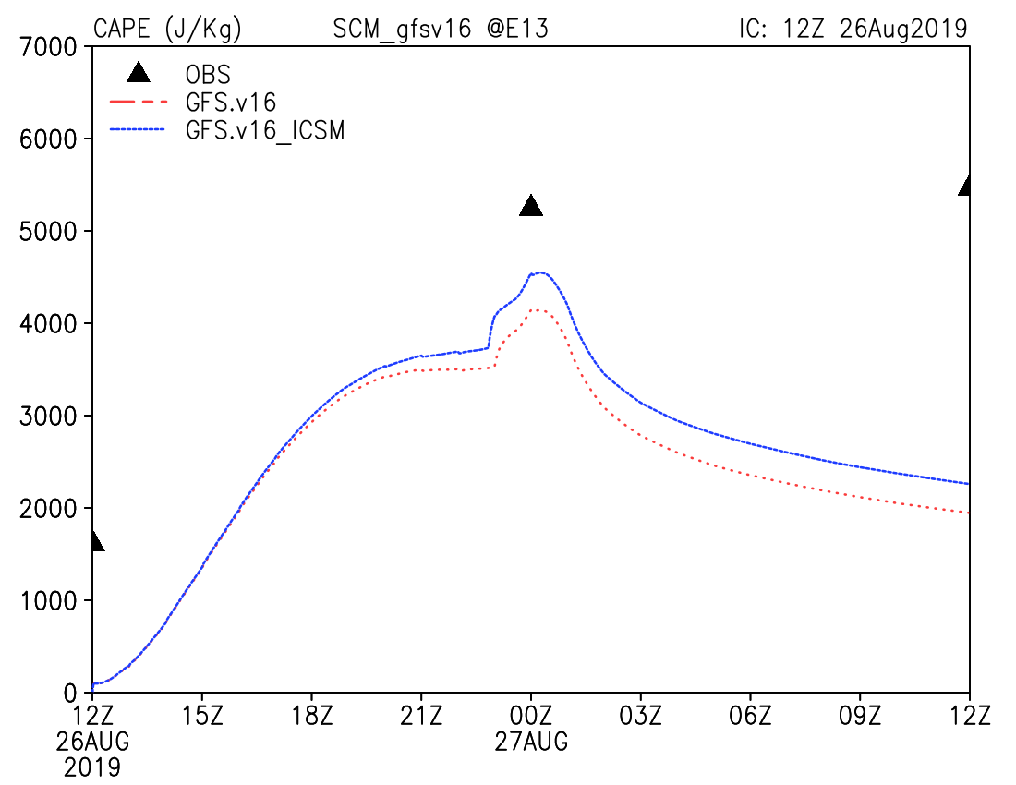
Single Column Model Simulations
Replace soil moisture in SCM with those from land-only simulation
Observed CAPE at Norman, OK and LH at ARM-SGP sites
Extracted initialization produces low LH and low CAPE
Perturbed SM produces increased LH and CAPE

Slide 22
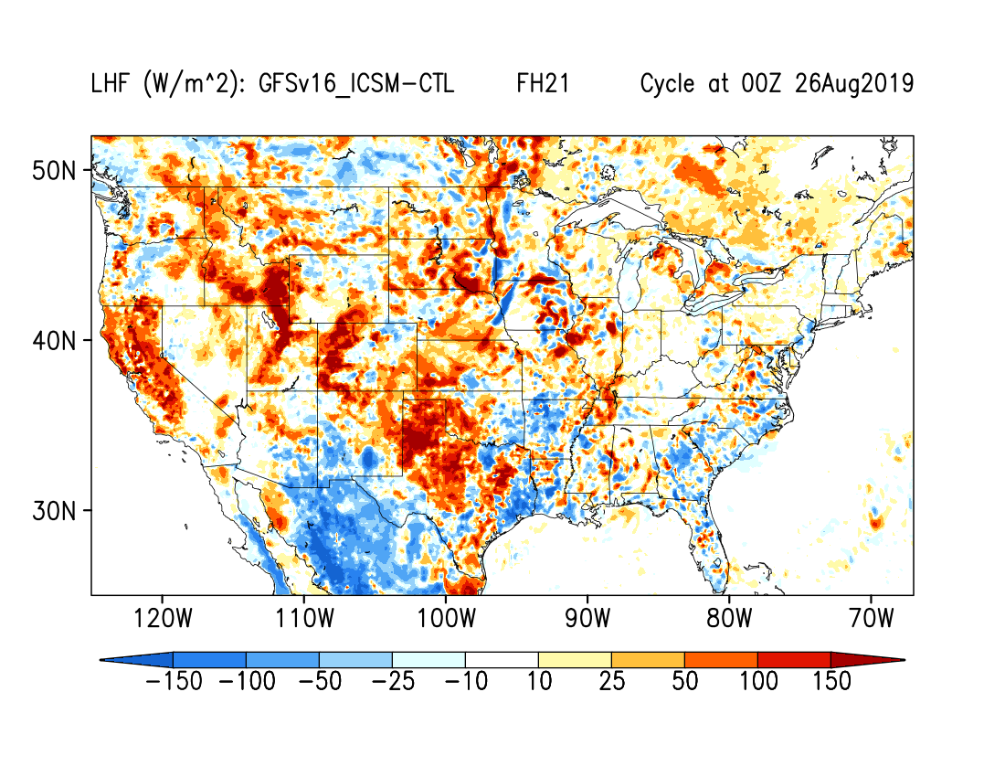
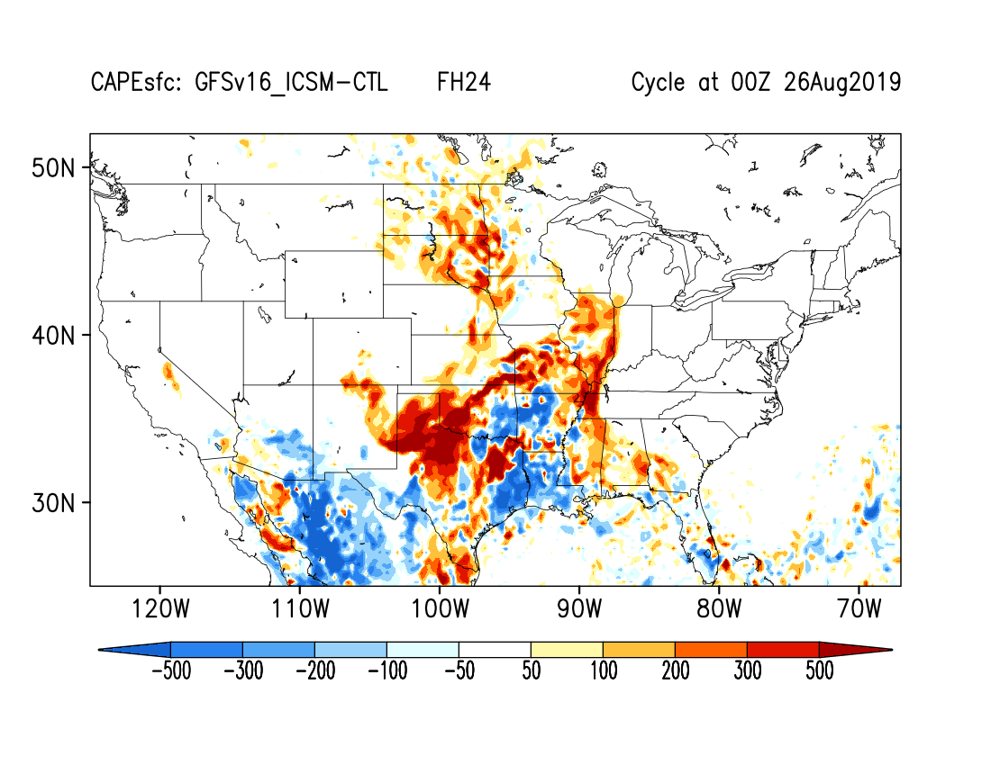
Coupled Model Simulations
Using new soil moisture produces increased latent heat flux
Using new soil moisture produces increased CAPE in region of interest

Slide 23
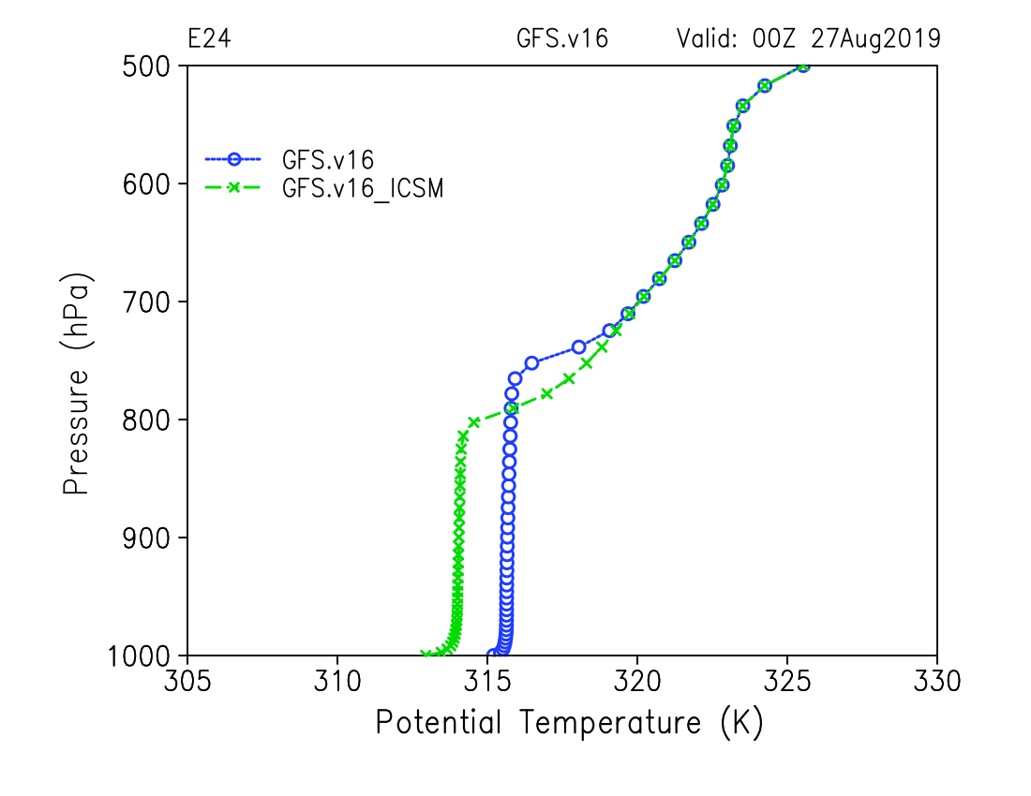
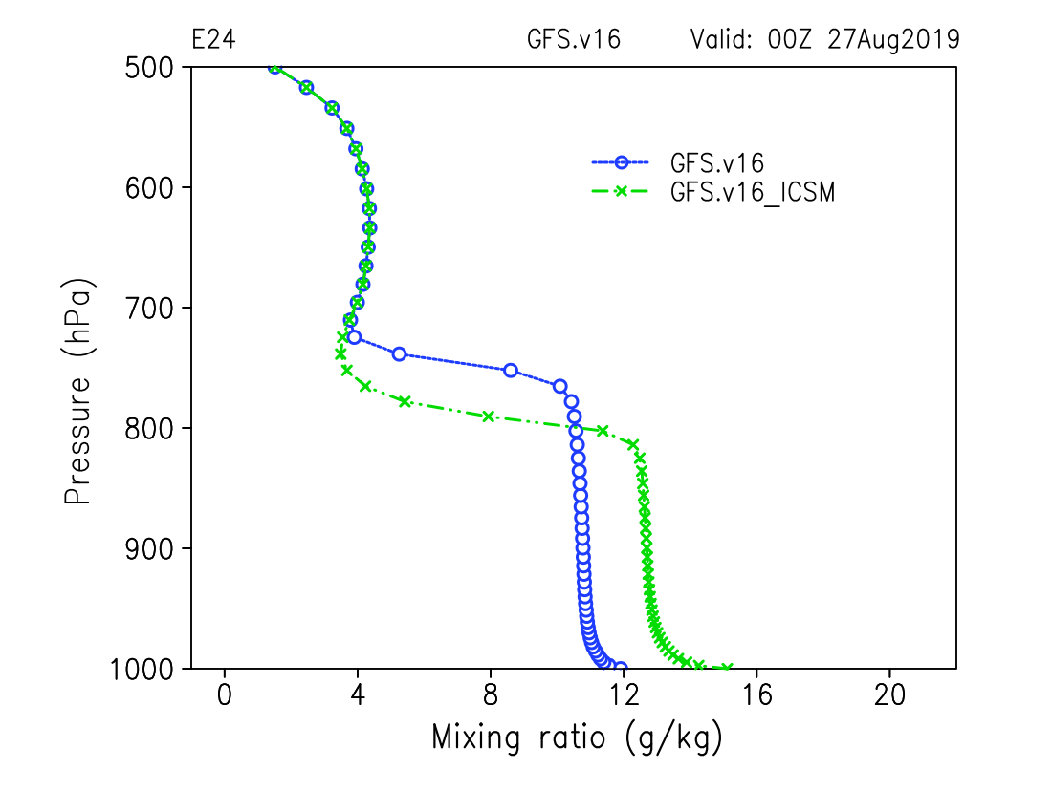
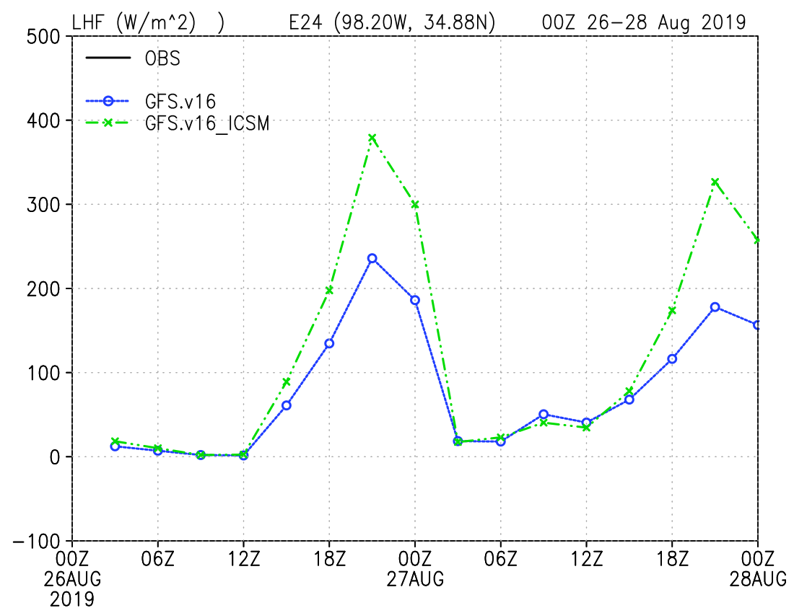
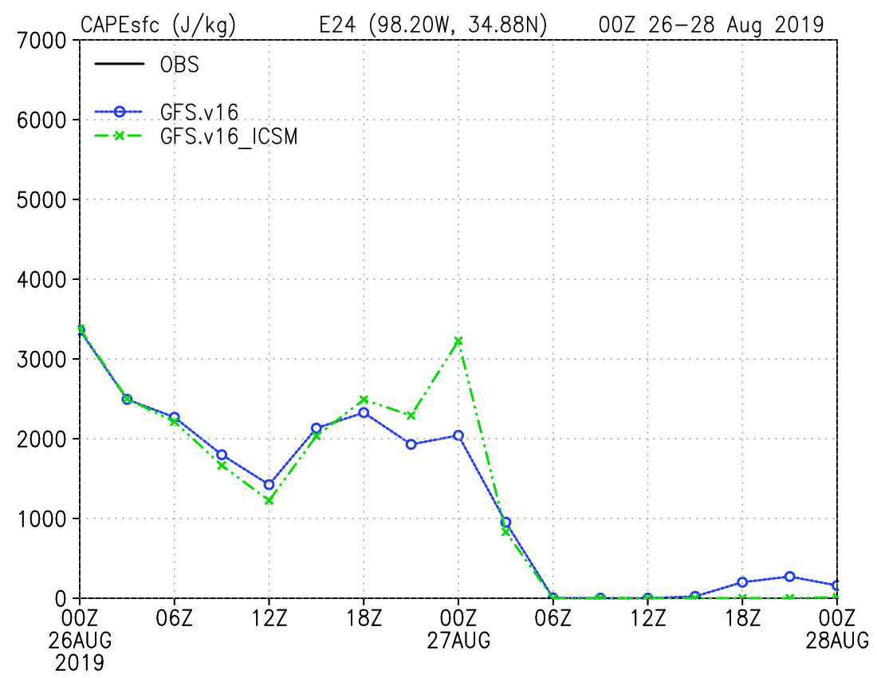
Coupled Model Simulations
Produces cooler and wetter mixed layer at ARM-SGP site
Bumps up latent heat flux by about 100W/m²
Localized CAPE increase of 1000J/kg
OUN CAPE

Slide 24
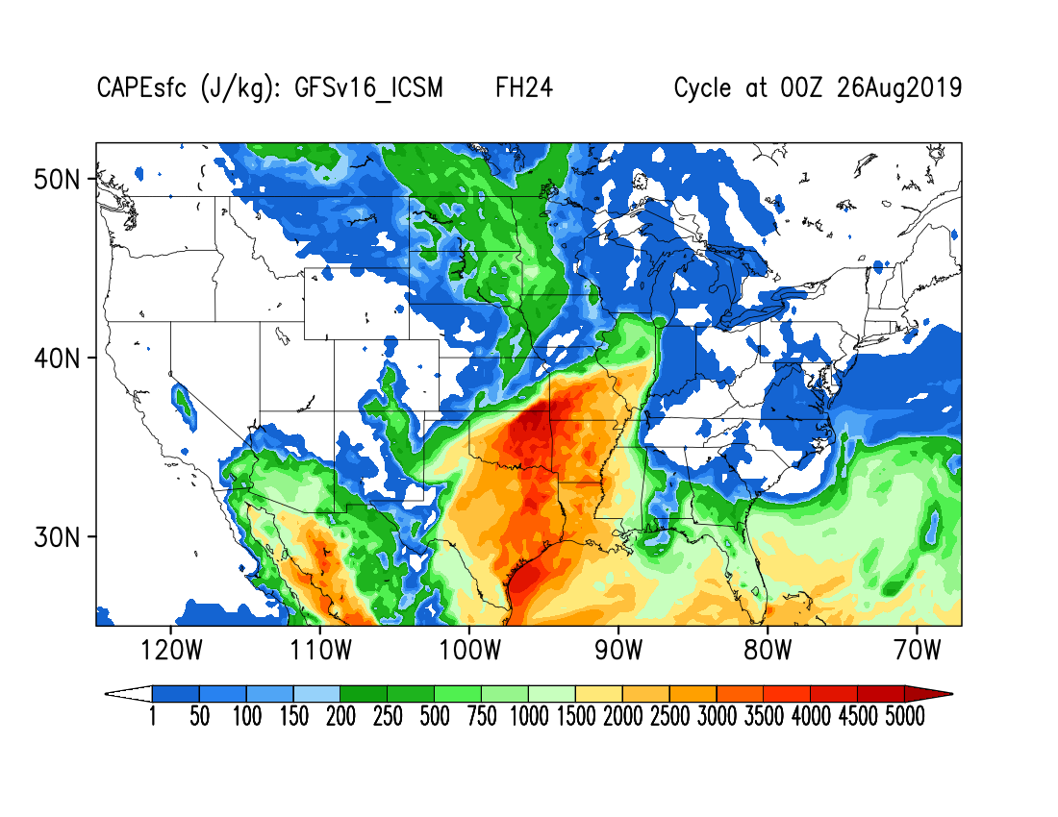
Coupled Model Simulations
Encouraging response to changes to soil moisture initializations in the coupled system
Response in coupled system is consistent with single column model
Soil moisture change responsible for 10-20% of moisture physics tendency
FH24
FH24
HRRR

Slide 25
UFS Hierarchical Testing/Evaluation Gaps
Need common evaluation capabilities throughout hierarchical development, METplus is being developed with HSD in mind
  discussions ongoing to add land-specific evaluation to METplus
  streamline community contributions (e.g., observations)
UFS Metrics Workshop was an important step toward elevating land-specific metrics, moving beyond those driven by atmospheric priorities
  soil moisture/temperature, turbulent fluxes, coupling metrics, snow/streamflow

Slide 26
Community Engagement and Collaboration
Provide clear, defined hierarchical path from research to operations using a relevant environment
  Involve both operational-priority “super” metrics and land process metrics
  Are land process metrics stable throughout the hierarchical path?
Increasing collaboration with the community
  Grows organically with a well-designed Hierarchical Testing and Evaluation Framework
  Need to give the community a core set of tools and cases to facilitate collaboration

Slide 27
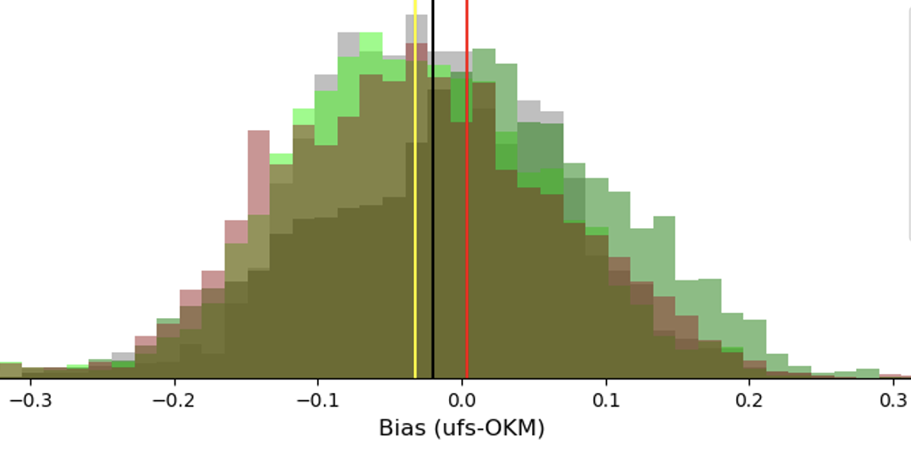
Land-only Simulations
Comparison with Oklahoma Mesonet soil moisture shows test simulation has good agreement in mean bias
5 cm Soil Moisture

