Slide 1


Local and remote land-atmospheric interaction in determining warm season rainfall and its predictability over US Great Plains
Rong Fu¹
Gaoyun Wang^{1,2,3}, Yizhou Zhuang¹
¹Department of Atmospheric and Oceanic Sciences, UCLA
²Department of Atmospheric and Oceanic Sciences, School of Physics, Peking University, Beijing, China.
³The High School Affiliated to Southern University of Science and Technology
Third PAN-GASS Meeting, Understanding and Modeling Atmospheric Processes,
Monterey California, July 25-29, 2022
1

Slide 2
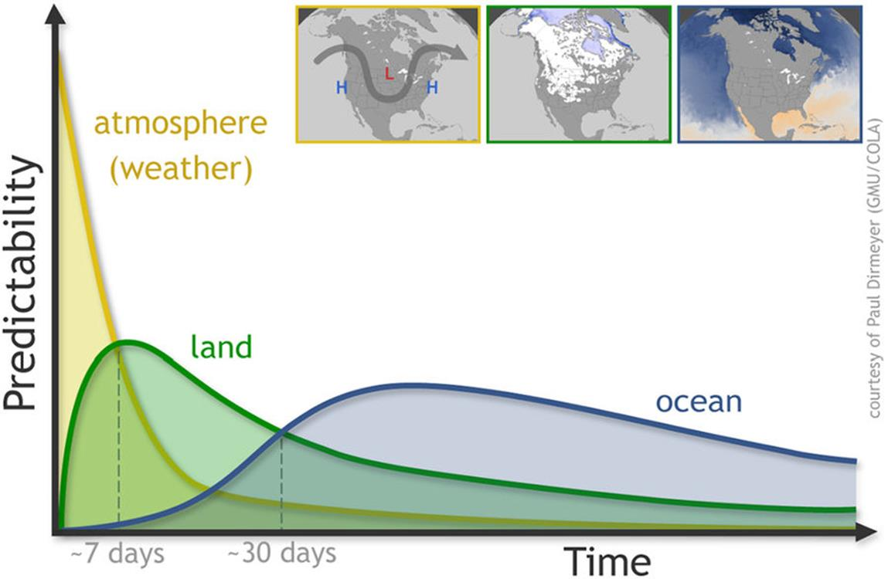
Land-atmospheric interaction is a promising source of S2S precipitation predictability
Sources of predictability
Dirmeyer diagram
2

Slide 3
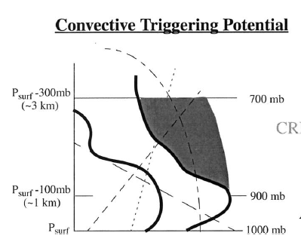
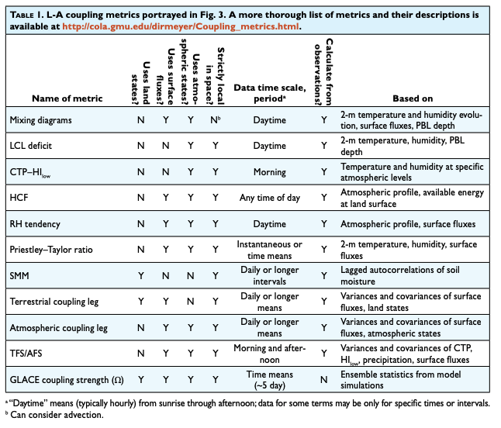

Local Land-Atmospheric Coupling Perspective
- Focus on land surface and PBL
Santanello et al. 2018, BAMS, The LoCo Metrices
CTP
T₈₅₀ - T_{d,850}
T₉₅₀ - T_{d,950}
PBL
Findell & Eltahir 2003: Land-atmospheric coupling indicator
CTP integrated buoyancy from 900-700 hPa
Hi_{low} ≡ (T₉₅₀ - T_{d,950}) + (T₈₅₀ - T_{d,850}) (PBL dryness)
3

Slide 4
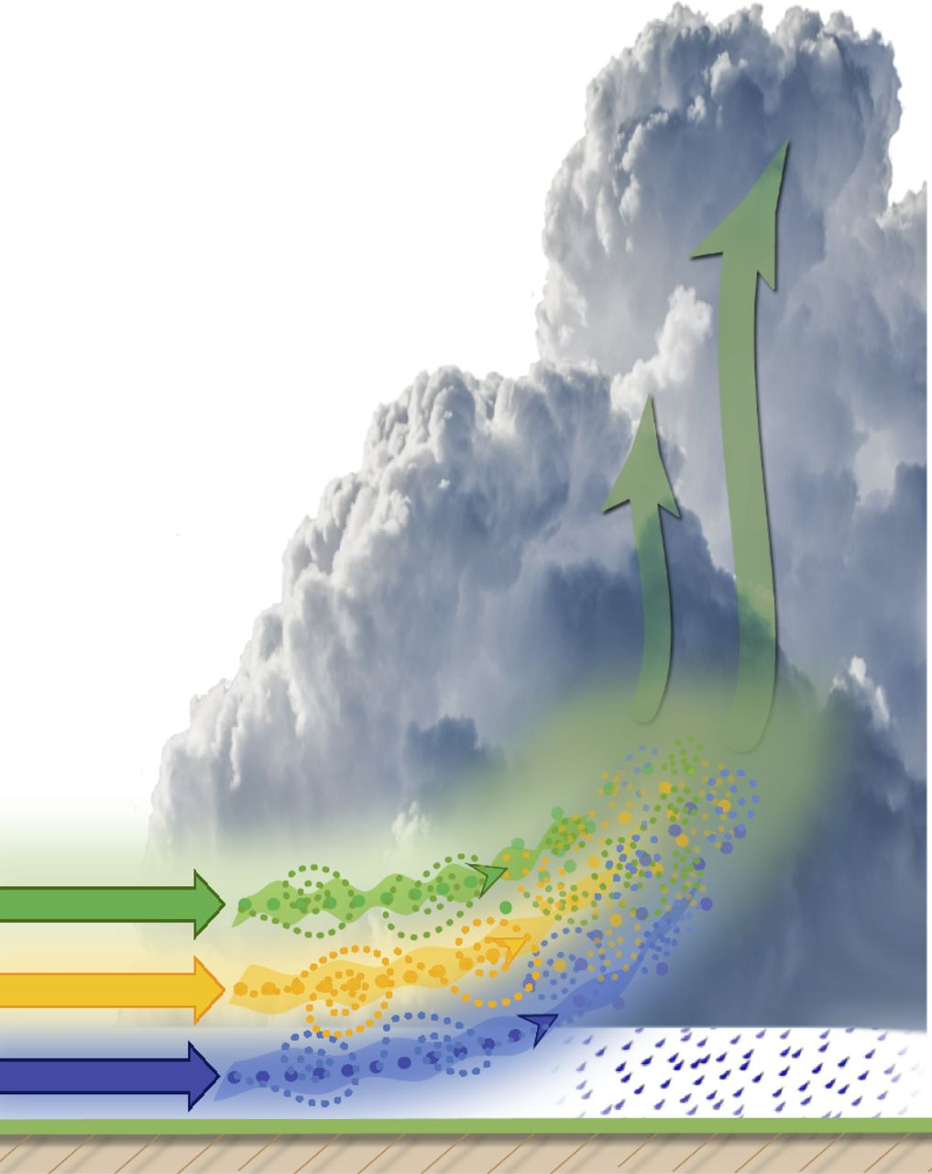

Lower tropospheric (LT) moisture (2-4 km) controls the occurrence and intensity of deep convection and rainfall
Schiro et al. 2018
Lower troposphere humidity
PBL
Cloud base entrainment
Bretherton et al. 2004; Maps et al. 2006; Holloway & Neelin 2009; Schrio et al. 2018
Zhang and Klein 2010
4

Slide 5
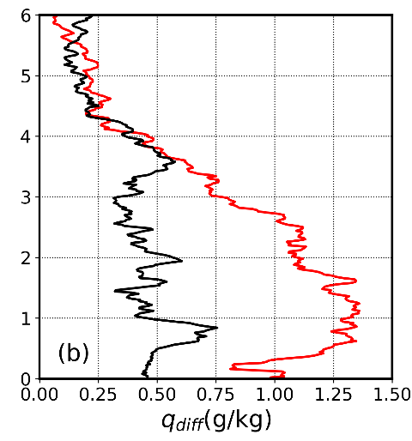
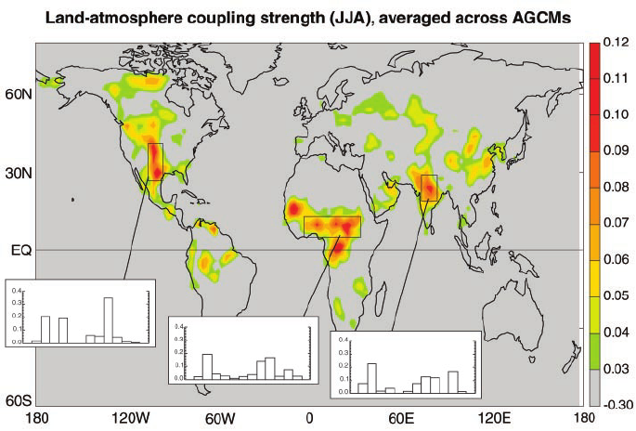
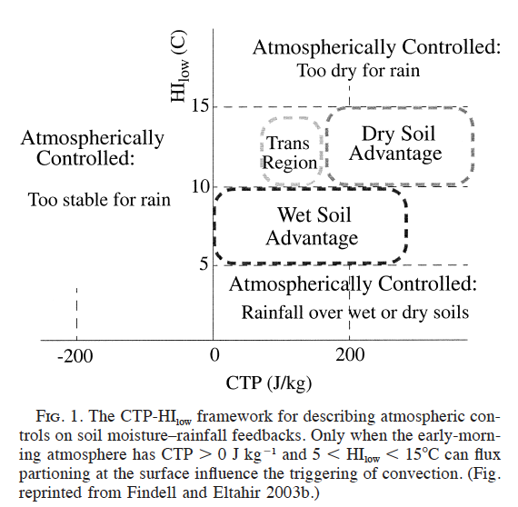
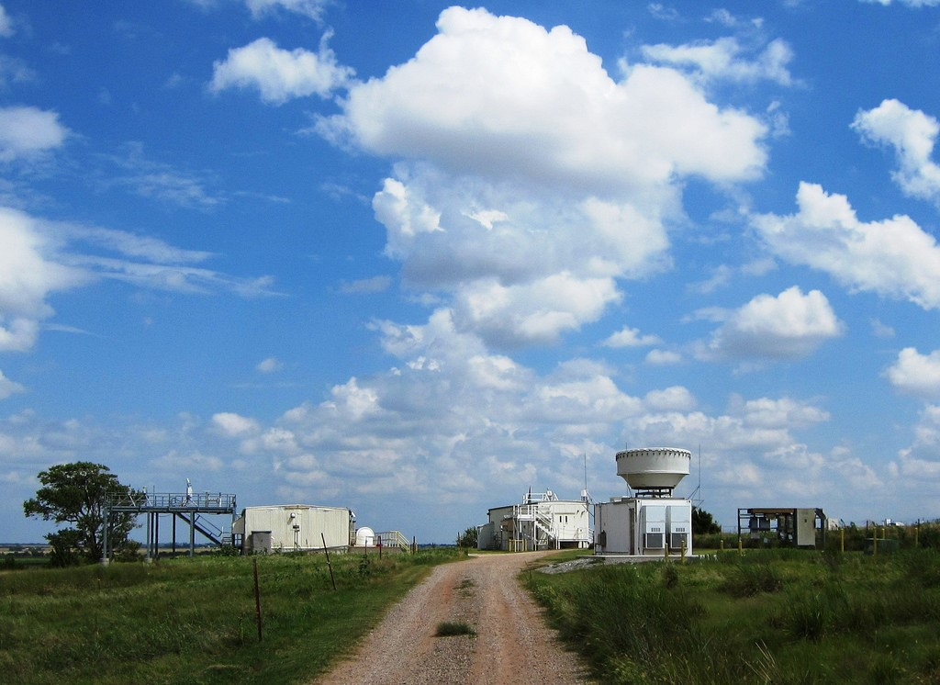
Strong moist anomalies in the LT in later morning is preferred precondition for afternoon rainfall, especially for the dry coupling
Afternoon P – No rainy
Dry coupling: CTP’ > 0
ARM SGP site
Wet coupling: HI_{low}’ < 0
Findell & Eltahir 2003
Wakefiled et al. (2019)
5
Notes:
CTP’ and Hilow’ are standardized anomalies

Slide 6
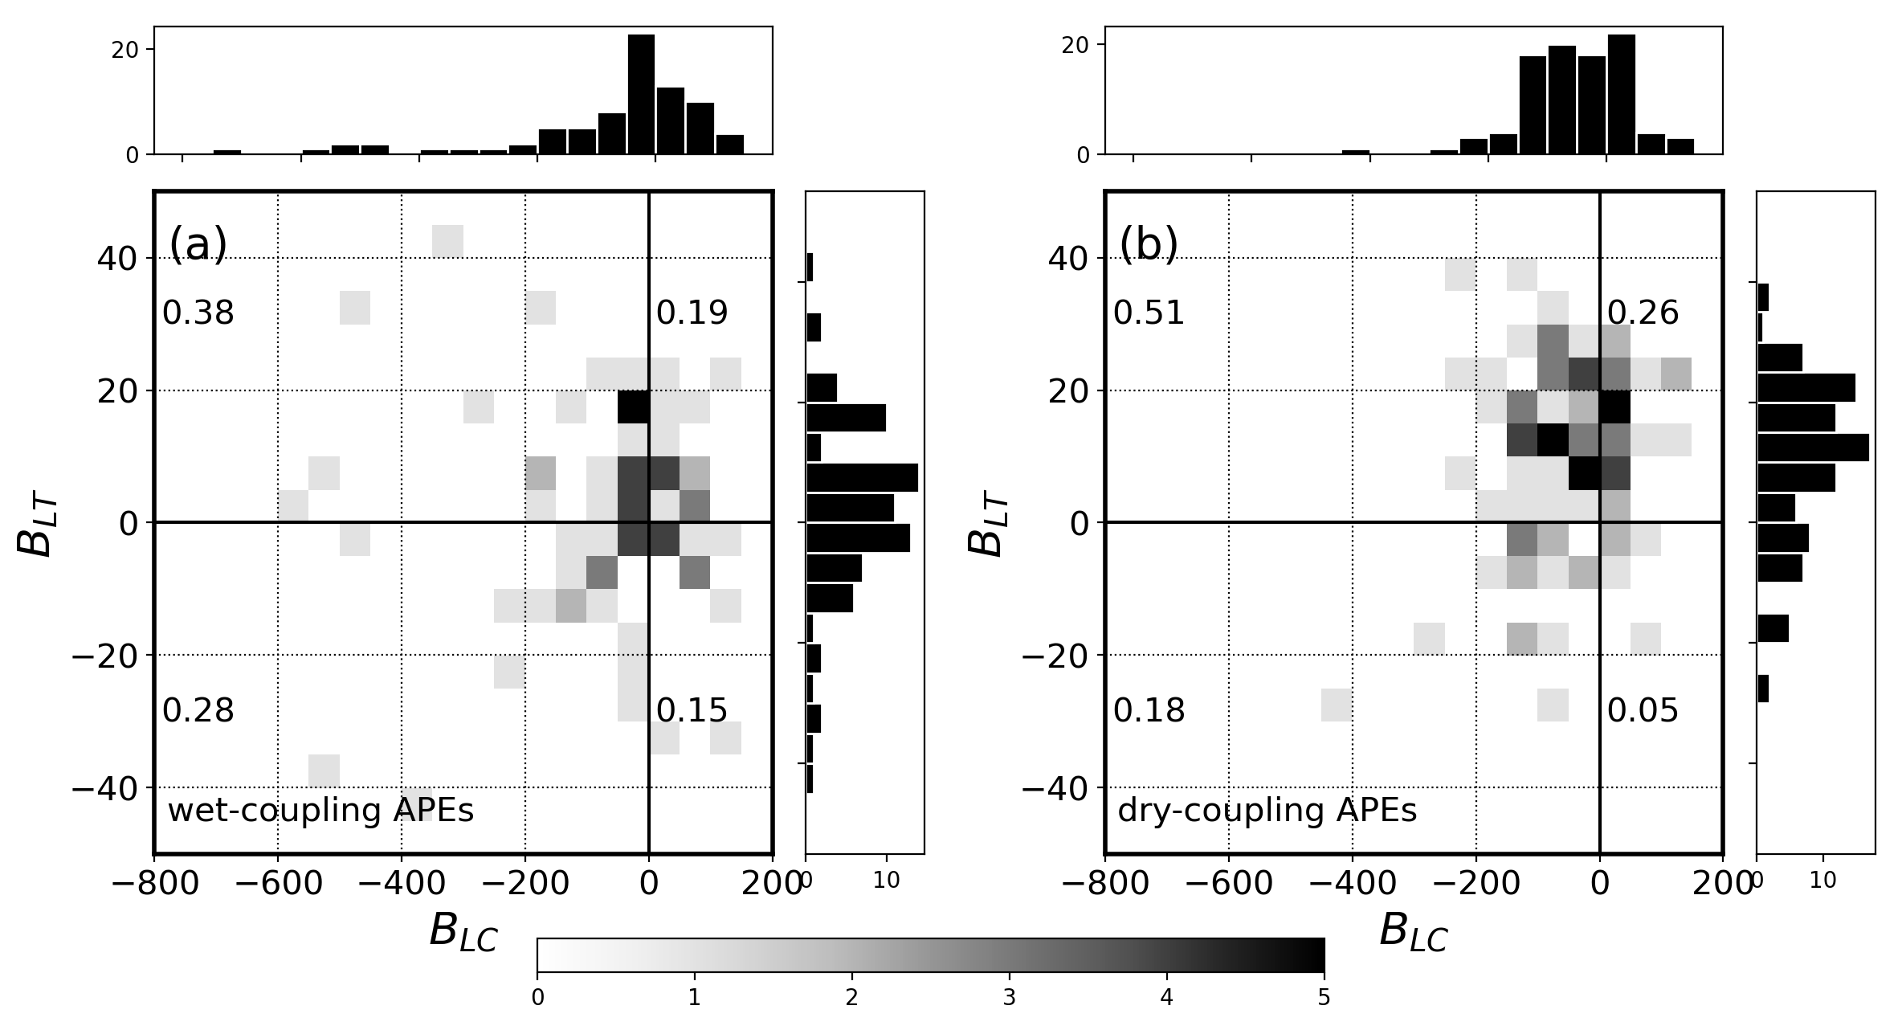
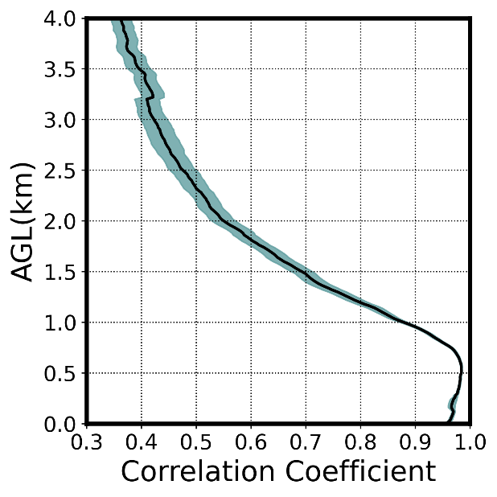
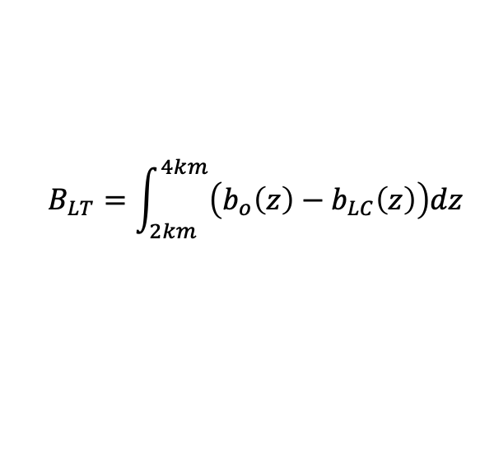
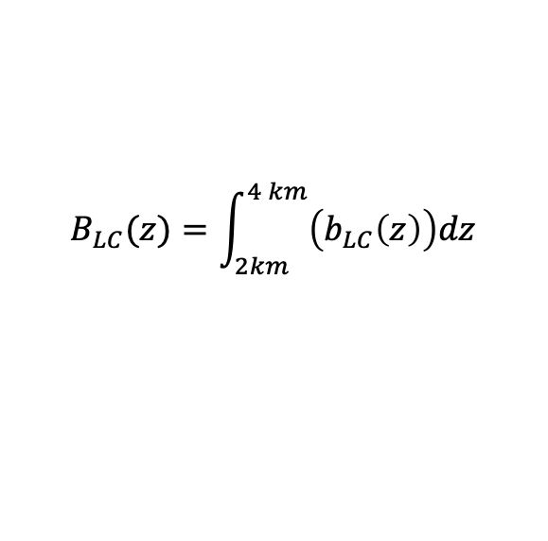
LT humidity is
as important as PBL humidity for wet soil advantage land-atmospheric coupling,
more important than the PBL humidity for dry soil advantage land-atmospheric coupling
Wet soil advantaged coupling
Dry soil advantaged coupling
$$B_{LT}=\int_{2km}^{4km}{\left(b_{o}\left(z\right)−b_{LC}\left(z\right)\right)dz}$$
PBL
PBL
$$B_{LC}(z)=\int_{2km}^{4 km}{\left(b_{LC}\left(z\right)\right)dz}$$
Moist LT (57%).
LT
Moist LT (77%).
LT
q(z) with q(PBL)
Convective buoyancy related to LT humidity
Dry PBL
Dry PBL
Moist PBL (31%)
Moist PBL (34%)
Dry LT
Dry LT
Convective buoyancy related to PBL humidity
Wang et al. 2022, in preparation
6

Slide 7
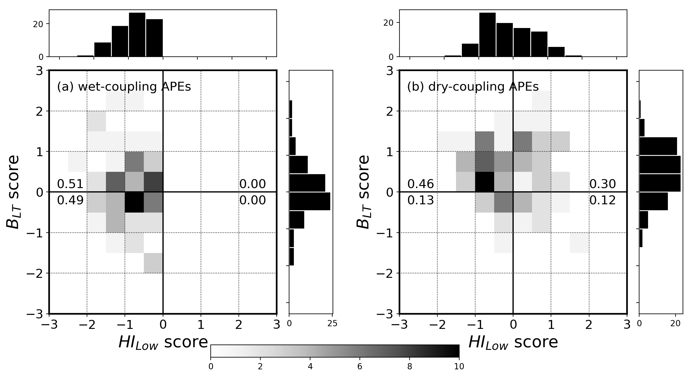
Moist LT enhances land-atmosphere coupling for dry soil advantaged coupling
Hi_{LOW} vs. B_{LT}
PBL
PBL
LT
LT
WET LT: 76%
Wet PBL
Wet LT
Dry PBL
Wet LT
Wet PBL
Wet LT
Dry PBL
Wet LT
Wet PBL
Dry LT
Dry PBL
Dry LT
Wet PBL
Dry LT
Dry PBL
Dry LT
WET PBL: 59%
Wet soil advantaged coupling afternoon rain
Dry soil advantaged coupling afternoon rain
7
Notes:
Replace by wet coupling

Slide 8
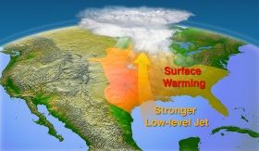
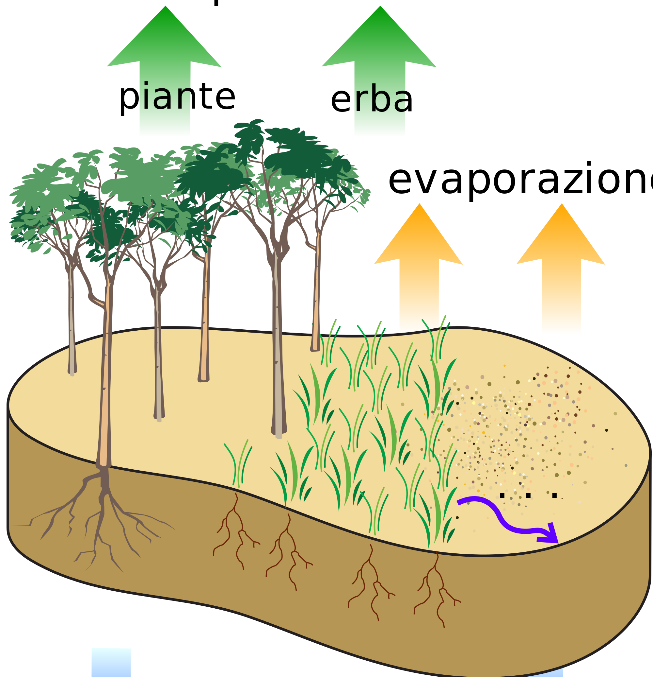
The non-local influence on local land-atmospheric coupling:
4 km
LT
Dry spring
Summer Drought
PBL
Sub-surface
Source: Image by Nathan Johnson, PNNL
10

Slide 9
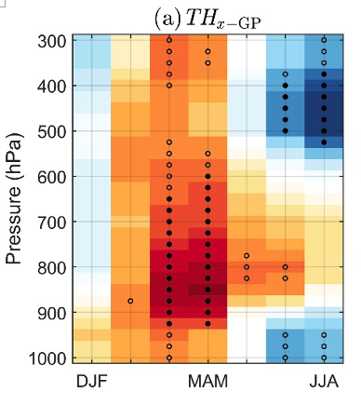
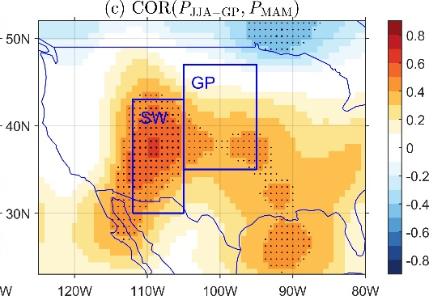
How does LT moisture influence summer droughts predictability over the US Great Plain?
The summer precipitation anomalies over US GP is most influenced by precipitation anomalies over SW US.
Weak spring moisture transport
Summer Drought
Zhuang et al. 2020, JH, DTF3 special issue
8

Slide 10
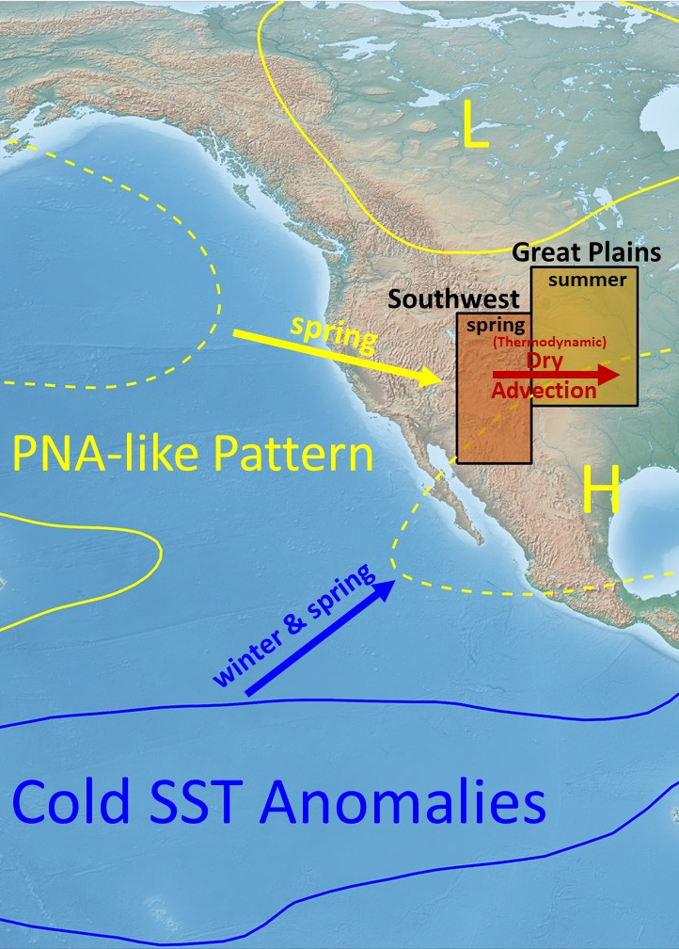
Potential Source of the predictability for warm season drought over the U.S. Great Plains.
Spring La Niña
⇒ ↓ rainfall over SW US
⇒ ↓ LT moisture advection to GP
⇒ ↓ Summer rainfall over GP
Erfanian and Fu 2019, ACP
Zhuang et al. 2020, JH, DTF3 special issue
9

Slide 11
Take Home Message
No local influence, through LT moisture transport and convective entrainment, can influence local land-atmospheric coupling, especially for dry soil advantaged coupling that is important for drought predictability.
4 km
Drier
spring
LT
Summer drought
PBL
Sub-surface
Source: Image by Nathan Johnson, PNNL
10

