Slide 1
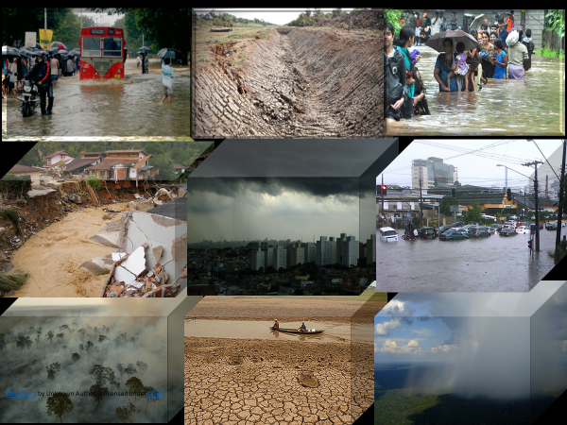
CLIVAR/GEWEX Monsoons Panel
Professor Leila Carvalho
University of California, Santa Barbara
Co-chair of the CLIVAR/GEWEX Monsoons Panel

Slide 2
Short Overview
Monsoon Panel Structure and Goals.
Working Groups Goals and Key Themes.
Recent Activities.
Cross-Panel and Cross-Regional Activities.
Mapping the MP into the WRCP Activities.
Future Plans.

Slide 3
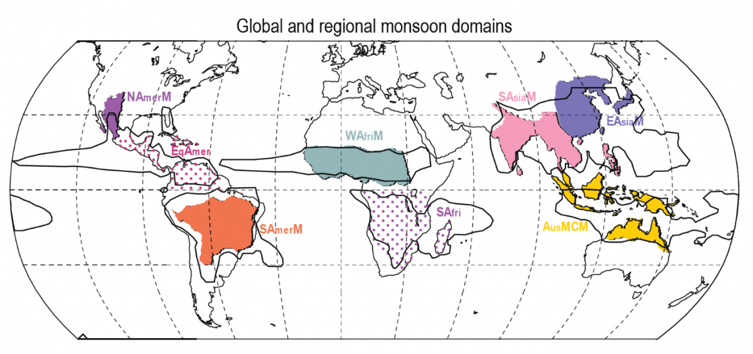
CLIVAR/GEWEX Monsoons Panel
(March 2021- March 2022)
Co-Chairs: Dr Leila Carvalho (USA) & Dr Aurel Moise (Singapore)
Dr Suryachandra A. Rao (India, recently appointed in place of Dr. Moise)
Supported by IMPO: https://impo.tropmet.res.in/
Dr Rupa Kumar Kolli, Honorary Scientist, Dr Susmitha Joseph, Officer-in-charge
American
Monsoons
NAM and SAM
African
monsoons NAF and SAF
Asian/Australian
monsoons
A joint panel spanning both CLIVAR & GEWEX with membership from both communities
3

Slide 4
Panel Objectives
Overarching Goal: advancing understanding of monsoon variability and improving its prediction with observations and modelling as cornerstones of research activities
Specific Goals
Emphasize linkages across scales and physical processes
Seek new methods to enhance monitoring, advance diagnostics and improve models
Develop more elaborated process studies coordinated with modelling activities (e.g. Global Monsoon Model Intercomparison Project (GMMIP) within CMIP6, Long Range Forecasting Monsoon, Working Group on Subseasonal to Interdecadal Prediction (WGSIP) etc.)
Empower the next generation of scientists around the world to advance our knowledge of monsoon systems, in particular in key regions of interest
4
Notes:
4

Slide 5
Panel structure - 2022
Three Regional Working Groups (WGs):
Tasked with identifying priority areas for targeting advances in their regions;
Relatively flexible to organize themselves under the guidance of MP;
Had undergone major membership and science plan changes in 2022 (majority are ECS)
CLIVAR/GEWEX Monsoons Panel
(14 members)
Co-Chairs: Leila Carvalho & Suryachandra Rao
The MP takes a global view
WG Asian-Australian Monsoons
(17 members)
Co-Chairs: Gill Martin (MP) &
Tieh Yong Koh
WG African Monsoons
(19 members)
Co-chairs: Claudine Wenhaji & Akintomide Akinsanola
WG American Monsoons
(14 members)
Co-Chairs: Alice Grimm &
Tereza Cavazos
Working Groups: Dedicated to Region-specific details (e.g, engaging regional stakeholders and managing local knowledge exchange and up-skilling) .
5
Notes:
CONTEXT:
Monsoon systems
Major mode of variability in the tropics, water and energy budgets
Affect the lives of billions of people, in several of the world’s poorest nations
Poor skills in NWP and climate simulations on all time and space (synoptic, intra-seasonal, seasonal, decadal, centenial)
CLIVAR and GEWEX recognize a general need for
A more global view of the monsoons
Sharing knowledge and best practice
Better coordination of monsoon research

Slide 6
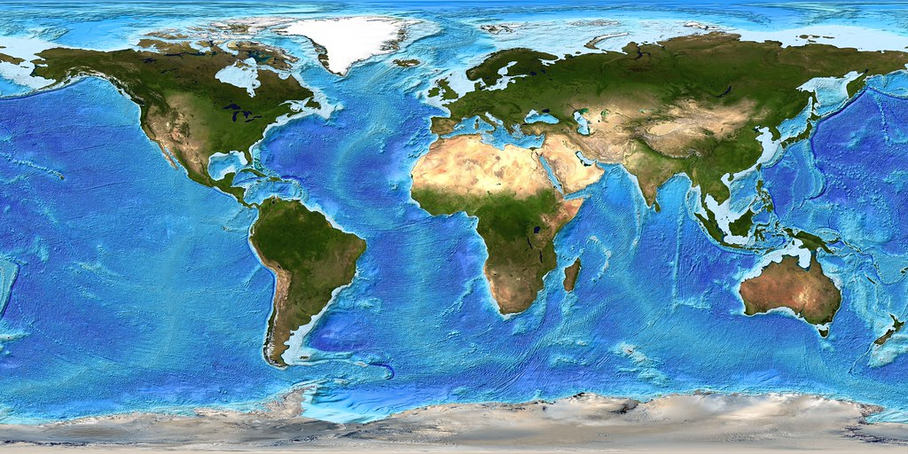
Current MP Membership: Geographic Distribution
Gender distribution: 7 Female / 7 male
Current Membership & Status https://impo.tropmet.res.in/mp-members.html
1 UK
1 Germany
1 USA
2 Italy
1 China
1 UAE
2 India
1 Kenya
1 Singapore
1 Rwanda
1 Brazil
1 Madagascar
This Photo by Unknown Author is licensed under CC BY
Notes:
6

Slide 7
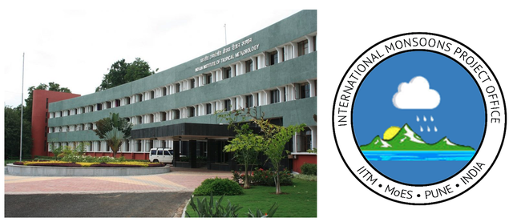
Evolution of ICMPO into IMPO under WCRP/WWRP: (July 2021- onwards)
The scope of the International Climate Monsoon Project Office (ICMPO) has been broadened to cover the monsoon research activities of both the WCRP and World Weather Research Programme (WWRP) through the establishment of a new International Monsoons Project Office (IMPO) that continues to be hosted by the Indian Institute of Tropical Meteorology (IITM), Pune, India, under a new agreement signed between WMO and IITM.

Slide 8
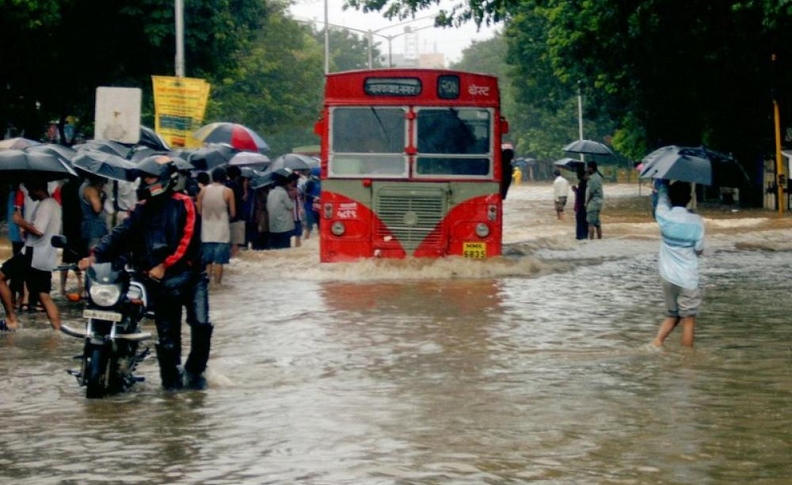
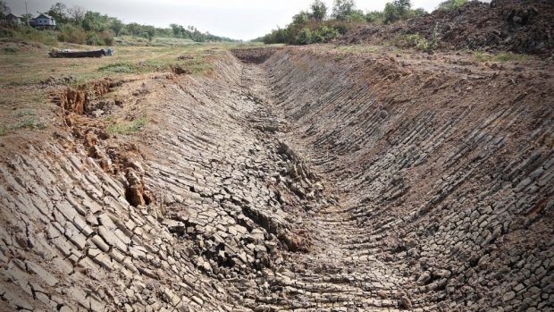
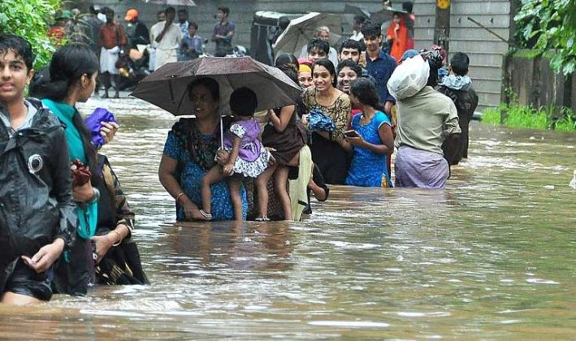
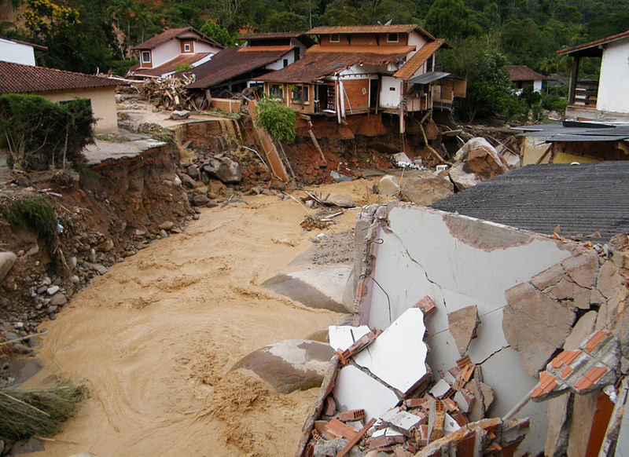
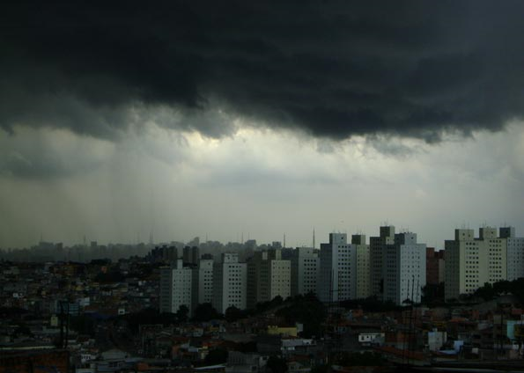
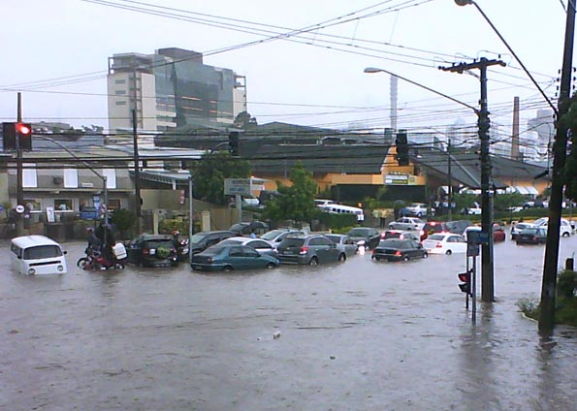
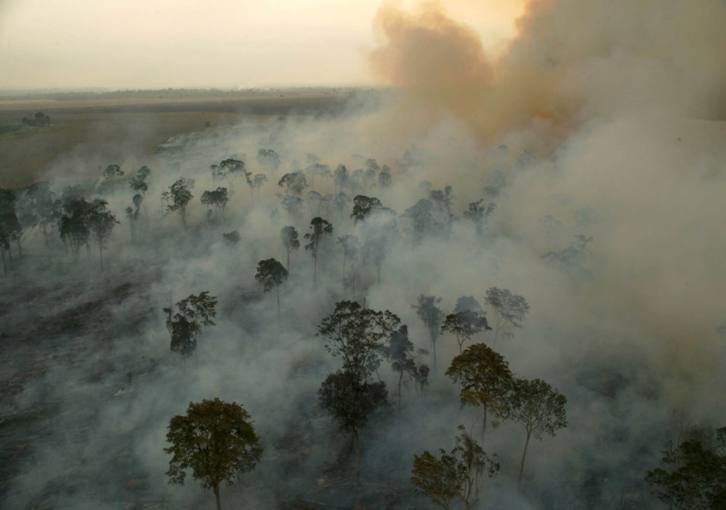
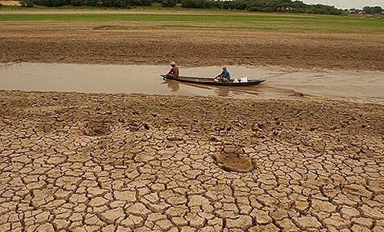
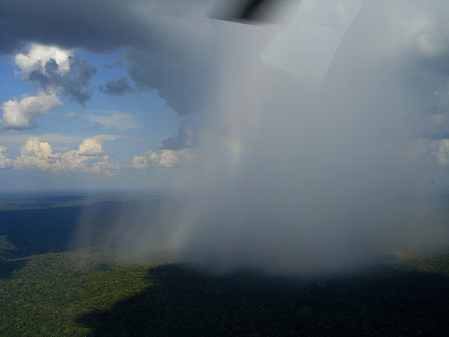
Working Groups Goals
and Key Themes
This Photo by Unknown Author is licensed under CC BY

Slide 9
Common Activities to all Working Groups
Provide authoritative information on processes understanding, models' fidelity in their (regional components) representations, forecast skill assessment, and future projections of changes in monsoons under different radiative forcing scenarios

Slide 10
Asian-Australian Monsoon Working Group (AAMWG)
Promote and facilitate active engagement and interaction among research, operational predictions and stakeholders in the different regional monsoon components of the Asian-Australian Monsoon
Key Themes:
Research-to-operations for monsoon seasons in SE Asia.
How well are high-impact weather events understood and forecast?
Monsoon Teleconnections and Processes in models.

Slide 11
American Monsoons Working Group (AMMWG)
Promote and facilitate collaborative research and training.
Support capacity building for early career scientists.
Key Themes:
Subseasonal-to-seasonal predictability of the American Monsoons.
Mechanisms and teleconnections driving monsoon variability on multiple temporal scales and their representation in models.
Present and future climate changes in the American Monsoons.

Slide 12
African Monsoons Working Group (AFMWG)
Constituted of 3 Sub-groups formed on (1) West Africa, (2) Central Africa and (3) East & South Africa
Promote and facilitate research collaborations.
Conduct innovative African monsoon-related research.
Key Themes:
Emphasis on sub-seasonal to seasonal prediction and climate change.
Monsoons representation in climate models.
Optimization of the use of operational seasonal prediction products, including Regional Climate Outlook Forums (RCOFs) in Africa.

Slide 13
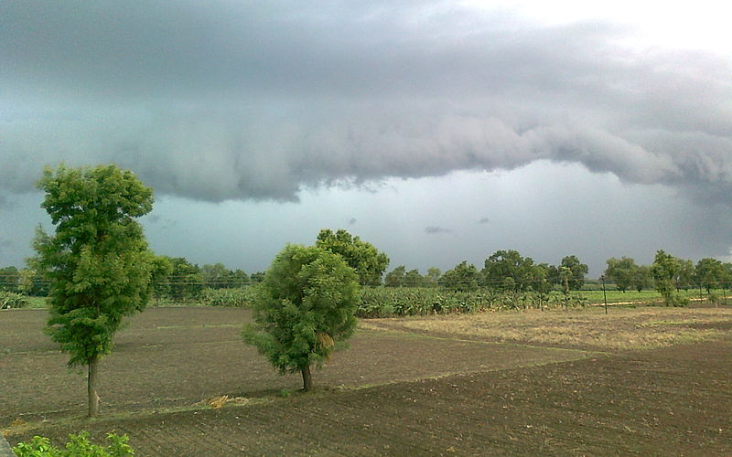
Recent Activities
Monsoons Panel and its Regional WGs
13
Notes:
13

Slide 14
Global Monsoons Panel meetings
Last face-to-face: MP4 at AGU2019 Fall Meeting, December 2019
Monsoon Panel had (almost) monthly meetings via well-attended teleconferences throughout 2021
Updated ToRs and Work Plan; Presentations; Discussion on problems with regional WG’s (African Monsoon ToRs are yet to be finalized)
Regional WG’s have been quite dormant in 2020/2021, which the MP is keen to address in 2022 (progress has been recently made)
14
Notes:
14

Slide 15
Workshops Supported by MP
The Seventh WMO International Workshop on the Monsoons (IWM-7) in collaboration with the World Weather Research Programme (WWRP), held during 23-26 March 2022 (https://mausam.imd.gov.in/IWM7/).
Online Training Workshop on Subseasonal to Seasonal (S2S) Prediction of Monsoons held in conjunction with and preceding the IWM-7 (https://impo.tropmet.res.in/iwm7training.php) held during 1-12 November 2021.
Asian Oceania Geosciences Society Annual meeting: (2021 - virtual), session AS15: The Asian Monsoon in a Warming Environment, Ramesh Kripalani, Kyung-Ja Ha, Renguang Wu, Jai-Ho Oh, and Surya Chandra Rao
Members Participated in more than 15 workshops
15
Notes:
15

Slide 16
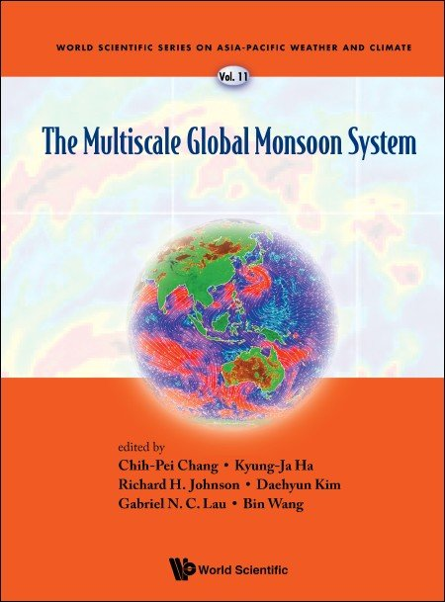
Scientific Results from Activities
H. Annamalai (+ other members of the Asia-Australia WG): Grand challenges in monsoon modelling and systematic biases
L. Carvalho: Extremes in South American Monsoon
A. Grimm : South and North American monsoons
A. Lenouo, S. Janicot, F. Kamga et al. : Central African monsoon
A. Moise : Australian summer monsoon
S. A. Rao: Land-Ocean Contrast in ISMR
A. Turner: GMMIP
7 Chapter Contributions
C-P Chang et al Eds
Around 50 Publications from Members and Other Chapters in Books
16
Notes:
16

Slide 17
Cross-Panel and Cross-Regional Activities
17
Notes:
17

Slide 18
Asian-Australian Monsoons
S2S: Developing capacity of Southeast Asian countries to apply subseasonal-to-seasonal forecasts and forecasting tools.
Regional Climate Outlook Forums (COFs):
Participation in the South Asian Climate Outlook Forum (SASCOF) sessions
Participation in the ASEAN Climate Outlook Forum (ASEANCOF-15).
Discuss the ASEANCOF Working Group,
Provide update on the forming of the Southeast Asian Regional Climate Center (RCC) Network
Participate in the WMO-led discussion on finalizing the roadmap towards objective RCOF outlooks
18
Notes:
18

Slide 19
Global Monsoons Model Intercomparison Project (GMMIP), contribution to CMIP6 and IPCC AR6
GMMIP initiated through the Monsoon Panel Co-Chairs T. Zhou, J. Kinter III, A. Turner
21 modelling groups signed up
Tier 1 Extended AMIP
Tier 2 Ocean pacemaker (AMO, IOP)
Tier 3 orographic forcing
Analysis of simulations is ongoing; some papers already published
ESG has data from GMMIP
Andy Turner is Lead Author (LA) IPCC 6th Assessment Report WGI The Physical Science Basis, Chapter 10: Linking global to regional climate change. Contributing Author (CA) of Technical Summary.
19
Notes:
19

Slide 20
Interaction with SPARC and GEWEX
SPARC
Possible collaboration still being developed;
Monsoon teleconnection dynamics;
Collaboration on monsoon-related SPARC activities (e.g., Atmospheric Composition and the Asian Monsoon);
Monsoon-related summer schools/Training workshops
Monsoons Panel featured in the latest SPARC Newsletter
GEWEX
In discussion with Global Atmospheric System Studies (GASS) Co-Chairs on cross-panel activities
The diurnal cycle white paper/project provides a good way forward for further collaborations
20
Notes:
20

Slide 21
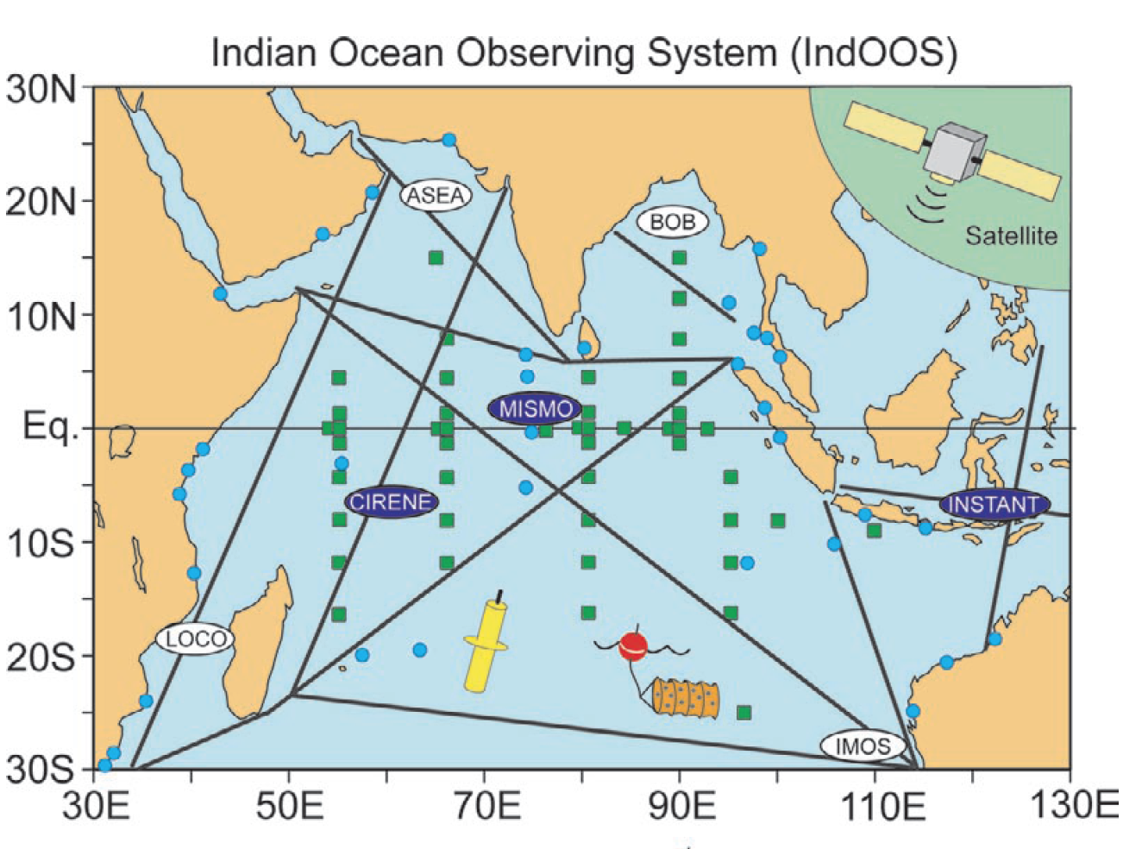
Links with ocean activities
CLIVAR/IOC-GOOS Indian Ocean Region Panel (IORP)
Annamalai contributed to the IORP activities (cross CLIVAR activities)
As a contribution to cross-panel activities, he developed research on Indian Ocean observing systems (IndOOS-2) (two publications).
Discussions are held with co-chair (Roxy) on a cross panel activity on ocean observations relevant to monsoon prediction.
21
Notes:
21

Slide 22
Mapping MP onto the new WCRP structure: LHA Examples
Explaining and predicting earth system change
My Climate Risk
Digital Earths
Support Work in cooperation with regional, national and multinational programs
improve regional weather forecasting, prediction of extreme events and their impacts.
In association with IORP, MP is coming up with a report on impact of observations from moored buoys on prediction of South Asian Monsoon
Process-based diagnostics.
identify sources of model errors in simulating monsoon precipitation
Enhance capacities of researchers and students in monsoon-related topics, by organizing or supporting training workshops and advanced schools, scientific congresses, sessions on monsoon themes, etc.
WCRP Academy

Slide 23
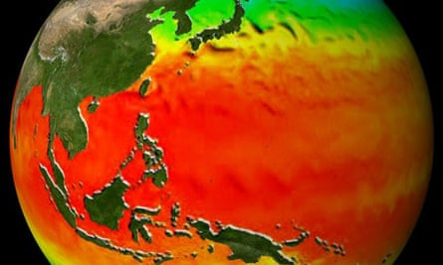
Future Plans
23
This Photo by Unknown Author is licensed under CC BY-SA
This Photo by Unknown Author is licensed under CC BY-SA
This Photo by Unknown Author is licensed under CC BY
Notes:
23

Slide 24
Pan-WG workshop would be logically a part of the MP's work plan, so you may add it there.
an-working group workshop (both in-person and online)
SYMPOSIUMS, CONFERENCES AND TRAINING WORKSHOPS
MP: Pan-Working Group Workshop (both in-person and online)
1) AAMWG (Asian-Australian Monsoons Working group):
proposed a biennial symposium series, "Asian-Australian Monsoon: Linking Research to Operational Needs"
The inaugural symposium : AS40 session of the same title at the Asia Oceania Geosciences Society (AOGS) Annual Meeting 2022
2)AMMWG (American Monsoon Working Group)
Organization of a special session on regional monsoons at the WCRP Open Science Conference on “Bridging Climate and Society” (Dr. Tereza Cavazos AMMWG co-chair and WCRP – scientific organization)
Second open training workshop on the South American Monsoon ;
3) AFMWG (African Monsoon Working Group):
Workshop/Seminar for African students; Hosting sessions at AGU/AMS/EGU
Organize monsoon meetings and training workshops for students;
FUNDING IS NECESSARY TO ORGANIZE IN PERSON WORKSHOPS
Notes:
24

Slide 25
Continued and future Panel Activities
Continued interaction with the IPCC AR6 and CMIP6 process, especially GMMIP through Andy Turner and other MP members.
Promote continued S2S diagnosis: we will seek to engage further with regional activities (S2S-SEA) and the university sector in analysing the available large data
Finalize plans for engagement with SPARC
Finalize plans for further engagement with GEWEX GLASS & GASS (in particular regarding land-surface interactions and projects such as ALMIP, coordinated by A. Boone)
Explore possibilities of closely working with WGSIP-LRFM project.
Write review articles (e.g – Special issue of a Journal on African Monsoons; (Needs financial support)
25
Notes:
25

Slide 26
Cross-Group and Cross-Panel Activities
Better cross-group collaborations;
Cross-panel activities: coordinate with other panels (e.g., Indian Ocean, WGSIP-LRFM etc.) for emerging research for societal needs.
Support a monitoring strategy designed by the Ocean Panels for the tropical and subtropical oceans necessary for investigating the structure and variability of the regional monsoons
26
Notes:
26

Slide 27
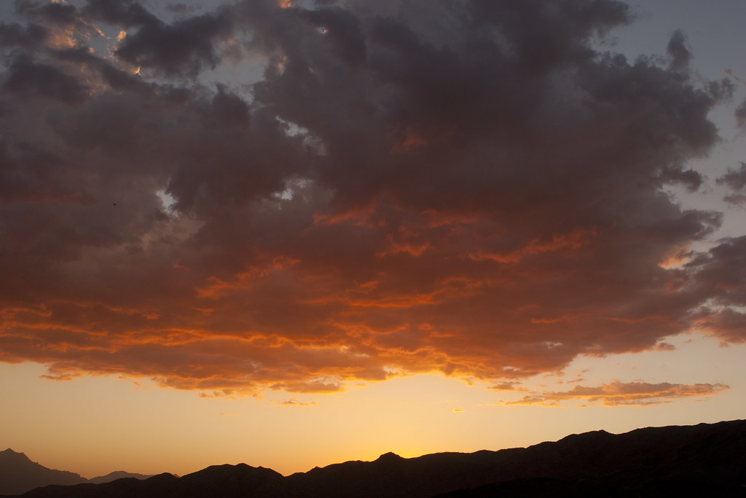
Thank you for your attention
27
Notes:
27

Slide 28
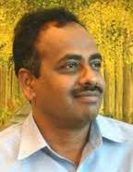
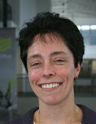
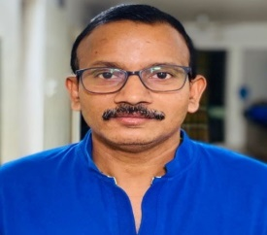
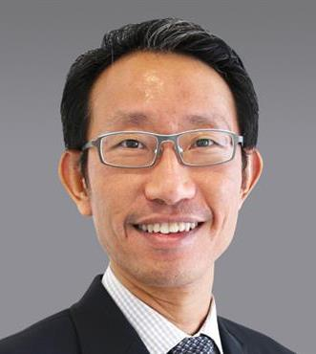
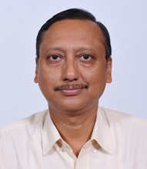
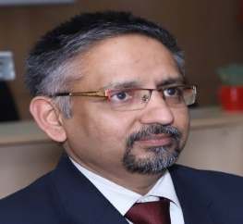
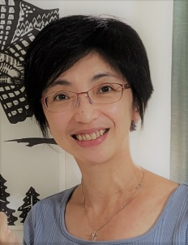
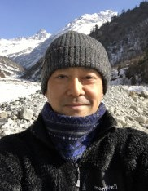
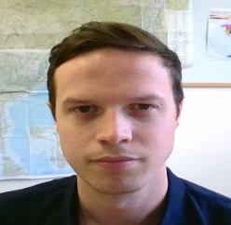
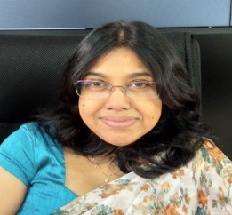
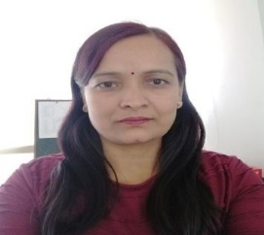
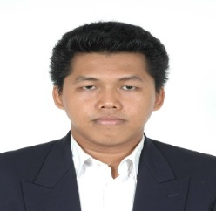
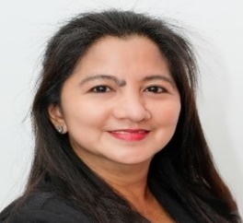
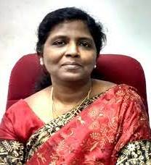
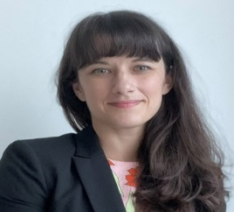
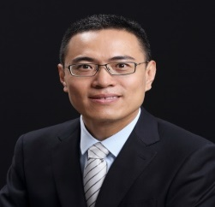
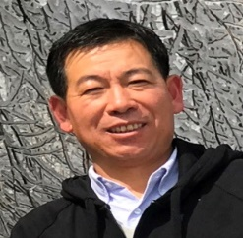
REGIONAL WORKING GROUP ON ASIAN-AUSTRALIAN MONSOONS: MEMBERS
H Annamalai
Gill Martin
A Suryachandra Rao
Tieh Yong Koh
P Mukhopadhyay
R Ashrit
Wei-Ting Chen
Hatsuki Fujinami
Kieran Hunt
S. Jayawardena
Indira Kadel
Donaldi Permana
Ana Liza Solis
Usha Tune
Thea Turkington
Lin Wang
Huqiang Zhang

Slide 29
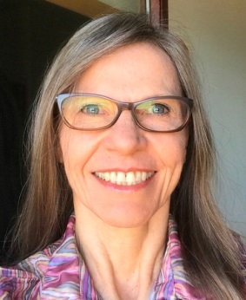
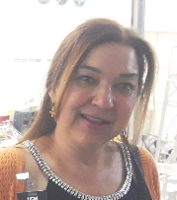
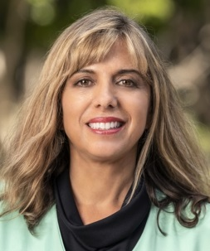
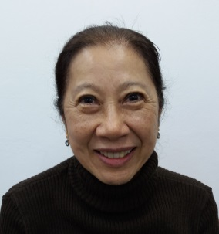
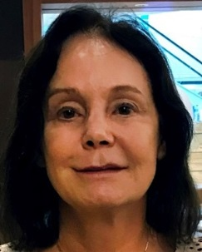
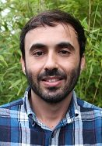
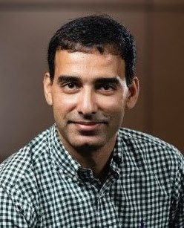
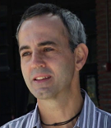
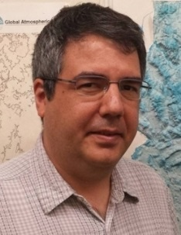
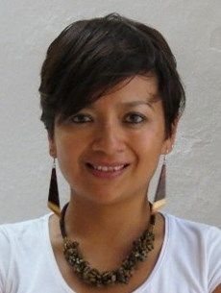
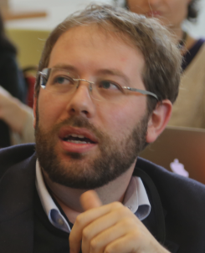
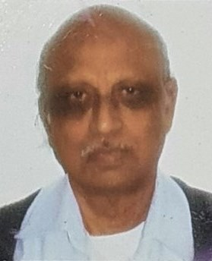
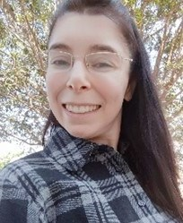
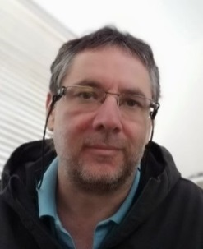
REGIONAL WORKING GROUP ON AMERICAN MONSOONS: MEMBERS
Alice Grimm
Tereza Cavazos
Leila Carvalho
Mary Kayano
I Cavalcanti
F. de Andrade
M Ashfaq
M Barreiro
C Castro
R Cerezo-Mota
S Pascale
V B Rao
M Reboita
C T Thompson

Slide 30
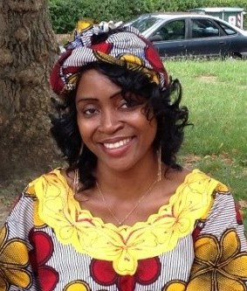
REGIONAL WORKING GROUP ON AFRICAN MONSOONS: MEMBERS
Claudine Wenhaji Ndomeni
Akintomide Akinsanola
R Barimalala
Mary Kilavi
B Lamptey
M Adeniyi
Ismaila Diallo
Ross Dixon
Aissatou Faye
M Gudoshava
P-A Monerie
S Nangombe
V Ongoma
Izidine Pinto
W P Mba
K Silvério
A T Tchio
A V Derbetini
C Wainwright

Slide 31
Activities in a nutshell
Formed 3 regional Working Groups with focused research plans and objectives.
Contributed for organization of 2 workshops (IWM-7 and S2S training workshop) and few sessions in leading conferences.
Published 7 Chapters (mostly review articles) in the book titled ”Multi Scale Global Monsoons System”
Members (MP/WGs) contributed to over 50 research articles in the last year
Cross-Panel activities initiated: IPCC AR6 and CMIP6 especially on GMMIP, IORP, SPARC, GEWEX and S2S

