Slide 1
Flood risk prediction under climate change from global to local scales
Huan Wu, Zhijun Huang, Weitian Chen, Lulu Jiang, Ying Hu, Chaoqun Li
Hydrometeorological Extremes simulatioN Group (HENG),
School of Atmospheric Sciences, Sun Yat-sen University (SYSU)
Notes:
Global to Local Flood Monitoring and Forecasting

Slide 2
目录
01
Observed and simulated flood changes
CONTENTS
Global to local Hydrometeorological Solution for floods: short-term climate scale flood risk forecasting
02

Slide 3
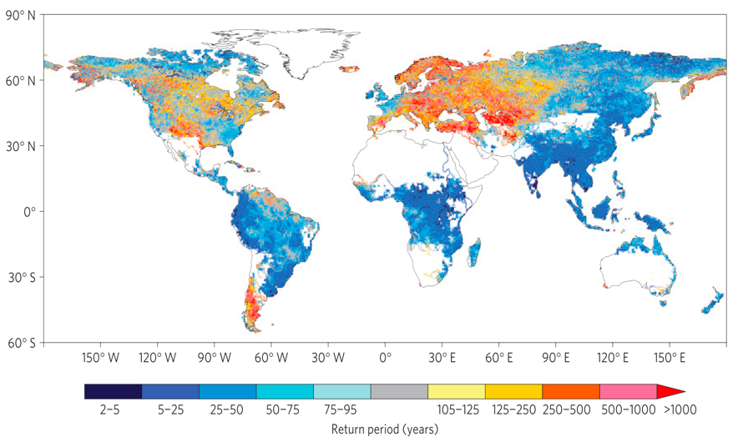
Projection of future flood change
100-yr return flood is projected to happen more frequently in most of the world in 21C than 20C under RCP8.5 scenario with CMIP5 models.
Model projection
Hirabayashi, 2013, Nature Climate Change
Notes:
Projection of future flood change is one of the most active topics among the hydrometeorology communities, for example, 100-yr return flood is projected to happen more frequently in most of the world.
However, such projections are widely accepted to have very large uncertainties due to the uncertainties in the climate forcings and hydrological models.

Slide 4
Observed impacts of climate change on flood
Change in the Magnitude of River Flooding in the United States, 1965–2015
Change in the Frequency of River Flooding in the United States, 1965–2015
Yet, existing models are ill-suited to provide reliable long-term projections of climate change at the local level.
Slater and Villarini, USGS, 2016
【4】
Notes:
So we have to understand the historic changes in flooding based on observations as the first step to assess the flood change in future.
The U.S. Geological Survey maintains thousands of stream gauges across the United States. Based on the long-term, well quality-controlled streamflow observation data at natural river basin (with little impacts of dam/reservoir, and land use),
the changes of flood magnitude and frequency in the recent 50 years (between 1965-2015) shows very strong spatial variability. The sign of changes can be different in the same local catchment.
Yet, existing models are ill-suited to provide reliable long-term projections of climate change at the local level.
----------------
Floods have generally become larger in rivers and streams across large parts of the Northeast and Midwest. Flood magnitude has generally decreased in the West, southern Appalachia, and northern Michigan (see Figure 1).
Large floods have become more frequent across the Northeast, Pacific Northwest, and northern Great Plains. Flood frequency has decreased in some other parts of the country, especially the Southwest and the Rockies (see Figure 2).
Increases and decreases in frequency and magnitude of river flood events generally coincide with increases and decreases in the frequency of heavy rainfall events
The U.S. Geological Survey maintains thousands of stream gauges across the United States. Each gauge measures water level and discharge—the amount of water flowing past the gauge. This indicator uses total daily discharge data from about 500 long-term stream gauge stations where trends are not substantially influenced by dams, reservoir management, wastewater treatment facilities, or land-use change.
One way to determine whether the magnitude of flooding has changed is by studying the largest flood event from each year. This indicator examines the maximum discharge from every year at every station to identify whether peak flows have generally increased or decreased. This indicator also analyzes whether large flood events have become more or less frequent over time, based on daily discharge records.
This indicator starts in 1965 because flood data have been available for a large number of sites to support a national-level analysis since then.

Slide 5
Observed and naturalized flood history at sub-catchment scale
Actual Flood
A detailed documentation of significant flood events for each Strahler-order sub-catchment over the CONUS domain during the period of 1998-2013
Huang & Wu revealed there were 40% (1906) of total 4,661 major flood events (above 20-year return) were muted by flood defense infrastructures and management;
Natural Flood
Peak months of flood frequency at sub-catchment scale
Huang & Wu, BAMS, 2021
Notes:
According to our recent study, revealed there were 40% (1906) of total 4,661 major flood events (above 20-year return) were muted by flood defense infrastructures and management,
Which introduces more challenges in predicting future flood changes without considering human activities, such as dam/reservoir operations

Slide 6
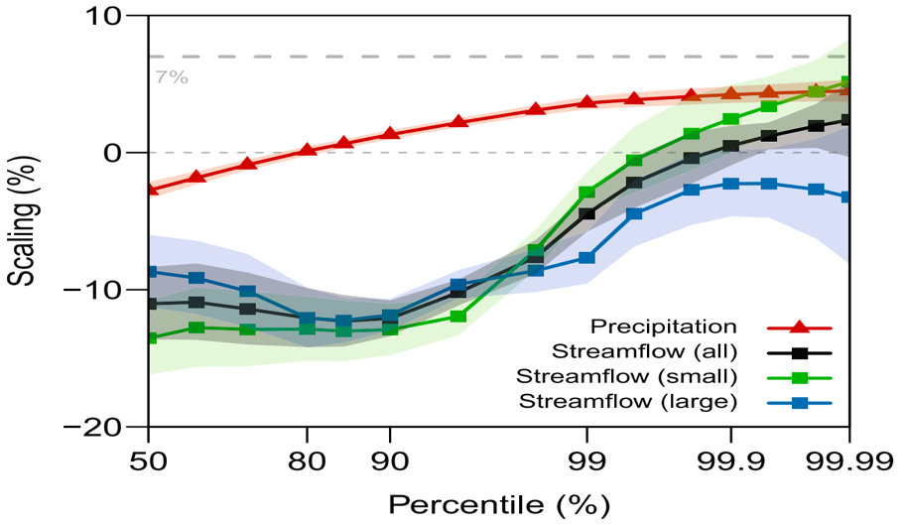
Observed impacts of climate change on different type of floods
Historic observations show that large riverine floods tend be weaken while small river floods tend to be stronger as responding to increasing precipitation.
Observations of Australia river basins
Precipitation
Flash flood
Large riverine flood
Sharma & Lettenmaier, 2018, WRR
【6】
Notes:
Further more, long term observations of Australia river basins show that large riverine floods tend to be weaken while small river floods tend to be stronger as responding to increasing precipitation.
The different type floods response to precipitation increase in different ways which requires the hydrological model has to better deal with multiple scale flood processes.

Slide 7
Observed impacts of climate change on flood
The percentage of the CONUS that experienced much greater than normal precipitation
The percentage of the CONUS where a much greater than normal portion of total annual precipitation has come from extreme single-day precipitation events
NOAA, 2021
Increases and decreases in frequency and magnitude of river flood events generally coincide with increases and decreases in the frequency of heavy rainfall events
【7】
Notes:
However, overall Increases and decreases in frequency and magnitude of river flood events generally coincide with increases and decreases in the frequency of heavy rainfall events
Figure 1 shows the percentage of the land area of the contiguous 48 states that experienced much greater than normal precipitation in any given year, which means it scored 2.0 or above on the annual Standardized Precipitation Index. The thicker line shows a nine-year weighted average that smooths out some of the year-to-year fluctuations.
Figure 2 shows the percentage of the land area of the contiguous 48 states where a much greater than normal portion of total annual precipitation has come from extreme single-day precipitation events. The bars represent individual years, while the line is a nine-year weighted average.
Key Points
In recent years, a larger percentage of precipitation has come in the form of intense single-day events. Nine of the top 10 years for extreme one-day precipitation events have occurred since 1996 (see Figure on the right).
The prevalence of extreme single-day precipitation events remained fairly steady between 1910 and the 1980s, but has risen substantially since then. Over the entire period from 1910 to 2020, the portion of the country experiencing extreme single-day precipitation events increased at a rate of about half a percentage point per decade (see Figure 1).
The percentage of land area experiencing much greater than normal yearly precipitation totals increased between 1895 and 2020. There has been much year-to-year variability, however. In some years there were no abnormally wet areas, while a few others had abnormally high precipitation totals over 10 percent or more of the contiguous 48 states’ land area (see Figure on the left). For example, 1941 was extremely wet in the West, while 1982 was very wet nationwide.³
Figures 1 and 2 are both consistent with other studies that have found an increase in heavy precipitation over timeframes ranging from single days to seasons to years.⁴ For more information on trends in overall precipitation levels, see the U.S. and Global Precipitation indicator.

Slide 8
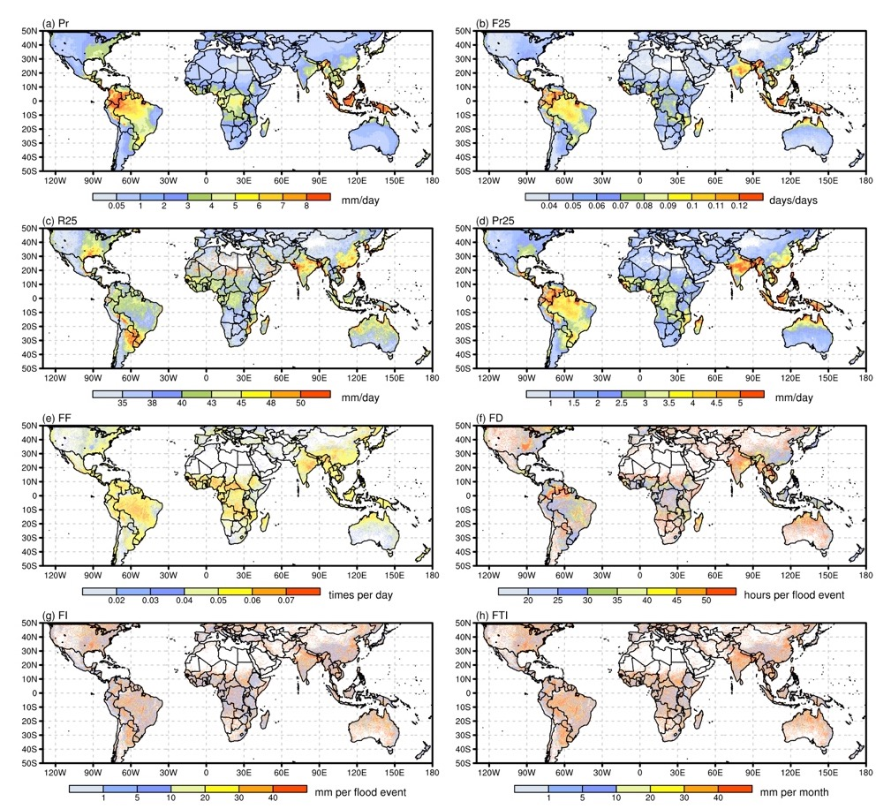
Precipitation-flooding characteristics
Total precipitation amount
Frequency
Precipitation
Intensity
Precipitation amount >25mm
Frequency
Duration
Flood
Intensity per event
Intensity per month
Notes:
Precipitation is the major key to understand flooding and its change as flood is highly linked to precipitation characters.
We break precipitation into a few major features.
《1》Spatial distributions of the four flood indices during the TRMM period are shown in Fig. 1e-h. Flood frequency (FF) has roughly similar spatial distribution as for Pr, F25, and Pr25. High FF values appear approximately in the same locations as regional precipitation maxima, such as in the Maritime Continent, southeastern coast of Asia, southeastern USA, tropical Africa, etc.
《2》FF tends to be more relevant to F25 and Pr25 than to Pr, for instance, along the northern coast of Australia, northeast India. However, the correspondence between FF and R25 tends to be weak, suggesting that flood frequency might be closely related to monthly mean precipitation and extreme precipitation frequency in many regions.
《3》The other three flood indices (FD, FI, and FTI) in general have similar spatial distributions as FF. Nevertheless, their spatial features have many detailed discrepancies from that for FF. In particular, these three indices show much more fragmented spatial features generally lacking focused regional maxima. It is also noted that these three flood indices may be not only associated with Pr, F25, Pr25, and FF, but also related to (extreme) precipitation intensity (R25). For instance, in the southeastern South America, there is no regional peak in FF, Pr, F25, and Pr25, however, high values in FD, FI, and FTI appear there seemingly manifesting the regional peak in R25.
《4》In summary, this Fig indicates that mean precipitation (and extreme precipitation) and floods generally have similar spatial distributions, which confirms that more precipitation often corresponds to higher probability of the occurrence of floods. However, differences exist between precipitation and floods regarding their spatial features. For example, regional peaks for Pr, F25, and Pr25 appear in the north parts of South America, but high values for FF, FI, and FTI are generally seen south of them.

Slide 9
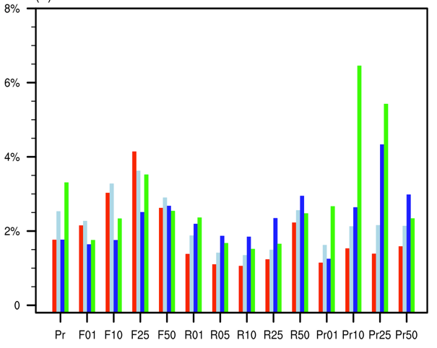
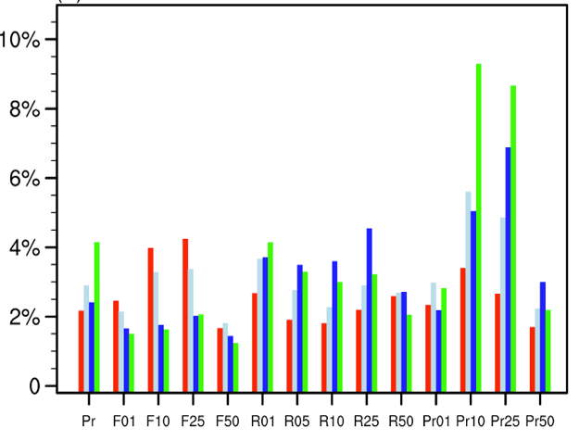
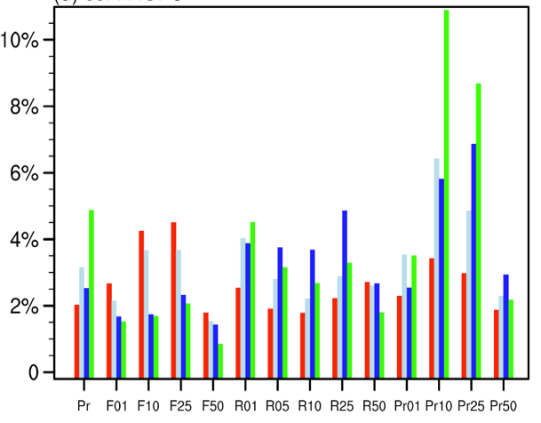
Global statistics of precipitation-flood characteristics
The ratios of grids with the largest correlations and the total grids
Observed precipitation
(2000-2020)
CMIP5 GCMs precipitation
(1986-2005)
CMIP5 GCMs precipitation
(2026-2045, RCP8.5)
The dominant role of the frequency of extreme precipitation events in the occurrence and duration of of floods.
Flood intensity (FI and FTI) tends to be more associated with total precipitation volume especially for those extreme precipitation events.
Yan &Wu et al., Journal of Climate, 2020; GRL 2021
Notes:
To provide a more quantitative estimation of the relations between floods and precipitation indices, the total number of grids with the largest correlation coefficient with the various individual precipitation indices for each flood index are counted and then divided by the total number of grids over global lands between 50ºN-50ºS. The resulting ratios (percentages) can then be applied to illuminate the preferences of precipitation factors for each flood index globally (Fig. 6).
《1》不同的洪水特征收到各种降水特征的不同影响。但是：
《2》For FF, F25 is the precipitation index that has the largest number of grids with the highest correlation during both seasons, clearly showing the dominant role of the frequency of extreme precipitation events in the occurrence of floods. The precipitation indices with the second and third largest number of grids with the highest correlation are F10 and F50, further confirming the importance of precipitation frequency in the occurrence of floods.
《3》As FF, FD also has a similar relation with precipitation frequency. For FI and FTI, the precipitation indices that produce the largest number of grids of the highest correlation are Pr25 during both seasons and Pr25 (Pr10) during DJF (JJA), respectively, suggesting that over most regions, in contrast to FF and FD, flood intensity (FI and FTI) tends to be more associated with total precipitation volume/magnitude especially for those extreme precipitation events.
《4》A further examination of Fig. 6 indicates that monthly mean precipitation (Pr) and precipitation frequency in particular F25 could impact flood intensity (FI and FTI) as well. It is further noted that precipitation intensity except the very high end one (R50) has a relatively weak impact on floods globally.

Slide 10
目录
01
Observed and simulated flood changes
CONTENTS
Global to local Hydrometeorological Solution for floods: short-term climate scale flood risk forecasting
02

Slide 11
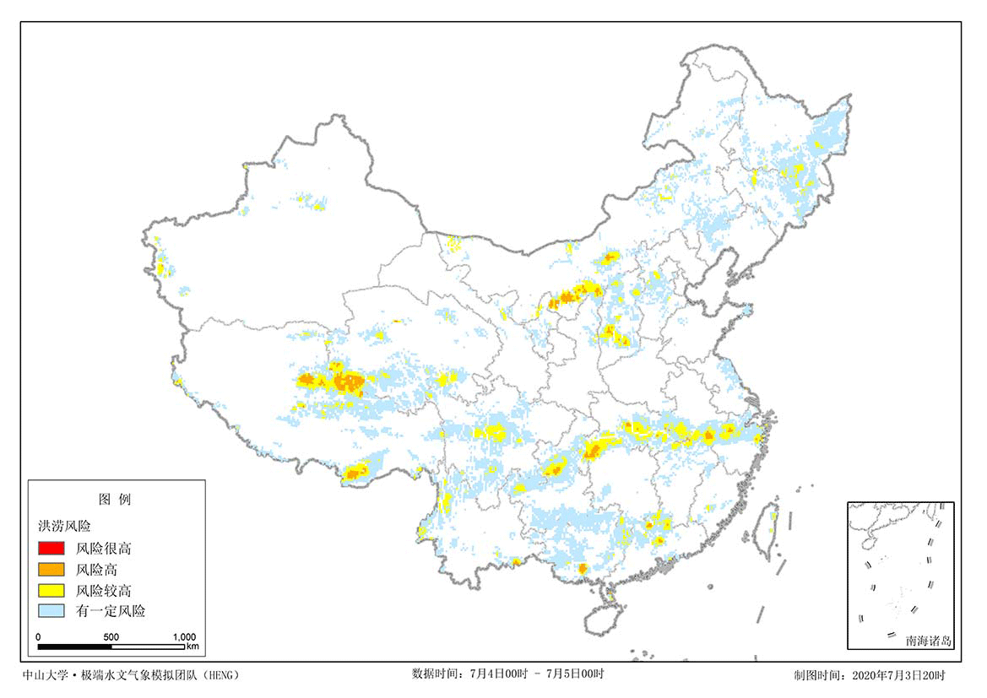
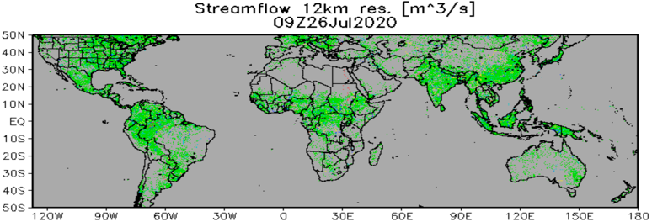
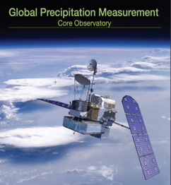
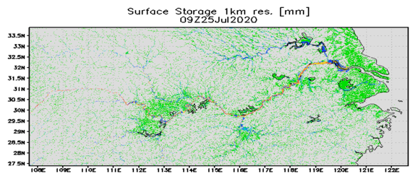
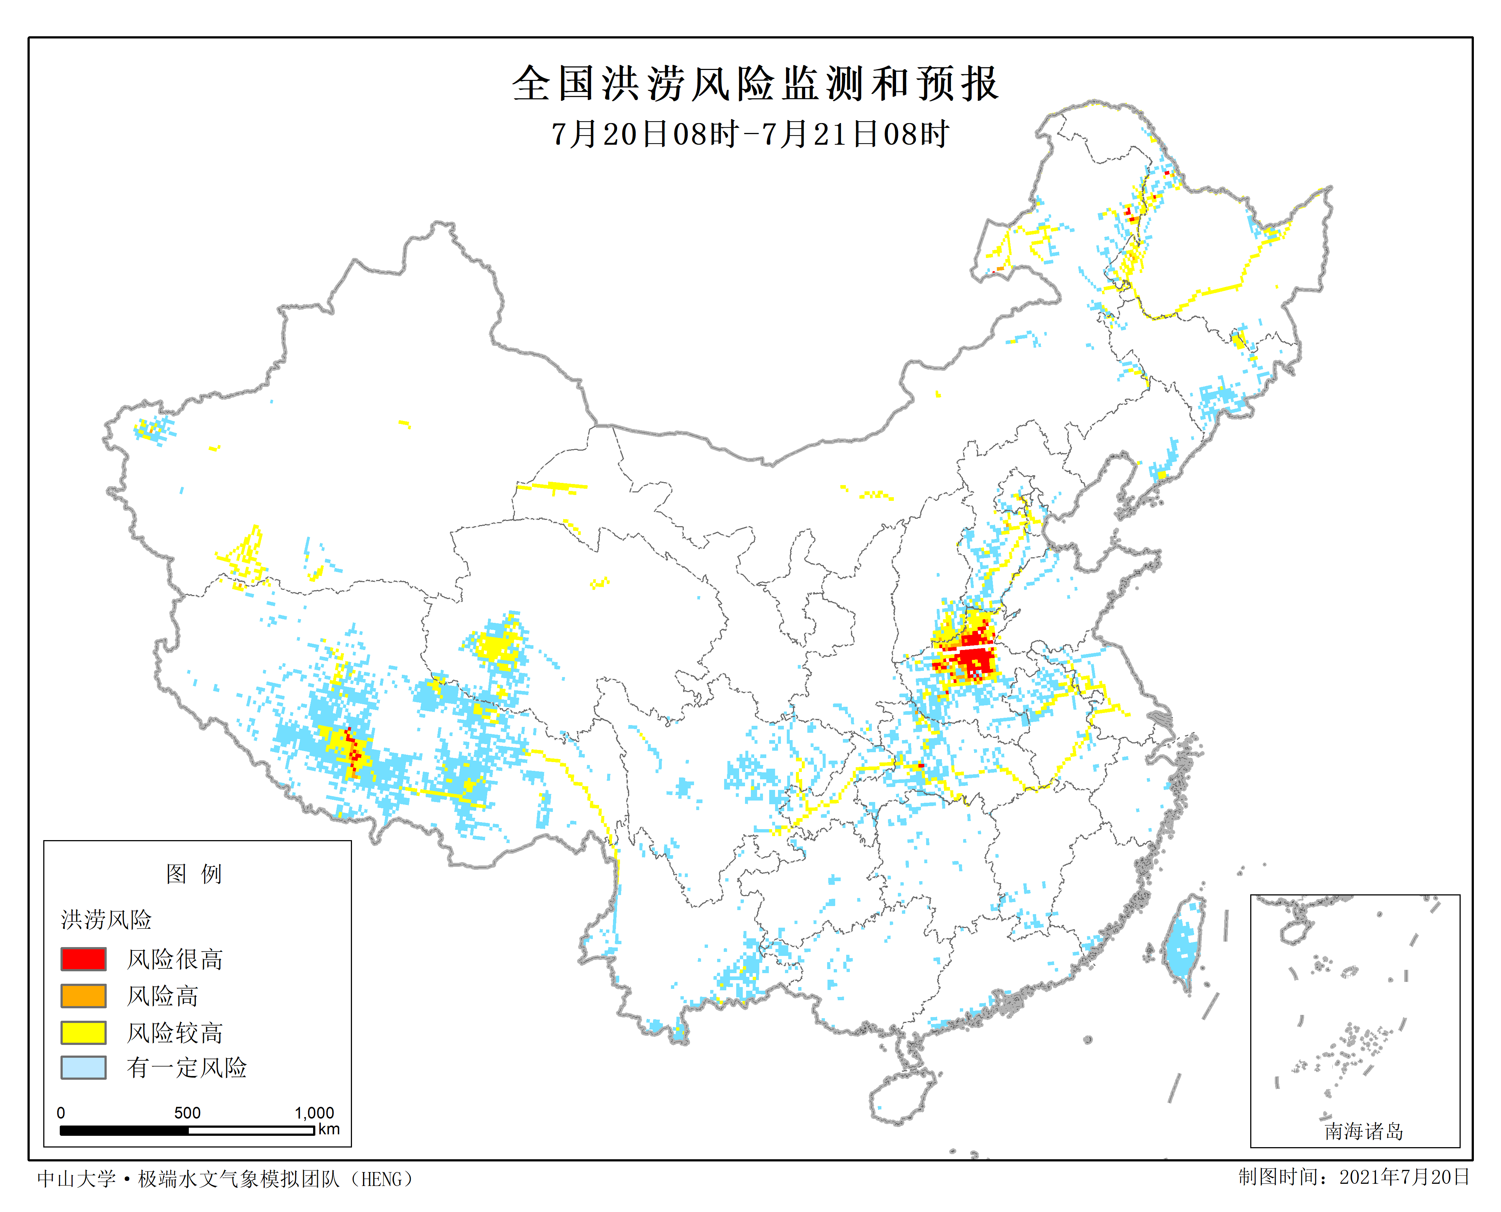
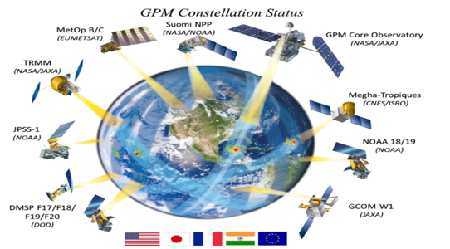
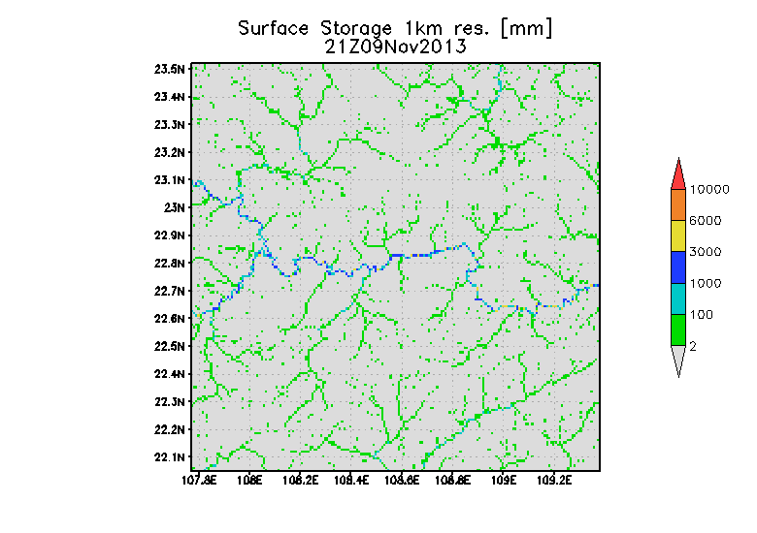
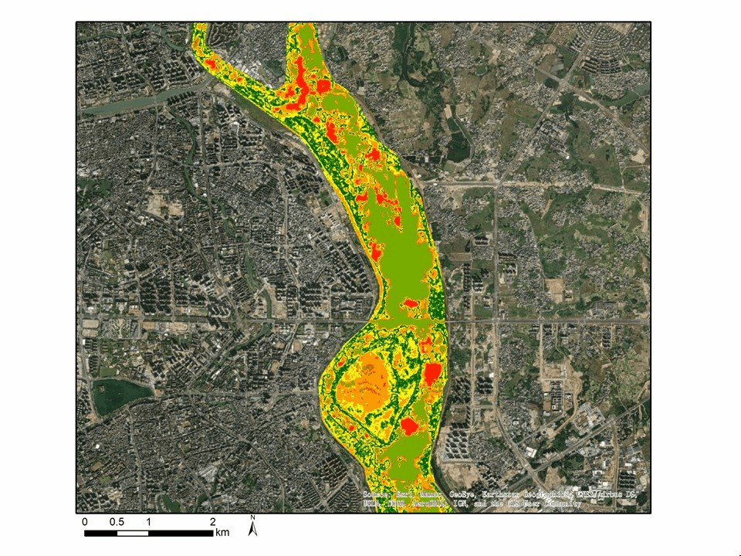
Glocal Hydrometeorological Solution on Floods (GHS-F)
3-hourly, 8th and 1km global flood detection and inundation mapping with hydrological model
2020
April 15, 2015
Global
to
Local
2021
1km resolution
Flash flood
Global Flood Monitoring System (GFMS, Wu et al., 2012, 2014), since 2010
River flood
10m-1km
Wu et al., 2011，2012, 2014;Chen 2022 WRR; 2019 RSE; Huang 2020, BAMS; Wu 2021, AAS; Huang 2023 JHM…
Urban flood 5m
【11】
Notes:
Since we developed first global flood monitoring system (GFMS) since 2010 using hydrological models driven by multiple satellite precipitation and Numerical Weather Prediction products to provide global flood simulation at 1/8 degree 3 hourly , we further developed a hydrometeorological solution on Floods which is modeling framework based on GFMS for flood forecast at global to local scales.
The GHS-F has also been operationally running for entire China mainland by National Meteorological Center for real time flood forecast to 10days since 2020.

Slide 12
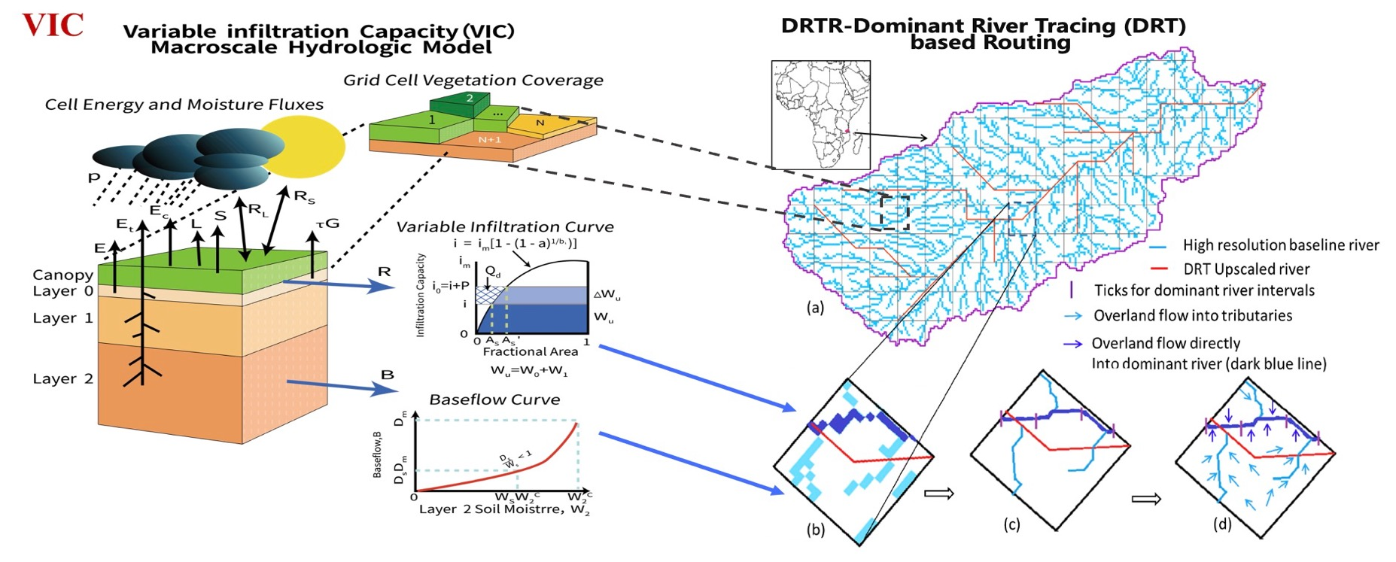
Dominant river tracing-Routing Integrated with VIC Environment (DRIVE) model
Liang et al.., 1996
DRIVE couples runoff generation-routing mechanisms based on the hierarchical dominant drainage network with advanced river basin-grid cell-subgrid parameterization schemes.
Wu et al.., 2012, JHM； Wu et al., 2012，2014，WRR
【12】

Slide 13
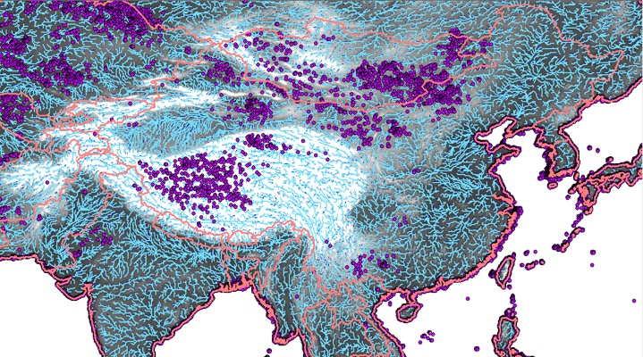
Hierarchical dominant river tracing (DRT) based
drainage network delineation
Flow direction, flow distance, slope, flow accumulation area, river width, river basin boundary etc.
$$\frac{∂Q}{∂x}+\frac{∂A}{∂t}=q$$
$$\frac{1}{g}\left(\frac{∂v}{∂t}+v\frac{∂v}{∂x}\right)+\frac{∂h}{∂x}=S_{0}−S_{f}$$
$$v=\frac{1}{n}R^{2/3}S^{1/2}$$
DRT derives drainage network with excellent performance in preserving the high resolution DEM information
DRIVE has strong stability and adaptability at various spatial resolutions and scales
River network topology
Wu et al., 2011, 2012, WRR
【13】

Slide 14
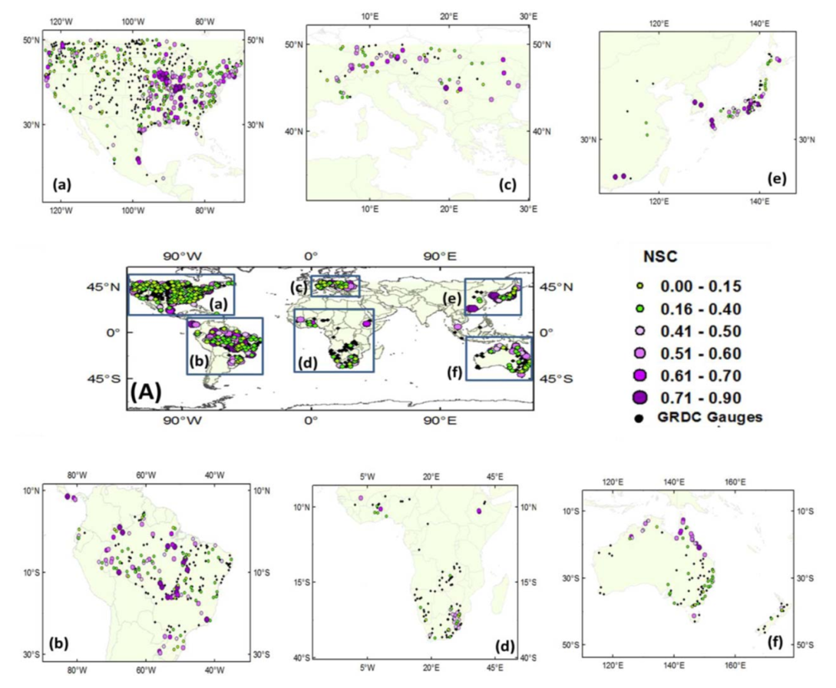
Long-term Evaluation against Streamflow Gauge Observations
DRIVE-RP model performance:
Daily: 32% of gauges with positive values with mean of 0.22
Monthly: 60% of gauges with positive values with mean of 0.39
DRIVE-RP model performance at 1,121 GRDC streamflow gauges across the globe
Wu et al., 2014 WRR
【14】

Slide 15
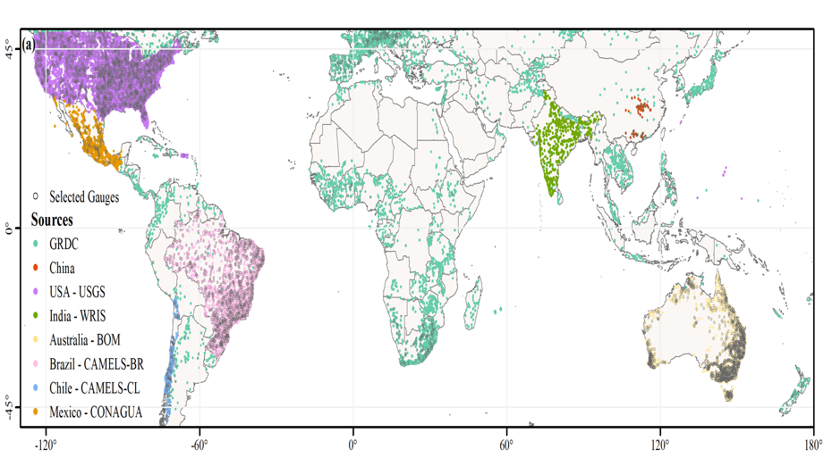
Long-term Evaluation against Streamflow Gauge Observations (2001-2019)
 | Simulated Discharge | Daily NSE > 0 |  | Daily R >0.4
 |  | % of gauges | Mean metrics | % of gauges | Mean metrics
GRDC | DRIVE-F | 39.2% | 0.30 | 75.0% | 0.62
 | DRIVE-RP (Wu et al., 2014) | 32.0% | 0.22 | 58.0% | 0.57
 | DRIVE-E | 17.4% | 0.24 | 61.7% | 0.58
 | DRIVE-RT (Wu et al., 2014) | 19.0% | 0.16 | 42.0% | 0.53
All Gauges | DRIVE-F | 34.0% | 0.27 | 65.8% | 0.60
 | DRIVE-E | 15.9% | 0.21 | 51.5% | 0.56
Africa | DRIVE-F | 32.9% | 0.27 | 65.8% | 0.60
 | DRIVE-E | 15.5% | 0.22 | 51.6% | 0.56
Asia | DRIVE-F | 56.8% | 0.37 | 83.2% | 0.65
 | DRIVE-E | 48.9% | 0.31 | 80.0% | 0.64
Oceania | DRIVE-F | 24.9% | 0.20 | 48.7% | 0.54
 | DRIVE-E | 14.3% | 0.14 | 26.0% | 0.52
North America | DRIVE-F | 36.6% | 0.28 | 68.9% | 0.60
 | DRIVE-E | 6.8% | 0.18 | 55.9% | 0.55
South America | DRIVE-F | 41.1% | 0.32 | 80.8% | 0.65
 | DRIVE-E | 32.8% | 0.25 | 75.9% | 0.60
Europe | DRIVE-F | 21.6% | 0.21 | 78.9% | 0.56
 | DRIVE-E | 11.9% | 0.14 | 60.5% | 0.51
Better performance than described in Wu et al. (2014) that focus on TMPA
IMERG
TMPA
Spatial distribution of 5,828 collected stream gages
Huang & Wu et al., 2023 JHM
【15】

Slide 16
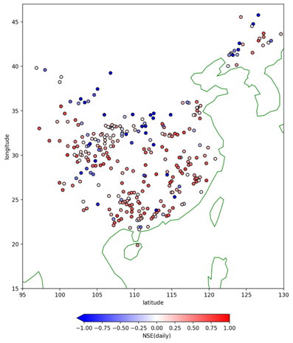
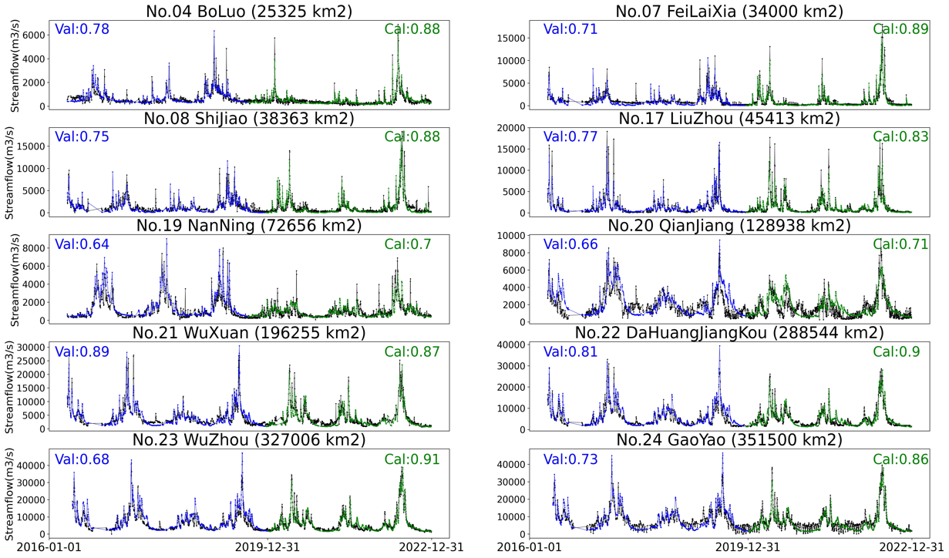
Long-term Evaluation against Streamflow Gauge Observations
Performed well in most basins
Well captured both flood occurrence and magnitude
【16】

Slide 17
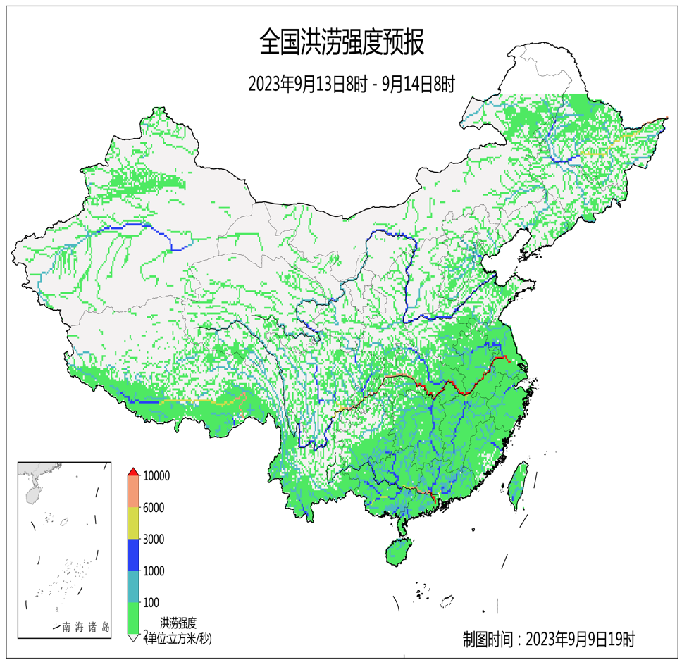
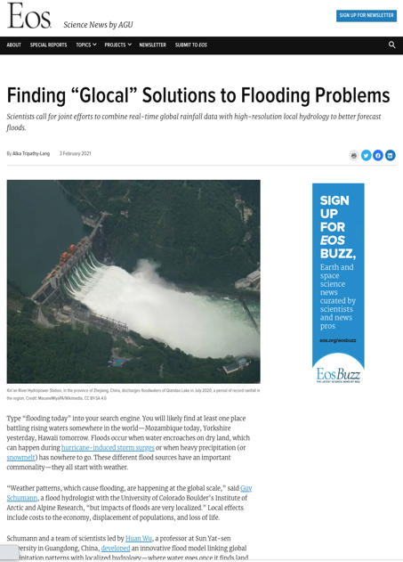
GHS-F@China： National to local flood forecasting
Flash flooding
Urban flooding
【17】

Slide 18
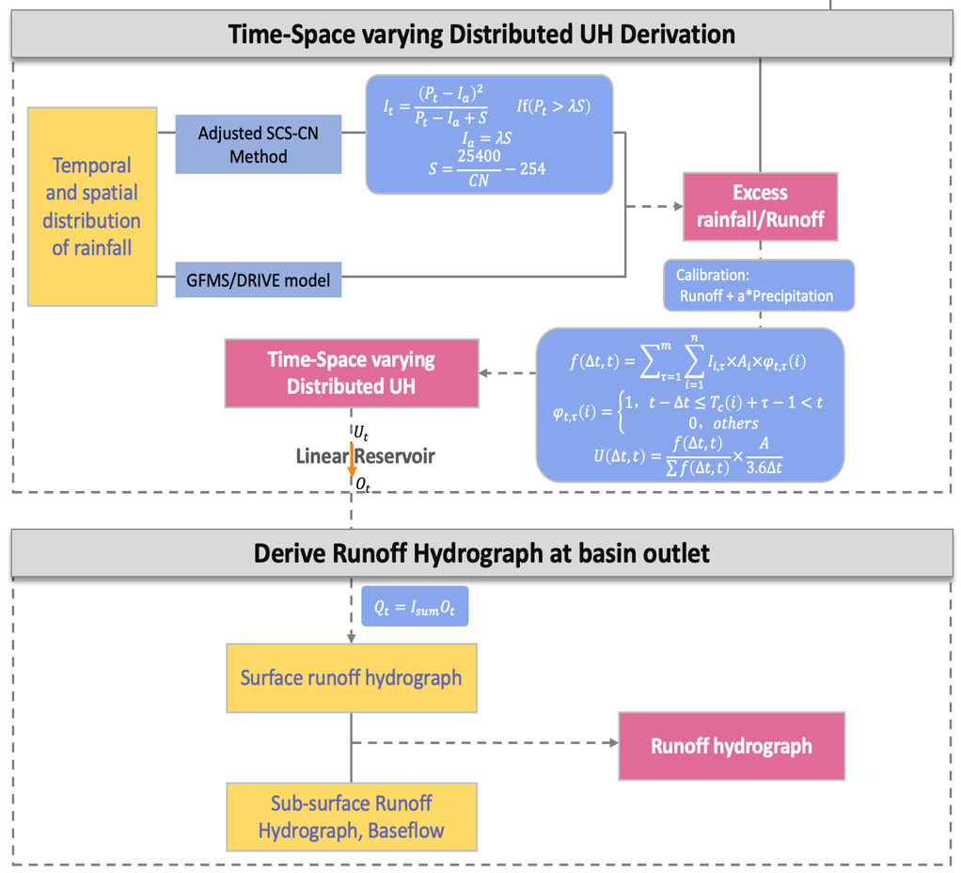
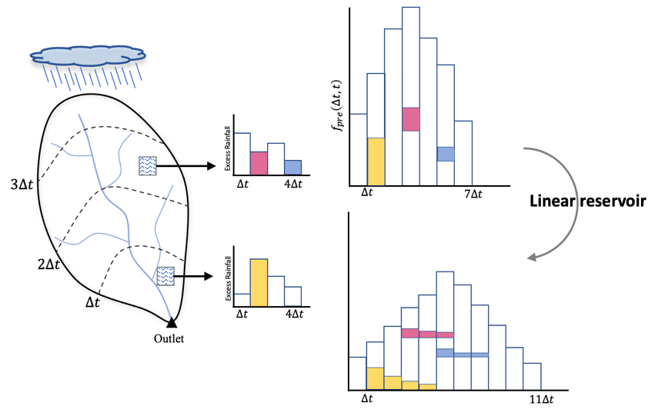
A Time-Space varying Distributed Unit Hydrograph(TS-DUH)
Considering the heterogeneous and dynamic runoff contribution caused by rainfall and soil moisture variations
Two runoff methods: the adjusted SCS-CN method and the DRIVE-Runoff output by the DRIVE model
Hu & Wu, in prep.
【18】
Notes:
Considering the heterogeneous and dynamic runoff contribution caused by rainfall and soil moisture variations.

Slide 19
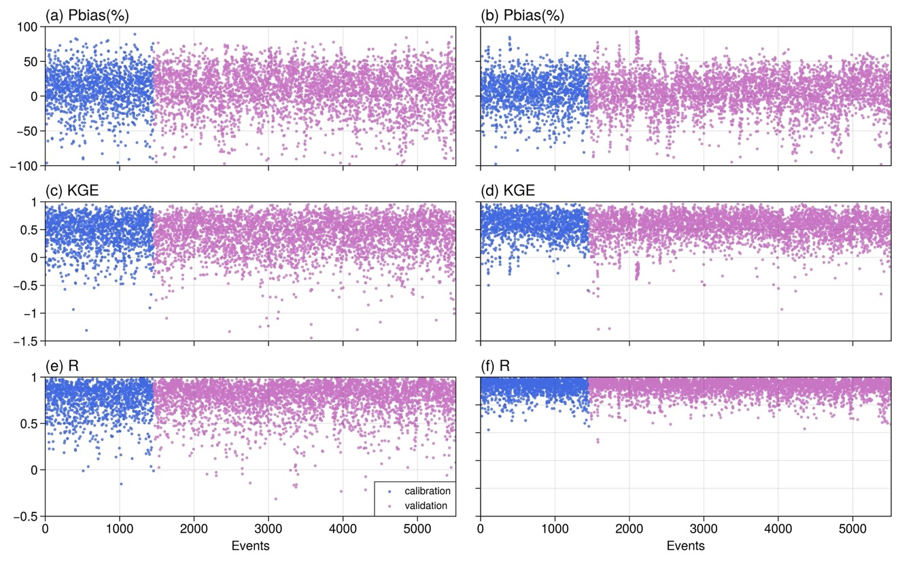
Event-based flash flood discharge simulation skill assessment
CN-TS-DUH
DRIVE-TS-DUH
Precipitation：NLDAS-2
Runoff yield：SCS-CN Vs. DRIVE-Runoff
Flow routing：TS-DUH
Time step : 1h
Abs(Pbias)<0.2: 48%
Abs(Pbias)<0.2: 54%
5,517 flash flood events at 243 stations (1985-2016)
Six events per station are randomly selected for calibration
POD:
SCS-CN ~ 0.8
DRIVE-Runoff ~ 0.9
KGE>0.4: 57%
KGE>0.4: 77%
R>0.4: 96%
R>0.4: 98%
Hu & Wu, in prep.
【19】

Slide 20
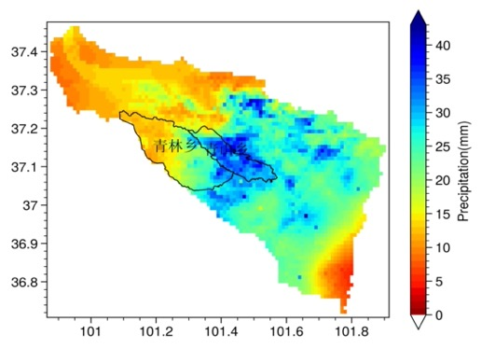
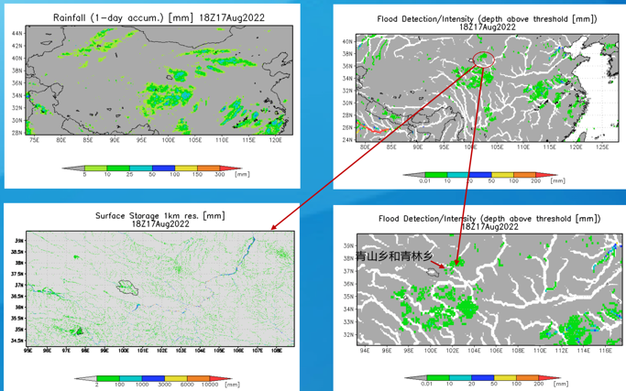
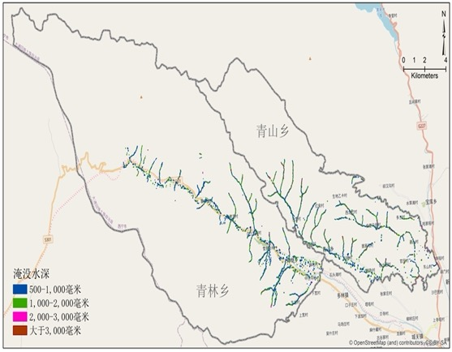
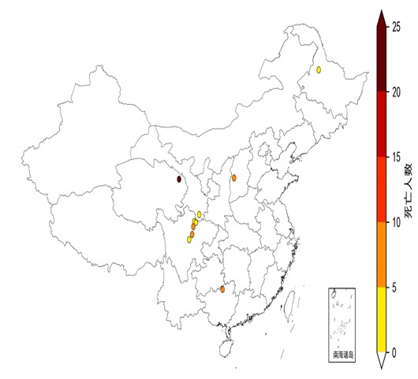
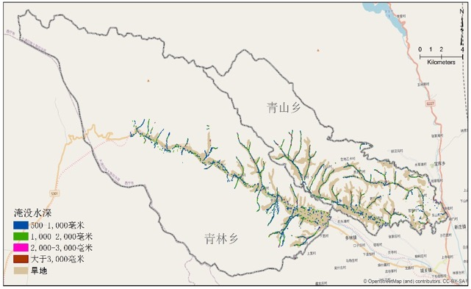
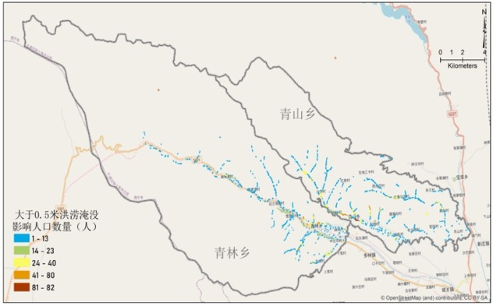
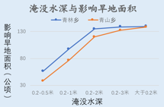
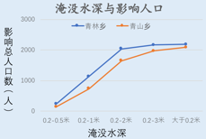
Case 2: Local scale (Flash) flooding, Aug. 18, 2022
10km
35mm P
1km
12.5m
Global
Hydrodynamic downscaling to
Local
Datong, Qinghai
1793 people transferred vs. reported 1600
31 people loss
12.5m
12.5m
【20】

Slide 22
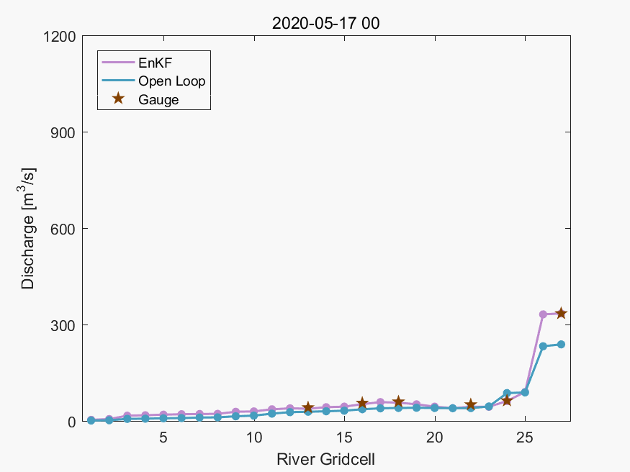
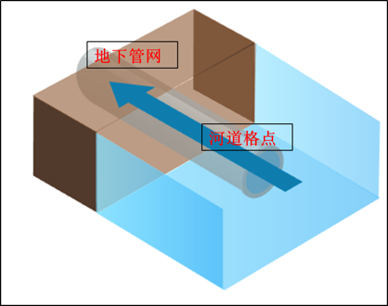
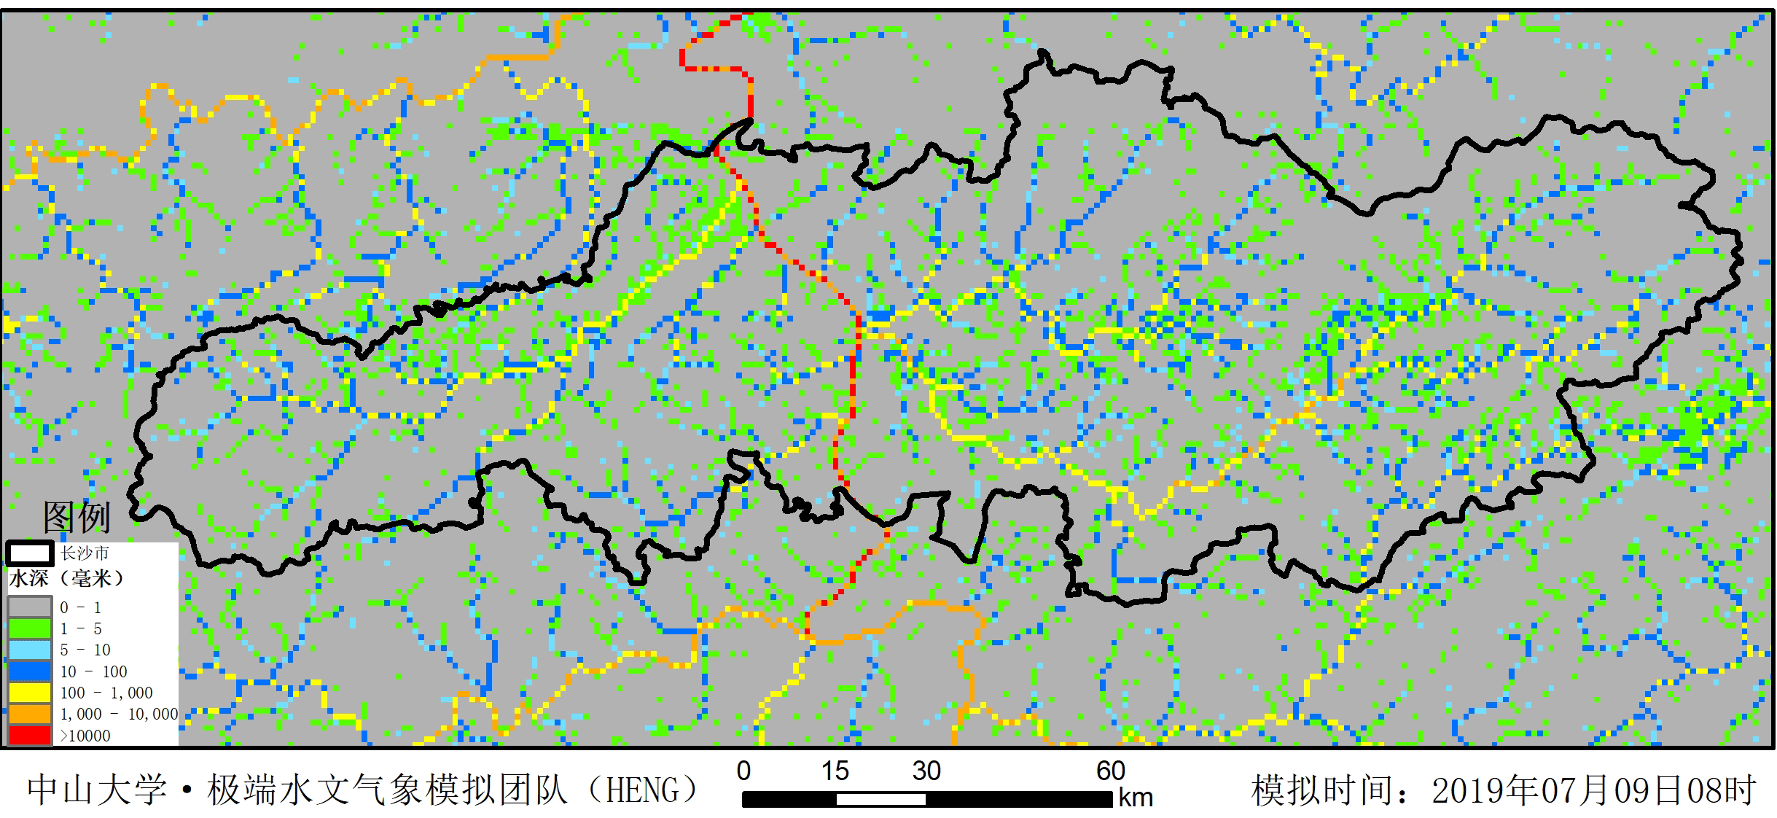
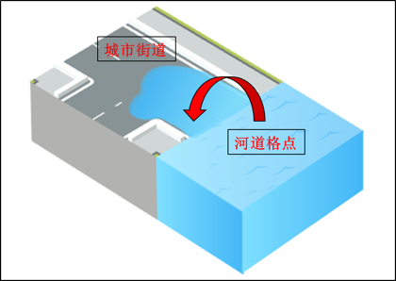
Real-time streamflow assimilation for better fluvial-urban coupled flood monitoring and forecasting
1D simulation
河道-管道顶托/倒灌
(manhole inundation and
return flow)
流域实时径流同化(river flow assimilation)
2D simulation
河道漫溢
(River overbank flow)
With assimilating real-time upstream river stage observations, the DRIVE-urban model provides accurate downstream water level for modeling of river overbank flow inundation and manhole return water inundation, which allows for detailed and reliable street inundation mapping.
【22】

Slide 24
Summary
Multi-scale floods (Flash flood, Riverine flood and Urban flood) need to and can be well addressed in one modeling framework for better risk estimation and response under the warming climate;
The DRIVE model based Glocal Hydrometeorological Solution on Floods (GHS-F) has been working with good applications from global to local scales, indicating pathways for further improvement;
Challenges ahead mainly lie in fundamental datasets: precipitation, DEM etc.

Slide 25
Thanks

