Slide 1
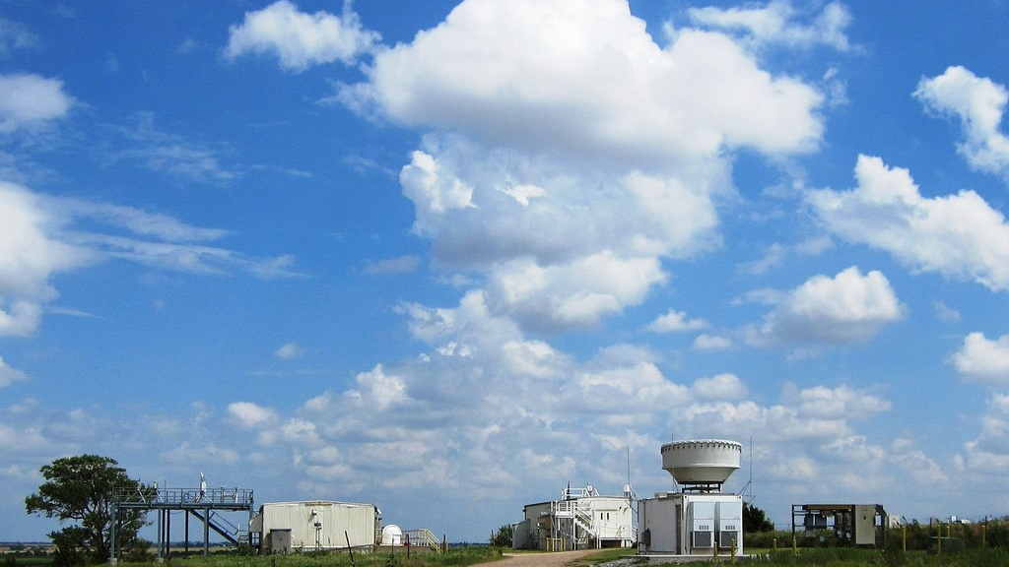
Regime-specific Cloud Vertical Overlap Characteristics from Radar and Lidar Observations at the ARM sites
Kelly Balmes^{1, 2}, Joe Sedlar^{1, 2}, Laura Riihimaki^{1, 2}
Joe Olson³, Dave Turner³, Kathy Lantz²
¹CIRES/CU Boulder
²NOAA GML
³NOAA GSL
Source: ARM

Slide 2
Source: ARM
Notes:
If we start by looking at the picture from the title slide, we see lots of variation in the cloud field horizontally and vertically

Slide 3
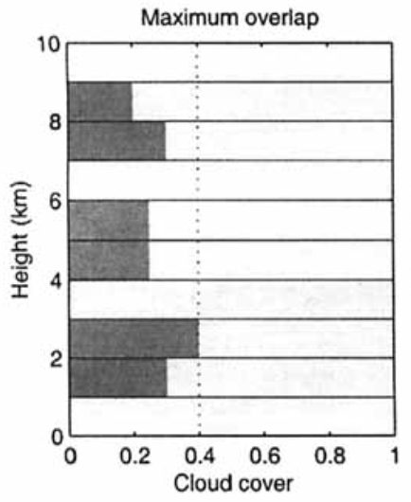
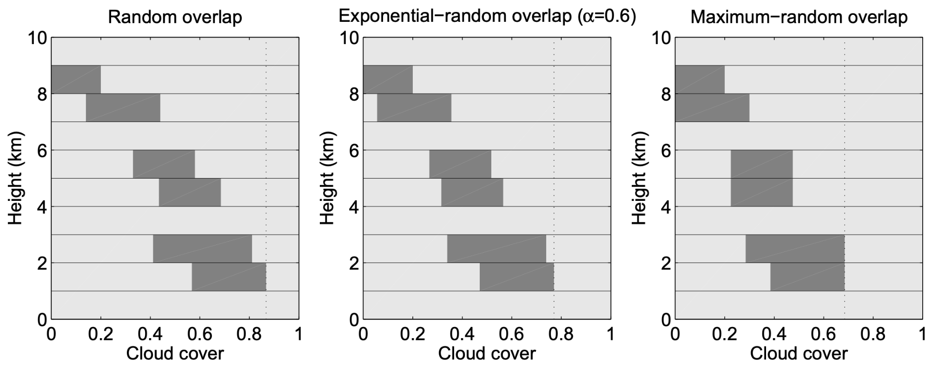
Model representation of sub-grid scale clouds
Hogan and Illingworth (2000), Hogan and Stonk (2008)
Notes:
To represent this in non cloud resolving models, this require assumptions for the subgrid scale clouds
This is often represented by cloud overlap methods which we see in the schematic here
Example of maximum, random, and combinations of them

Slide 4
Exponential-random overlap and the overlap parameter (⍺)
CF_{true} = ⍺ * CF_{max} + (1 - ⍺) * CF_{rand}
⍺ = 0 ⇒ random overlap
⍺ = 1 ⇒ maximum overlap
⍺ < 0 ⇒ minimum overlap
Hogan and Stonk (2008)
Notes:
Now looking at exponential random overlap method
The overlap parameter or alpha relates true CF w/ CF max, CF random
alpha = 0, random overlap, alpha = 1 max overlap
And negative alpha corresponds to min overlap
In the schematic, alpha = 0.6, it is inbetween maximum and random overlap

Slide 5
Exponential-random overlap and the overlap parameter (⍺)
CF_{true} = ⍺ * CF_{max} + (1 - ⍺) * CF_{rand}
⍺ = 0 ⇒ random overlap
⍺ = 1 ⇒ maximum overlap
⍺ < 0 ⇒ minimum overlap
⍺ = exp(-Δz/L⍺)
Δz = layer separation
L⍺ = decorrelation length scale
Hogan and Stonk (2008)
Notes:
Another way is alpha w/ layer separation, decorrelation length
So as the layer separation increases, alpha decreases
Overlap transitions from maximum overlap to random overlap
And this is modulated by the decorrelation length scale

Slide 6
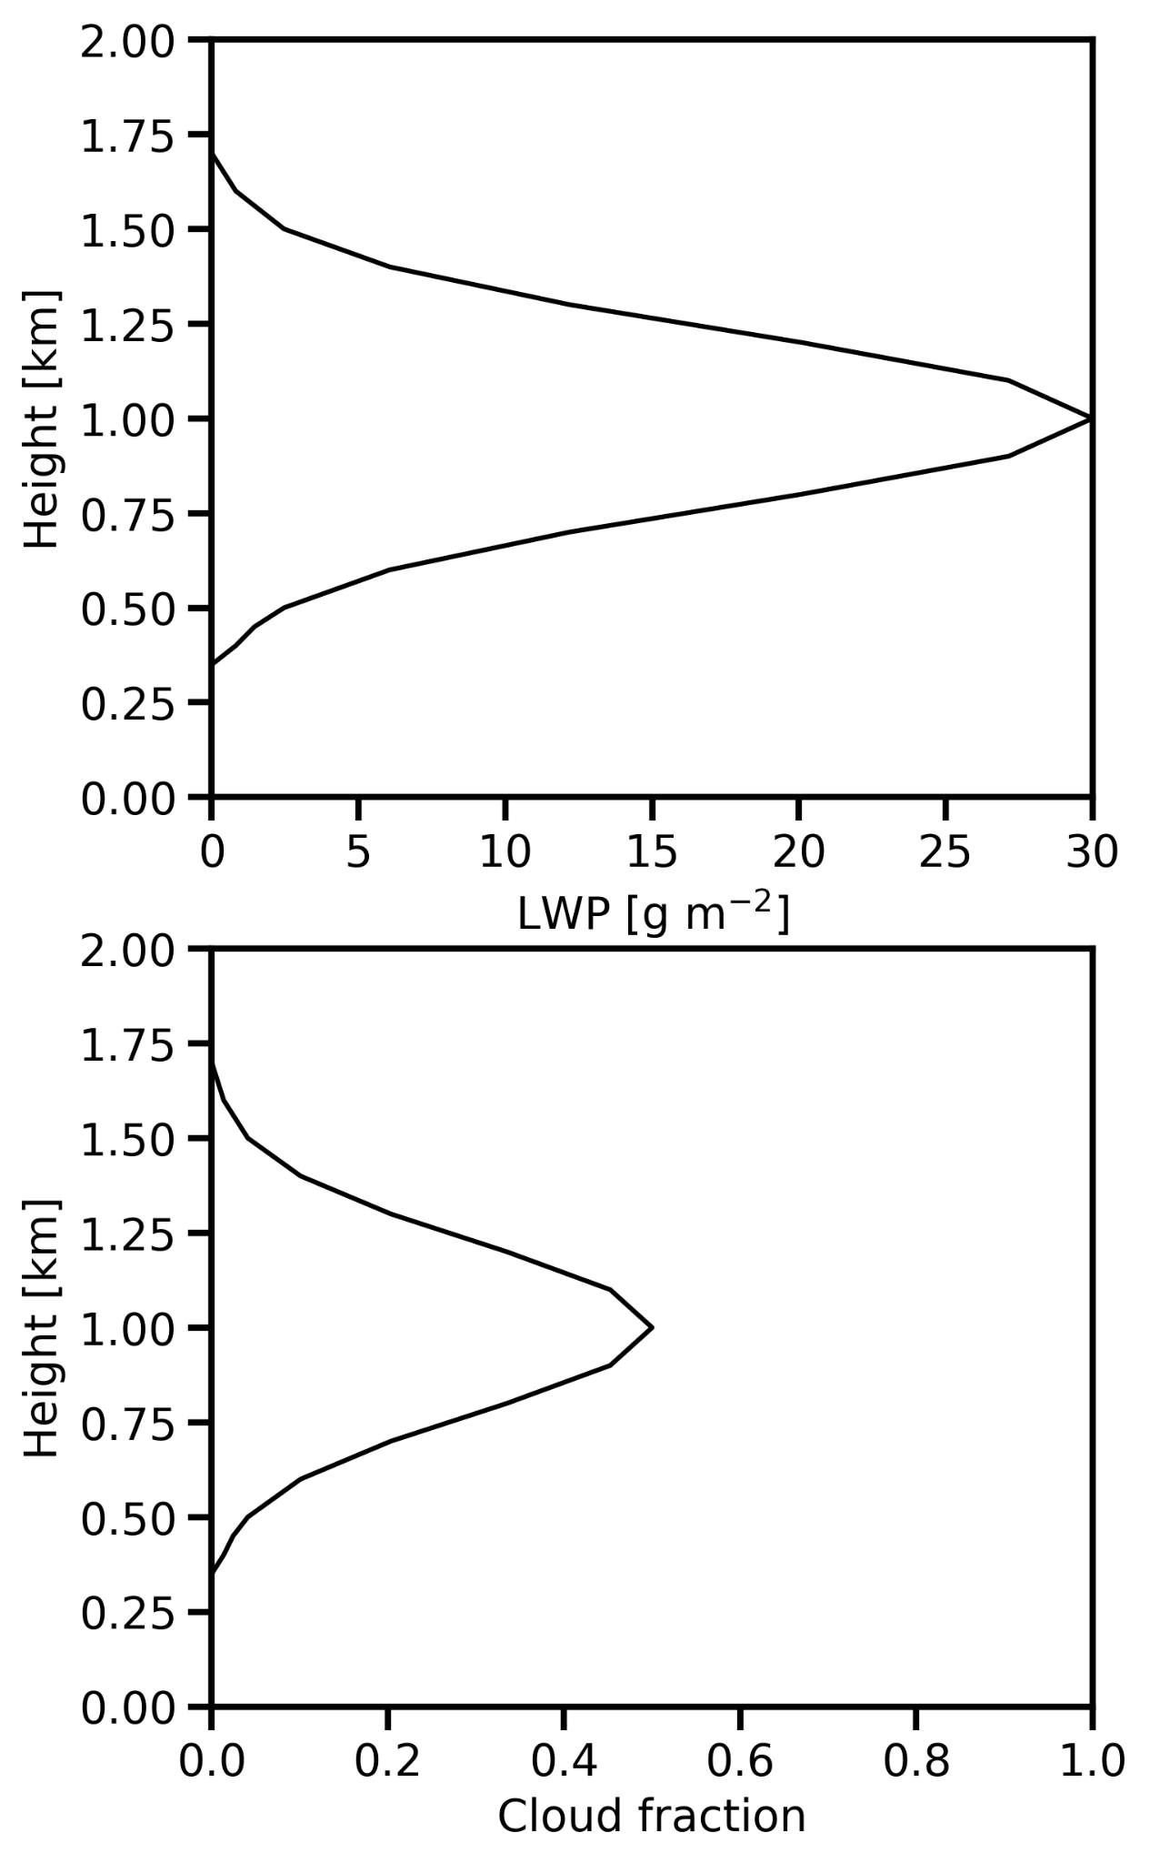
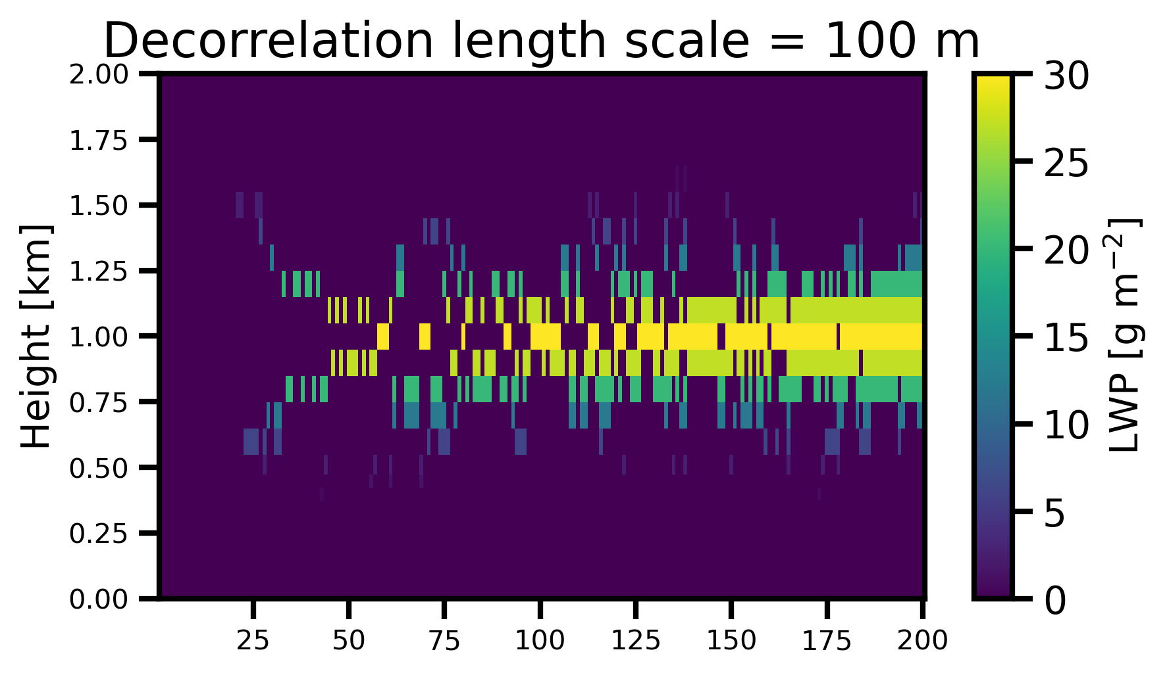
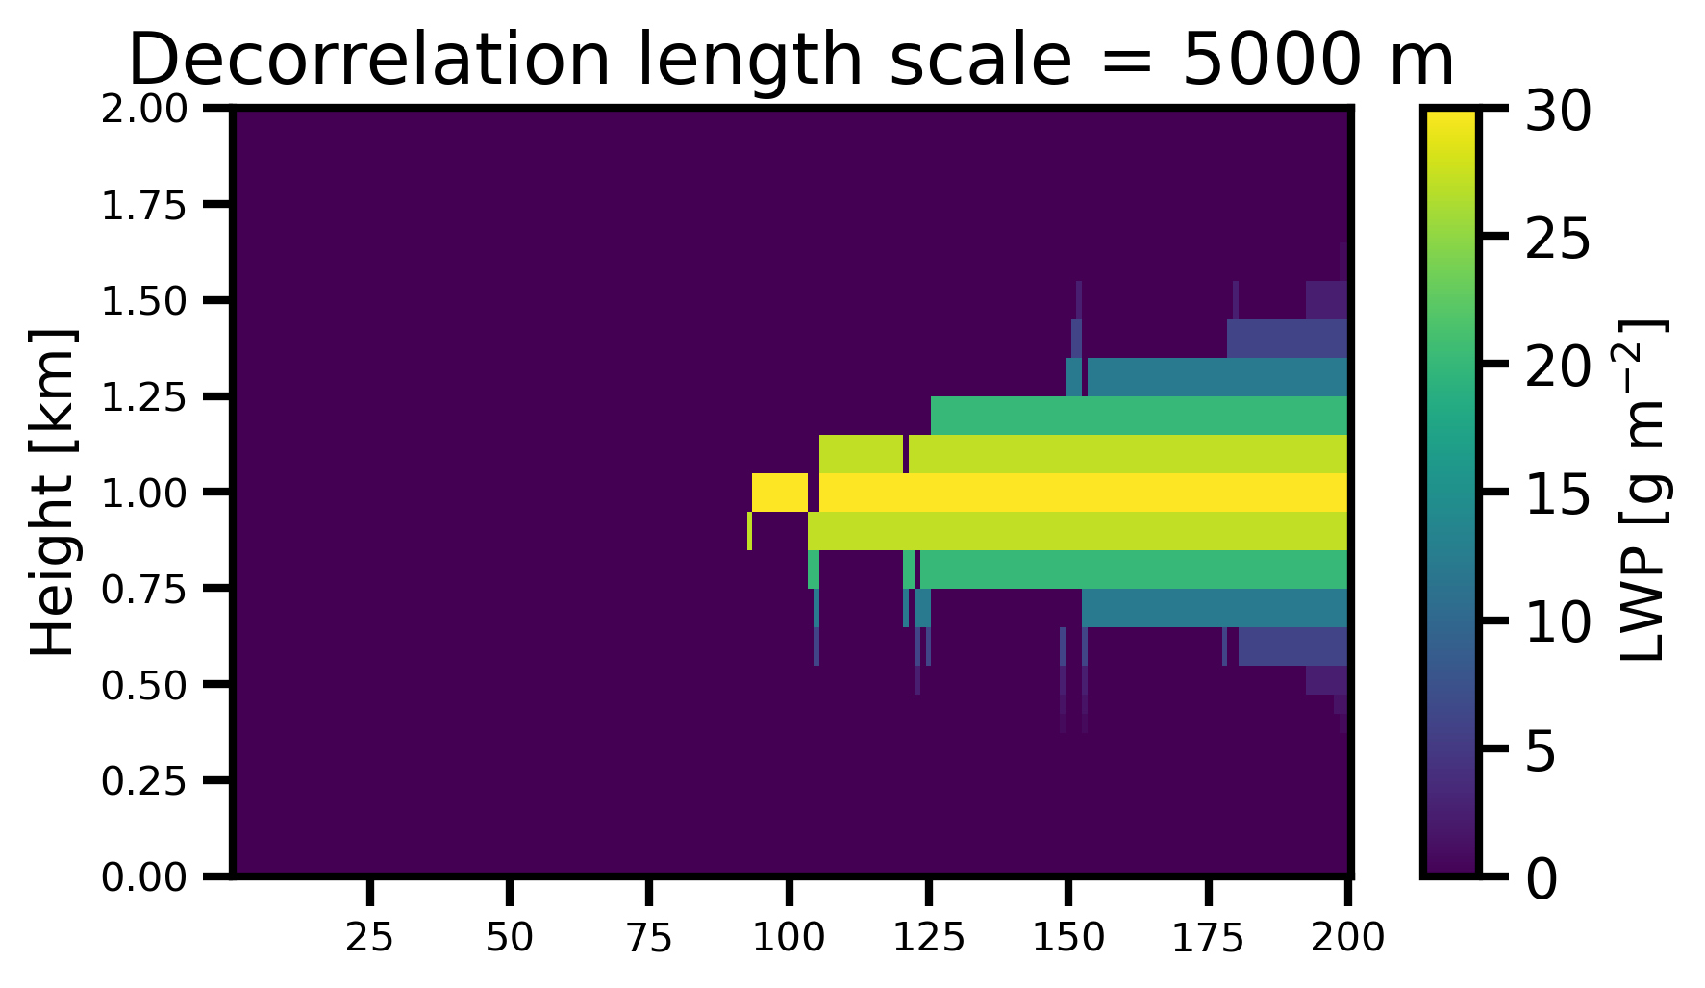
Exponential-random overlap and decorrelation length scale
Notes:
To understand how the decorrelation length scale affects the model cloud input, consider this LWP and CF profile on the left
cloud centered at 1 km max CF=0.5 and the corresponding LWP profile above
Then figures on the right show the cloud field for a decorr of 100 m and 5 km
So smaller decorrelation length = less coherent cloud field w/ a larger CF
The opposite is seen for 5 km: greater proportion of clear-sky subcolumns

Slide 7
Exponential-random overlap and decorrelation length scale
SW_{down} = 268 W m⁻²
LW_{down} = 342 W m⁻²
SW_{down} = 330 W m⁻²
LW_{down} = 319 W m⁻²
Spread of ~60 W m⁻² for SW, ~20 W m⁻² for LW!
Notes:
The two cloud fields are inputted into a radiative transfer model
the fluxes are averaged, monte carlo independent column approximation
The results for the surface SW down and LW down are shown below each
For the same LWP and CF profile on the left
the spread is ~60 W/m2 for SW, ~20 W/m2 for LW

Slide 8
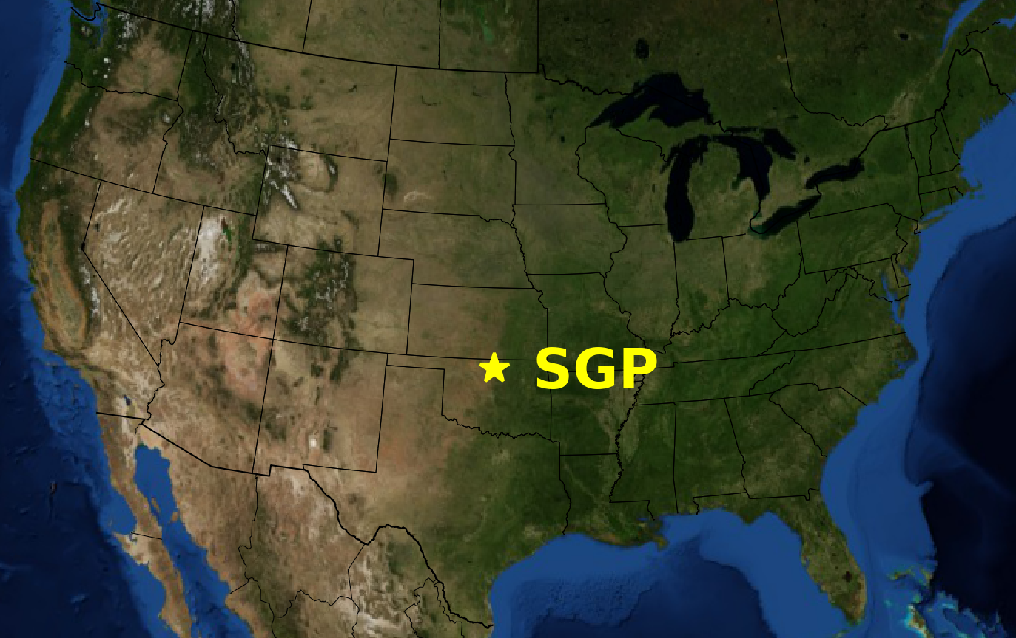
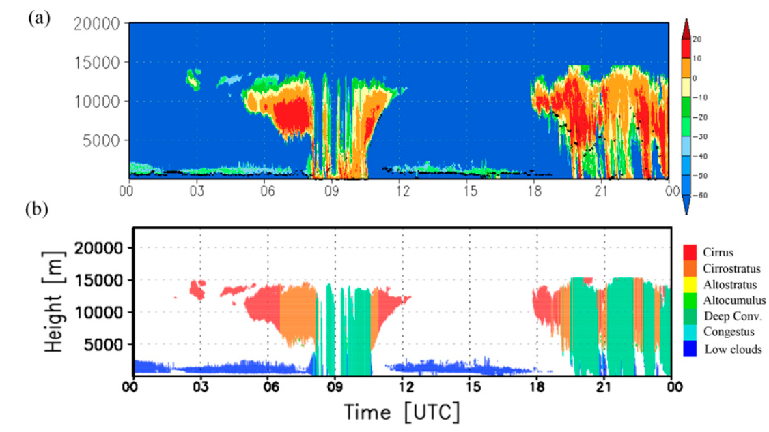
What is the observed decorrelation length scale at SGP?
Location: Atmospheric Radiation Measurement Program (ARM) Southern Great Plains (SGP) site in Lamont, Oklahoma
Data: Cloud boundaries and cloud types from the CLDTYPE data product
  Cloud types include low cloud, congestus, deep convection, altocumulus, altostratus, cirrostratus/anvil, and cirrus (Lim et al., 2019)
Time period: Nov 8, 1996 to Sept 29, 2021 (1 minute resolution)
Lim et al. (2019)
Notes:
The spread of the surface radiative fluxes motivates understanding what the observed decorrelation length scale is
to better inform what value to use in models
looking at obs from the ARM SGP site in Oklahoma
Considering the CLDTYPE data product
which provides cloud boundaries and cloud types from radar/lidar
An example of the data bottom right of the slide for 1 day at SGP

Slide 9
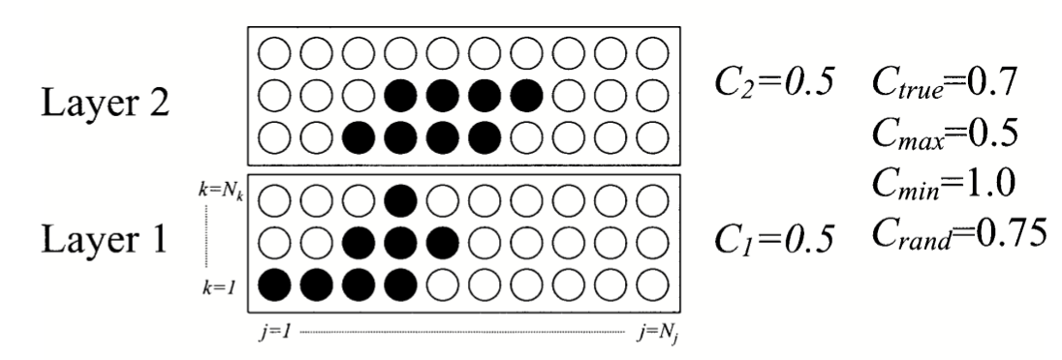
Cloud overlap observations methods
Cloud fractions (CF) and overlap parameter (⍺) are calculated for each partial cloudy layer pair (0 < CF₁, CF₂< 0.5) considering resolution of 1 hr and 360 m
  Method similar to Hogan and Illingworth (2000), Mace and Benson-Troth (2002), Naud et al. (2008), etc. except for CF<0.5 following Tompkins and Di Giuseppe (2015) and Li et al. (2019)
CF_{max} = max(CF₁, CF₂)
CF_{min} = min(1.0, CF₁ + CF₂)
CF_{rand} = CF₁ + CF₂ - CF₁ * CF₂
Mace and Benson-Troth (2002)
Notes:
The cloud observations are then converted into CF observations by considering each partial cloudy layer pair up to CF of 0.5
Considering 1 hr blocks of profiles at a vertical resolution of 360 m
Similar to previous overlap studies except only CF below 0.5
For each partial cloud layer pair, the true, max, min and random CF are calculated based on the equations on the right
For example, the schematic shows how the cloud mask is converted into these CFs

Slide 10
Cloud overlap observations methods
Cloud fractions (CF) and overlap parameter (⍺) are calculated for each partial cloudy layer pair (0 < CF₁, CF₂< 0.5) considering resolution of 1 hr and 360 m
  Method similar to Hogan and Illingworth (2000), Mace and Benson-Troth (2002), Naud et al. (2008), etc. except for CF<0.5 following Tompkins and Di Giuseppe (2015) and Li et al. (2019)
CF_{max} = max(CF₁, CF₂)
CF_{min} = min(1.0, CF₁ + CF₂)
CF_{rand} = CF₁ + CF₂ - CF₁ * CF₂
CF_{true} = ⍺ * CF_{max} + (1 - ⍺) * CF_{rand}
⍺ = (CF_{true} - CF_{rand})/(CF_{max} - CF_{rand})
⍺ = 0 ⇒ random
⍺ = 1 ⇒ maximum
⍺ < 0 ⇒ minimum
Mace and Benson-Troth (2002)
Notes:
In addition to the CFs, the overlap parameter or alpha is calculated, which we saw earlier in the slides
As a reminder, alpha relates if the true CF is closer to CF max or CF random

Slide 11
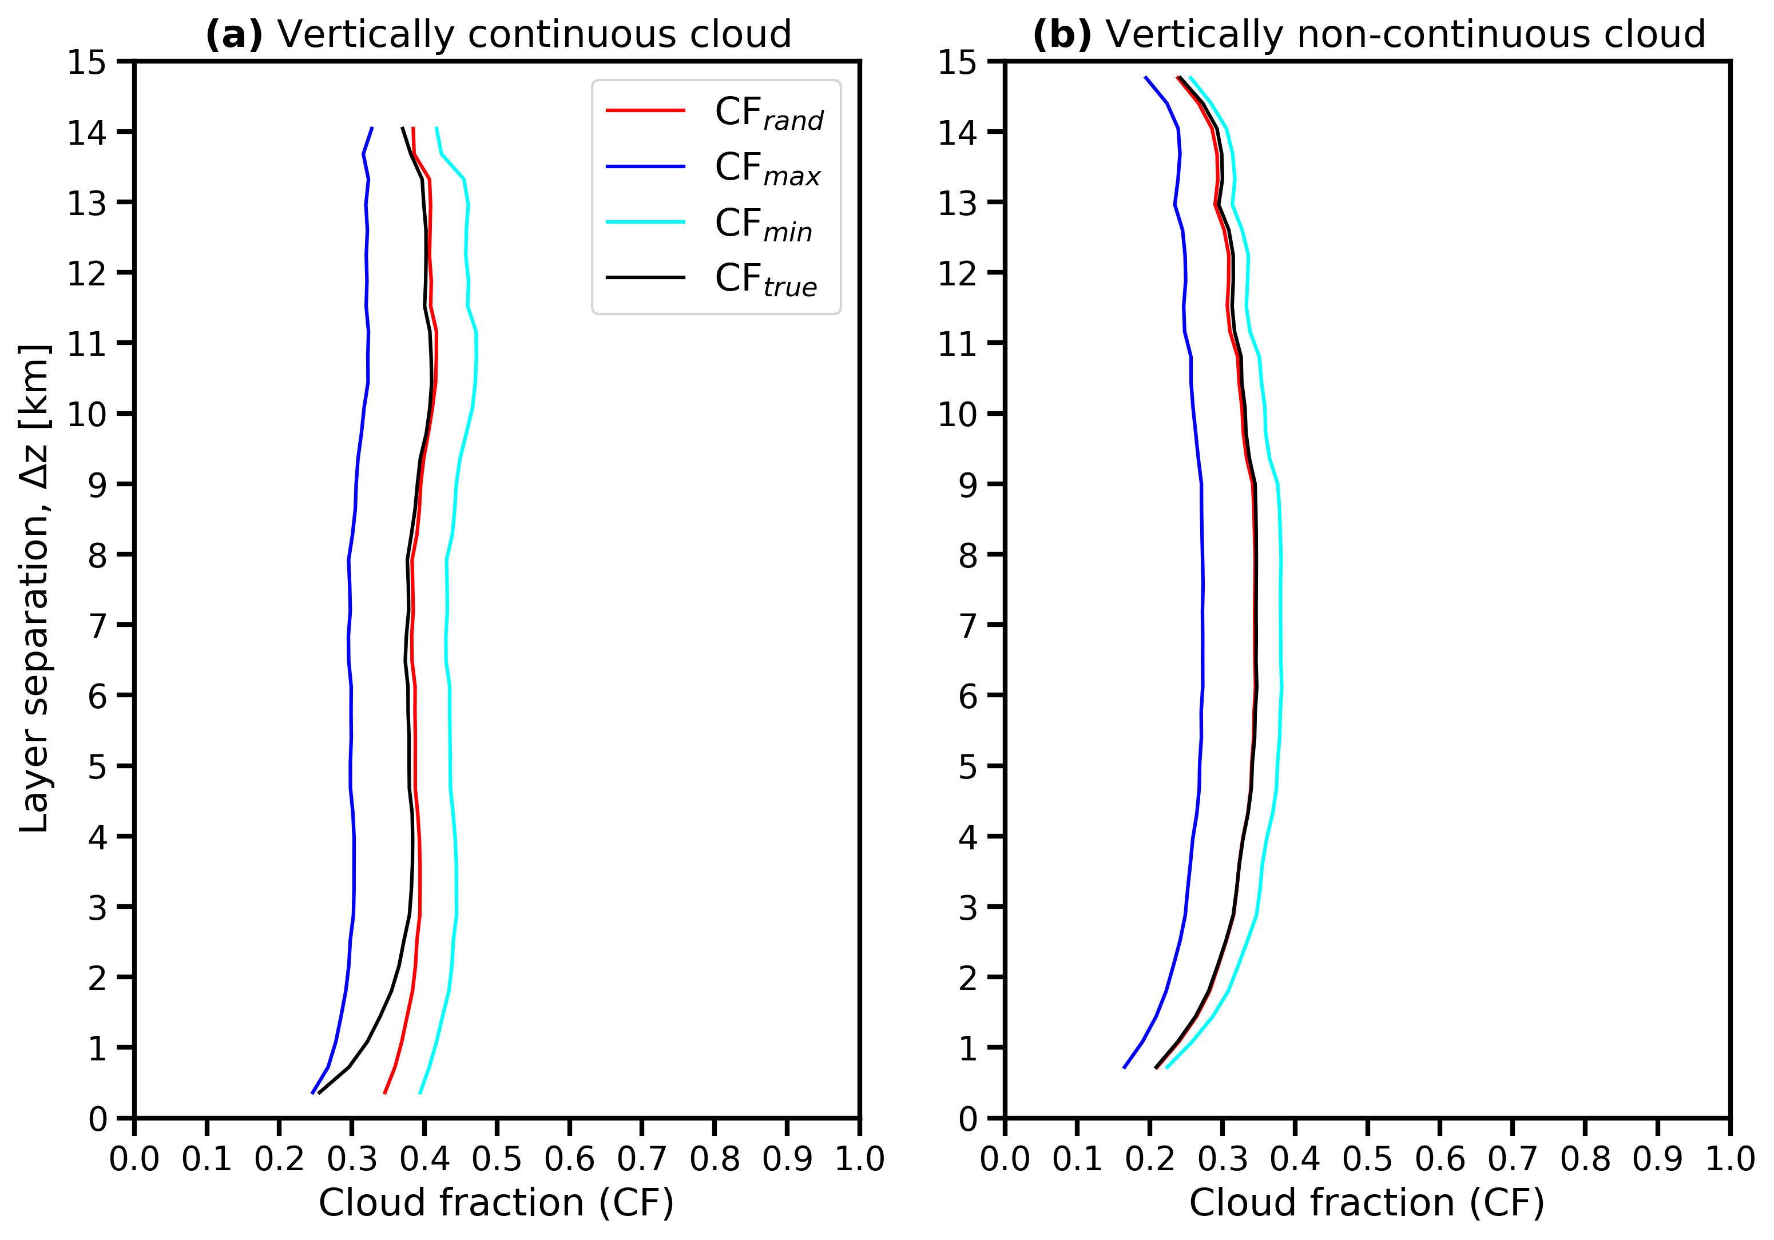
SGP cloud fraction overlap observations
Notes:
Applying those methods to the 25 years of data at SGP the mean CF as a function of layer separation are shown
For vertically continuous cloud on the left
so when CF>0 for every layer inbetween the two cloud layers considers
And for vertically non continuous on the right
for any cloud layer pairs compared with any clear-sky inbetween them

Slide 12
SGP cloud fraction overlap observations
Continuous clouds:
Close to CF_{max} at small layer separation
Transitions to CF_{rand} as layer separation increases
Non-continuous clouds:
Close to CF_{rand}
Notes:
So for continuous clouds true CF in black is close to the max CF in dark blue at small layer separation
As the layer separation increase, the true CF transitions to following the random CF in red
For non continuous clouds on the right, the true CF is close to the CF rand for small and larger layer separations

Slide 13
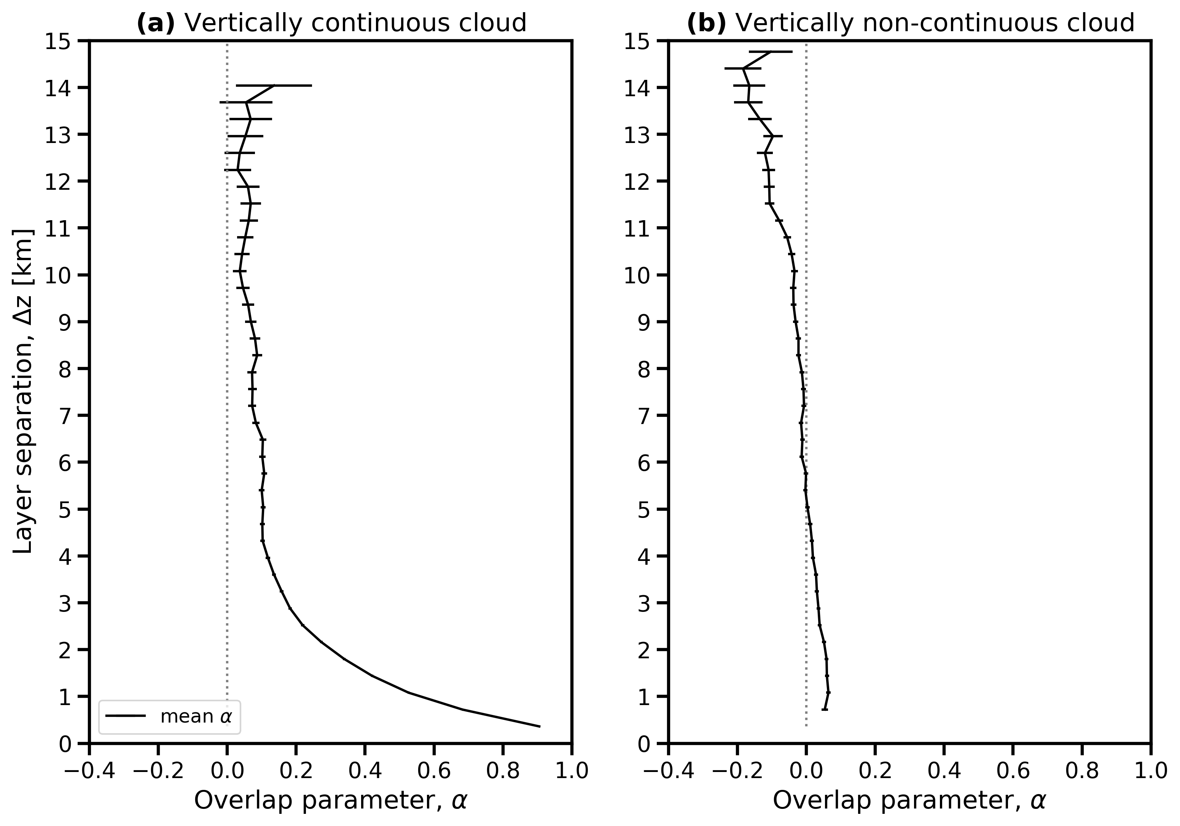
SGP ⍺ cloud overlap observations
⍺ = 0 ⇒ random
⍺ = 1 ⇒ maximum
⍺ < 0 ⇒ minimum
CF_{true} = ⍺ * CF_{max} + (1 - ⍺) * CF_{rand}
Notes:
This can also be interpreted in terms of the overlap parameter alpha
The mean alpha is plotted as a function of layer separation
So at small layer separation for vertically continuous clouds, alpha is near 1 which corresponds to maximum overlap
At larger layer separation, alpha approaches 0, which corresponds to random overlap
For vertically non continuous clouds alpha is near 0 throughout

Slide 14
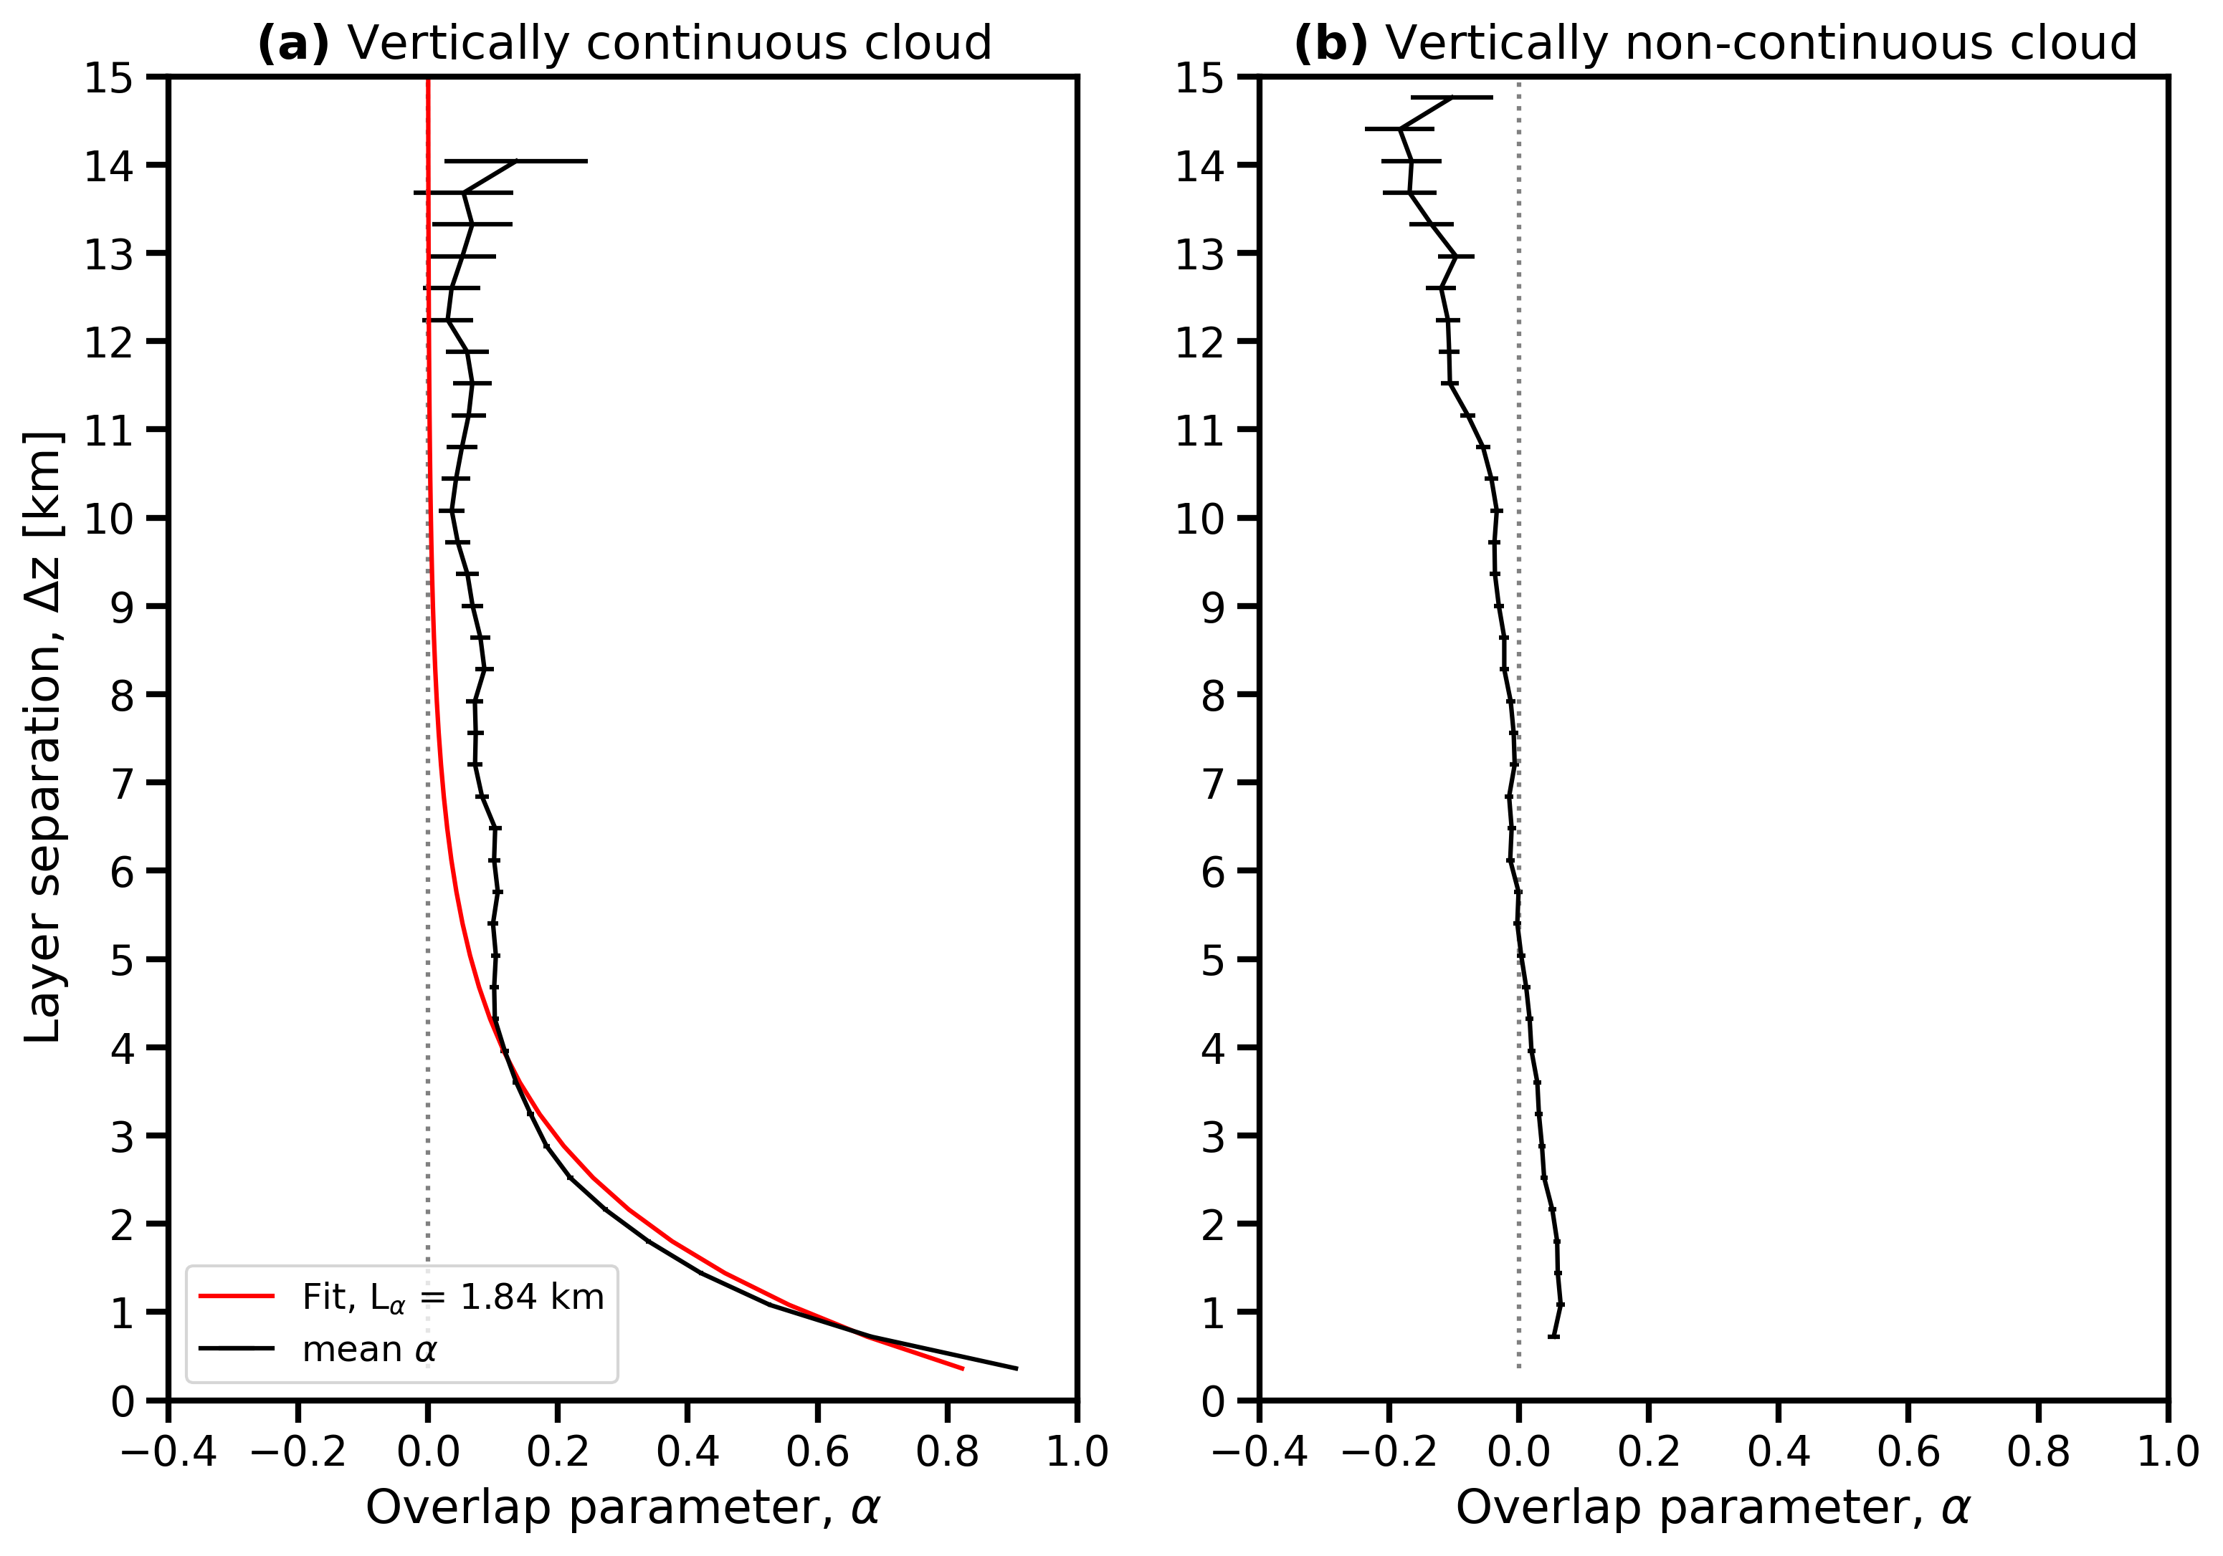
SGP ⍺ cloud overlap observations
⍺ = 0 ⇒ random
⍺ = 1 ⇒ maximum
⍺ < 0 ⇒ minimum
CF_{true} = ⍺ * CF_{max} + (1 - ⍺) * CF_{rand}
Decorrelation length scale (L⍺) found by fitting observations to ⍺ = exp(-Δz/L⍺)
Notes:
For vertically continuous clouds, we can fit an exponential that relates alpha, layer separation and decorrelation length
as shown in the equation on the bottom right
By fitting the observations to this exponential form, we can get the decorrelation length scale
For observations at SGP, the decorrelation length scale is 1.84 km and shown in red

Slide 15
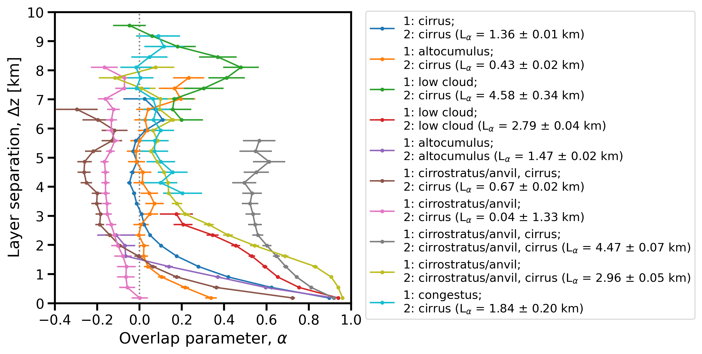
SGP ⍺, decorrelation length observations by cloud type
⍺ = exp(-Δz/L⍺)
Notes:
The previous slide showed the alpha observations considering all clouds regardless of type
The alpha observations are also separated by the classified cloud types
The decorrelation length scale can then be found considering the cloud types
This is shown in the legend in the parentheses
So for cirrus/cirrus we see the decorrelation length is 1.36 km
Overall the values range from 0.04 km for cirrostratus/cirrus to 4.58 km for low/cirrus

Slide 16
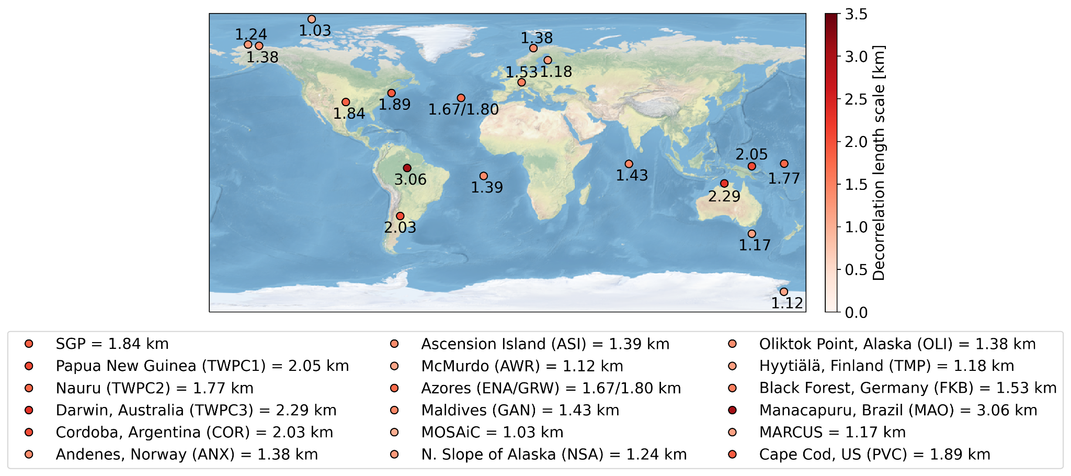
Decorrelation length scale by location
Notes:
Previous for ARM SGP site in Oklahoma
other long term and short term ARM sites where available
With the value in the text near the lat/lon location and the color dot corresponding to that value
where lower values are lighter red and higher values are darker red
Overall the values ranged from 1.03 km in the Arctic MOSAIC to 3.06 km in Brazil GoAMAZON

Slide 17
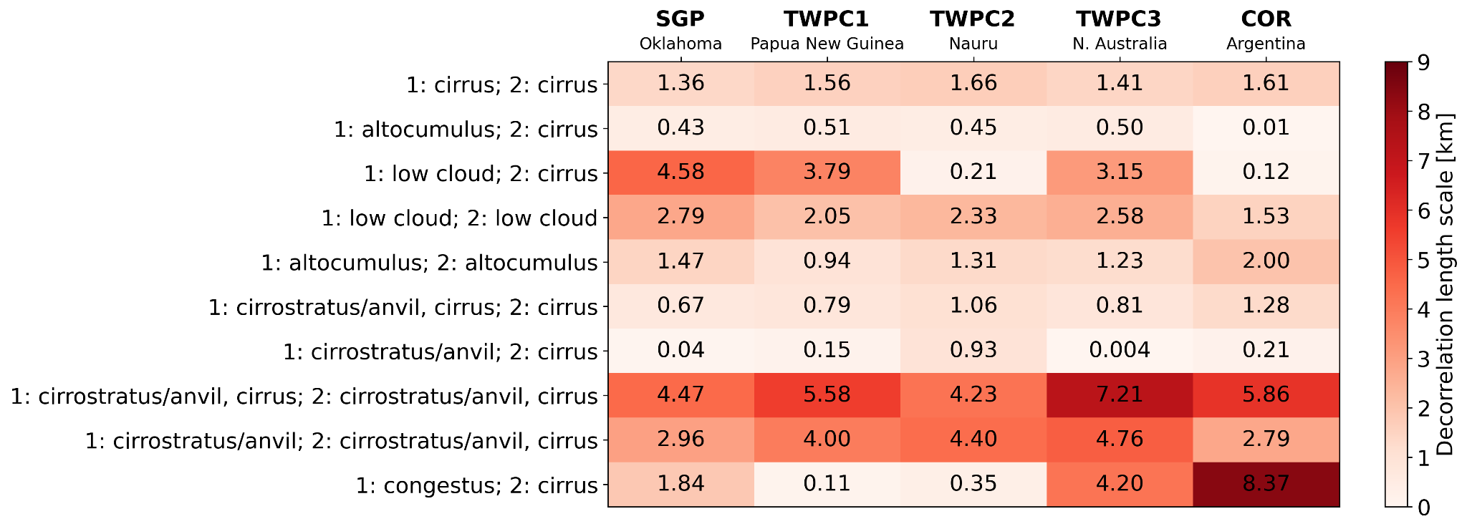
Decorrelation length scale by cloud types, location
Notes:
For the sites in which the cldtype data product is available
Papua New Guinea, Nauru Island and N. Australia Argentina
the decorrelation length scale is found for the top 10 most common cloud type pairs for SGP
similarities but also some differences across the sites
For example, cirrus/cirrus values all 1.4 to 1.7 km
However for low cloud/cirrus for example, the values are > 3 km for SGP TWPC1 TWPC3 but about 0.1-0.2 km for TWPC2 and Argentina

Slide 18
Summary
Cloud vertical overlap characteristics are found from radar/lidar observations at the ARM SGP (Oklahoma) site and other ARM sites globally
  The decorrelation length scale at SGP is found to be 1.84 km
  Values ranged from 1.03 km (Arctic) to 3.06 km (Brazil) for all sites considered
The decorrelation length scale are considered for common cloud type pairs
  Values ranged from 0.04 km (cirrostratus; cirrus) to 4.58 km (low cloud; cirrus) at SGP
  Similarities/differences noted for values when considering the same cloud types across sites
Notes:
So to summarize, the cloud vertical overlap characteristics are found from radar/lidar observations at SGP and other ARM sites globally
At SGP, the decorrelation length scale is 1.84 km based on 25 years of data
And when considering all sites globally the values ranged from about 1 km in the Arctic to about 3 km in Brazil
The overlap observations were also considered by cloud type pairs
At SGP the values ranged from 0.04 km for cirrostratus/cirrus to 4.58 km for low cloud/cirrus
For other sites where cloud type classification data is available, the decorrelation length scale showed similarities but also differences across the sites in terms the top 10 common pairs at SGP

Slide 20
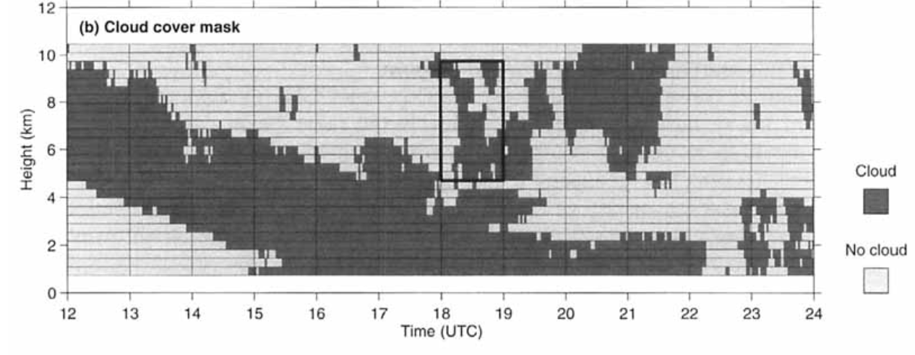
Cloud overlap observations methods
Converted the cloud boundaries into a cloud mask for vertical resolution of 360 m
Calculated cloud fractions for each 1 hour block from the cloud mask
  Restrictions on the profiles considered:
    No precipitation, instruments available (both radar and lidar), high-quality cloud boundaries or clear-sky detected by radar and lidar
    If any profiles in 1 hour block fail any criteria, cloud fractions are not considered
Hogan and Illingworth (2000)

Slide 21
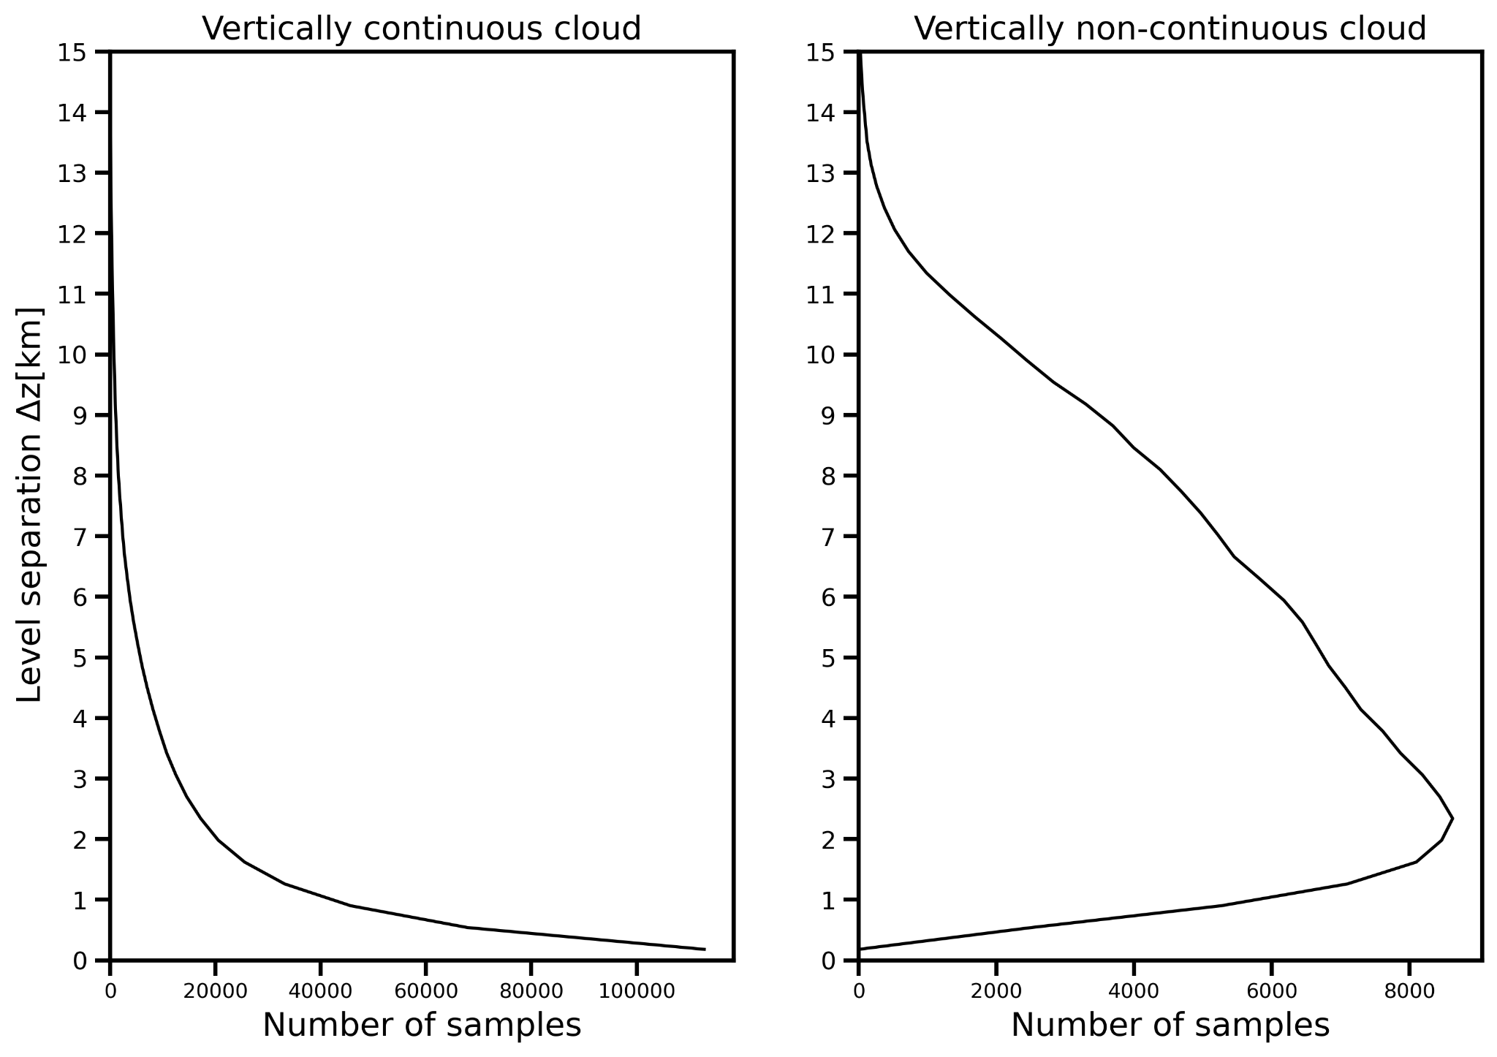
Number of samples - SGP

Slide 22
Site Abbreviation | Location | Time period | Decorrelation length scale [km]
SGP | Lamont, Oklahoma, United States | 1996-11-08 to 2021-09-29 | 1.84
COR | Cordoba, Argentina | 2018-09-23 to 2019-04-30 | 2.03
TWPC1 | Manus, Papua New Guinea | 1999-07-01 to 2014-05-02 | 2.05
TWPC2 | Nauru Island | 1998-11-01 to 2009-02-13 | 1.77
TWPC3 | Darwin, Australia | 2003-01-01 to 2014-05-02 | 2.29
ANX | Andenes, Norway | 2019-12-01 to 2020-05-31 | 1.38
ASI | Ascension Island, South Atlantic | 2016-07-12 to 2017-09-30 | 1.39
AWR | McMurdo Station, Antarctica | 2015-11-18 to 2017-01-02 | 1.12
ENA | Azores, Eastern North Atlantic | 2015-07-17 to 2021-09-30 | 1.67
GRW |  | 2009-06-06 to 2010-12-31 | 1.80
GAN | Gan Island, Maldives | 2011-10-09 to 2012-02-07 | 1.43
MOS | ship in Arctic Ocean, MOSAiC Field Campagin | 2019-10-11 to 2020-10-01 | 1.03
NSA | North Slope of Alaska | 2011-11-11 to 2021-09-30 | 1.24
OLI | Oliktok Point, Alaska, United States | 2015-10-01 to 2021-06-15 | 1.38
TMP | Hyytiälä, Finland | 2014-02-01 to 2014-09-13 | 1.18
FKB | Black Forest, Germany | 2007-03-29 to 2008-01-01 | 1.53
MAO | Manacapuru, Brazil | 2014-02-18 to 2015-11-30 | 3.06
MAR | ship in Southern Ocean, MARCUS field campaign | 2017-10-29 to 2018-03-24 | 1.17
PVC | Cape Cod, United States | 2012-10-12 to 2013-06-14 | 1.89

Slide 23
Number of samples by cloud type
Cloud type |  | Number of samples
Lower cloud layer | Upper cloud layer
cirrus | cirrus | 222,020
altocumulus | cirrus | 34,841
low cloud | cirrus | 28,692
low cloud | low cloud | 22,547
altocumulus | altocumulus | 15,436
cirrostratus/anvil, cirrus | cirrus | 14,294
cirrostratus/anvil | cirrus | 12,688
cirrostratus/anvil, cirrus | cirrostratus/anvil, cirrus | 11,426
cirrostratus/anvil | cirrostratus/anvil, cirrus | 11,087
congestus | cirrus | 7,910
Cloud height classification |  | Number of samples
Lower cloud layer | Upper cloud layer
high cloud | high cloud | 271,288
medium cloud | high cloud | 104,987
low cloud | high cloud | 79,123
low cloud | low cloud | 54,263
low cloud | medium cloud | 46,271
medium cloud | medium cloud | 37,867

Slide 24
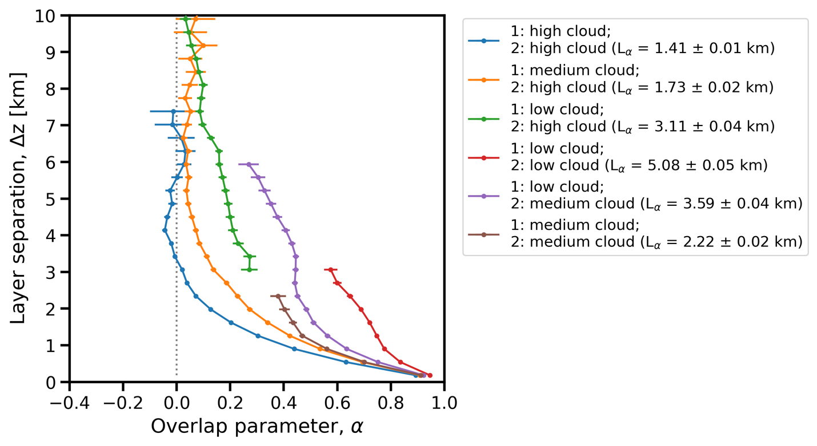
SGP ⍺, decorrelation length observations by cloud type

Slide 25
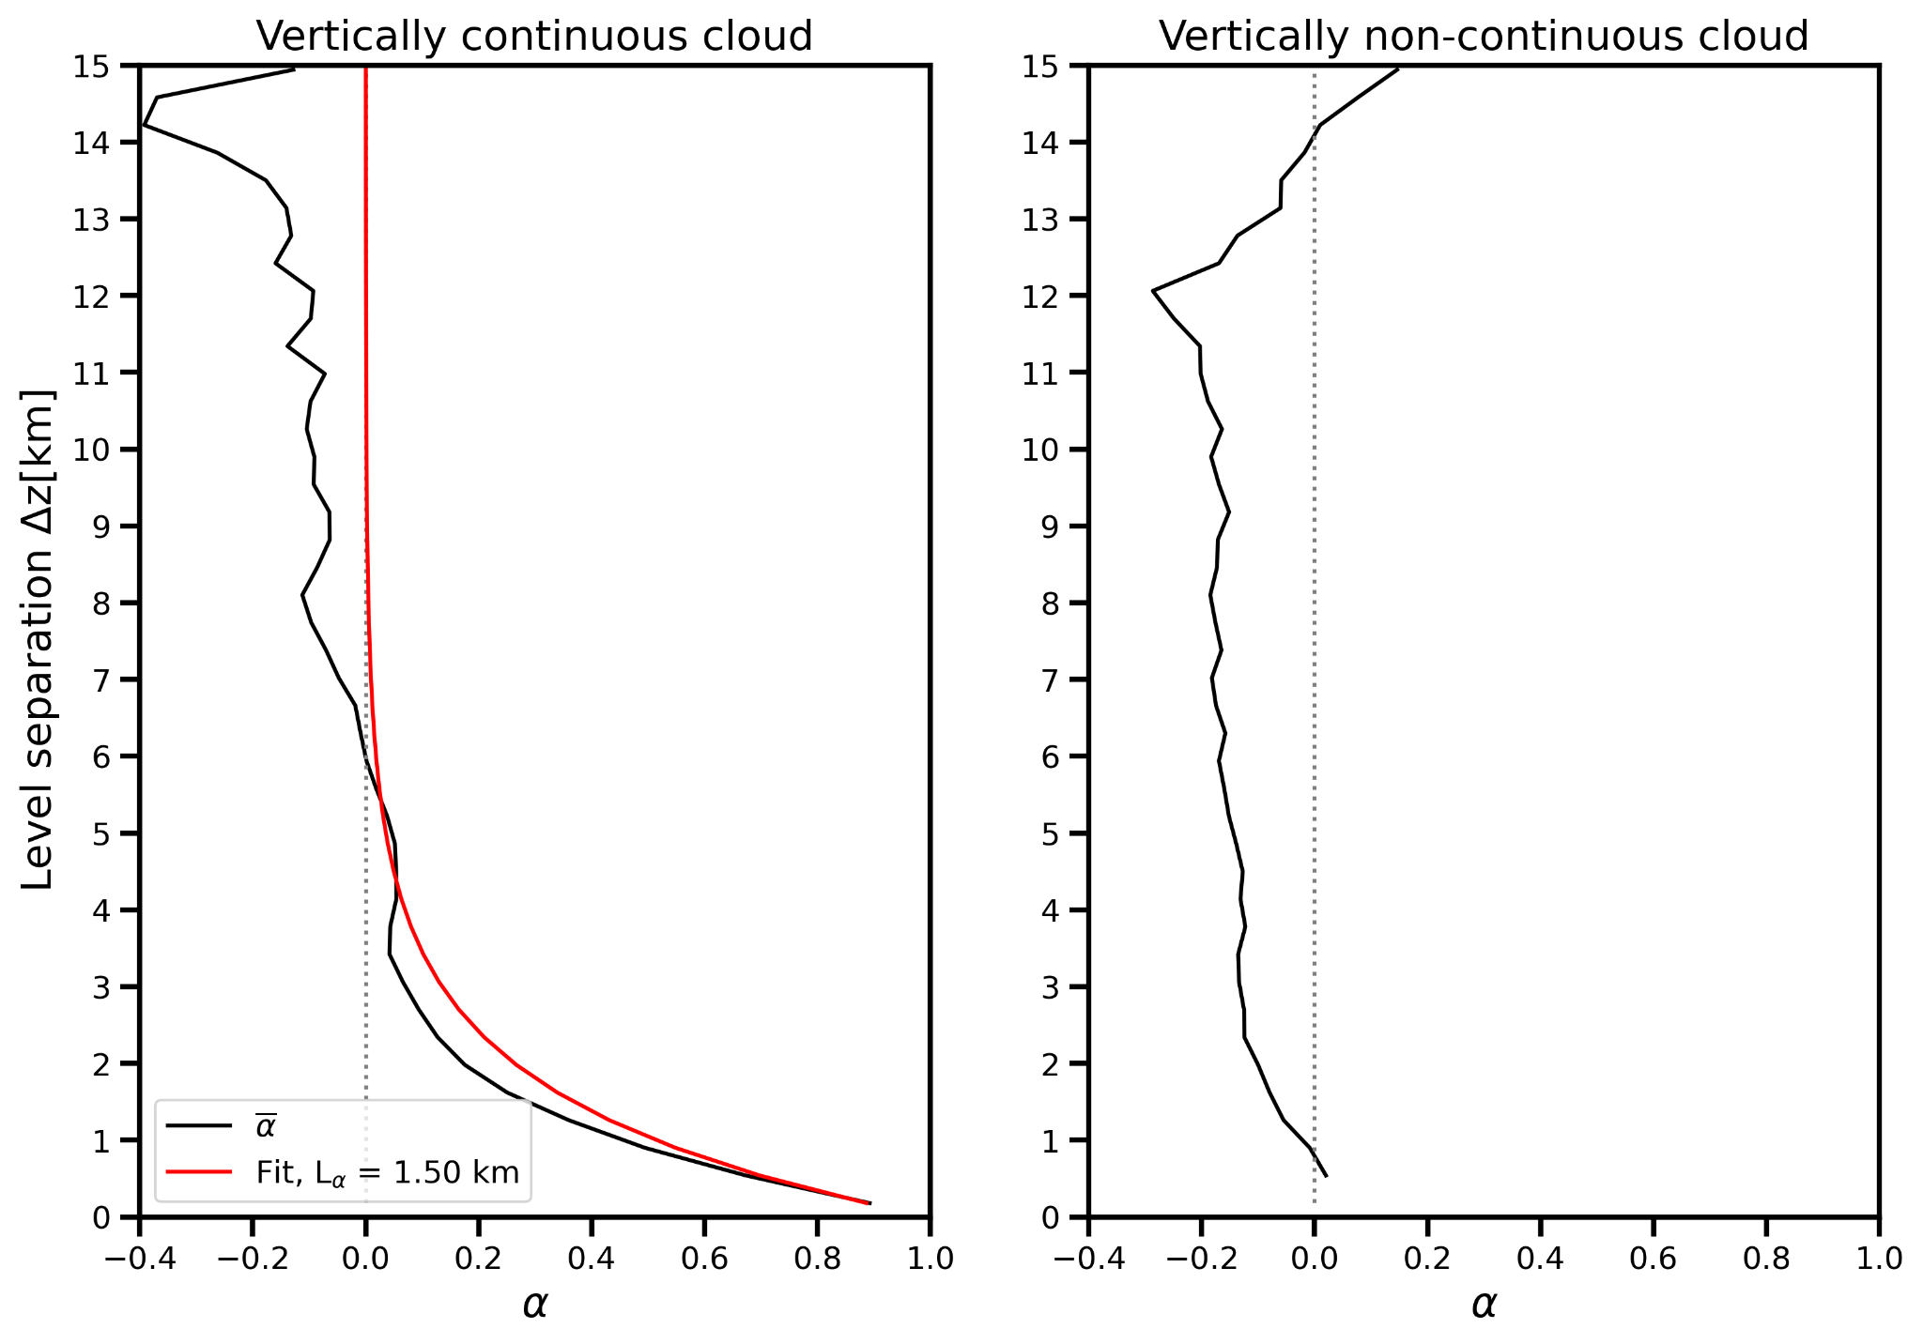
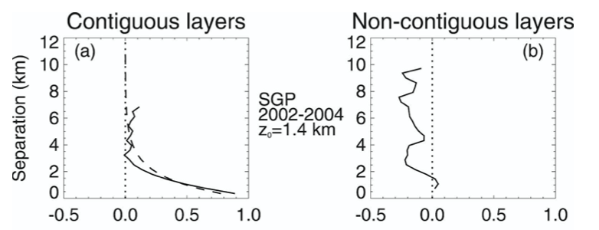
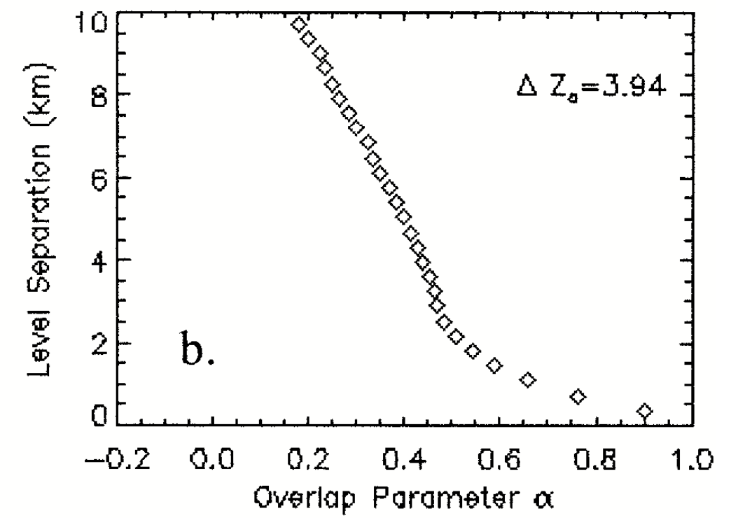
Alpha overlap observations compared to past SGP studies
Naud et al. (2007)
Mace and Benson-Troth (2002)
Note: considering 0<CF<1.0
(top right) Naud et al. (2008): winter only
(bottom right) Mace and Benson-Troth (2002): vertically continuous cloud only

Slide 26
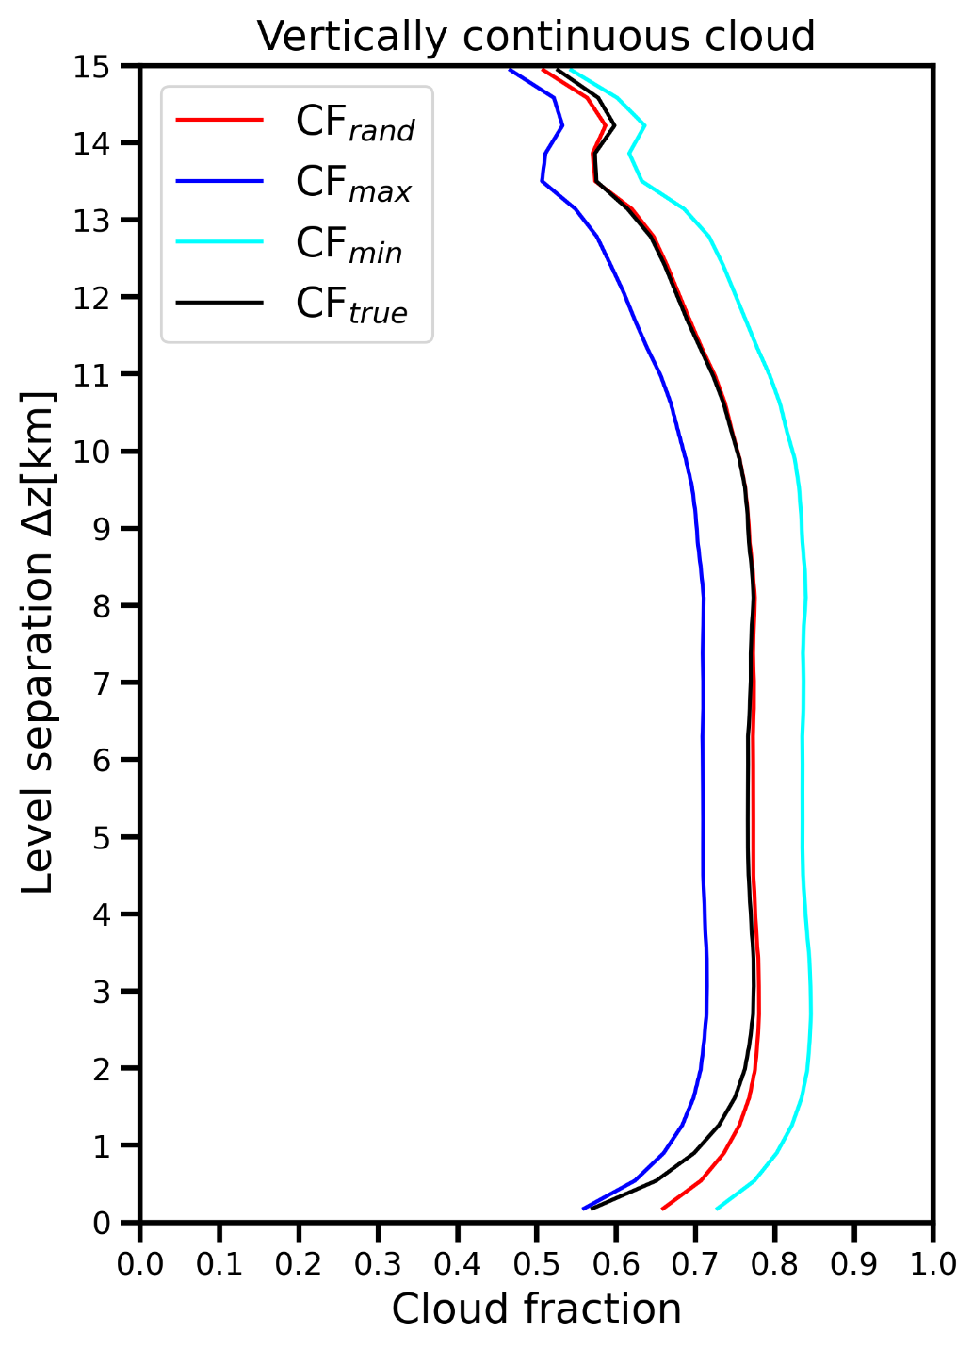
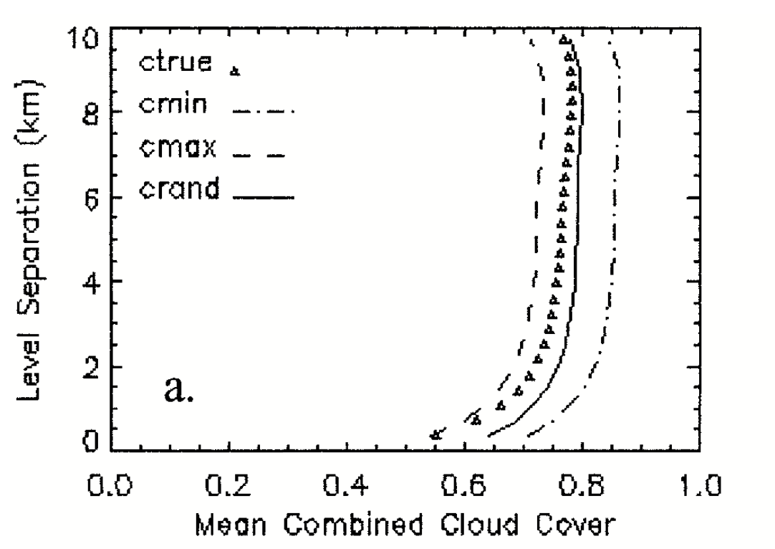
Cloud fraction observations compared to past SGP studies
Mace and Benson-Troth (2002)
Note: both figures are considering 0<CF<1.0

Slide 27
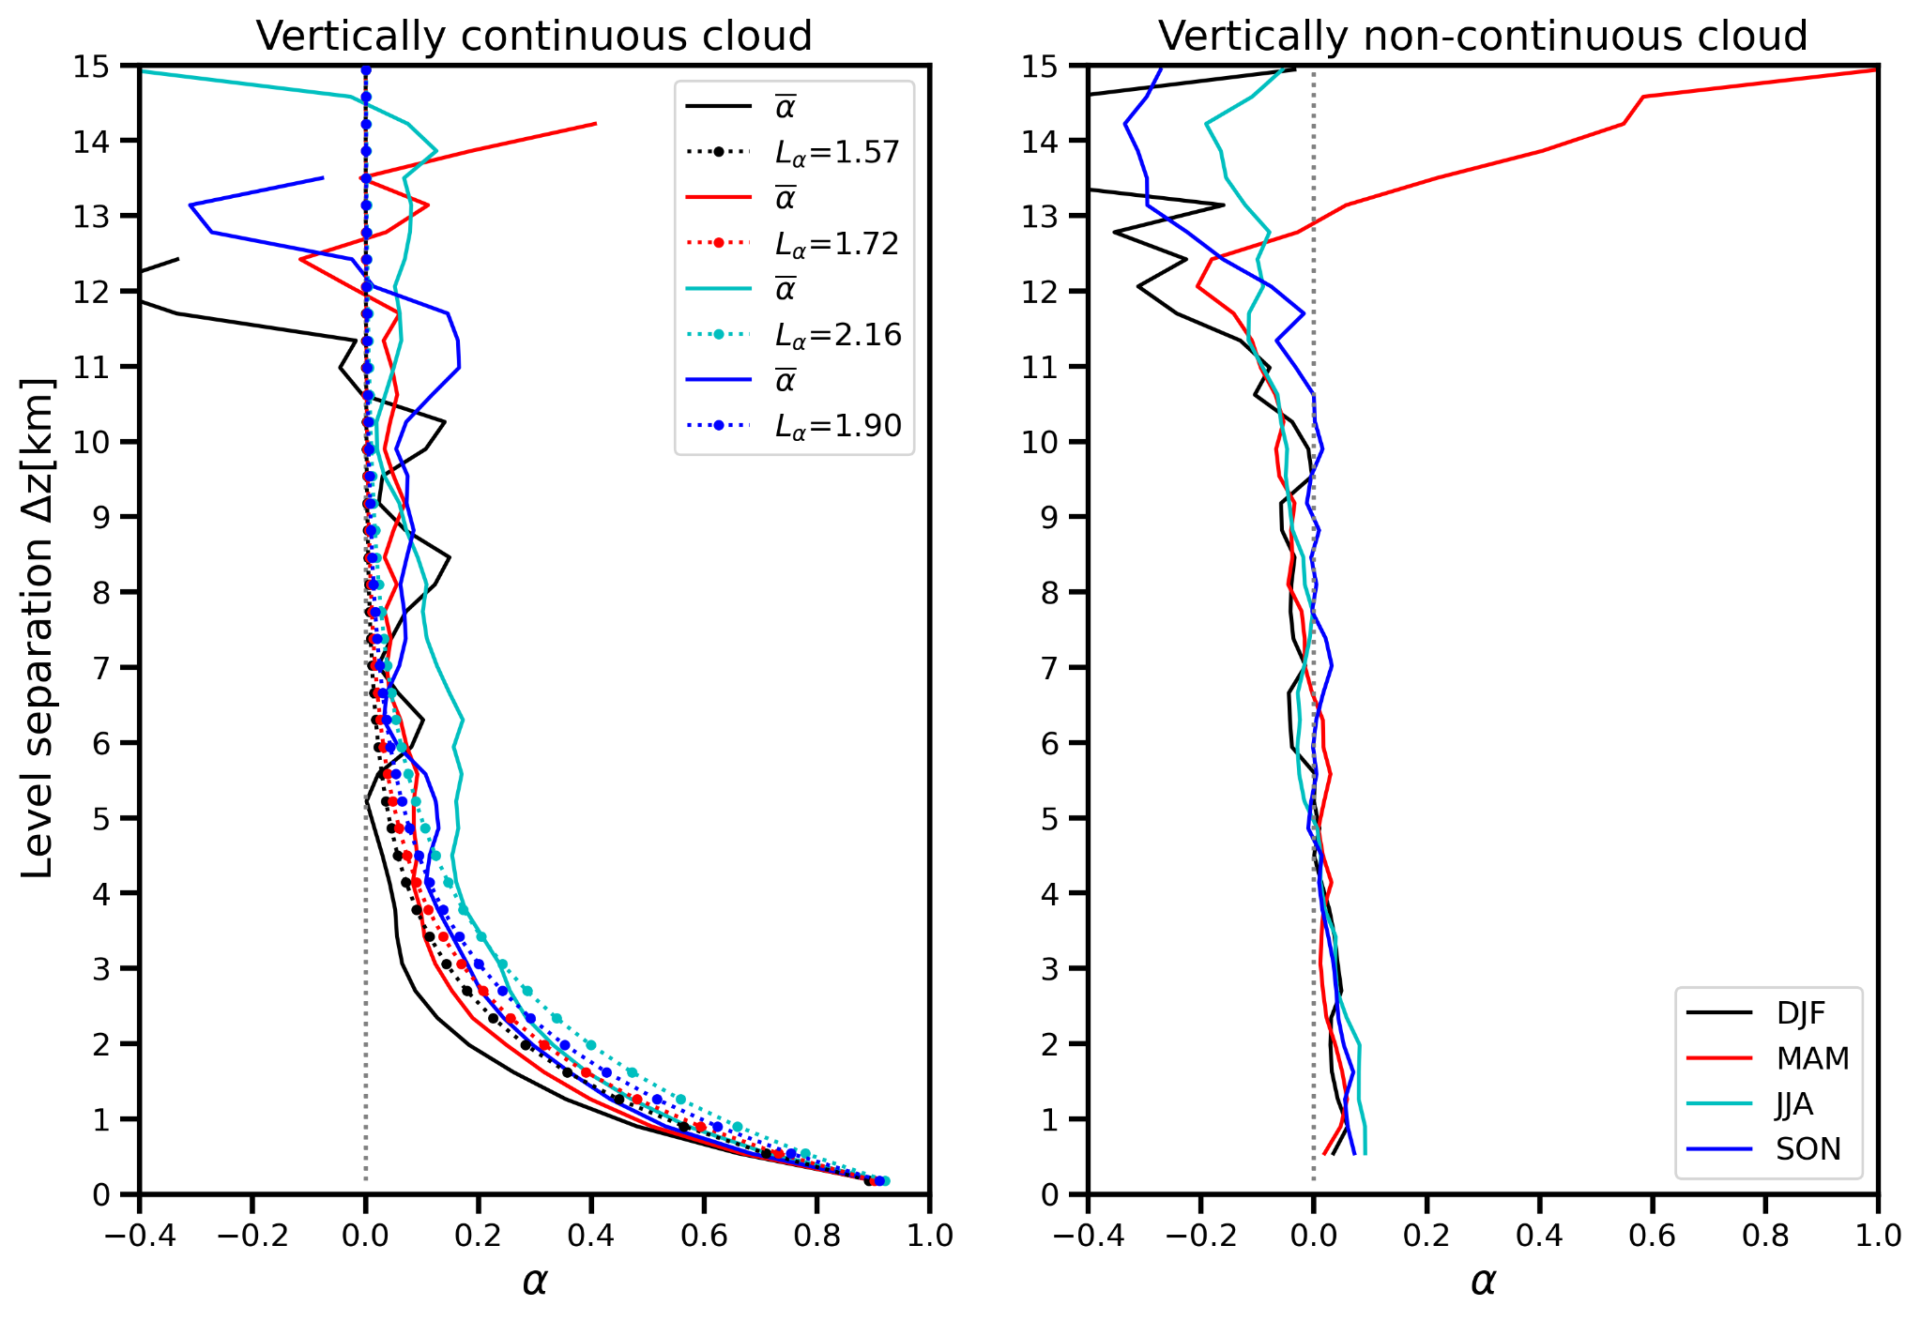
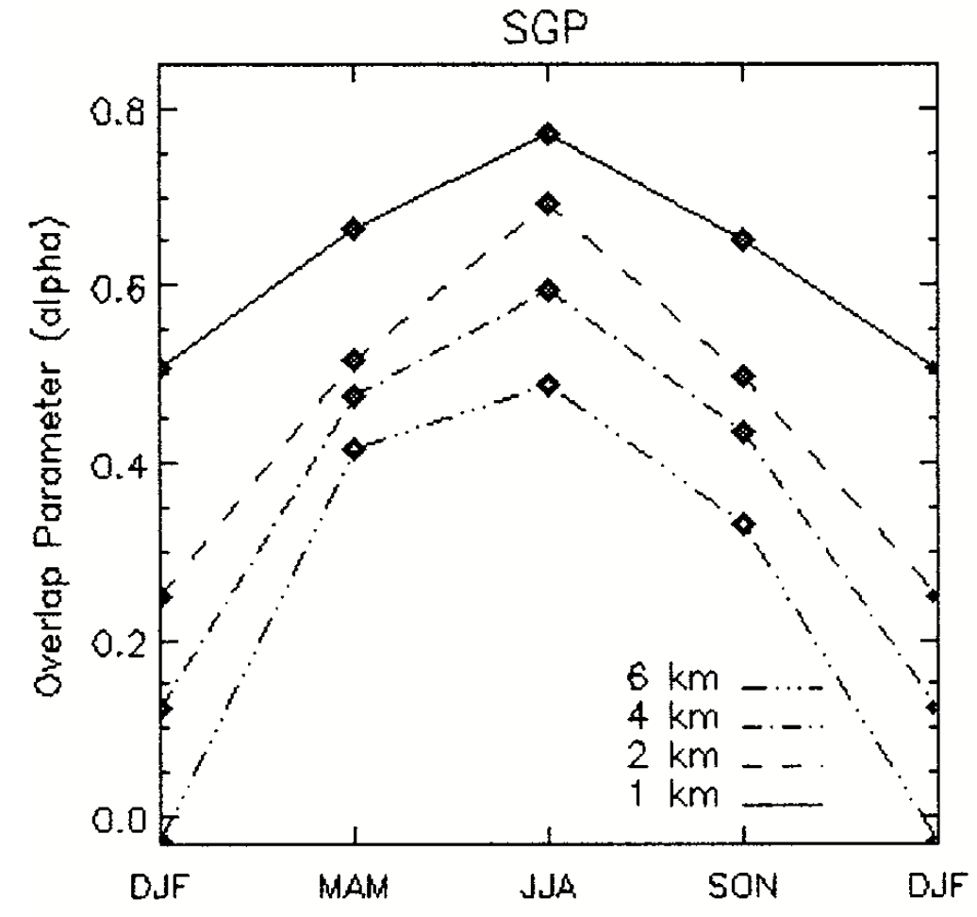
SGP alpha cloud overlap observations, by season
Mace and Benson-Troth (2002)

Slide 28
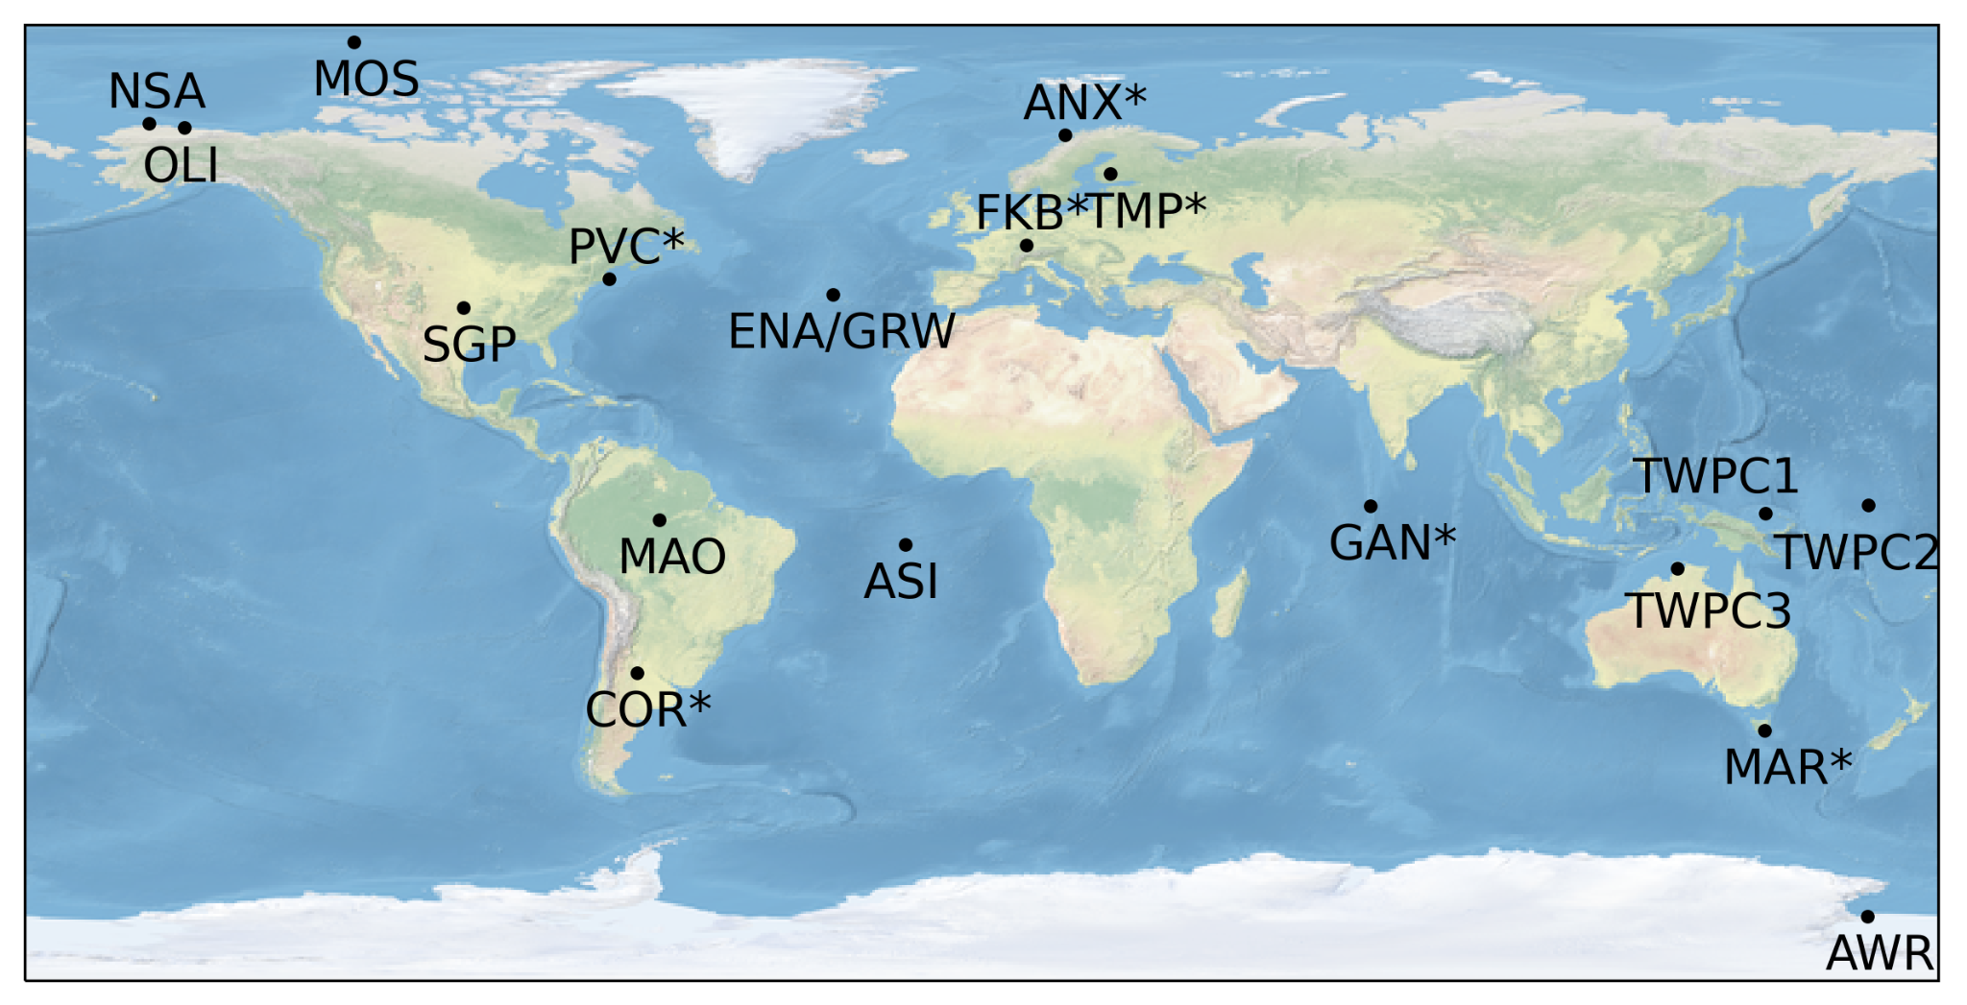
Other ARM sites
Cordoba, Argentina (COR), CACTI
Tropical Western Pacific (TWP)
    C1: Manus, Papua New Guinea
    C2: Nauru Island
    C3: Darwin, Australia
Azores, Eastern North Atlantic (ENA/GRW)
Oliktok Point, Alaska (OLI)
Gan Island, Maldives (GAN)
Hyytiälä, Finland (TMP)
McMurdo Station, Antarctica (AWR)
Ascension Island, S. Atlantic (ASI)
MOSAiC (MOS)
Andenes, Norway (ANX)
North Slope of Alaska (NSA)
Black Forest, Germany (FKB)
Cape Cod, USA; TCAP (PVC)
Manacapuru, Brazil; GOAMAZON (MAO)
MARCUS (MAR)
* indicates site with <1 year of data

Slide 29
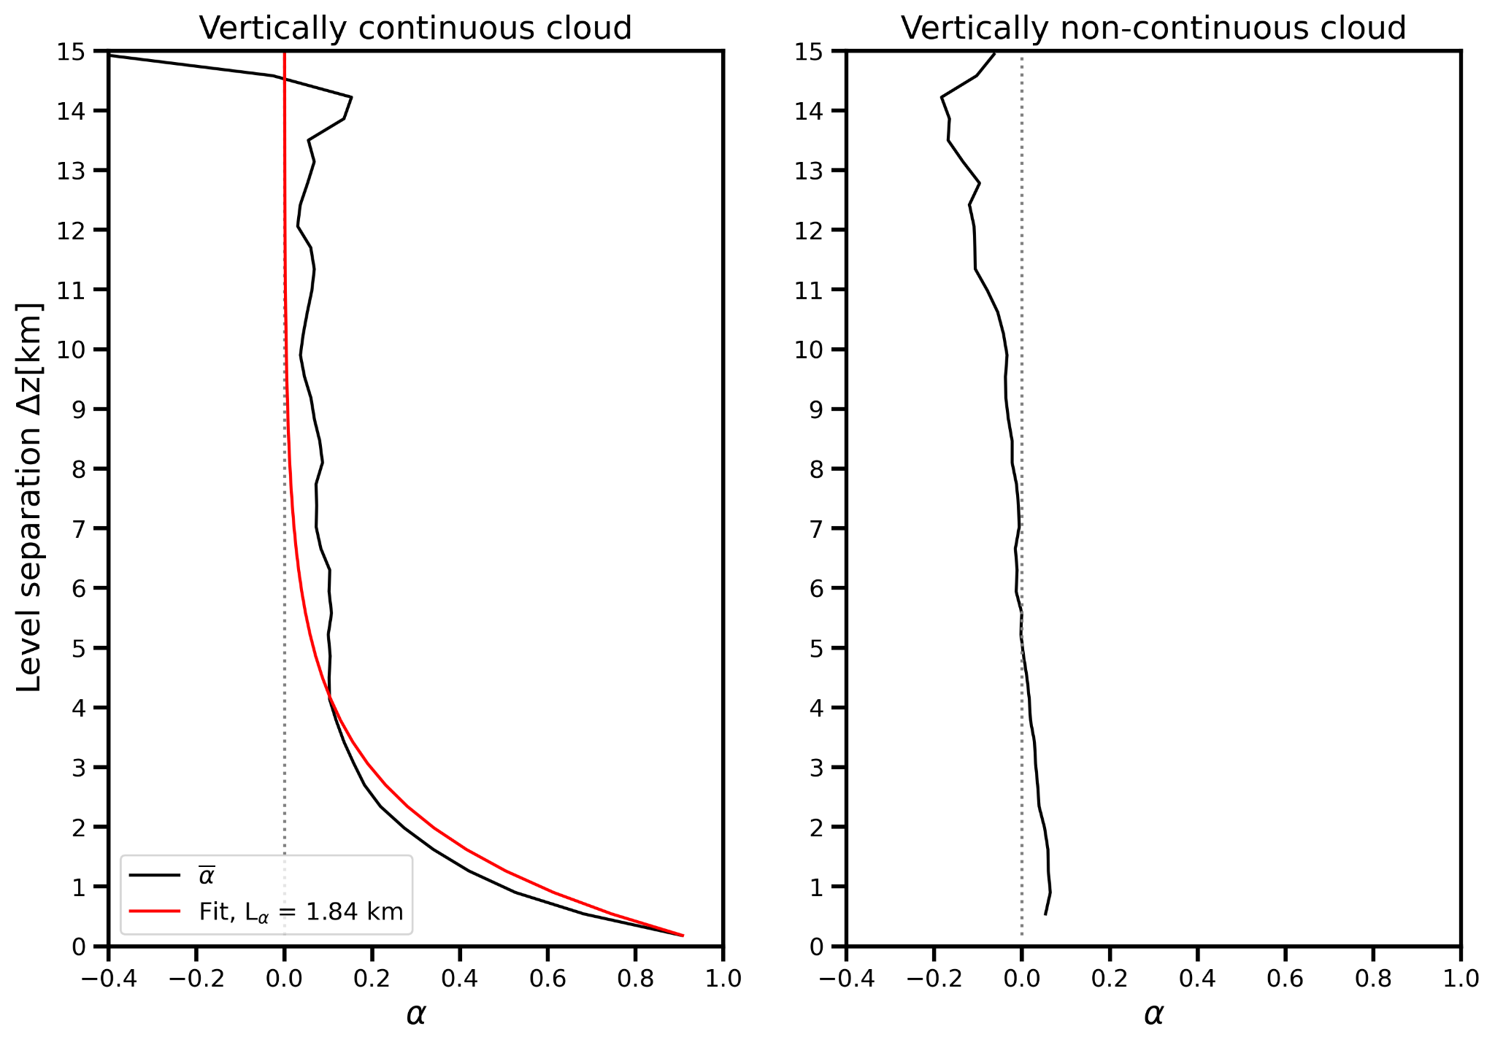
SGP decorrelation length scale: CF<1.0 vs CF<0.5
0< layer CF <1.0
e.g., Hogan and Illingworth (2000), Mace and Benson-Troth (2002), Naud et al. (2008)
0< layer CF <0.5
Reduces impact of data truncation on the results, e.g., Tompkins and Di Giuseppe (2015), Li et al. (2019)

Slide 30
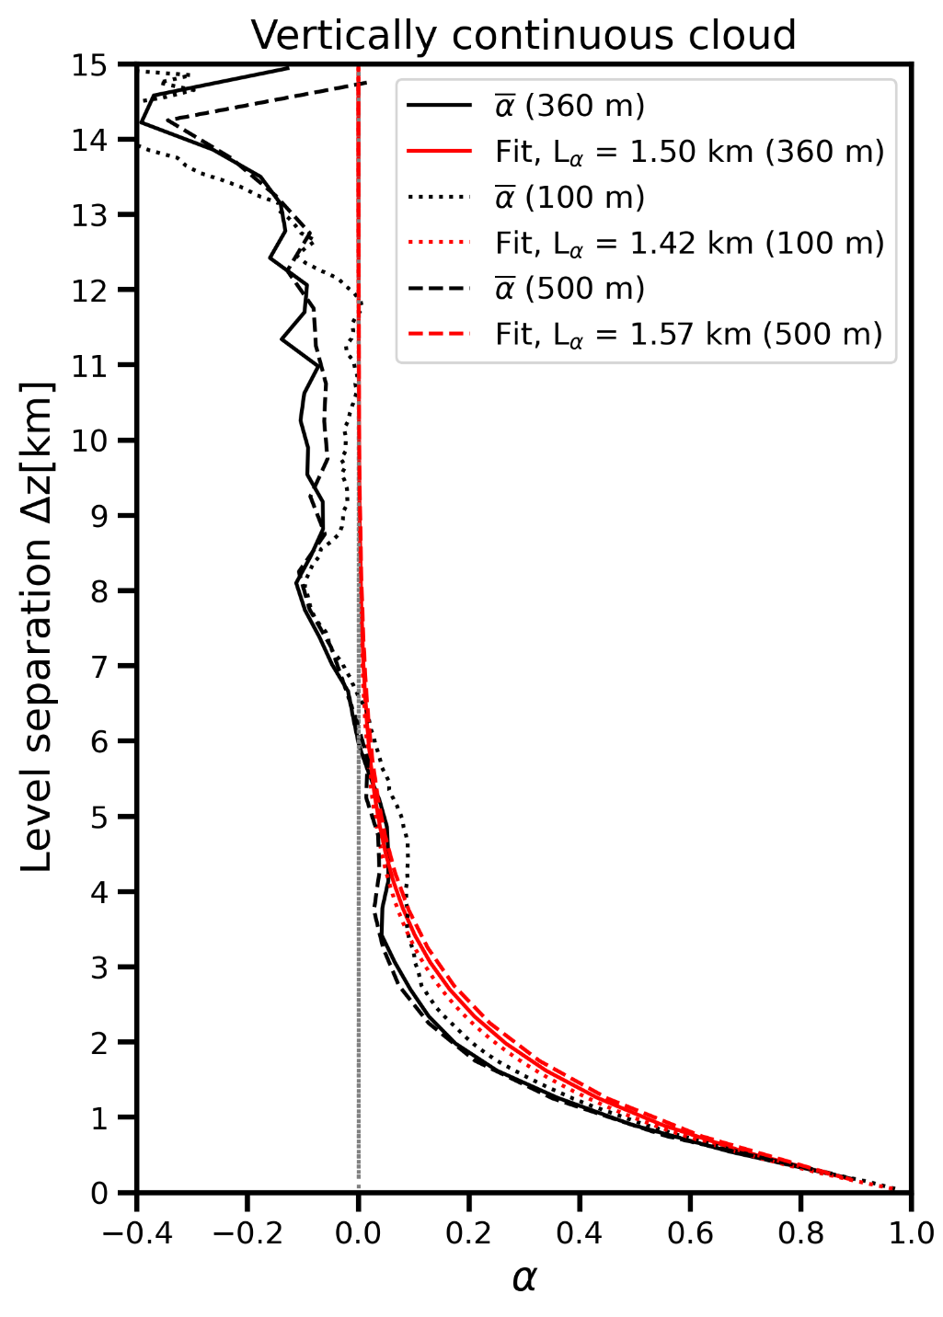
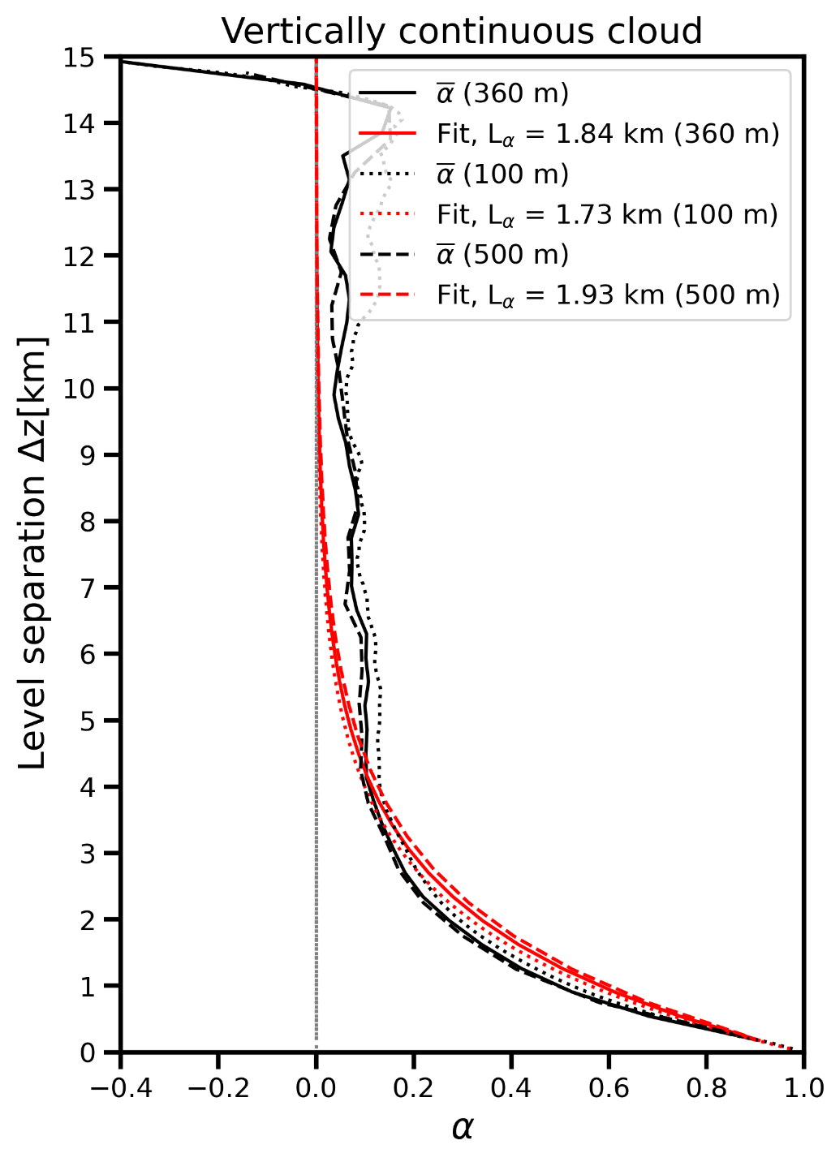
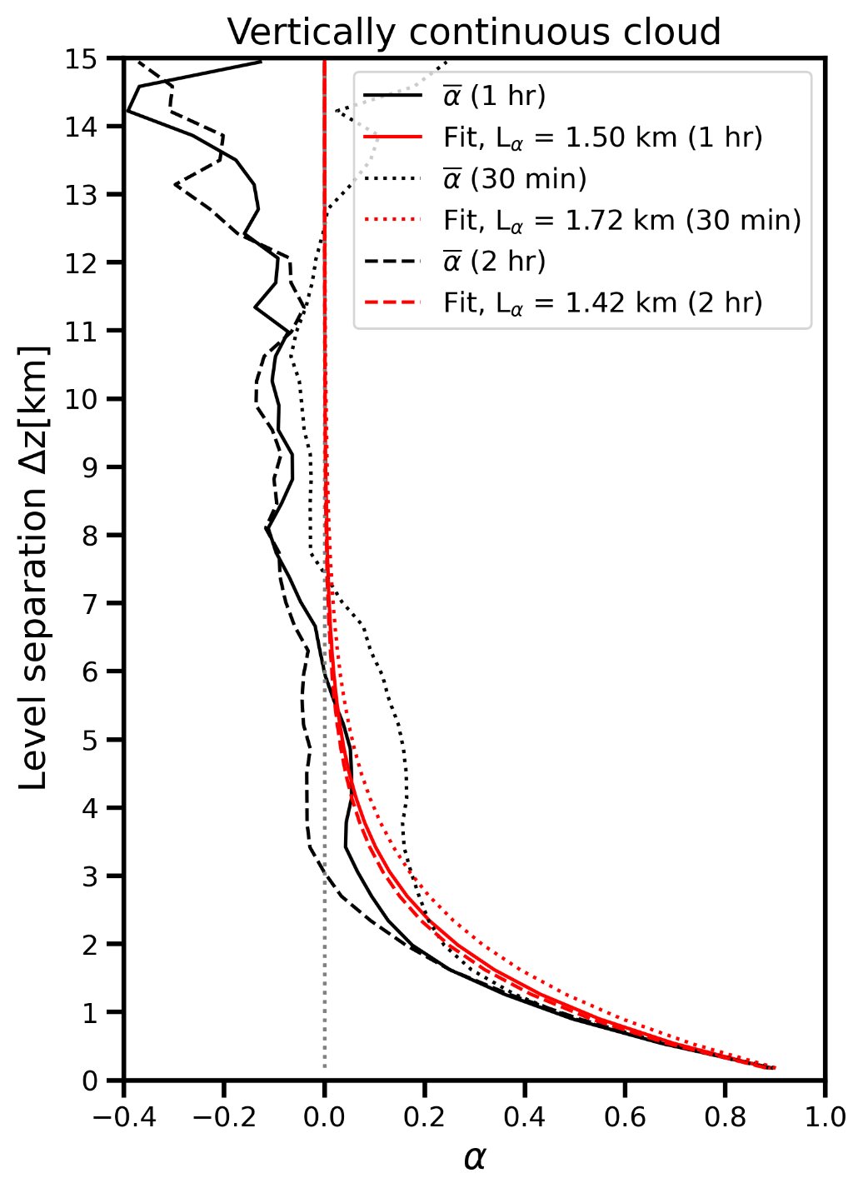
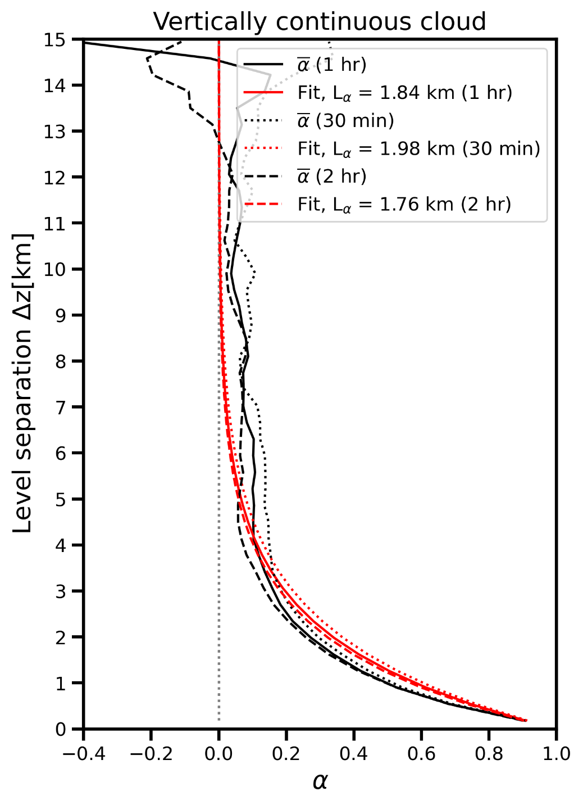
CF<0.5 decorrelation length sensitivity
Vertical resolution
Temporal resolution
0<CF<1.0
0<CF<0.5
0<CF<1.0
0<CF<0.5

Slide 31
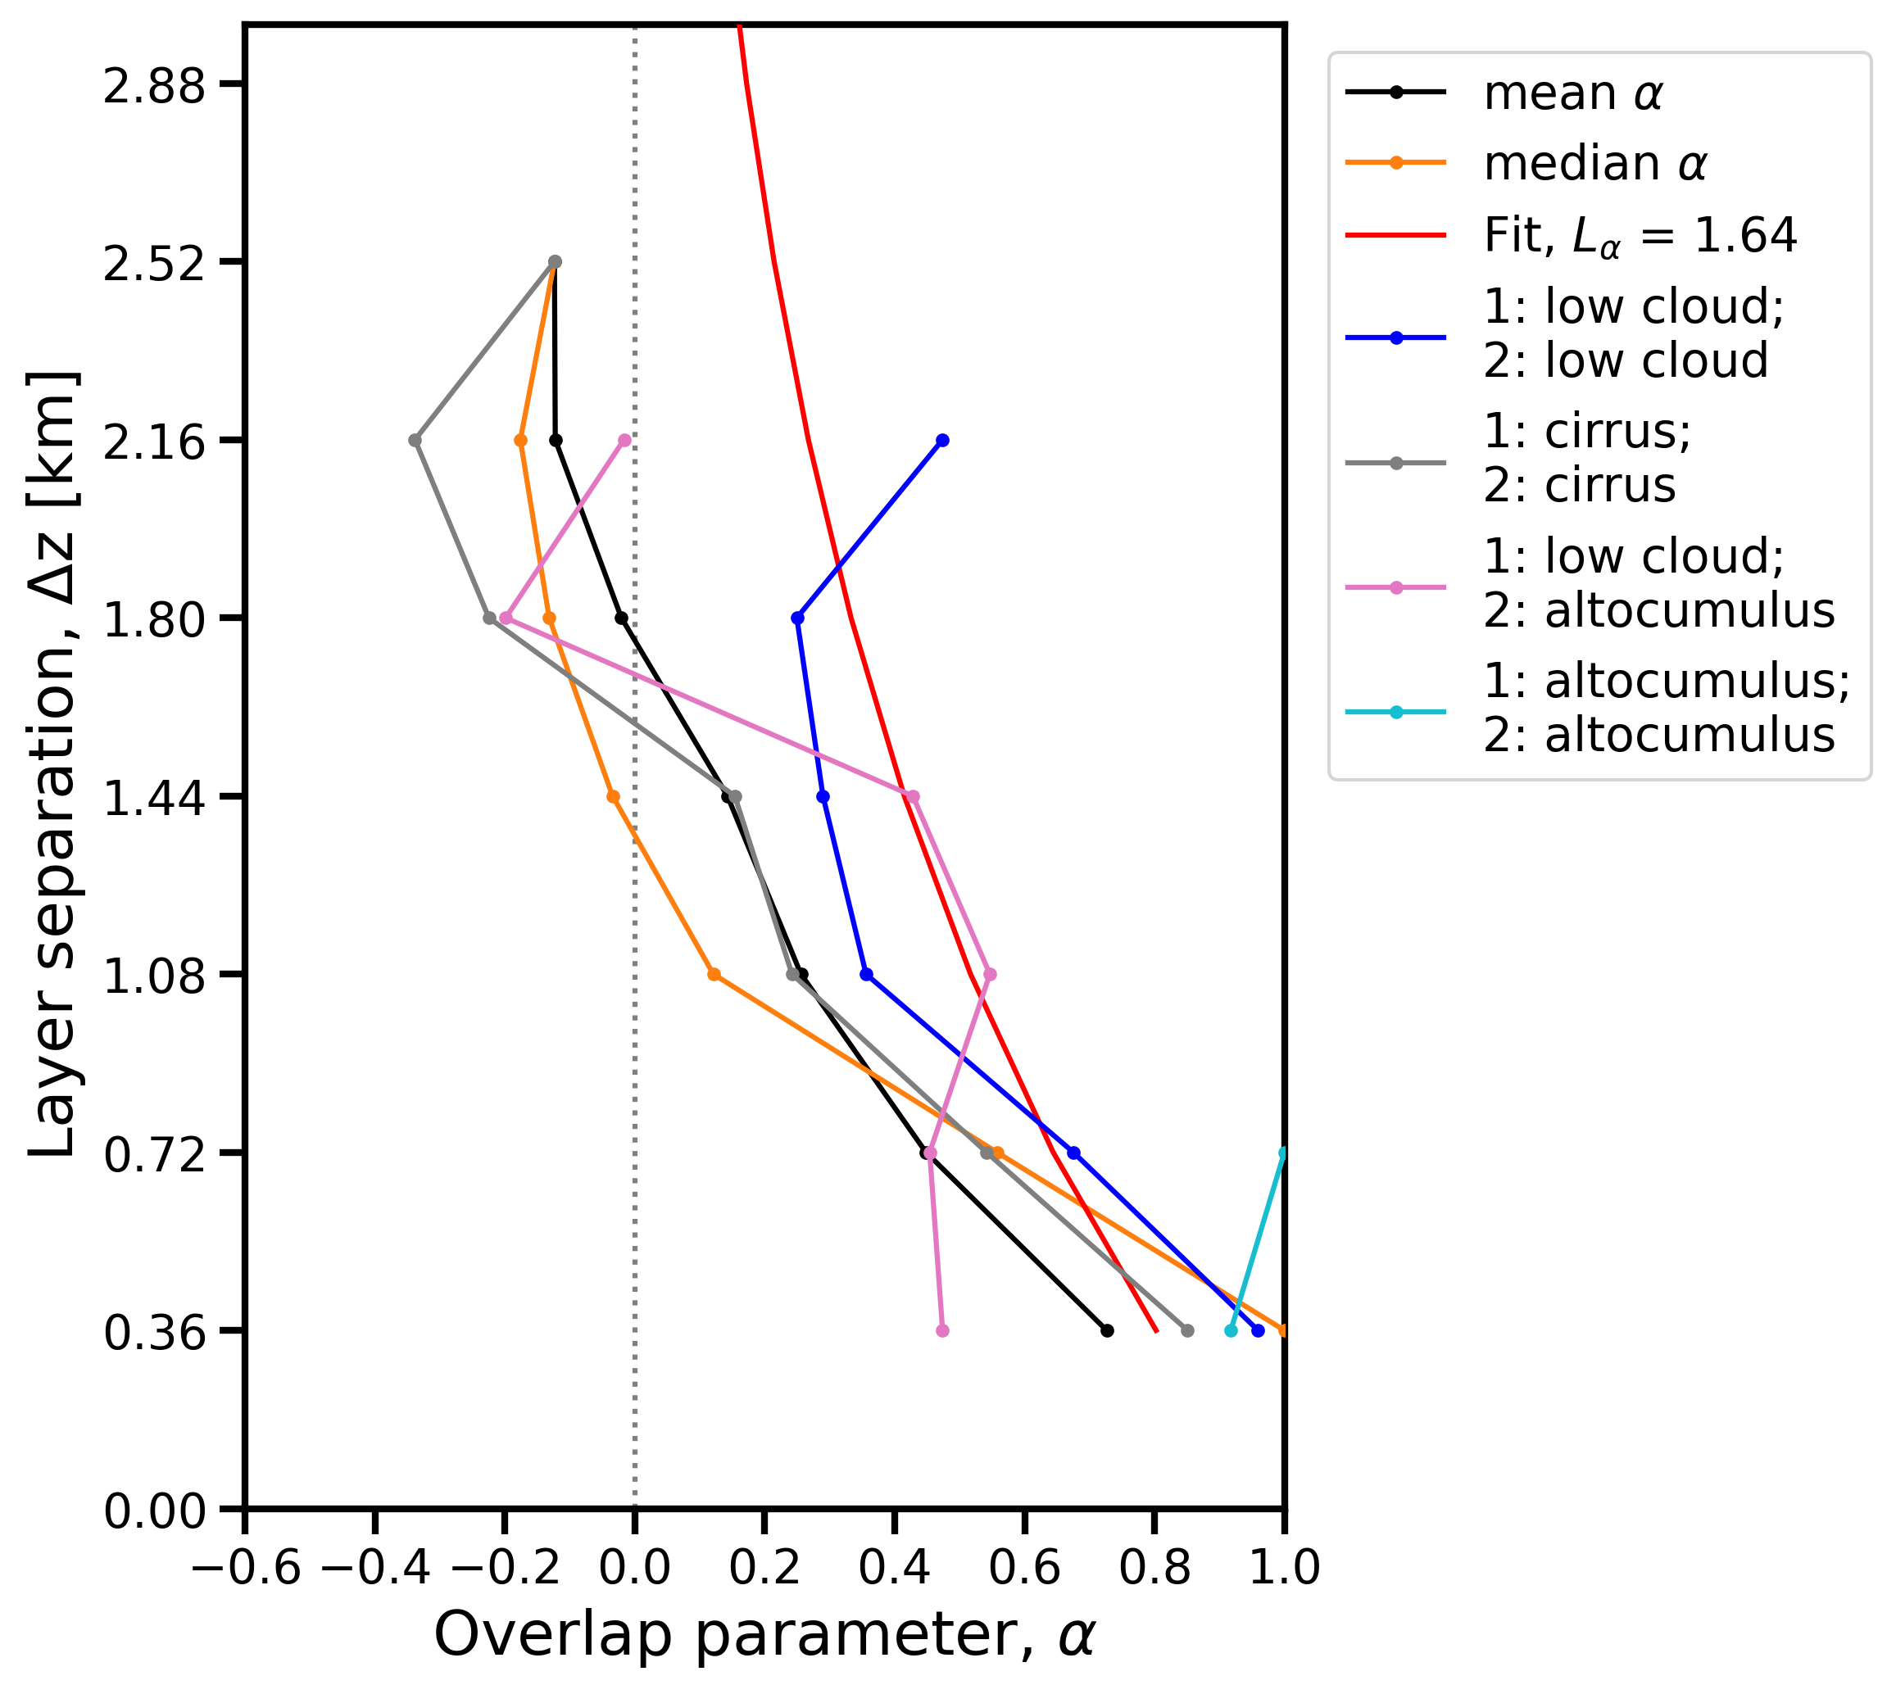
Shallow cumulus overlap observations
Constrained cloud overlap observations to shallow cumulus times
  From the “shallowcumulus” data product

Slide 32
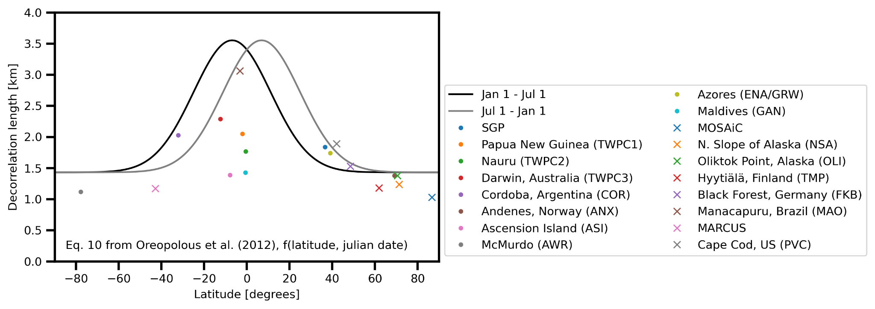
Decorrelation length scale vs latitude

Slide 33
RRTM sensitivity runs (overlap methods, decorrelation length)

Slide 34
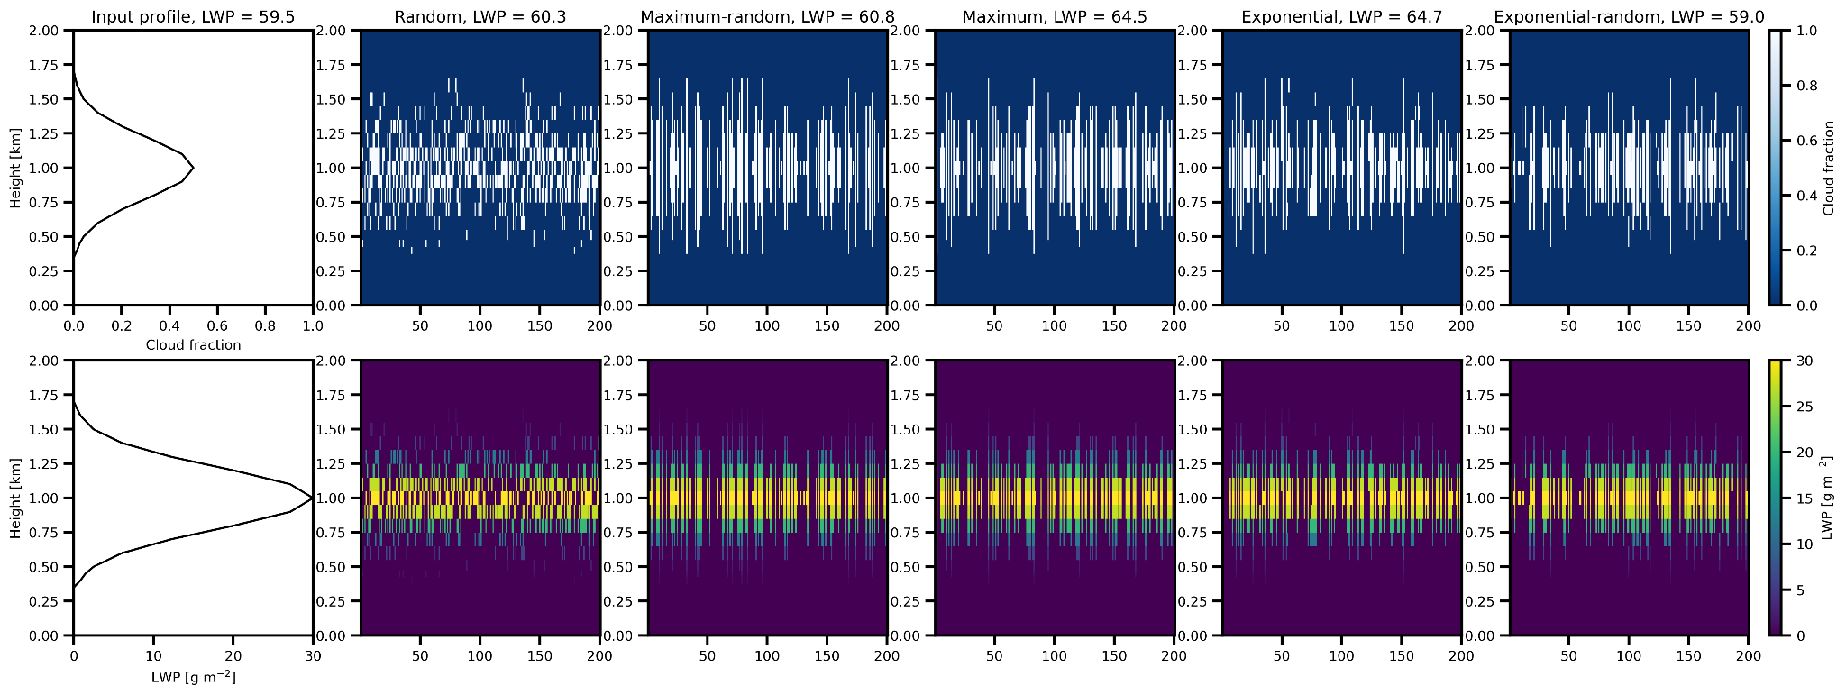
Stochastic clouds for liquid cloud at 1 km, overlap method
Notes:
SZA = 57.78

Slide 35
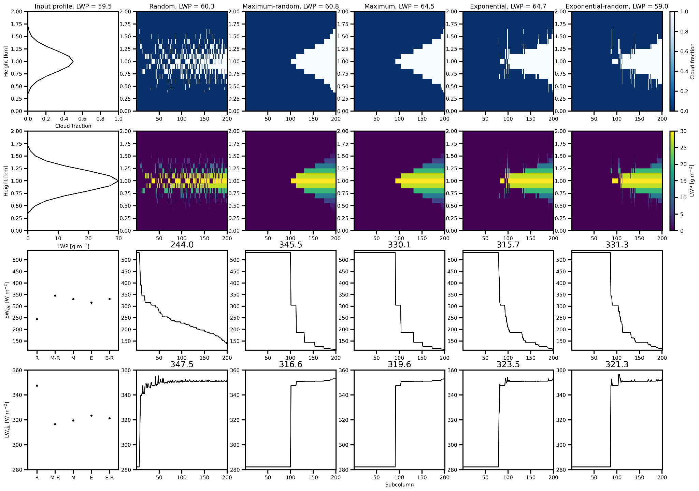
Stochastic clouds for liq. cloud, 1 km inputted into RRTM
Randomly generated but subcolumns sorted by increasing LWP
SWD ranges from 244.0 to 345.5 W m⁻²
LWD ranges from 316.6 to 347.5 W m⁻²

Slide 36
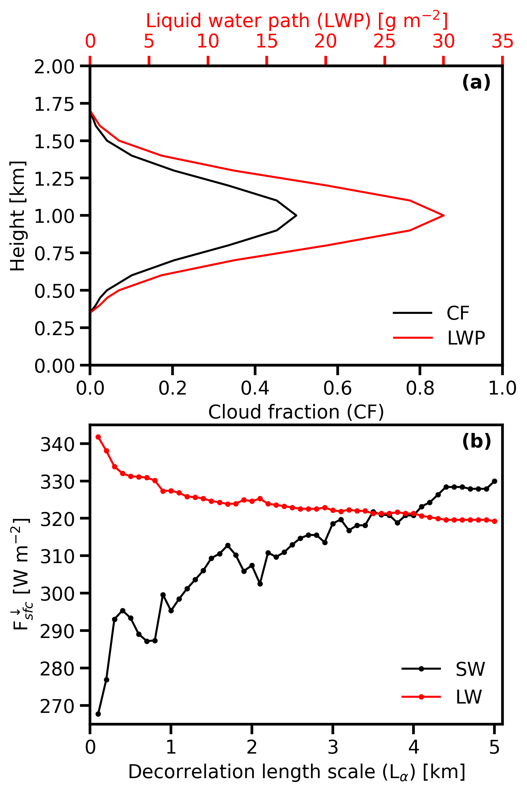
Decorrelation length scale impacts on surface fluxes
SW_{down} increases with decorrelation length, LW_{down} decreases with decorrelation length

Slide 37
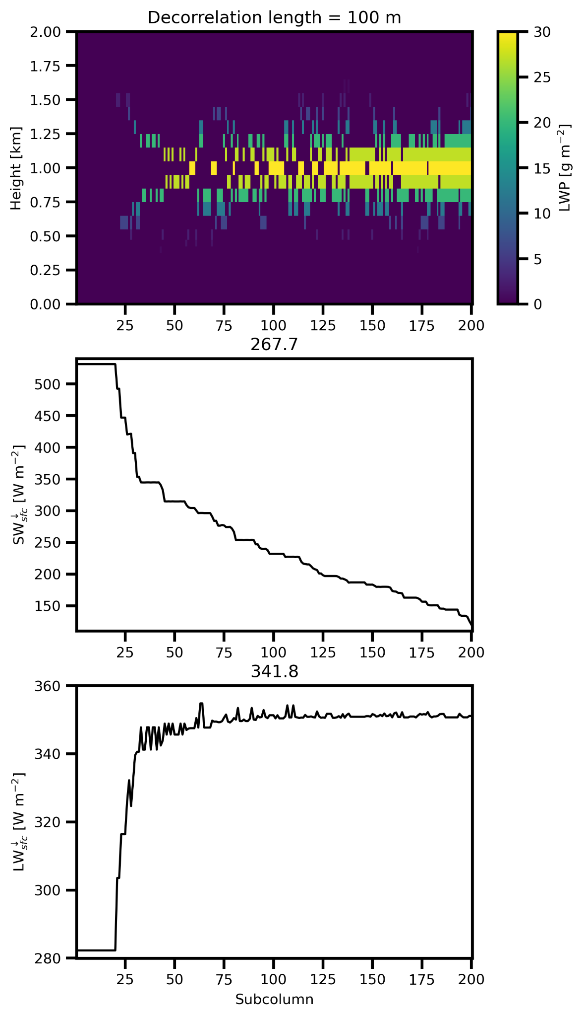
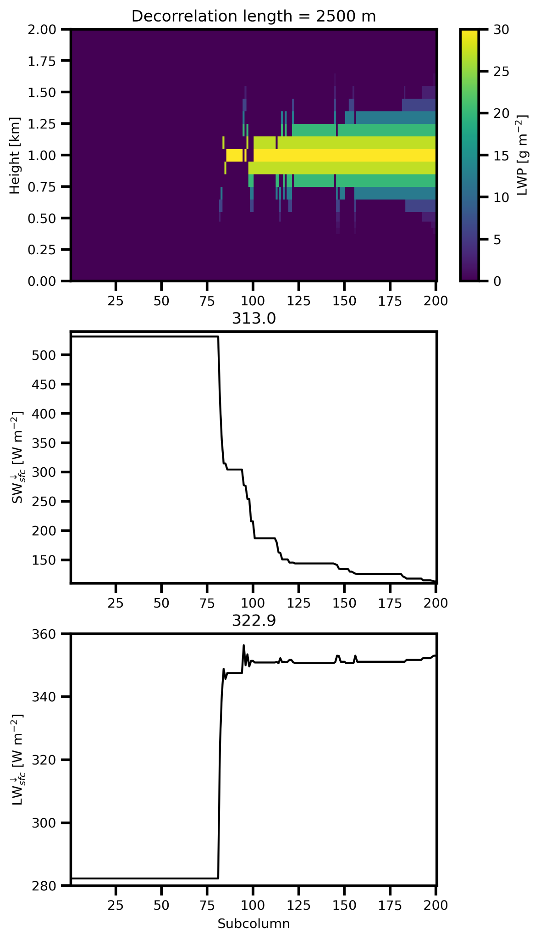
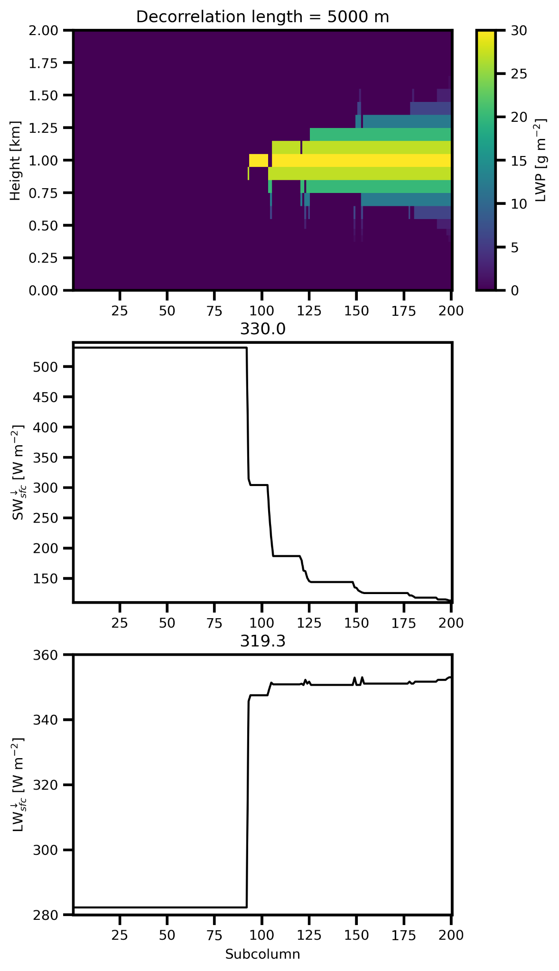
Decorrelation length impacts on surface fluxes
Randomly generated but subcolumns sorted by increasing LWP
Increasing clear-sky profiles with increasing decorrelation length

