Slide 1



A theory for deep convection initiation based on cloud base area and environmental saturation deficit
Hugh Morrison¹, John Peters², Kamal Kant Chandrakar¹,
Steven Sherwood³
¹MMM Laboratory, National Center for Atmospheric Research
²Pennsylvania State University/Naval Postgraduate School
³Climate Change Research Centre, University of New South Wales
3rd Pan-GASS Meeting
July 28, 2022
NCAR is a Federally Funded Research and Development Center, sponsored by the National Science Foundation.

Slide 2
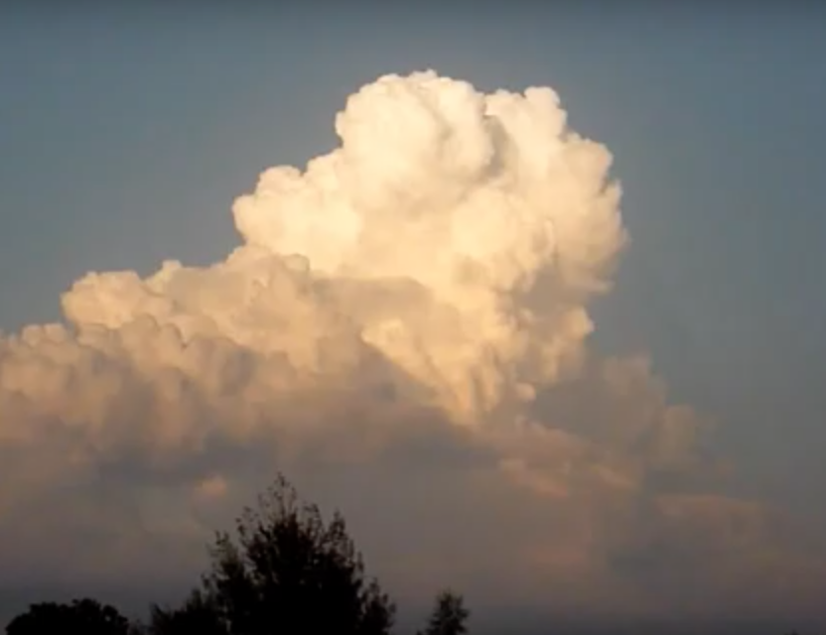
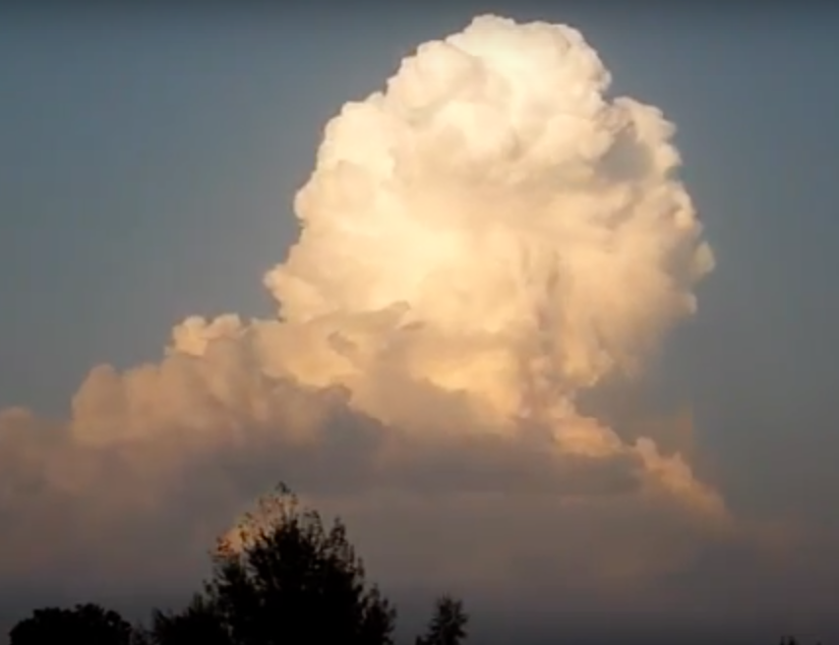
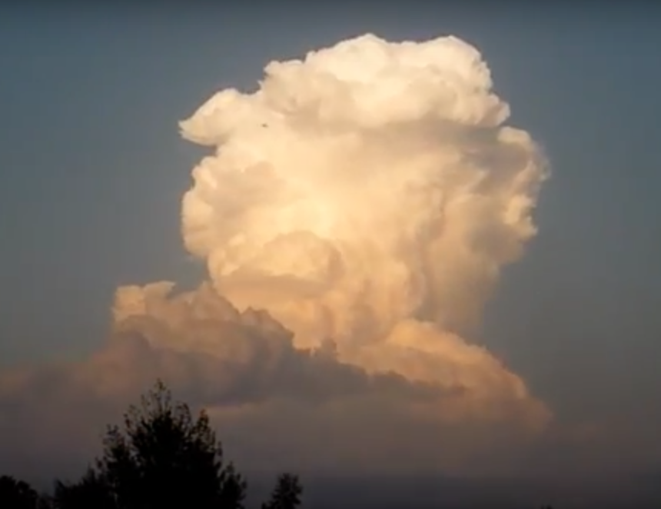
A requirement for deep convection initiation is existence of CAPE with a LNB in upper troposphere, and ability of parcels to overcome CIN.
However… this doesn’t tell the full story. It is very common to meet these conditions across a wide region but not have deep convection.
What are the additional factors controlling whether deep convection initiates?
Notes:
e.g., Critical for severe convective weather (lack of CI can be implicated in “bust” forecasts). Critical for diurnal cycle of precip in climate models..

Slide 3
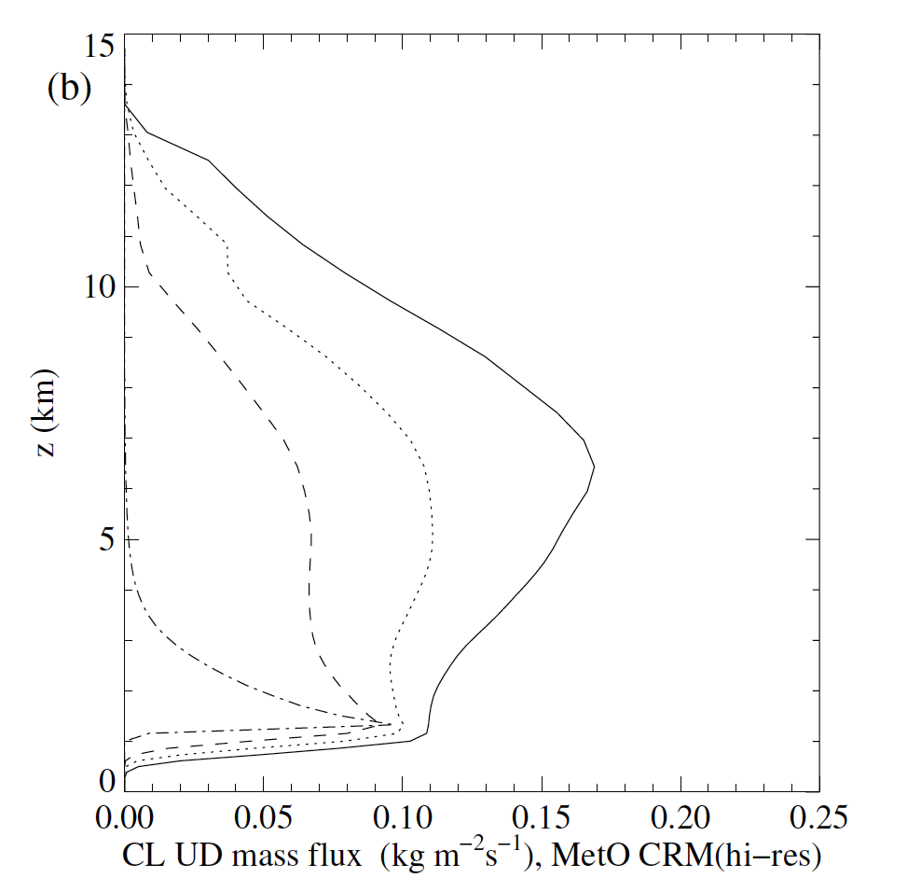
The connection to environmental relative humidity
Numerous studies going back decades have shown a close connection between the propensity for convection going deep and the environmental RH above the LFC*.
This occurs main because of effects on cloud evaporation from entrainment/mixing, not virtual effects of water vapor on density (buoyancy) which are small.
Moist
(RH = 90%)
Derbyshire et al.
2004, QJRMS
*This includes idea of moisture pre-conditioning, where shallower clouds deposit mid-tropospheric moisture which enhances subsequent cloud development.
Dry
(RH = 25%)

Slide 4
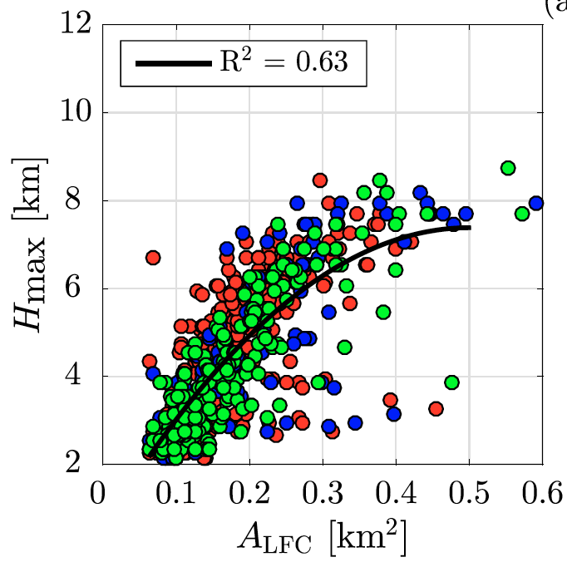
Other studies have suggested the role of cloud width
Wider clouds → relatively less dilution by entrainment (see, e.g., Khairoutdinov and Randall 2006, Kuang and Bretherton 2006, others)
Rouseau-Rizzi et al. 2017, JAS

Slide 5
Basic science questions
Are these two factors (RH and R) related in how they influence deep convective initiation? What are their relative roles?
Can a simple scaling explain how these factors impact deep convection initiation in a simple framework that controls for other factors?
Methods:
Idealized large-eddy simulation (LES) using CM1
Theoretical analysis with a simple updraft dilution model
Morrison, H., J. M. Peters, K. K. Chandrakar, and S. C. Sherwood, 2022: Influences of environmental relative humidity and horizontal scale of sub-cloud ascent on deep convective initiation. J. Atmos. Sci., 79, 337-359.

Slide 6
CM1 (Bryan and Fritsch 2002) model setup:
Dx = Dy = Dz = 50 m
Microphysics with saturation adjustment only (cloud condensation/evaporation) → no precip!
Initial environment is unsheared
Weisman-Klemp sounding but modified environmental RH above 2 km: 30, 60, 90%.
Three ensemble members for each configuration (different seeds for initial noise applied to theta field).
Forced by surface fluxes following 10th International Cloud Modeling Workshop cumulus congestus case →
- horizontally-unform 1st hour (to spin up BL turbulence)
- horizontally-varying (Gaussian-shaped) after 1 hour to
generate low-level circulation.

Slide 7
LES forcing
~1 km
Hour 0 to 1: Uniform surface fluxes to spin up PBL turbulence
Uniform surface sensible and latent heat fluxes
Hours 1 to 3: Uniform + Gaussian-shaped surface flux to generate low-level circulation. Horizontal scale of sub-cloud ascent is controlled by L_{H} = 1, 1.5, 2.5, or 4 km.
L_{H}
Uniform surface + Gaussian shaped sensible and latent heat fluxes

Slide 8
CM1 Results
Vertical cross section snapshots at the times indicated of vertical velocity (color fill) and buoyancy (black contour lines) for narrow (left) and wide (right) updrafts at cloud base, for the humid
(RH = 0.9) environment.
w

Slide 9
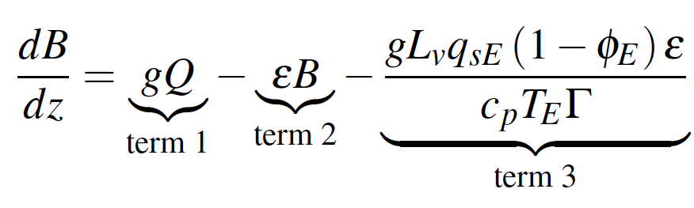
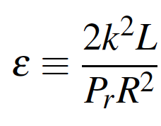
A simple dilution model
(follows from Morrison 2017, JAS; Morrison et al. 2020, JAS)
Obtain expression for buoyancy B of a rising cloud parcel → apply first-order k-theory to lateral mixing of T and q_{v} in a parcel near top of a rising updraft. Approximate horizontal derivates as a simple linear finite difference. Neglect vertical mixing. This gives:
k = mixing constant
Pr = Prandtl number
L = turbulent mixing length
R = cloud radius
Φ_{E} = environmental relative humidity
L_{v} = latent heat of vaporization
Γ = (1+L_{v}/c_{p})dq_{s}/dT
g = accel. of gravity
Q = environmental minus moist pseudo-
adiabatic lapse rate divided by T_{E}
T_{E} = environmental temperature
q_{SE} = environmental saturation mixing ratio

Slide 10
Results of LES and simple model
Equilibrium height
Rapid shift from shallow to deep with changes in R of ~200-400 m, values of R where this happens increases with decreasing RH
Red (RH = 0.9)
Green (RH = 0.6)
Blue (RH = 0.3)
Lines: theory
Crosses: CM1 LES for each ensemble member averaged from 140-180 min

Slide 11
Results: simple model
Use two thermodynamic soundings:
1) Weisman-Klemp modified with constant RH above 2 km (High CAPE)
–> identical to CM1 runs
2) reduced lapse rate above LFC so that pseudo-adiabatic buoyancy (and
thus CAPE) is uniformly reduced by a factor of 4 (Low CAPE).
Integrate dB/dz equation numerically, find equilibrium height (height above LFC where buoyancy goes to 0).
R²/(1-φ_{E}) = 2.25
R²/(1-φ_{E}) = 0.52

Slide 12
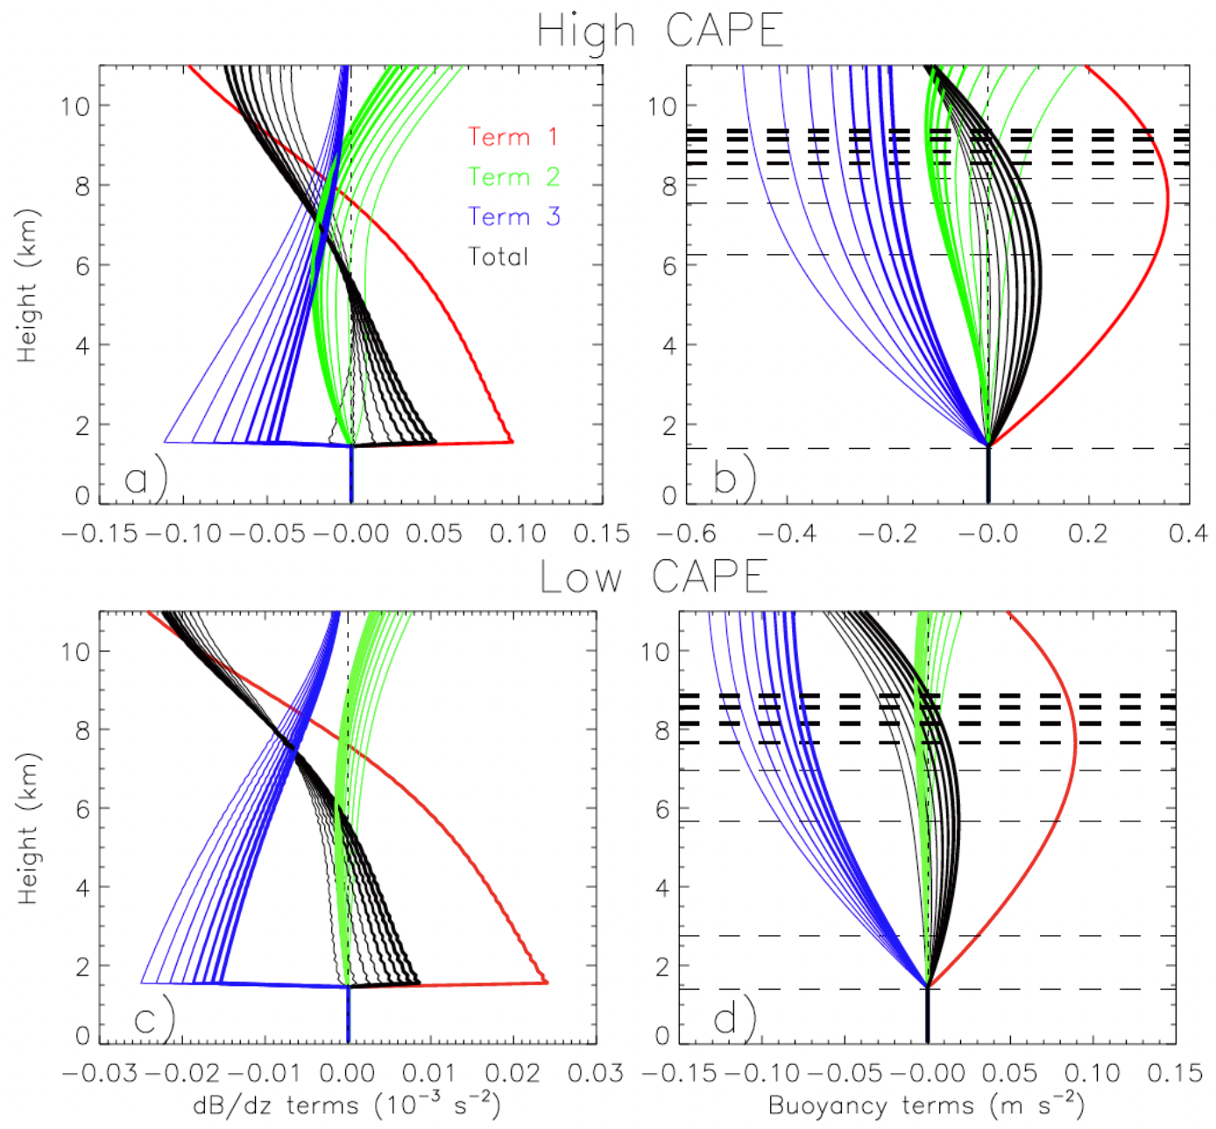
Why such a sharp transition with R and scaling with R²/(1-φ_{E})?
Since the dB/dz profile is mainly a balance between production by term 1 and sink from term 3, this implies dB/dz < 0 when
|term 1|/|term 3| < 1.
We can set dB/dz = 0 to find this transition point, neglect term 2, use the expression for ε, and rearrange terms to show transition to deep convection occurs when the ratio R²/(1-φ_{E}) is greater than a certain lapse rate-dependent threshold value (dashed lines in the figure in the previous slide).

Slide 13
Conclusions
These results support the idea of a scale selection controlling deep convection initiation under idealized conditions:
In environments potentially supporting deep convection, initiation occurs when the area of cloud base (or sub-cloud ascent) exceeds a certain threshold scale, and this scale decreases with an increase in environmental relative humidity (and lapse rate).
The transition to deep convection in the space of (R, φ_{E}) is well described by curves of constant R²/(1 - φ_{E}) that vary with lapse rate. Change from shallow to deep convection happens with changes to cloud base R of as little as a few hundred meters.
Overall, suggests that small changes to horizontal scale of low-level circulations driven by external forcing or convection itself (e.g. cold pools) could be dominant regulator of deep convective initiation.

Slide 14
Caveats and additional work
This study is consistent with many previous studies, but synthesizes and provides a conceptual framework for understanding factors influencing deep convection initiation.
However… the simulations presented here were highly idealized. Is the scaling proposed here still applicable as complicating factors are added?
Obviously real world deep convection is far more complicated:
Environmental wind shear (see also Peters et al. 2022a,b, JAS)
Microphysics and cold pools
Environments with sharp vertical gradients in static stability and RH
Many other relevant length and time scales…
Additional LES are needed both to better cover the phase space (particularly thermodynamic sounding) and to explore how the scaling is influenced by these other factors.

Slide 15
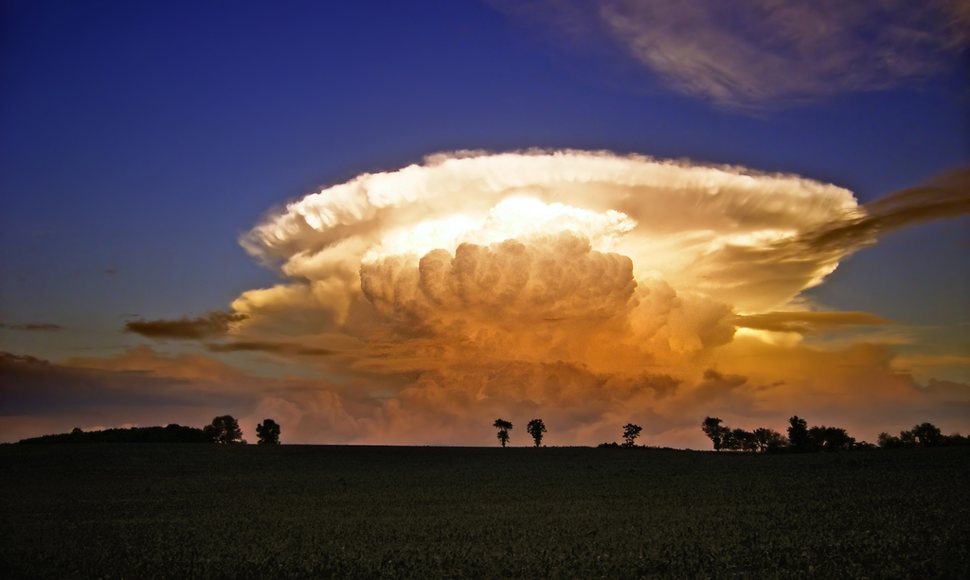
Thank you!
Questions?
Funding:
DOE ASR DE-SC00246356 and DE-SC0020104
NSF Base Funding
NSF AGS-1841674
Australian Research Council grant FL150100035
ARC Centre of Excellence for Climate Extremes
We thank NCAR CISL for support high-performance computing support on Cheyenne.
https://www.flickr.com/photos/nicholas_t/543334336

Slide 16
Results of LES and simple model
Equilibrium height
Maximum in-cloud buoyancy
Rapid shift from shallow to deep with changes in R of ~200-400 m, R where this happens increases with decreasing RH
Lines: theory
Crosses: CM1 LES for each ensemble member averaged from 140-180 min
Red (RH = 0.9)
Green (RH = 0.6)
Blue (RH = 0.3)

Slide 17
Comparison of CM1 simulations and theory for the passive tracer

Slide 18
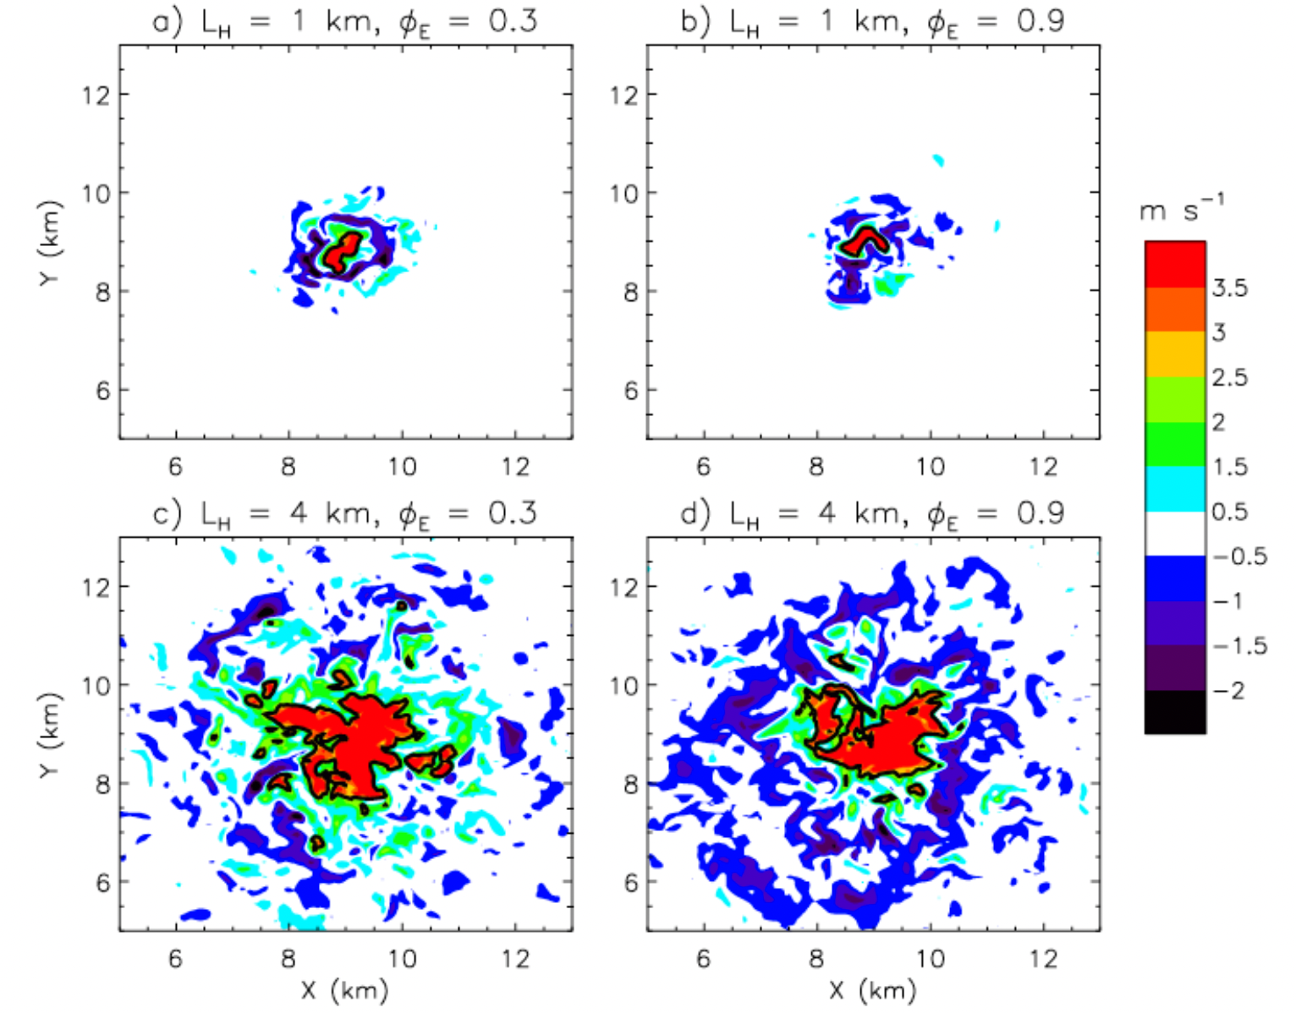

Slide 19
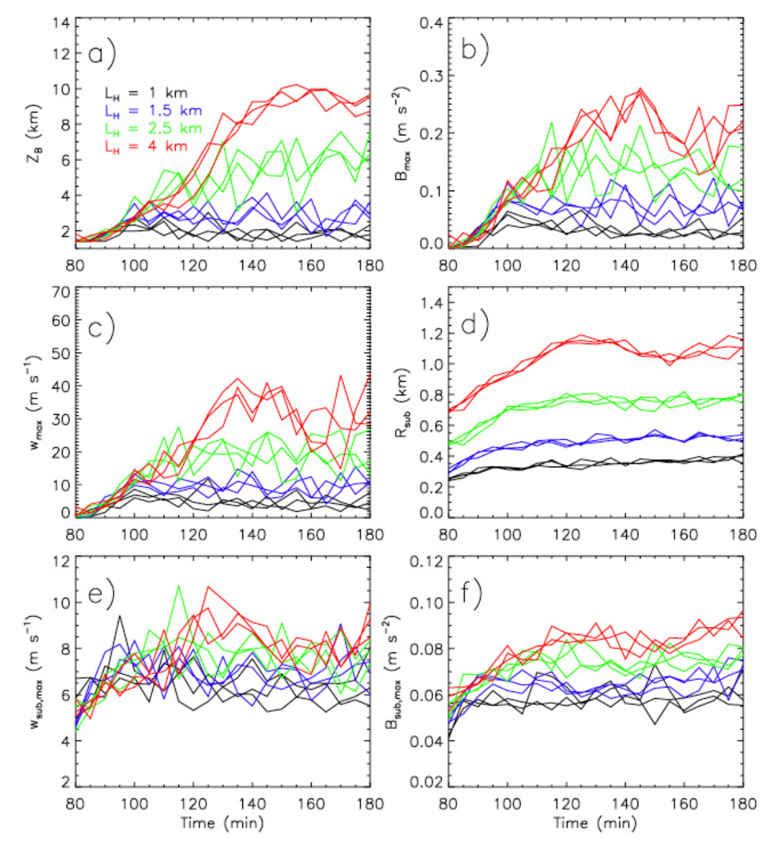

Slide 20
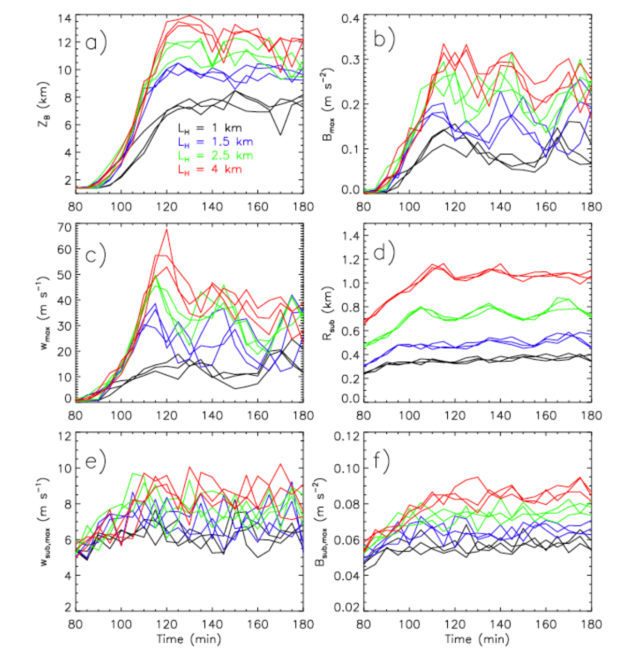

Slide 21
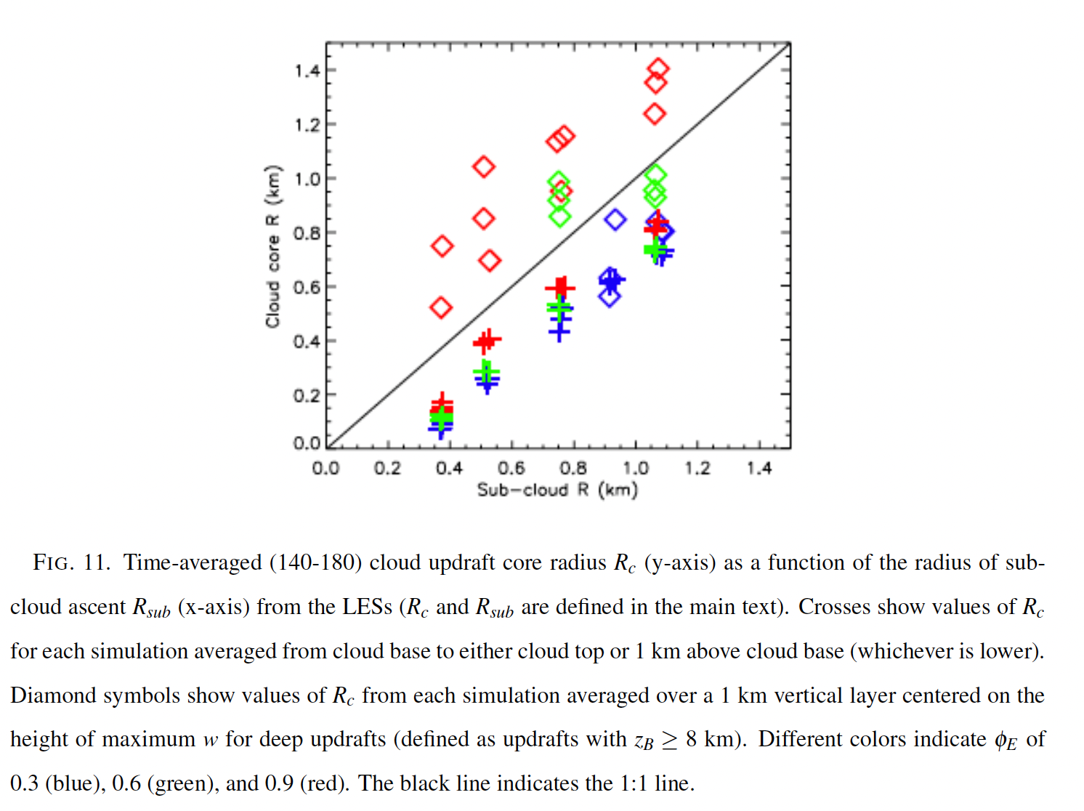

Slide 22
