Slide 1




Locally Generated Convections over Land and Their Driving Mechanisms: Inferences from Observations
Yunyan Zhang
PAN-GASS
July 26, 2022
Many thanks to
Cheng Tao (LLNL)
Jungmin Lee (LLNL)
Steve Klein (LLNL)
Courtney Schumarcher (TAMU)
Likun Wang (NOAA)
Rusen Ӧktem (LBL)
David Romps (LBL)
Jingjing Tian Yang Tian
LLNL NCAR
DOE Early Career Research Program

Slide 2
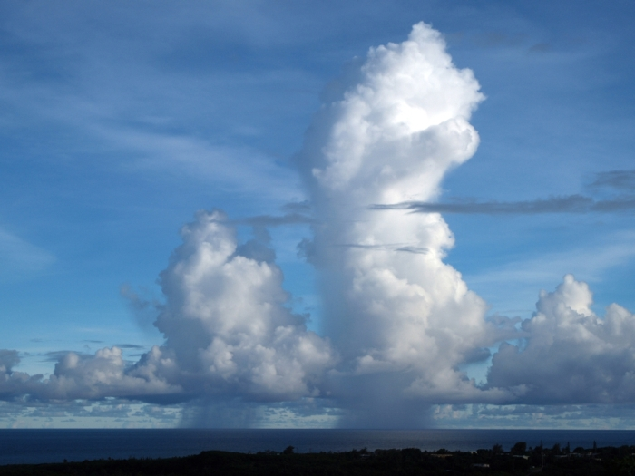
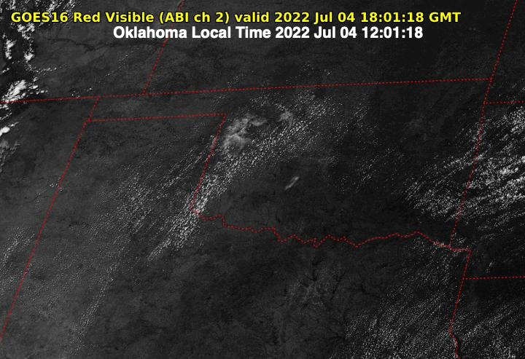
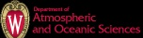
Locally Generated Shallow Cumulus and Deep Convection
Photo Source: Roger Smith
Temporal scale: within one diurnal cycle
Spatial scale: from sub-kilometer to a few tens of kilometers
The convective life stages before upscaling to Mesoscale Convective Systems (MCS)

Slide 3


Why are we interested in local convection regimes over land?
Atmospheric Control
versus Land Surface Control
Transition to Deep Conv.
important summertime climate
model biases
conceptually ideal/simple
Forced
ShCu
Active
ShCu
q
$$θ$$
LFC
Santanello, et al, 2011
Spatial Heterogeneity
Secondary Circulation

Slide 4
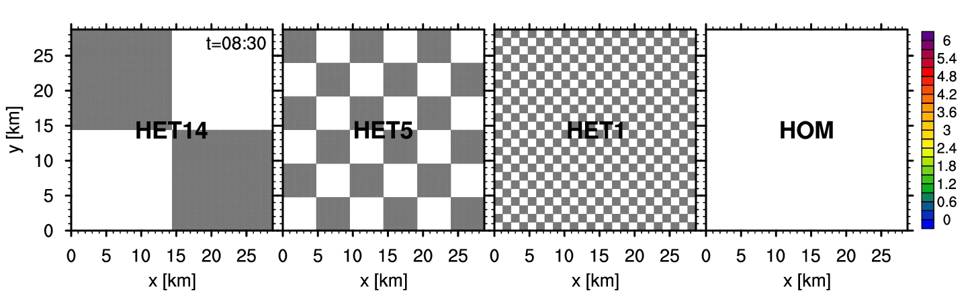
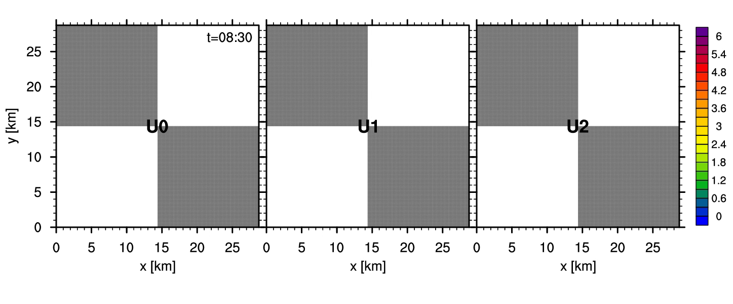
Why are we interested in local convection regimes over land?
Increasing patch size : zero background wind
Atmospheric Control
versus Land Surface Control
Transition to Deep Conv.
important summertime climate
model biases
conceptually ideal/simple
Forced
ShCu
Active
ShCu
q
$$θ$$
Dry
Wet
LFC
Color contour: cloud top height. (Lee et al. 2019)
Patch 14.4km : Increasing Background wind
Santanello, et al, 2011
Spatial Heterogeneity
Secondary Circulation

Slide 5

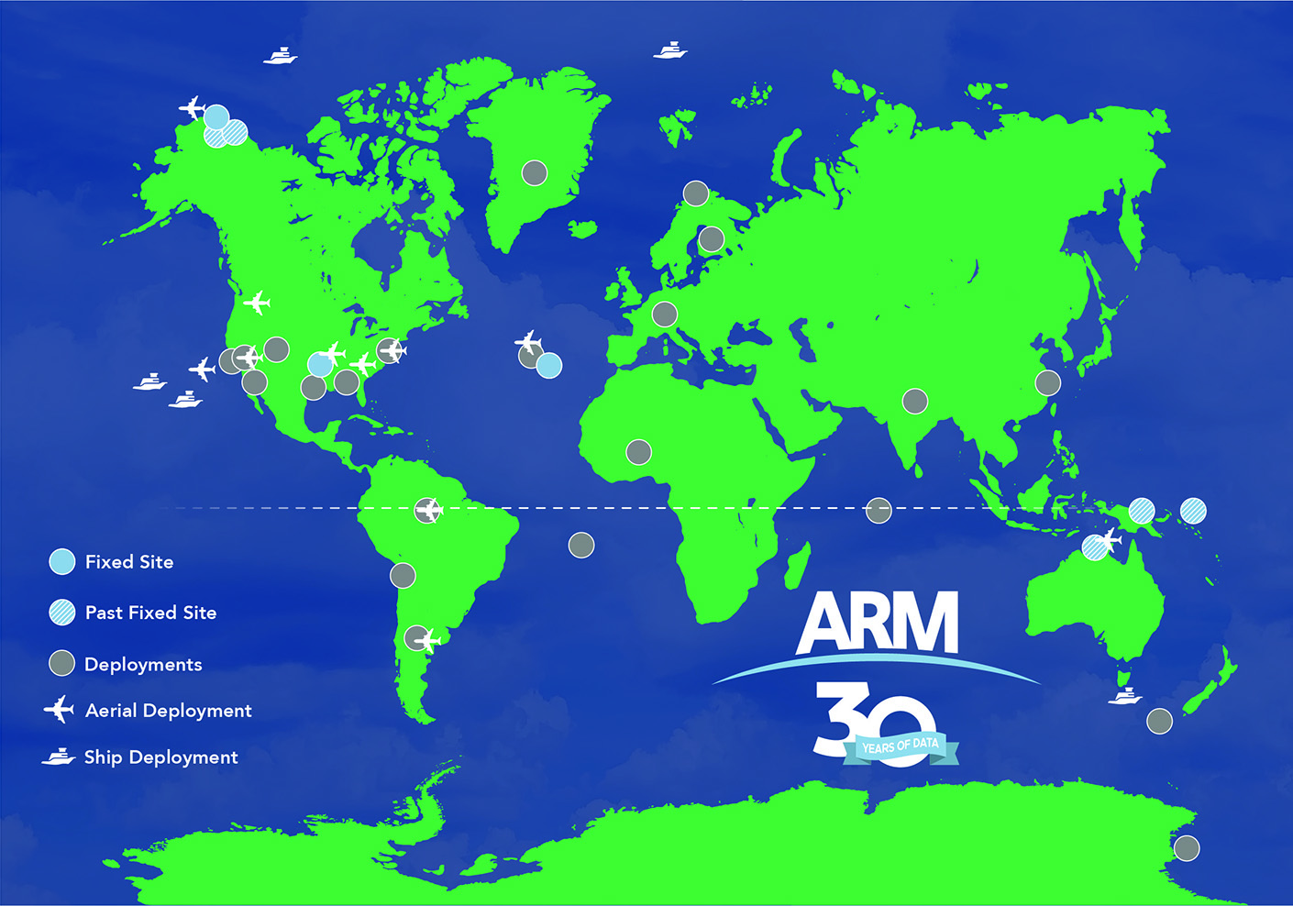
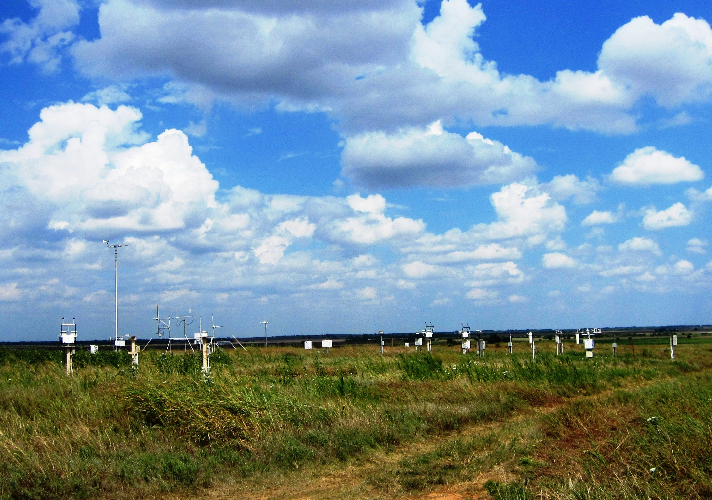
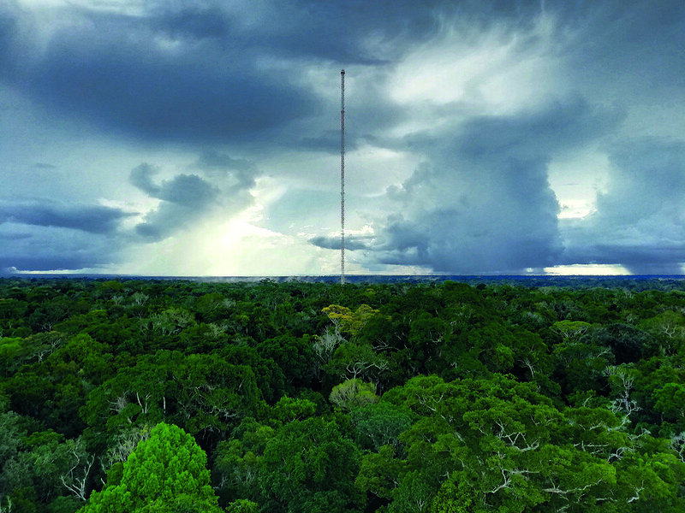
Two convection regimes from observations
Satellite
1. Shallow Cumulus over
Mid-Latitude Southern Great Plains (SGP)
2. Deep Convection over
Tropical Amazon Rainforest
Photo Source: www.arm.gov
Figure Source: www.arm.gov
Photo Source: Sebastian Brill
Heterogeneous land surface type
Similar atmospheric conditions
Homogeneous land surface type
Different atmospheric conditions
Zhang & Klein 2010, 2013; Zhang et al. 2017; Lareau et al. 2018; Lee et al. 2019; Lim et al. 2019; Terai et al. 2019; Tao et al. 2019, 2021; Y. Tian et al. 2021, 2022; J. Tian et al. 2021, 2022

Slide 6
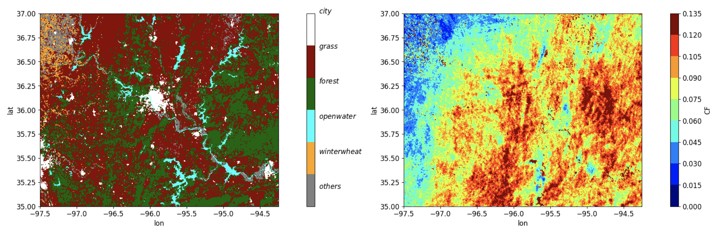
How does land cover and its heterogeneity length scale affect summertime shallow cumulus at SGP?
1. Shallow Cumulus over
Mid-Latitude Southern Great Plains (SGP)
SGP land cover map
Photo Source: www.arm.gov
Figure Source: www.arm.gov
Heterogeneous land surface
Similar atmospheric conditions
1. High resolution (temporal and spatial) cloud observation over large regions with different land covers
2. Definition of land heterogeneity length scale from observations

Slide 7

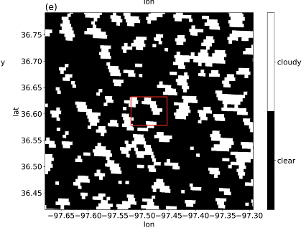
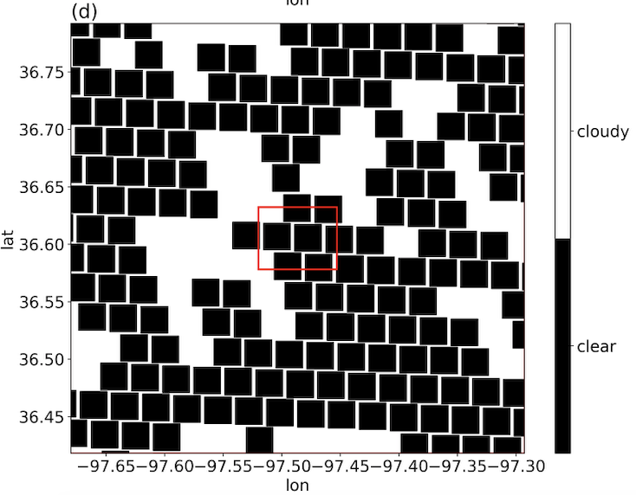
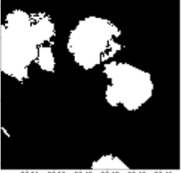


A newly developed ShCu detection method for GOES-16
ARM Ground-based Stereo-cameras
(50-meter, 20-second, 6³ km³)
Most accurate 4-D (x-y-z-t) ShCu
Latest high-resolution reflectance data (GOES-16, 5 mins, 500 meters)
Our Newly Detected ShCu
GOES-16 Operational Cloud Mask
Cloud: White
Clear-Sky: Black
Romps & Ӧktem (2018)
Southern Great Plains (SGP) site
GOES-16 Cloudy pixel: R(x,y,t) >= R_{clear} (x,y,t) + ∆R
A GOES simulator is developed and applied to Stereo-camera data to foster apple-to-apple validation
Tian, J., Y. Zhang, S. A. Klein, L. Wang, R. Ӧktem and D. M. Romps, 2021: Summertime continental shallow cumulus cloud detection using GOES-16 satellite and ground-based stereo cameras at the DOE ARM Southern Great Plains site. Remote Sens., 13, 2309. https://doi.org/10.3390/rs13122309

Slide 8
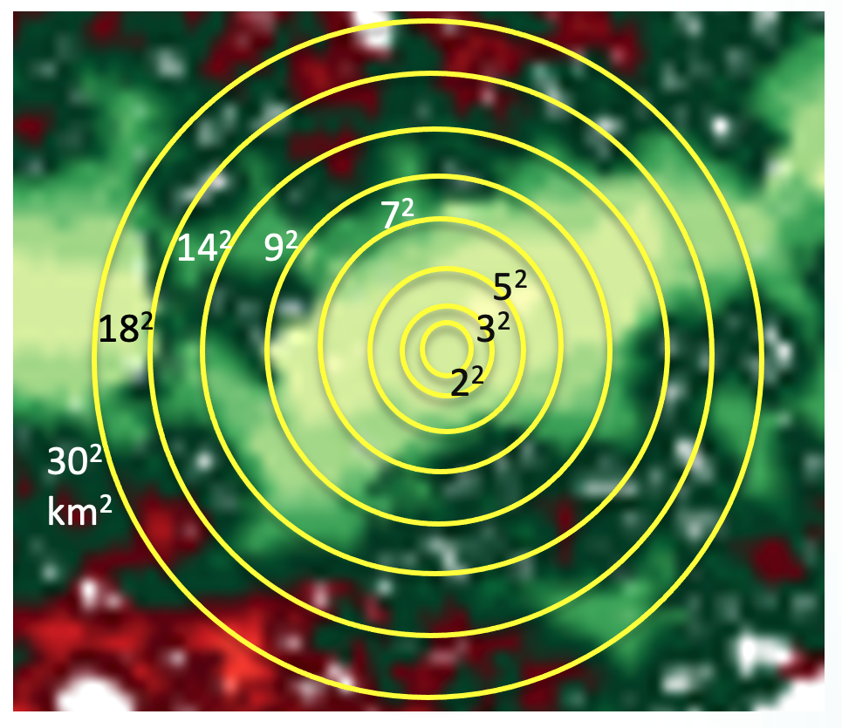
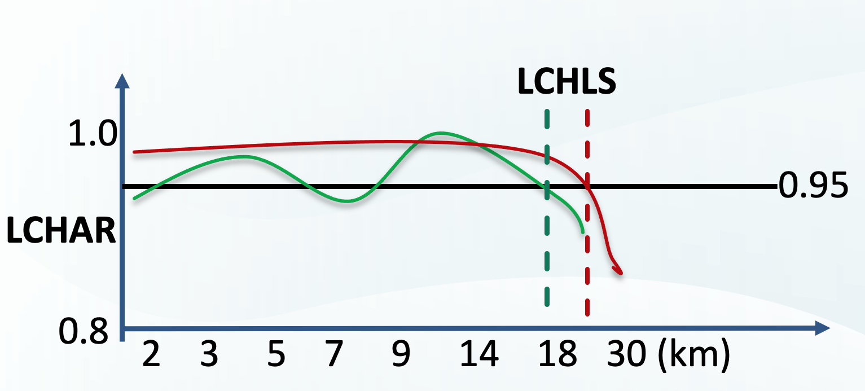
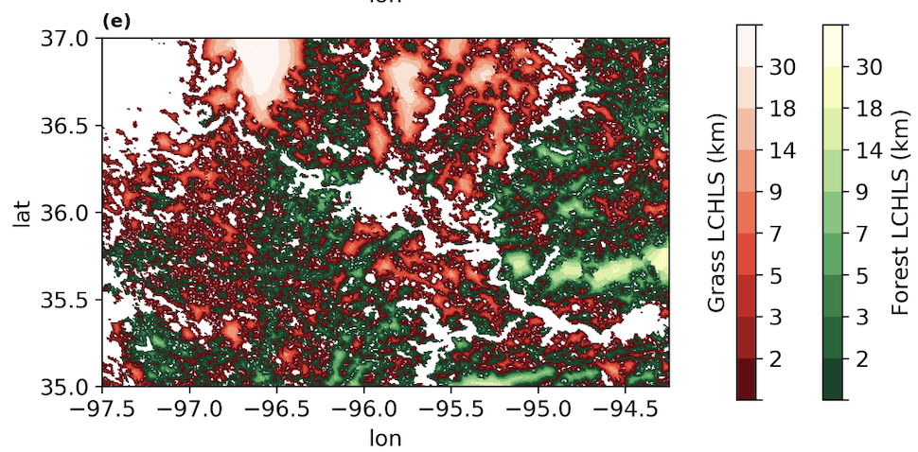
How to define land cover heterogeneity length scale?
LCHLS MAP
Land cover homogeneity area ratio (LCHAR_{x}):
An area ratio of a certain land cover type in a land pixel’s surrounding area of x²-km^{2.}
Land cover heterogeneity length scale (LCHLS):
Find the largest length scale (x) for which the regional LCHAR > 0.95.
Forest Grassland

Slide 9
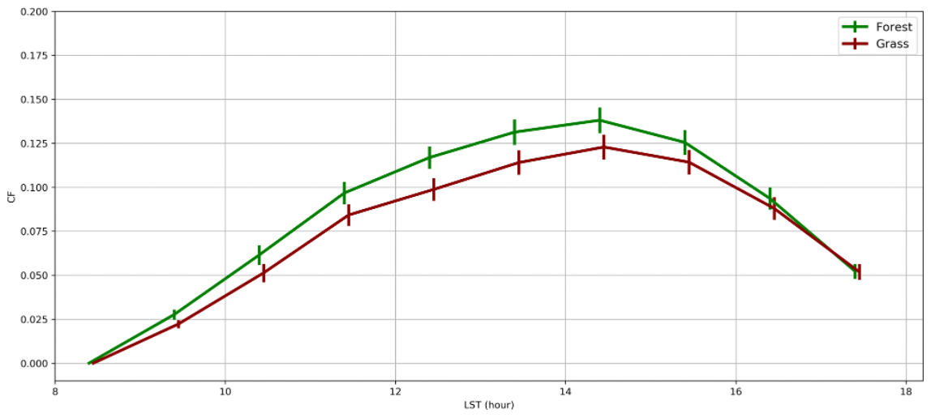
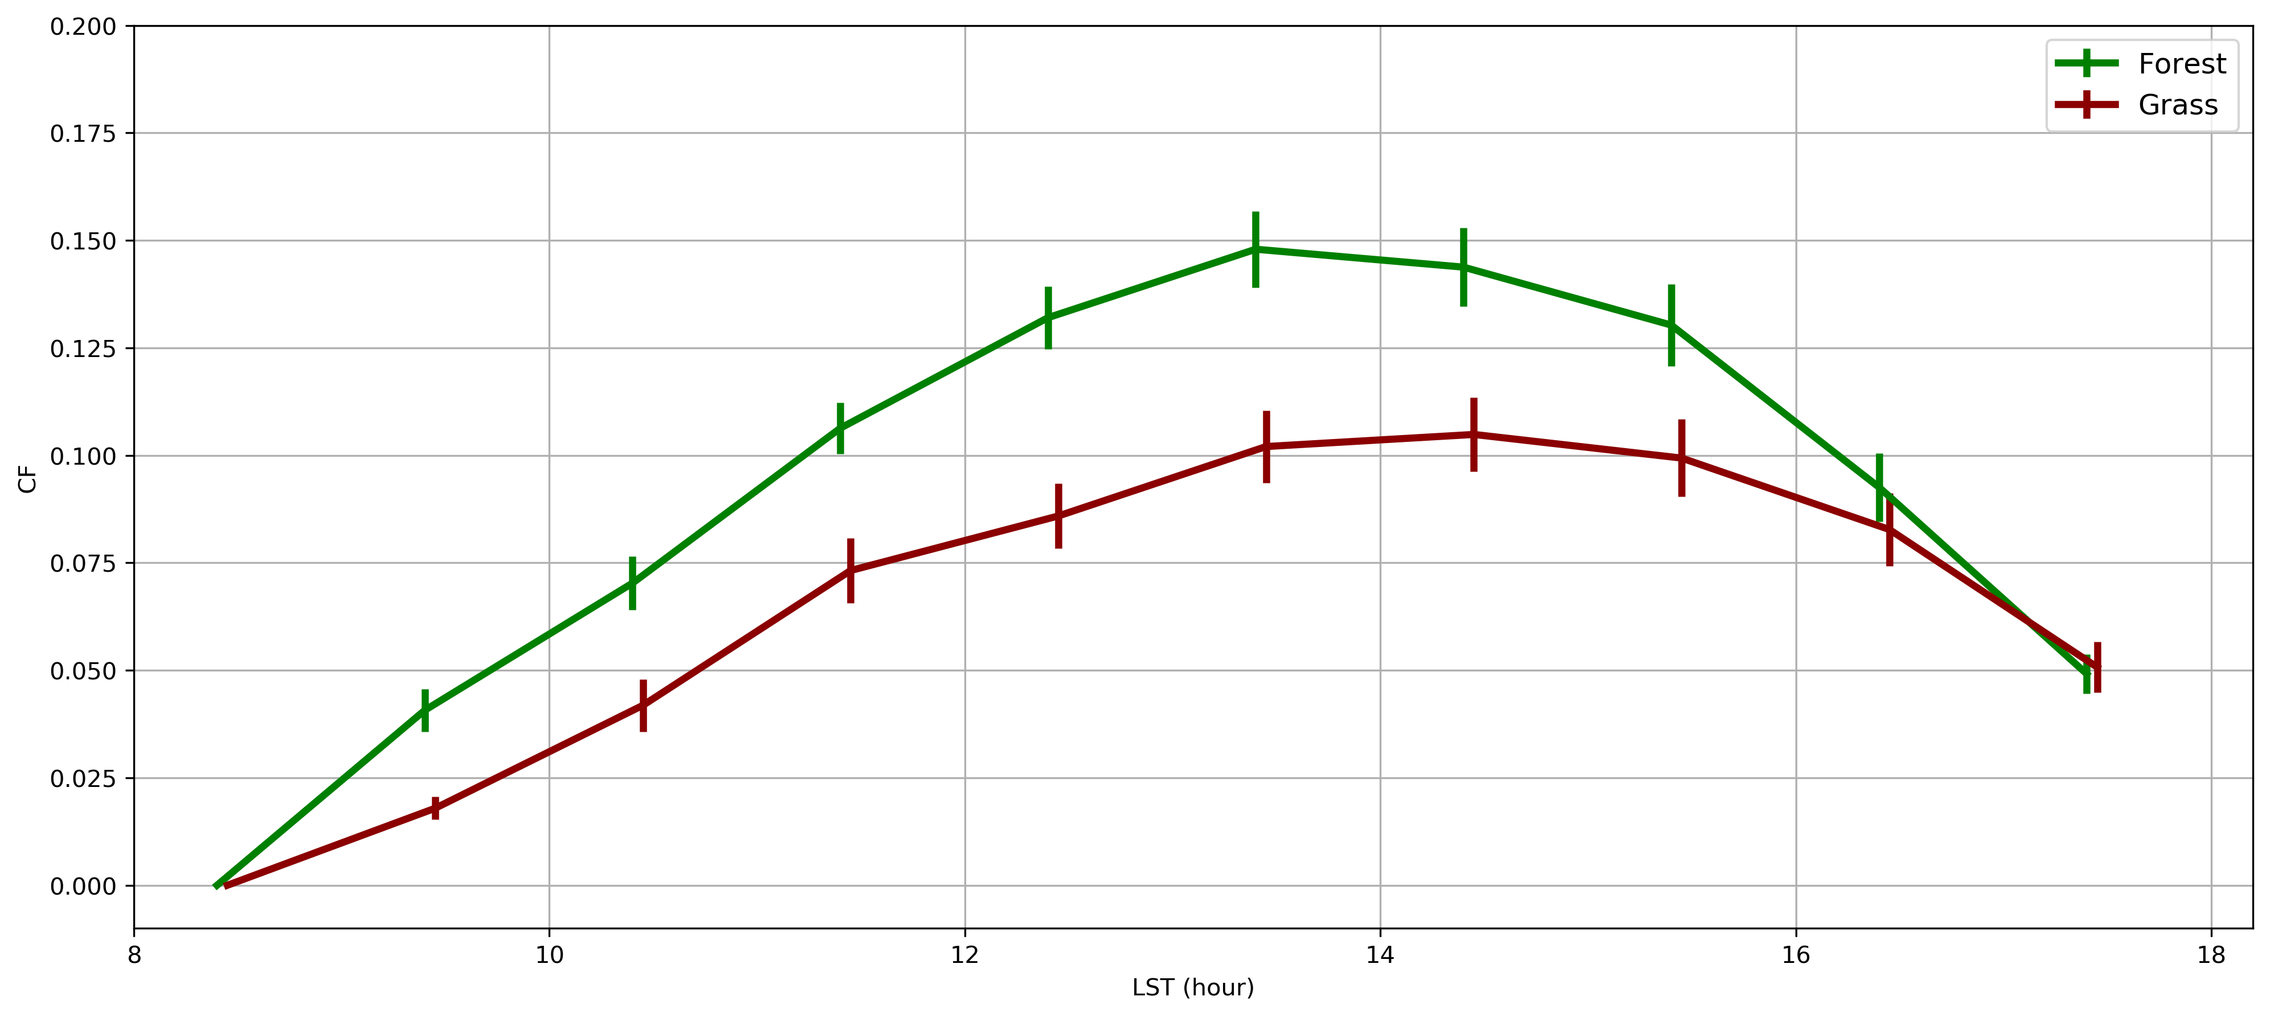
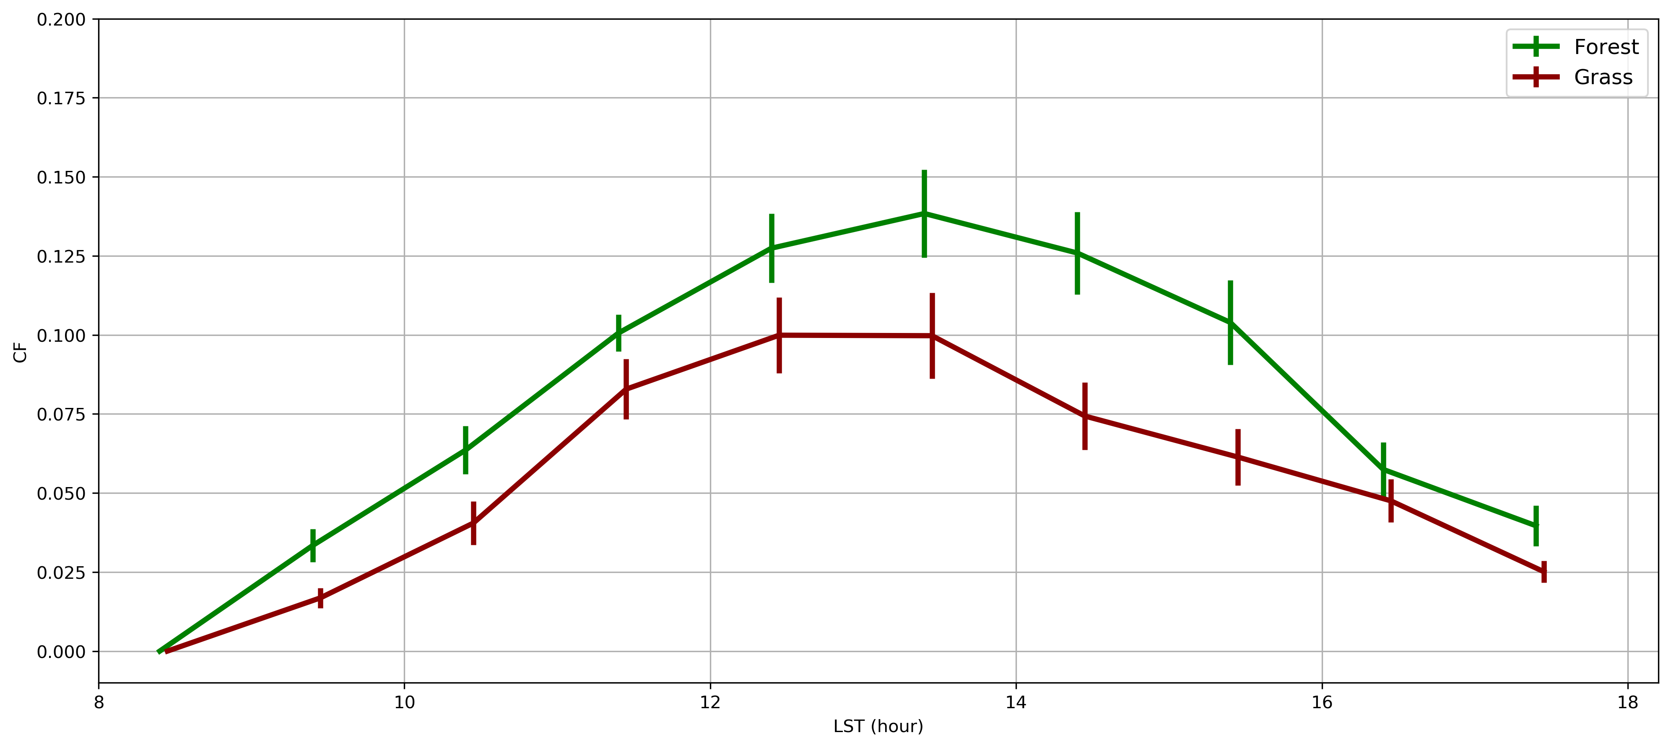
ShCu occurrence over forest and grassland at SGP
All Cases
Larger Patches
Larger Patches & Low Winds
20
20
20
15
15
15
10
10
10
Cloud Fraction (CF)
5
5
5
0
0
0
8 10 12 14 16 18
8 10 12 14 16 18
8 10 12 14 16 18
Local Time (hour)
Local Time (hour)
Local Time (hour)
    Shallow cumulus cloud fraction is larger over forest than over grassland.
    The difference is even more significant 1) over the land cover/type patches > 5 km
and 2) with wind speed < 3m/s

Slide 10
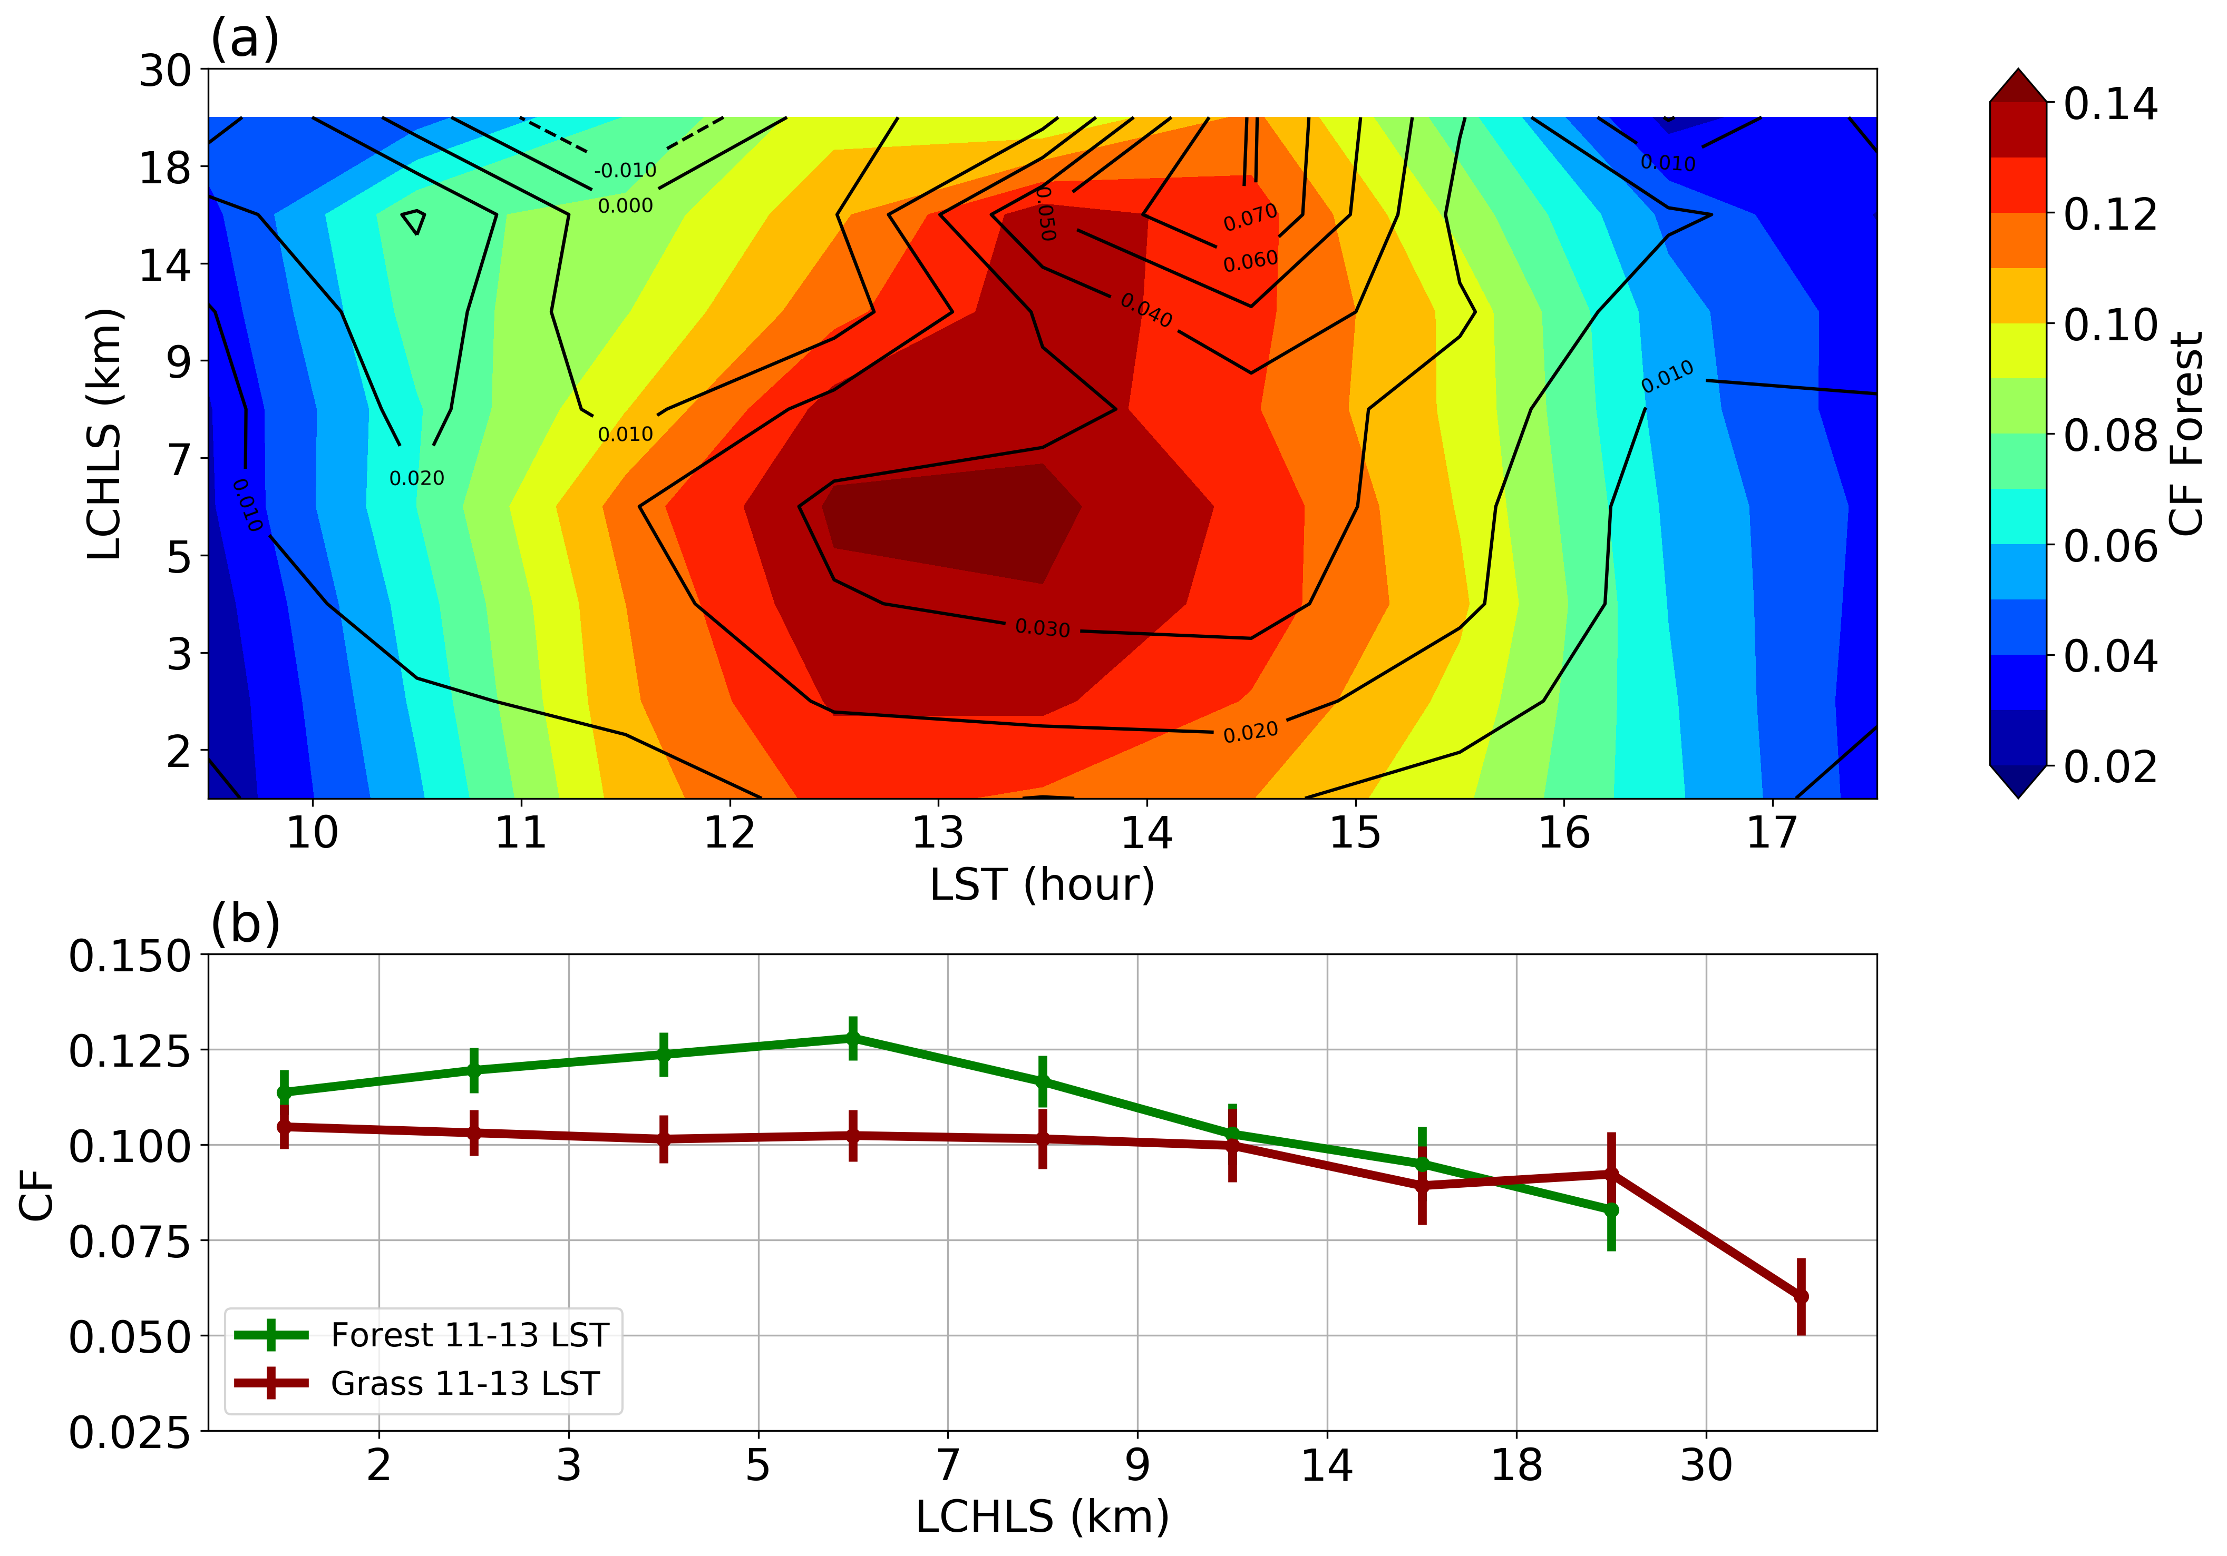
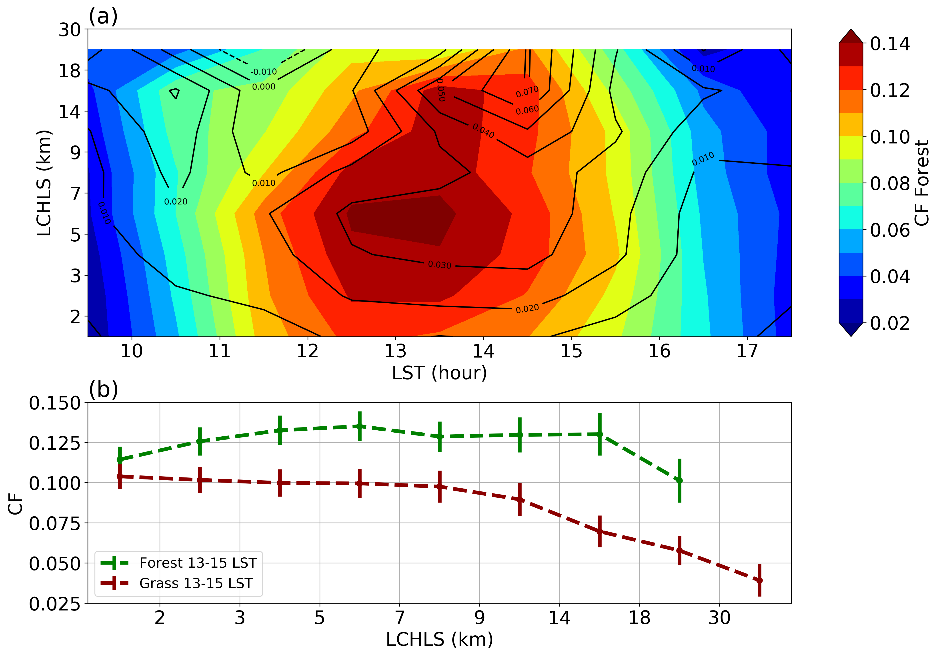
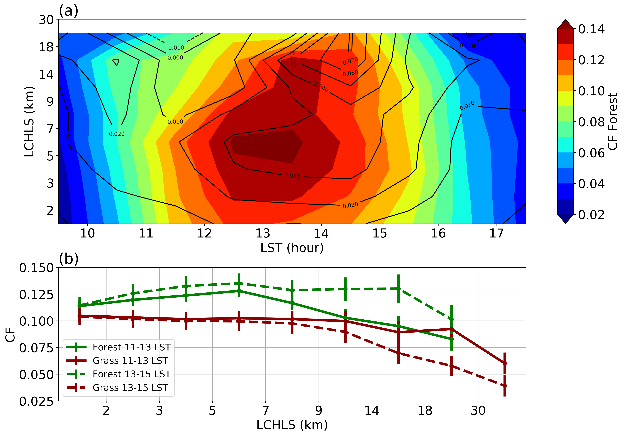
How does the effect of heterogeneity length scales evolve?
      Around Noontime, shallow cumulus prefers to occur more over smaller forest patches (<9km).
      In the earlier afternoon, the cloud fraction difference (forest and grassland) is more pronounced over larger patches (>9km).
Such shift suggests it takes time for secondary circulation to have impact on larger patches.
Tian, J., Zhang, Y., Klein, S.A., Wang, L., Öktem, R., 2022: How does land cover and its heterogeneity length scale affect the formation of summertime shallow cumulus clouds in observations from the US Southern Great Plains? Geophys. Res. Lett., e2021GL097070, https://doi.org/10.1029/2021GL097070

Slide 11
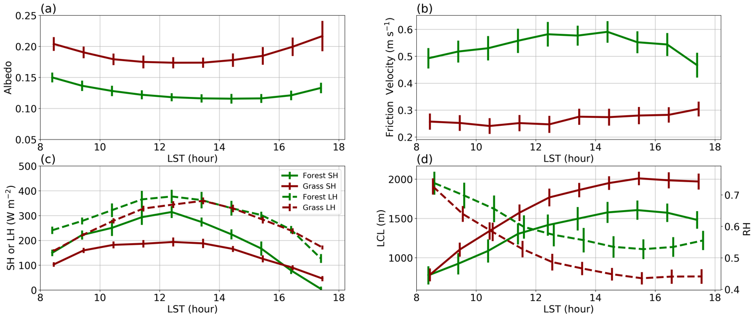
Do ARM surface observations support CF differences?
Forest Grassland
Larger Friction Velocity
Lower Albedo
Higher RH
Larger SH (50%) & LH (25%)
Lower LCL

Slide 12
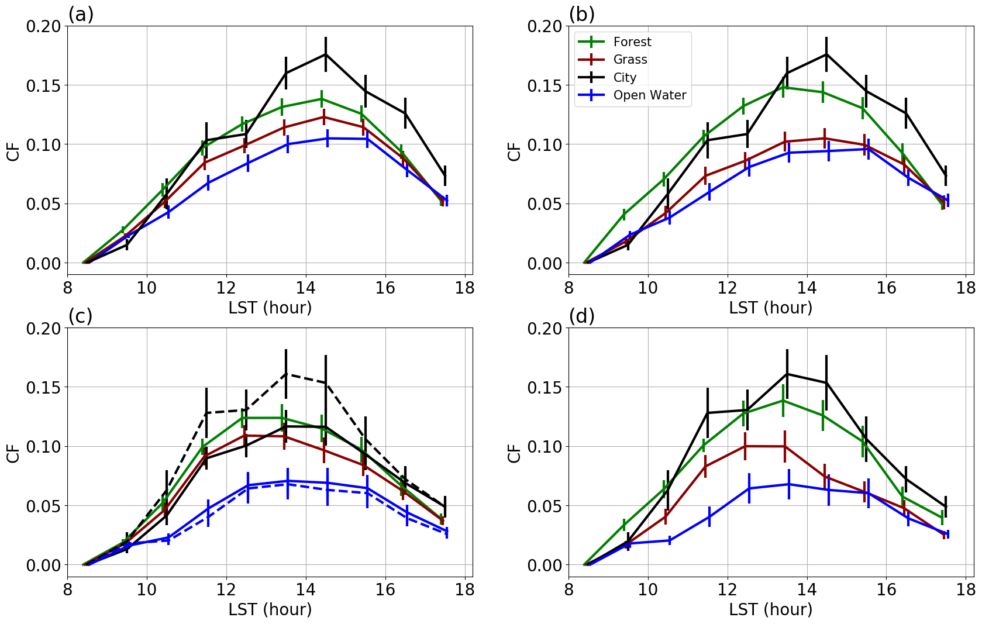
Cloud fraction over open water and “urban” area
Tulsa, Oklahoma (20 km)
City
Forest
Grassland/Pasture
Open Water/ Lake
Length of the vertical bars:
Two standard errors (~68% confidence interval) of 15-min average CF samples
The lowest CFs over open waters during all the daytime hour.
It shows a pronounced CF increase over the city of Tulsa.

Slide 13
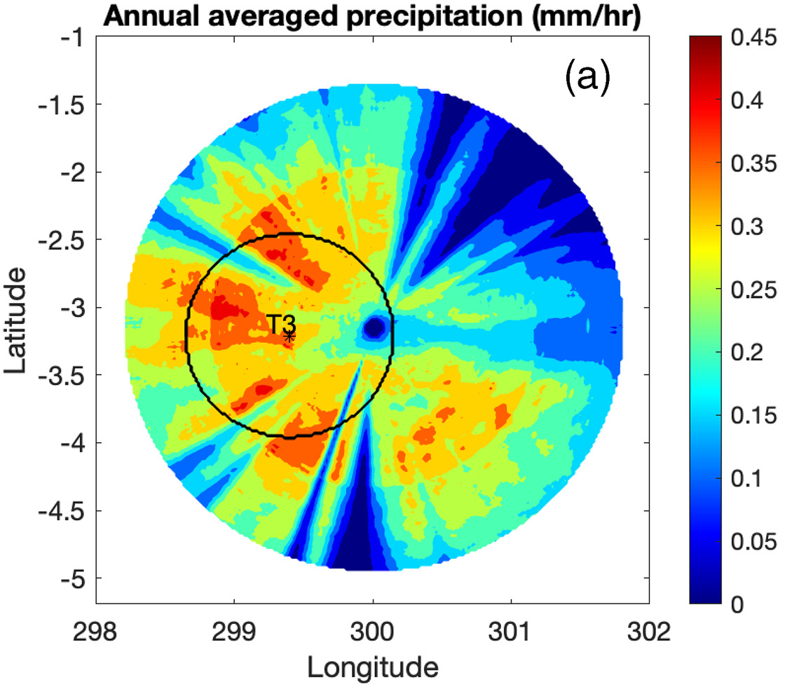
What determines the number and the timing of pulses in afternoon precipitation of deep convection over Amazon?
GOAmazon
Scanning precipitation radar (SIPAM)
(12 minutes; 1.8 km)
2. Deep Convection over
Tropical Amazon Rainforest
Figure Source: www.arm.gov
Photo Source: Sebastian Brill
Homogeneous land surface
Different atmospheric conditions
150 km
Local deep convection days: 10dBZ echo top > 7 km
Tracking algorithm is developed using SIPAM data to study convective cluster evolution and interactions
Tian, Y., Zhang, Y., Klein, S. A., & Schumacher, C. (2021). Interpreting the diurnal cycle of clouds and precipitation in the ARM GoAmazon observations: Shallow to deep convection transition.
J. Geophys. Res. Atmos., 126, e2020JD033766 .https://doi.org/10.1029/2020JD033766

Slide 14
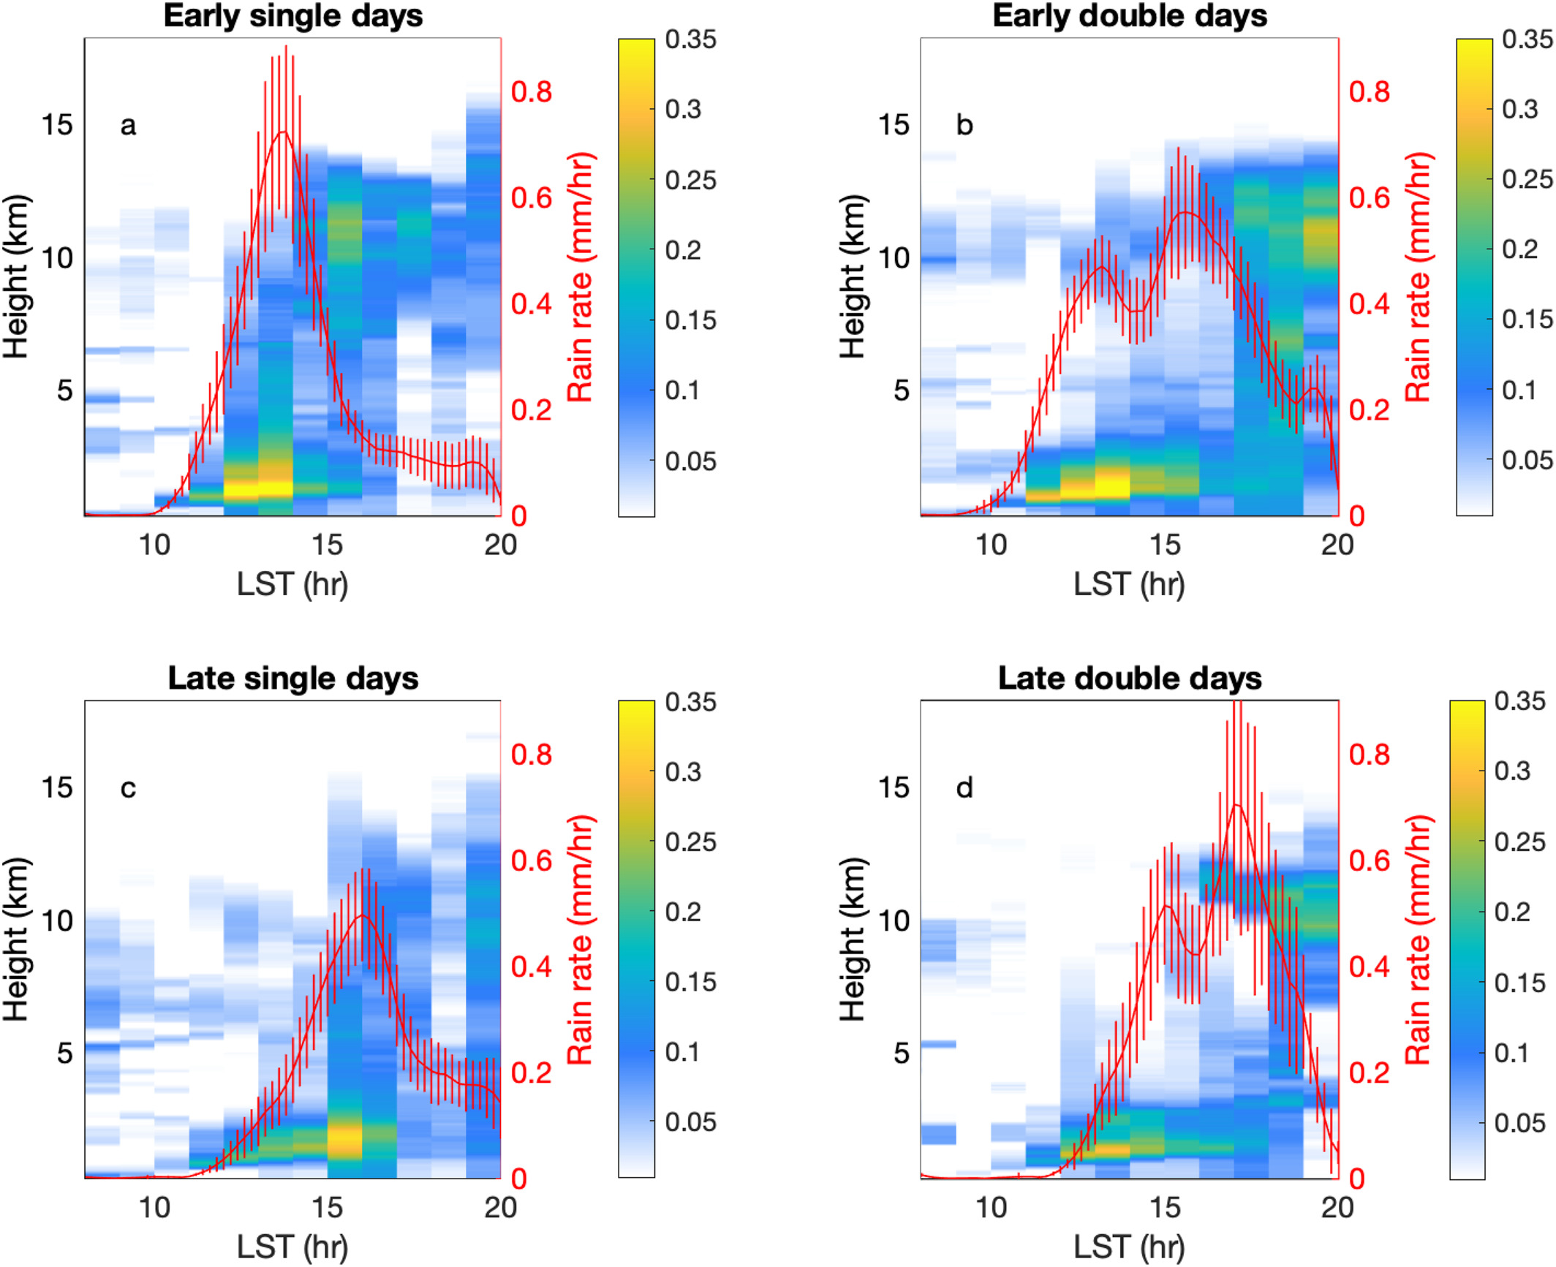
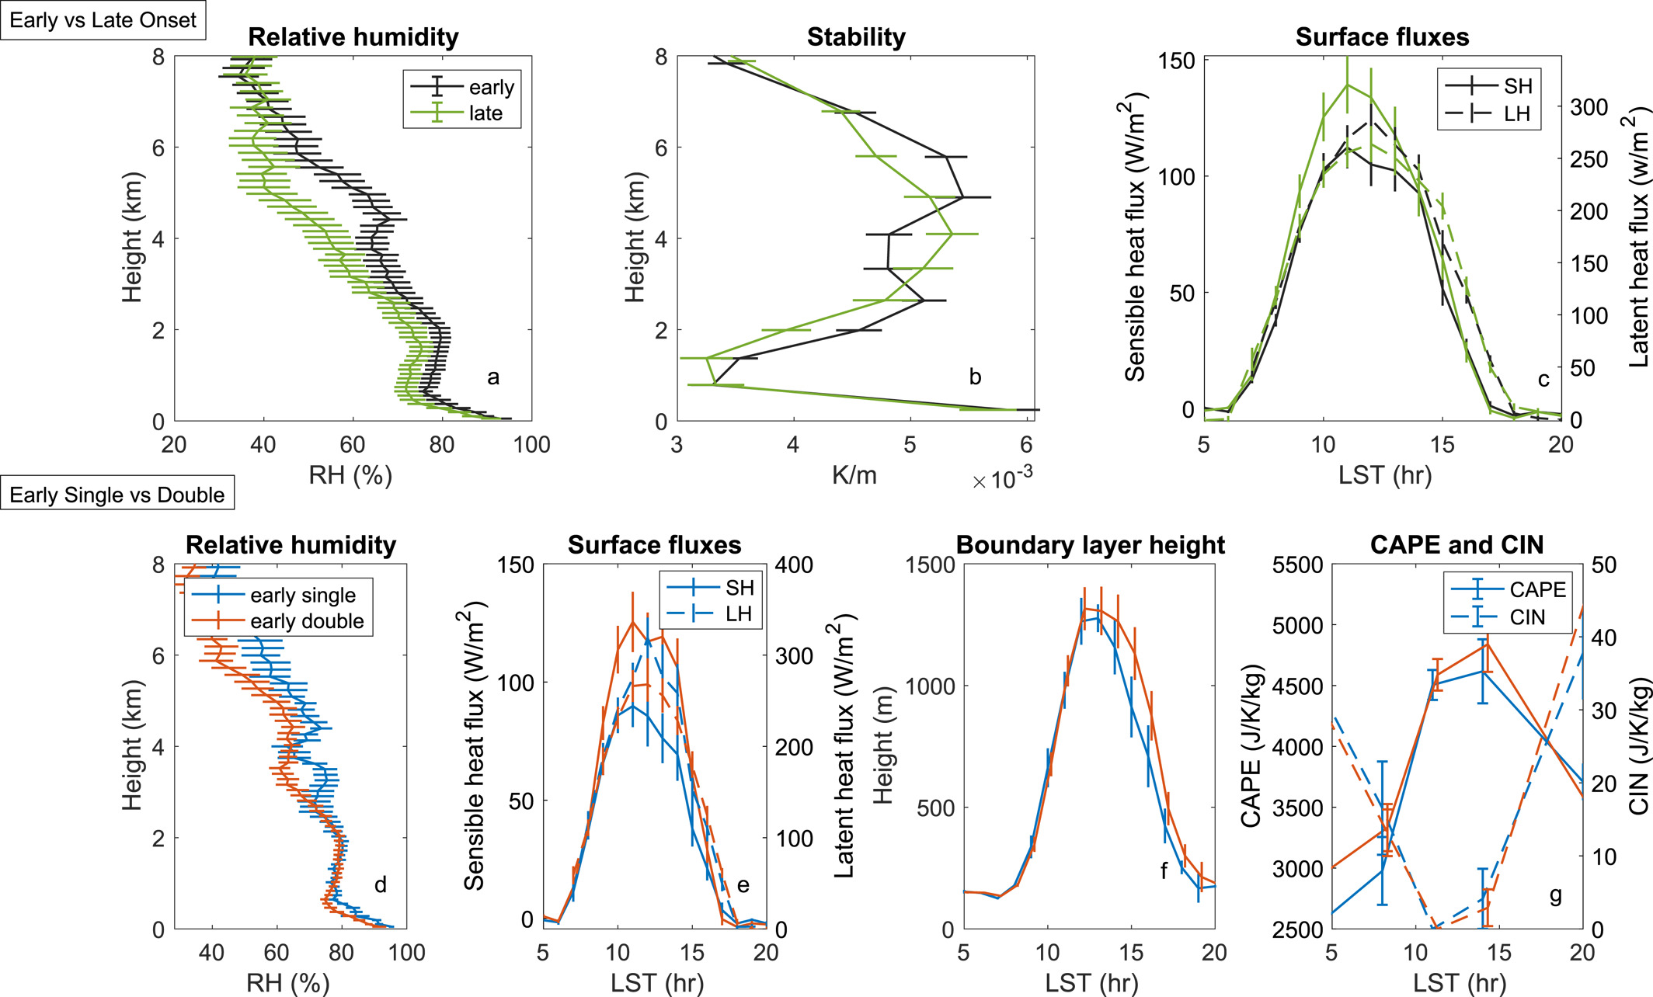
Four modes of local afternoon deep convection
Single Pulse
Double Pulses (2-hr apart)
17%
28%
Early onset
Before 2 p.m.
26%
11%
Late onset
After 2 p.m.
What makes deep convection sustained into late evening during double-pulse days?

Slide 15
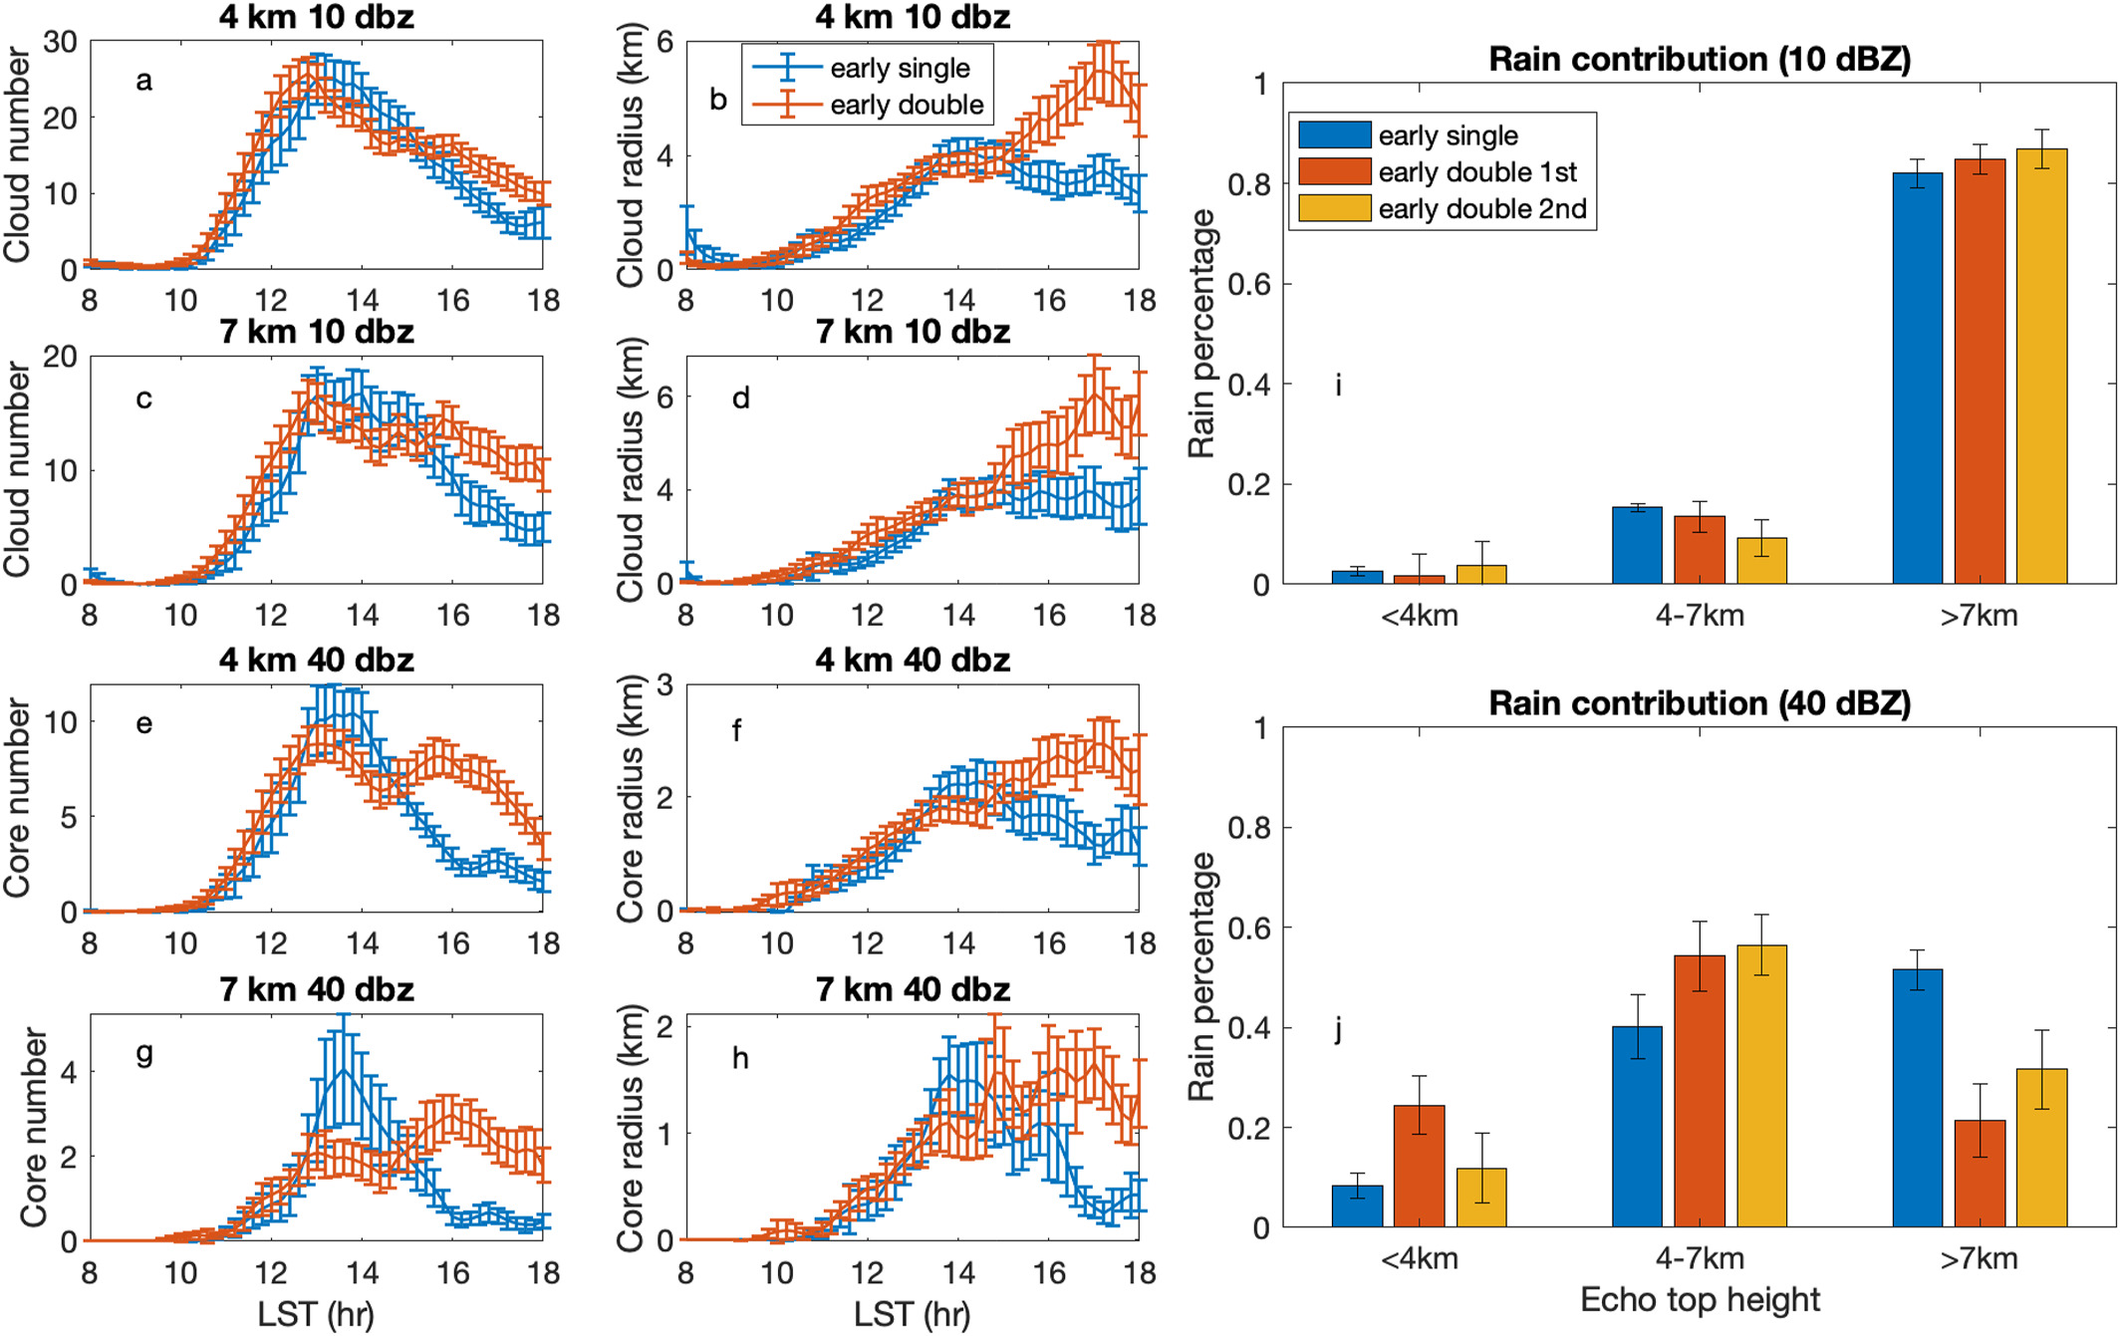
Clouds (10dbz) versus convective cores (40dz)
On double-pulse days,
the cloud clusters grow larger while sustaining their numbers from 1st to 2nd pulse
24%
8%
On single-pulse days, there are more deep and large convective cores than the 1st pulse of double-pulse days
More shallow convective cores on 1st pulse hints at the moistening of lower troposphere

Slide 16
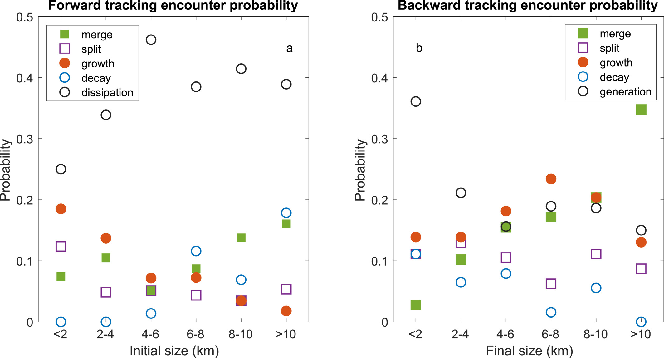
Evolution of convective clusters between 1st and 2nd pulses
1st pulse clusters when evolving to 2nd:
2nd pulse clusters when tracing back to 1st:
With sizes > 6 km, it tends to merge
Larger clusters tend to be results of merging, 1/3 for largest bin
Smaller clusters more likely to grow for survival
~20% are coming from natural growth
Majority of clusters dissipate
15 - 20% from
new generation
Tian, Y., Zhang, Y., & Klein, S. A. (2022). What determines the number and the timing of pulses in afternoon precipitation in the Green Ocean Amazon (GoAmazon) observations?
Geophys. Res. Lett., 49, e2021GL096075. https://doi.org/10.1029/2021GL096075

Slide 17
Summary
Local convection regime classification facilitates detailed examination of fast interactive physics using co-located observations.
Observational evidence is found
  The impact of land cover and its heterogeneity length scale on shallow cumulus occurrence
  RH control on convection transition, onset timing and number of precipitation pulses
  Aggregation and natural growth of convective clusters help sustain deep convection
We plan to use observational statistics to diagnose and improve global high-res models e.g., regional refined or global cloud resolving models (~3 km)
Shallow
Late onset
Early-onset
Two Pulses
Early-onset
Single Pulse

Slide 18
Thank you!

