Slide 1

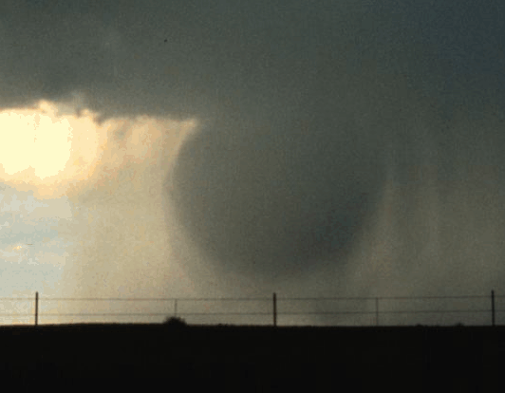


What controls downdraft characteristics (and why should we care)?
or….
Downdrafts, the Real “Dark Energy” of the Atmosphere
Julia Windmiller^{1,2}, Jiawei Bao¹, Steve Sherwood*², Moutassem El-Rafei², David Fuchs², Thomas Schanzer²
¹ Max Planck Institut for Meteorologie, Hamburg
² Climate Change Research Centre, UNSW Sydney
National Weather Service

Slide 2
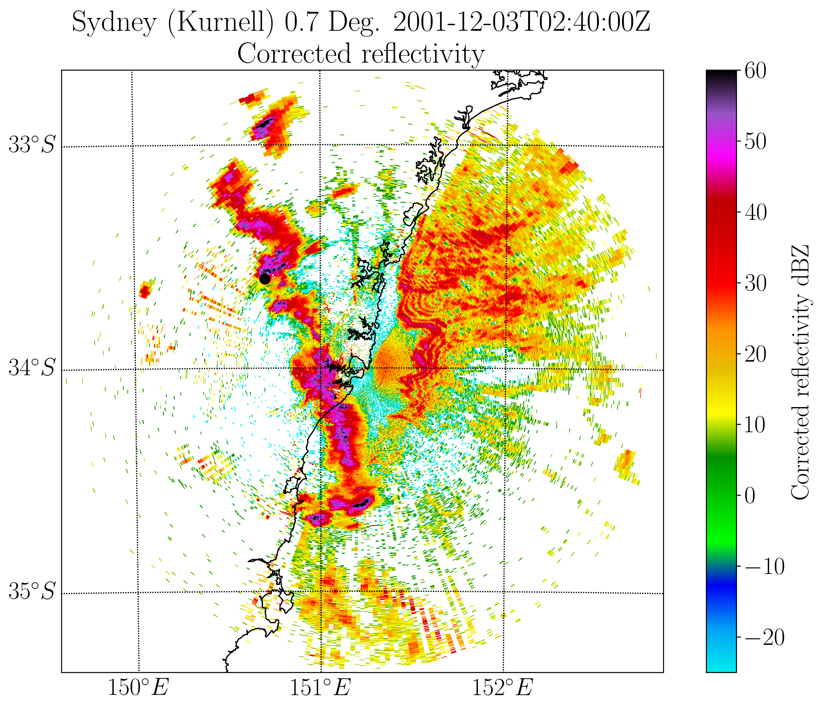

Strongest recorded 3s wind gust in NSW in last 30 years:
174 km/hr

Slide 3
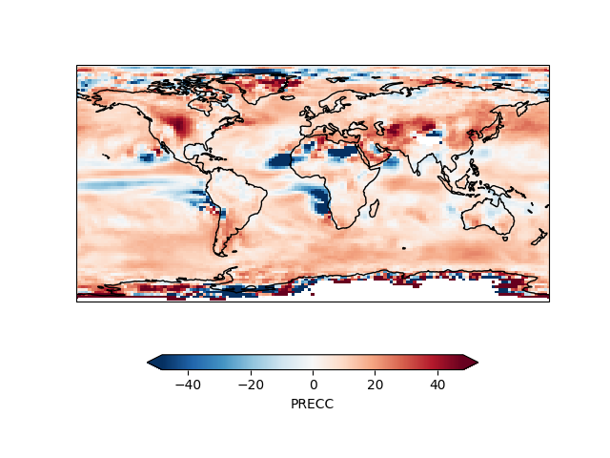
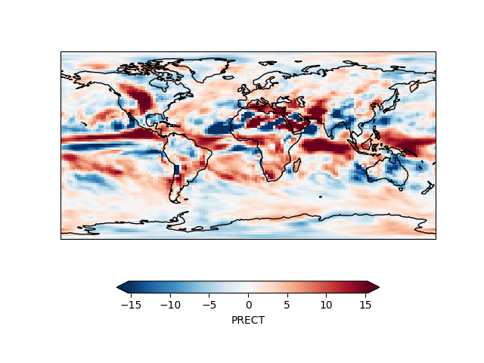
Effect of removing convective downdrafts from CAM5
Convective precip change (%)
Total precip change (%)

Slide 4
Gust outflows result from downdrafts, and are essentially ballistic (Jeevanjee and Romps 2015, Robinson et al. 2013).
Climate effects determined by downdraft thermal properties.
Q. What controls downdraft properties?
DD Intensity sensitive to lapse rate (e.g. Srivistava 1985, Giangrande et al. 2016)
CRM DD mass flux tends to scale with updraft, perhaps due to a precipitation link (Trapp and Woznicki 2017, Marion and Trapp 2019)
Higher ambient humidity might favour stronger DD (Srivistava 1985) but this may depend on height (e.g. Proctor 1989; Torri and Kuang 2016) and other obs suggest the opposite (e.g. Giangrande et al. 2016)

Slide 5
 | Zhang-McFarlane | Kain-Fritsch | New Tiedke
Starting level | Min in henv or h*env, whichever is lower | 150-200 hPa above intake layer (lowest 60 hPa that is convecting) | Where 50/50 cld+env mixture will sink (and below min in θe⁻env)
Kinematics / Dynamics | Rain stays in descending parcel | Rain falls into environmental air | Rainy parcel obeys momentum eq.
Mass flux profile | Grows by entrainment from specified initial value | Specified peak at top of intake layer, linear decay above/below | Grows by entrainment from specified initial value
Specified mass flux value | Init: 0.2 P/(P+Pcrit) Mup | Peak: 2(1-RH) Mup | Init: 0.3 Mup
Entrainment | ε = 2εup | High; implicit in specified M profile | ε = 0.2/km + f(B,w)

Slide 6
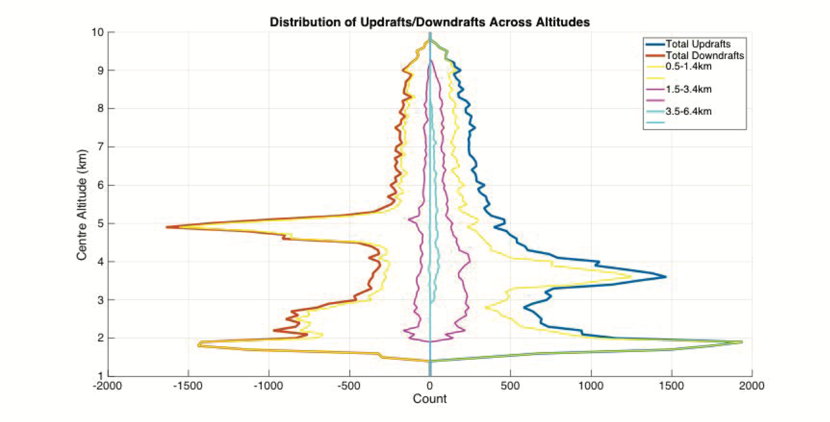
Downdrafts (and updrafts) occur at all levels
Downdrafts
Updrafts
Darwin vertical doppler radar
Yeung et al. 2021
See also Giangrande et al. 2013

Slide 7
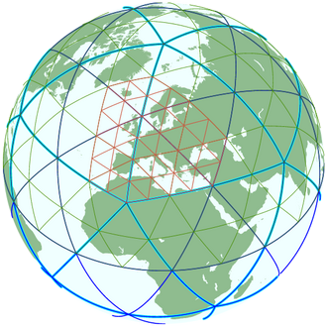
Examine environment-downdraft relationship in simulated convection
ICON model v2.1.02; DYAMOND setup
20 days simulation, global, 5km mesh, 90 levels (use last five days only)
Model output every 15 min

Slide 8
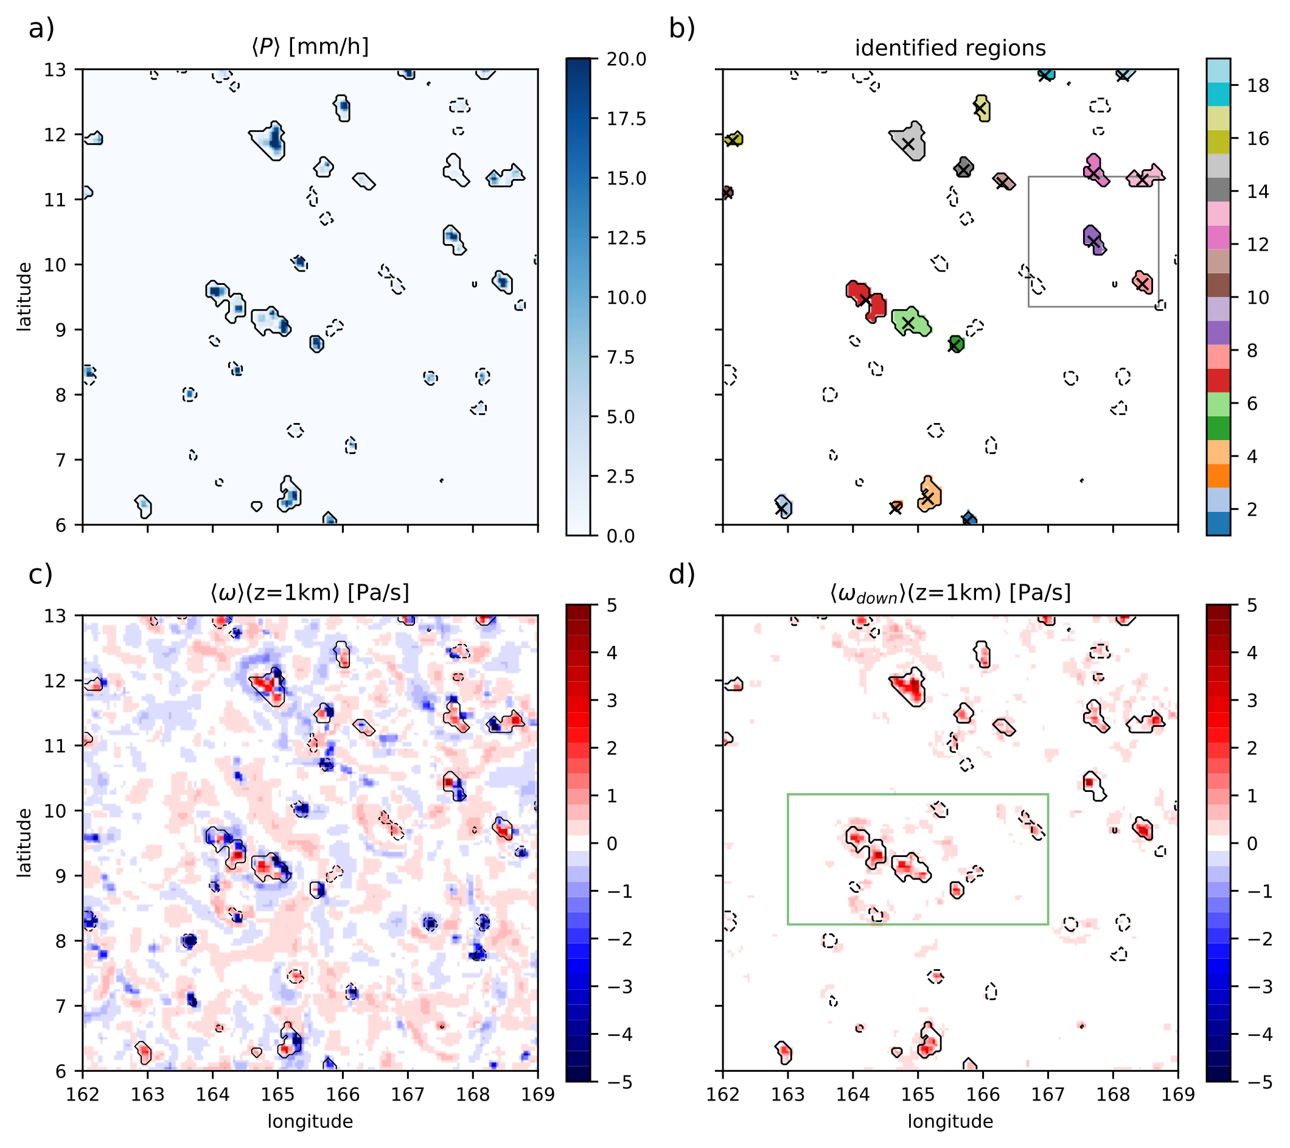
Object identification
Precipitation objects found
Recorded for each object:
  Updraft and downdraft mass fluxes and mean velocities (1 Pa/sec threshold from 1-3km altitude applied)
  Mean environmental conditions (200x200km box)
Precip and draft properties lag environmental ones by 0.5-2 hrs.

Slide 9
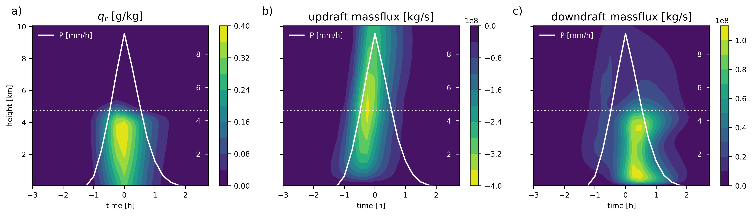
ICON is missing upper-level downdrafts
10 km
0 km

Slide 10
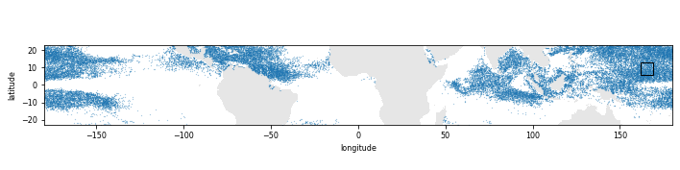
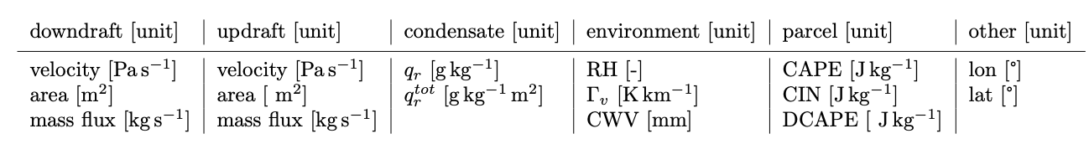
Where the precipitation objects happened:
Predictors:
Prediction methods:
Dendrogram
Random Forest
Linear Regression

Slide 11
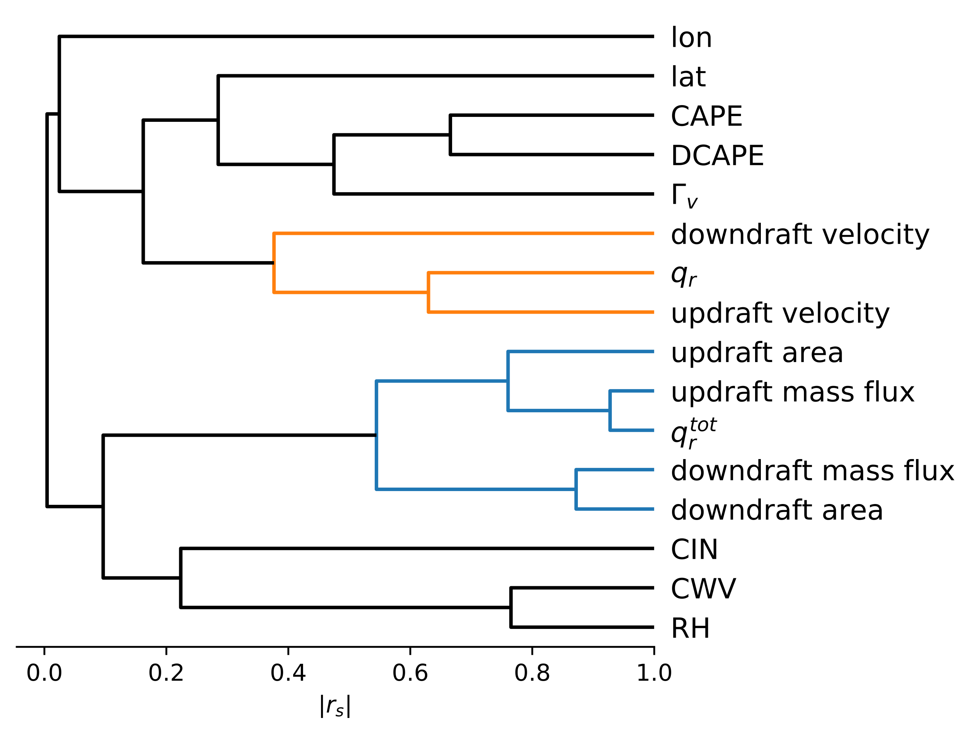
1. Dendrogram

Slide 12
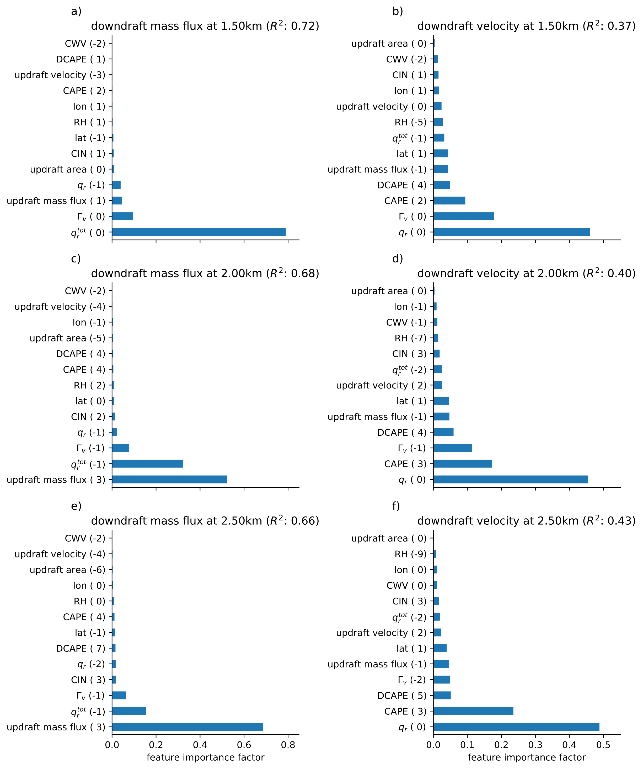
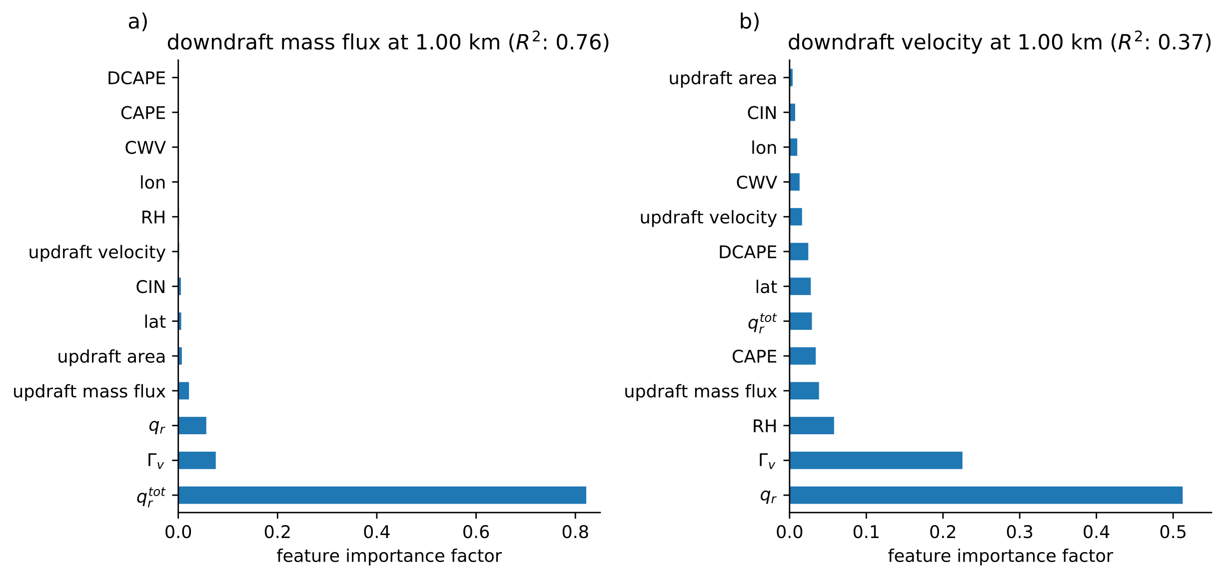
2. Random Forest
Mass flux
Velocity
2.5 km altitude
Best DD predictor depends somewhat on draft height, but:
DD area closely related to updraft area (~4:1 ratio agrees w/Darwin data)
DD velocity related to rain; less predictable than area/mass flux.
1 km altitude

Slide 13
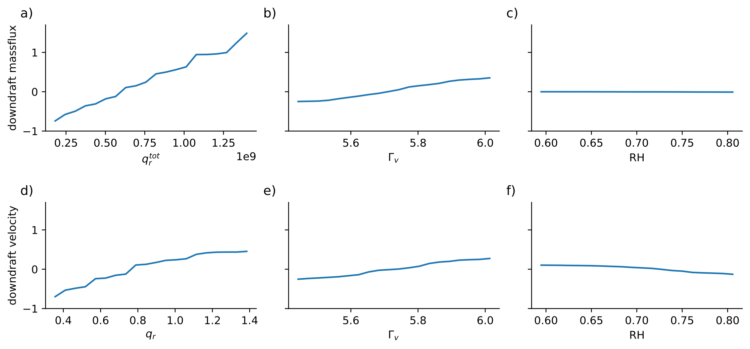
2. Random Forest
Regressions from the RF are approximately linear
3. Linear regression (not shown) produces essentially same results as RF.
—> Good for parameterization…?

Slide 14
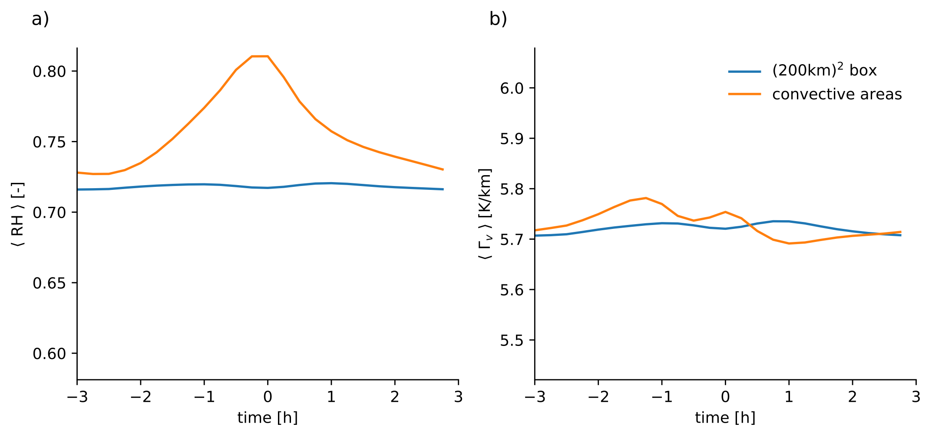
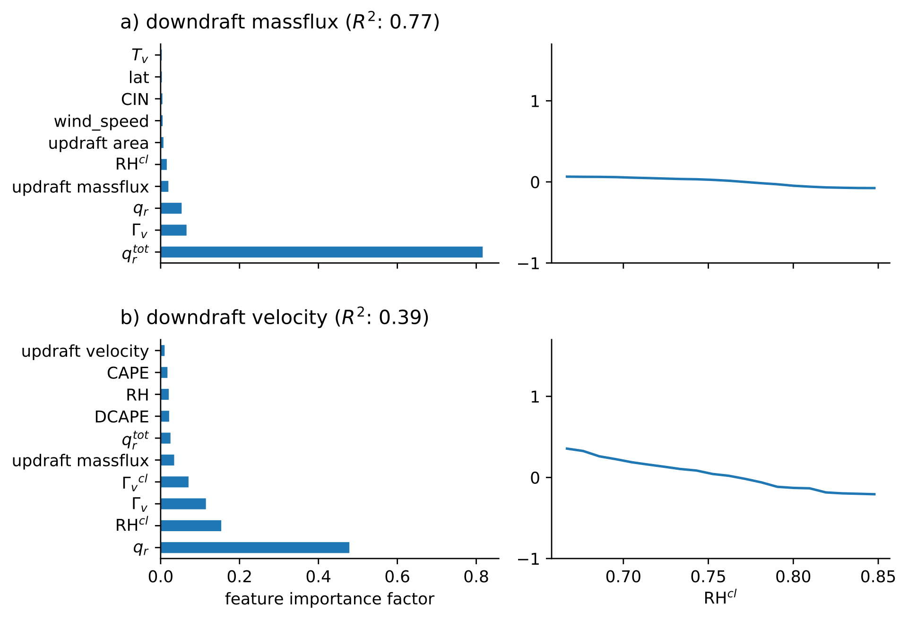
Why isn’t ambient humidity important?
Opposing effects from
  molecular weight (high RH —> stronger DD)
  entrainment (high RH —> weaker DD)
If we reduce the environment size substantially we begin to see high RH impede DD

Slide 15
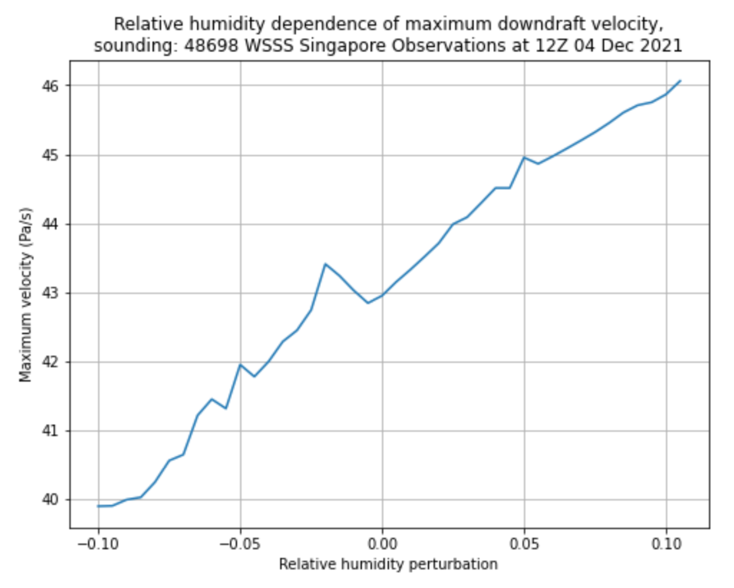
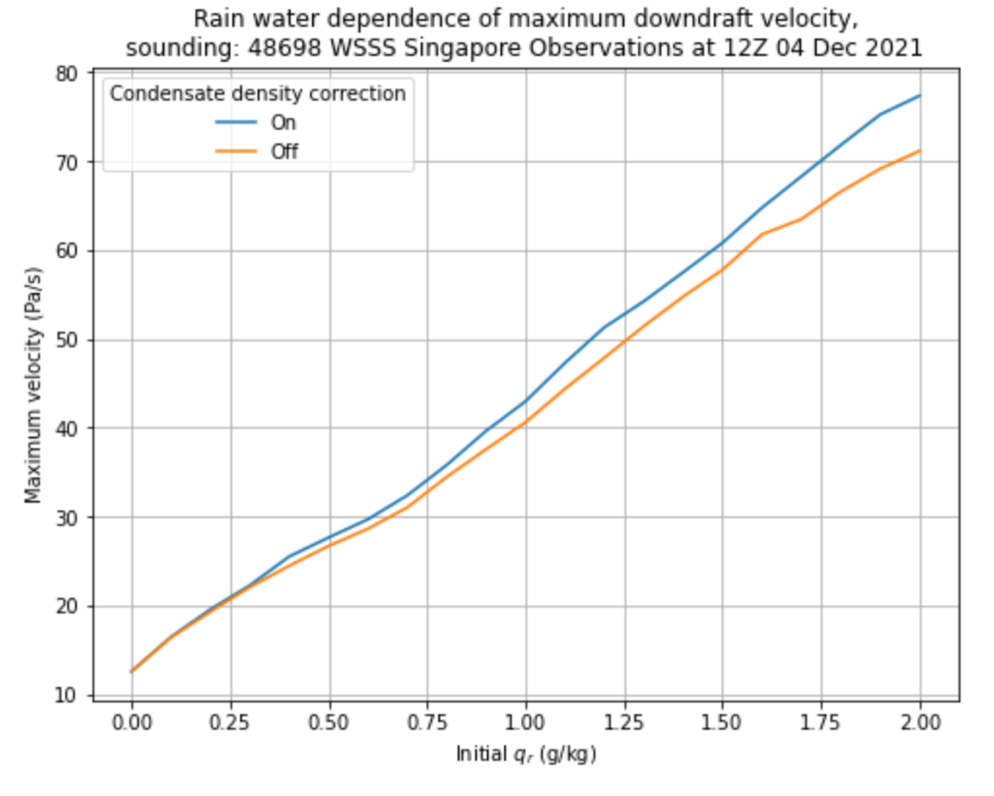
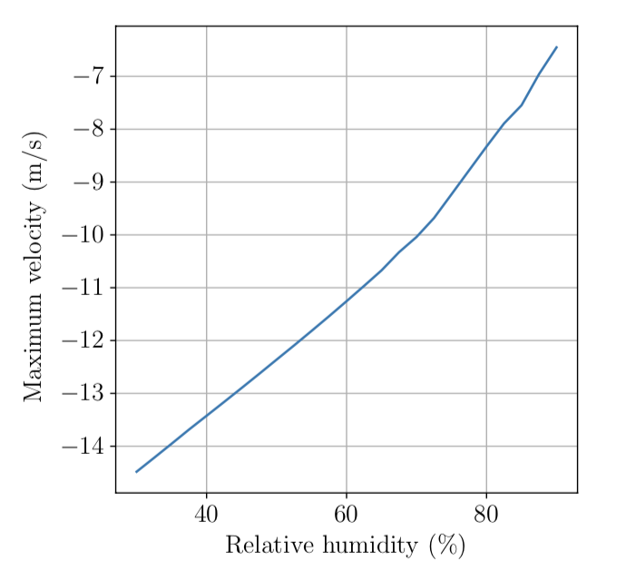
Parcel calculations
No entrainment
Confirm linearity of sensitivity
Show that sensitivity to RH can be of either sign
Stronger DD
entrainment
Stronger DD
RH —>

Slide 16
Summary
In ICON:
  Downdraft area scales linearly with updraft area, about 4:1 ratio
  Downdraft speed determined by rain water mixing ratio
  Ambient humidity over substantial area (200 km^2) not important
Causality still an issue even though DD properties lag predictors. Resolution also a big issue.
New Python package for calculating properties of descending air parcels developed by Thomas Schanzer
Available at: https://pypi.org/project/dparcel/
New Downdraft Interest group formed! You are not alone. s.sherwood@unsw.edu.au

