Slide 1



EarthWorks
Progress towards a storm-resolving coupled model
David Randall¹, James Hurrell¹, Donald Dazlich¹, Lantao Sun¹
William Skamarock², Andrew Gettelman², Thomas Hauser², Sheri Mickelson², Mariana Vertenstein²
Richard Loft³, Phil Jones⁴
¹Colorado State University
²National Center for Atmospheric Research
³AreandDee, LLC
⁴Los Alamos National Laboratory

Slide 2

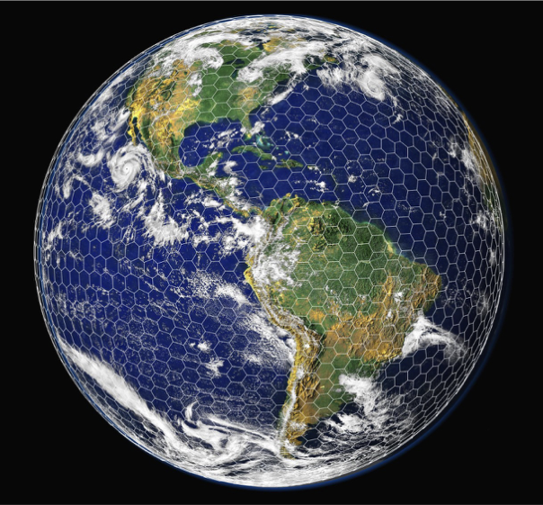
EarthWorks
EarthWorks is a five-year university-based project, supported by NSF CISE, to develop a global storm-resolving coupled model that uses a single uniform global grid for the atmosphere, ocean, sea ice and land surface
Earthworks is based on NCAR-supported Community Earth System Model (CESM) and components from the Model for Prediction Across Scales (MPAS):
CAM6 physics with the MPAS non-hydrostatic dynamics
MPAS ocean model developed at LANL
MPAS sea ice model, based on CISE
Community Land Model (CLM)
Goal: High-resolution coupled global modeling on U.S. supercomputers for the CESM community

Slide 3
EarthWorks
Single mesh for all components – global 3.75 km cell spacing
GPU-enabled components,
1 SYPD on US leadership computing systems by 2025.
SOME INITIAL OBJECTIVES:
Port MPAS Ocean and Sea Ice into the CESM framework ✓
Assemble a working CPU version of the EarthWorks configuration ✓
Complete fully coupled simulations at relatively coarse grid resolutions ✓
Test MPAS-CAM6 physics at convection-permitting spatial scales (Begun)
Port critical-path portions of EarthWorks to GPUs (Progressing)

Slide 4
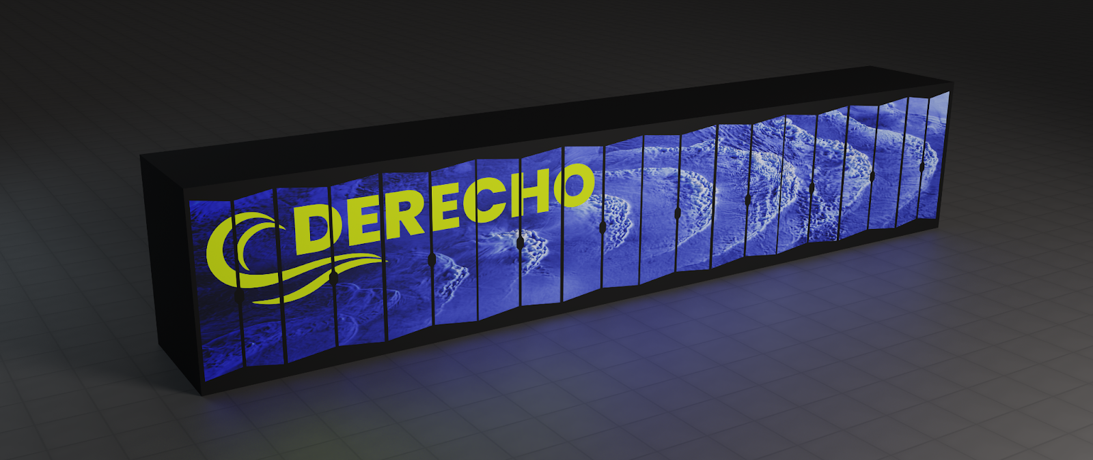

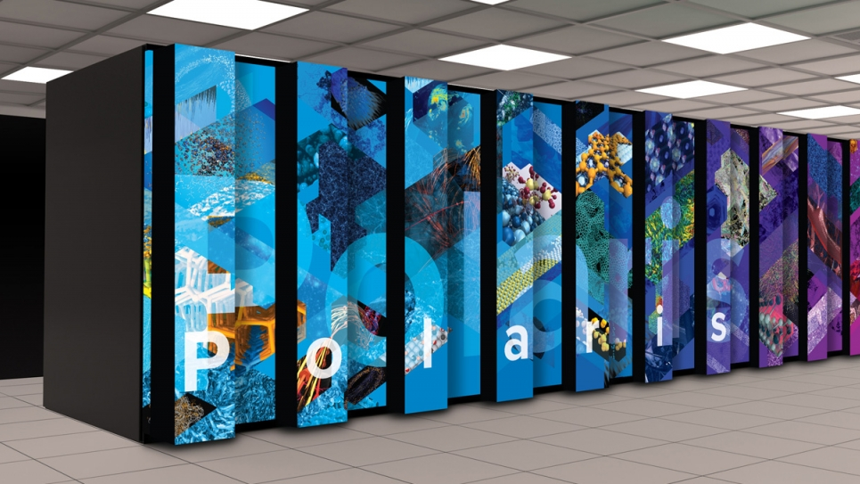

Earthworks Initial Target Platforms
EarthWorks is currently pursuing workflow portability across these leadership-computing systems.
  NSF Systems:
    NCAR: Cheyenne¹ Derecho*
    Texas Advanced Computing Center: Frontera¹ Horizon²
  DoE Systems:
    Argonne National Lab: ThetaGPU* Polaris*
    NERSC: Perlmutter*
*AMD + NVIDIA GPU
¹Intel CPU architecture
²Unknown architecture
Notes:
Notes: - An important objective is to enable the US climate and weather research community to use the faster machines in the world.
Our goal is to build and test across multiple platforms and centers to ensure EarthWorks is easy to build and run.
We are initially focused on a subset of large NSF and DoE systems, because of our limited resources.
Several systems, shown in green are based on hybrid nodes composed of AMD CPUs and NVIDIA GPUs.
Systems shown in blue, e.g. Cheyenne, Frontera are Intel Xeon CPU-based systems.
The architecture of Horizon, the mid-decade NSF Leadership Class system at TACC, is currently undefined.
On NSF systems:
At NCAR, Key point: a large Cheyenne allocation has recently been awarded to continue to build and test the CPU version of EarthWorks. Awarded Resources at NCAR include: Casper: 10,000.0 Core-hours, Campaign Storage: 110.0 TB , Cheyenne: 22,2M Core-hours
Key point: At TACC, a Community Earth System Model (CESM) using the MPAS atmosphere will serve as a Characteristic Science Application (CSA) for NSF’s next generation Leadership Class Computing Facility (LCCF) system, tentatively called Horizon, and EarthWorks is collaborating in this effort. Under this CSA program, TACC is paying for a postdoc at CSU to help work on establishing a “figure of merit” for measuring earth system model improvements. We have 10,000 node-hours of Frontera and 1800 node-hours of Longhorn, and 10 TB of shared storage allocated at TACC for this work.
DoE systems:
Argonne National Laboratory: Key point: EarthWorks has received a Director Discretionary at ALCF, primarily for GPU porting and testing. Namely: 80 node-hrs on Theta (an Intel KNL system), 256 node-hrs on ThetaGPU (a GPU system), 25 node-hrs on the Cooley, a data analysis system, and 20 TB of storage on Grand (kind of like GLADE).
National Energy Research Scientific Computing (NERSC) Center: Key Point: We received an ERCAP (Energy Research Computing Allocations Process) proposal for CPU/GPU testing. Namely: 500 AMD CPU node-hour and 175 hybrid CPU/GPU node-hours on Perlmutter, along with 20 TB of community file system (CFS) - again kinda like GLADE, and 2 TB of data archive.
What about Exascale systems? Now, in case you are asked about migrating to Aurora or Frontier, the big exascale systems, understand that to run on Aurora we will need to migrate our directives from OpenACC to OpenMP. This is not trivial, but we are seeing some automated tools emerging for assisting in this migration. For example, Jian Sun at NCAR in CISL/TDD Division has performed tests on the PUMAS cloud microphysics code, translating OpenACC to OpenMP semi-automatically, with reasonable performance portability demonstrated.

Slide 5

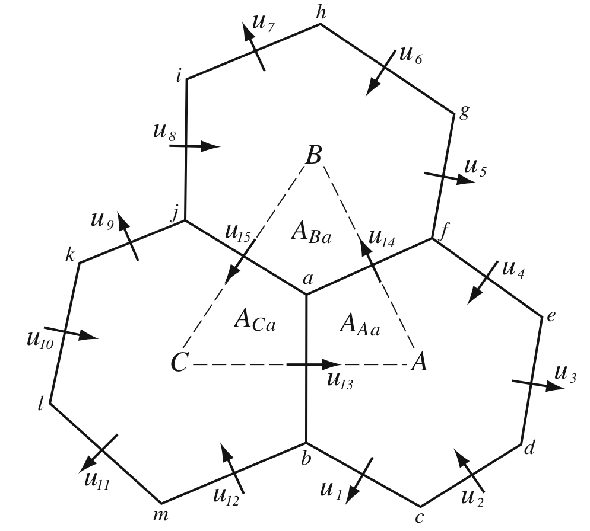
MPAS-Atmosphere solves the fully-compressible nonhydrostatic equations
Unstructured spherical centroidal Voronoi meshes
Mostly hexagons, some pentagons and 7-sided cells
Cell centers are at cell center-of-mass (centroidal).
Cell edges bisect lines connecting cell centers; perpendicular.
Uniform resolution – traditional icosahedral mesh.
Lloyd’s method used to generate variable-resolution meshes based on user-specified density function.
Time integration scheme:
Split-explicit Runge-Kutta (3rd order)
Prognostic equations for coupled variables.
Generalized height coordinate.

Slide 6
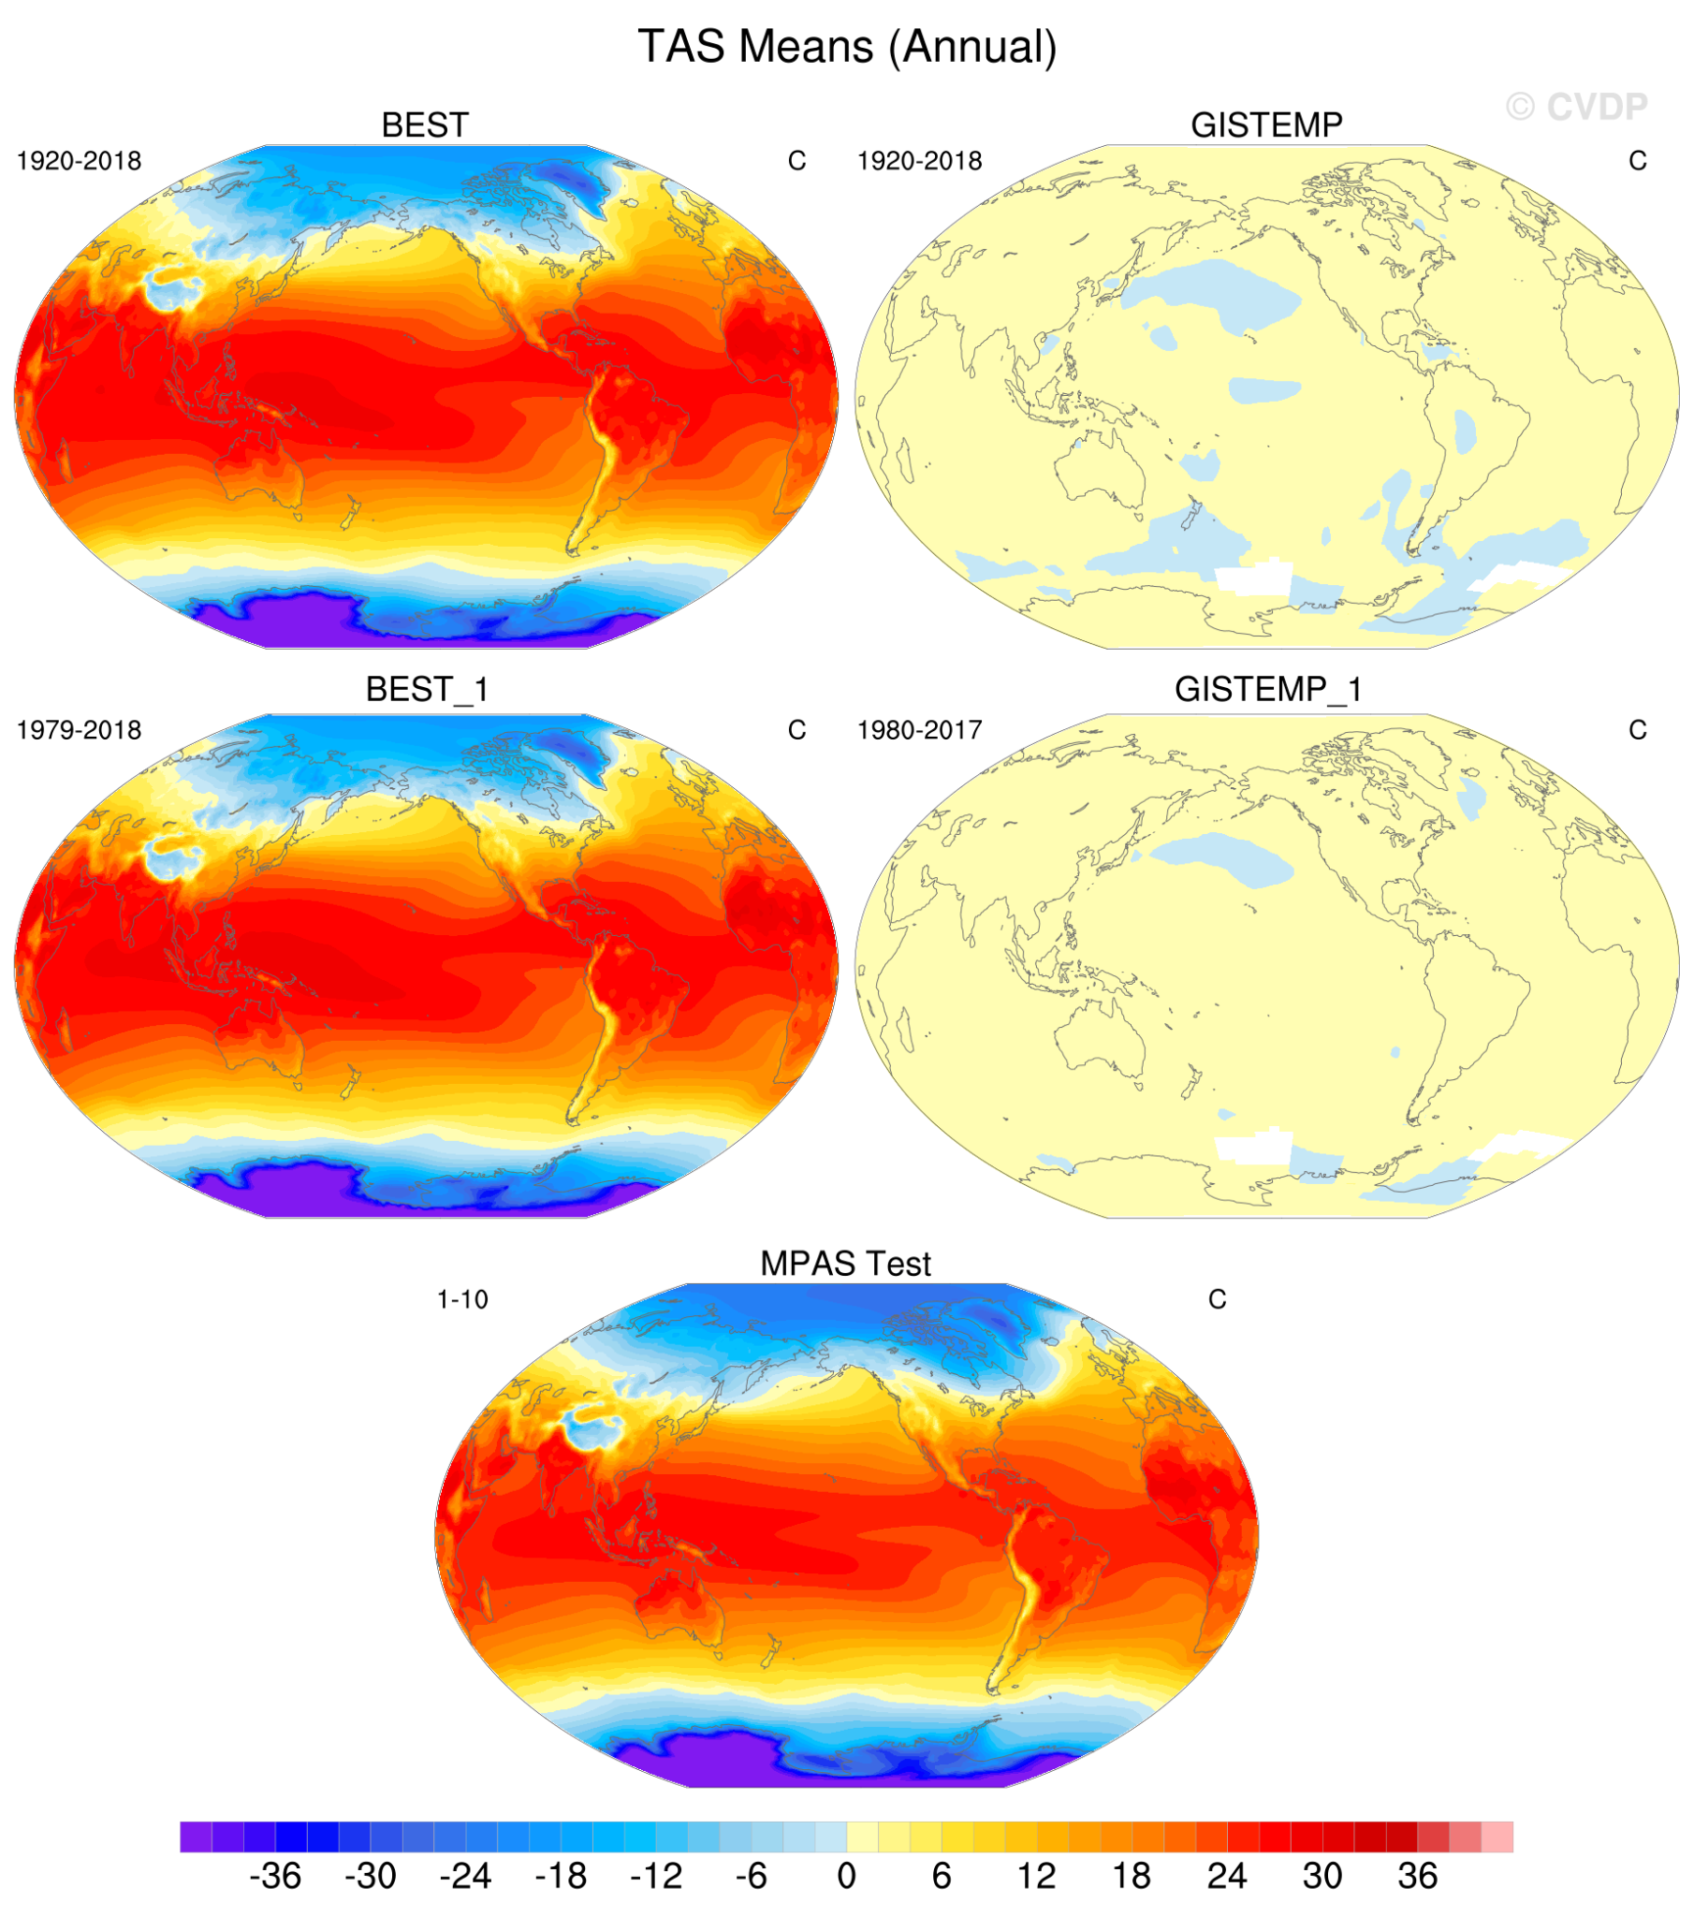
EarthWorks
CPU version of the EarthWorks configuration
Run at coarse resolution (e.g., 60 km)
Surface Air Temperature
Observed
EarthWorks
Notes:
Made with CVDP …

Slide 7
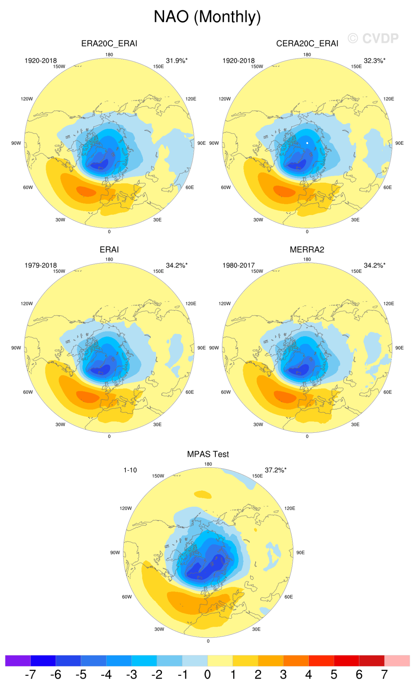
EarthWorks
North Atlantic Oscillation (Monthly)
Observed (ERA5)
EarthWorks
Sea level pressure EOF 1

Slide 8
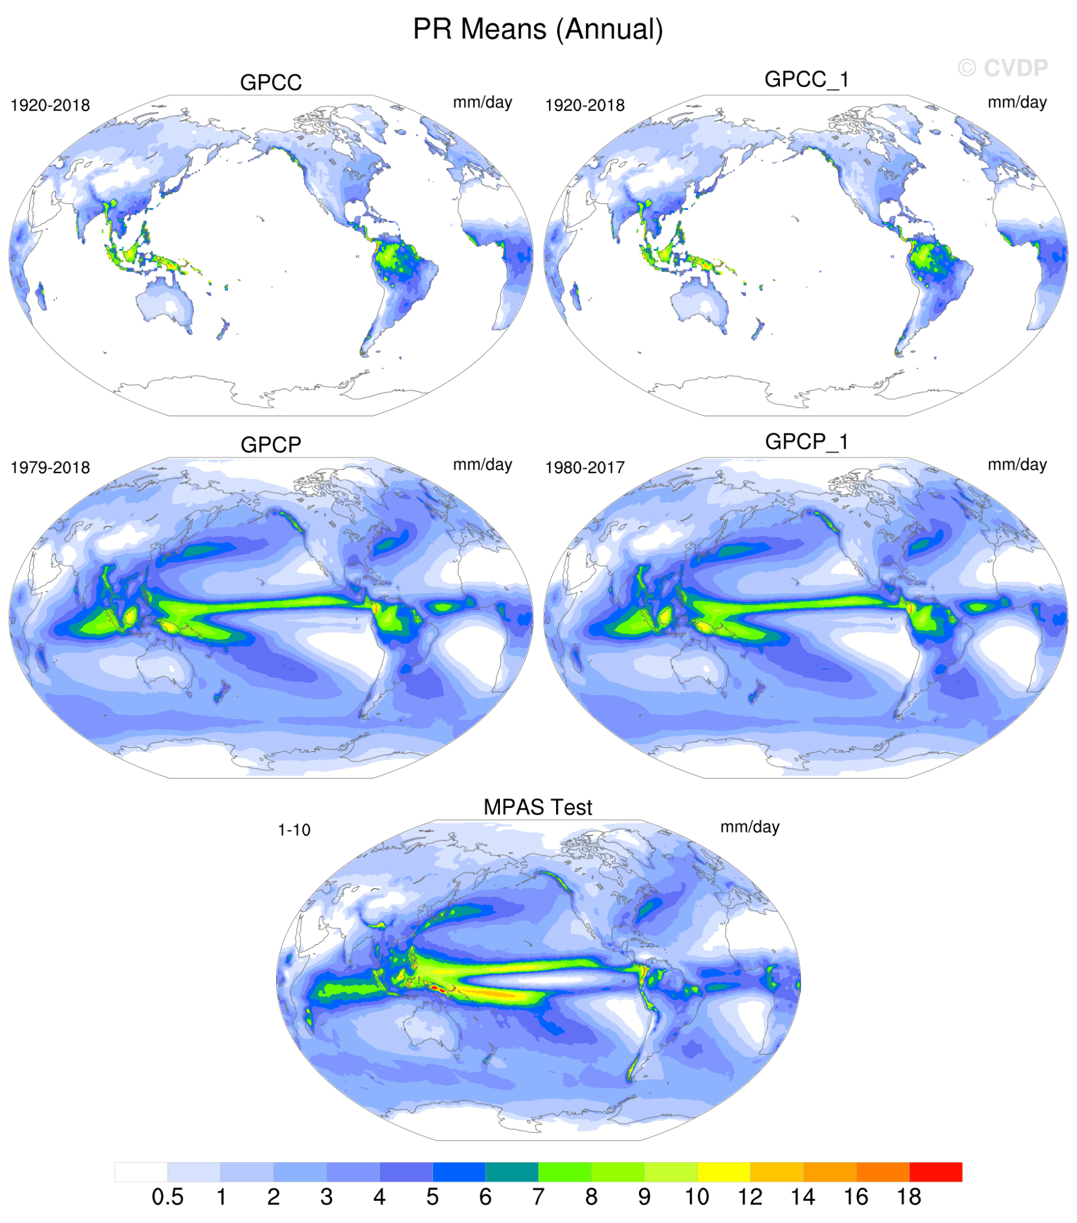
EarthWorks
Total Precipitation
Observed
EarthWorks

Slide 9
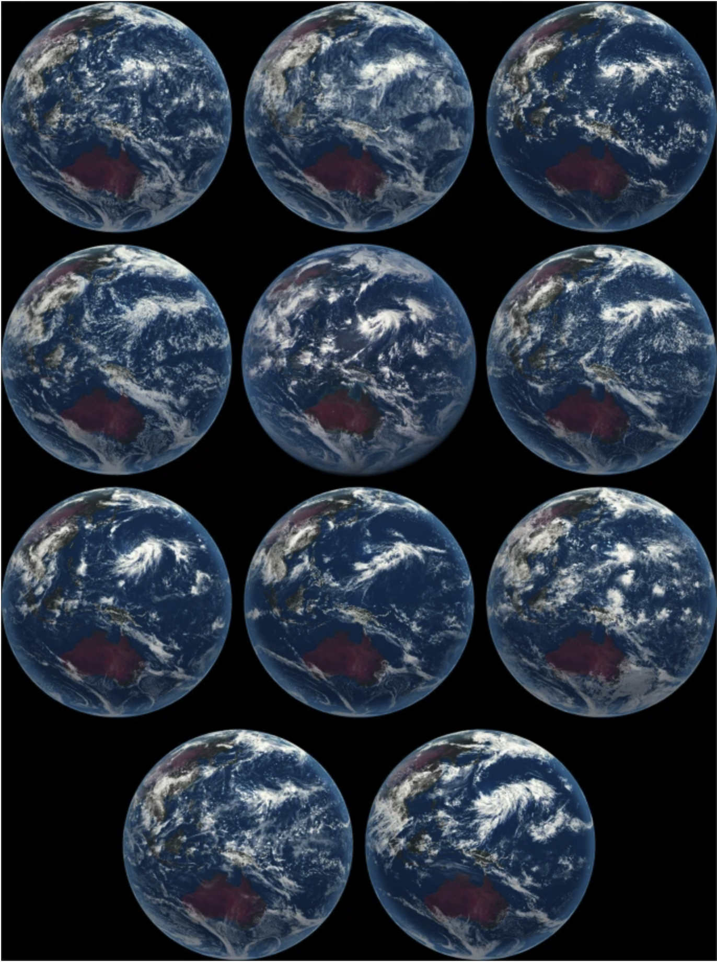
EarthWorks
What can we say about global atmospheric modeling at convection-permitting resolution?
Simulations capture large-scale flow.
Look “realistic” from global perspective.
Differences at convective scale are apparent.
NWP research and operational communities have been employing convective-permitting resolutions (regionally) for 3+ decades.
We can leverage this experience.
EarthWorks: Use variable-resolution MPAS capabilities to test CESM/MPAS/CAM6 physics at storm scale.
Short simulations (days), focus evaluations on convective system structure and evolution.
From DYAMOND (Stevens et al 2019)

Slide 10
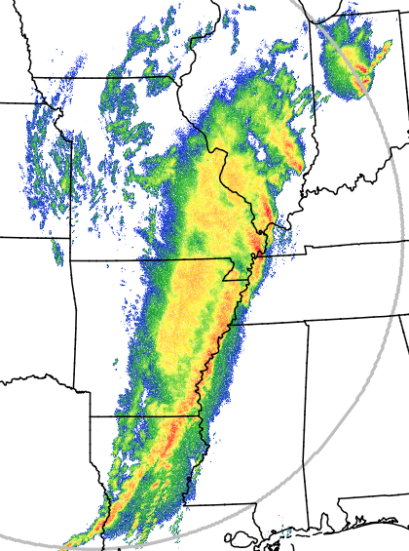
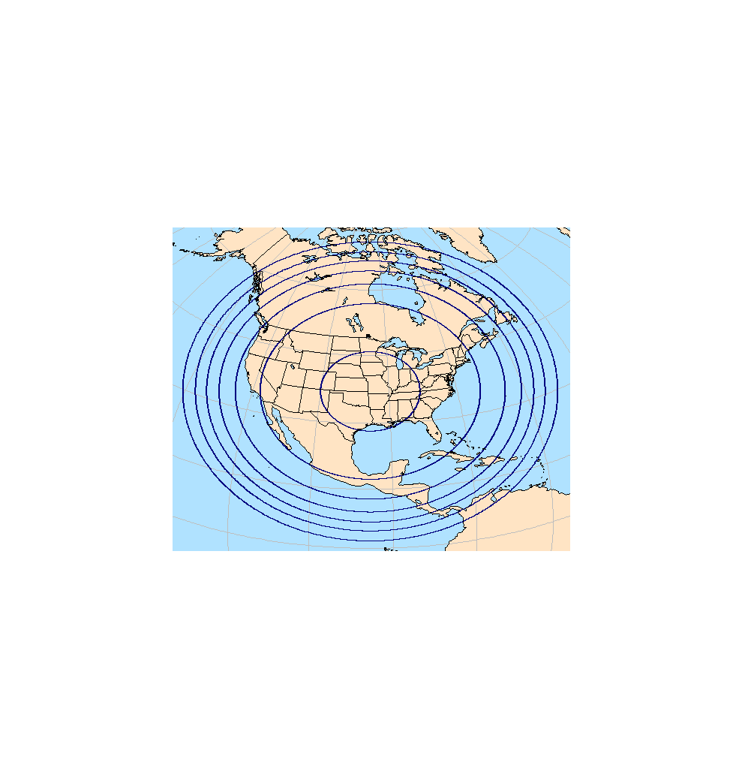
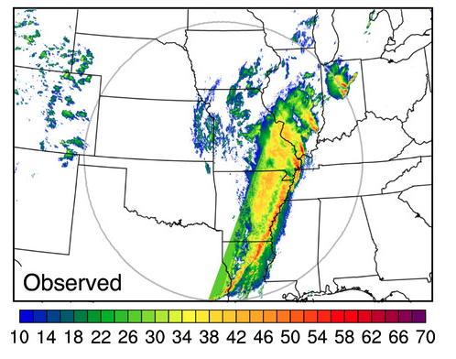
Atmosphere Testing
MPAS - CAM6 physics at convection-permitting scales
Central US spring test case, 24 hour forecast
0 UTC 26 April 2017 initialization
60-3 km variable-resolution mesh
Observed reflectivity (dBZ)
00 UTC 27 April 2017
trailing
stratiform
leading line
comma-shaped
convective system

Slide 11
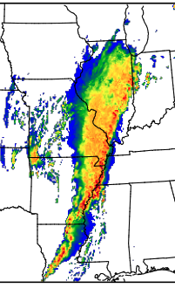
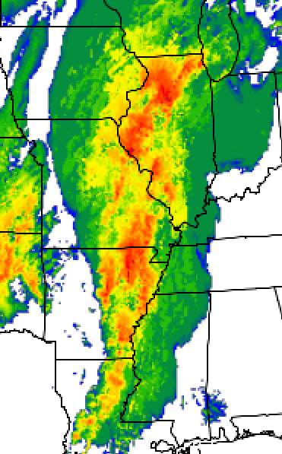
Atmosphere Testing
MPAS - CAM6 physics at convection-permitting scales
Central US spring test case, 24 hour forecast
observed
WRF physics
CAM6/MG3
Takeaways:
CAM6 physics is stable at 3 km for these cases
MG3 microphysics is an improvement over MG2 (not shown)
System-scale structure not well simulated with CAM6 physics (leading line - trailing stratiform structure).
There are issues with the physics that need to be addressed.
Reflectivity (dBZ)

Slide 12
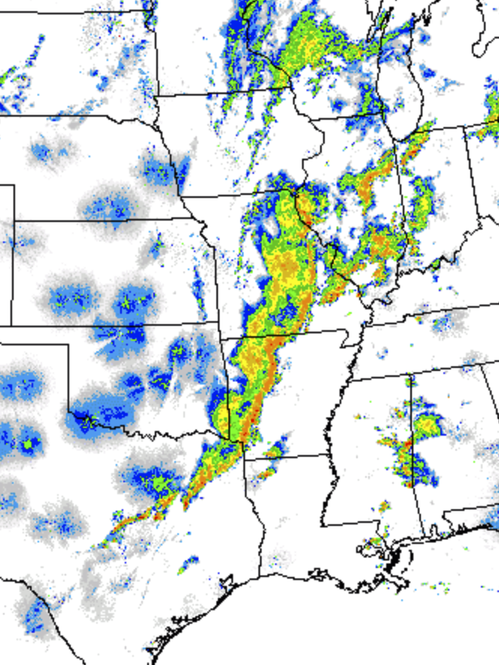
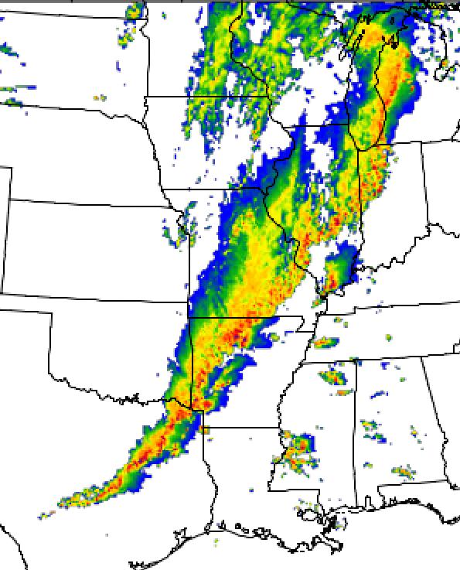
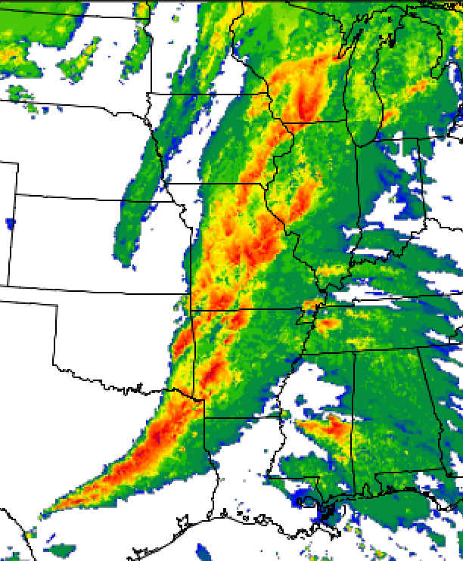
Atmosphere Testing
MPAS - CAM6 physics at convection-permitting scales
Another Central US spring test case, 27 hour forecast
Valid 03 UTC 10 October 2014
observed
WRF physics
CAM6/MG3
Issues with CAM6 physics are similar to those in the previous case.
Other tests underway:
Tropical convection and tropical cyclones.
Reflectivity (dBZ)

Slide 13

Summary
MPAS ocean and sea ice have been successfully ported into the CESM framework. Fully coupled 60 km 10-year simulation completed; 30 km simulation underway.
MPAS atmosphere and ocean can now be run on GPUs outside of the CESM framework.
Once CLUBB has been ported to GPUs, CAM6 physics will run on GPUs as well
CAM6 physics is being tested at convection-permitting scales
Our goal is that EarthWorks will produce at least one simulated year per day on a 3.75 km grid by the completion of the project

