Slide 1


Land-Atmosphere Interactions and the Changing Hydrologic Cycle
Dr. Kirsten L. Findell
Geophysical Fluid Dynamics Laboratory
Princeton, NJ with Suqin Duan (UCLA) and Stephan Fueglistaler (Princeton)
Pan-GASS Meeting
Monterey, California
25-29 July 2022

Slide 2
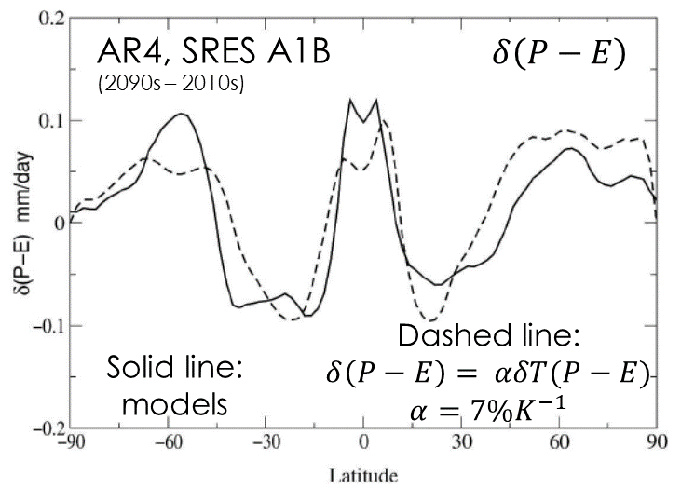
The hydrologic cycle in a warming world
Held and Soden, JClim 2006
Clausius-Clapyron: Saturation vapor pressure increases by about 7% per degree of warming
Held and Soden (2006): Pattern of precipitation minus evaporation (P-E) is amplified as temperatures increase:
the wet-get-wetter, the dry-get-drier
Paradigm is relevant over the oceans where moisture is always available for evaporation
Over land, the paradigm does not hold
  Greve et al. (2014): obs-based datasets (1948-2005)
We’re going to look at daily data, rather than monthly or annual averages
We’re going to focus on mechanistic processes
Greve et al., NatGeo 2014

Slide 3

The Soil Moisture - Aridity Index (SM-AI) Percentile phase space
X-axis: daily SM percentiles
  Provides a visual of the PDF of soil moisture
  Can be linked to percent of time a given location is in different SM-ET behavioral regimes
Y-axis: Climatological Aridity Index (AI) percentiles
  An indication of the broad context of each grid point
Following Milly and Dunne (2016, 2017):
Aridity Index =
$$0.8\frac{{Radiation}_{net}^{sfc}}{L_{v}⋅Precipitation}$$
Mean pre-industrial control SM and AI of 8 CMIP5 models

Slide 4
The nonlinear SM-ET relationship
Energy- limited regime
Water- limited regime
Change x-axis to percentiles
  Can easily gauge percent of time that grid point is in each regime
  And how those percentages change in a warming world
Using GFDL-ESM2M pre-industrial control
soil moisture in top 10 cm,
Focusing on 5-month warm season (MJJAS/NDJFM)
30 years of data

Slide 5
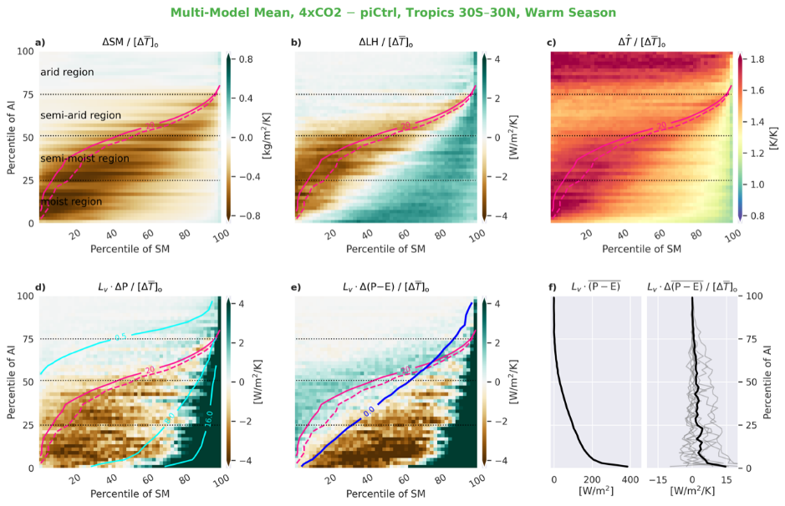
The SM-AI Percentile phase space
ΔLH/ΔT_{o}
Using 8 CMIP5 models, 4xCO₂ – preindustrial control experiments
20 kg/m² loosely aligns with the critical point

Slide 6
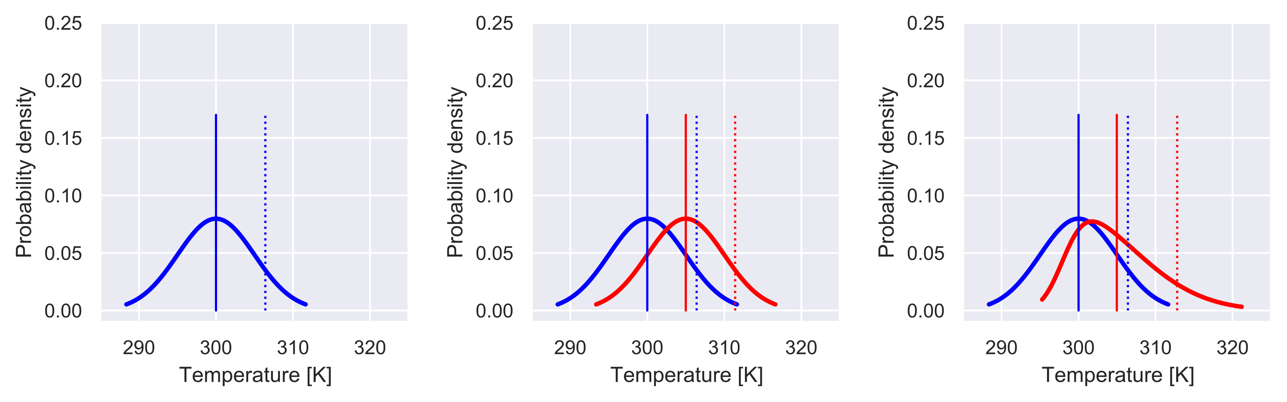
Temperature response
Daily maximum temperature increases are most pronounced:
  In arid regions: uniform increase on all days
    PDF change: uniform shift to warmer temperatures
  In moist and semi-moist regions: on days with moisture limitation
    PDF change: warm shift + lengthening of the warmest tail
Uniform shift
Longer warm tail

Slide 7
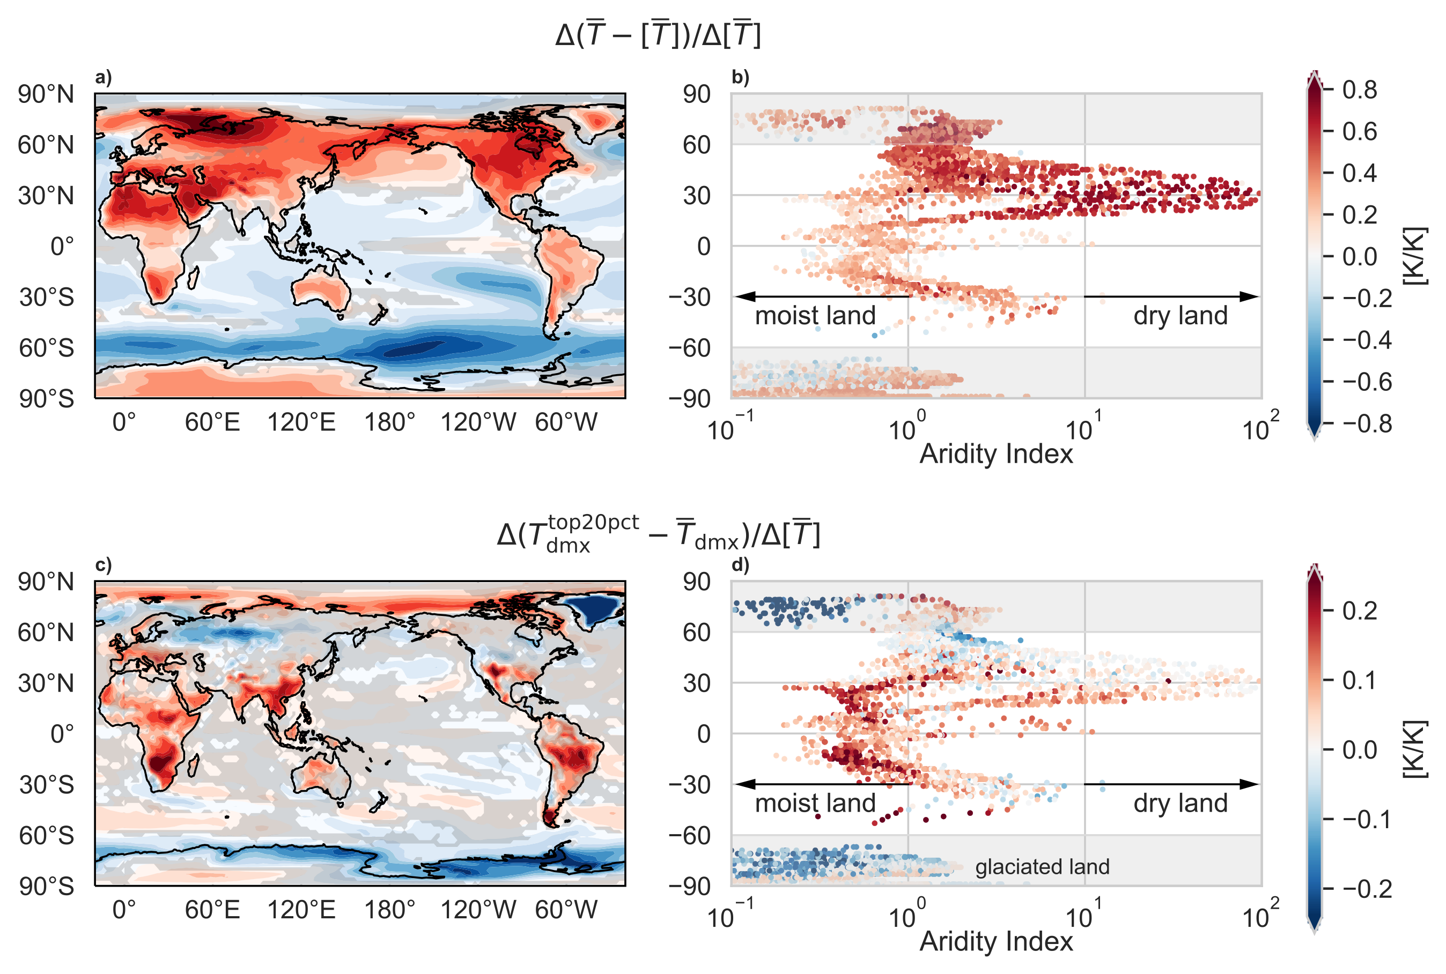
Summertime temperature distribution changes
Mean warming:
Land warms more than the ocean;
Dry land warms more than moist land.
Extreme-relative-to-mean warming:
Moist land in tropics/subtropics feature amplified warming in the extreme relative to the mean,
Duan, Findell, and Wright, GRL 2020

Slide 8
Individual models: ΔLH for 4xCO₂ - piCtl
LH reductions are most severe around the critical point

Slide 9
Individual models: ΔLH for 4xCO₂ - piCtl
Difficult to draw general conclusions from this geographic view

Slide 10
What about Precip?
Very little change (though positive) at high AI
In moist and semi-moist regions:
Wet days get more rain, dry days get less rain
This is not the answer to how wet-gets-wetter changes on land:
Need to look at (P-E)
Substantial P decreases in the drier part of the PDF at each location (each AI)
Large P increases in the already wet part of the PDF at each location (each AI)

Slide 11
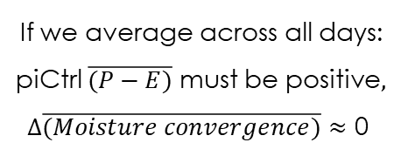
How wet-gets-wetter manifests on land
piCtrl
If we average across all days:
piCtrl $\overline{(P−E)}$ must be positive$,$
$∆\overline{(Moisture convergence)}≈$ 0
Wet-gets-wetter:
would see increases to the right of the blue
piCtl(P-E)=0.0 line, and decreases to the left
But clearly (P-E) is redistributed in time

Slide 12
How wet-gets-wetter manifests on land: by process regime
Very little change in the dry regime
Transitional, water-limited regime:
Positive change: reductions of E
are greater than reductions of P
Wet, energy-limited regime gets drier
Super-wet (active rain) regime gets wetter

Slide 13



How wet-gets-wetter manifests on land: by climatological region
In arid regions:
Almost no change
In semi-arid regions:
All regimes manifest;
Water-limited most prominent (~60%)
In semi-moist and moist regions:
Active rain regime gets wetter,
Wet, energy-limited regime gets drier,
Water-limited regime: less moisture divergence

Slide 14
The Aridity Index – Daily Soil Moisture Phase Space shows how relationships change over land with warming
Duan, Findell and Fueglistaler, 2022, In revision for PNAS
Need to work with daily time-scale data
Powerful tool for understanding vulnerability to heatwaves and comparing model behaviors
Results from many other studies can be understood within the context of this phase space
Mechanistic consistency between models and reanalysis*

Slide 15
Thank you!

Slide 16
Extra slides….

Slide 17
Do obs (or ERA5) agree?
Base state

Slide 18
Do obs (or ERA5) agree?
Change normalized by mean tropical ocean warming

Slide 19
ERA5 Trends
Visible changes in the 1990s and 2000s
  Highlights the difficulties of working with (and assimilating) a changing observational system
  Highlights the need to revisit the observations and determine the root cause of these rapid changes

Slide 20
Seasonal changes of (P-E): Do wet seasons get wetter and dry seasons get drier?
CMIP6 MMM Δ(P-E)
Future – Hist
(last 30 yrs each)
Multi-model mean seasonal changes in water availability in CMIP5 and CMIP6
The dry/wet season: the three consecutive months with lowest/highest mean P-E in the historical period in each model.
Wet sea
~45% of area: Wet seasons get wetter, dry seasons get drier
~20% of area: Wet seasons get drier, dry seasons get wetter
Dry sea
(P-E) (mm/day)
Ann Range
ES or RS = Extended or reduced seasonality
Zhou, Findell et al., In revision for Nature Comm.

Slide 21
Seasonal changes of (P-E): Do wet seasons get wetter and dry seasons get drier?
Uses soil moisture override experiments from CMIP6 to show
The reduced seasonality is largely driven by a strong soil moisture effect during the dry season
Wet sea
Dry sea
Ann Range
LFMIP = Land Feedback MIP;
Future simulation has SM prescribed to mean seasonal cycle from 1980-2014;
5 models
Zhou, Findell et al., In revision for Nature Comm.

Slide 22
Reduced seasonality regions
Reduced ET and enhanced moisture convergence in the dry season
Consistent with a strong transitional regime presence

Slide 23
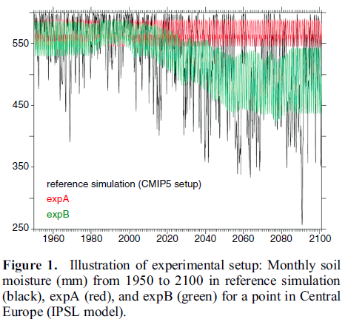
Impact of Soil Moisture-Atmosphere Interactions on Surface Climate Variability
GLACE-CMIP5 experiment: Simulations with soil moisture overrides: fixed 30-year climatology or moving 30-year climatology
Berg, Findell et al., JClim 2014
Central Asia, 2m temp
Climatological SM
Seneviratne, et al., GRL, 2013
Interactive SM
EF
H
SW_{dn}
λE
SM

Slide 24
Impact of Soil Moisture-Atmospheric Interactions on Surface Climate Variability
How changes to soil moisture availability influence surface temperature is location dependent
Berg, Findell et al., JClim 2014

Slide 25
Individual models: ΔSM for 4xCO₂ - piCtl
Most severe drying tends to occur around 20 kg/m² in the MMM and most models

Slide 27
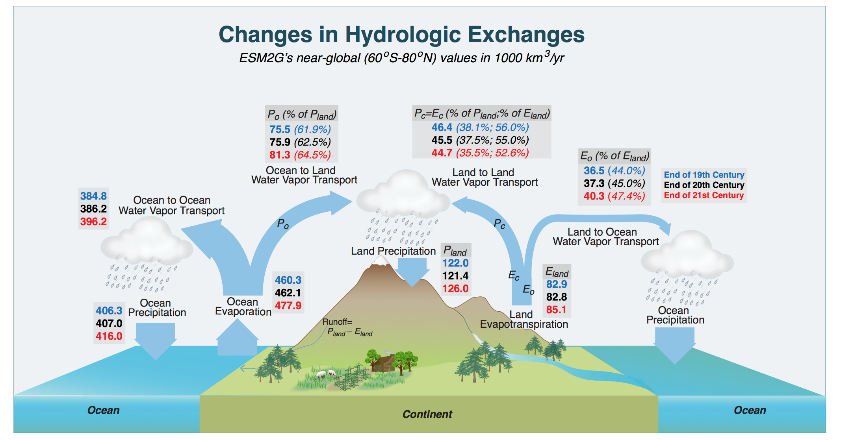
Continental moisture recycling decreases by 2-3% with each degree of increase in global temperatures
As global temperatures warm, both recycling ratios get smaller:
the ocean imprint on continental hydrology gets bigger
Findell et al., JClim 2019

Slide 28
The nonlinear SM-ET relationship
Work led by Suqin Duan (now at UCLA)
Duan, Findell and Fueglistaler, 2022, In revision for PNAS
Dry regime: no evapotranspiration
Transitional regime: water-limited regime
  Increasing SM means increasing ET
  Soil and vegetation characteristics determine slope and critical point
  These are dynamic! Especially rooting density and depth: changing access to deeper moisture
Wet regime: energy-limited regime
  Increasing SM does not change ET
Super-wet regime: active rain regime
  Clouds limit incoming radiation
  Boundary layer air is ~saturated, limiting ET-demand

Slide 29
The nonlinear SM-ET relationship
Example grid point:
  Logical alignment of precip with SM and LH
  Temperature extremes are most pronounced on days in the transitional or dry regimes
Change x-axis to percentiles
  Can easily gauge percent of time that grid point is in each regime
  Can easily gauge how those percentages change in a warming world
Using GFDL-ESM2M pre-industrial control
soil moisture in top 10 cm,
Focusing on 5-month warm season (MJJAS/NDJFM)
30 years of data

