Slide 1
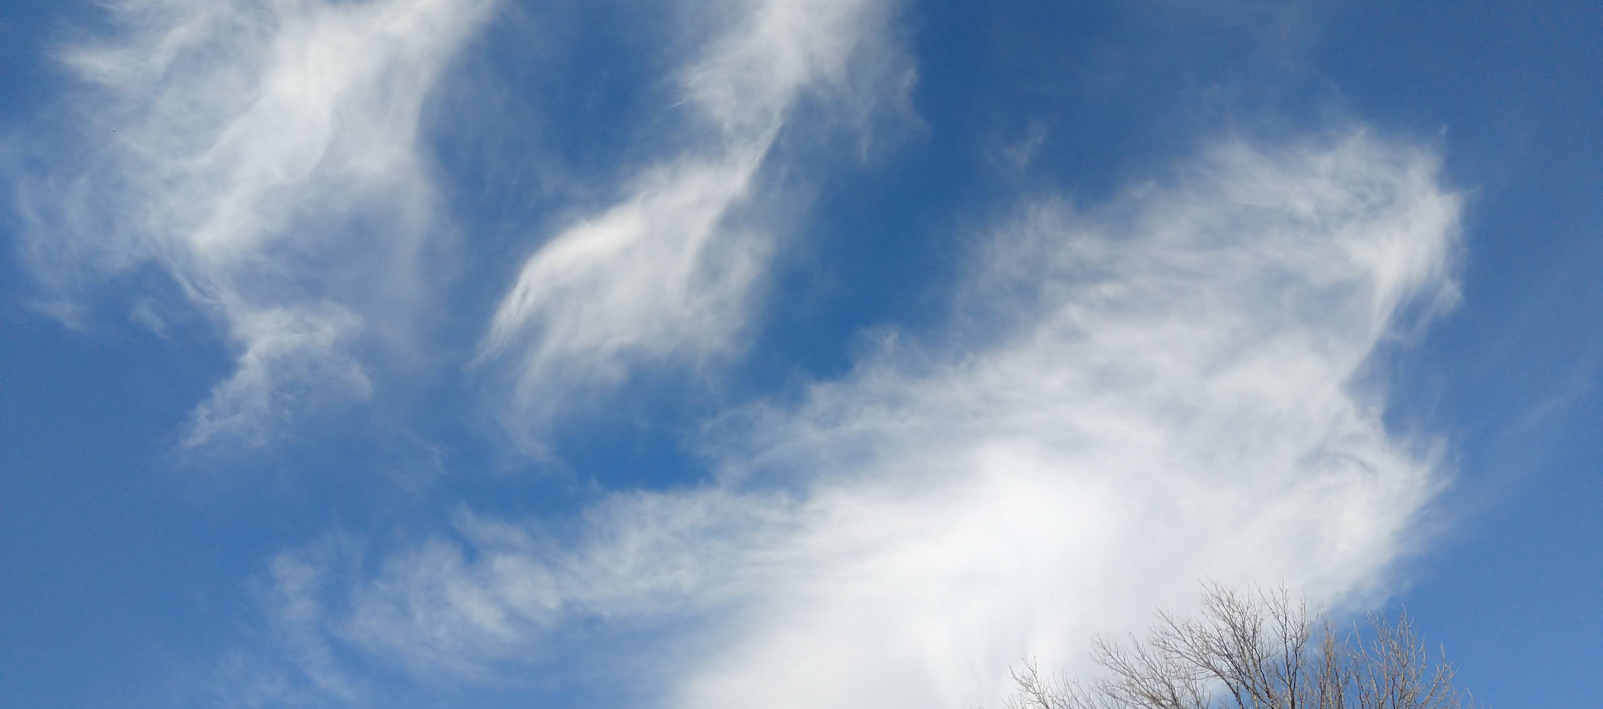





Two Perspectives of Ice Microphysical Impact on Cloud-Radiative Heating
Sylvia Sullivan, University of Arizona, Karlsruhe Institute of Technology
Aiko Voigt, University of Vienna
Christian Rolf and Martina Krämer, Forschungszentrum Jülich
Annette Miltenberger, University of Mainz

Slide 2


Ice clouds generate an atmospheric heating-cooling dipole.
Pressure [Pa]
cloud-top cooling
reemission of that absorbed infrared out to space
in-cloud heating
increased infrared absorption relative to clear sky
Radiative heating [K day⁻¹]
2

Slide 3
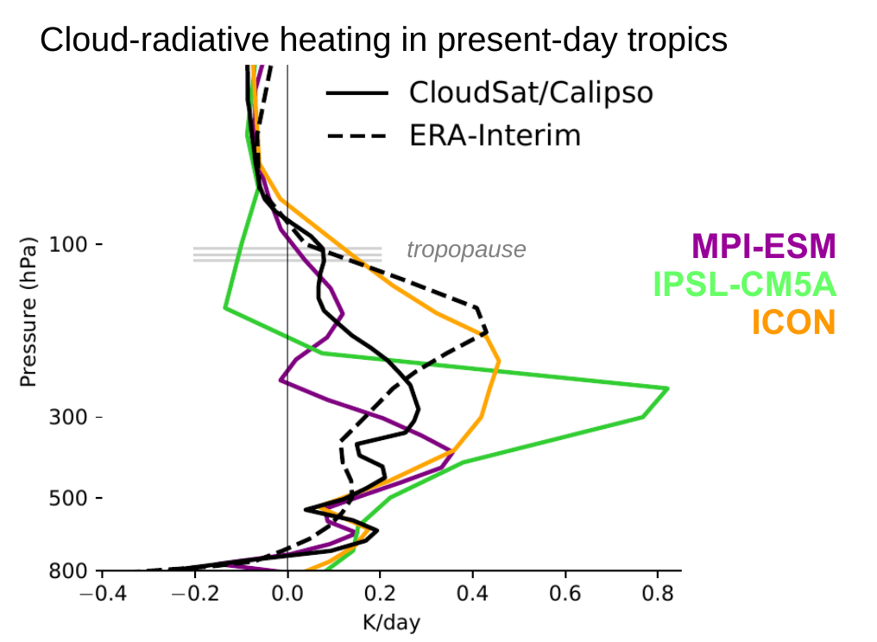
This heating-cooling dipole varies from different sources.
P
cloud-top cooling
in-cloud heating
Radiative heating [K day⁻¹]
So what?
Robust cirrus lifting with warming →
A. Voigt, N. Albern, G. Papavasileiou (2019) J. Clim.
Hadley cell expansion ¹
Poleward shift and strengthening of the NH jet stream ^{2,3}
3
¹ Voigt & Shaw (2015) Nat. Geosci.
² Albern et al. (2018) Geophys. Res. Lett.
³ Voigt et al. (2021) WIRES Clim Change

Slide 4
How much does ice microphysics contribute to this variability in cloud-radiative heating?
z
Part 1: Eulerian perspective using limited-area simulations
A. Voigt, N. Albern, G. Papavasileiou (2019) J. Clim.
Part 2: Lagrangian perspective using trajectories
t
4
formation
development
dissipation

Slide 5
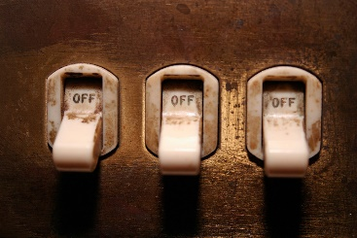
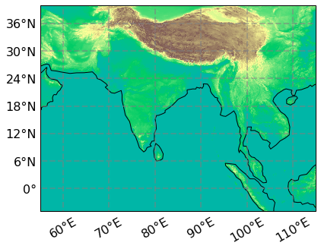
We “flip” four microphysical switches in storm-resolving simulations.
M
V
A
R
One-Moment or two-moment microphysics scheme
Default or higher Vertical resolution
Aerosol dependence or not in nucleation
Consistent size (effective Radius) of crystals between microphysics and radiation or not
Icosahedral Nonhydrostatic Model (ICON), 2.5-km equivalent resolution, 3 days of simulation (StratoClim Flight 7 - August 2017)
5
Notes:
Default resolution = 75 levels
Higher resolution = 120

Slide 6
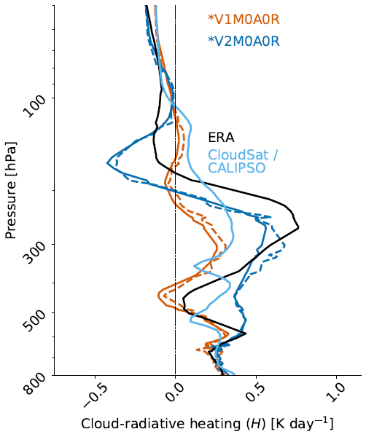
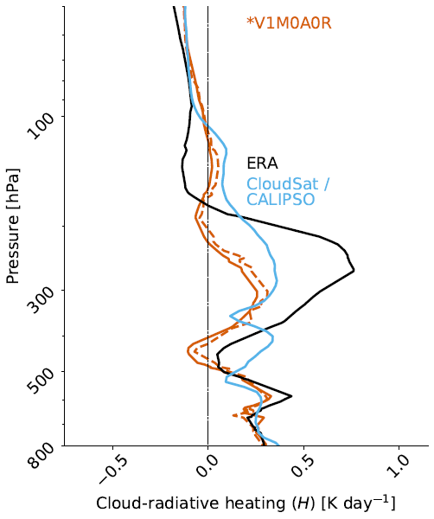
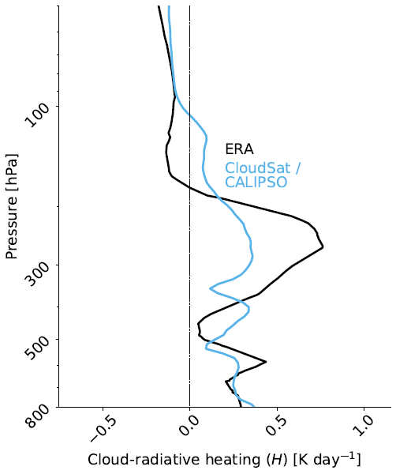
M – microphysics V – vert res R – ice crystal size A - aerosol
Reanalysis and satellite profiles do not agree.
Vertical resolution has little impact.
In-cloud heating is almost 2 times larger from 1M → 2M.
6
Sullivan and Voigt (2021). Comms. Earth & Env.

Slide 7
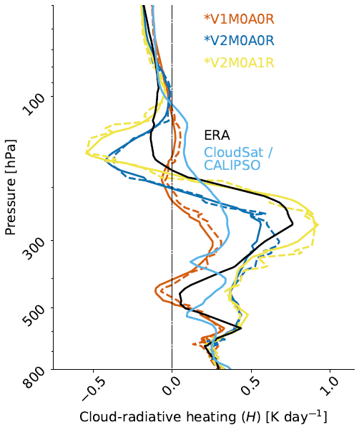
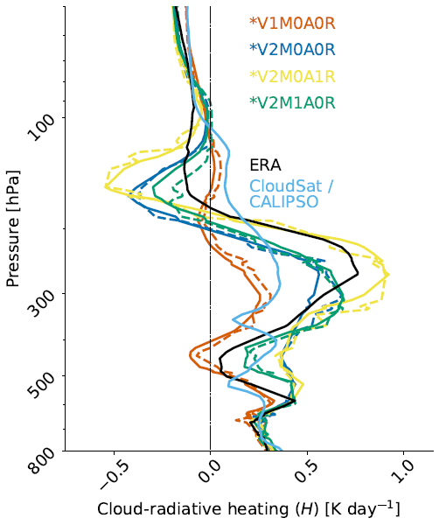
M – microphysics V – vert res R – ice crystal size A - aerosol
Heating-cooling dipole increases by a factor of 2 with consistent ice crystal size.
Aerosol dependence moderates the dipole somewhat.
7
Sullivan and Voigt (2021). Comms. Earth & Env.

Slide 8
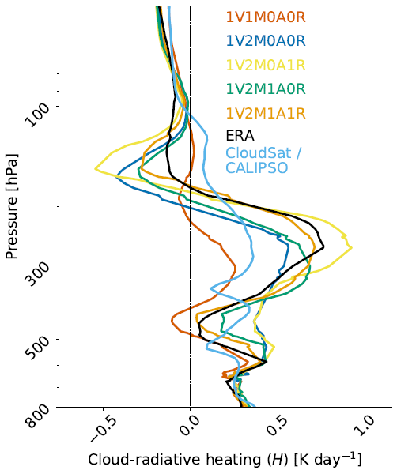
Reanalysis and satellite profiles do not agree.
We can kind of generate whatever we want with ice microphysics switches...
Vertical resolution has little impact.
Cloud-top cooling is almost 10 times larger 1M → 2M.
Heating-cooling dipole increases by a factor of 2 with consistent ice crystal size.
Aerosol dependence moderates the dipole somewhat.
… but we can also understand why.
Combined aerosol dependence and consistent crystal size agrees best with ERA.
8

Slide 9
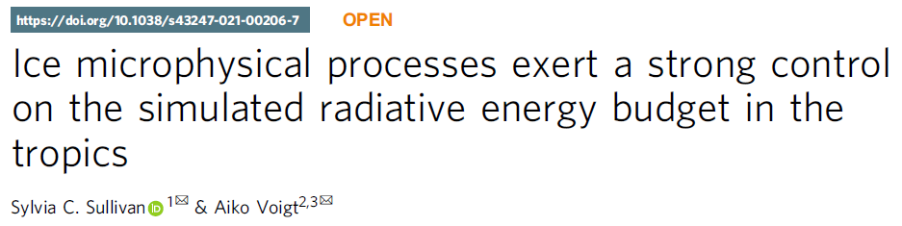
… but we can also understand why.
z
microphysical-dynamic feedbacks
Communications Earth & Environment 2021
decreased conversion to snow
larger ice cloud radiative heating
more efficient heterogeneous ice nucleation
Part 2: Lagrangian perspective using trajectories
t
9
formation
development
dissipation

Slide 10


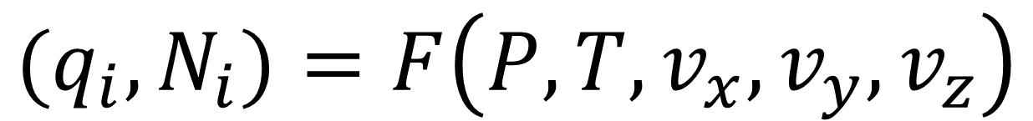


What if we constrain microphysical-dynamic feedbacks?
Ice crystals radiatively heat by absorption.
(1)
(2)
radiative heating
microphysics scheme
$$\dot{Q}∝(N_{i},∫q_{i} dP^{′})$$
$${(q_{i},N}_{i})=F\left(P,T,v_{x}, v_{y},v_{z}\right)$$
+
Radiative heating generates buoyant ascent...
… and ascent produces supersaturation and nucleation.
$$\frac{∂v_{z}}{∂t}∝\dot{Q}$$
(3)
10

Slide 11


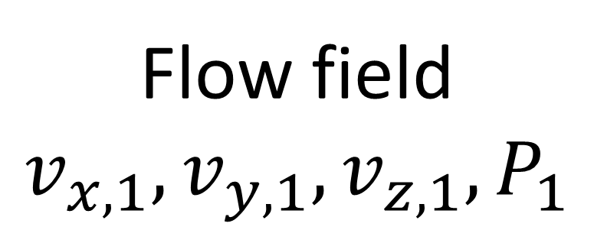
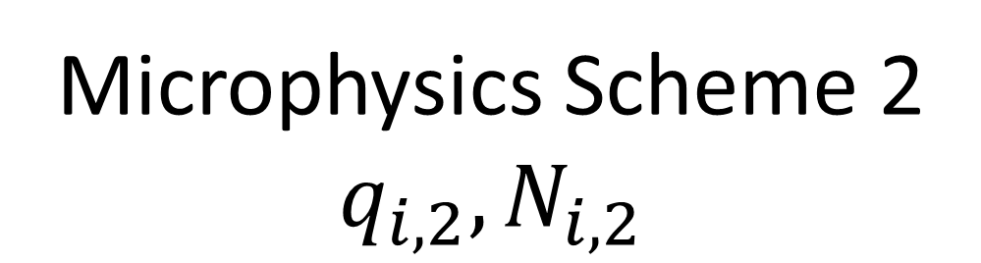
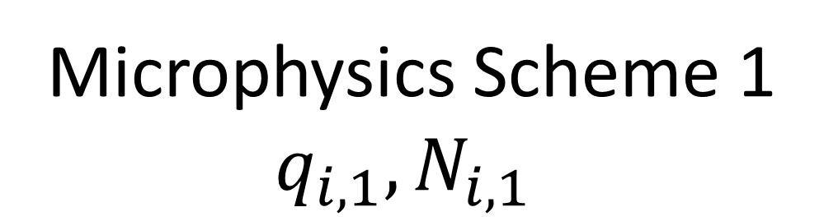
Feedbacks are constrained with fixed inputs along trajectories.
(a variant of microphysical piggybacking)
Trajectories
Offline scheme
Flow field
$$v_{x, 1}, v_{y,1}, v_{z,1}, P_{1}$$
6 simulations
C/I – CLaMS-Ice / ICON
M – 1- or 2-moment
Microphysics Scheme 1
$$q_{i,1}, N_{i,1}$$
Microphysics Scheme 2
$$q_{i,2}, N_{i,2}$$
1- or 2-moment schemes in ICON
2-moment scheme in CLaMS-Ice
11

Slide 12
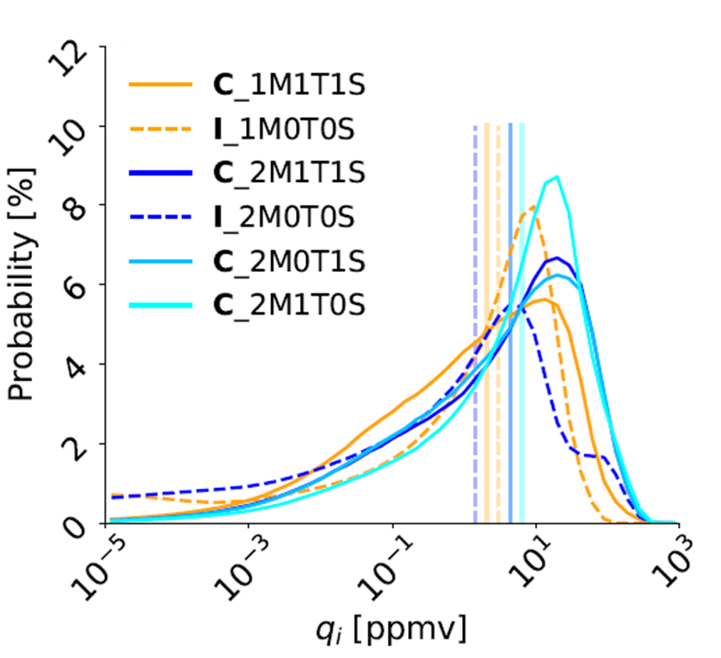

How does cloud ice mass compare across these trajectories?
Median cloud ice mass varies by a factor of 5 even with feedbacks constrained.
Structural differences in microphysics suffice to generate such a spread.
12
Sullivan, Voigt, Miltenberger, Rolf, and Krämer (2022). Under review at J. Adv. Model. Earth Sys.
Notes:
“perhaps as the addition of uncertain parameters in more sophisticated schemes expands the space of possible cloud states”

Slide 13
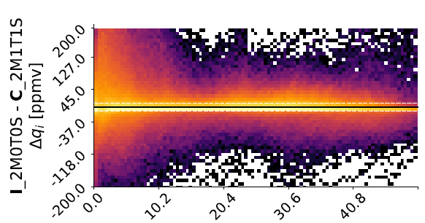
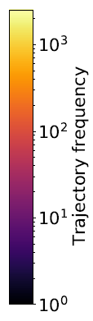
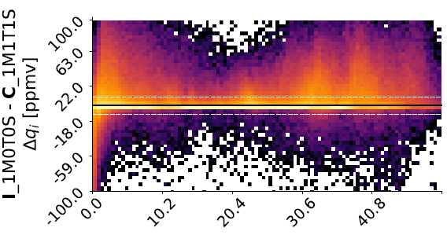

How rapidly does cloud ice mass diverge between schemes?
ICON-CLaMS 2M ice mass difference [ppmv]
ICON-CLaMS 1M ice mass difference [ppmv]
fairly quickly within cirrus lifetime
Structural differences in initial cirrus formation – preexisting ice or nucleation – drive cloud ice mass variation.
13
Sullivan, Voigt, Miltenberger, Rolf, and Krämer (2022). Under review at J. Adv. Model. Earth Sys.

Slide 14
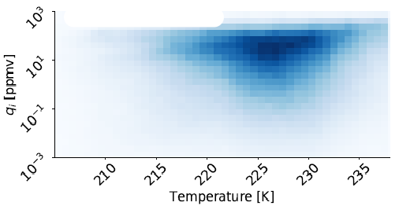
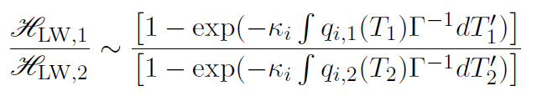

To scale relative heating rates for the different trajectories, we use
temperature distributions of cloud ice mass.
integrated q_{i} over that depth
temperature depth of non-negligible q_{i}
and
absorption cross section
lapse rate
14

Slide 15
How much does ice microphysics contribute to this variability in cloud-radiative heating?
z
Part 1: Eulerian perspective
4-fold
Feedbacks with dynamics
Ice-to-snow conversion
Heterogeneous nucleation efficiency
Part 2: Lagrangian perspective
2-fold
Dominated by structural differences in ice formation
A. Voigt, N. Albern, G. Papavasileiou (2019) J. Clim.
t
15
formation
development
dissipation

Slide 16
Supplementary Slides

Slide 17
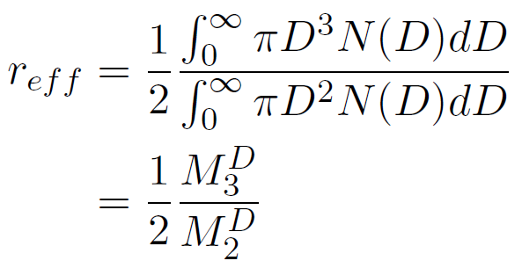

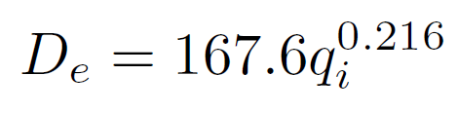

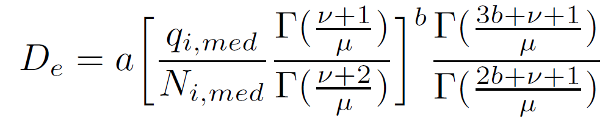
Consistent size (effective Radius) of crystals between microphysics and radiation or not
two-moment microphysics
radiation
17

Slide 18
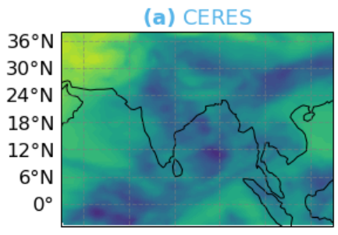
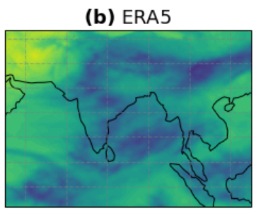
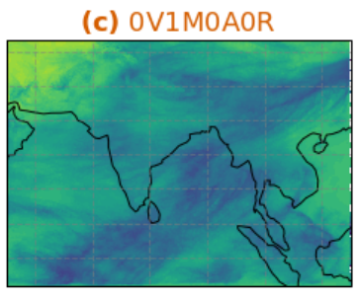
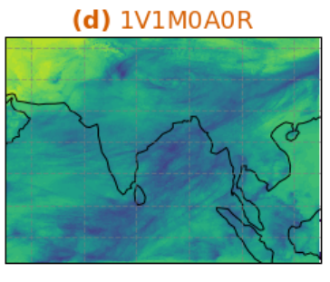
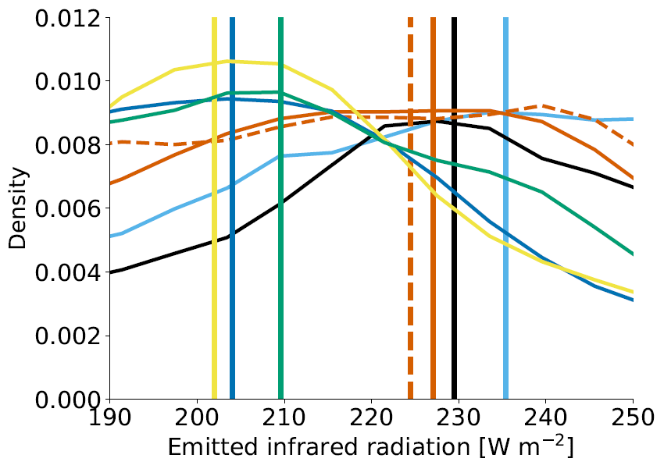
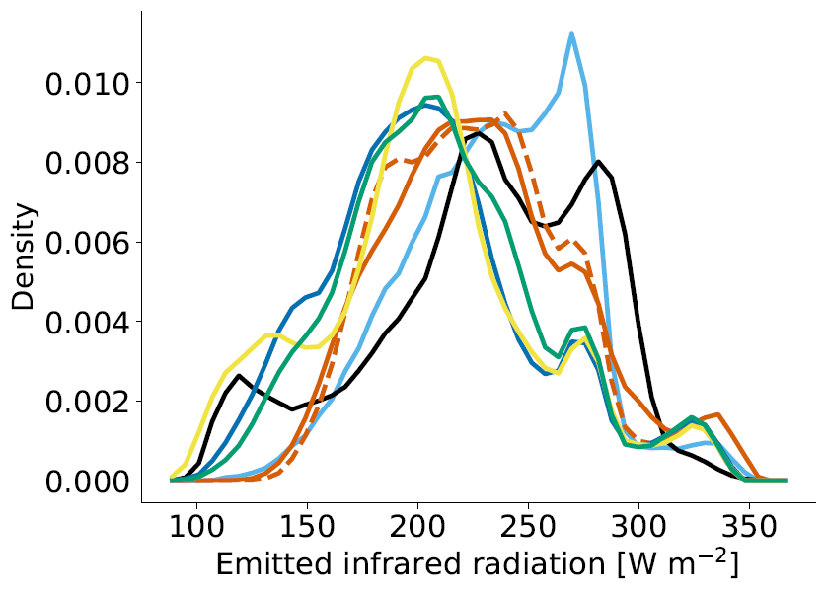
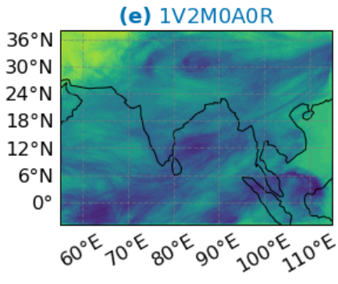
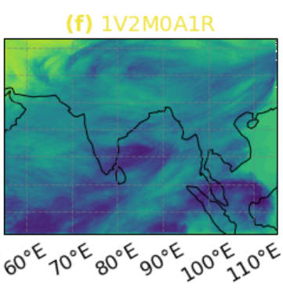
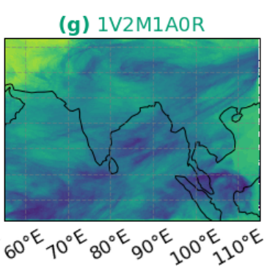
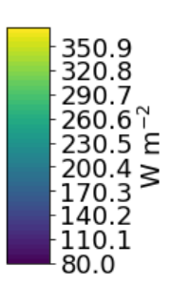
Ice formation can affect the ability of Earth’s atmosphere to cool by 30 W m⁻².
CERES
Reanalysis
0V1M0A0R
0V2M0A0R
0V2M0A1R
0V2M1A0R
more cooling
less atmospheric cooling
18

Slide 19
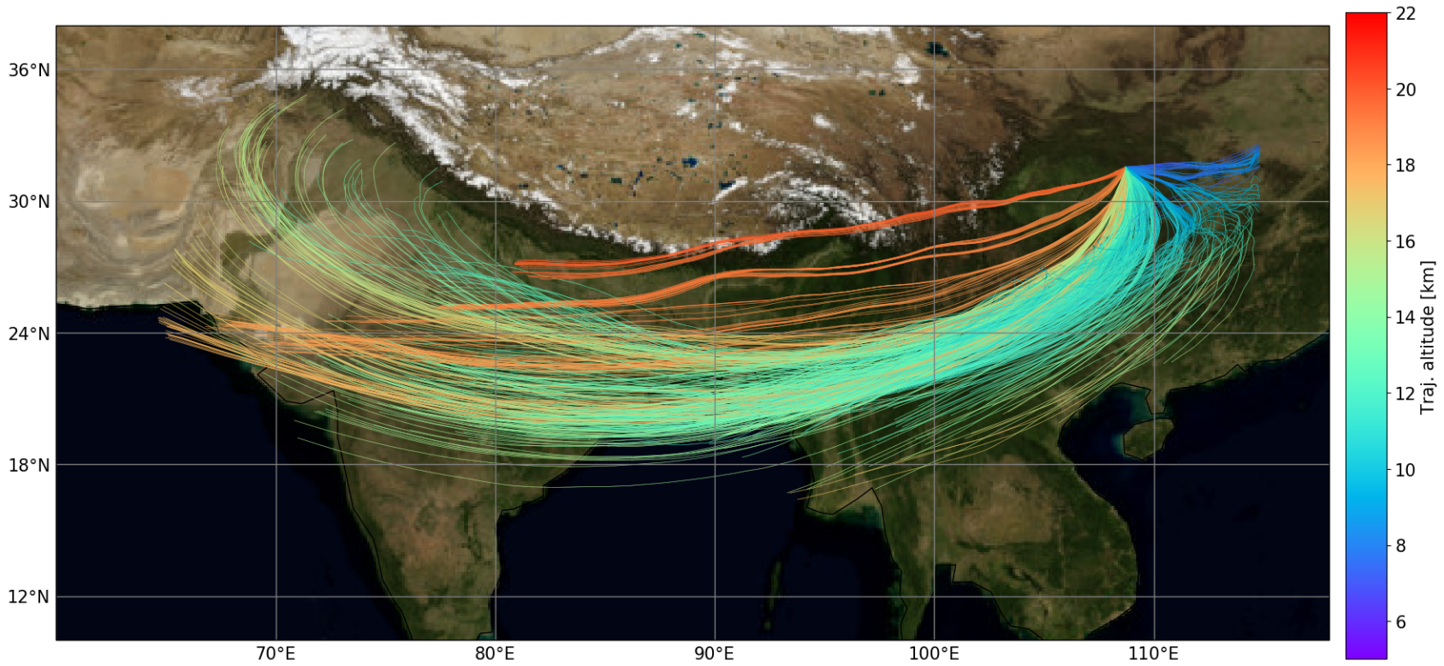
Feedbacks are constrained with fixed inputs along trajectories.
22 km
36⁰N
30000 extracted trajectories
20 km
18 km
30⁰N
8000 time points
Trajectory altitude
24⁰N
18⁰N
6 simulations
10 km
8 km
12⁰N
1.4 billion samples
6 km
70⁰E
80⁰E
90⁰E
100⁰E
110⁰E
C/I – CLaMS-Ice or ICON M – microphysics T – temp fluctuations
19

