Slide 1
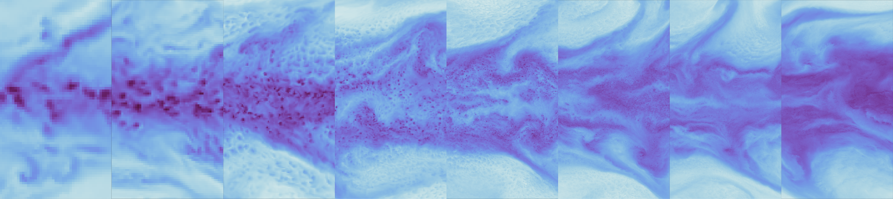
Do GSRMs converge?
Aqua-planets experiments with ICON
160 km
80 km
40 km
20 km
10 km
5 km
2.5 km
1 km
Instantaneous precipitable water across different resolution in the tropics
Angel Peinado Bravo
Daniel Klocke, Bjorn Stevens
Max-Planck-Institut für Meteorologie
Notes:
Original Title: Convergence of Aqua-planet Experiments with Explicit Convection at resolution from 157 km up to 1.2km. How far are we from ITCZ convergence?
Possible titles:
Convergence of aqua-planet experiments with explicit convection across different horizontal resolutions
Convergence of aqua-planet experiments with increasing resolution for Global Storm Resolving Models
How far are we from the general circulation convergence?
Does Global Storm Resolving Models converge?

Slide 2

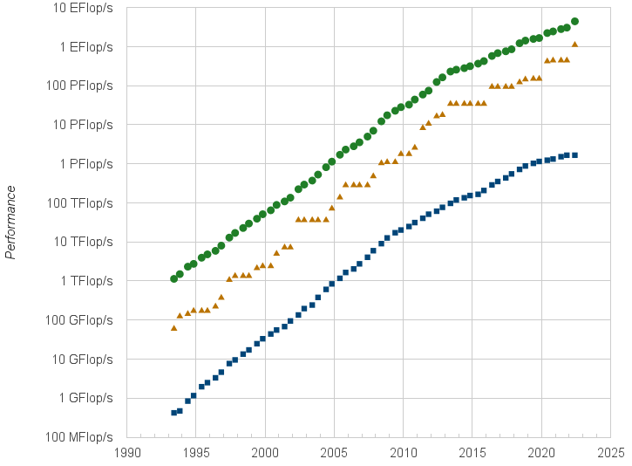
Motivation
Earth Simulator
sum
#1
#500
ICON grid configuration
Performance development Top500 [2]
Do GSRMs converge?
How far do we need to refine the grid to obtain a statistical convergence of the general circulation? For example, the Intertropical Convergence Zone (ITCZ)
Notes:
Earth systems models or ESMs have developed over the years since the landmark paper of Smagorinsky in 1963 for different purposes. One category of them are the Global Storm Resolving models (GSRMs) which are designed to solve different flavors of non-hydrostatic equations through the usage of km-scale global grids. For example, the ICON model is Icosahedral non-hydrostatic model GSRMs, which is been developed at the Max-planck Institute of Meteorology in Germany and has been used in our experiments.
This type of ESMs is able to simulate deep and shallow convection explicitly. Thus , avoiding the usage of convection parameterisation and avoid the known problems of it. However, this category of ESMs requires large computation power to solve several days or months and more ove it present several technical challenges in the field of computer science. This have been one of the main drawbacks of GSRMs.
The pioneer GSRM was NICAM wich used one of the most known historical supercomputers, the Earth Simulator with 41 TFLOPs of performance. This dates in the early 2000’s. At this time thinking to run GSRMs for months was unthinkable but the technology progressed since that date as observed in the Performance development Top500 graph. This year we have the first exascale supercomputer frontier and in the upcoming years we will have more of them as JUPITER the planned first exascale supercomputer in Europe by 2023.
This would mean that the technology is at reach of our hands, to run decadal simulations and understand more earth climate but.... some question arises:
Does this approach converge?
How far do we need to refine the horizontal model resolution to obtain a statistical convergence of the general circulation? For example, the intertropical convergence zone (ITCZ)
-> And those are the question I would like to address with today’s presentation.

Slide 3

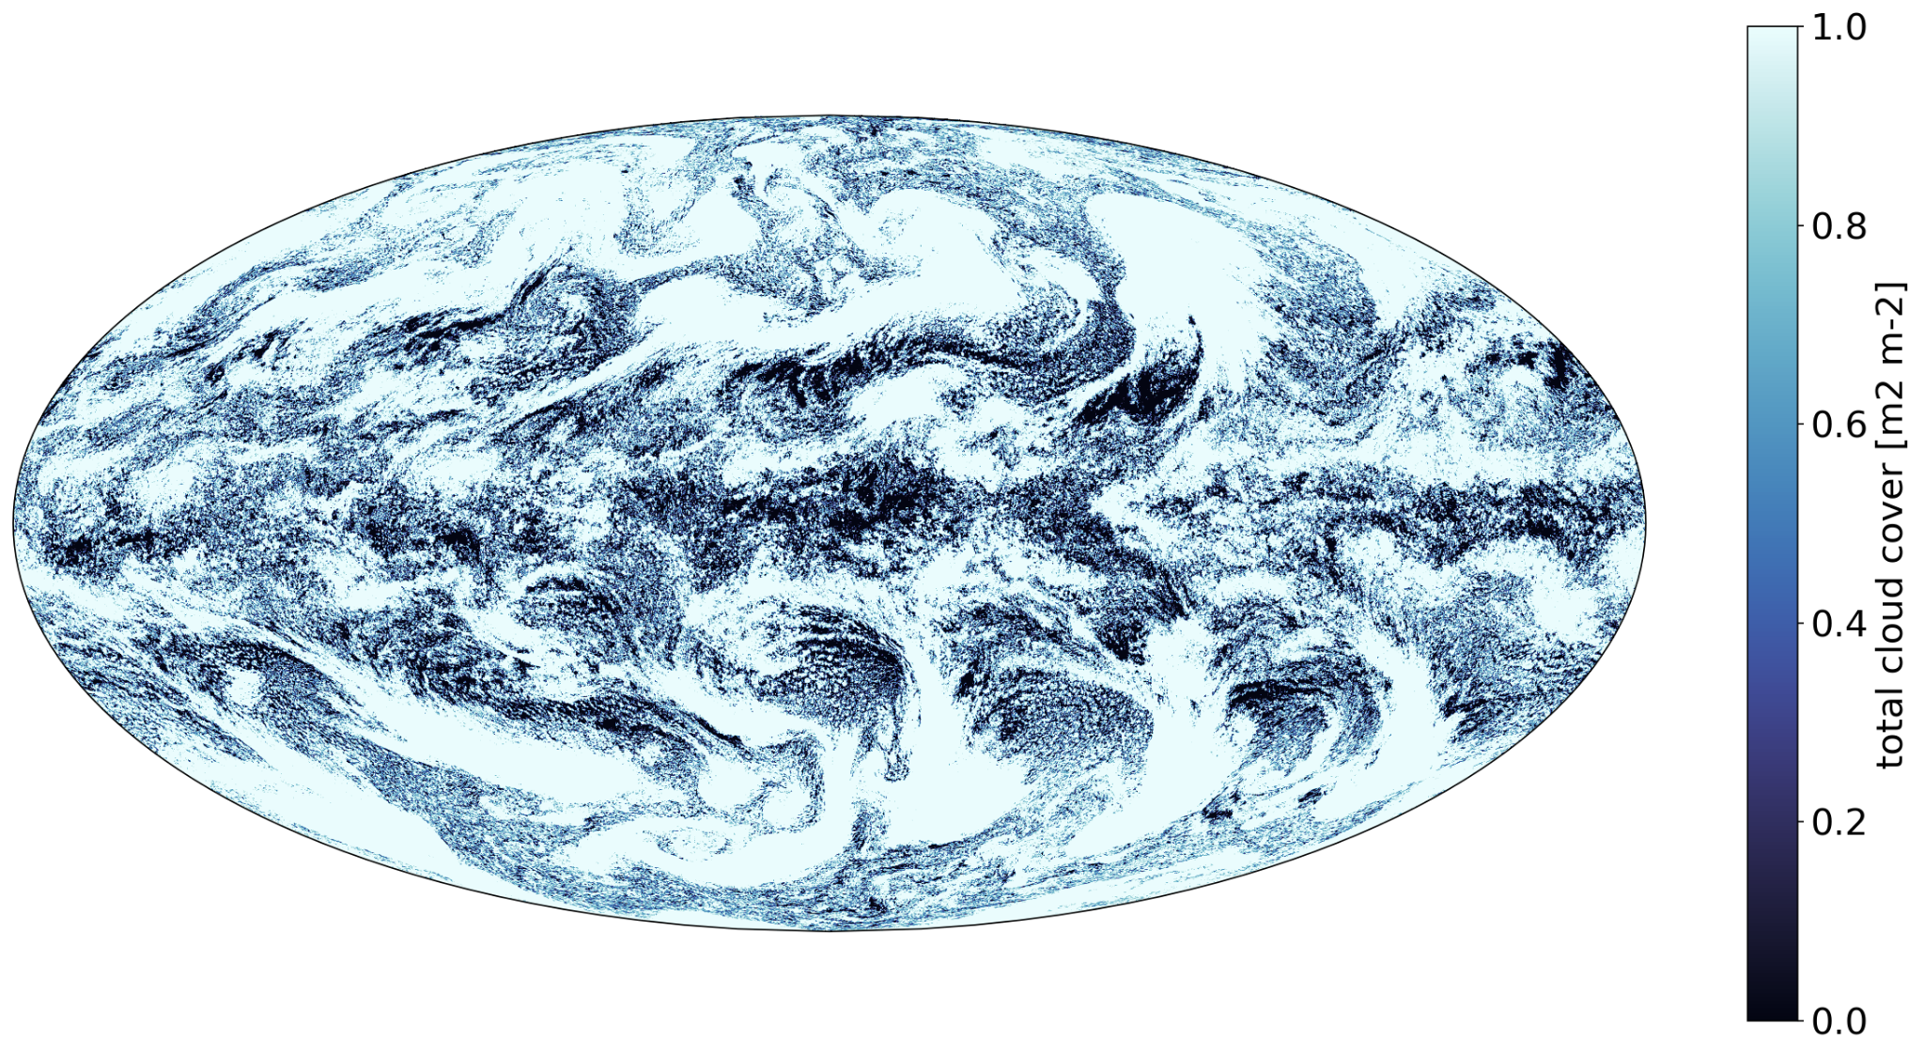
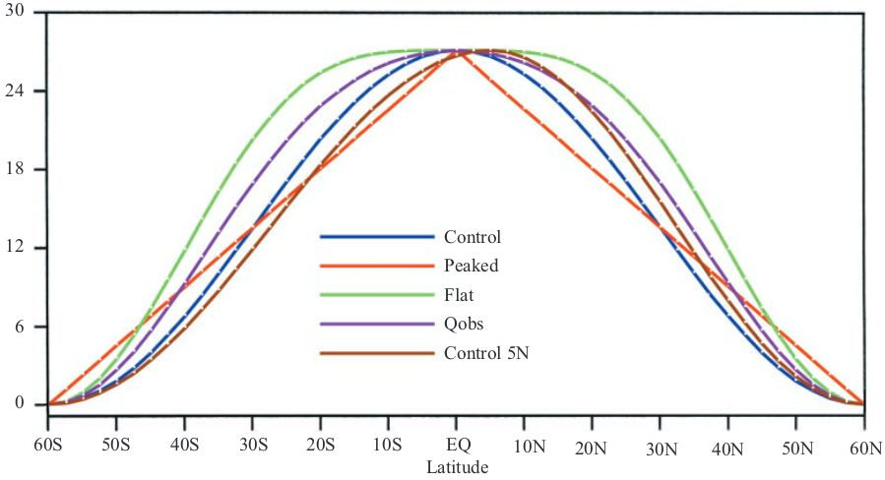
Aqua-planet Setup
SST Profile: QOBS [2]
Aqua-control Protocol
(Cloud Feedback Model intercomparison project [7])
Spin up time: 6 months
Integration time: 10 years
….
SST distribution used in aqua-planet experiments [2]
Cloud cover in an aqua-planet of 5 km resolution
Notes:
To do this, we decided on a series of experiments following or inspired by the work of Williamson and Medeiros [4,5,6]. Moreover, we took into account the protocol proposed at the Cloud Feedback Model intercomparison project (CFMIP), the aqua-control [7].
The experiment consists of an idealized Earth-like atmosphere without sea-ice nor land, with a perpetual equinox and diurnal cycle, and, a constant zonal sea surface temperature. There are different zonal profiles as described by Neale and Hoskins and observed on the lower plot. It has normally a peak at the equator and a gradient of temperature from the tropics to the poles. In our case we choose the QOBS SST profiles since it has a closer answer to earth atmosphere characteristic compared to Control or the others. And voila we have the aquaplanet, an example can bee seen here where we show the total cloud cover with the experiment of 5 kms.
But what about the integration and spin-up requirement? According to the protocol, it is 10 years of integration time and 6 months of spin-up. This is not viable with high resolutions for several reasons, not only the heavy computation cost and time required to run the simulation but also the limit in memory of storage of the output.
-> Thus, there is a need for an initialization strategy, to reduce the spin-up time to weeks, ideally, and to define how many months are representative of a large integration time.

Slide 4
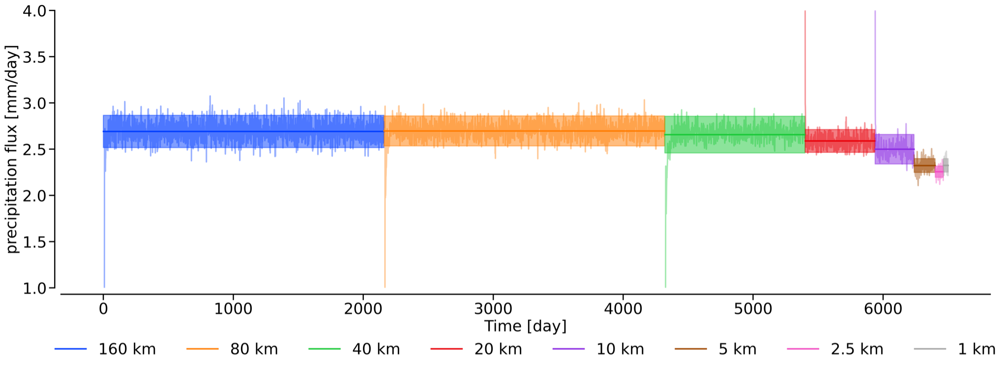
Initialisation Strategy
6 yrs
6 yrs
3 yrs
1.5 yrs
10 m
6 m
4 m
1.5 m
A simple view of the cascade strategy considering spin up and analysis time
Notes:
The initialisation strategy can be appreciated in the present figure, where the x-axis is the amount of simulated days, the y-axis the global mean precipitation flux ,and each experiments has a different color according to its resolution. The experiments resolutions goes from 160 km to 1 km resolution in a cascade fashion.
But what this mean…This mean that we run a coarser resolution from a theoretical profile, an uniform stable atmosphere. Once it overcome the spin up and reach the end of the integration time, we take its instantaneous output of different fields and use it as an initial state or approximation for the next resolution. For example, the experiment of 40 km is initialized using the 80 km last step of its integration time. This procedure happens for each resolution, which resembles a cascade.
With this type of strategy we were able to reduce the spin up from 6 months to barely 15-30 days andiIf we want to be conservative I would choose 2 months.
# To say?? The observed peaks are due to the spin-up time which reduces according to how close or how big the jump between resolutions is. Besides, there is no error or bias transported from the coarse resolution into the finer one.
-> Thus, this approach is quite viable to perform high resolution experiments in Aqua-Planets and we can proceed with the main question, are we converging?

Slide 5
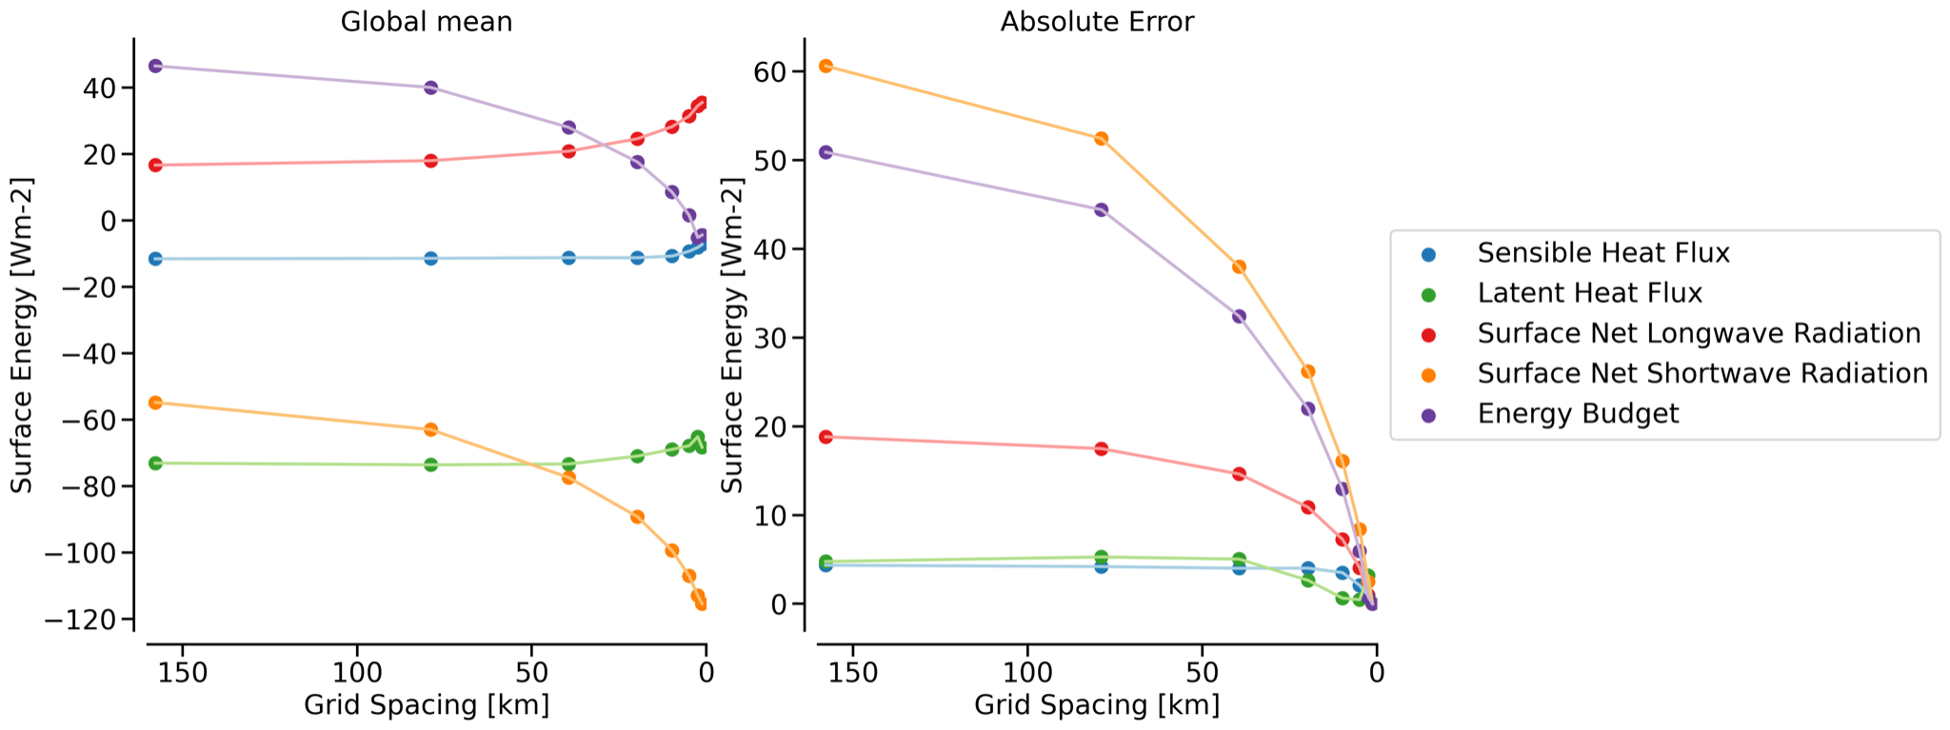
Global Energy Converge across resolutions
Energy Convergence - Surface
Notes:
First, we should look at the global average quantities. In this case, we are looking at the energy balance at the surface.
On the left, we have its convergence compared to resolution and the absolute difference with respect to the finer resolution. In this point, the experiment of 1 km is taken as reference since it is considered to be closer to the true.
At first, let see sensible and latent heat, with colors blue and green, seems to achieve convergence early around resolutions of 10km are good to go.
On the other hand, net longwave radiation starts to converge at a higher resolution 10 - 5 km.
But more considerable is shortwave, which seems to converge a high resolutions of 5 - 2.5 km.
This result is quite expectable since net shortwave is highly impacted by cloud representation which is achieved in the GSRMs approach.
-> However, these are global averages. What about zonal mean profiles?

Slide 6
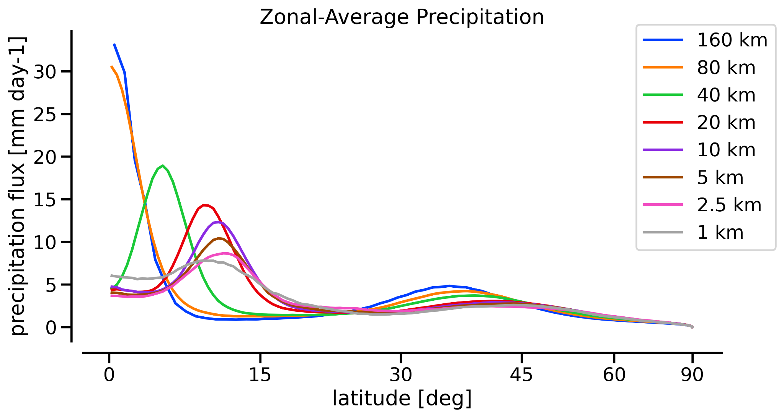
Zonal Convergence - ITCZ
11 deg
8 mm/day
Zonal-Mean Precipitation Flux
Notes:
We are observing at Precipitation flux. The plots have the x-axis as the sine of the latitude since we want to observe or give more weight to the tropics, and the output has been interpolated to 0.5 deg if they were finer than this resolution.
Here where we can observe the Inter-Tropical Convergence Zone, where lower resolution, 160 and 80 km, have one ITCZ. Meanwhile, higher resolution presents two.
As we can observe, the ITCZ seems to converge across resolution and seems to converge with 5 -2.5 km with maximum precipitation rate of 8 mm per day around 11 deg but also the structure of it.
In addition, a drier area appears in the equator due to a small circulation which pushes the ITCZ further from the equator, this we will observe in the next slides.
-> On the other hand, what about the general circulation?

Slide 7
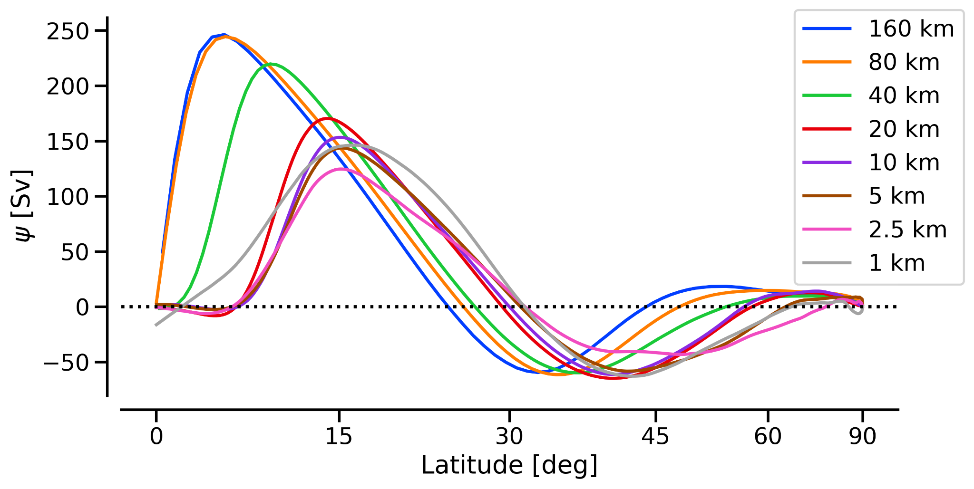
Zonal Convergence - ITCZ
15 deg
30.5 deg
130 Sv
Zonal-Mean Meridional Mass Stream Functionn
Notes:
Another way to observe or quantify the ITCZ is the usage of the Zonal-Mean mass stream function, also known as stream function or psi. This quantity gives a view of the meridional vertical circulation between pressure levels, in this case 300 and 700 hPa. It helps also to see the Hadley cells, the ascending and descending circulation. By using this parameter we can also have some metrics of the ITCZ such as the location, width and intensity.
For the location of the ITCZ we can take the location and maximum of the stream function. Across the resolution the location seems to converge at 15 deg with a maximum of 130 Sv with resolution range 2.5-5 km. Another metric is the location of the crossing zero stream function, which reflect the end of the descending circulation of the Hardley, this metric seems to converge at 30.5 deg with resolution around 2.5-5 km.
Here we can observe that it seems that there is a small circulation around the equator which pushes the Hadley cell and the ITCZ too.

Slide 8
Conclusions
We are able to perform simulations of 1 km resolution
We see convergence in diverse metrics and quantities in the aqua-planet.
From the point of view of large scales affected by the addition of smaller scales, our result show that 2.5 km is sufficient in diverse metrics and analysis.
For example:
Global-Avg OLR 149 W/m² ~10.0-5.0km
Jet stream intensity 35m/s ~5.0km
Jet stream position 45deg ~1.0km
Global-Avg CRE 16.8 W²/m² ~1.0km
ITCZ intensity 130 Sv || 8 mm/day ~1.0km
ITCZ position 15deg ~1.0km
Since we see convergence, what about in aqua-planets with external forcing? Do we converge too?
Do difference GSRMs converge to a similar statistical state?
Notes:
To conclude with the presentation:
We are able to perform simulations of 1 km resolution [with speed of 4SDPD with only CPUs and with GPUs this would increase considerably]. This allows us to run experiments for reasonable integration times to see convergence at high resolution.
In this regard, we can see convergence in diverse metrics and variables in the aqua-planet experiments, for example, with resolutions of 5.0 km OLR and Jet Stream intensity, but other quantities seems to require more integration time, such as Jet Stream and ITCZ position position.
On the other hand we can observe a tendency to convergence for Precipitation, the ITCZ intensity and Cloud Radiative Effect at 1km resolution.
Thus, from the point of view of large scales affected by the addition of smaller scales, our result show that 2.5 km sufy in diverse metrics and variables.
However, I wonder: *Say what it is written* but most importantly *Say what it is written*

Slide 9
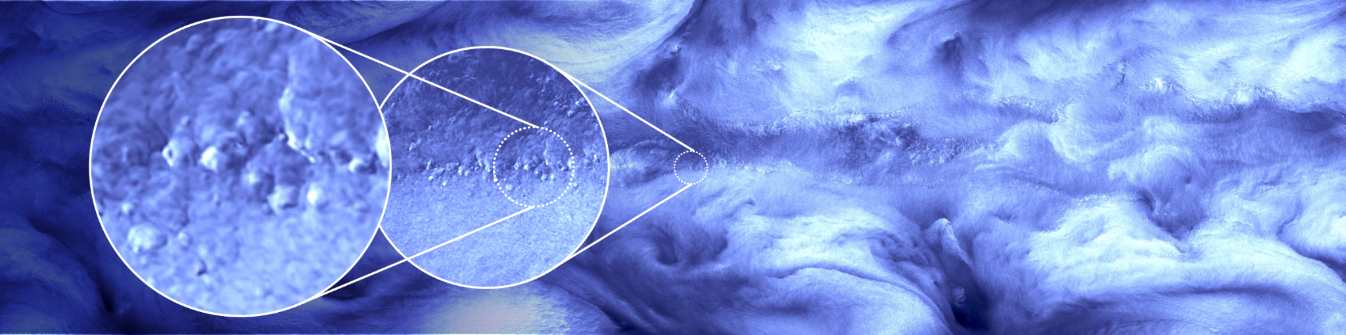
Thanks for your attention!
Latent heat in the tropics with an horizontal resolution of 1km using ICON in an aqua-planet experiment

Slide 10
Bibliography
[1] Top500 List. (n.d.). Performance development. https://top500.org/statistics/perfdevel/
[2] Neale, R.B, Hoskins, B.J, A standard test for AGCMs including their physical parameterization I: the proposal, Atmos. Sci. Lett., 1(2), 101-107, https://doi.org/10.1006/asle.2000.0022
[3] J. Smagorinsky, Mon. Weather Rev, 91, 99 (1963)
[4] Williamson D. L., Convergence of aqua-planet simulations with increasing resolution in the Community Atmospheric Model, Version 3, Tellus, 60A, 848-862. https://doi.org/10.1111/j.1600-0870.2008.00339.x
[5] Blackburn, M., Williamson D. L., and K. Nakajima (2013), The Aqua-Planet Experiment (APE): CONTROL SST Simulation, J. Meteorol. Soc. Jpn. 91A, 17– 56, https://doi.org/10.2151/jmsj.2013-A02
[6] Medeiros, B., Williamson D. L., and Olson, J. G. Olson (2016), Reference aquaplanet climate in the Community Atmospheric Model, Version 5, J. Adv. Model. Earth Syst., 8, 406-424, https://doi.org/10.1002/2015MS000593
[7] Webb et al. 2017, The Cloud Feedback Model Intercomparison Project (CFMIP) contribution to CMIP6, Geosci. Model Dev., 10, 359–384, 2017, https://doi.org/10.5194/gmd-10-359-2017
[8] Stevens B., and Bony S., Climate change (2013). What are climate models missing? Science 340, 1053–1054. https://doi.org/10.1126/science.1237554

Slide 11
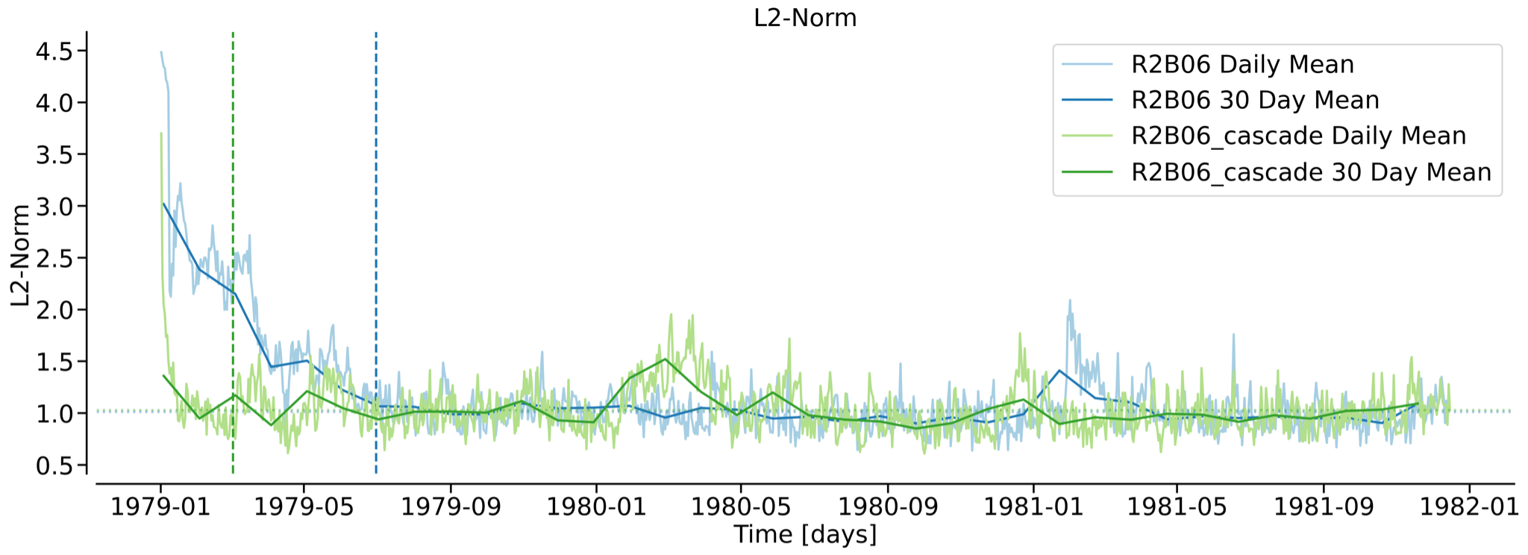
Appendix: Initialisation Strategy
Time convergence of precipitation for different initialisation with a grid
resolution of 40 km, daily average and 30 day average.

Slide 12
Appendix: Convergence at some quantities
Resolution | km | 160 | 80 | 40 | 20 | 10 | 5 | 2.5 | 1
CRE | W m-2 | 66.69 | 58.799 | 48.624 | 39.295 | 31.099 | 24.543 | 19.342 | 16.755
Precipitation | mm day-1 | 2.702 | 2.708 | 2.686 | 2.585 | 2.488 | 2.34 | 2.256 | 2.333
Water Budget | mm day-1 | 0.177 | 0.166 | 0.151 | 0.134 | 0.105 | -0.002 | 0.004 | -0.027
Water Vapor Path | mm | 13.006 | 13.208 | 13.136 | 12.856 | 12.958 | 13.397 | 13.684 | 14.248
Cloud Water Path | mm | 21.74e-2 | 18.86e-2 | 14.57e-2 | 11.06e-2 | 8.29e-2 | 6.35e-2 | 5.10e-2 | 4.51e-2
Cloud Ice Path | mm | 9.37e-3 | 8.47e-3 | 7.76e-3 | 7.06e-3 | 6.78e-3 | 6.92e-3 | 7.07e-3 | 7.23e-3
𝛹max | Sv | 2.46e+2 | 2.44e+2 | 2.19e+2 | 1.71e+2 | 1.54e+2 | 1.45e+2 | 1.27e+2 | 1.44e+2
𝛹max Position | deg | 5 | 6 | 9 | 14 | 15 | 15 | 15.5 | 15.5
𝛹0 Position | deg | 24.45 | 25.76 | 26.76 | 29.29 | 30.15 | 30.73 | 31.79 | 31.58
Prmax | mm day-1 | 33.31 | 30.63 | 18.84 | 14.41 | 12.37 | 10.42 | 8.65 | 7.86
Prmax Position | deg | 0 | 0 | 5.25 | 9.75 | 10.5 | 11 | 11.25 | 9.5
Jet Intensity | m s-1 | 51.39 | 47.27 | 45.31 | 35.36 | 34.52 | 35.05 | 30.645 | 34.83
Jet Position | deg | 28.66 | 29.73 | 28.83 | 30.17 | 43.27 | 45.39 | 30.22 | 45.55

Slide 13
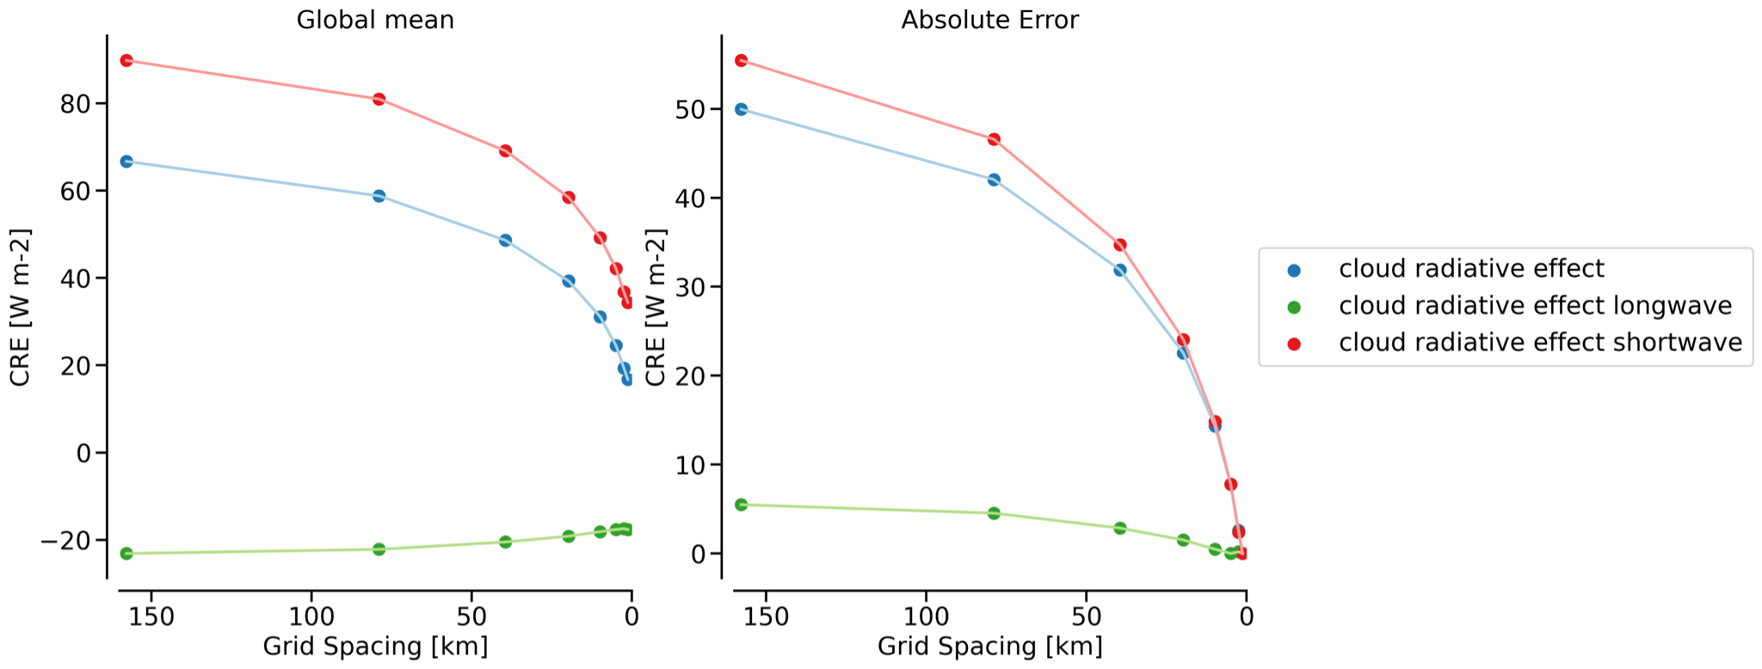
Appendix: Global CRE across resolutions
Energy Convergence - Cloud radiative effect

Slide 14
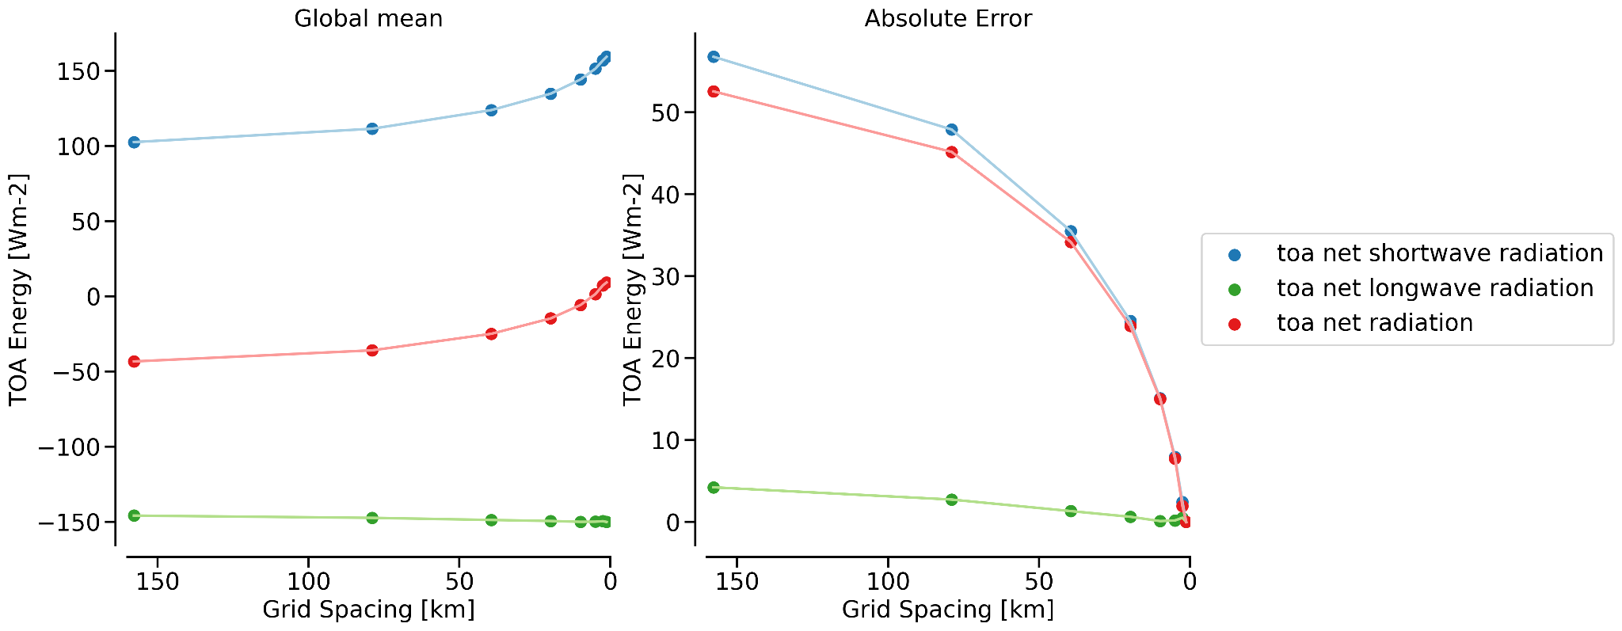
Appendix: Global Energy Converge
Energy Convergence - TOA

Slide 15
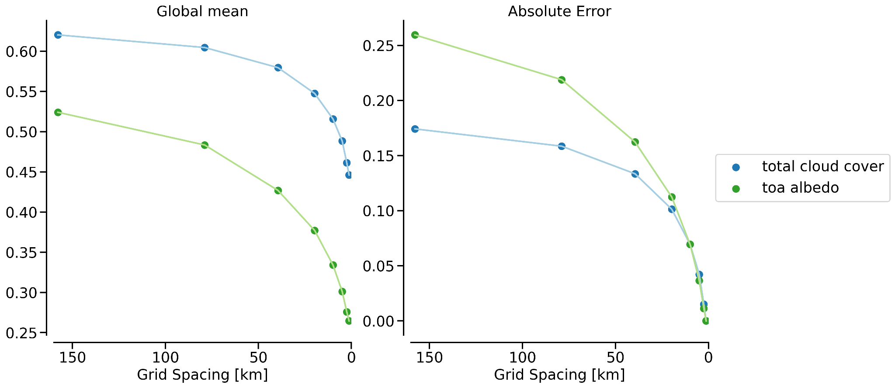
Appendix: Global Cloud Converge
Energy Convergence - Clouds effects

Slide 16
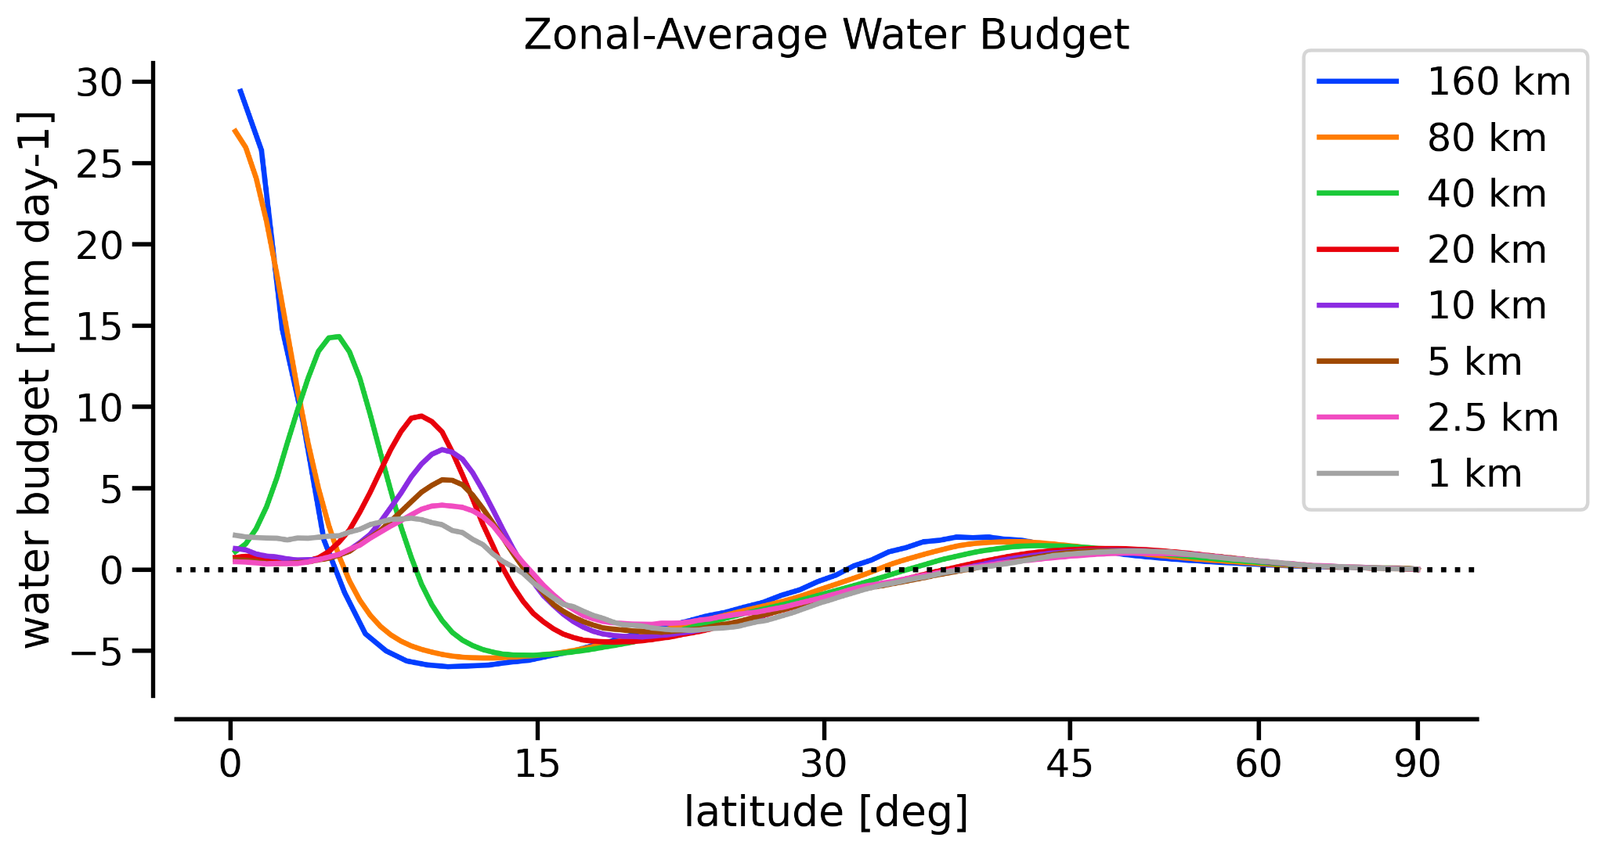
Appendix: Zonal Convergence - ITCZ
Zonal-Average convergence of the water budget

Slide 17
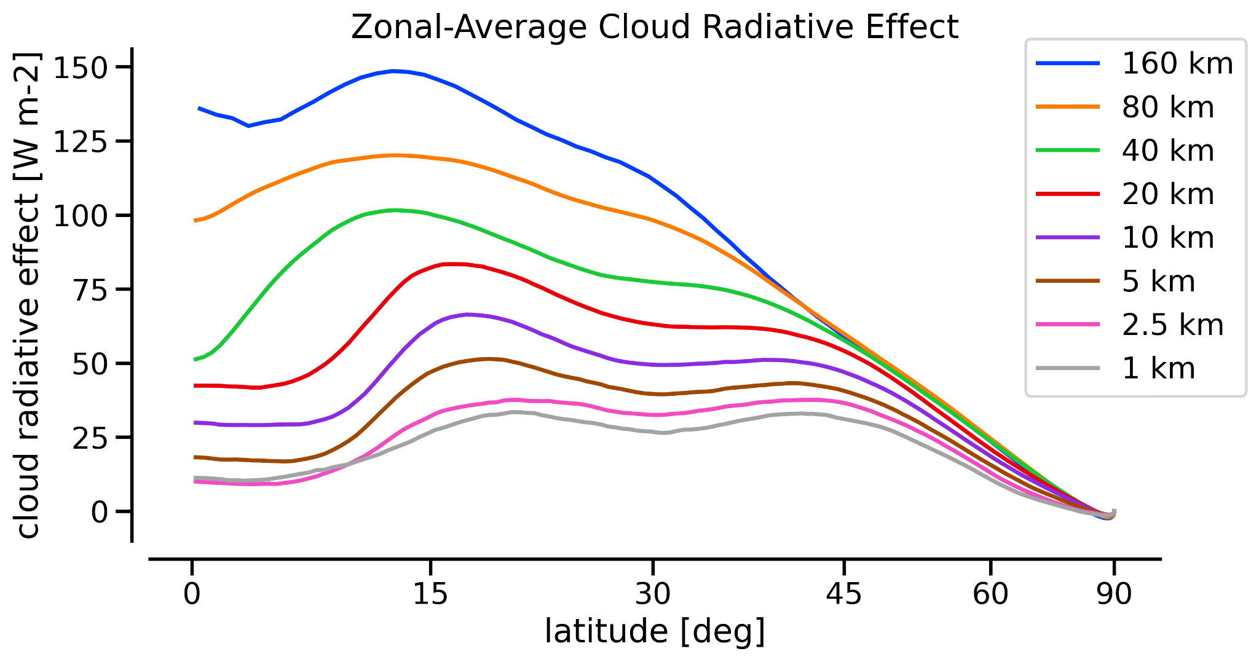
Appendix: Zonal Convergence - ITCZ
Zonal-Average convergence of CRE

Slide 18
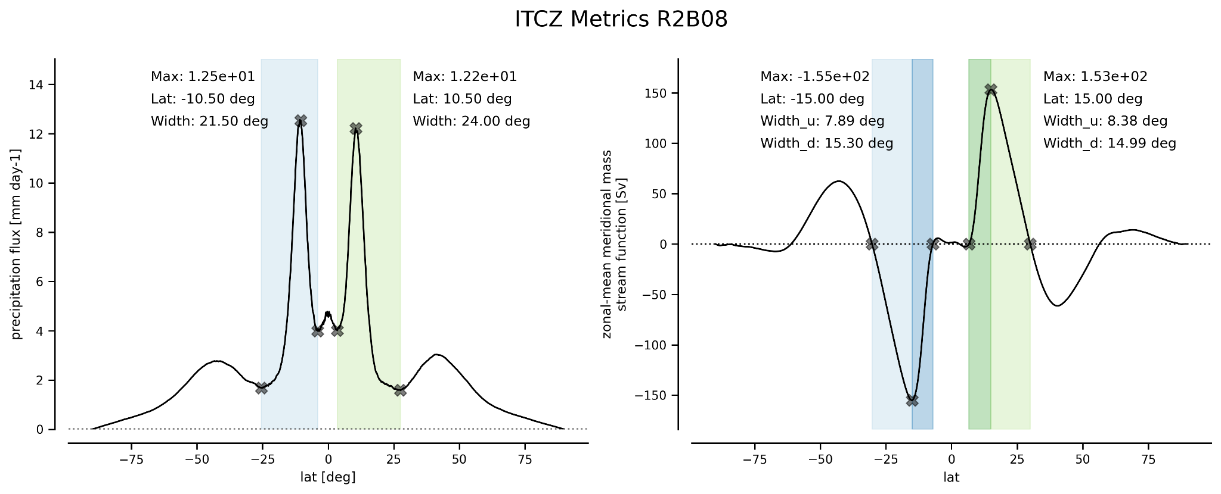
Appendix: The ITCZ at higher resolutions

Slide 19
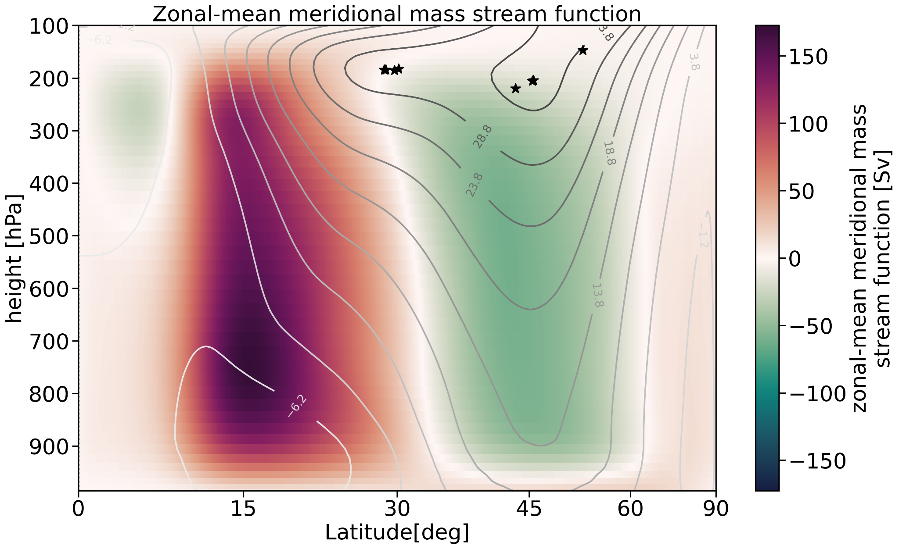
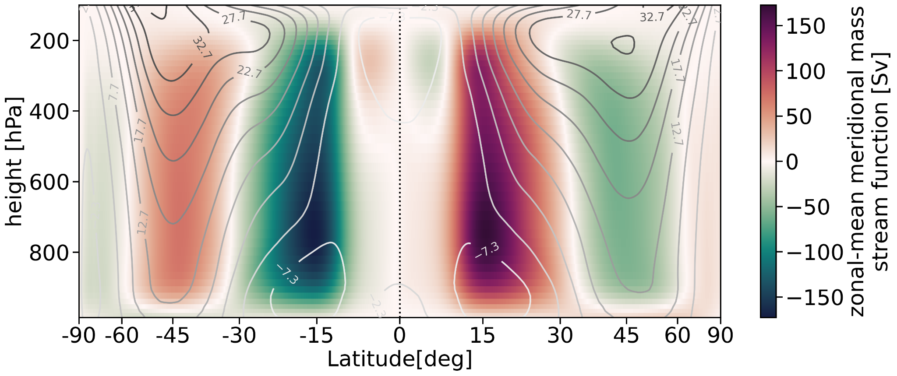
Appendix: General Circulation
Half-Zonal-Mean Meridional Mass Stream Function with Zonal Winds Contours
Zonal-Mean Meridional Mass Stream Function with Zonal Winds Contours

