Slide 1
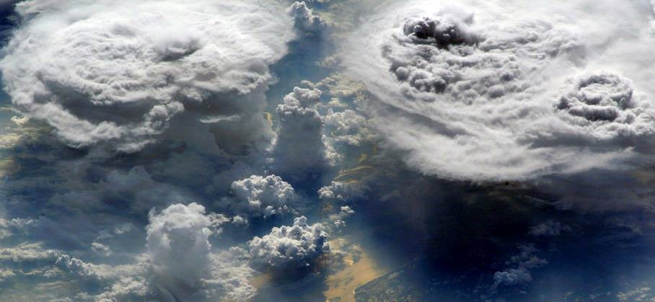







Towards a 3D view of Cloud Systems
using Synergistic Satellite Observations & Machine Learning:
Linking atmospheric heating to convective organization
Claudia Stubenrauch
with contributions by Giulio Mandorli, Giacomo Caria, Xiaoting Chen
Laboratoire de Météorologie Dynamique / IPSL, Paris, France
GEWEX UTCC PROES
GEWEX Pan-GASS meeting, Monterey, USA, 25-29 July 2022
Notes:
1

Slide 2
Motivation & approach
Climate warming :
change in tropical convective intensity & organisation ?
-> size & emissivity structure of cirrus anvils
-> heating gradients -> large-scale circulation
GEWEX UTCC PROES (https://gewex-utcc-proes.aeris-data.fr)
© H. Stubenrauch
Goals: - understand relation betw. convection, cirrus anvils & radiative heating
- provide observational metrics to probe processes involving UT cloud systems
To advance our understanding on UT cloud feedbacks, we are coupling
IR Sounder near-cloud-top properties, sensitive to cirrus (day & night) & good instantaneous coverage
vertical structure & rain areas within UT clouds (from CALIPSO-CloudSat & ML )
3D diabatic heating (radiative from CALIPSO-CloudSat & ML & latent from TRMM & ML)
Cloud System Concept, relating cirrus anvil properties to convection
metrics of convective organisation, based on precipitating areas within UT clouds (from CloudSat & ML)
simulation experiments, using observational 3D diabatic HR fields to force climate system & study changes in atmospheric circulation for different situations of convective organization
-> quantify dynamical response of climate system to atmospheric heating

Slide 3
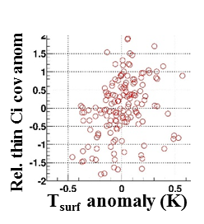
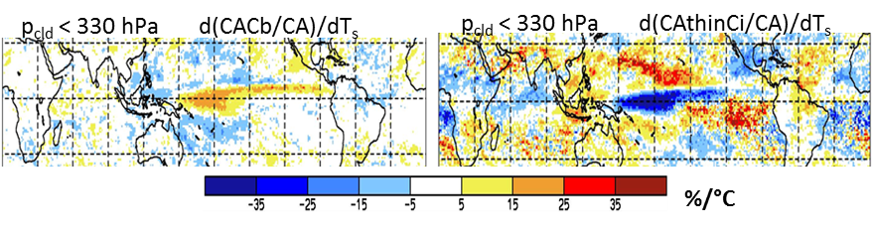
Clouds from IR Sounder (CIRS) -> UT cloud types
HIRS AIRS, CrIS IASI (1,2,3), IASI-NG
>1979 / ≥ 1995: 7:30/ 1:30 AM/PM ≥2002 / ≥ 2012 : 1:30 AM/PM ≥2006 / ≥ 2012 / ≥ 2020 : 9:30 AM/PM
ISCCP
high cloud amount
AIRS-CIRS
good IR spectral resolution -> sensitive to cirrus
similar performance day & night, COD_{vis} > 0.1,
also in the case of lower clouds underneath
long time series (HIRS, AIRS, IASI)
good areal coverage
distinction between opaque & semi-transparent
UT clouds by using emissivity
July
(Stubenrauch et al., ACP, 2017)
How do tropical UT cloud types change with respect to T_{surf} ?
Changes in relative occurrence of Cb & thin Ci clouds per °C warming show different geographical patterns
-> change in heating gradients -> affects atmospheric circulation

Slide 4
From Cloud Retrieval to Cloud System Approach
clouds are extended objects, driven by dynamics -> organized systems
R
E
C
O
N
S
T
R
U
C
T
I
O
N
1) group adjacent grid boxes with high clouds of similar height (p_{cld})
1 Jul 2007 AM AIRS
fill data gaps using PDF method build UT cloud systems
2) use ε_{cld} to distinguish convective core, thick cirrus, thin cirrus (only IR sounder)
Protopapadaki et al. ACP 2017
based on
p_{cld} & ε_{cld}
30N-30S: UT clouds cover 35%; UT cloud systems cover 20 – 25% (depending on definition)
Mesoscale convective systems cover 15 – 20% ; Cloud System Approach allows to link convection to anvils

Slide 5
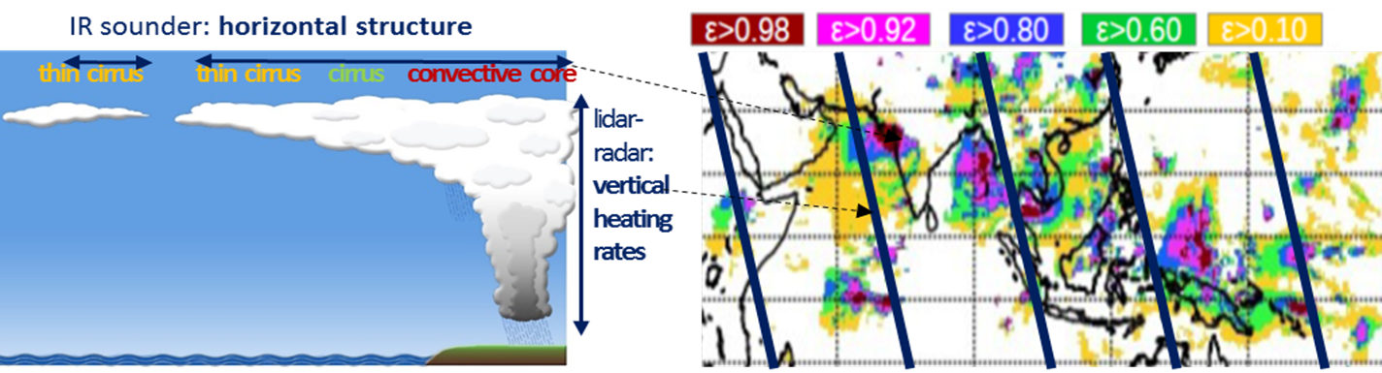
3D snapshot reconstruction using synergistic data & Machine Learning
add vertical structure & precipitation
emissivity structure of UT cloud systems
vertical structure & precipitation:
1) CloudSat-lidar on narrow nadir tracks
2) TRMM radar : small coverage at specific LT
LT within 20 min of 1h30 AM
expand vertical structure & precipitation info across UT cloud systems & environment by machine learning:
1) develop optimized ‘non-linear regression & classification models’ based on neural networks,
training on collocated data (AIRS-CloudSat-lidar 2007-2010, AIRS-TRMM 2004-2015, IASI-TRMM 2007-2015)
2) apply these models on the whole CIRS data record (2003-2019)
use derived atmospheric properties (similar for AIRS & IASI) :
X : CIRS cloud variables & ERA-Interim atmosphere
F(X) : CloudSat-lidar radiative heating rates, Z_{top} & Z_{top}-Z_{base}, rain rate, cloud layering from NASA FLXHR v4, GEOPROF, PRECIP-column
TRMM latent heating rates from NASA SLH v6
X
F(X)

Slide 6
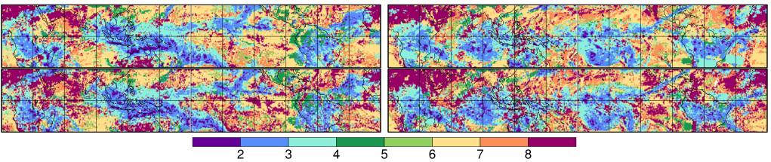

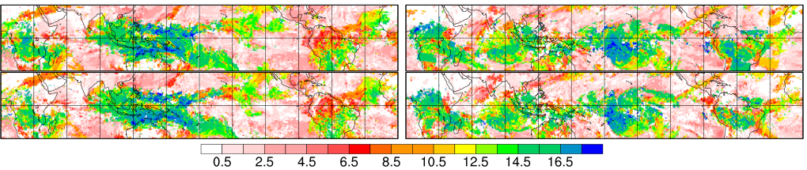
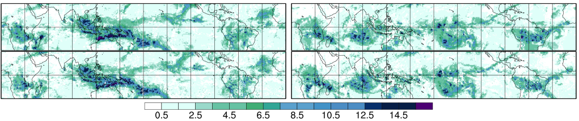
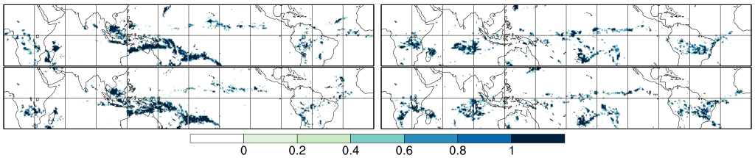
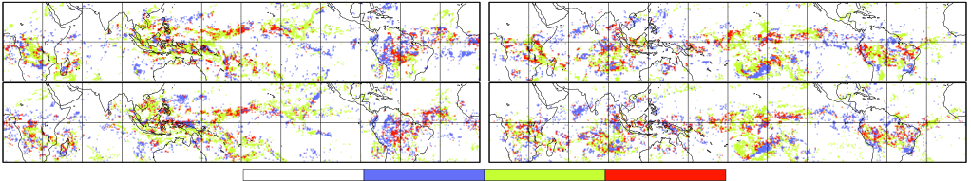
3 Jan 2008 (La Niña) 17 Jan 2016 (El Niño)
ANN regression & classification models
Rain Rate (no / light / heavy)
accuracy 65 - 70%
snapshots of horizontal structures :
cloud type
Cb Ci thin Ci midlevel lowlevel clear sky
different structures for
La Niña - El Niño
top height
km
combined AIRS-IASI statistics : 2008 - 2018
vertical extent
km
derive convective organization from rainy areas within UT clouds
frct(RR>0)
Multiple layers: mostly lower clouds underneath Ci / thin Ci
structures prolongated by very thin Ci above lower clouds
cloud layering
clouds above clouds below clouds above & below CIRS clouds

Slide 7
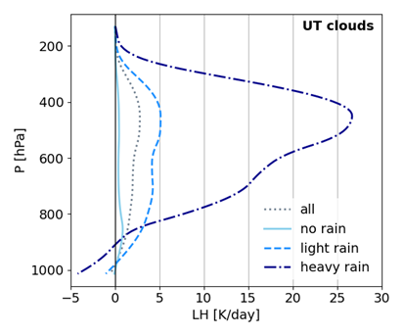
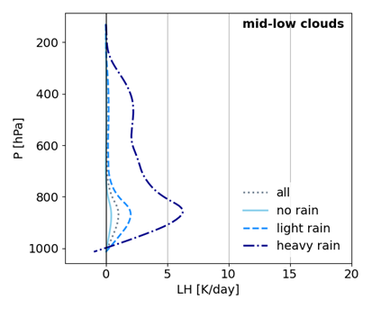
Rain rate classification– Latent heating coherence
AIRS ML & CloudSat TRMM
LH for heavy rain about 10 times larger LH of mid- / lowlevel clouds smaller
than tropical average from UT clouds & in lower troposphere
Stubenrauch et al., ACP 2022, to be submitted

Slide 8
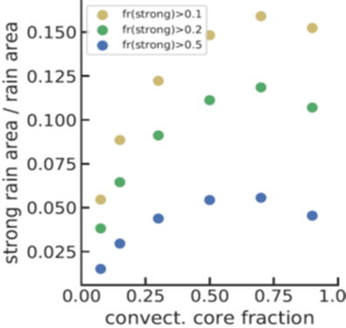
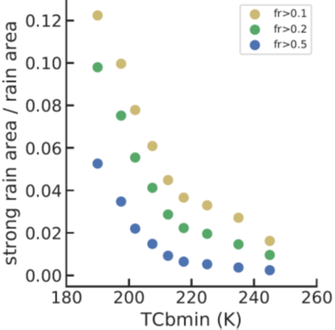
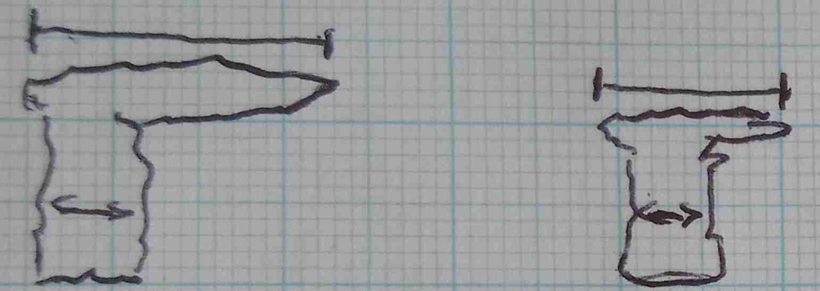
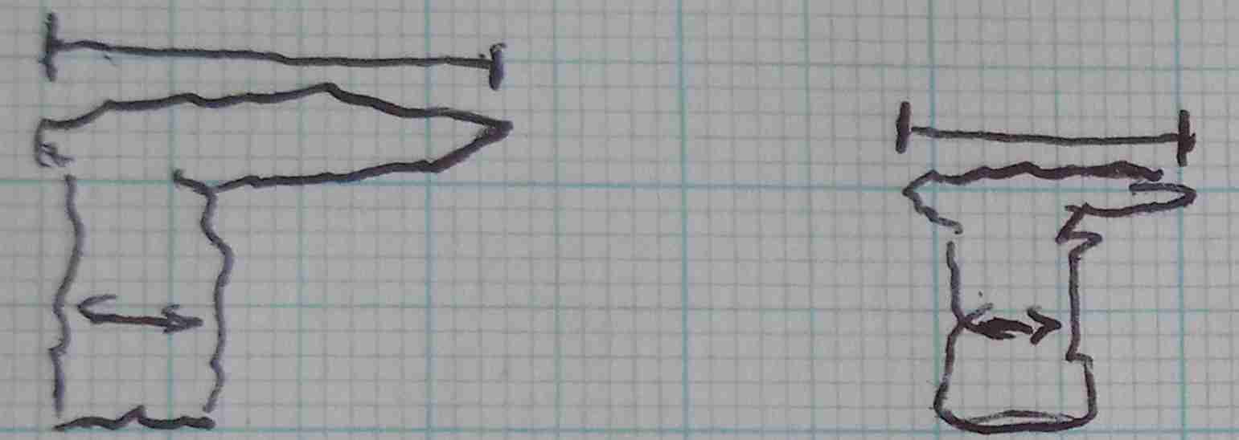
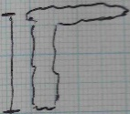
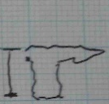
Process-oriented behaviour of mesoscale convective cloud systems
Stubenrauch et al., ACP 2022, to be submitted
convective core fraction : min T within core of mature systems:
proxy for life stage proxy for convective depth
increasing age of system
increasing convective depth
max. rain intensity after first development of anvils
Deeper convection leads to larger heavy rain areas
in agreement with other studies (Roca et al. 2014, Takahashi et al. 2021, …)
-> reliability of ML derived rain

Slide 9
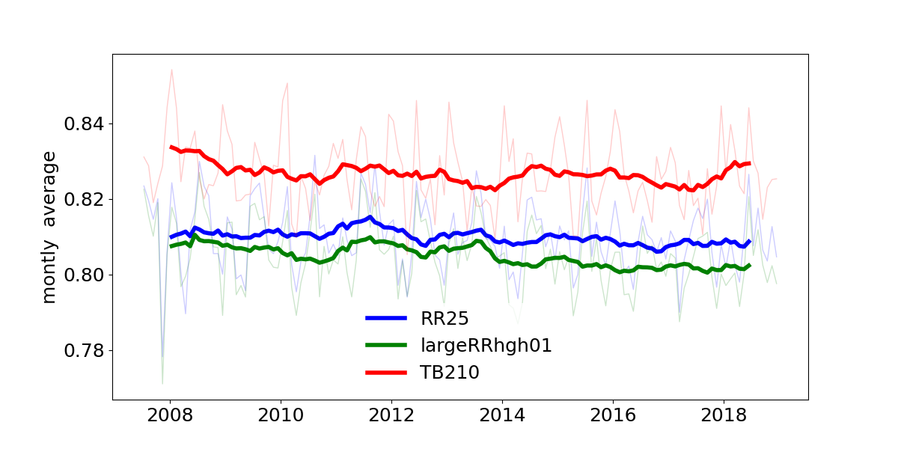
Changes related to convective organization identified by I_{org}
Organization indices are discriminators between clustered and unclustered objects
I_{org} considers the distances between objects : cumulative nearest neighbour & random distribution
I_{org} > 0.5 organized
Build convective objects from 0.5° cells, using different proxies for convection:
T_{B} < 210 K large average rain rate indicator (at least certain rain) strong rain fraction > 10%
& compute I_{org} over 30N-30S, deseasonalized monthly averages smoothed by 12-month running means
Correlation between I_{org} & thin cirrus coverage:
-0.25, -0.73, -0.63
in all cases:
Larger convective organization in the tropics leads to slightly less thin cirrus coverage
I_{org}

Slide 10
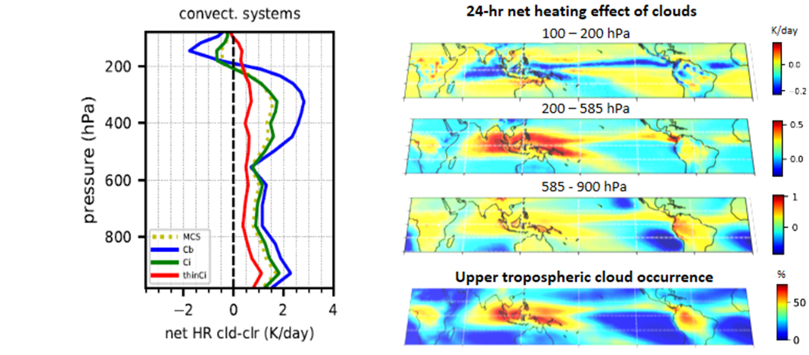
Expansion of nadir track NASA FLXHR radiative heating rates (2007 – 2010)
15 year AIRS swath radiative HR statistics (2004 – 2018)
Radiative Impact of UT cloud systems in tropics
ML
8 ANN regression models (Cb, Ci, mid/low clds, clr sky over ocean / land)
Stubenrauch et al., ACP 2021
Cloud System Concept + 3D HR fields :
1) relation between convection – cirrus anvil
2) process-oriented GCM evaluation
3) dynamical response to atmospheric heating

Slide 11
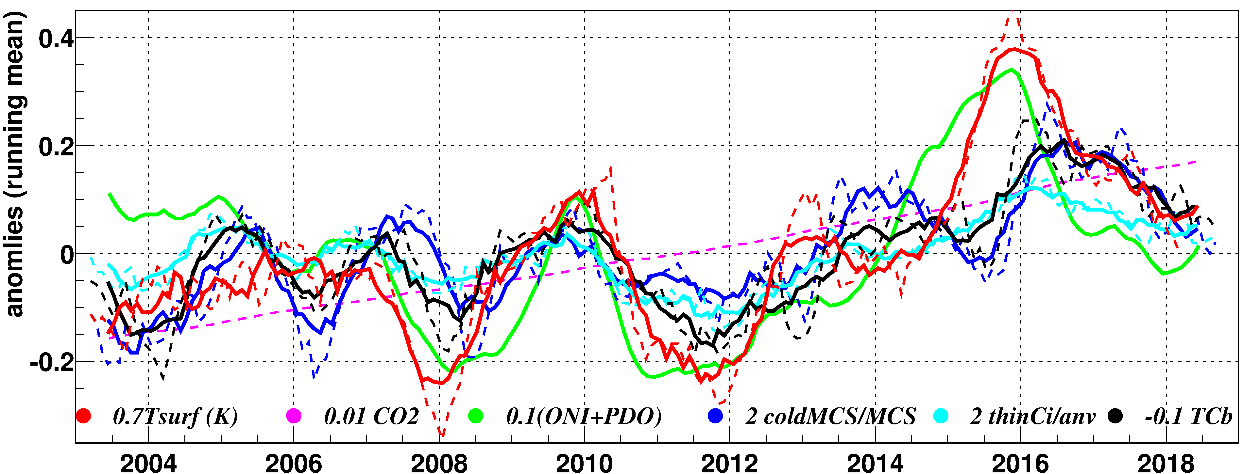
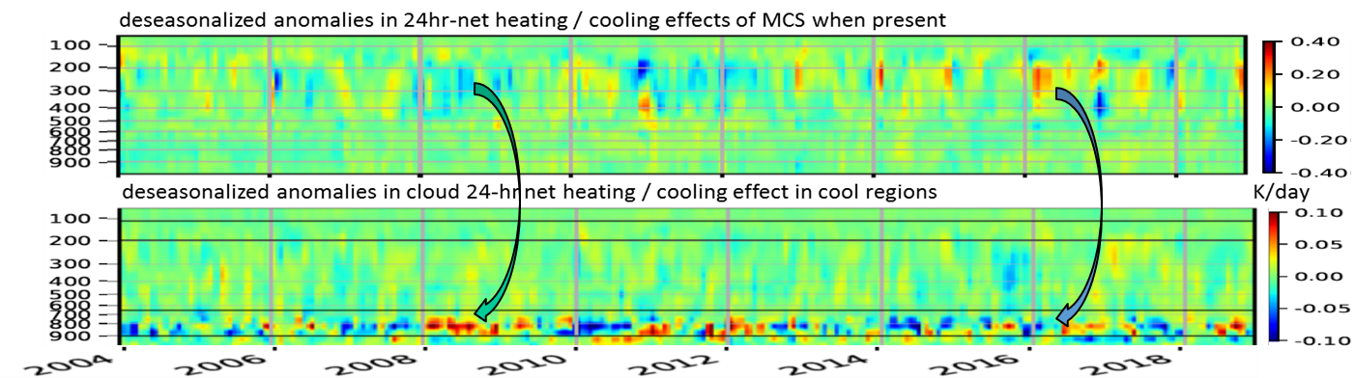
MCS & Heating pattern changes related to tropical T_{surf} anomalies
MCSs get colder (deeper) & thin cirrus area / total anvil area increases with tropical surface warming : dT_{Cb}/dT_{surf} = -3.4 ± 0.2 K/K (r=0.78) d(A_{thCi}/A_{anv})/dT_{surf} = 12 ± 1 %/K (r=0.85)
Stubenrauch et al., ACP 2021
in warm periods (El Niño) deeper warming of upper & mid troposphere & cooling above the systems
correlation (r=0.71) between MCS heating in upper & mid troposphere
& (low-level) cloud cooling in lower atmosphere in cool regions
} energy constraint
Notes:
11

Slide 12
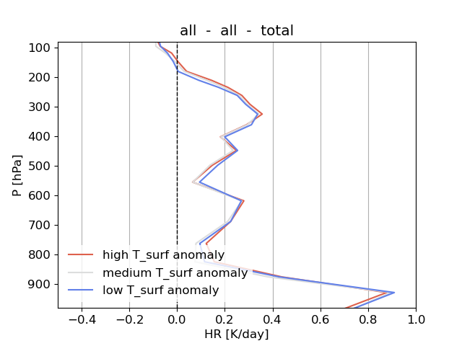
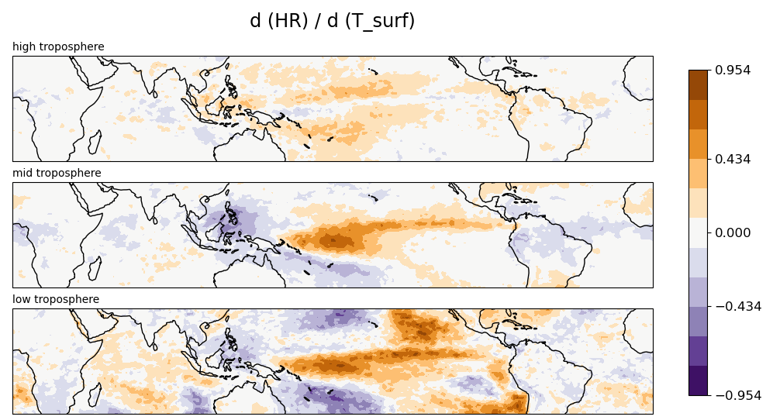
CRE average & pattern changes related to tropical T_{surf} anomalies
15N-15S
HR = HR(all) – HR(clr sky)
Tropical CRE profile in UT slightly shifted higher & larger (as expected from CRM simulations)
Patterns similar to ENSO

Slide 13
Expanding TRMM Latent Heating via ML on CIRS-ERA
develop & apply 12 ANN regression models ((UT / midlow clds) x (no / light / heavy rain) over ocean / land)
to AIRS-ERA & IASI-ERA data
Evaluation Application
300-600 hPa
K/day
30% quantiles
For precipitating clouds
ML provides better results than classification
3% -> 70% coverage
-> horizontal structures of heating profiles
similar results by applying IASI or AIRS models on IASI -> application of AIRS models on IASI for radiative HRs

Slide 14
Conclusions
The synergy of different satellite instruments gives a more complete picture of clouds
complete 3D snapshots (necessary for process studies) & longer time series
can be constructed by Machine Learning applied on cloud & atm. variables
Though the ML models introduce additional uncertainties,
3D snapshots allow to study horizontal structure -> convective organization
Positive correlation between thin cirrus surrounding MCS & tropical Tsurf anomaly,
while negative correlation between thin cirrus area & tropical I_{org}
Time series correlation of ML radiative heating demonstrates
energetic constrains between convective & subsidence regions
Cloud System Concept allows
- to study relationships between convection & anvils
- process-oriented evaluation of GCM parameterizations

Slide 15
Outlook & discussion
HR fields & convective organization metrics & Cloud System Concept will be used to
quantify the dynamical response of the climate system to atmospheric diabatic heating
(bypassing cloud parameterizations in the climate model) in cooperation with L. Li, LMD
When expanding datasets via ML, the evaluation with collocated training / validation data is not sufficient; one needs to carefully evaluate relationships & time series
GEWEX UTCC PROES (PROcess Evaluation Study on Upper Tropospheric Clouds & Convection)
working group to advance our understanding on UT cloud feedbacks, https://gewex-utcc-proes.aeris-data/fr
breakout meeting this evening:
Synergies with other datasets & modelling to be further explored & discussed
Please join us if you are interested !

