Slide 1
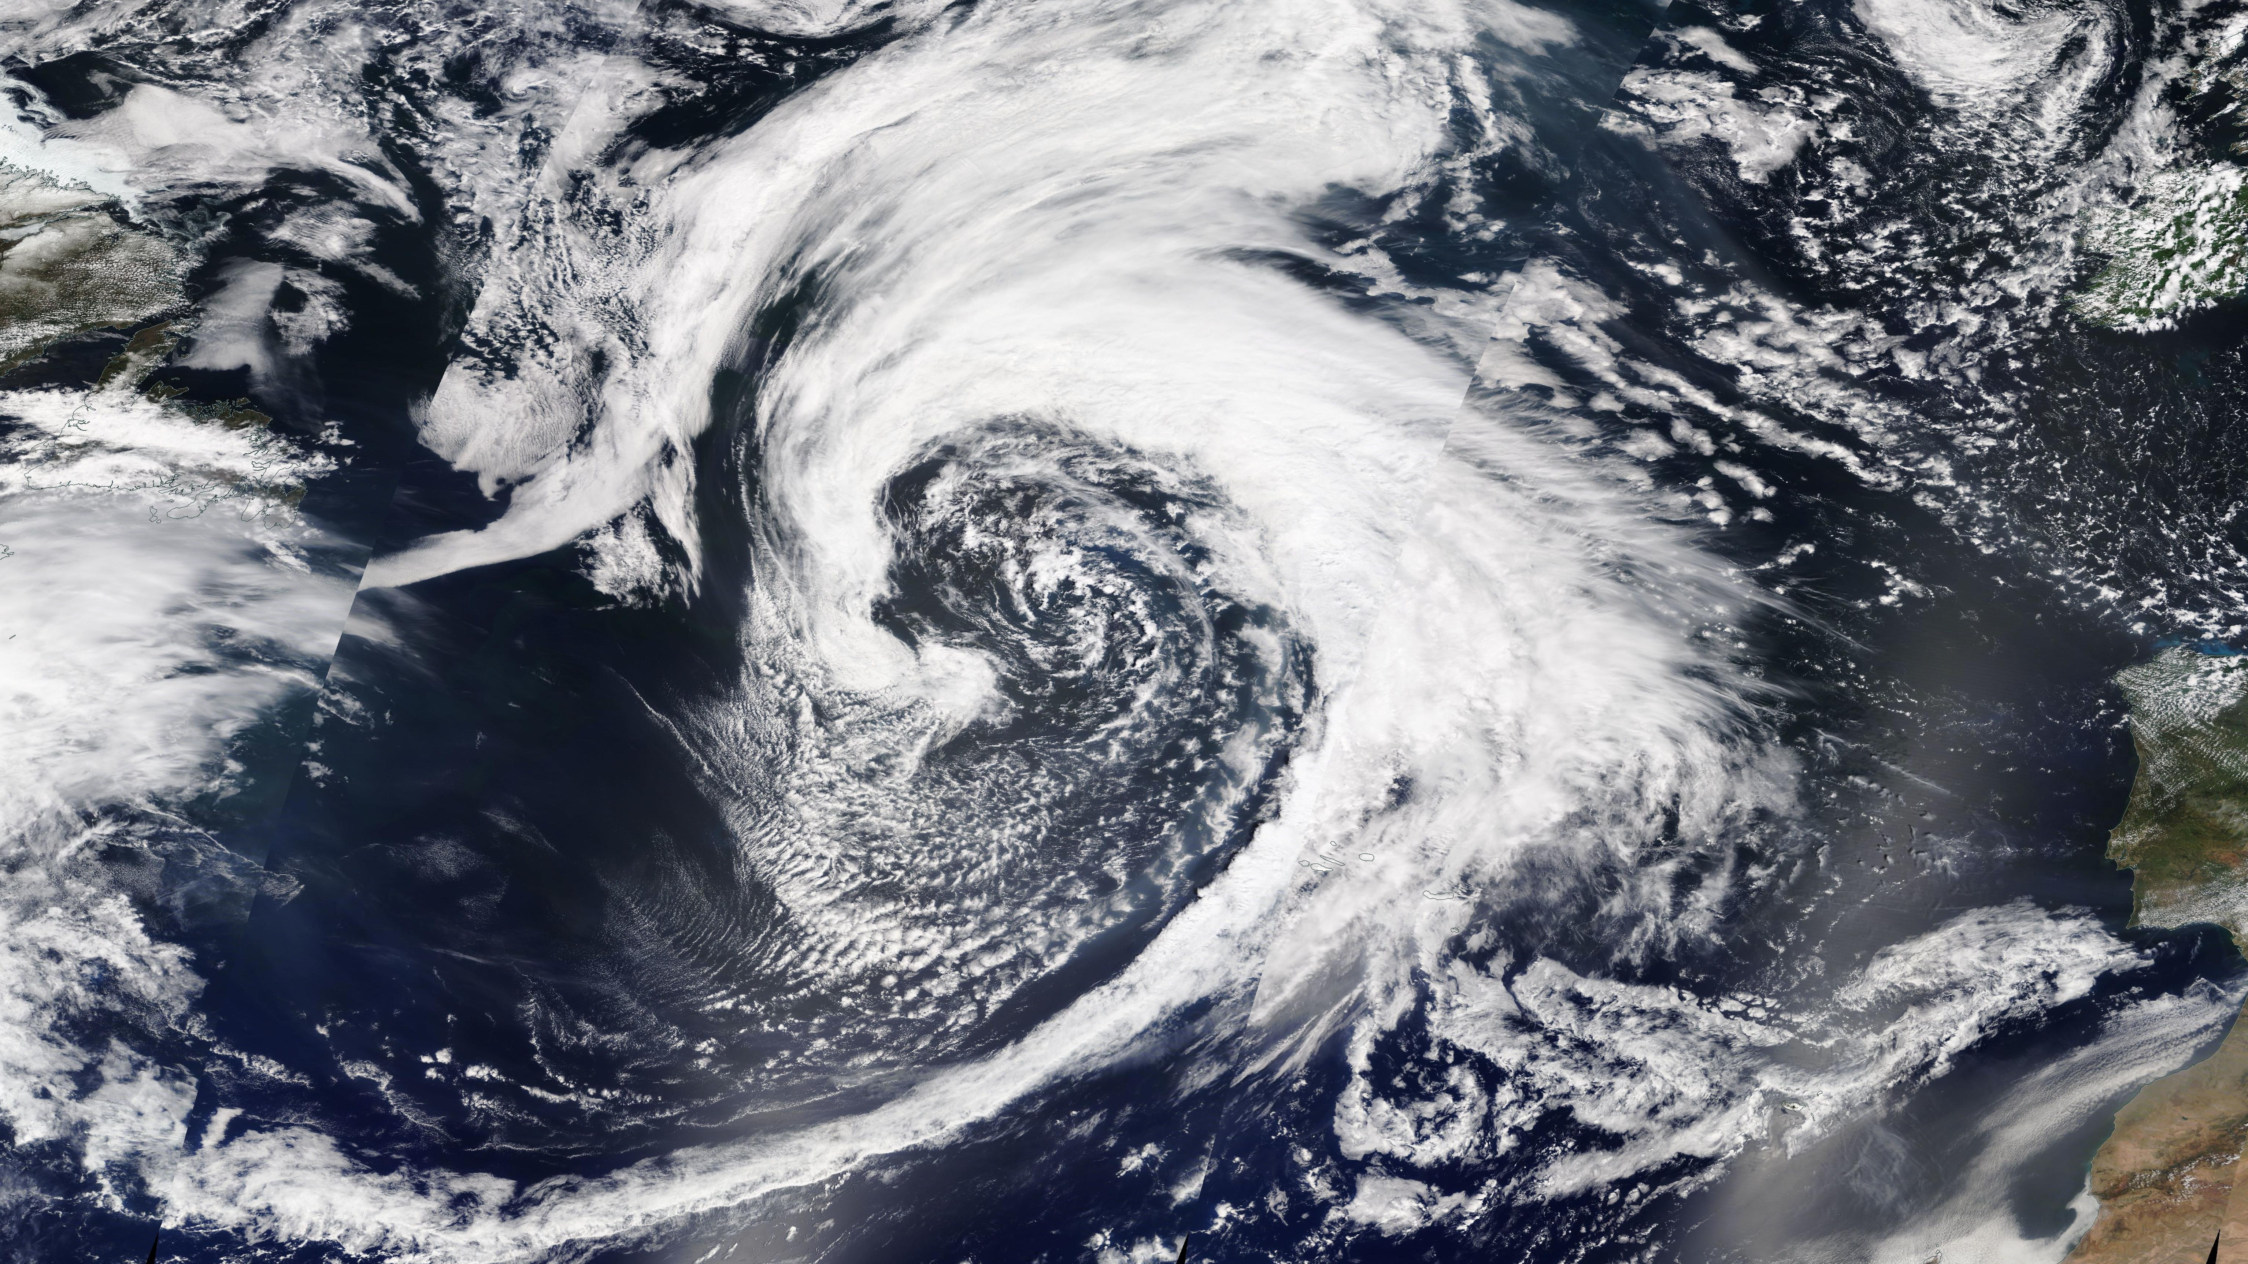

Understanding the importance of extra-tropical cyclones for the North Atlantic free-tropospheric aerosol budget
August Mikkelsen¹, Daniel T. McCoy¹, Hamish Gordon², Mueed Khan², Rob Wood³, Isabel L. McCoy⁴
¹ University of Wyoming, Laramie, WY
² Carnegie Mellon University, Pittsburgh, PA
³ University of Washington, Seattle, WA
⁴ Rosenstiel School of Marine and Atmospheric Science, University of Miami, Miami, FL, USA

Slide 2
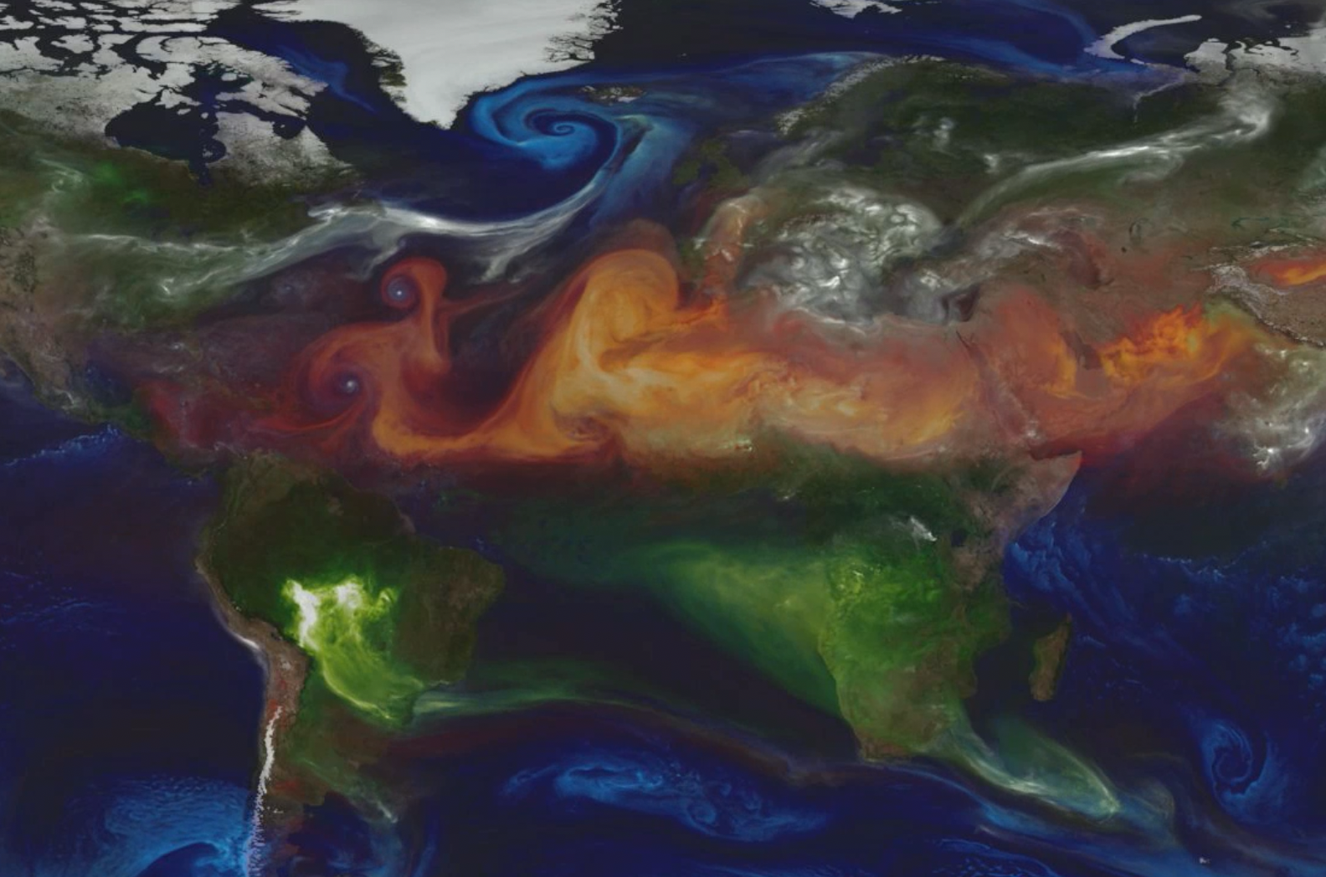
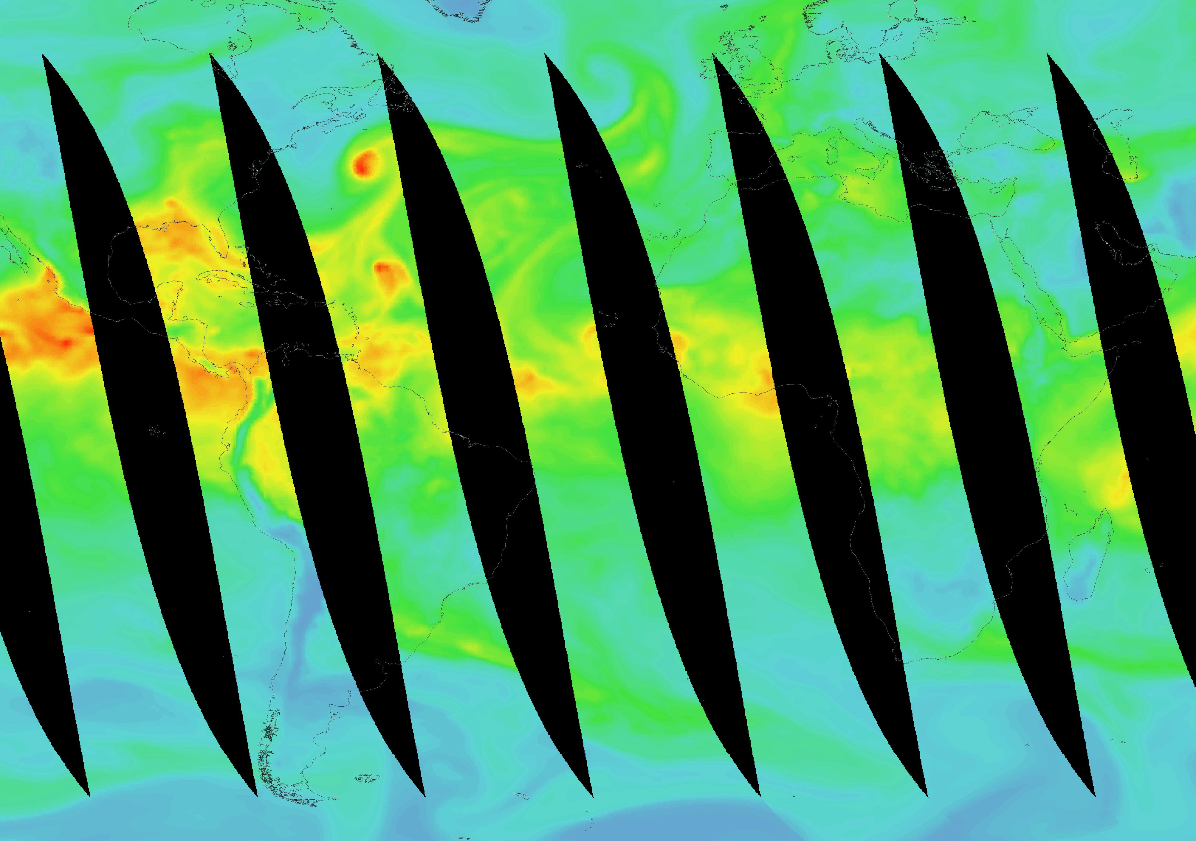
Background
Cooling from aerosols is still a major uncertainty in climate projections
Extratropical cyclones factor into global aerosol budgets
How aerosols interact with cyclones is poorly understood*
columnar water vapor from AMSR-E aboard NASA’s Aqua
NASA GMAO GEOS-5 aerosol visualization
*Grandey et al, 2013
Notes:
Chakarborte paper plot, worldview AR w/ aerosol

Slide 3
Goals
Determining how aerosols affect and are affected by clouds and precipitation near marine extratropical cyclone fronts
Determining how aerosols are transported and processed by cyclones

Slide 4
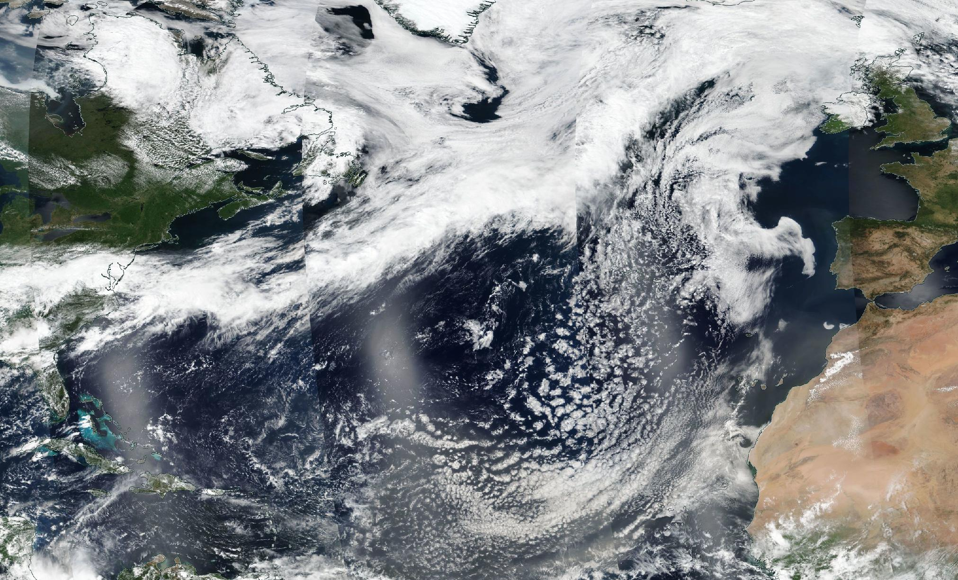
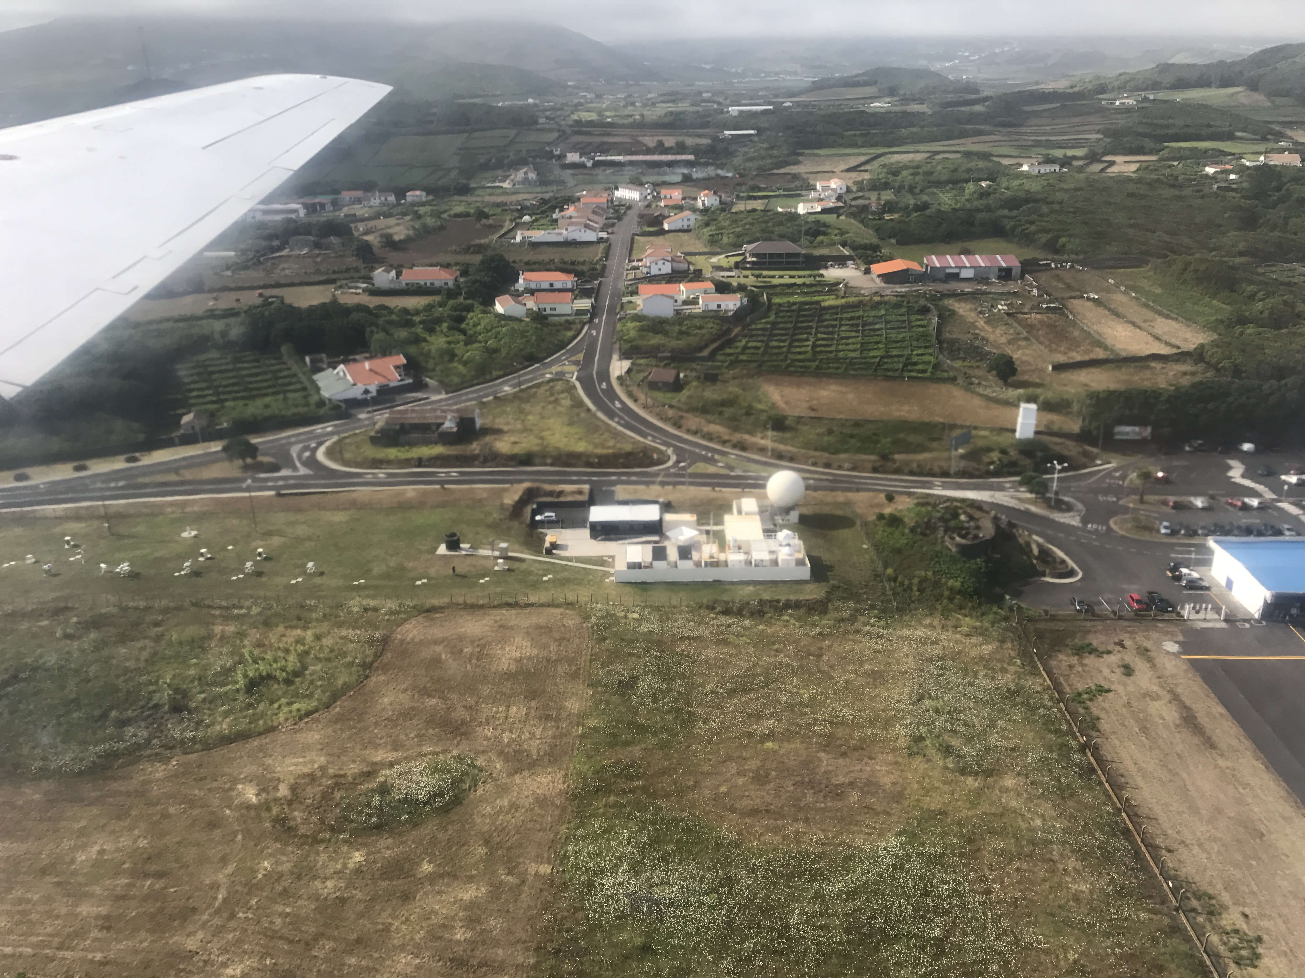
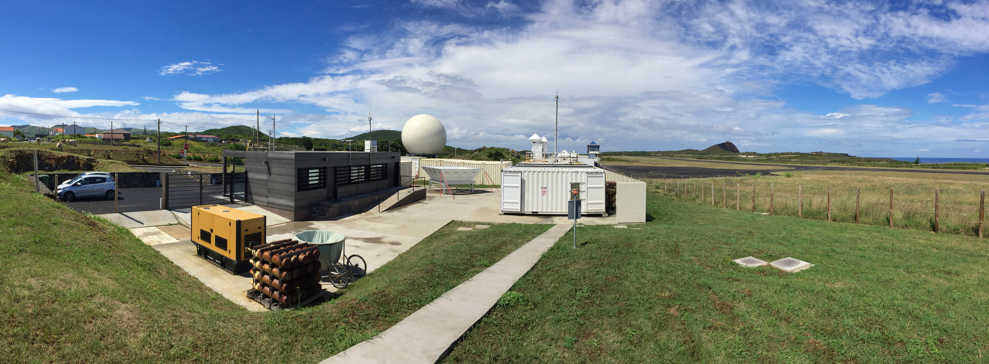
East North Atlantic (ENA)
DOE ARM atmospheric observatory
Graciosa Island, the Azores

Slide 5
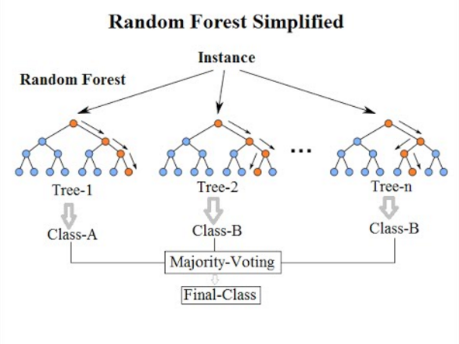
Finding Fronts
Trained a random forest cold front classification model using daily surface observations from ENA and archived NWS DIFAX surface analyses
  A random forest is an ensemble of decision trees (hence, a forest)
  For training data, we recorded whether a cold front passed over the island based on archived surface analyses
With this archive of days when fronts passed, we then found the exact front passage time based on the “slope” of ten-minute temperature change
After subsetting for only days when all utilized instruments were functional, we had 233 fronts

Slide 6
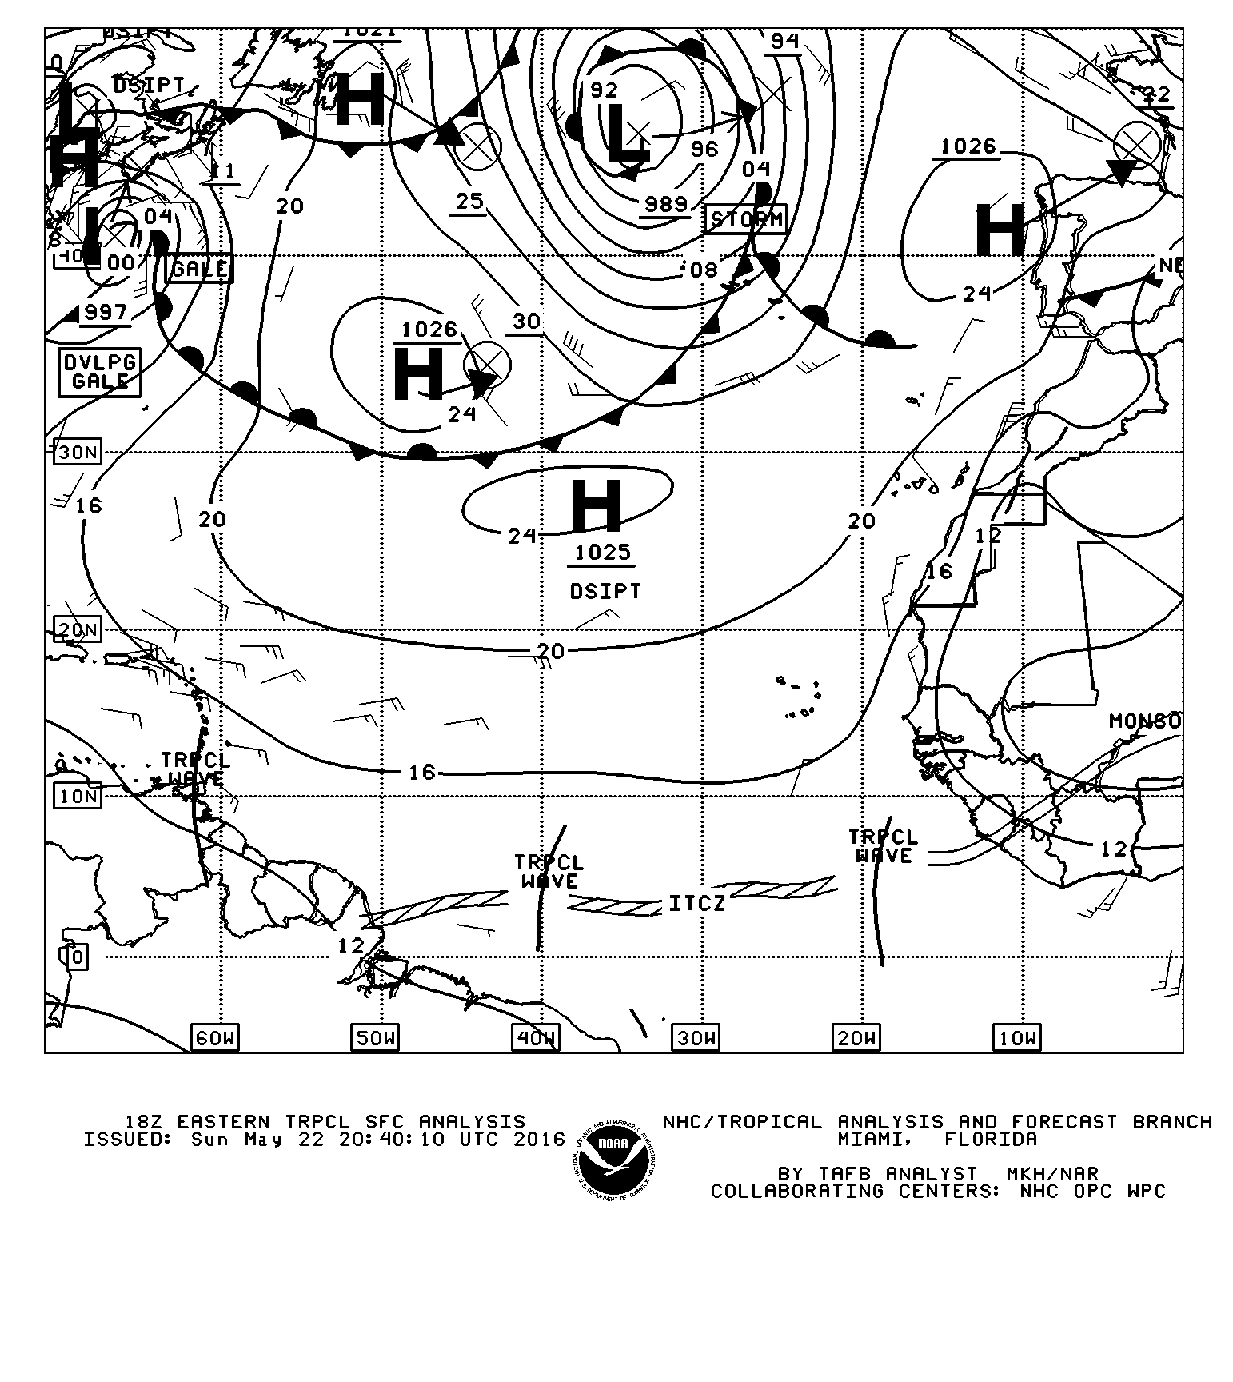
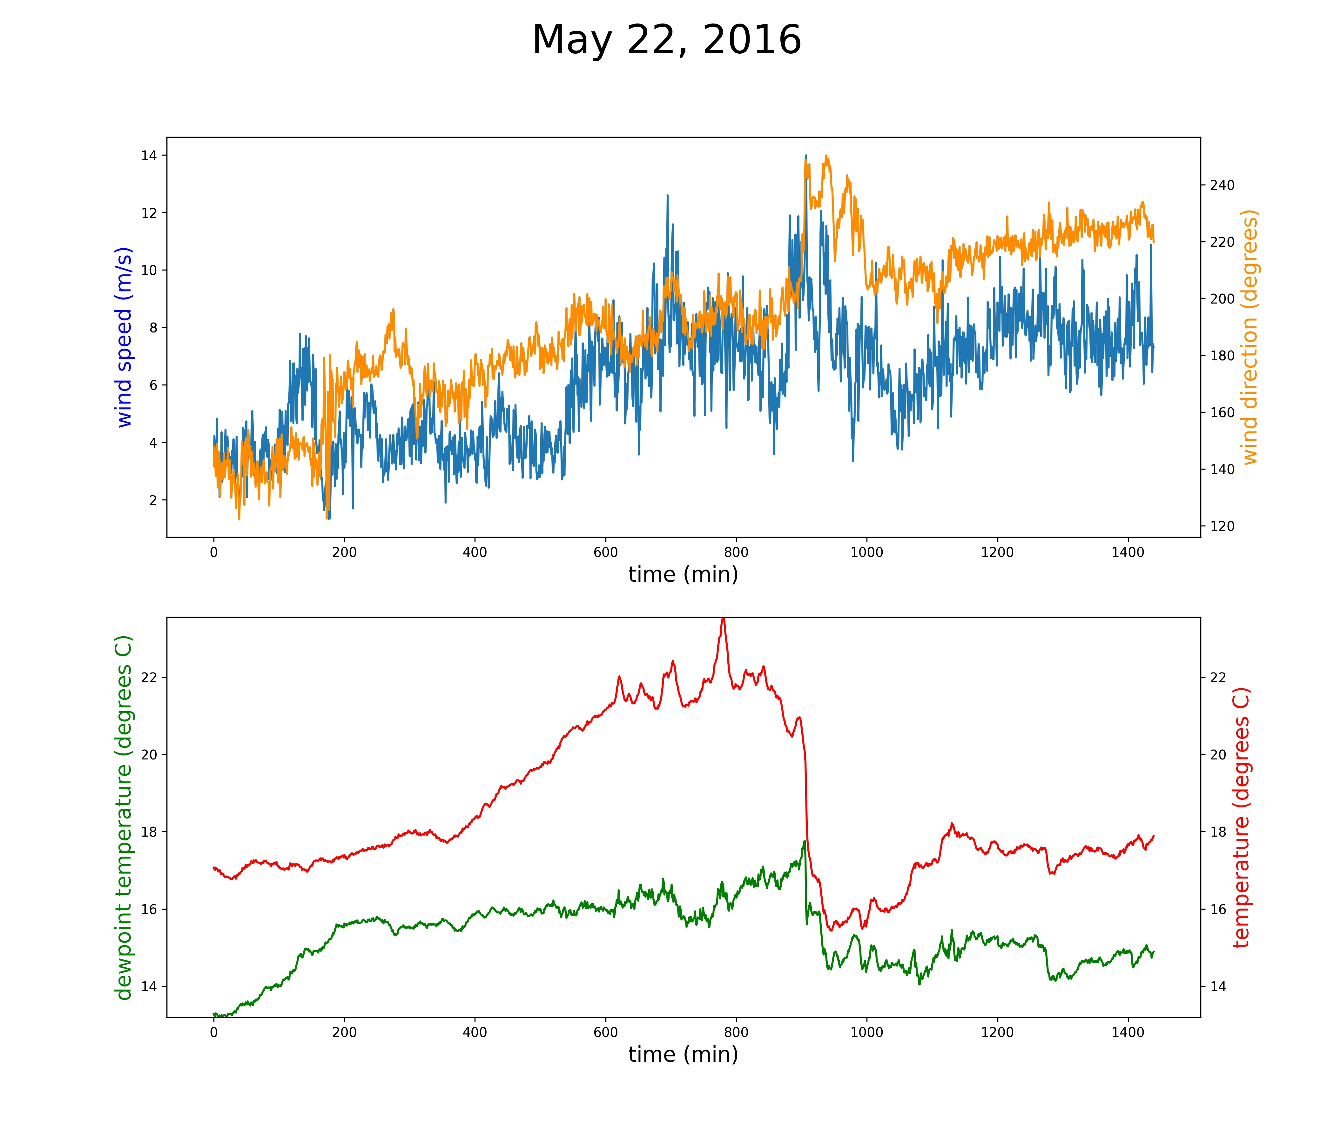
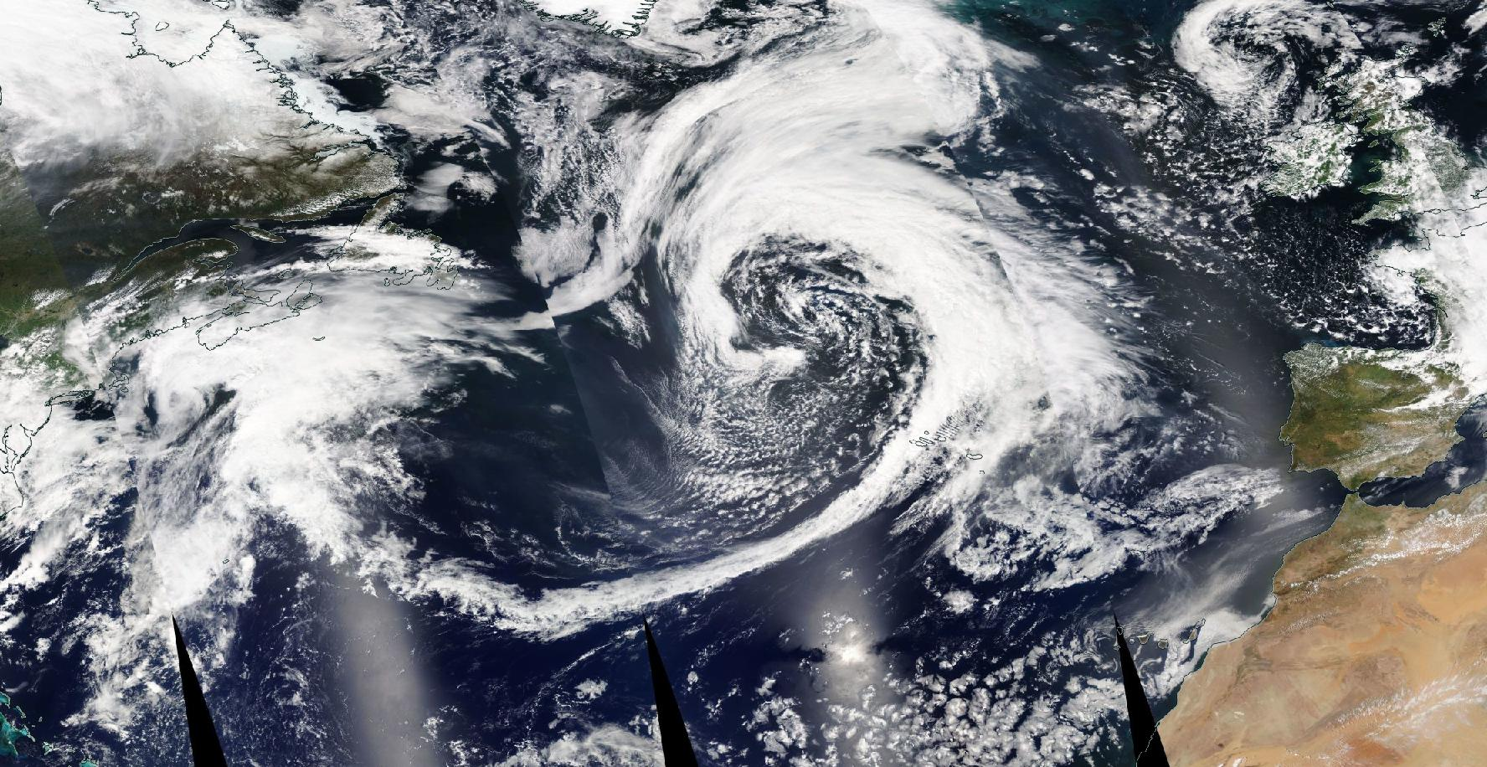
Front Example
Cold front
Notes:
NWS DIFAX map for this day

Slide 7
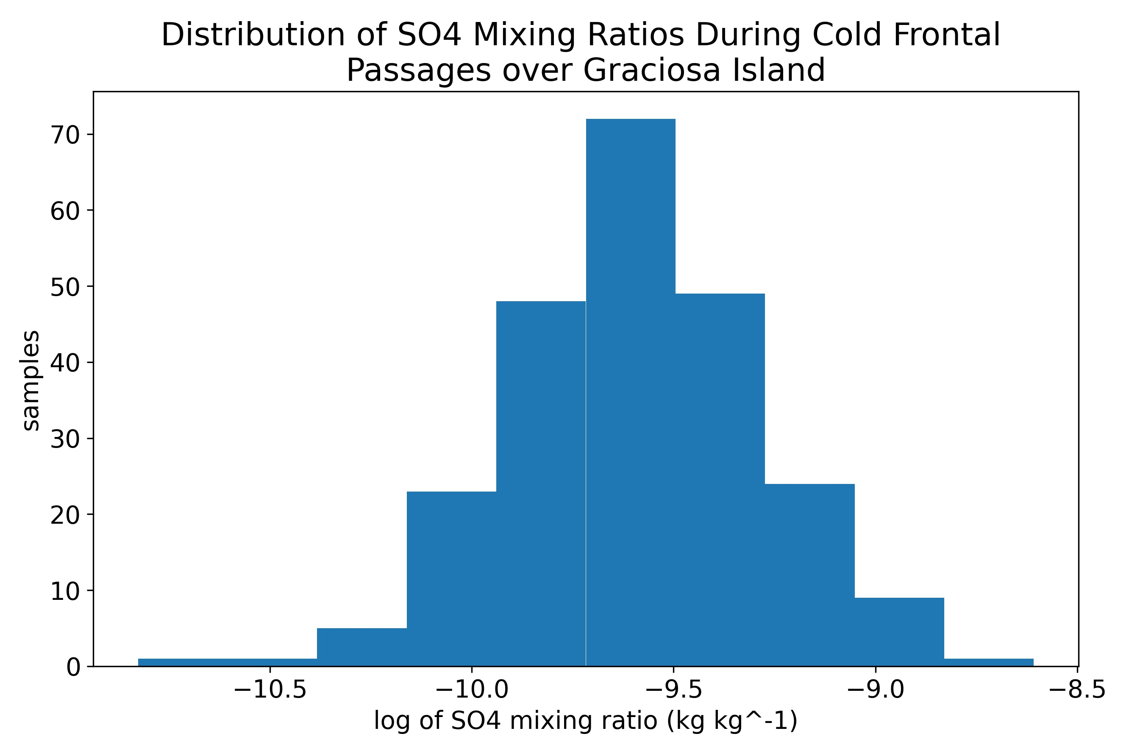
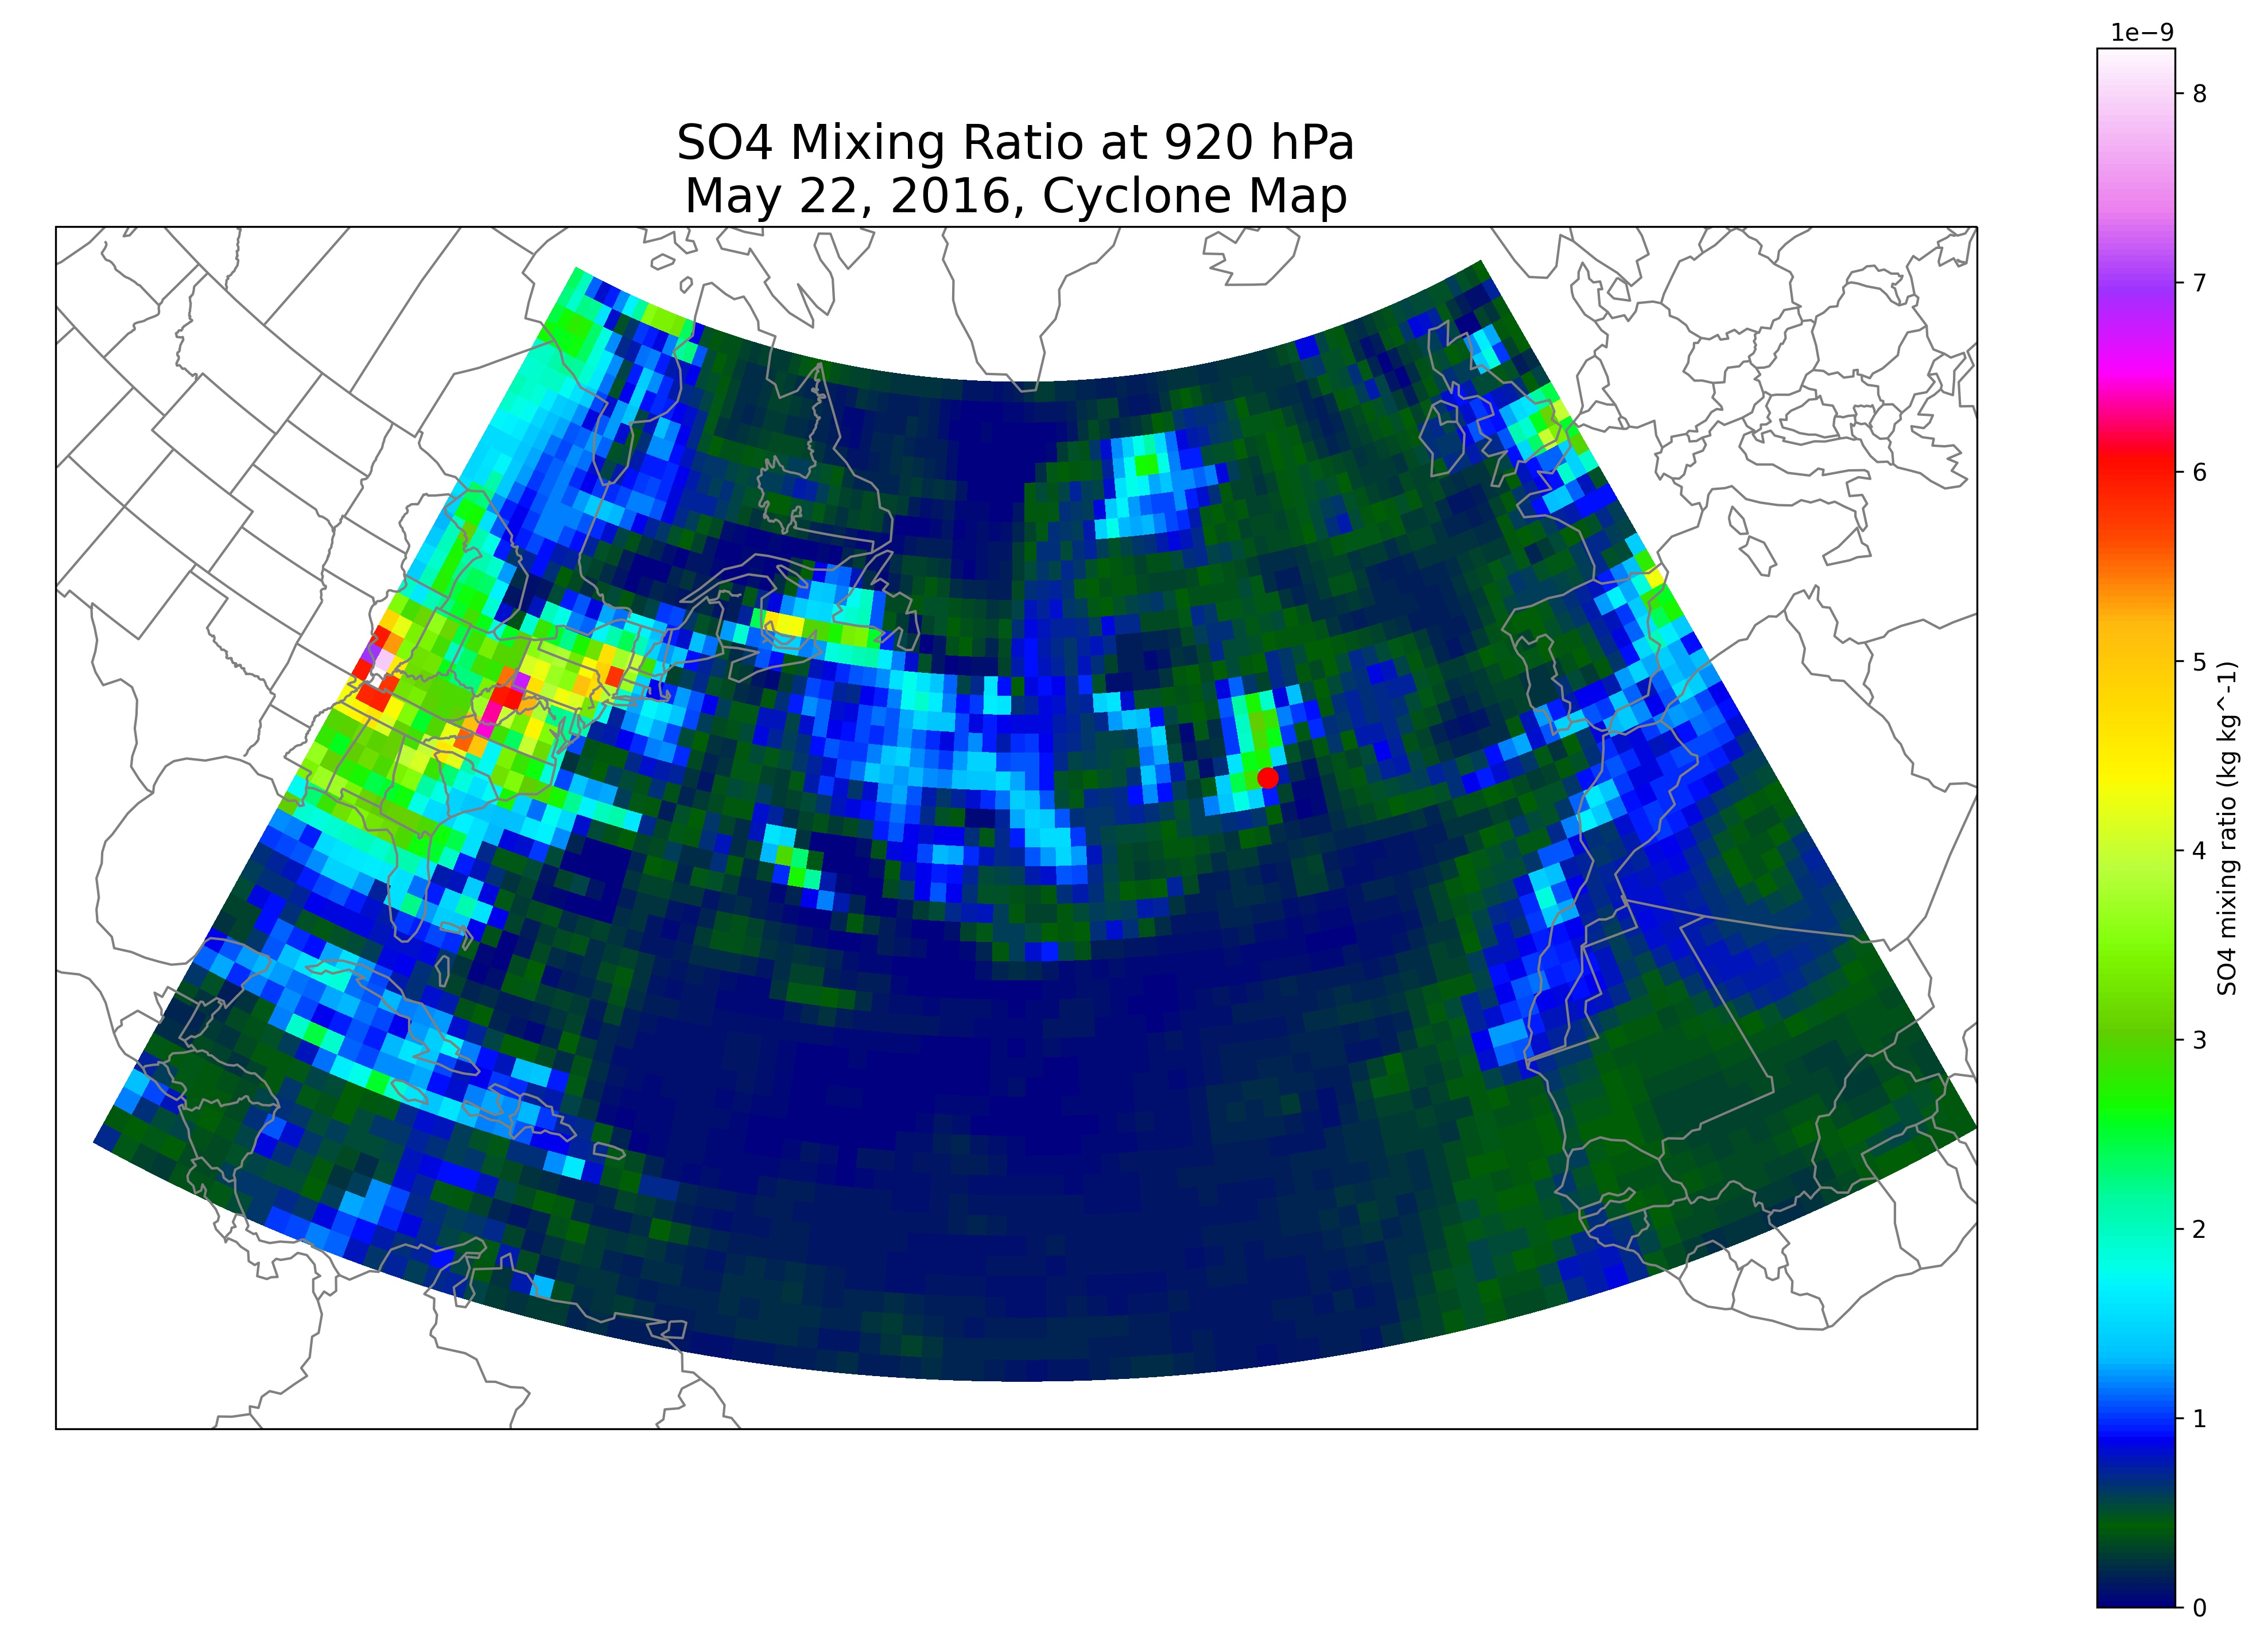
Clean Fronts/Dirty Fronts
From MERRA2 reanalysis, we utilized the SO₄ mixing ratio at 920 hPa* at Graciosa
Defined fronts as clean or dirty based on the log of the averaged SO₄ mixing ratio of the prefrontal air
  If mixing ratio >= 50th percentile, the front is “dirty”
920 hPa chosen primarily for strong signal and to see the WCB
*D. T. McCoy et al, 2017
Notes:
Proposal vertical crosssection (920 hPa), add map examples

Slide 8
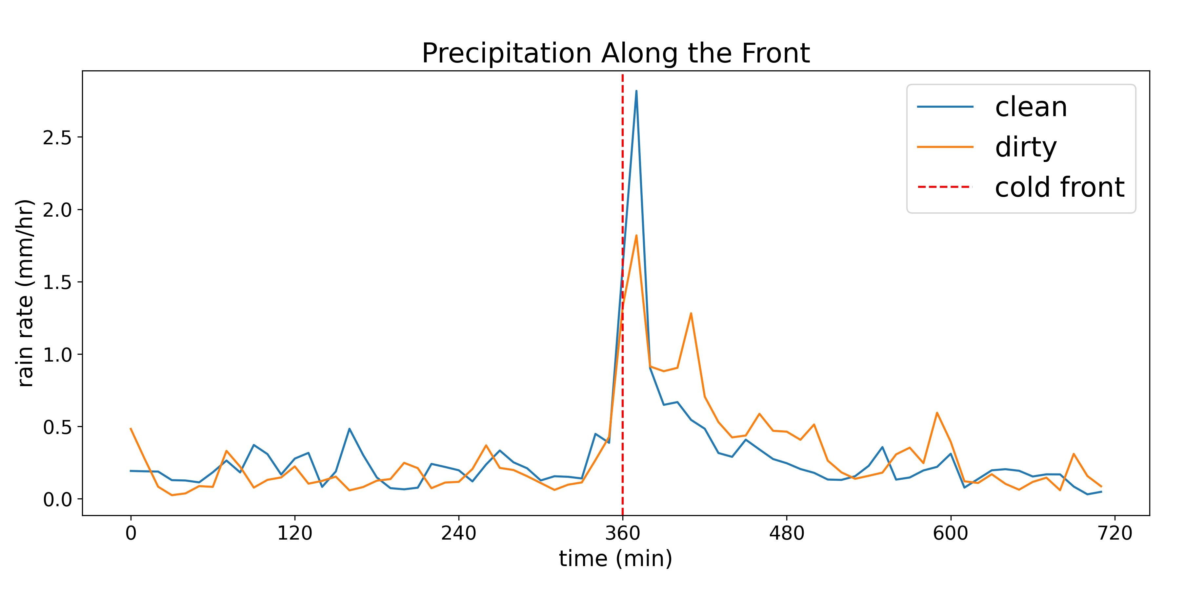
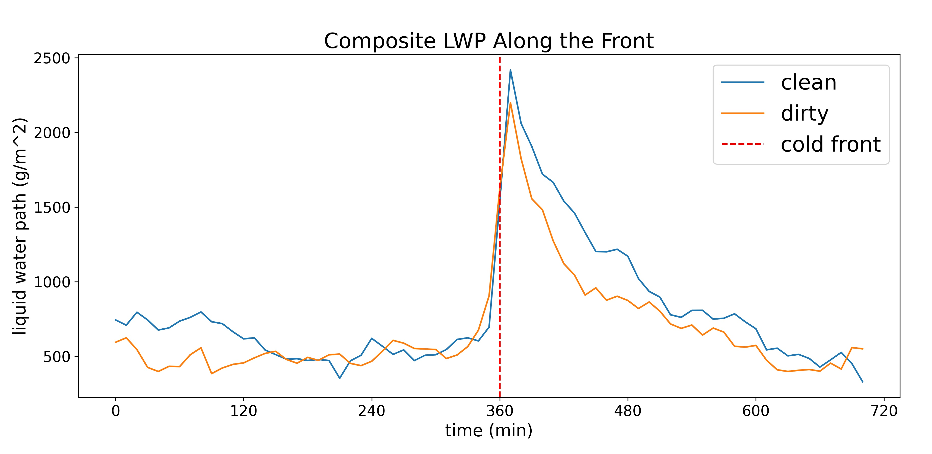
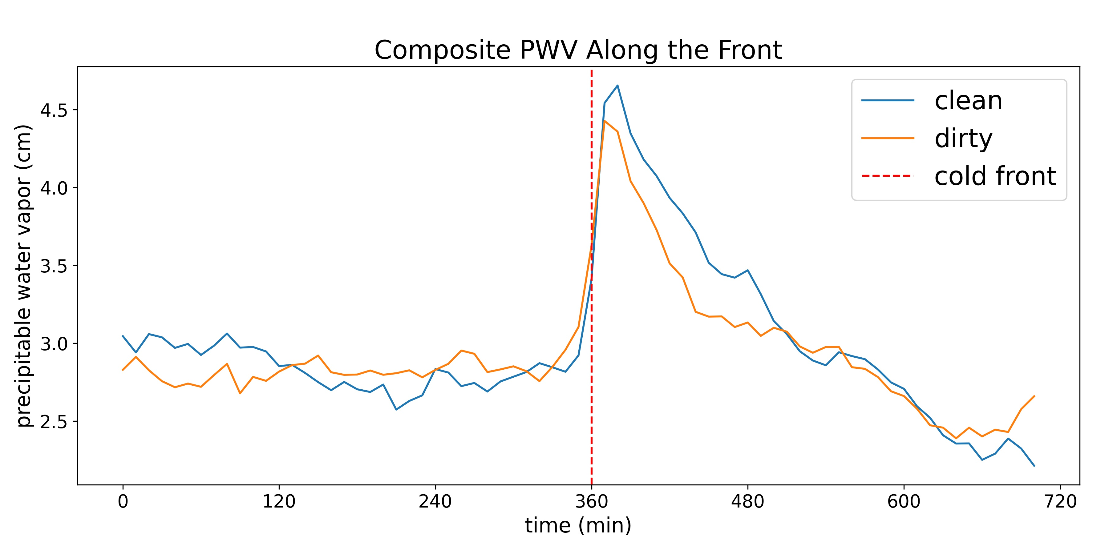
Composite Time Series
Fronts are very distinct
Compositing time series of 6 hours before/after frontal passage
Precipitation heavier in cleaner prefrontal volume
Liquid water path and precipitable water vapor similarly higher with cleaner prefrontal volume
So: do stronger atmospheric rivers come with less aerosol transport?
Notes:
Really strong ARs seem to come along with smaller aerosol transport; examining these will be something to think about

Slide 9
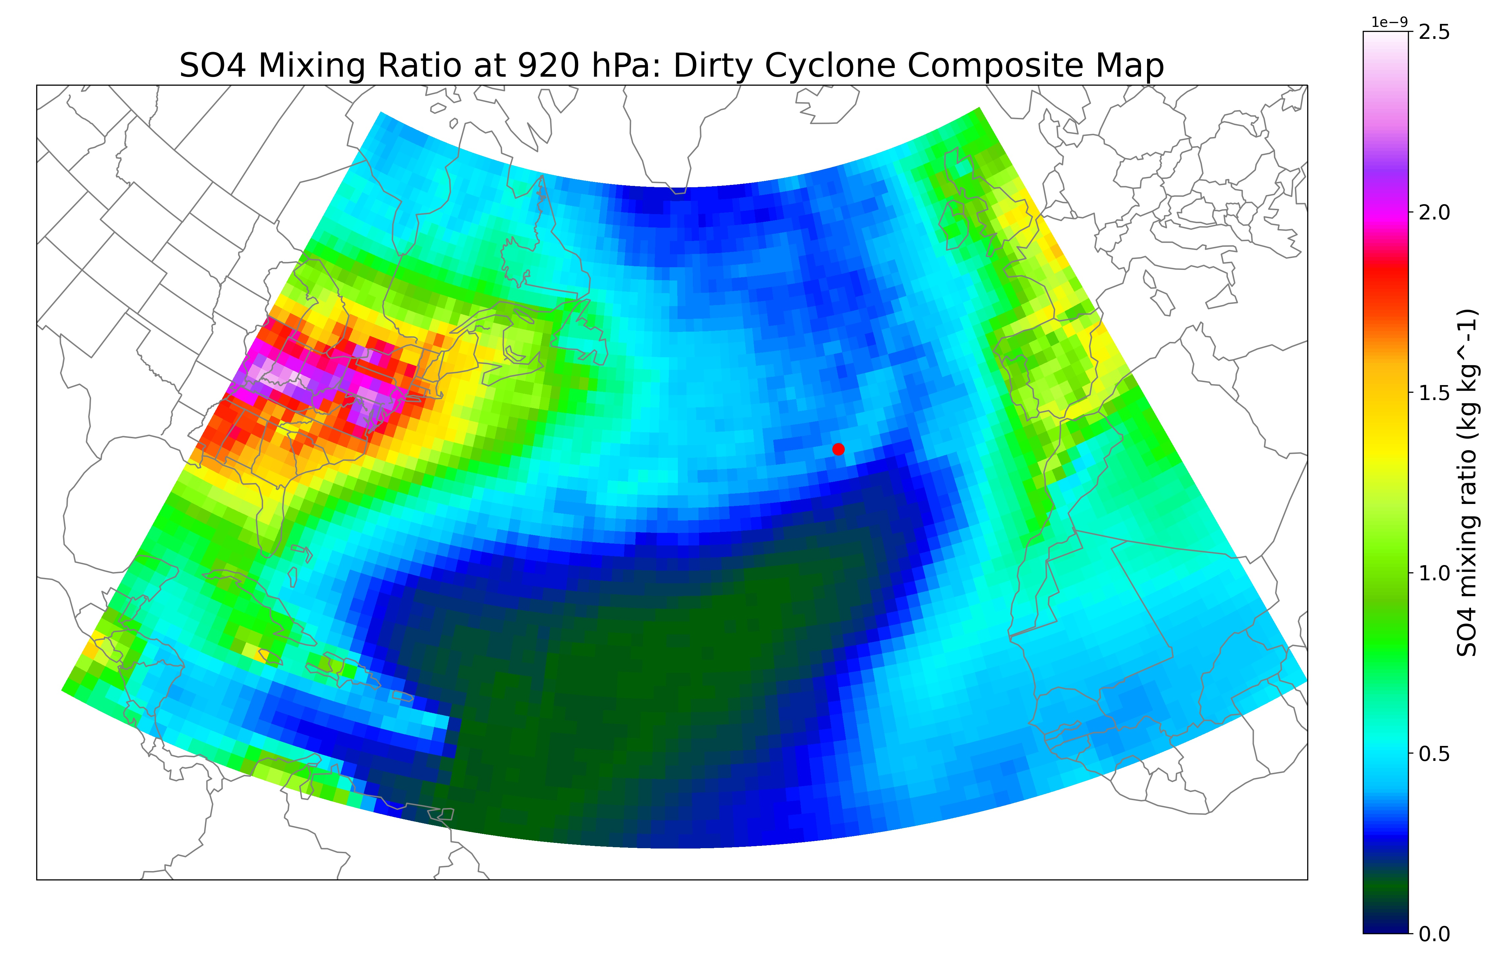
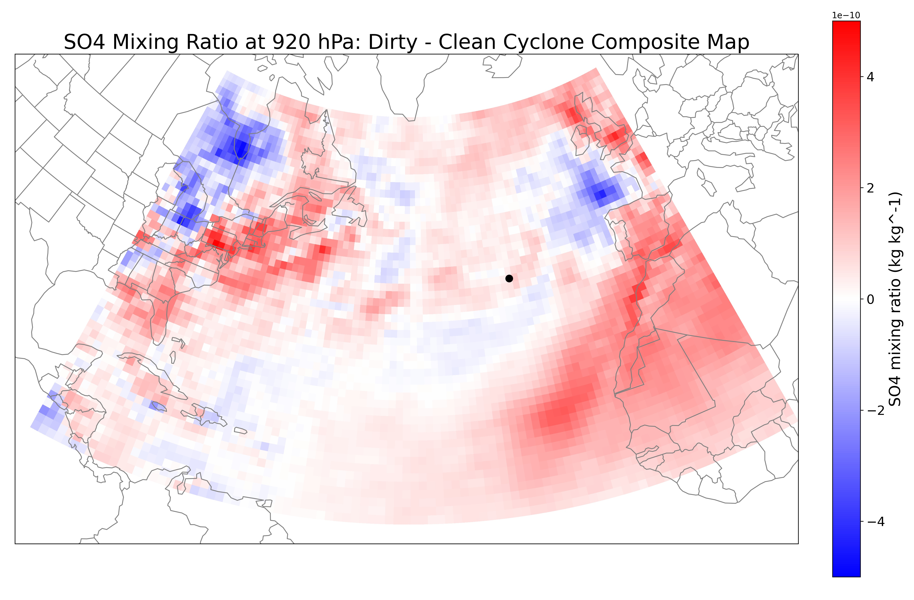
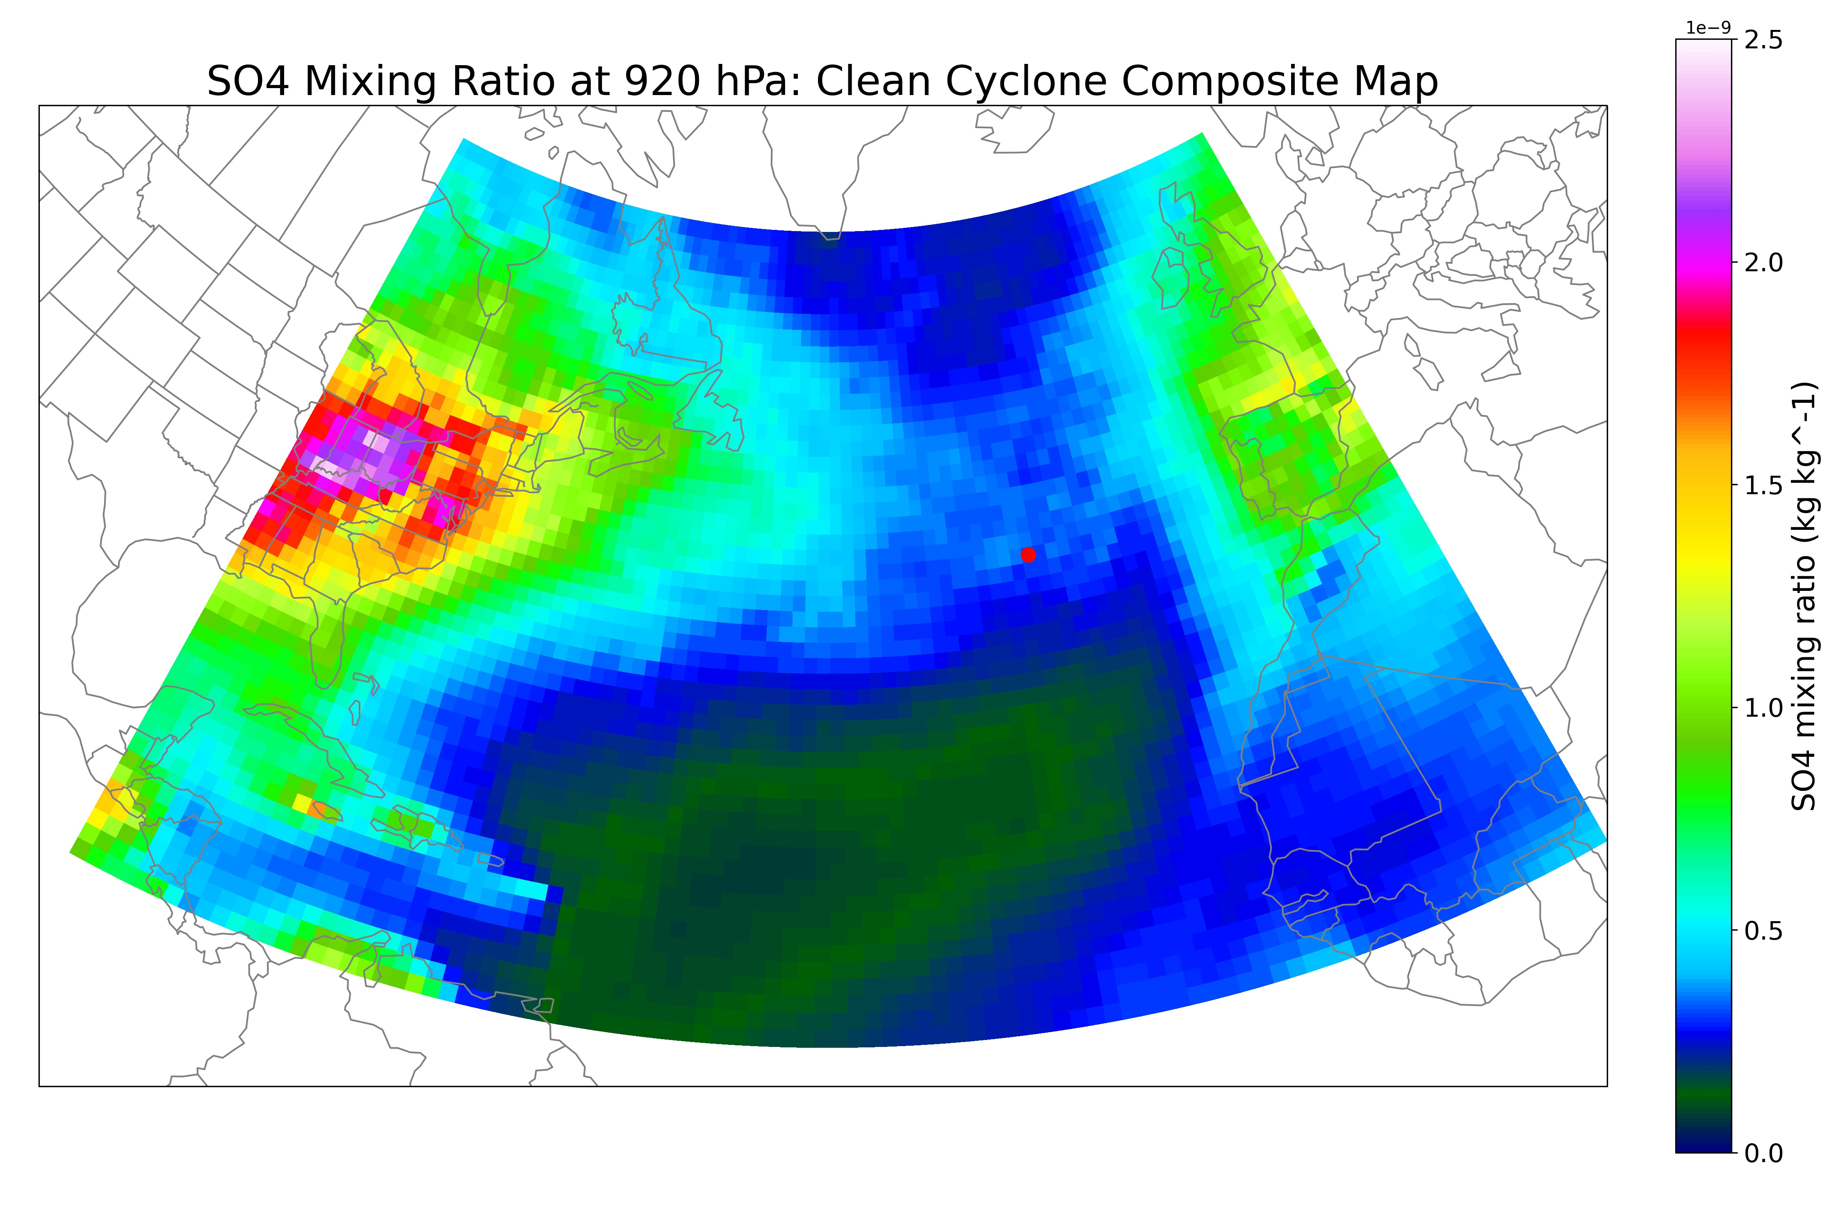
Composite Maps
Composites stratified based on earlier SO4 mixing ratio scheme
Generally see a much cleaner North Africa in clean regime
More distinct AR at Graciosa and dirtier eastern North American coast in dirty regime

Slide 10


Model Comparison
Simulations needed to:
Understand how aerosol processes interact
Quantify cyclone effects on aerosol budgets
Determine implications for radiation and climate
By running regional models at a cloud-resolving resolution, we can achieve insights into difficult-to-observe processes
Hamish Gordon
Mueed Khan
Notes:
What is model resolution? What’s the physics package? Add worldview, surface analysis

Slide 11
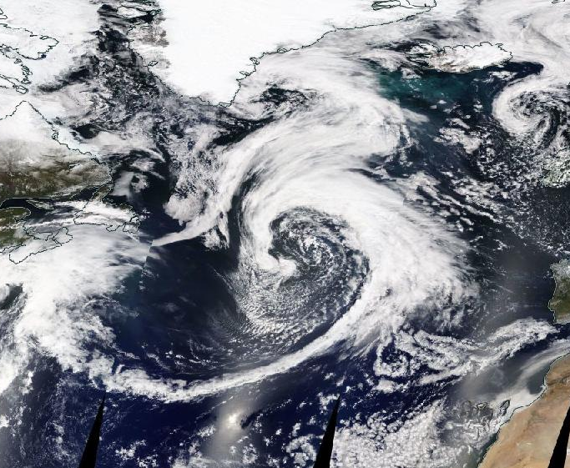
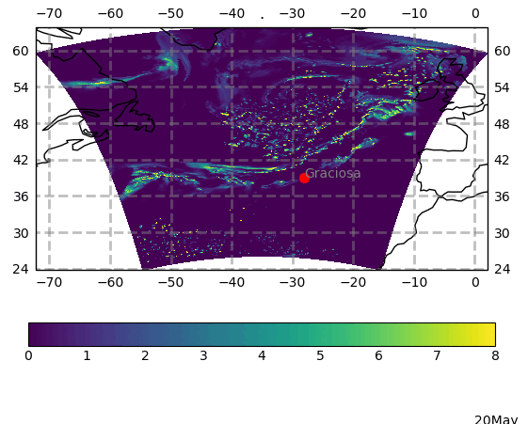
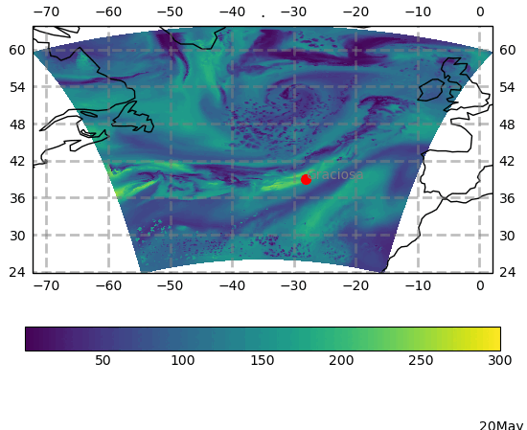
May 22, 2016
Case Study
Liquid water path (kg m⁻² )
Accumulation mode aerosols concentration (cm⁻³)

Slide 12
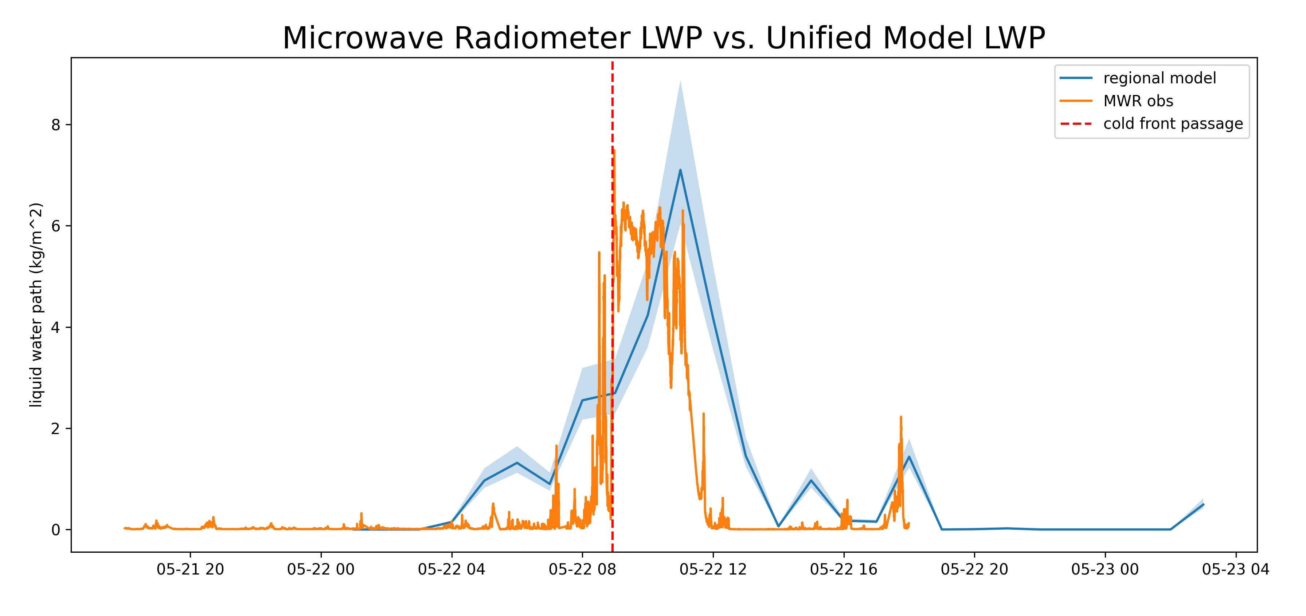

Slide 13
Future Work
Composite back trajectories for current clean and dirty regimes
  Are all these clean or dirty atmospheric pulling from the same place?
Composite SLP and other MERRA-2 products for further geographic analysis
Further refinement of the cold front random forest algorithm
  Overall, the random forest algorithm tends to underpredict fronts in the winter and overpredict in the summer.
Comparing composites of ”very dirty” vs. ”very clean” cyclones, using the more extreme ends of the distribution
Performing similar analysis on warm frontal passages
  So far we’ve been focusing on cold frontal passages because they’re much easier to detect and distinguish, but warm fronts are important too!

Slide 14
Takeaways
Cleaner ARs tend to bring more precipitation along their cold frontal passage
Cleaner ARs also tend to have lower LWP and WV
Case study simulations so far agree well with observations
Thank you!

Slide 15
Backup Slides

Slide 16
Comparison with UM Regional Model
We are very interested in model comparison with observations, and our colleagues at CMU are running a regional model of the UM with the RA2M (Regional Atmosphere 2 for Mid-latitudes) configuration and the global driving model has the GA7.2_GL8.1 configuration (global atmosphere 7.2, global land 8.1).
The only deviations from RA2M are to use the CASIM cloud microphysics module, which is standard at RA3M but not at RA2M, and the UK chemistry and Aerosols module UKCA (both of these are needed for aerosol-cloud interactions)
Data are written out every three hours, at 7km spatial resolution horizontally with 70 vertical levels extending to 40km altitude
Model is reinitialised to UM analyses every 24 hours, so every 24 hours we run a “forecast” simulation. Each daily “forecast” is 30 hours long, so we generate a complete time series by using the last 24 hours of each 30, and throwing away the first six hours as a spin-up. Aerosols are carried forward from one “forecast” to the next.
The regional model has the RA2M configuration. The basic RA2 configuration is similar to, but upgraded from, the RA1 configuration documented by Bush et al: https://gmd.copernicus.org/articles/13/1999/2020/gmd-13-1999-2020.html while the CASIM and UKCA parts are documented here: https://acp.copernicus.org/articles/20/10997/2020/acp-20-10997-2020.html
Notes:
What is model resolution? What’s the physics package? Add worldview, surface analysis

