Slide 1

The Organization and Vertical Structure of Shallow Convection
in Marine Cold-Air Outbreaks, based on Cold-Air Outbreaks in
the Marine Boundary Layer Experiment (COMBLE): Developing
the Framework for an Intercomparison Modeling Study
Timothy Juliano, NCAR
Ann Fridlind, Bart Geerts, Pavlos Kollias, Branko Kosovic, Christian Lackner, Zackary Mages, Mikhail Ovchinnikov, Florian Tornow, Yonggang Wang, Peng Wu, Lulin Xue, Yunyan Zhang, Xue Zheng
July 25, 2022

Slide 2
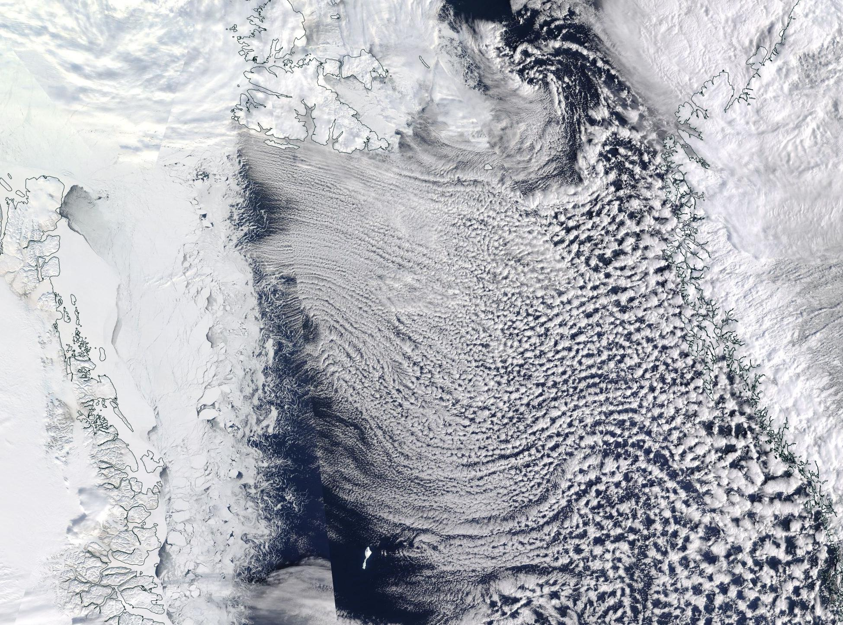
MODIS visible image from
28 March 2020 at ~11 UTC
Arctic mixed-phase cloud strucures
Cloud streets
During favorable CAO conditions, convective boundary layer (CBL) develops over the open ocean due to substantial air-sea temperature contrast
Positive (upward) surface fluxes, strong shear, convective processes, and a growth in the CBL depth with increasing fetch
Intricate mixed-phase cloud structures that transition from narrow cloud streets or helical rolls near the ice edge to open cells farther downstream
Representing details of mesoscale cloud properties and organization is challenging for many numerical models across scales
N
Greenland
ice sheet
Closed convective cells
Location of Andenes, Norway
Larger, open cells
Pan-GASS, Organization of shallow and deep convection, COMBLE Modeling Intercomparison 1

Slide 3
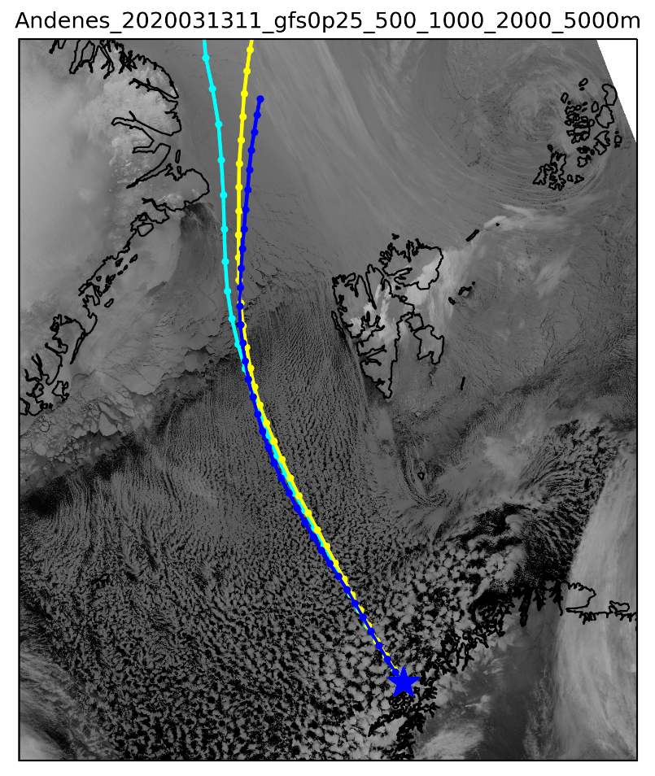
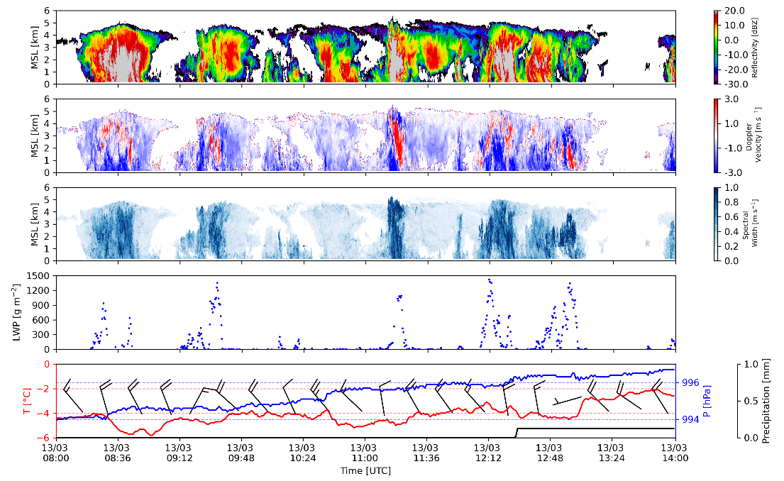
The Cold-Air Outbreaks in the Marine Boundary Layer Experiment (COMBLE )
Measurements conducted from 1 Dec 2019 – 31 May 2020 around Norwegian Sea
Overall goal: quantify properties of shallow convective clouds that develop during CAOs
~18% of campaign hours experienced CAO conditions at Andenes, with several strong events
Case of interest:
13 March 2020
Pan-GASS, Organization of shallow and deep convection, COMBLE Modeling Intercomparison 2

Slide 4
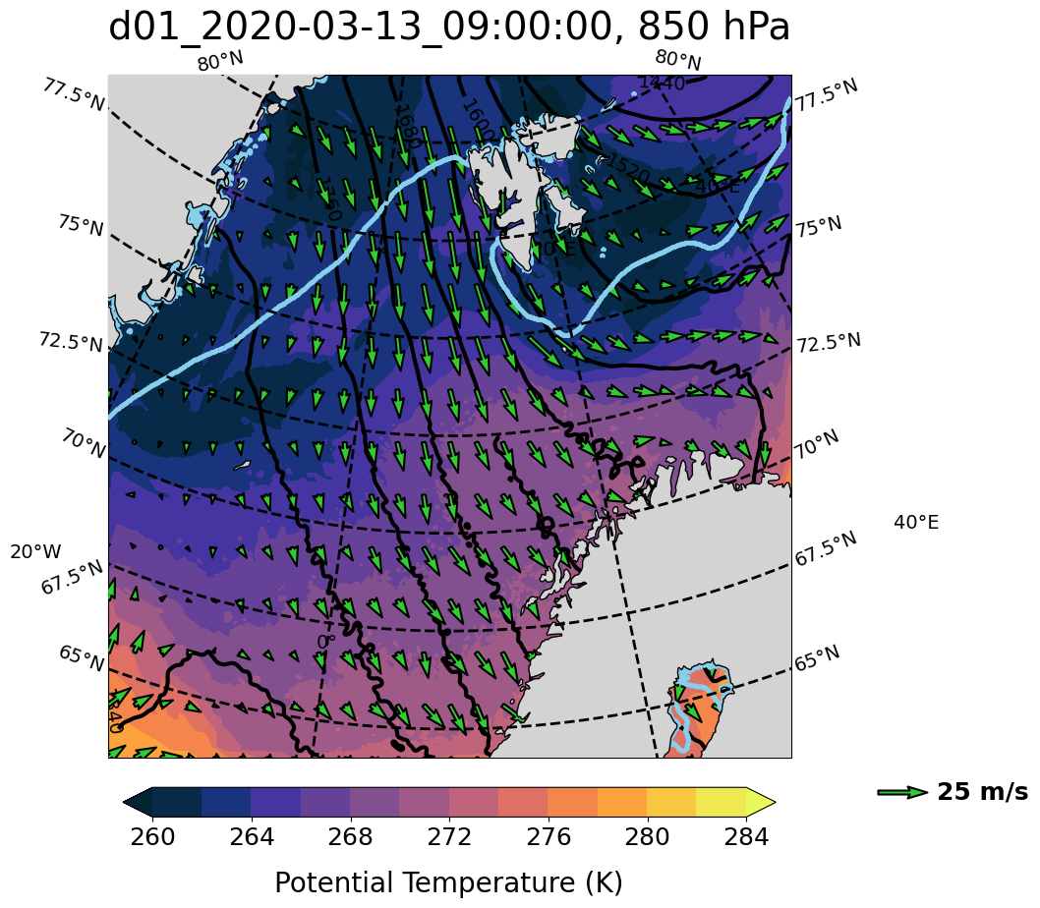
Lagrangian large-eddy simulation (LES) approach
Lagrangian perspective: following BL flow computed along ERA5 trajectory
Hourly sfc & large-scale conditions from ERA5 to represent “moving” domain (Galilean transformation)
Begin 13 March 00 UTC (ice edge), end 13 March 18 UTC (Andenes)
Key physics:
Morrison MP w/ total ice nucleation rate following prior Arctic intercomparison studies [Morrison et al. (2011) and Ovchinnikov et al. (2014)]
RRMTG LW radiation, revised MM5 sfc. layer physics (M-O theory, Charnock)
3D Deardorff TKE SGS model
Start of Lagrangian domain
– Ice edge
LES domain
Pan-GASS, Organization of shallow and deep convection, COMBLE Modeling Intercomparison 3
Notes:
Add damping layer info

Slide 5
Lagrangian large-eddy simulation (LES) approach
Start of Lagrangian domain
– Ice edge
Two main configurations:
1. Single domain: Doubly periodic
BC, Δx=Δy=90 m, Δz=100 m,
22.5x22.5x9 km; used as a
“testbed” for sensitivities
2. Two domains: Periodic outer,
Δx=Δy=90 / 30 m, Δz~30 m,
32x32x6 / 97x97x6 km; used to
explore mesoscale
organization and related
spectral properties
LES domain
Pan-GASS, Organization of shallow and deep convection, COMBLE Modeling Intercomparison 4

Slide 6
Various sensitivities conducted
Domain configuration | Microphysics | Surface forcing | Large-scale forcing
Increasing z levels | Varying N_{d} | Varying SST | Varying nudging timescale
Strawman intercomparison setup (larger domain, coarser dx, increased z levels) | Varying ice nucleation rate (N_{i}) |  | No θ / Q_{v} nudging
 | No Ice Processes |  | Subsidence
 | No Graupel
PNNL & NASA/GISS conducting parallel simulations to test these & other sensitivities related to these topics
Pan-GASS, Organization of shallow and deep convection, COMBLE Modeling Intercomparison 5

Slide 7
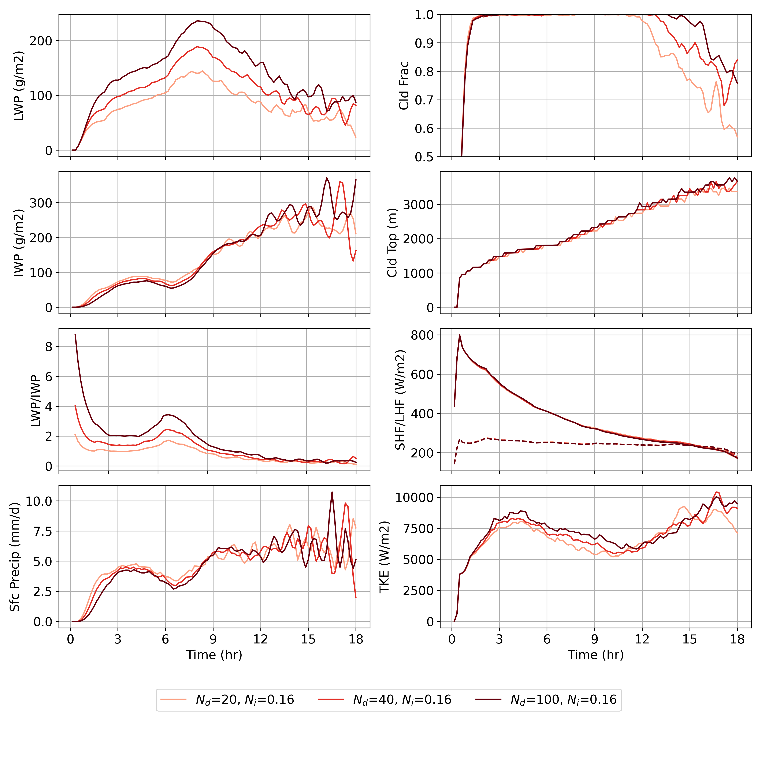
Impact of varying N_{d} and N_{i} : time series
N_{d} = (20,40,100) cm⁻³
N_{i} = 0.16 L⁻¹
As N_{d} increases:
Increase in LWP
  Decrease in IWP (relatively little sensitivity)
  LWP/IWP increases
  Increase in TKE
  Delayed cloud breakup
Pan-GASS, Organization of shallow and deep convection, COMBLE Modeling Intercomparison 6

Slide 8
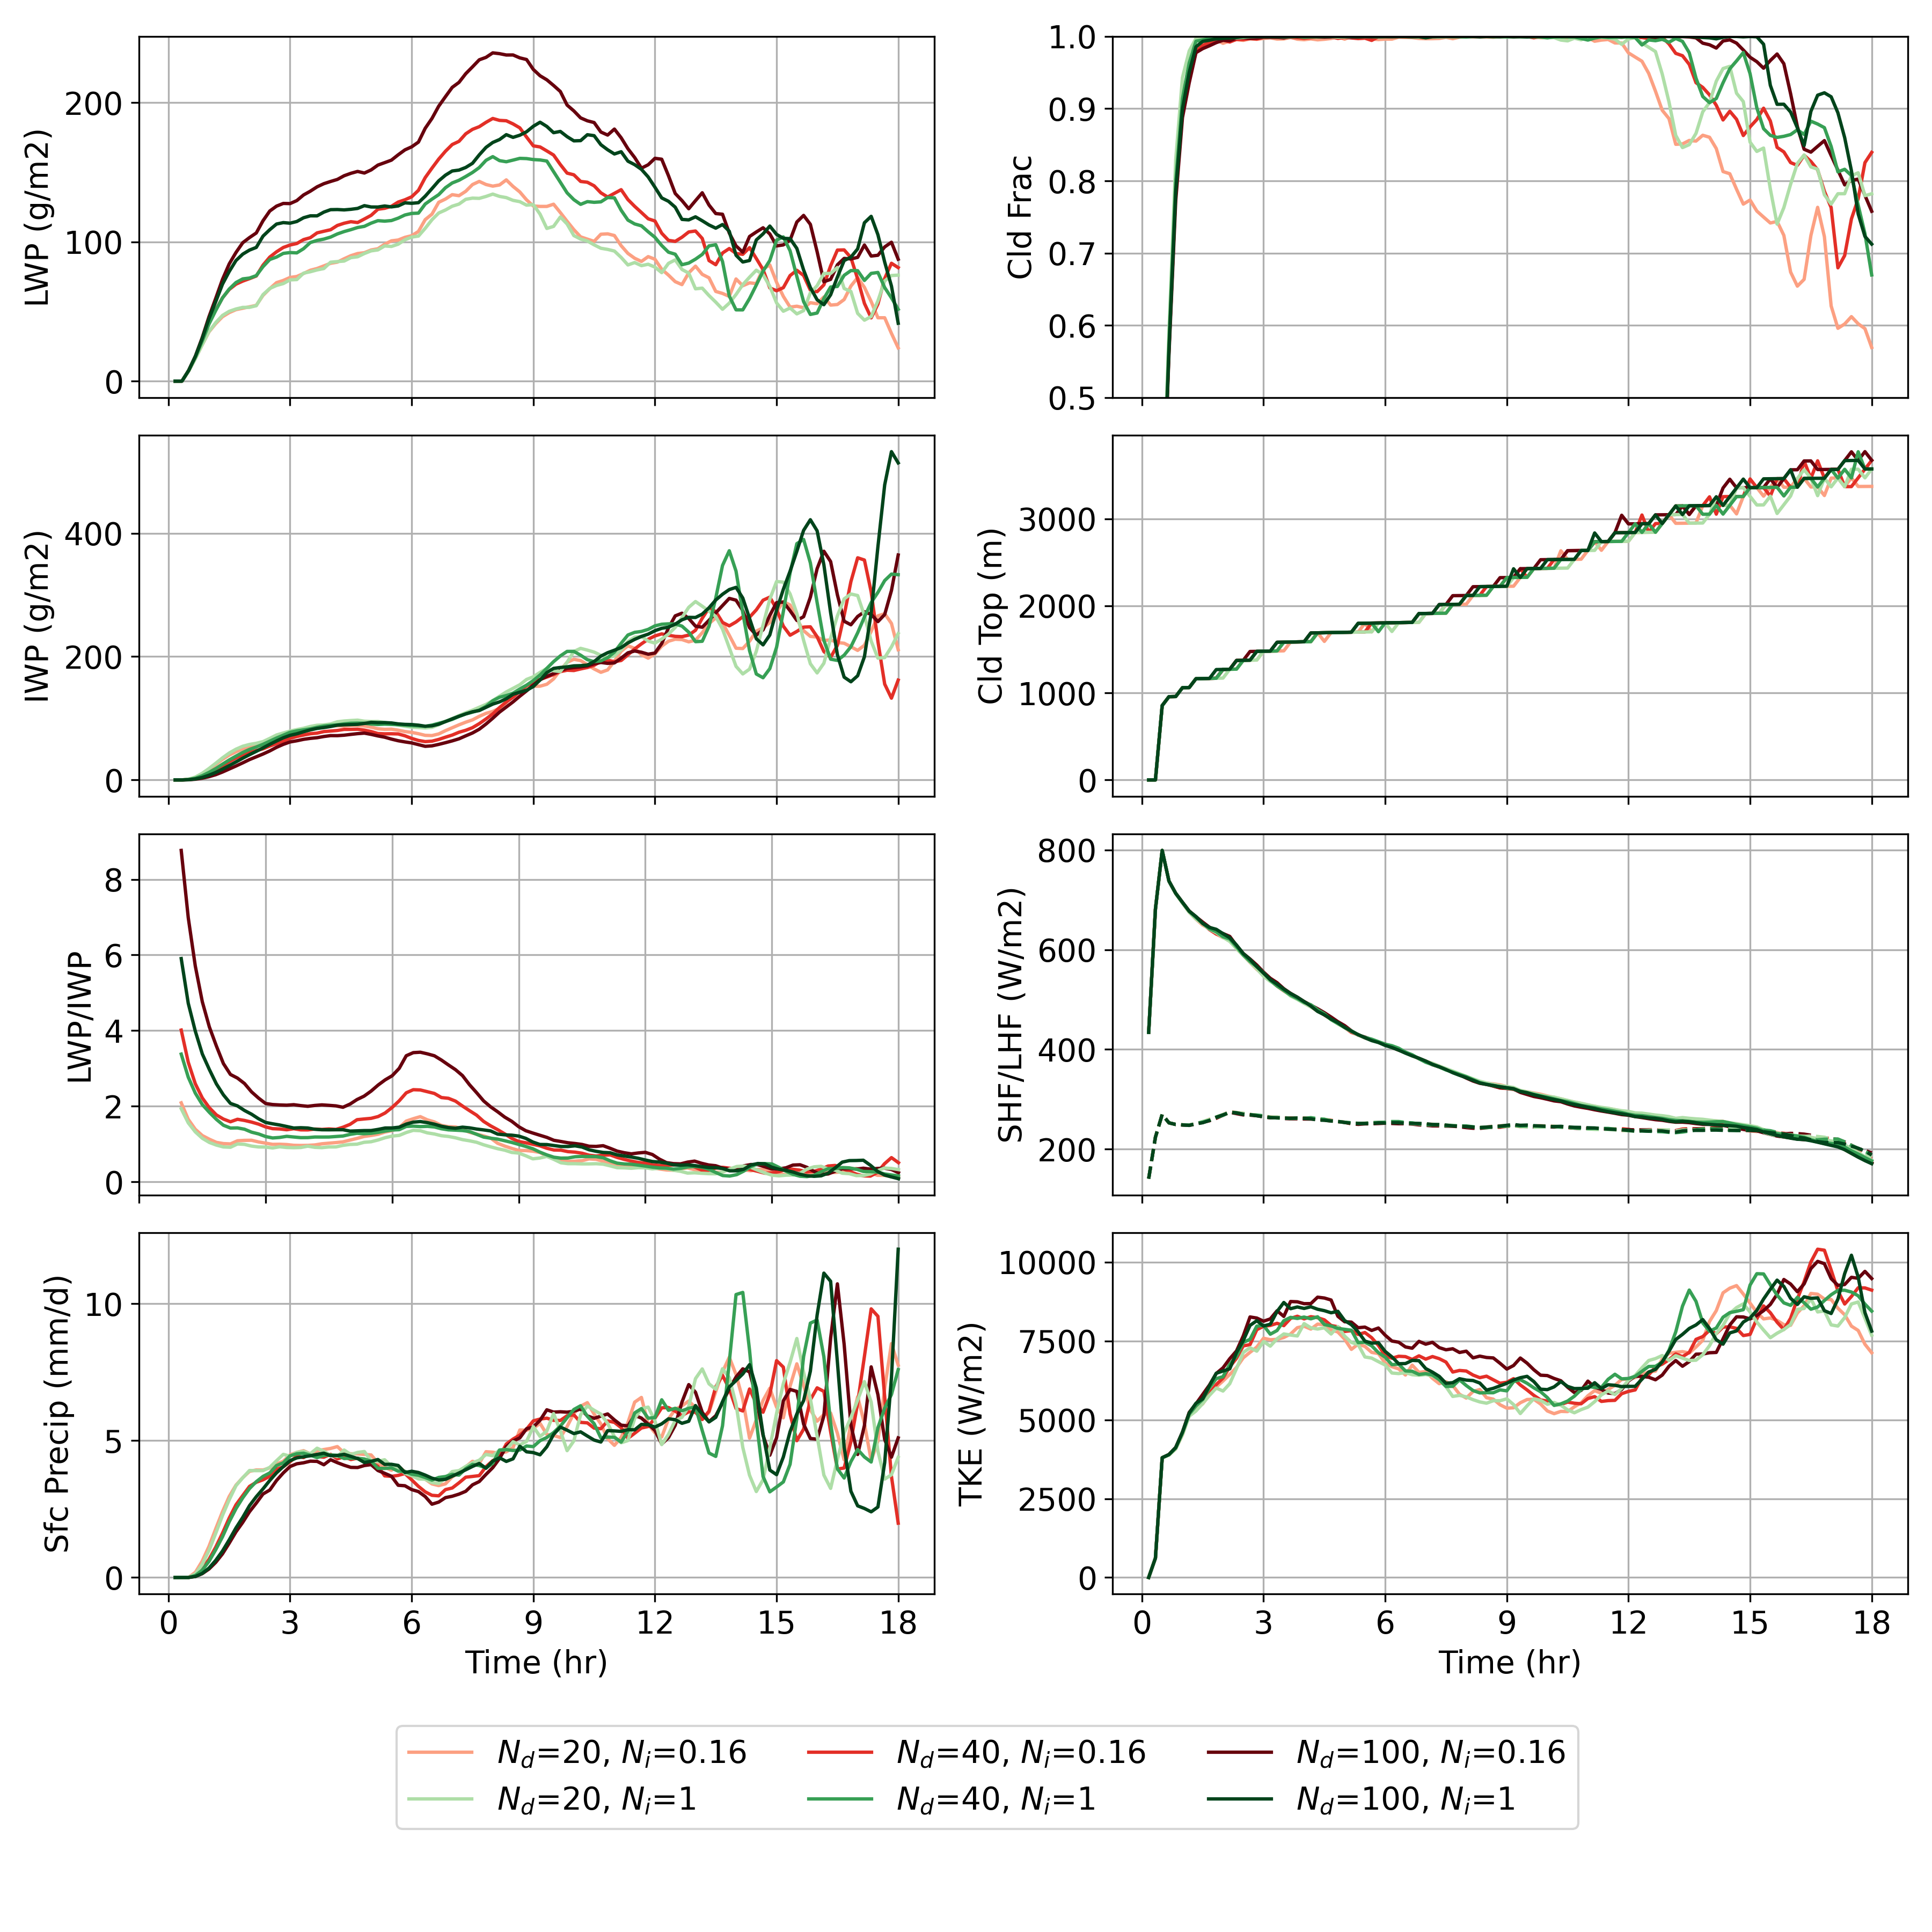
Impact of varying N_{d} and N_{i} : time series
N_{d} = (20,40,100) cm⁻³
N_{i} = (0.16,1) L⁻¹
As N_{d} increases:
Similar trends, but generally less sensitive for N_{i}=1 L⁻¹
As N_{i} increases:
Decrease in LWP
  Increase in IWP
  LWP/IWP decreases
  Delayed cloud breakup
Pan-GASS, Organization of shallow and deep convection, COMBLE Modeling Intercomparison 7

Slide 9
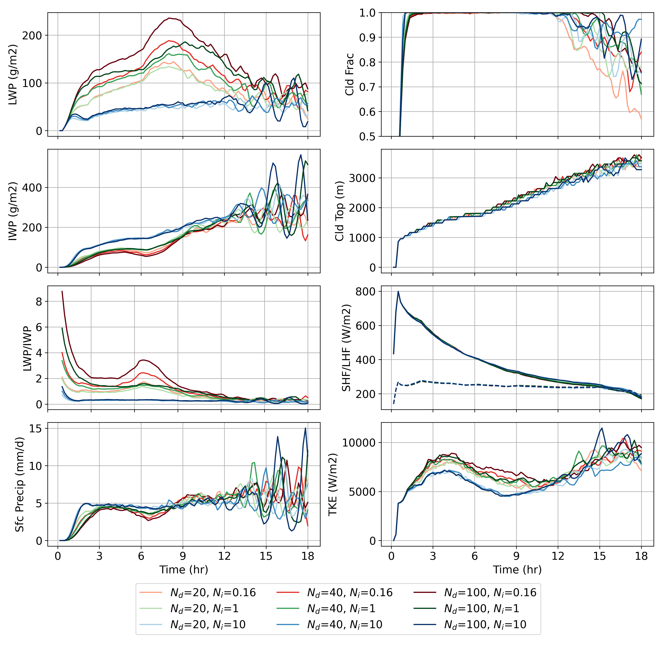
Impact of varying N_{d} and N_{i} : time series
N_{d} = (20,40,100) cm⁻³
N_{i} = (0.16,1,10) L⁻¹
As N_{d} increases:
Almost no sensitivity
As N_{i} increases:
Substantial decrease (increase) in LWP (IWP)
  Drastic LWP/IWP decrease
  Decrease in TKE
  Lower cloud tops
Pan-GASS, Organization of shallow and deep convection, COMBLE Modeling Intercomparison 8

Slide 10
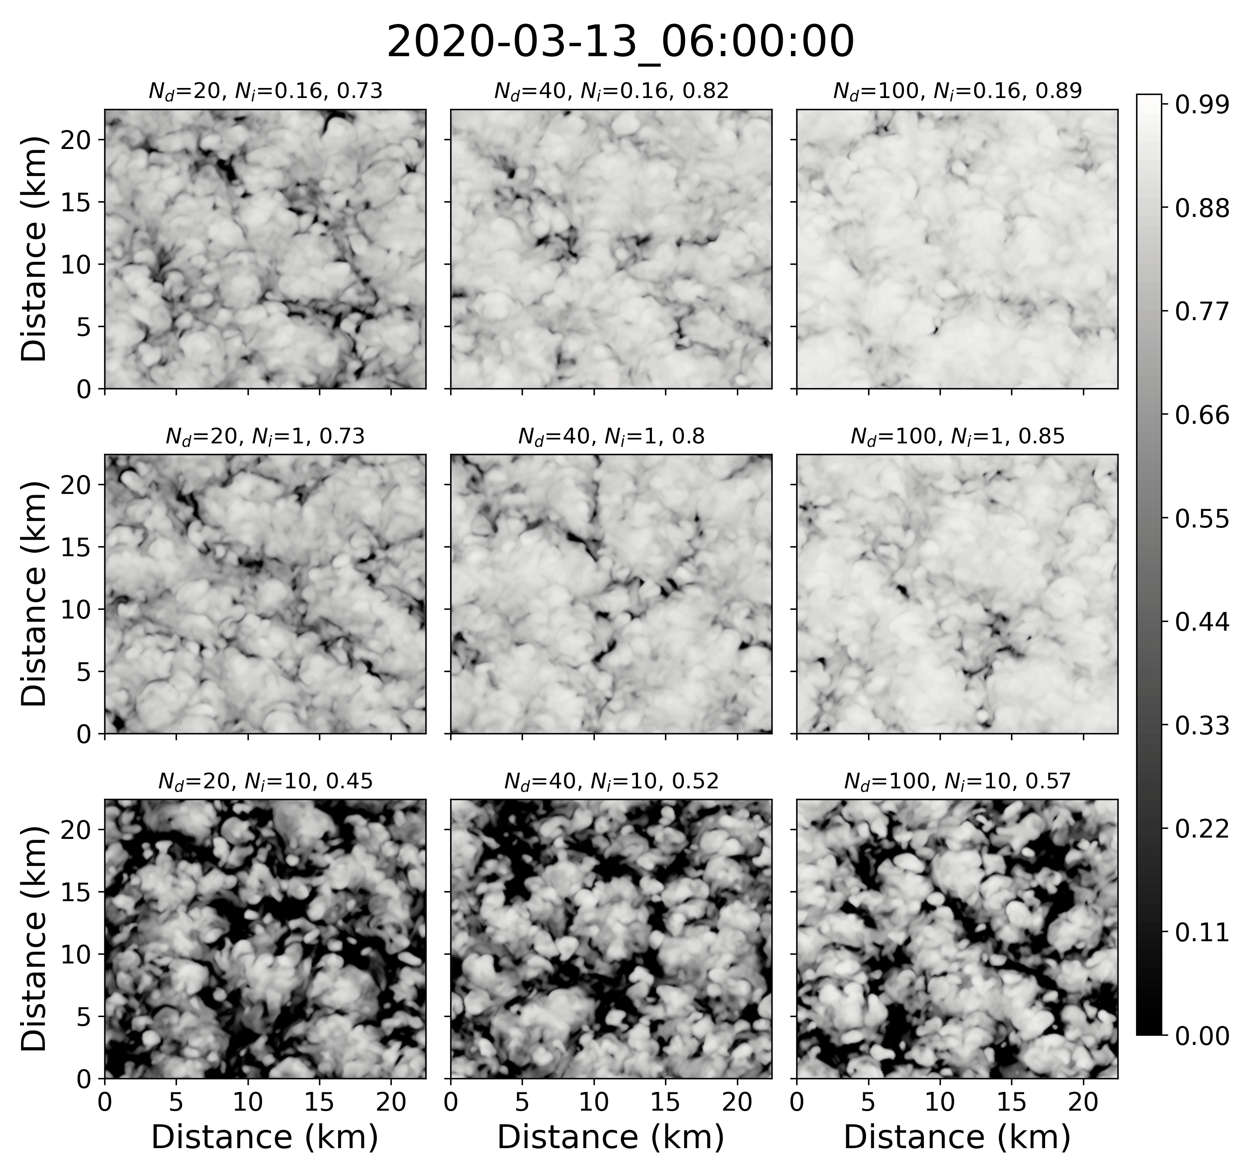
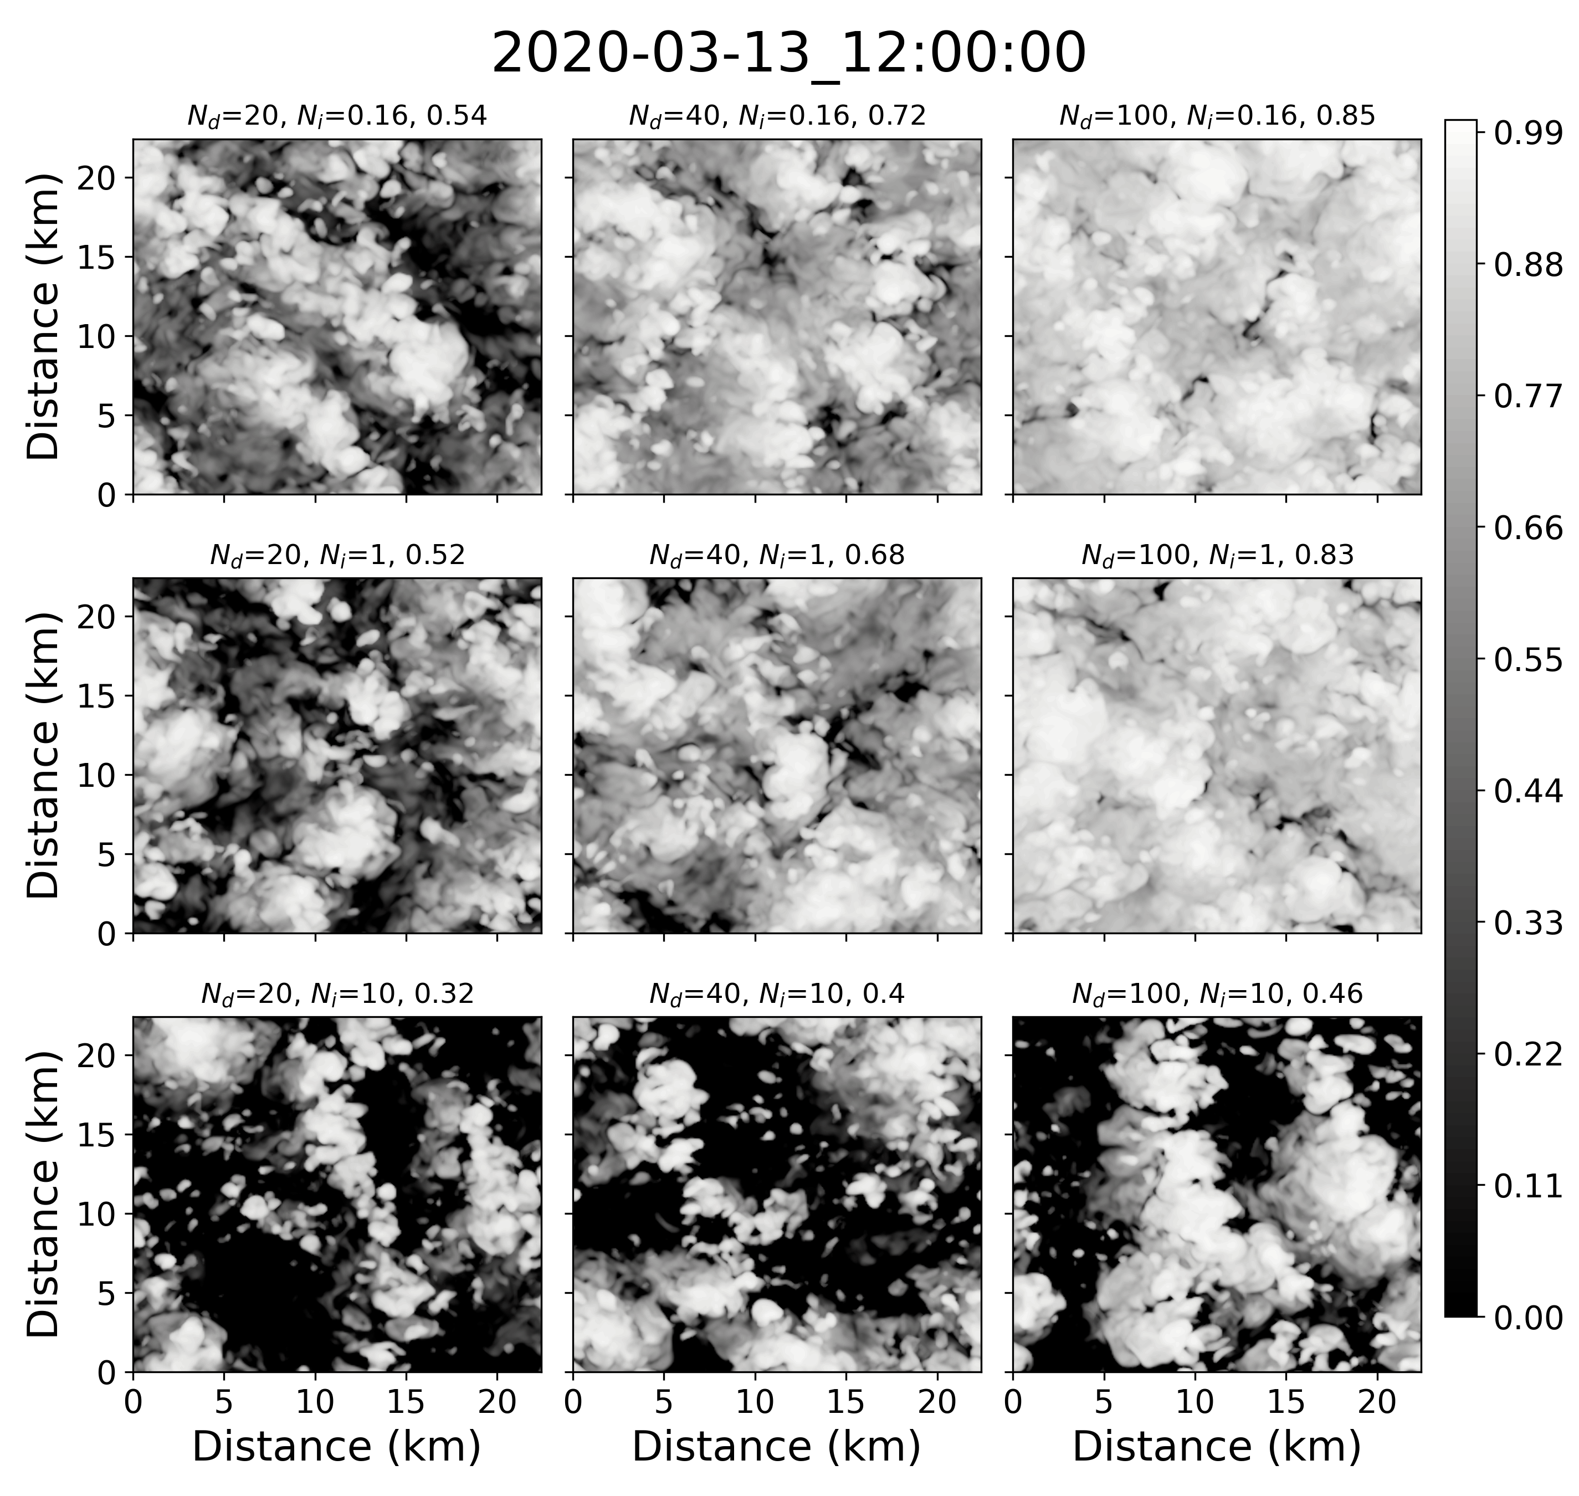
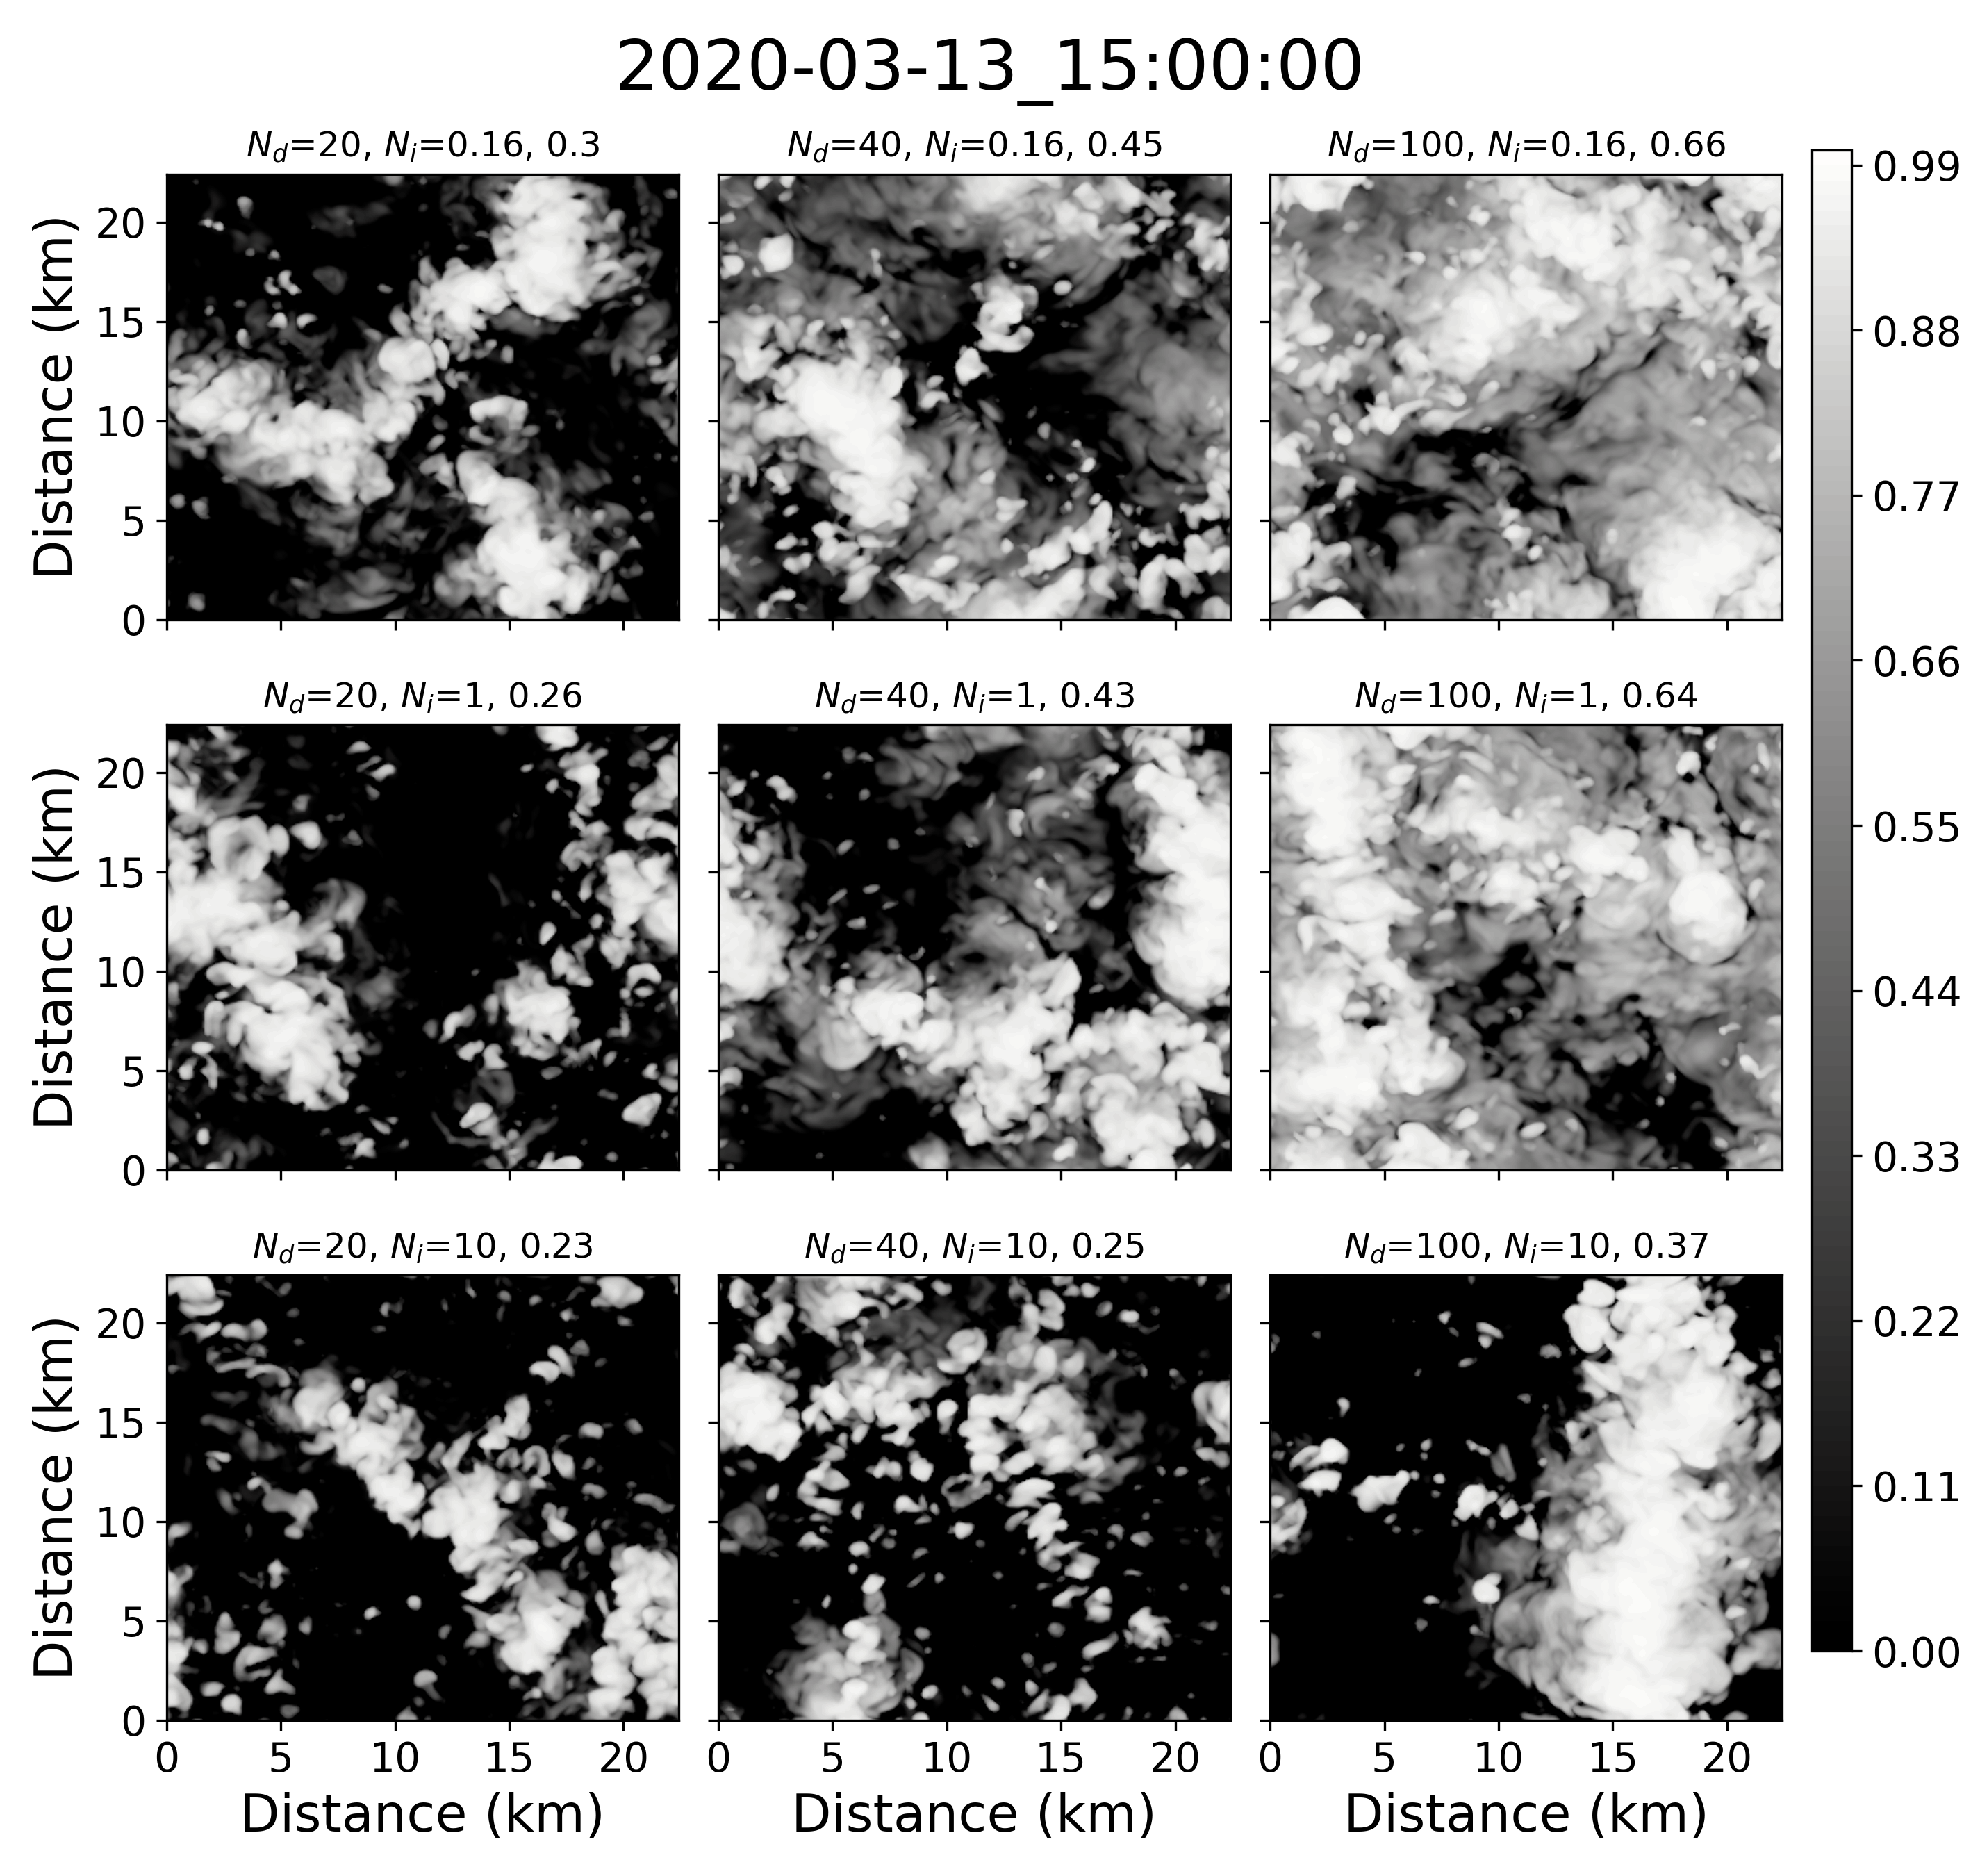
Impact of varying N_{d} and N_{i} : albedo
Increasing N_{i}
Increasing N_{d}
Smaller N_{d} leads to faster breakup
  N_{i} plays smaller role until sufficiently large
Pan-GASS, Organization of shallow and deep convection, COMBLE Modeling Intercomparison 9

Slide 11
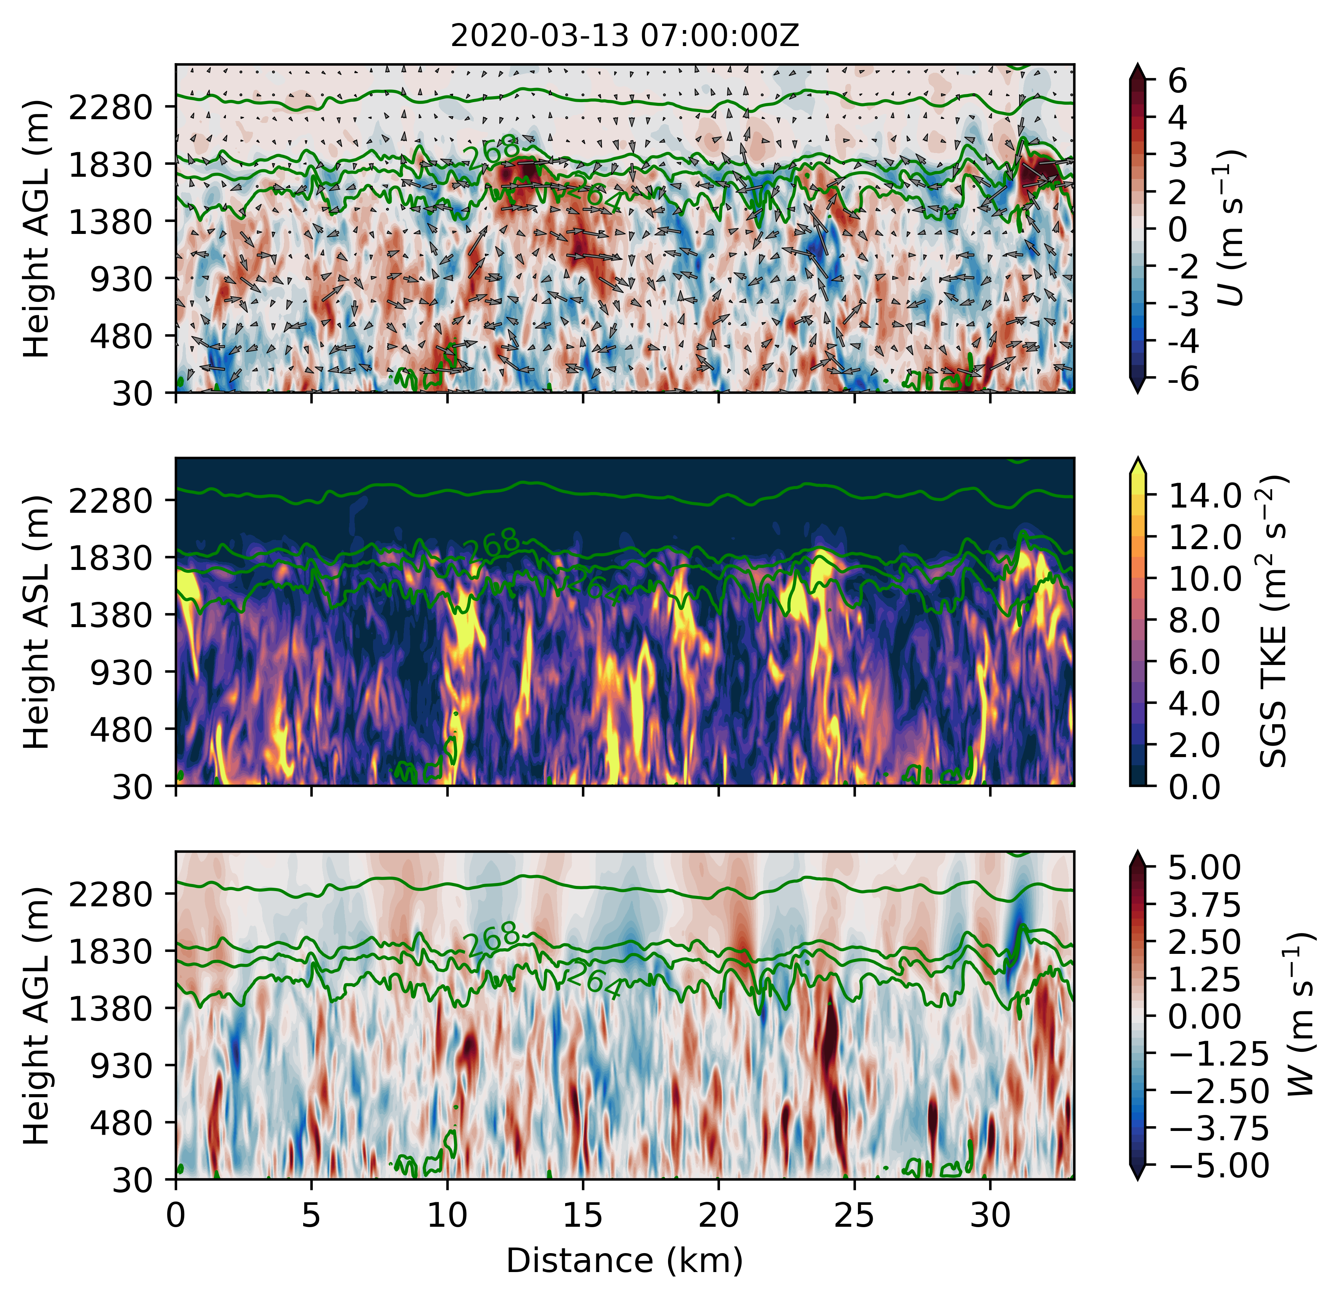
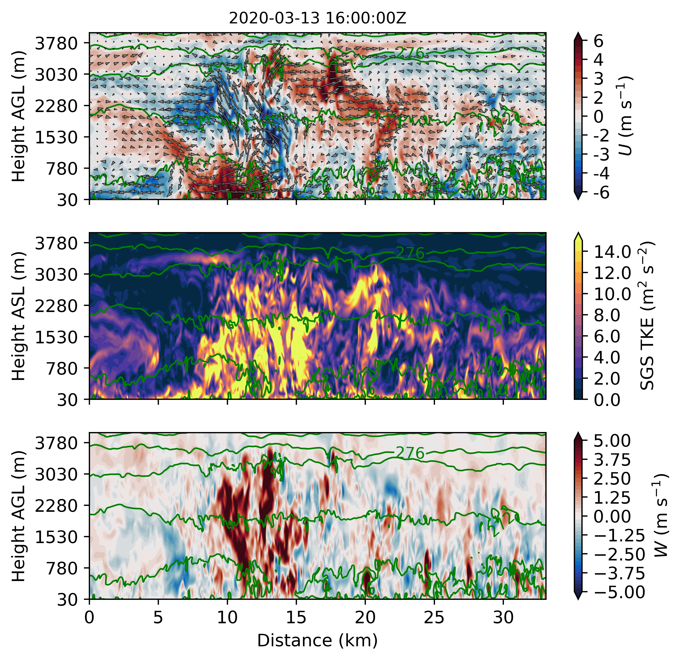
Example of roll and mature cell vertical structure
Roll
Mature cell
Normal wind (perturbation)
Circulations Δ~inner domain size
Circulations ~5 km
Small-scale turb
Large, coherent turbulent structures linked to sfc.
Small-scale updrafts tied to sfc
Vertical velocity
X-sections from inner domain
Pan-GASS, Organization of shallow and deep convection, COMBLE Modeling Intercomparison 10

Slide 12
Next steps for Lagrangian LES/SCM intercomparison
Main goals: evaluate simulated mesoscale cloud organization, as well as evolution of cloud properties, including vertical structure; elucidate role of aerosol and precipitation in controlling Arctic cloud transitions
Modeling setup: sfc. forcing/large-scale profiles from ERA5; LES domain size ~50x50x7km; Δx,y ≈ 150m; Δz ≈ 30m thru BL, stretch above; configs. for both “simple” micro. and prognostic aer.
Satellite retrievals: snapshots and time series of “domain-averaged” quantities (e.g., CTH, CTT, CWP, reflectance) corresponding to LES/SCM domain location
Ground-based obs at Andenes: detailed mesoscale organization (radar) and vertical structure of cloud properties, turbulence, dynamics, thermodynamics (radar, lidar, and in situ)
Support from DOE ARM to strengthen collaborations between observationalists and modelers: Approved access for use of Cumulus Cluster to host model outputs and perform automatic observation-model evaluation using DOE interface
We are recruiting all interested LES/SCM modelers, observationalists, and analysts! Visit
https://comble-intercomparison.readthedocs.io and sign up to be informed about upcoming plans, including webinar (tentatively end of Summer/early Fall 2022)
Pan-GASS, Organization of shallow and deep convection, COMBLE Modeling Intercomparison 11

Slide 13

Thank you !
Questions, comments, or collaborations:
tjuliano@ucar.edu
Pan-GASS, Organization of shallow and deep convection, COMBLE Modeling Intercomparison

Slide 14
Extra Slides
Pan-GASS, Organization of shallow and deep convection, COMBLE Modeling Intercomparison

Slide 15
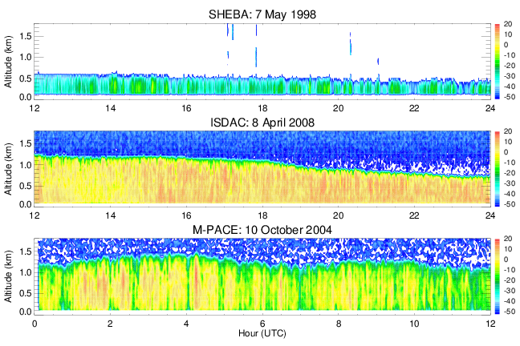
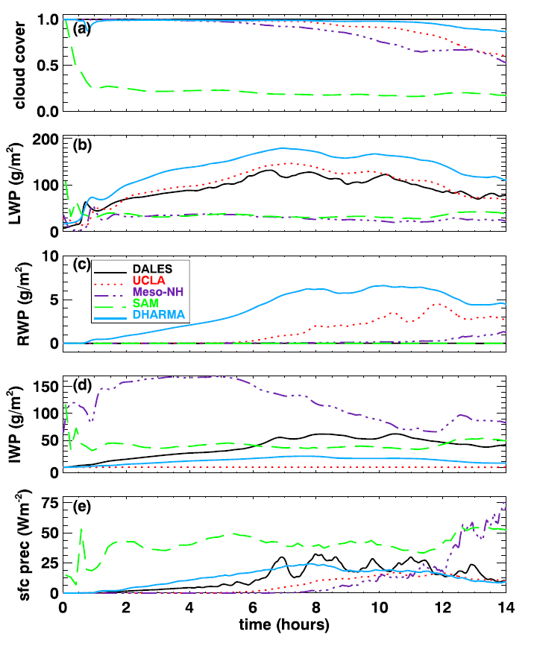
Very brief history on Arctic mixed-phase cloud model intercomparisons
Typically large-eddy simulations (LES) with an Eulerian approach: M-PACE (Klein et al. 2009), SHEBA (Morrison et al. 2011), ISDAC (Ovchinnikov et al. 2014) – Beaufort and Chukchi Seas
More recently, CONSTRAIN (de Roode et al. 2019) used Lagrangian approach – North Atlantic Ocean
de Roode
et al. (2019)
Fridlind and Ackerman (2018, Chp. 7)
Pan-GASS, Organization of shallow and deep convection, COMBLE Modeling Intercomparison

Slide 16
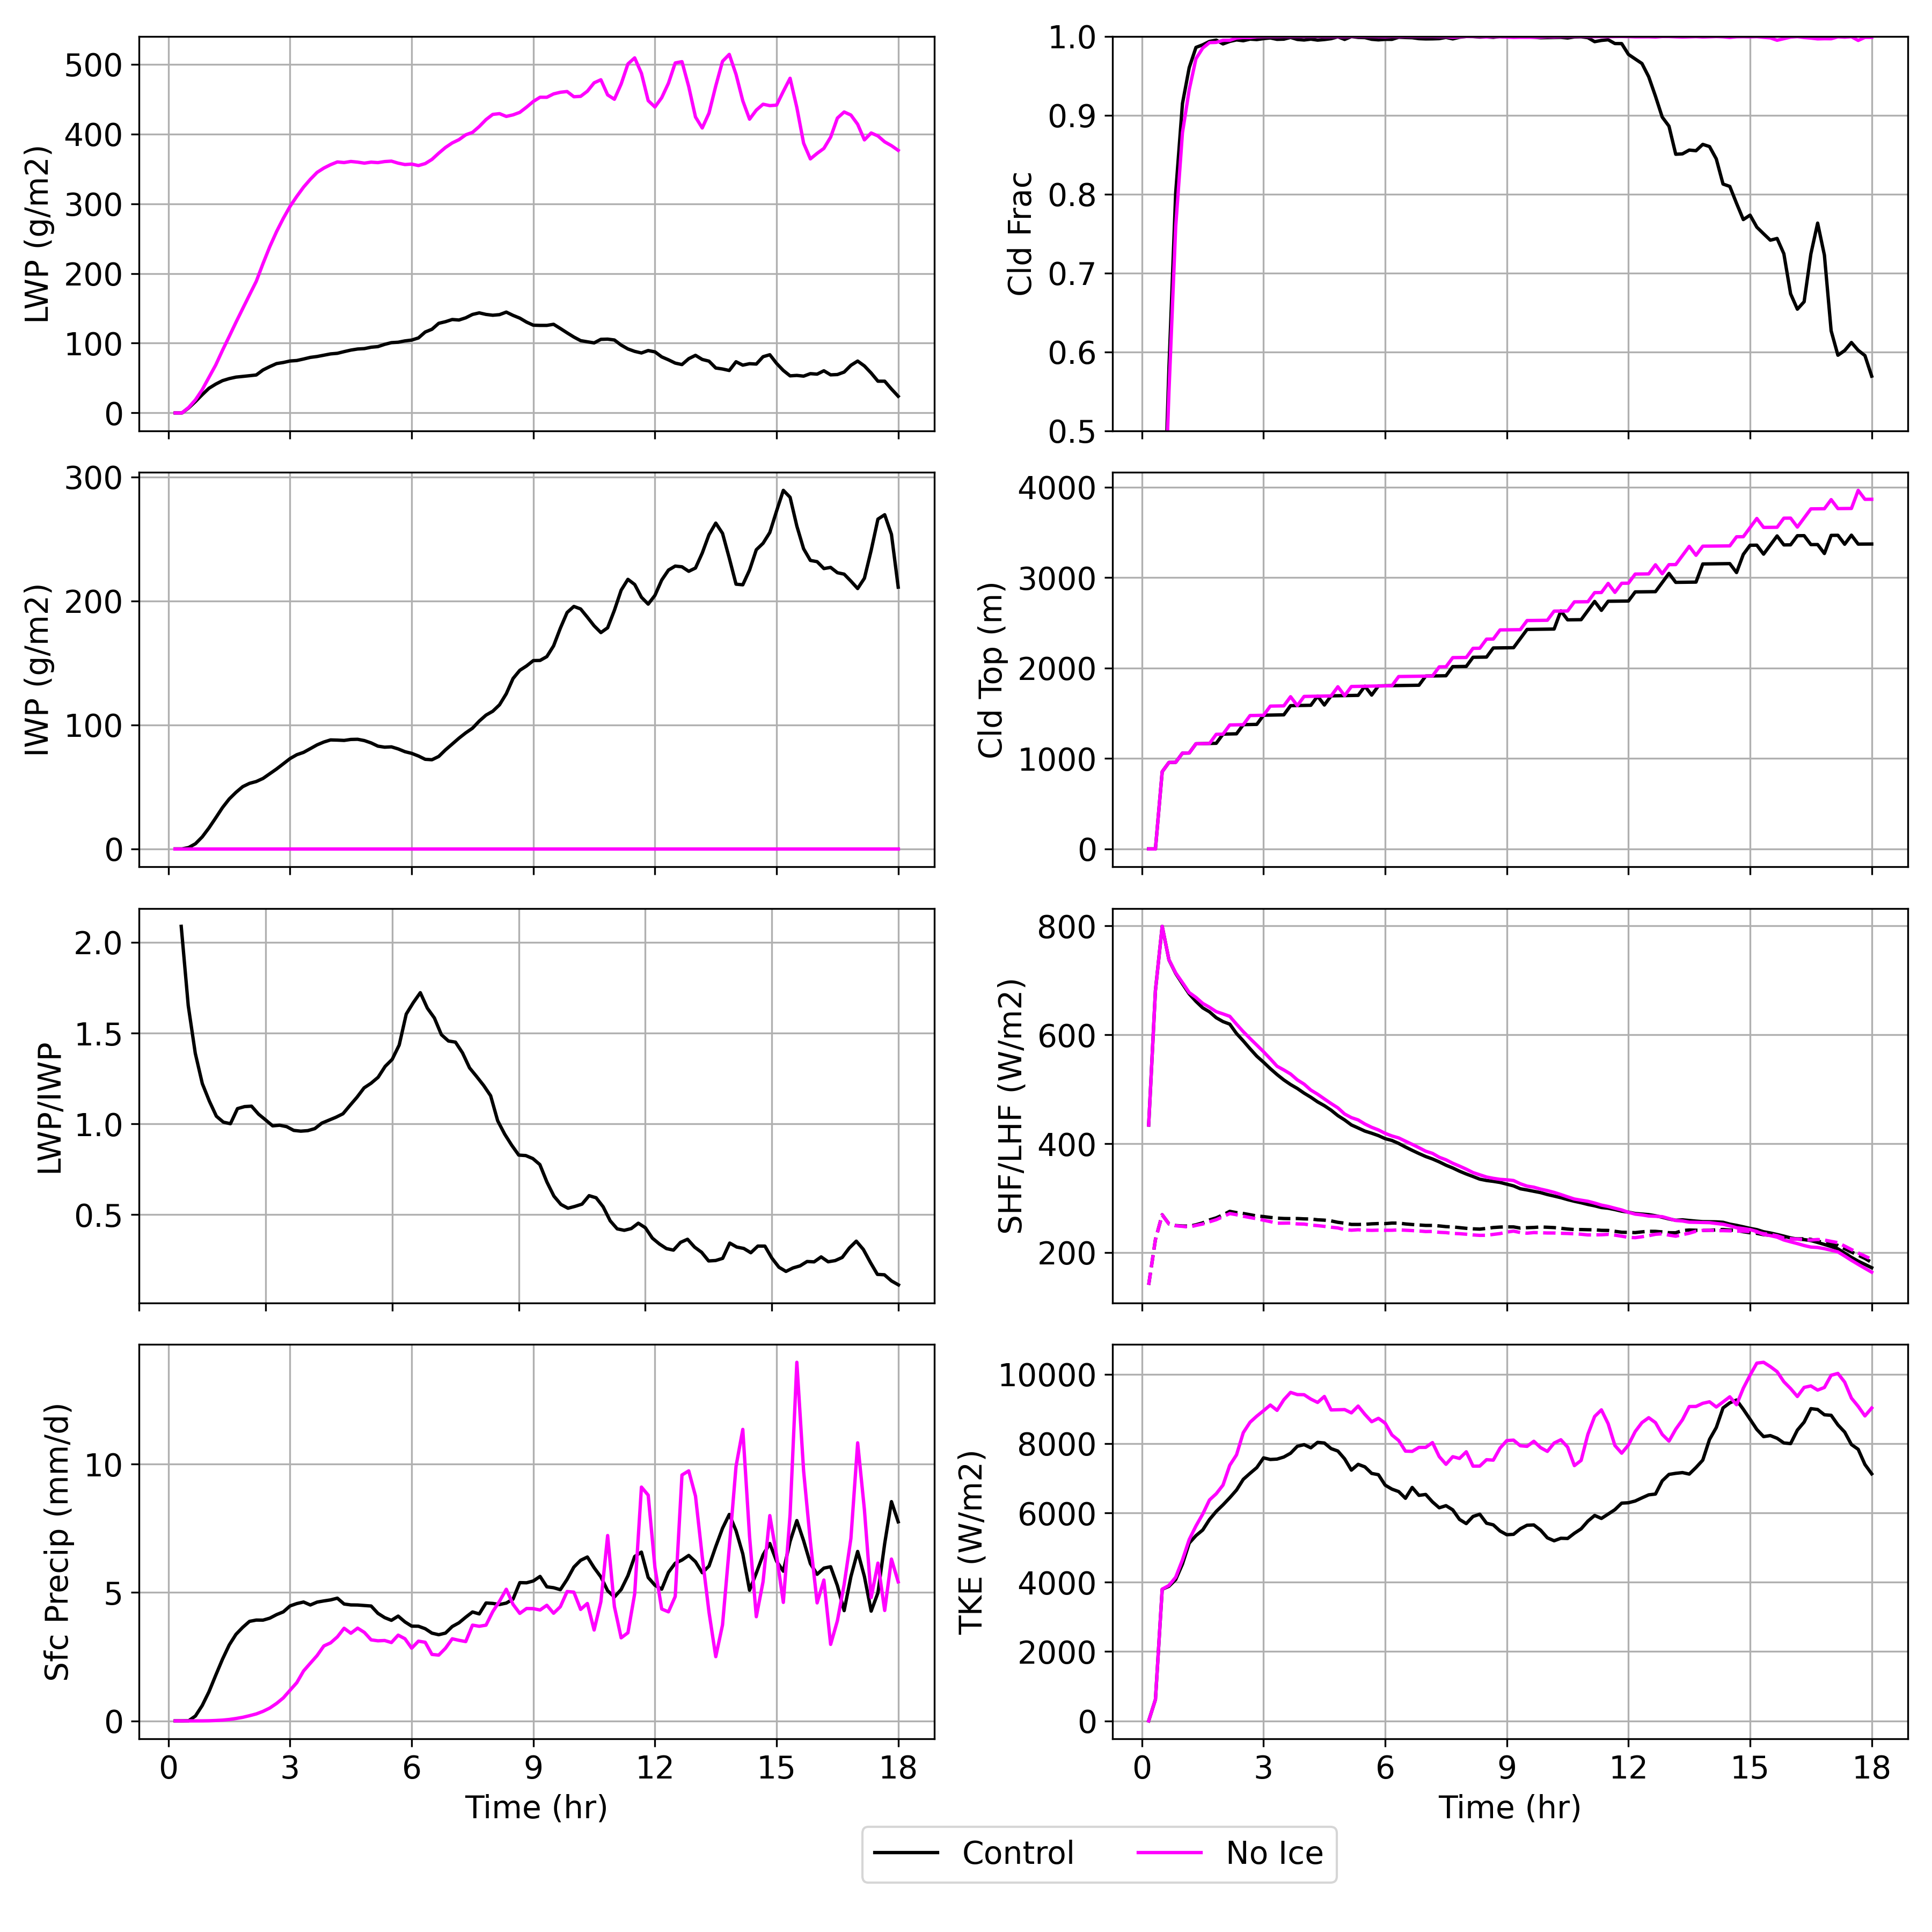
Impact of shutting down ice processes: time series
Control: N_{d} = 20 cm⁻³, N_{i} = 0.16 L⁻¹
Suppressing ice processes:
3-4x increase in LWP
  Delay in precipitation onset
  Increase in TKE
  Increase in cloud top
  No cloud breakup
Pan-GASS, Organization of shallow and deep convection, COMBLE Modeling Intercomparison

Slide 17
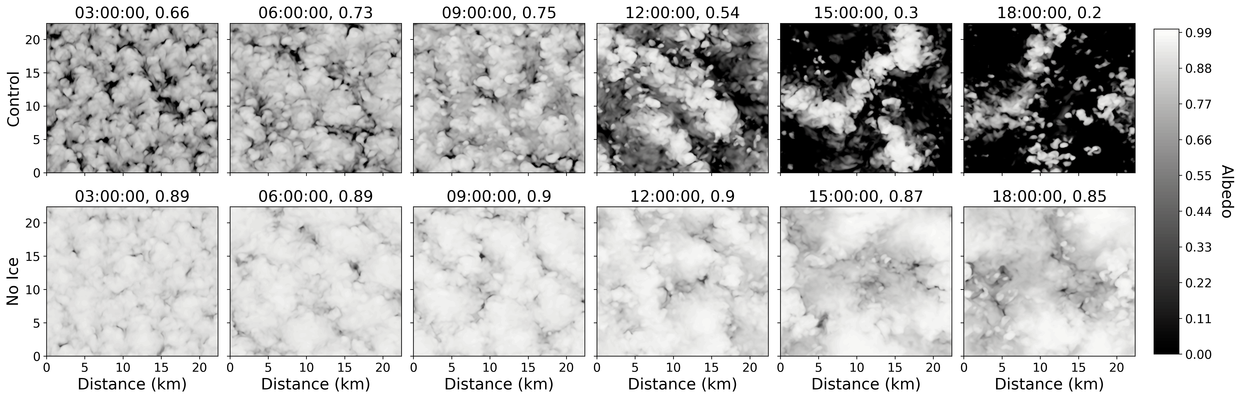
Impact of shutting down ice processes: albedo
Control: N_{d} = 20 cm⁻³, N_{i} = 0.16 L⁻¹
Pan-GASS, Organization of shallow and deep convection, COMBLE Modeling Intercomparison

Slide 18
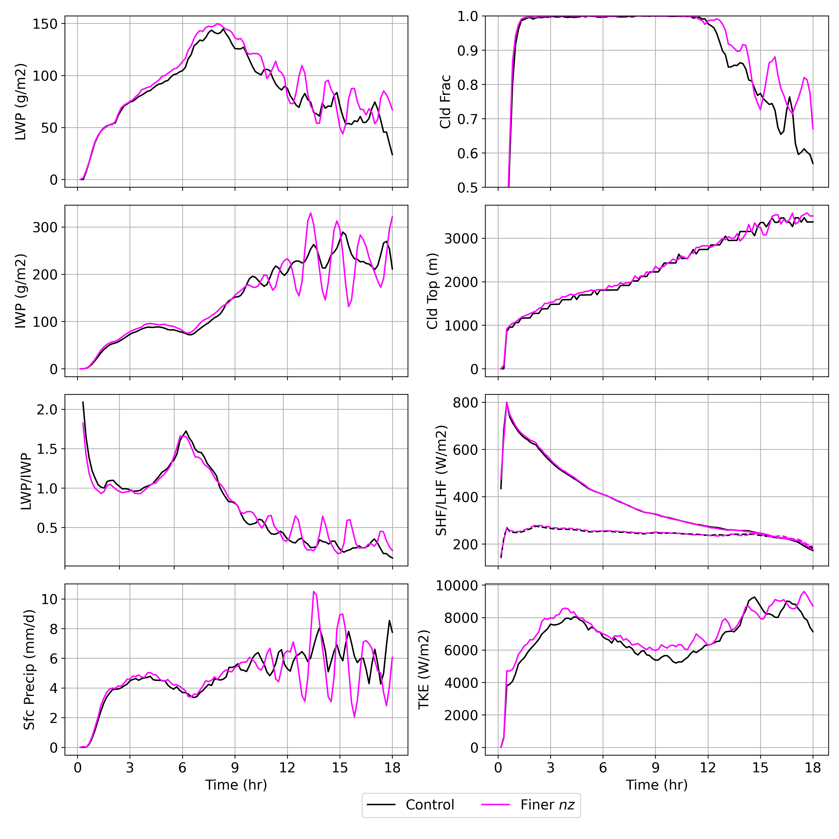
Impact of additional vertical levels
Pan-GASS, Organization of shallow and deep convection, COMBLE Modeling Intercomparison

Slide 19
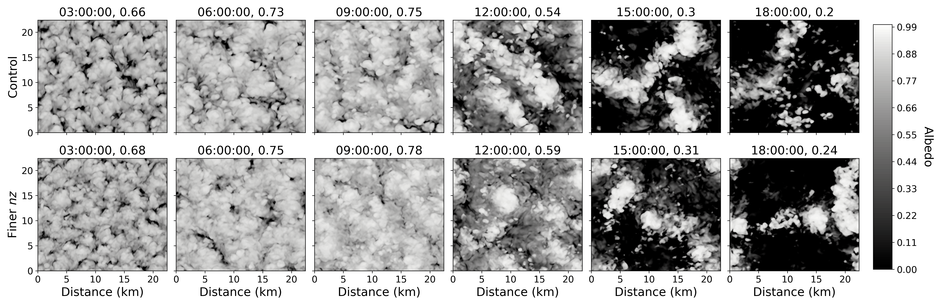
Impact of additional vertical levels
Pan-GASS, Organization of shallow and deep convection, COMBLE Modeling Intercomparison

Slide 20
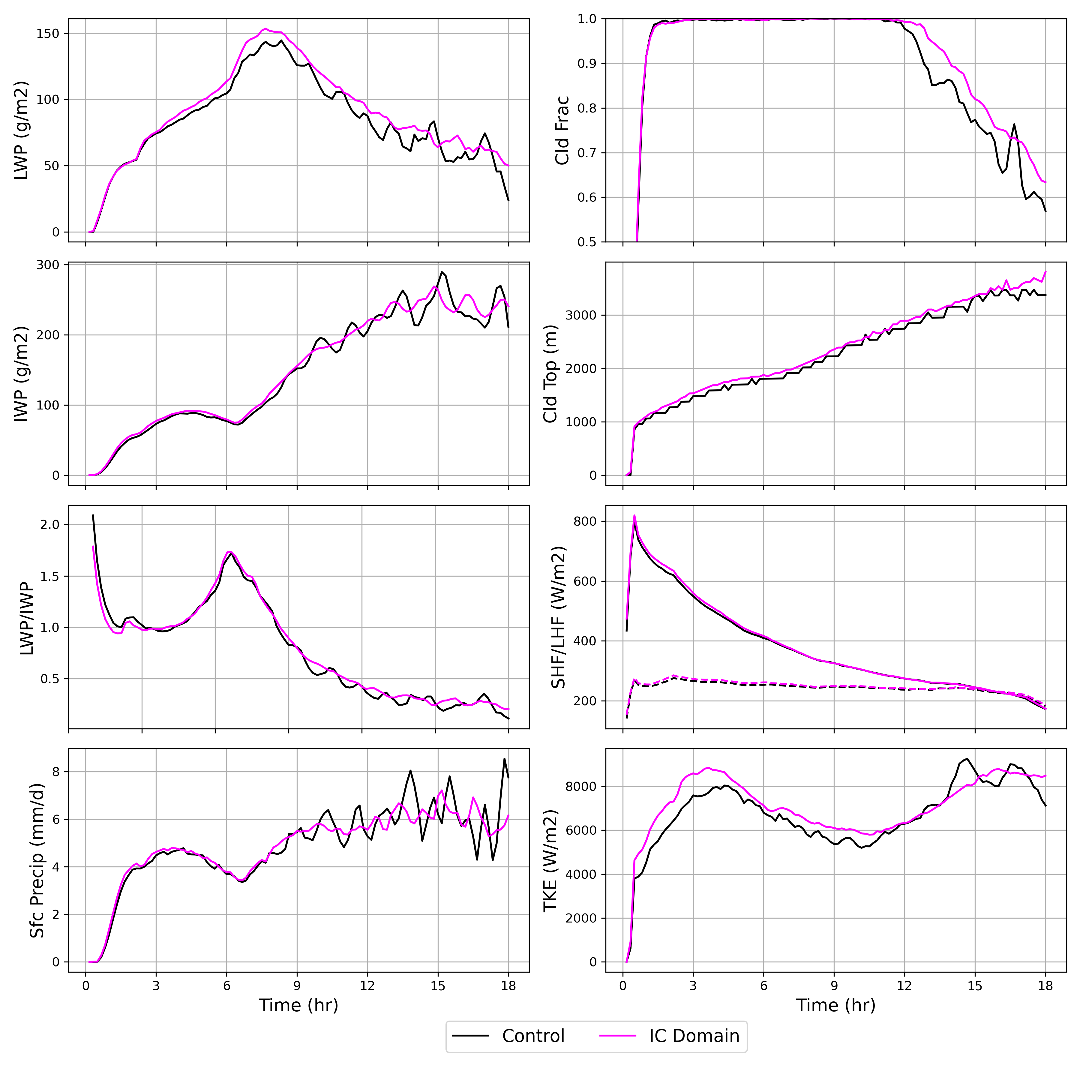
Impact of Strawman Intercomparison domain
Pan-GASS, Organization of shallow and deep convection, COMBLE Modeling Intercomparison

Slide 21
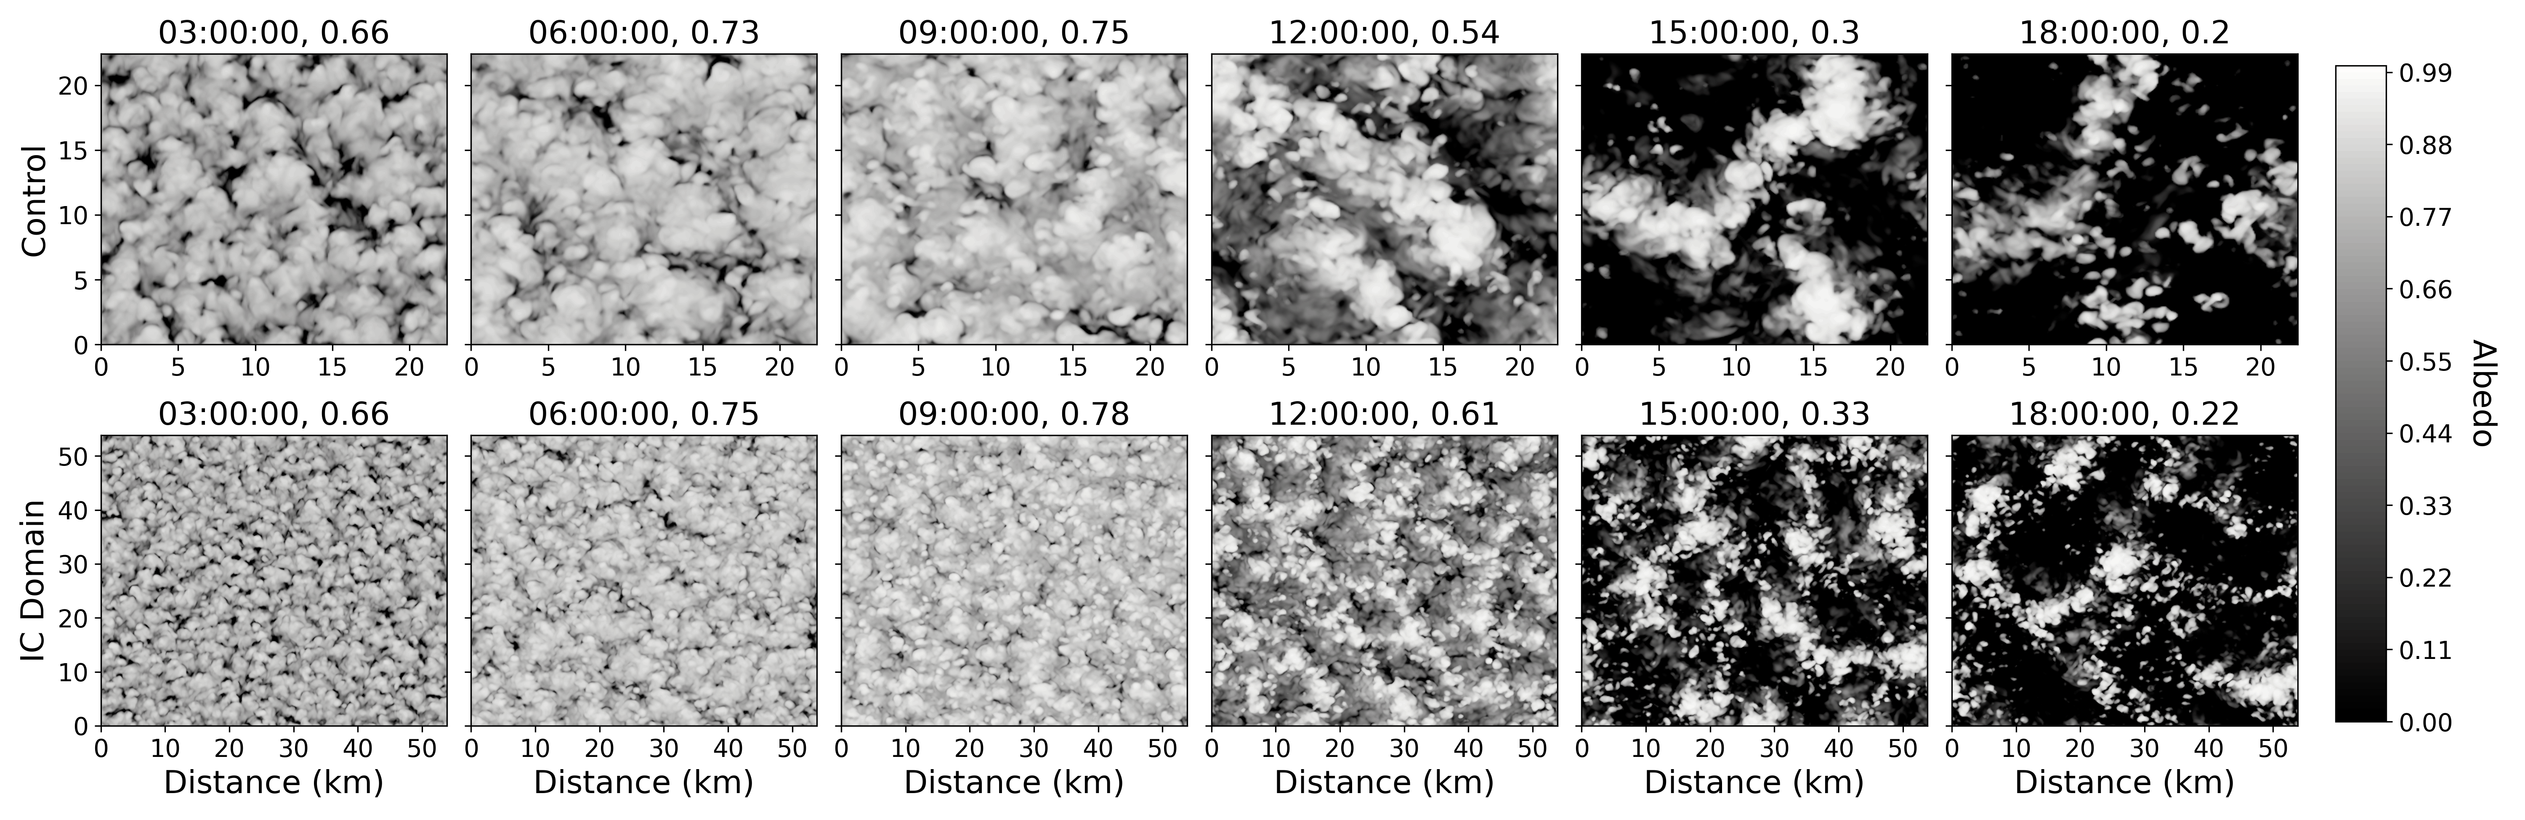
Impact of Strawman Intercomparison domain
Pan-GASS, Organization of shallow and deep convection, COMBLE Modeling Intercomparison

Slide 22
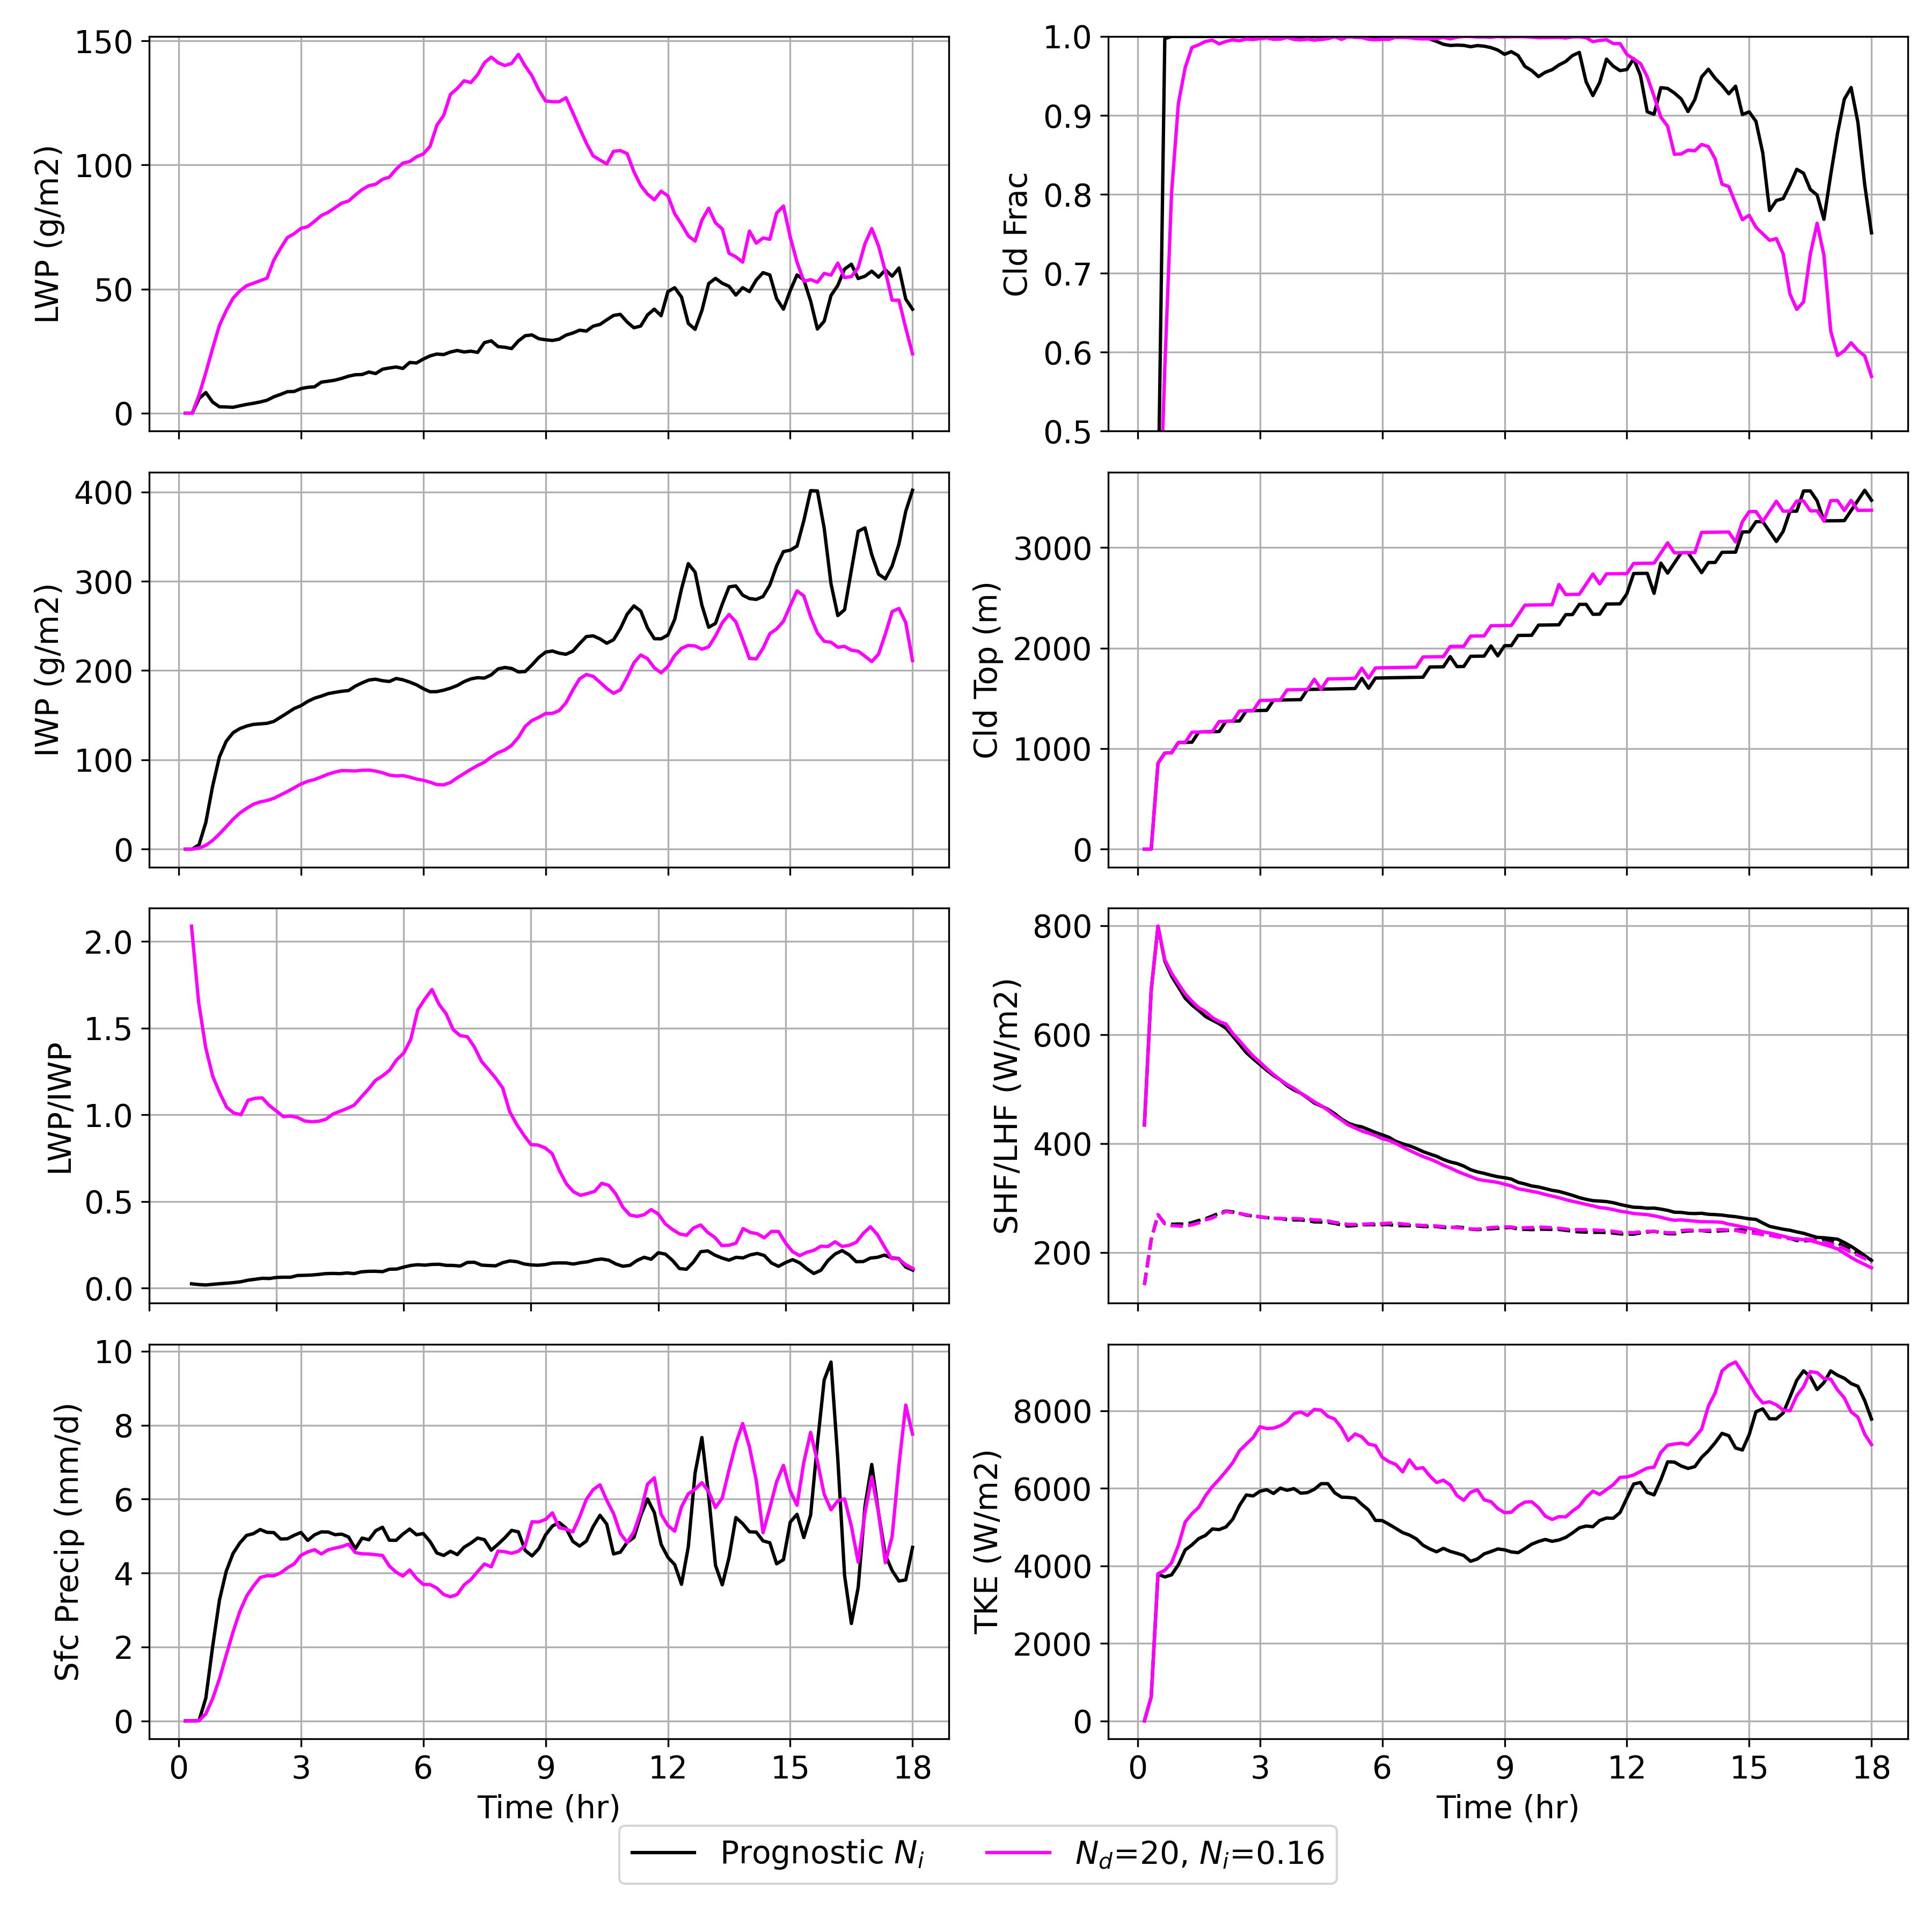
Impact of Prognostic N_{i}
Pan-GASS, Organization of shallow and deep convection, COMBLE Modeling Intercomparison

Slide 23
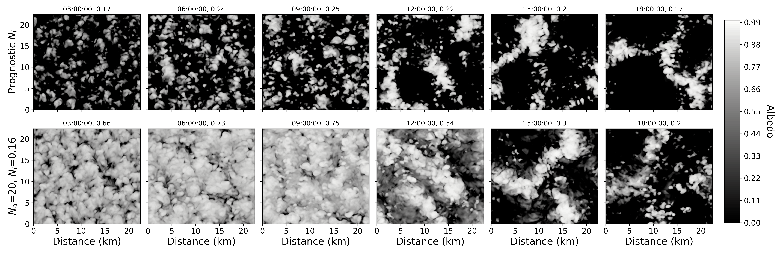
Impact of Prognostic N_{i}
Pan-GASS, Organization of shallow and deep convection, COMBLE Modeling Intercomparison

Slide 24
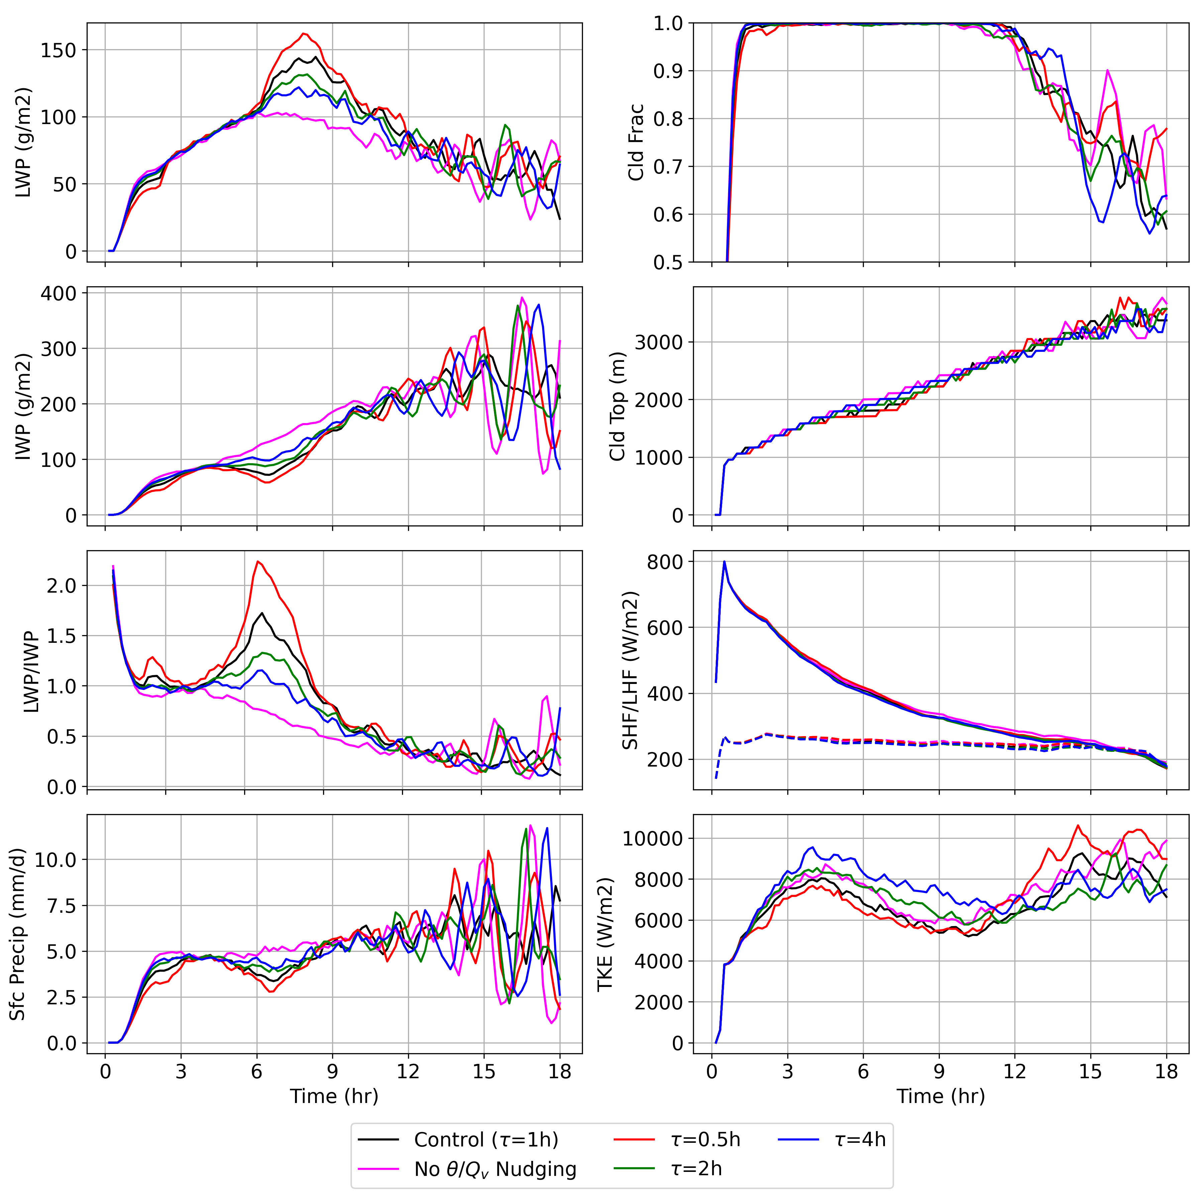
Impact of nudging options
Pan-GASS, Organization of shallow and deep convection, COMBLE Modeling Intercomparison

Slide 25
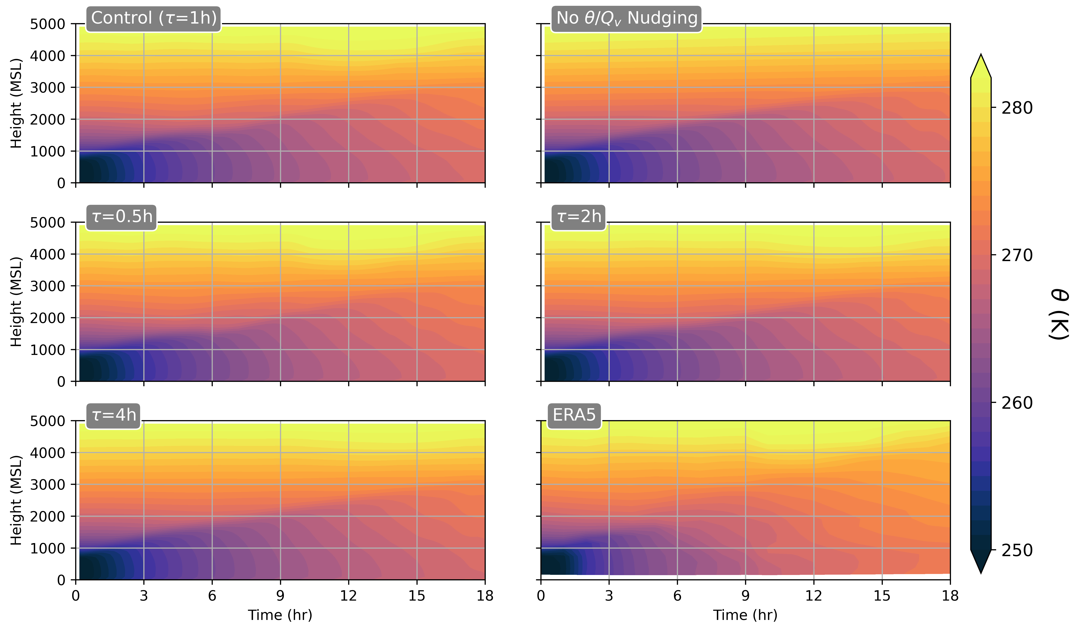
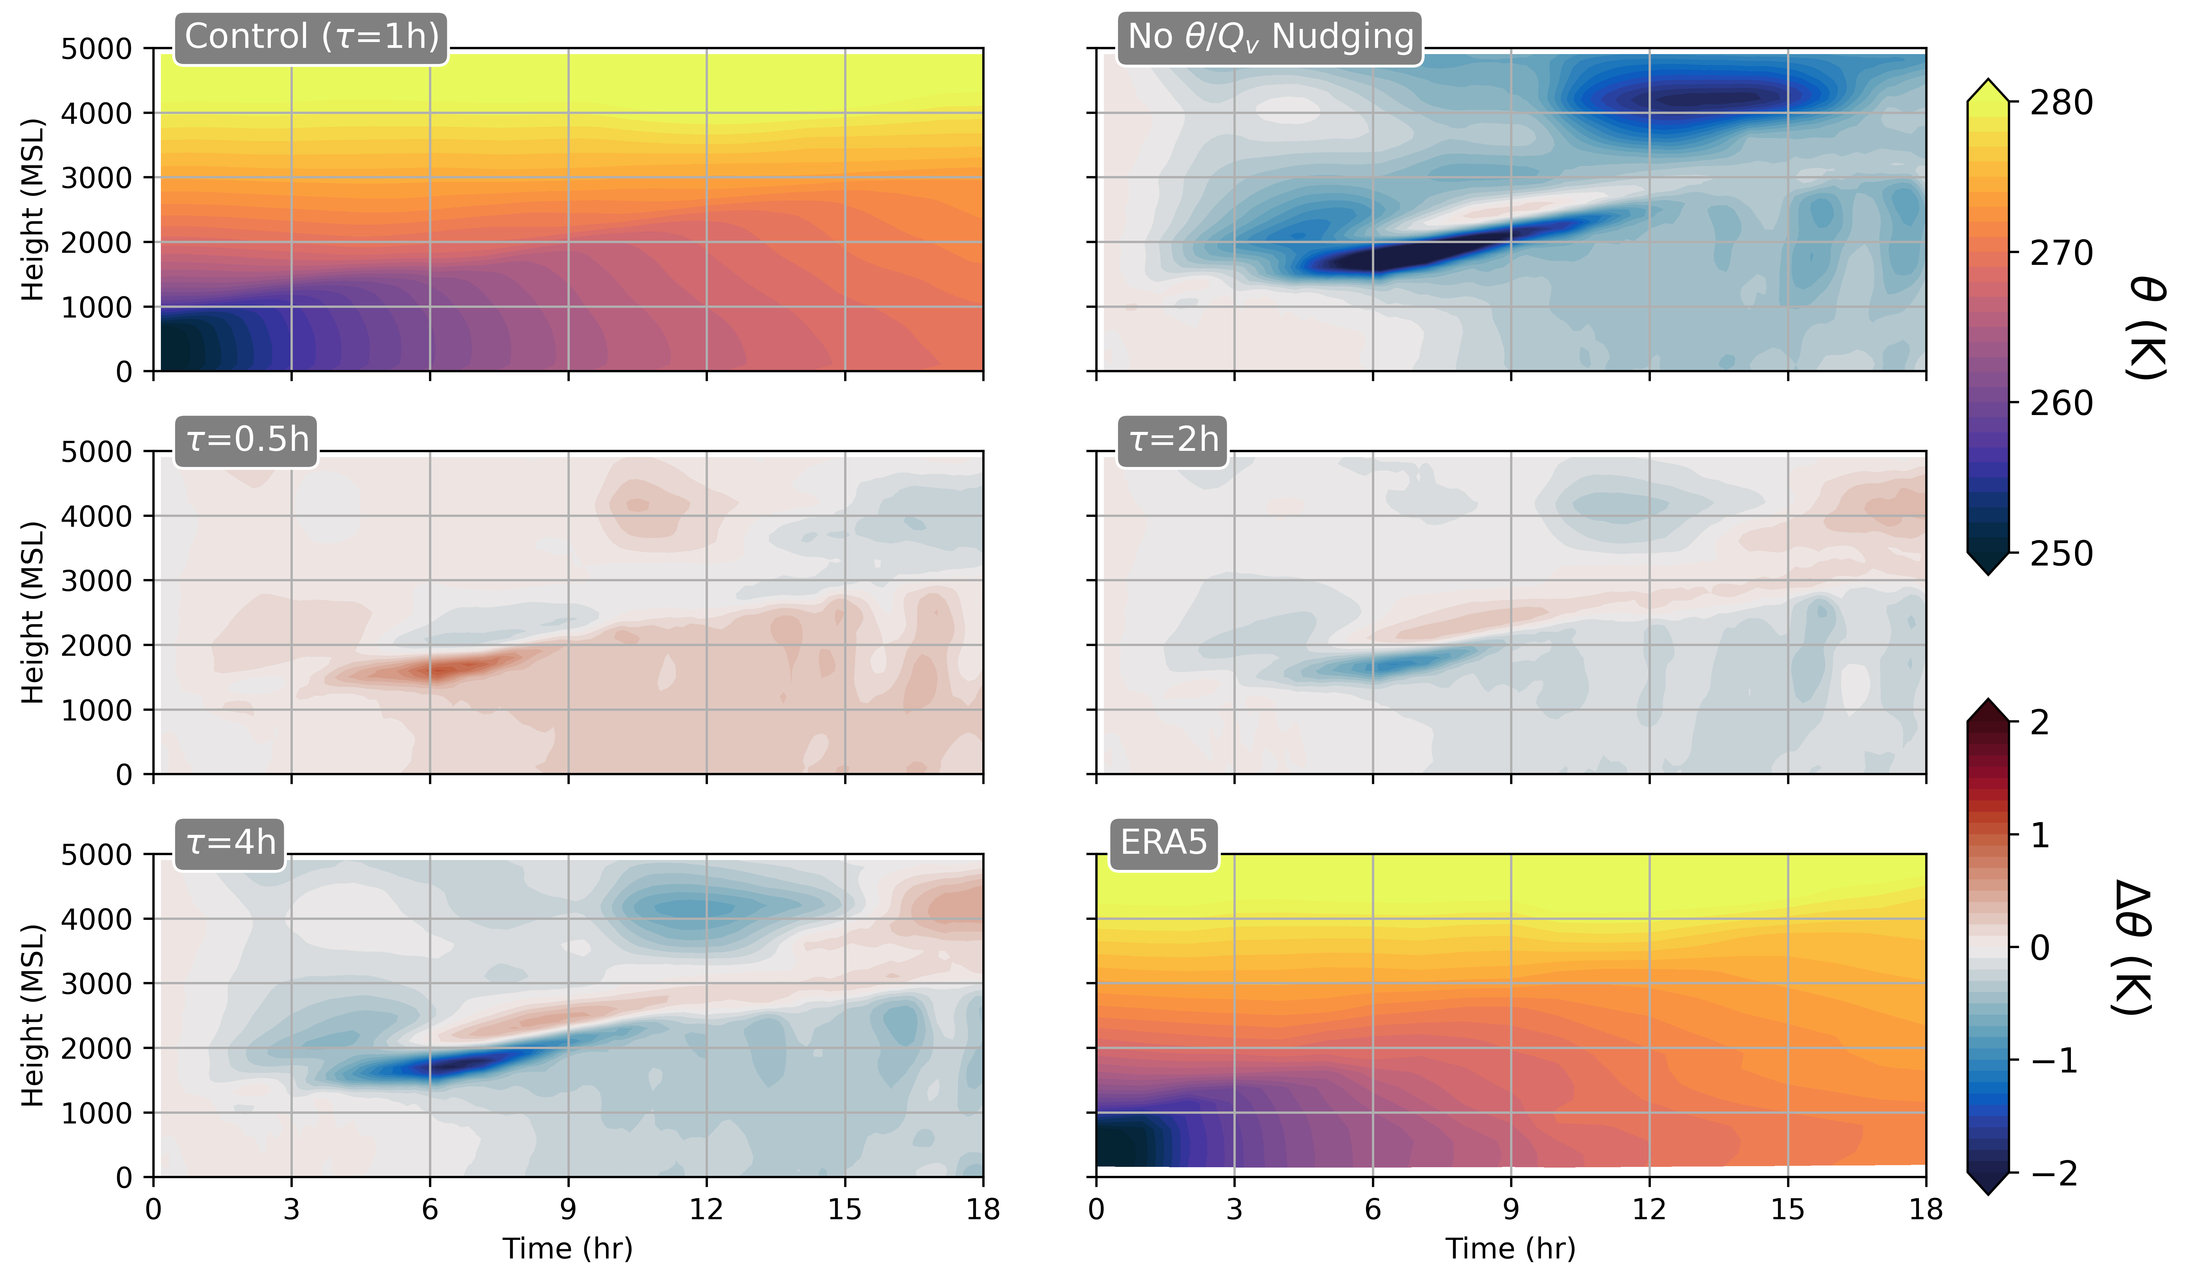
Impact of nudging options
Absolute magnitudes
Sensitivity minus Control
Pan-GASS, Organization of shallow and deep convection, COMBLE Modeling Intercomparison

Slide 26
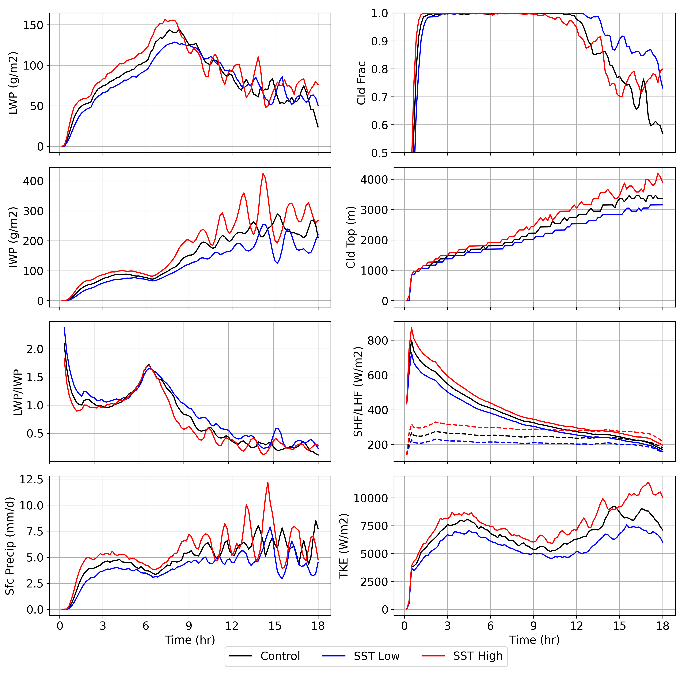
Impact of SST
Pan-GASS, Organization of shallow and deep convection, COMBLE Modeling Intercomparison

Slide 27
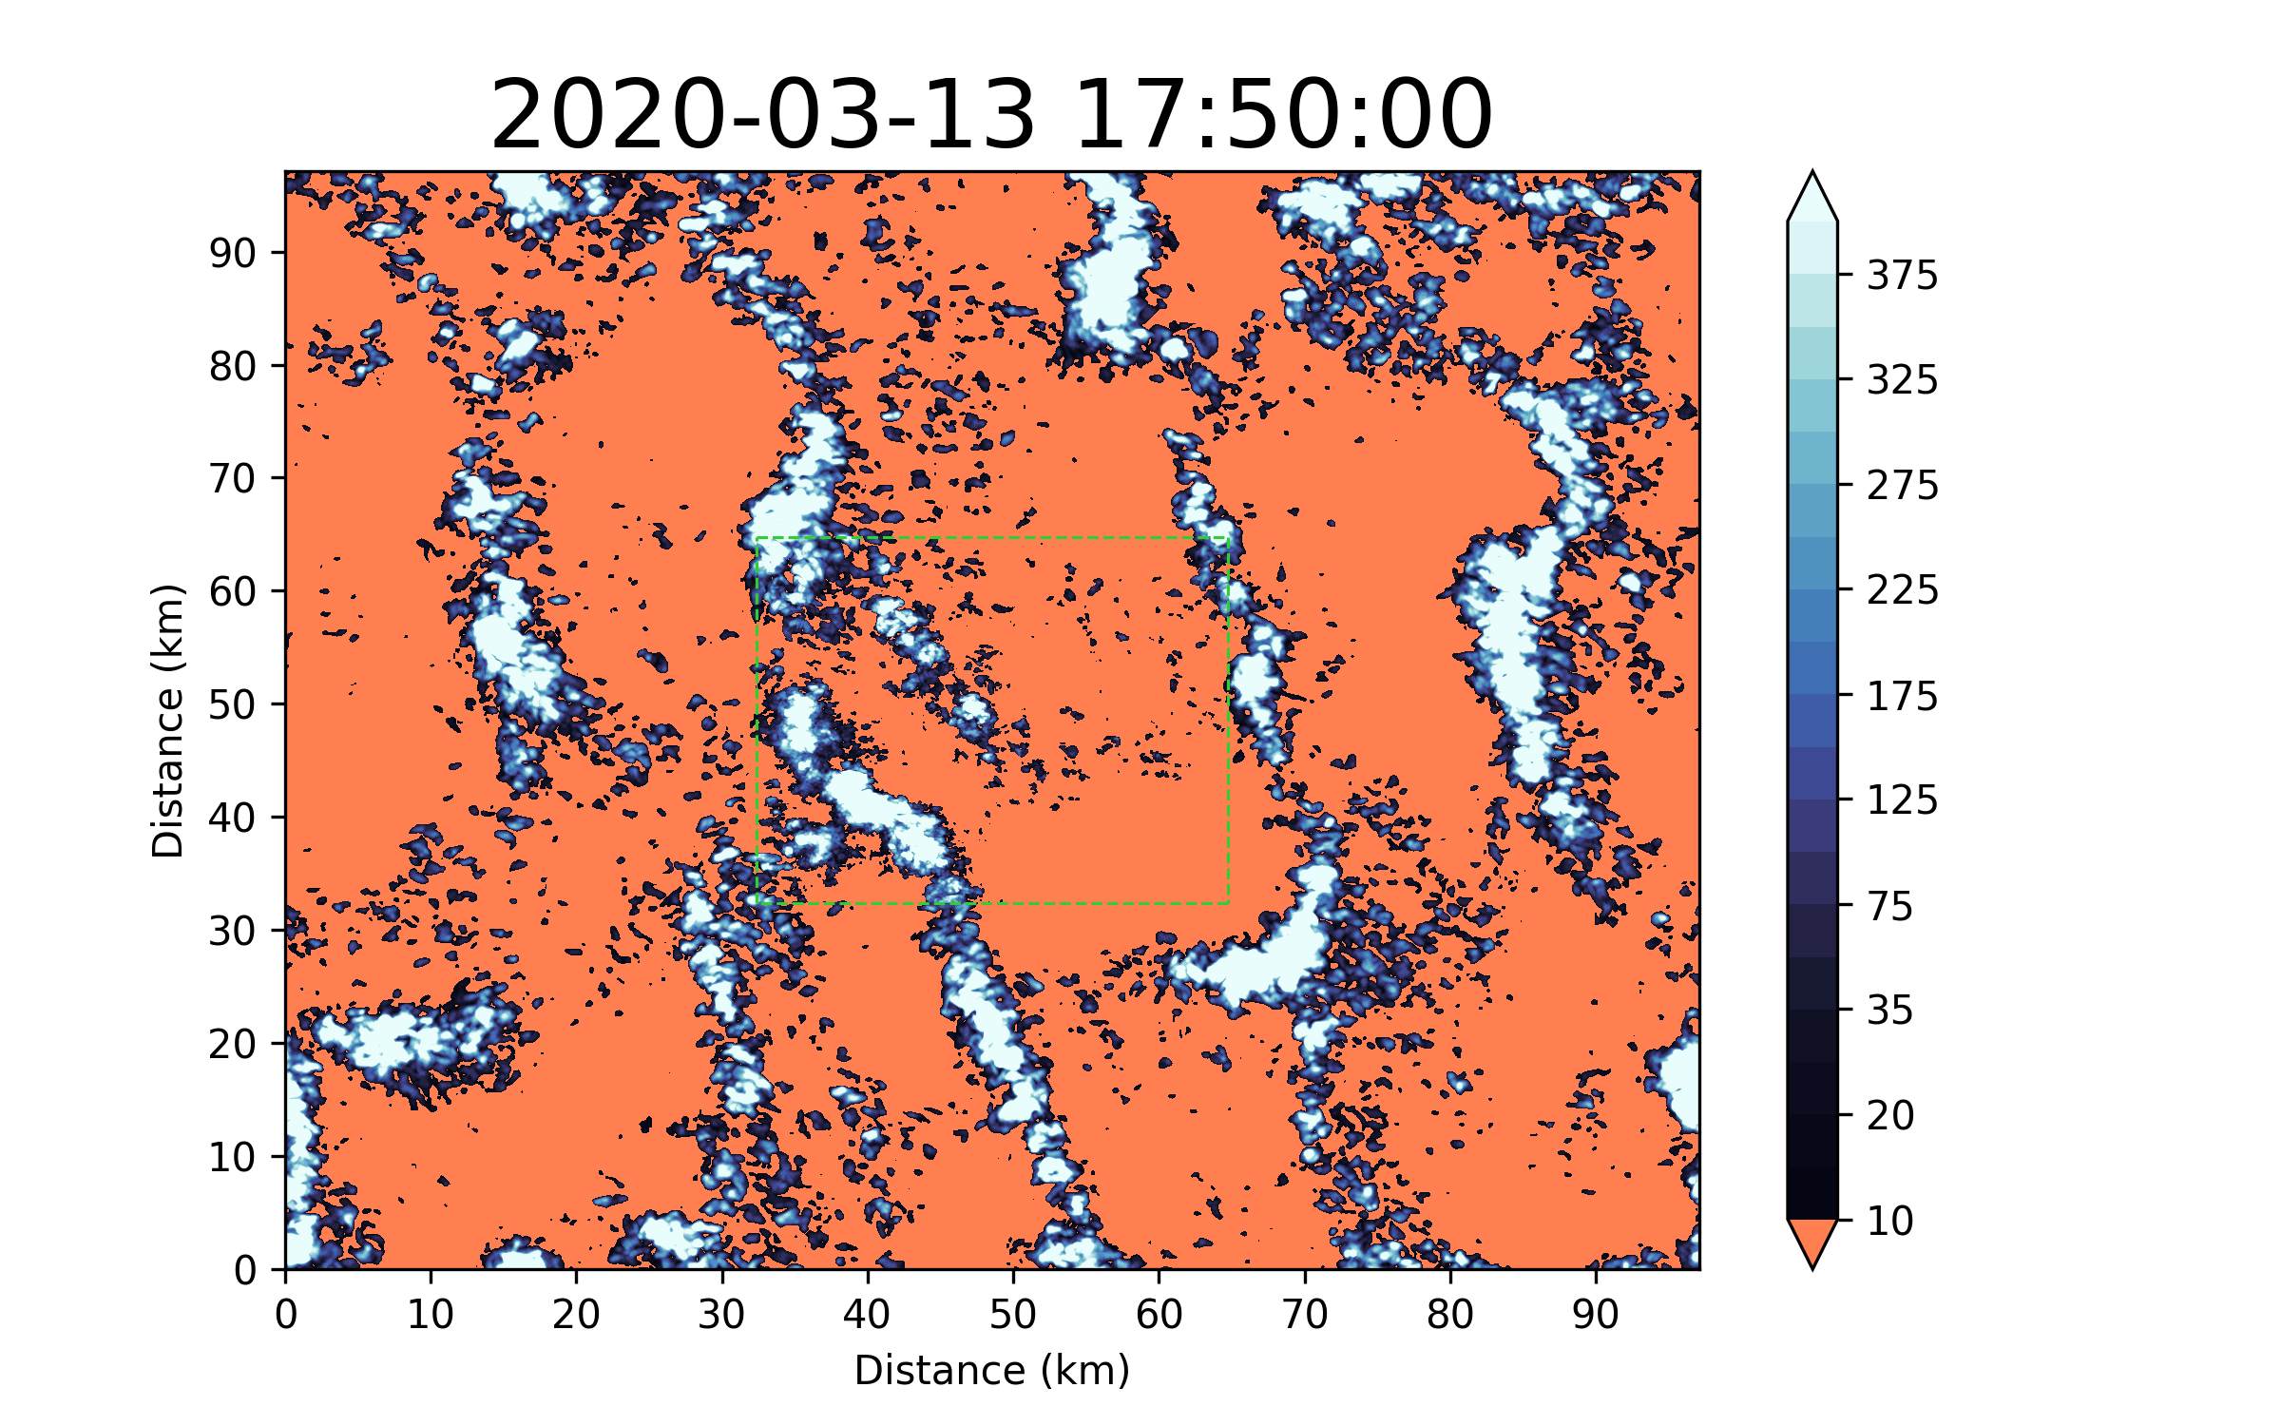
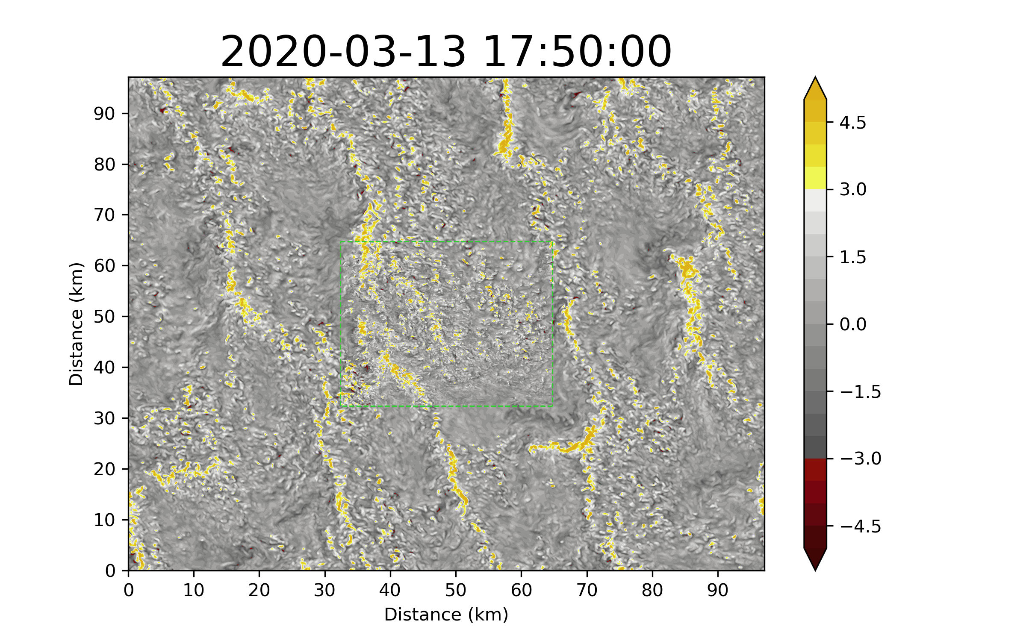
Strong updraft regions correlate with high LWP
LWP (g/m2)
W (m/s)
Cells now span ~20-40 km
z ~ 1500 m
Pan-GASS, Organization of shallow and deep convection, COMBLE Modeling Intercomparison

