Slide 1

YOPPsiteMIP the YOPP site model intercomparison project
Gunilla Svensson
Jonathan J. Day, Barbara Casati, Taneil Uttal, Siri-Jodah Khalsa, Eric Bazile, Elena Akish, Lara Ferrighi, Helmut Frank, Michael Gallagher, Øystein Godøy, Leslie Hartten, Laura Huang, Jareth Holt, Massimo Di Stefano, Zen Mariani, Sara Moris, Ewan O’Connor, Roberta Pirazzini, Amy Solomon, Johanna Tjernström, Mikhail Tolstykh, Teresa Valkonen,
the WWRP PPP YOPP Process Task Team and Thomas Jung
GEWEX Pan GASS, July 24-29, 2022, Monterrey, CA, US

Slide 2
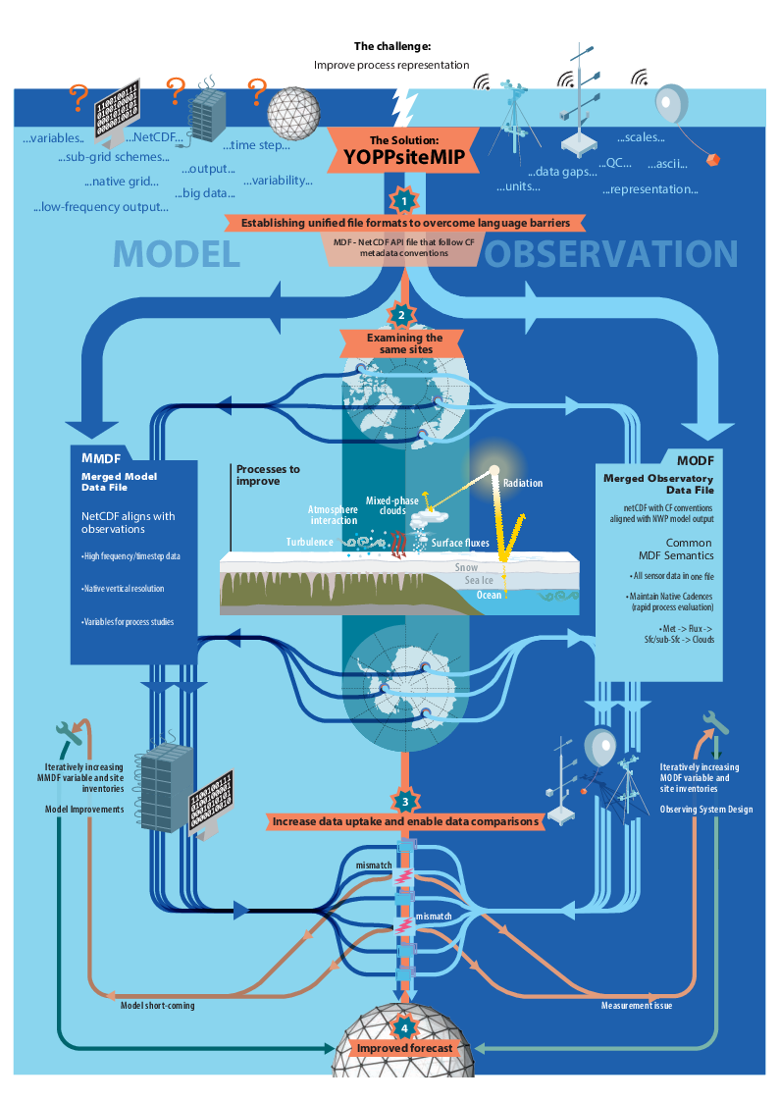
YOPPsiteMIP
A Polar model intercomparison and improvement project - MIIP
Global and Regional Numerical Weather Prediction Models provide column output at time-step frequency on model levels and surface (extending to subsurface)
A number of super sites provide data for the YOPP Special Observing Periods

Slide 3
YOPPsiteMIP
Focus on the data infrastructure to facilitate process diagnostics at multiple sites in the polar regions
Merged Data Format – Python toolkit to make, check and visualize

Slide 4
YOPPsiteMIP
Processes in focus are the parameterized processes and the interaction with the surface and below

Slide 5
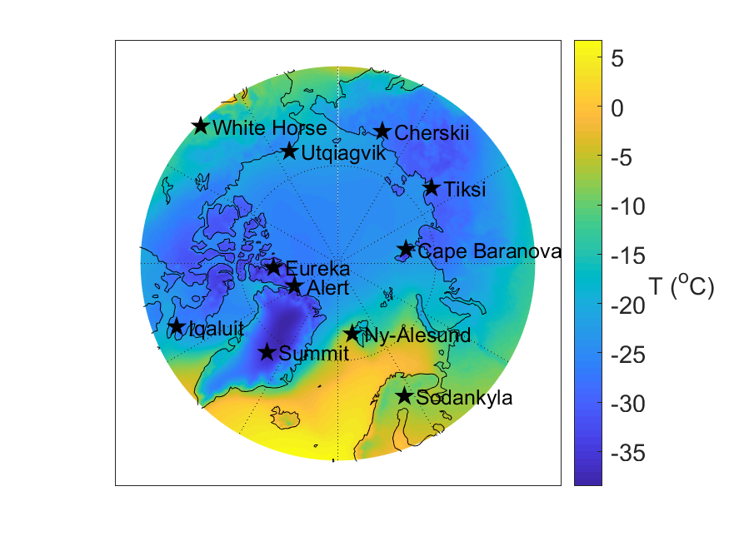
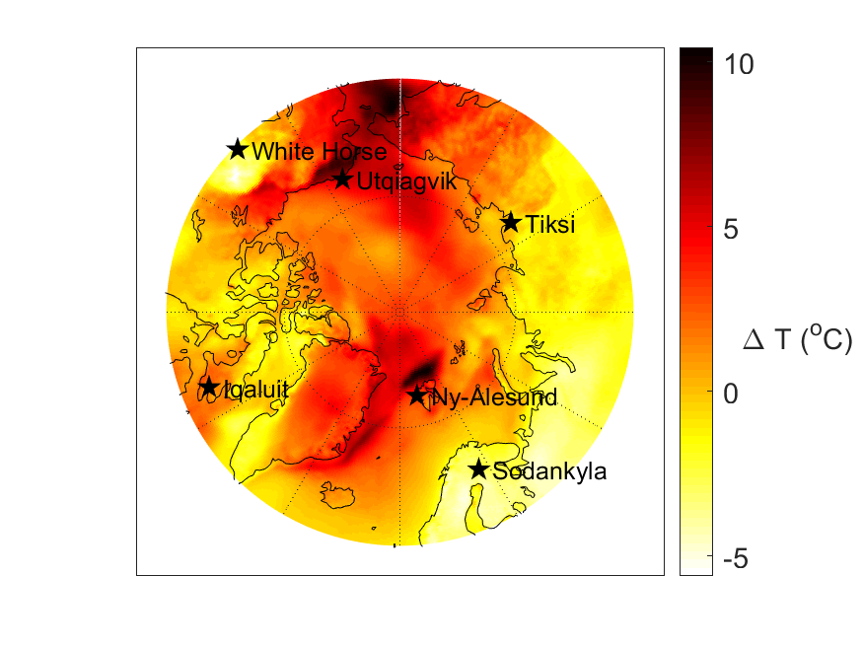
Special Observing Period 1 (SOP1) February & March 2018
Feb&March climatology 1990-2019
2018 Feb&March anomaly
MMDF sites
MODF sites already available
Same diagnostics can easily be applied on one or several models at one or several sites

Slide 6
Centre | Model-name | Global/Regional | Key Reference(s) | SOPs in YOPP portal in August 2022
ECMWF | IFS | Global: 9km/137L | Buizza et al., (2017) | SOP1, SOP2 & SOP-SH
Meteo-France | ARPEGE | Global: 7.5-15km in the Arctic/L105 | Roehrig et al., (2020) | SOP1, SOP2 & SOP-SH
Meteo-France | AROME-Arctic | Regional: 2.5km/L65 | Seity et al., (2011) | SOP1 & SOP2
ECCC | CAPS | Regional: 3km/L62 | Milbrandt et al., (2016) | SOP1 & SOP2
DWD | ICON | Global: ~13km/L90 | Zängl et al., (2015) | SOP1 & SOP2
HMCR | SL-AV | Global: ~20km/~L51 | Tolstykh et al., (2018, 2017) | SOP1 & SOP2
MetNo | AROME-Arctic | Regional: 2.5km/L65 | Müller et al. (2017) Bengtsson et al., (2017) | SOP1 & SOP2

Slide 7
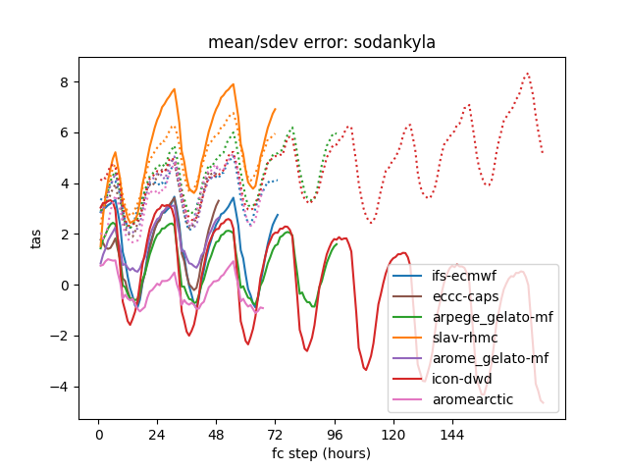
What do we learn?
Statistics for SOP1 Feb&March 2018
night
Sodankylä
Standard deviation of error
(dashed lines)
2-m temperature error (K)
Mean error
(solid lines)
day
00UTC
144
Forecast step (h)

Slide 8
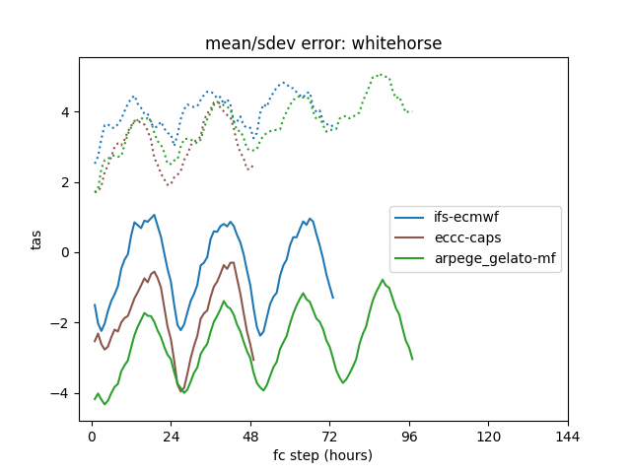
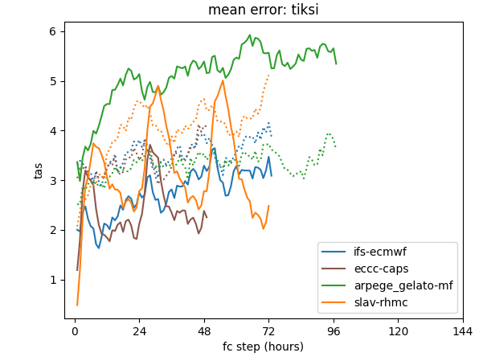
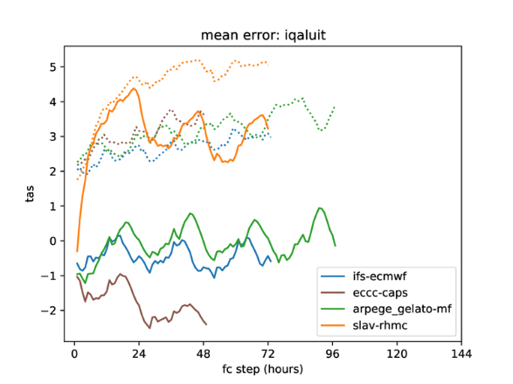
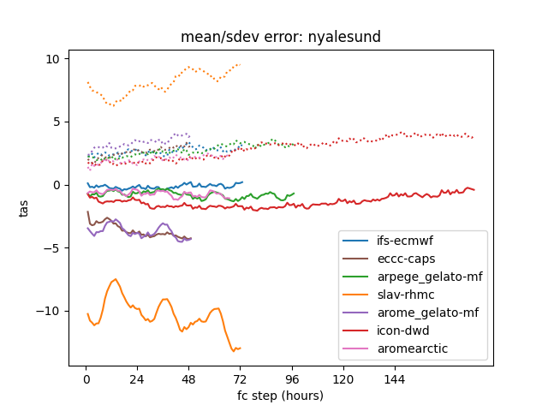
What do we learn?
Statistics for SOP1
5
5
0
5
0
0
5
5
0
5
0
0
-5

Slide 9
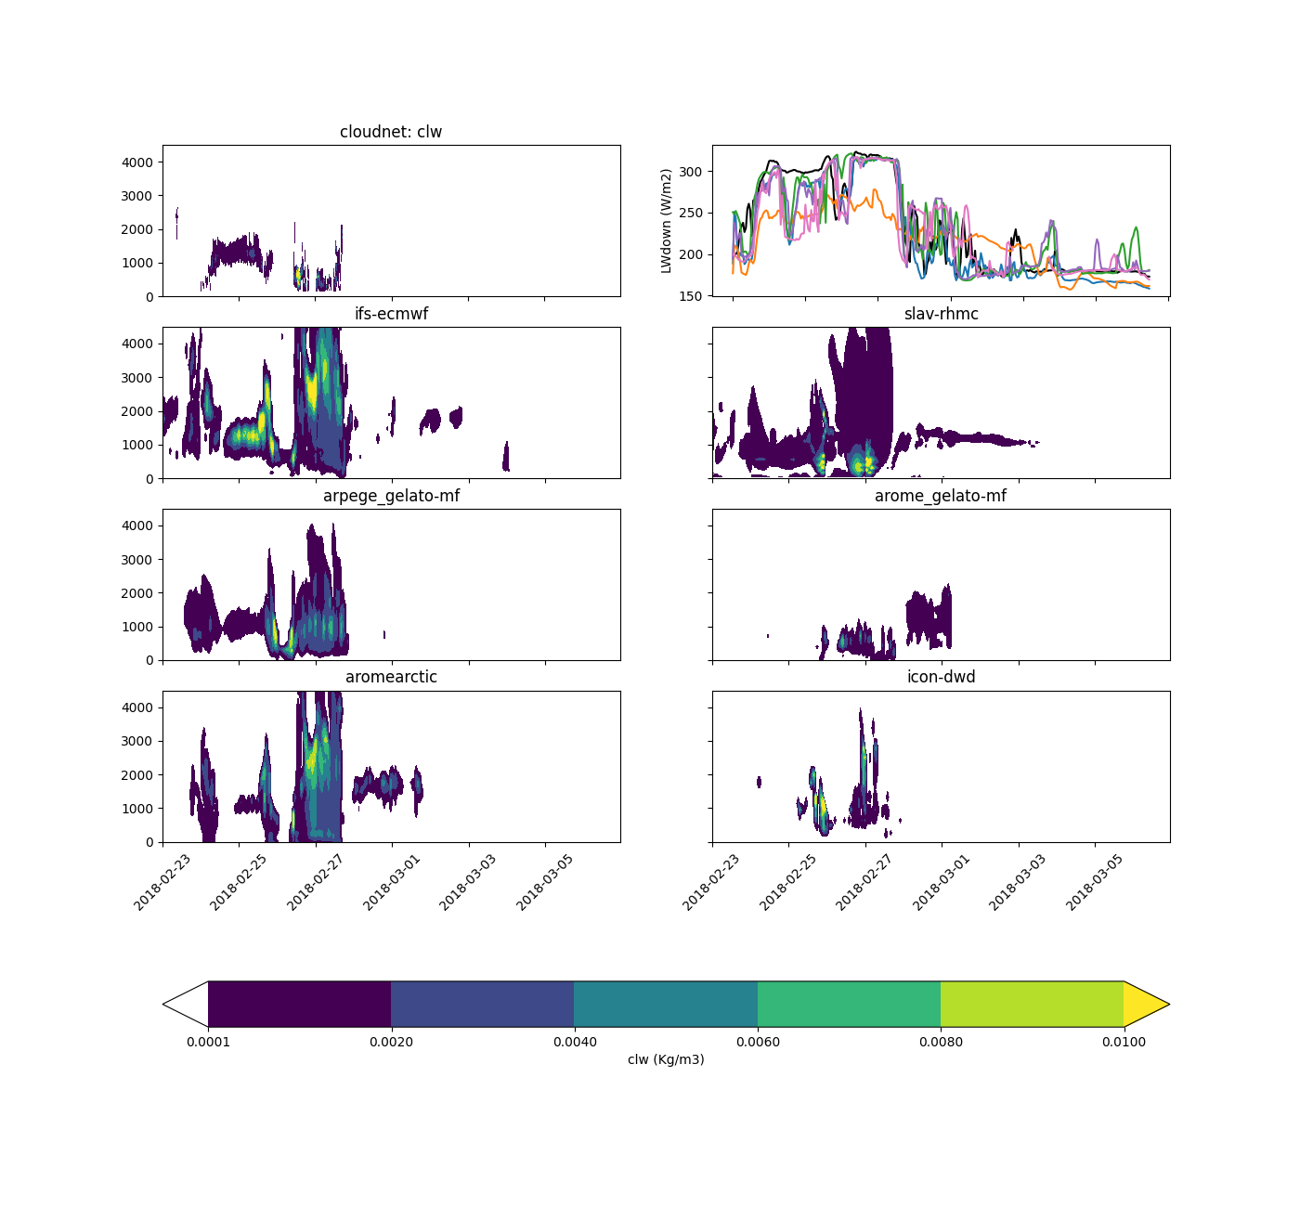
What do we learn?
Case study: 24 Feb to 6 March 2018 @ Ny Ålesund, Svalbard
4 km
Cloudnet
Cloud liquid water (kg m⁻³)
Black – Observations
Colors – NWP models concatenated hourly from T+24 to T+47
Long wave down (W m⁻²)
24 Feb
6 March

Slide 10
What do we learn?
Case study: 24 Feb to 6 March 2018 @ Ny Ålesund, Svalbard

Slide 11
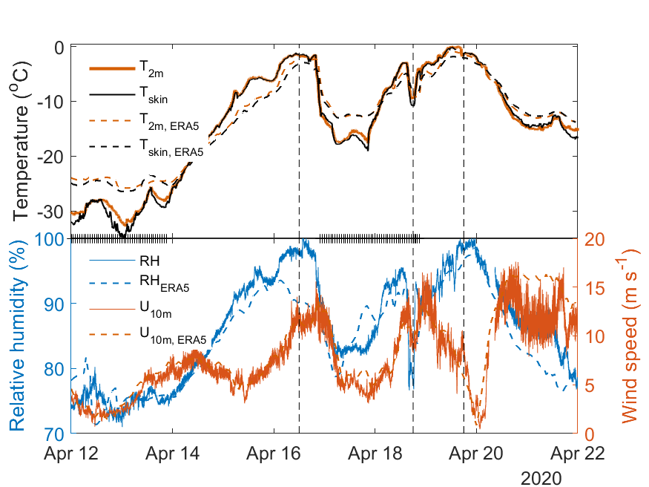
Polar process MIIP planned activities
Further analysis of NWP output at the MOSAiC, COMBLE, and YOPPsiteMIP sites
More models are welcome to join!
Nudged climate models are already suggested (discussed earlier this week, lead by Felix Pithan)

Slide 12
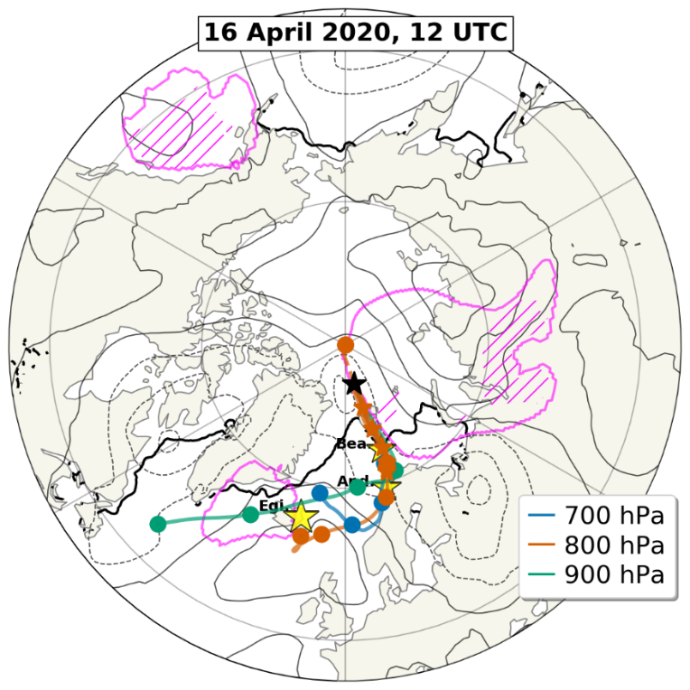
Polar process MIIP planned activities
Lagrangian analysis and modeling of warm air intrusions during the TOP

Slide 13
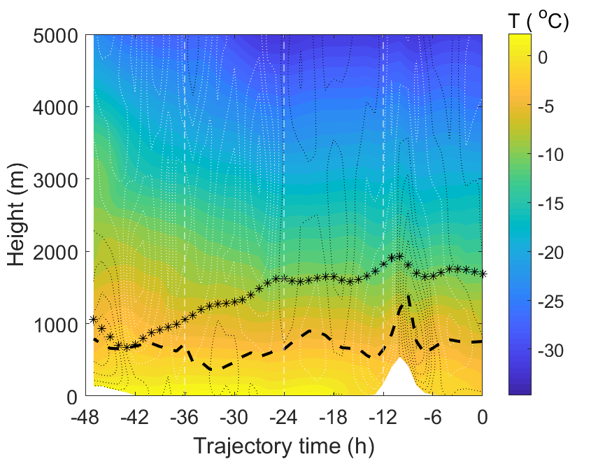
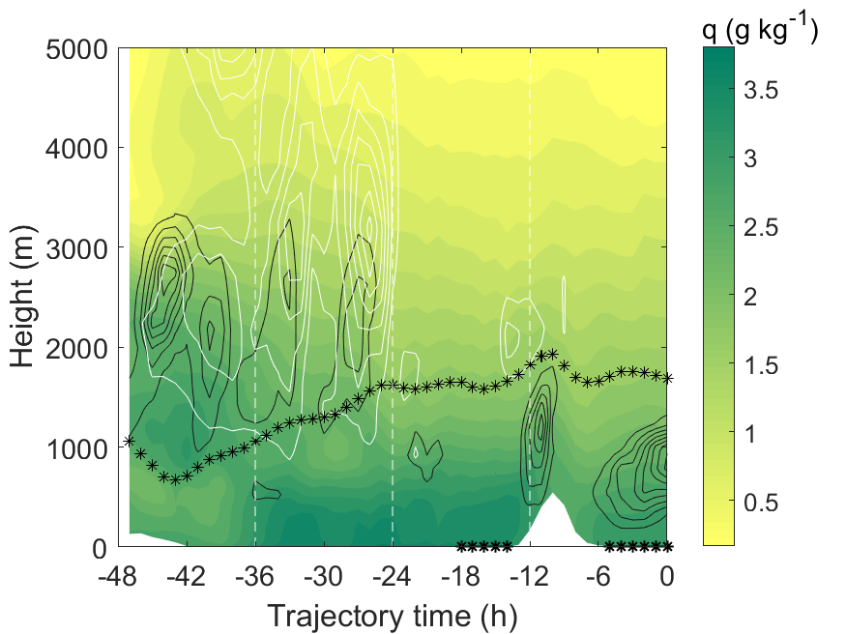
Polar process MIIP planned activities
Temperature and vertical velocity (up and down)
Humidity and clouds (liquid and ice)
Lagrangian analysis and modeling of warm air intrusions during the TOP

Slide 14
More information
Uttal et al., Merged Observatory Data Files (MODFs) for the YOPP site Model Intercomparison Project (YOPPsiteMIP) Manuscript
Day et al., The YOPP site Model Intercomparison Project (YOPPsiteMIP) phase 1: project overview and Arctic winter forecast evaluation Manuscript
Solomon et al., An Evaluation of Short-Term Forecasts of Wintertime Boundary-Layer and Surface Energy Budget Statistics in the Central Arctic Manuscript (See poster!)
Svensson et al., The YOPP TOP – warm air intrusions reaching the MOSAiC observations in April 2020 Manuscript
Hartten, Leslie M., & Khalsa, Siri Jodha S. (2022). The H-K Variable SchemaTable developed for the YOPPsiteMIP (1.2). Zenodo. https://doi.org/10.5281/zenodo.6463464
Gallagher M., et al., Merged Data Files toolkit Manuscript
MODF and MMDF datasets will be published in August https://yopp.met.no/

Slide 15
Summary
YOPPsiteMIP facilitate efficient evaluation of processes through common formatted obs. and model output files
MDF – merged data files (MODF and MMDF) concept comes with Python tools to make and check the files as well as visualize data
Land stations, MOSAiC, ice-breaker cruses with Oden – we welcome many more to use the MDF format
WWRP Polar Prediction Project ends at the end of 2022
Polar Process MIIP (Model Intercomparison and Improvement Project) will continue and bridge over to the new WWRP polar project planned to start in 2024
New activities using MOSAiC observations and Lagrangian perspectives are in the plans
Welcome to contribute with models and/or analysis, contact gunilla@misu.su.se

