Slide 1
Rapporteur report for GLASS panel activities
Thanks to the GLASS co-chairs for their efforts during the year, putting the panel report together and their positive responses to last year’s recommendations

Slide 2
GLASS panel list
Nathaniel Chaney, 2024 – Present (Co-chair)
Volker Wulfmeyer, 2025 – Present (Co-chair)
Souhail Boussetta, 2018 – Present
Laura Condon, 2022 – Present
John Edwards, 2014 – Present
Marina Hirota, 2023 – Present
Patricia Lawston-Parker, 2022 – Present
Xianhong Meng, 2019 – Present
Vimal Mishra, 2023 – Present
Nicholas Parazoo, 2024 – Present
Joshua Roundy, 2016 – Present (GHP liaison)
Asaminew Teshome Game, 2023 – Present
Anne Verhoef 2018 – Present
Yijian Zeng, 2020 – Present
Yunyan Zhang, 2021 – Present (GDAP liaison)
New members
Marc Calaf 2025 – Present
Jon Cranko Page 2025 - Present
Rotated off
Gab Abromowitz
Joseph Santanello
Panel terms have been introduced

Slide 3
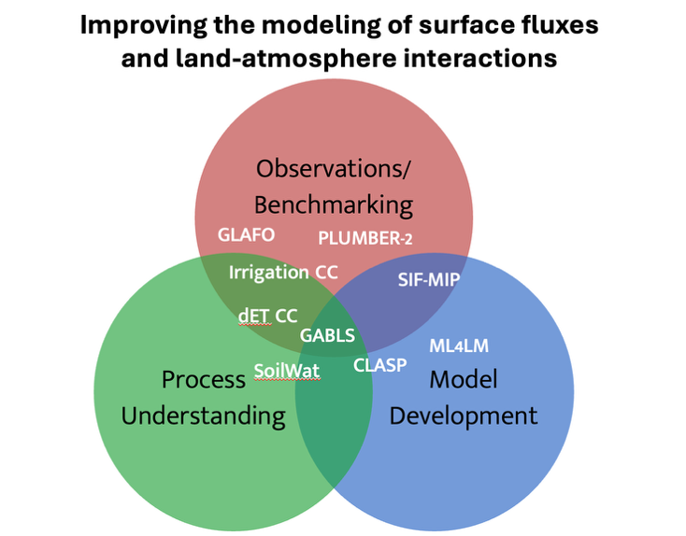
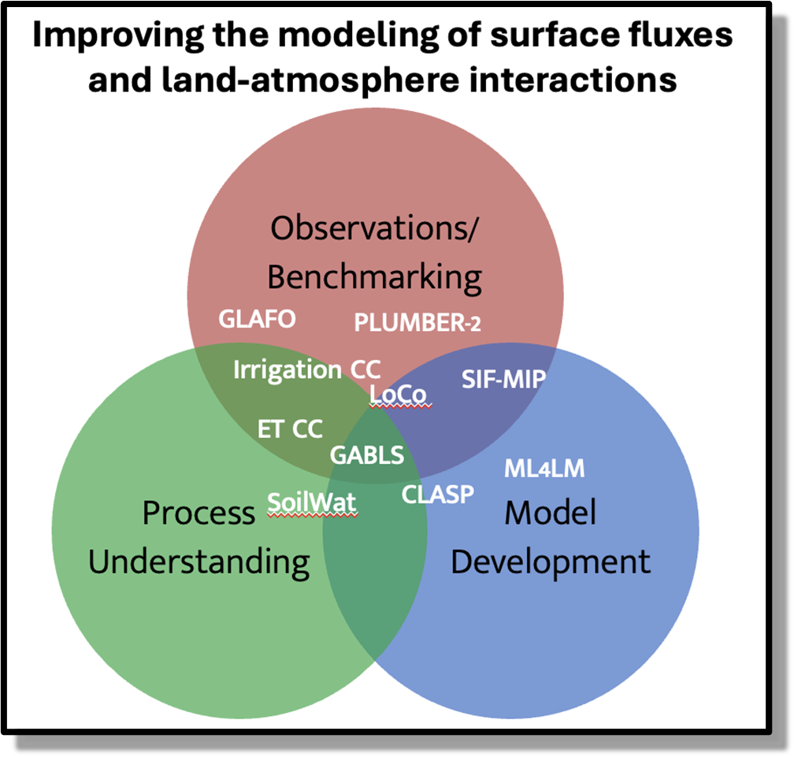
Current GLASS projects

Slide 4
Comments on report template
The report template could benefit from structural streamlining, elimination of redundancy, and enhanced readability.
Currently no part to explain response to previous rapporteurs’ report

Slide 5
Prioritising GLASS activities
Projects that wouldn’t happen if GLASS didn’t exist
GLAFO
SIF-MIP
Active projects
CLASP
GABLS
Key science working groups
- Embryo ideas
PLUMBER2
LoCo
ML4LM
Continued analysis
ET CC
SoilWat
Irrigation CC

Slide 6
Working groups and projects schematic
Heterogenous L-A interactions
Surface exchange and ABL processes
LAFI
CLASP
Observations
GLAFO
GABLS-5
“Revisiting MOST”
SIF-MIP
ML4LM
dET-CC
Anthropogenic L-A interactions
PLUMBER-2
“Next-Gen soil PTFs”
Irrigation CC
Benchmarking
Need to make sure working group names are inclusive
SoilWat

Slide 7
Progress towards GLASS sponsored projects
GLAFO
SIF-MIP
Heterogenous L-A interactions
LAFI
CLASP
Surface exchange and ABL processes
Active projects
Observations
CLASP
GABLS
GLAFO
GABLS-5
“Revisiting MOST”
LoCo
Key science working groups
- Embryo ideas
PLUMBER2
SIF-MIP
ML4LM
dET-CC
ML4LM
Continued analysis
Anthropogenic L-A interactions
PLUMBER-2
Irrigation CC
ET CC
SoilWat
“Next-Gen soil PTFs”
Irrigation CC
Benchmarking
SoilWat
Need to consider how established projects (e.g., CLASP) can be moved to the next level to establish international interest
Not all projects within the working groups need to be GLASS sponsored
Helps to manage fatigue in community by limiting projects

Slide 8
Prioritising GLASS activities
Projects that wouldn’t happen if GLASS didn’t exist
Vision: The GLASS Panel coordinates the evaluation and intercomparison of the new generation of land models and their applications to scientific queries of broad interest.
Should directly contribute towards the GEWEX science goals and WCRP objectives

Slide 9
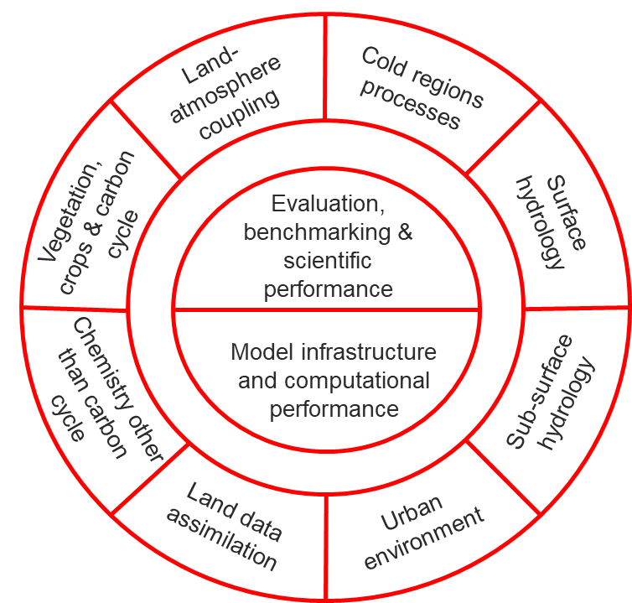
Example of potential key science areas
Number of science areas for land surface are not covered under the currently proposed working groups
Risk that community feels that it doesn’t fit into GLASS/GEWEX so does not engage
Need for panel to consider how working groups can be expanded over the next few years to be more inclusive to the whole LMS community
Also need to ensure that the working groups align with GEWEX objectives

Slide 10
Key benefits of new working group structure
Projects are motivated bottom up from engaged scientific discussion
Enables the community to establish the highest priority topics
More obvious way to establish cross-panel activities through shared scientific interests
Aim for ECS to take the lead in organising working groups
ECS have more time to organise meetings
ECS are enthusiastic and potentially more inclusive
Enables ECS to learn and develop from more experienced researchers who might lead new projects
ECS then serve on the GLASS panel and become exposed to the wider GEWEX community
Opportunity to have a more diverse panel membership

Slide 11
GLASS panel list
Nathaniel Chaney, 2024 – Present (Co-chair)
Volker Wulfmeyer, 2025 – Present (Co-chair)
Souhail Boussetta, 2018 – Present
Marc Calaf 2025 – Present
Laura Condon, 2022 – Present
John Edwards, 2014 – Present
Marina Hirota, 2023 – Present
Patricia Lawston-Parker, 2022 – Present
Xianhong Meng, 2019 – Present
Vimal Mishra, 2023 – Present
Jon Cranko Page 2025 – Present
Nicholas Parazoo, 2024 – Present
Joshua Roundy, 2016 – Present (GHP liaison)
Asaminew Teshome Game, 2023 – Present
Anne Verhoef 2018 – Present
Yijian Zeng, 2020 – Present
Yunyan Zhang, 2021 – Present (GDAP liaison)
Currently still 17 panel members!
6 Proposed working groups
Aim to reduce panel size to 14
2 members per working group
2 co-chairs
Could expand working group topics, but reorganise to stop proliferation of panel members

Slide 12
Pan-GLASS conference 2026
GASS
GHP
Benchmarking
Observations
CLIVAR
GDAP
GLASS
iLeaps
CliC
Heterogenous L-A interactions
GLASS
SoilWat
Safe Landing
Climates
Digital Earth
Engagement with other panels and WCRP groups not covered
Panel should think about how to initiate these
Work on joint sessions with:
GASS for Pan-GASS
GHP for Pan-GHP
Surface exchange and ABL processes
Anthropogenic L-A interactions

Slide 13
Key considerations in preparation for Pan-GLASS
Need to ensure sessions are organised in order to inspire ECRs to take on leading working groups
Should be a session to enable the community to identify other working groups that should be established
Need to consider how to engage ERCs that are not able to attend Pan-GLASS
Look at outreach though teaching opportunities
Once engaged, the working groups can be organised remotely enabling all ECRs to be engaged

