Slide 1
Positive subtropical low cloud feedback mechanisms in CFMIP-3/CMIP6 experiments.
Mark Webb, Adrian Lock
(Met Office)
Tomoo Ogura (NIES)
mark.webb@metoffice.gov.uk
July 2022

Slide 2
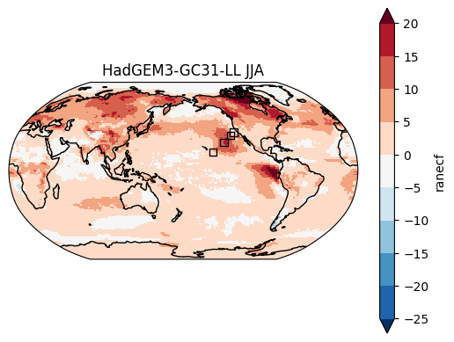
|
Why are subtropical low cloud feedbacks positive in climate models?
region
JJA Net Cloud Radiative Effect Response
AMIP+4K – AMIP (W/m²)
Various positive subtropical low cloud feedback mechanisms have been proposed in the literature.
Here we look responses in a range of cloud controlling factors, cloud properties and temperature / humidity budget terms in CFMIP-3 AMIP +4K experiments to test competing hypotheses.
We focus on locations within the GCSS Pacific Cross Section, as was the case for the CFMIP/GCSS Intercomparison of LES and SCMs (CGILS) project.
We start with HadGEM3-GC3.1-LL and then extend to include some other models which include temperature / humidity budget terms.
www.metoffice.gov.uk
© Crown Copyright, Met Office 2021

Slide 3
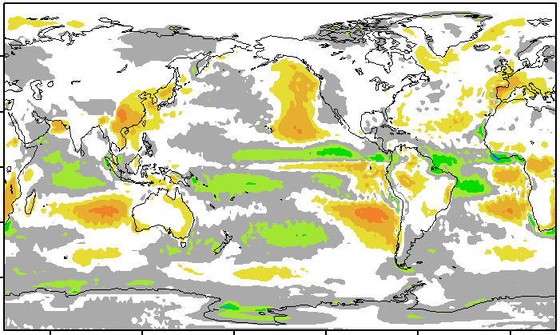
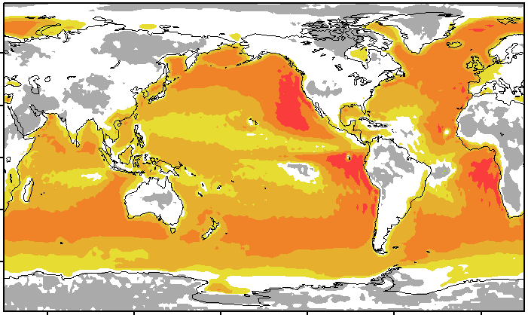
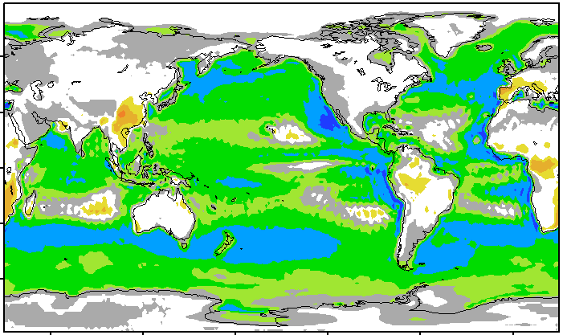
Ogura and Webb (in revision)
Low cloud feedback simulated by MIROC5/6 AMIP-p4K runs decomposed into SST-driven radiative and turbulent components.
Low cloud feedback
ΔLW
Atmosphere
ΔTurbulent
transport
Enhanced
warming
$$≈$$
Land
Ocean
16
[W/m²]
SST+4K
0
-16
$$+$$
Suppressed
warming
Radiative component induced by
△Surface LW Flux
dependence on (△SST)
Turbulent component induced by
△Surface Latent & Sensible Fluxes
dependence on (△SST)
Notes:
/oraid01/ogura/moon/work/miroc6.0/amip/shell/plot{305,306,307}.sh

Slide 4
|
HadGEM3-GC3.1-LL Stratocu/Cu transition cloud feedback
region
Net Cloud Radiative Effect Response
Annual Mean Climatology
AMIP+4K – AMIP (W/m²)
Californian Stratocumulus / Trade cumulus transition region [137°W, 26°N]
www.metoffice.gov.uk
© Crown Copyright, Met Office 2021

Slide 5
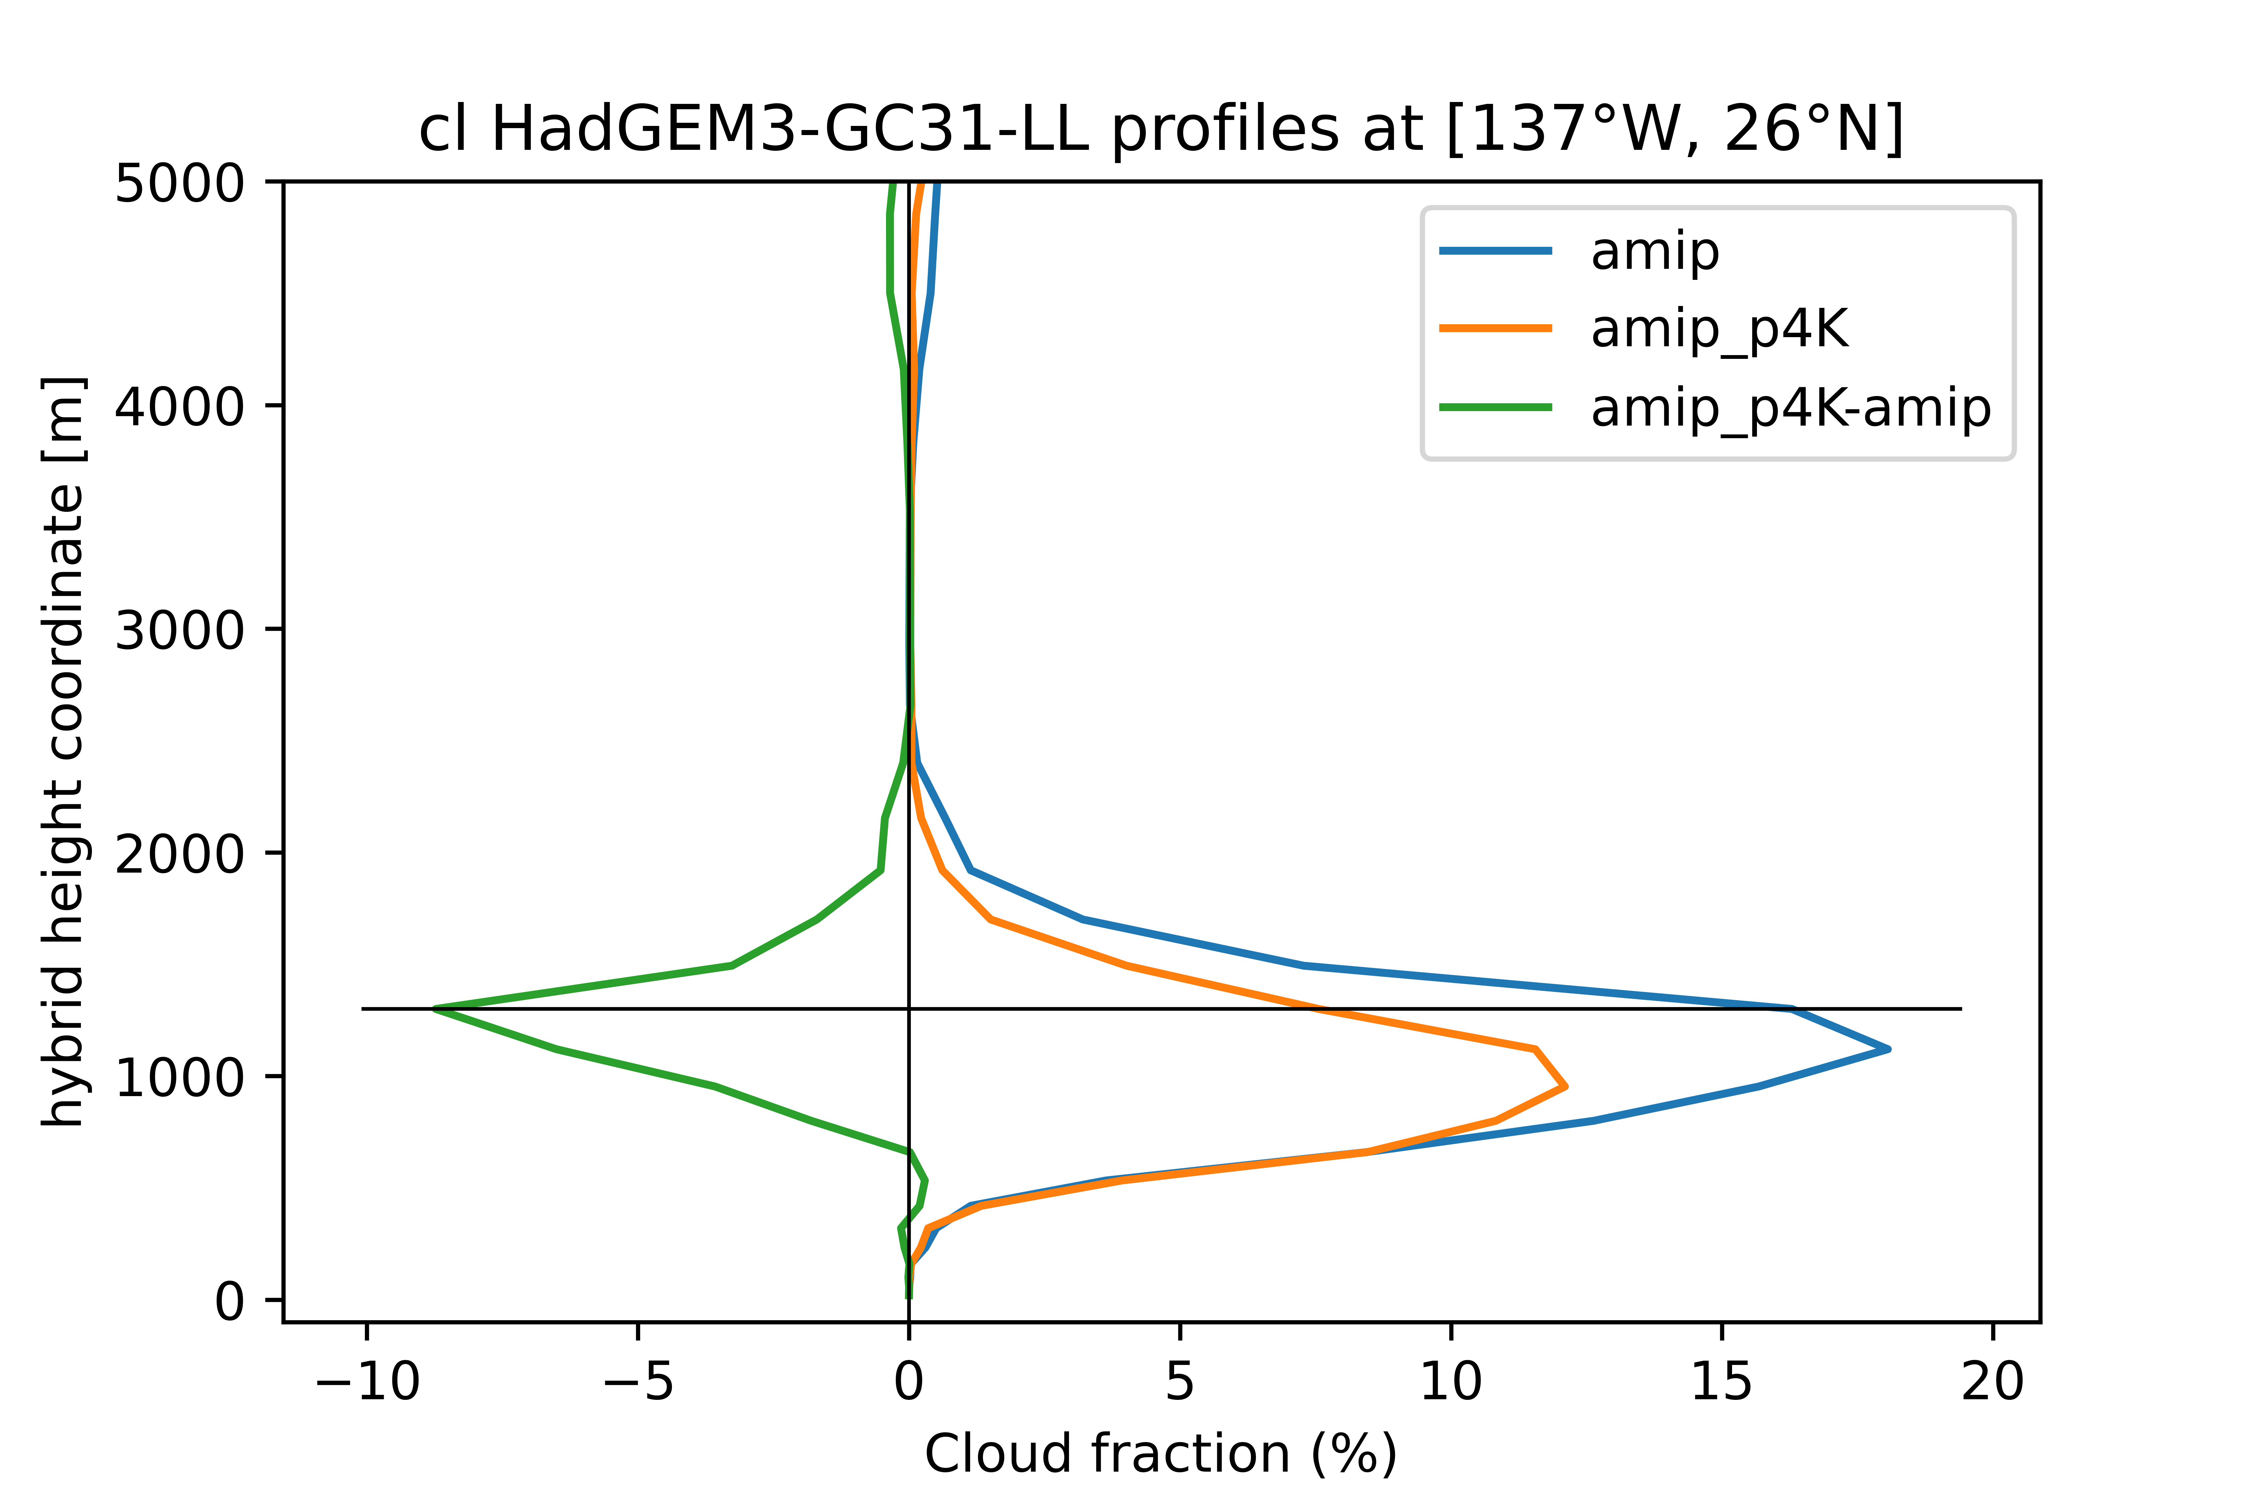
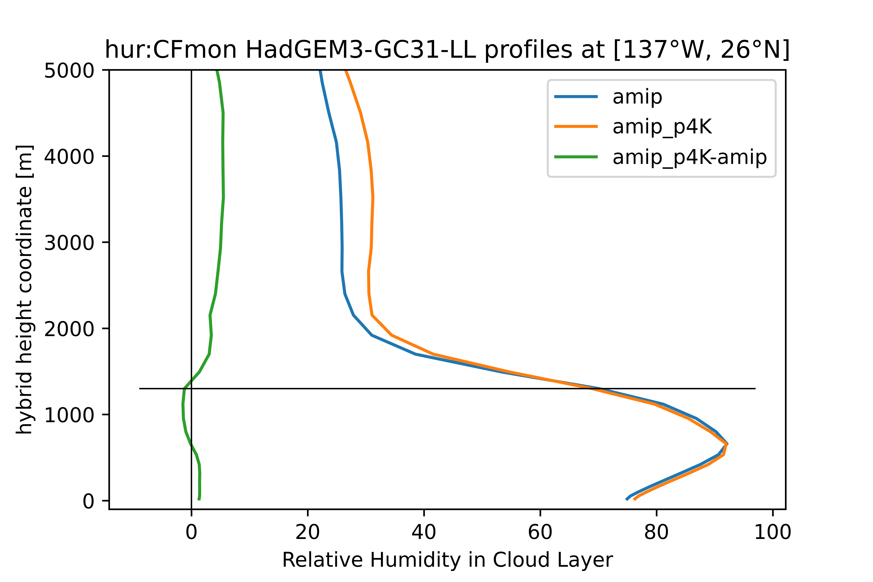
|
Cloud Fraction and Relative Humidity
Relative Humidity (%)
www.metoffice.gov.uk
© Crown Copyright, Met Office 2021

Slide 6
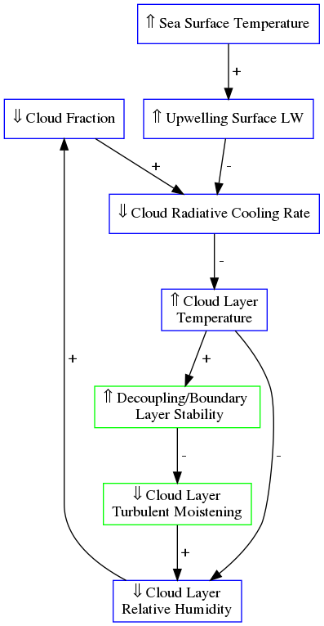
|
Surface LW forced feedback hypothesis: HadGEM3
Responses per K surface warming are expressed as percentages of the absolute magnitudes values in the control runs
www.metoffice.gov.uk

Slide 7
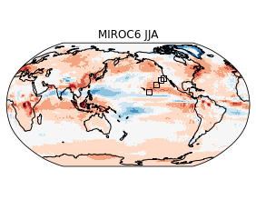
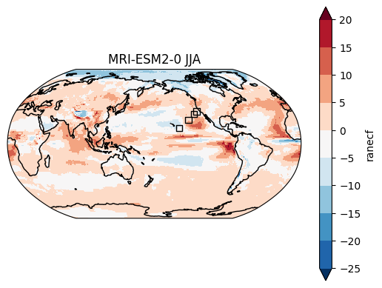
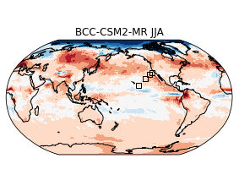
|
Stratocumulus / Trade Cumulus transition cloud feedback
region
Net Cloud Radiative Effect Response
AMIP+4K – AMIP (W/m²)
MIROC6 S7 [145W,20N]
Other models S9 [137W,26N]
www.metoffice.gov.uk
© Crown Copyright, Met Office 2021

Slide 8
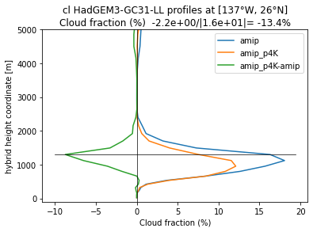
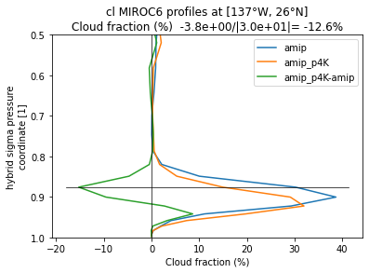
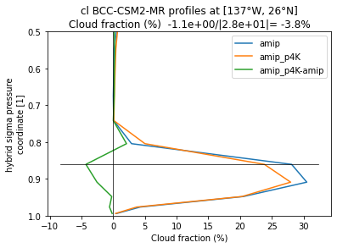
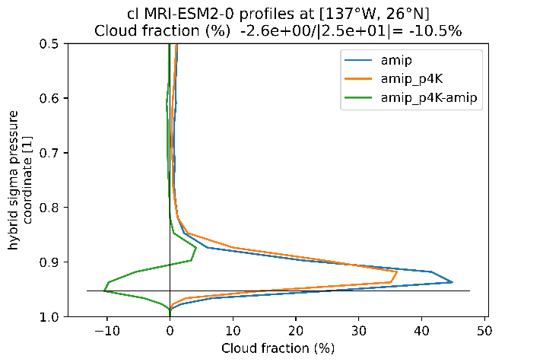
|
Stratocu/Cu transition cloud feedback
HadGEM3
MIROC6
MRI-ESM2.0
BCC-CSM2-MR
www.metoffice.gov.uk
© Crown Copyright, Met Office 2021

Slide 9
|
Evidence for and against proposed mechanisms in models.
Hypothesized low cloud fraction (LCF) reduction mechanism | BCC-CSM2-MR ↓ 4% LCF | HadGEM3-GC3.1-LL ↓ 13% LCF | MIROC6 ↓ 13% LCF | MRI-ESM2.0 ↓ 10% LCF
Ogura & Webb (in revision): Increased upward LW flux from surface heats cloud layer, stabilizes PBL, reduces turbulent moistening, reduces RH. | 1%↑ Upwelling LW clear-sky flux 2%↑ BL stability 2%↓ turb moistening 5% ↑ RH in cloud | 2% ↑ Upwelling LW clear-sky flux 1%↑ BL stability 9%↓ turb moistening 0.4%↓ RH in cloud | 2% ↑ Upwelling LW clear-sky flux 2%↑ BL stability 2.4%↓ RH in cloud | 1% ↑ Upwelling LW clear-sky flux 1%↓ BL stability 1% ↑ turb moistening 0.2%↓ RH in cloud
Consistent / Consistent but unlikely to explain full cloud response / Inconsistent

Slide 10
|
Evidence for and against proposed mechanisms in models.
Hypothesized low cloud fraction (LCF) reduction mechanism | BCC-CSM2-MR ↓ 4% LCF | HadGEM3-GC3.1-LL ↓ 13% LCF | MIROC6 ↓ 13% LCF | MRI-ESM2.0 ↓ 10% LCF
Ogura & Webb (in revision): Increased upward LW flux from surface heats cloud layer, stabilizes PBL, reduces turbulent moistening, reduces RH. | 1%↑ Upwelling LW clear-sky flux 2%↑ BL stability 2%↓ turb moistening 5% ↑ RH in cloud | 2% ↑ Upwelling LW clear-sky flux 1%↑ BL stability 9%↓ turb moistening 0.4%↓ RH in cloud | 2% ↑ Upwelling LW clear-sky flux 2%↑ BL stability 2.4%↓ RH in cloud | 1% ↑ Upwelling LW clear-sky flux 1%↓ BL stability 1% ↑ turb moistening 0.2%↓ RH in cloud
Brient & Bony 2013: Increased vertical q gradient => Enhanced MSE sink from vertical advection => reduced MSE sink from LW due to reduced low cloud fraction | 4% ↑ vert q grad 7% ↑ adv drying 3% ↑ LW MSE sink | 6% ↑ vert q grad 0.5%↑ adv drying 7% ↑ adv MSE sink 10%↓ rad MSE sink | 5% ↑ vert q grad 2%↑ adv drying 20%↑ adv htg 2%↓ adv MSE sink 9% ↓ rad MSE sink | 5% ↑ vert q grad 3% ↑ adv drying 1%↑ adv cooling 2% ↑ adv MSE sink 16%↓ rad MSE sink
Consistent / Consistent but unlikely to explain full cloud response / Inconsistent

Slide 11
|
Evidence for and against proposed mechanisms in models.
Hypothesized low cloud fraction (LCF) reduction mechanism | BCC-CSM2-MR ↓ 4% LCF | HadGEM3-GC3.1-LL ↓ 13% LCF | MIROC6 ↓ 13% LCF | MRI-ESM2.0 ↓ 10% LCF
Ogura & Webb (in revision): Increased upward LW flux from surface heats cloud layer, stabilizes PBL, reduces turbulent moistening, reduces RH. | 1%↑ Upwelling LW clear-sky flux 2%↑ BL stability 2%↓ turb moistening 5% ↑ RH in cloud | 2% ↑ Upwelling LW clear-sky flux 1%↑ BL stability 9%↓ turb moistening 0.4%↓ RH in cloud | 2% ↑ Upwelling LW clear-sky flux 2%↑ BL stability 2.4%↓ RH in cloud | 1% ↑ Upwelling LW clear-sky flux 1%↓ BL stability 1% ↑ turb moistening 0.2%↓ RH in cloud
Brient & Bony 2013: Increased vertical q gradient => Enhanced MSE sink from vertical advection => reduced MSE sink from LW due to reduced low cloud fraction | 4% ↑ vert q grad 7% ↑ adv drying 3% ↑ LW MSE sink | 6% ↑ vert q grad 0.5%↑ adv drying 7% ↑ adv MSE sink 10%↓ rad MSE sink | 5% ↑ vert q grad 2%↑ adv drying 20%↑ adv htg 2%↓ adv MSE sink 9% ↓ rad MSE sink | 5% ↑ vert q grad 3% ↑ adv drying 1%↑ adv cooling 2% ↑ adv MSE sink 16%↓ rad MSE sink
Bretherton et al. 2013: Increased downward LW from free troposphere, reduced cloud top entrainment, shallowing PBL, thinning of cloud. | 3% ↓ downward clear LW in cloud BL deepens 0.3% ↓ LWP | 3% ↓ downward clear LW in cloud BL shallows 7% ↓ LWP | 3% ↓ downward clear LW in cloud BL shallows 3% ↓ LWP | 3% ↓ downward clear LW in cloud BL deepens 1% ↓ LWP
Consistent / Consistent but unlikely to explain full cloud response / Inconsistent

Slide 12
|
Evidence for and against proposed mechanisms in models.
Hypothesized low cloud fraction (LCF) reduction mechanism | BCC-CSM2-MR ↓ 4% LCF | HadGEM3-GC3.1-LL ↓ 13% LCF | MIROC6 ↓ 13% LCF | MRI-ESM2.0 ↓ 10% LCF
Ogura & Webb (in revision): Increased upward LW flux from surface heats cloud layer, stabilizes PBL, reduces turbulent moistening, reduces RH. | 1%↑ Upwelling LW clear-sky flux 2%↑ BL stability 2%↓ turb moistening 5% ↑ RH in cloud | 2% ↑ Upwelling LW clear-sky flux 1%↑ BL stability 9%↓ turb moistening 0.4%↓ RH in cloud | 2% ↑ Upwelling LW clear-sky flux 2%↑ BL stability 2.4%↓ RH in cloud | 1% ↑ Upwelling LW clear-sky flux 1%↓ BL stability 1% ↑ turb moistening 0.2%↓ RH in cloud
Brient & Bony 2013: Increased vertical q gradient => Enhanced MSE sink from vertical advection => reduced MSE sink from LW due to reduced low cloud fraction | 4% ↑ vert q grad 7% ↑ adv drying 3% ↑ LW MSE sink | 6% ↑ vert q grad 0.5%↑ adv drying 7% ↑ adv MSE sink 10%↓ rad MSE sink | 5% ↑ vert q grad 2%↑ adv drying 20%↑ adv htg 2%↓ adv MSE sink 9% ↓ rad MSE sink | 5% ↑ vert q grad 3% ↑ adv drying 1%↑ adv cooling 2% ↑ adv MSE sink 16%↓ rad MSE sink
Bretherton et al. 2013: Increased downward LW from free troposphere, reduced cloud top entrainment, shallowing PBL, thinning of cloud. | 3% ↓ downward clear LW in cloud BL deepens 0.3% ↓ LWP | 3% ↓ downward clear LW in cloud BL shallows 7% ↓ LWP | 3% ↓ downward clear LW in cloud BL shallows 3% ↓ LWP | 3% ↓ downward clear LW in cloud BL deepens 1% ↓ LWP
Wyant et al., 1997 / Rieck et al., 2012: Increased surface LH flux => deepening / warming / drying PBL by convective entrainment | 4% ↑ Surface LHF 13%↑ Conv heating 4%↑ Conv moistening PBL deepens | 2% ↑ Surface LHF 6%↓ Conv heating 7%↓ Conv moistening PBL shallows | 0% ↑ in SLHF 7%↓ conv heating 16% ↓ conv drying PBL shallows | 3% ↑ SLHF 50%↑ conv heating 57% ↑ conv drying PBL deepens
Consistent / Consistent but unlikely to explain full cloud response / Inconsistent

Slide 13
|
Why are sub-tropical low cloud feedbacks positive in climate models?
We have tested some proposed mechanisms by comparing the relative sizes of changes in clouds, cloud controlling factors and tendencies in some CMIP6 +4K experiments at locations along the GCSS Pacific cross section between California and Hawaii.
We have demonstrated how quantitative comparisons of the relative sizes of responses can rule out some mechanisms in standard experiments, without requiring mechanism denial experiments.
Some mechanisms are ruled out in some models no single one remains.
Plans for further work include:
Extending to an exhaustive list of proposed positive low cloud feedback mechanisms, and more models.
Extending geographically e.g. using clustering to produce "mechanism maps".
Separating LW and turbulent responses to increasing SST in other GCMs and in LES.
Design of targeted experiments to test / isolate other positive subtropical cloud feedback mechanisms.

Slide 14
This is not just big data. This is big climate data.
Supplementary slides

Slide 15
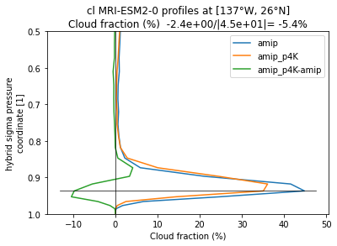
|
Stratocu/Cu transition cloud feedback
HadGEM3
MIROC6
MRI-ESM2.0
BCC-CSM2-MR
www.metoffice.gov.uk
© Crown Copyright, Met Office 2021

Slide 16
|
Why are sub-tropical low cloud feedbacks positive in climate models?
Wyant et. al 2009
Reick et al. 2010
Webb and Lock 2013
Brient and Bony 2013
Zhang et al. 2013
Jones et al. 2014
Blossey et al., 2013
Bretherton et al 2013
Bretherton et al 2015
Brient et al. 2016
Vial et. al 2016
Kawai et al. 2017
Tan et al. 2016, 2017
Schneider et. al 2019
Vogel et. al 2019
Narenpitak and Bretherton 2019

Slide 17
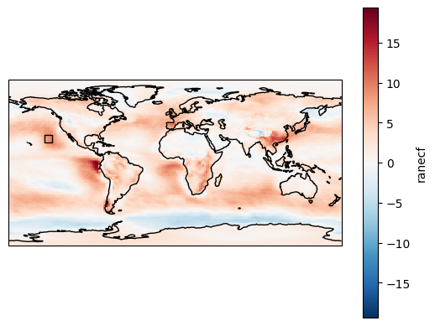
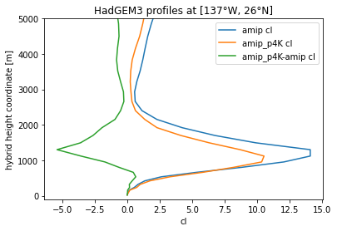
|
HadGEM3-GC3.1-LL Stratocu/Cu transition cloud feedback
region
Annual mean
Net Cloud Radiative Effect Response
amip+4K – amip (W/m²)
Largest cloud reduction at 1300m
Shallowing of clouds / PBL and reduced fraction
Californian Stratocumulus / Trade cumulus transition region [137°W, 26°N]
Cloud fraction (%)
Subtropical cloud feedbacks are positive in CFMIP amip+4K experiments with HadGEM3-GC3.1-LL
We explore low cloud feedback mechanisms in the Californian Sc/Cu transition region using CFMIP temperature and specific humidity tendency terms.
www.metoffice.gov.uk
© Crown Copyright, Met Office 2021

Slide 18
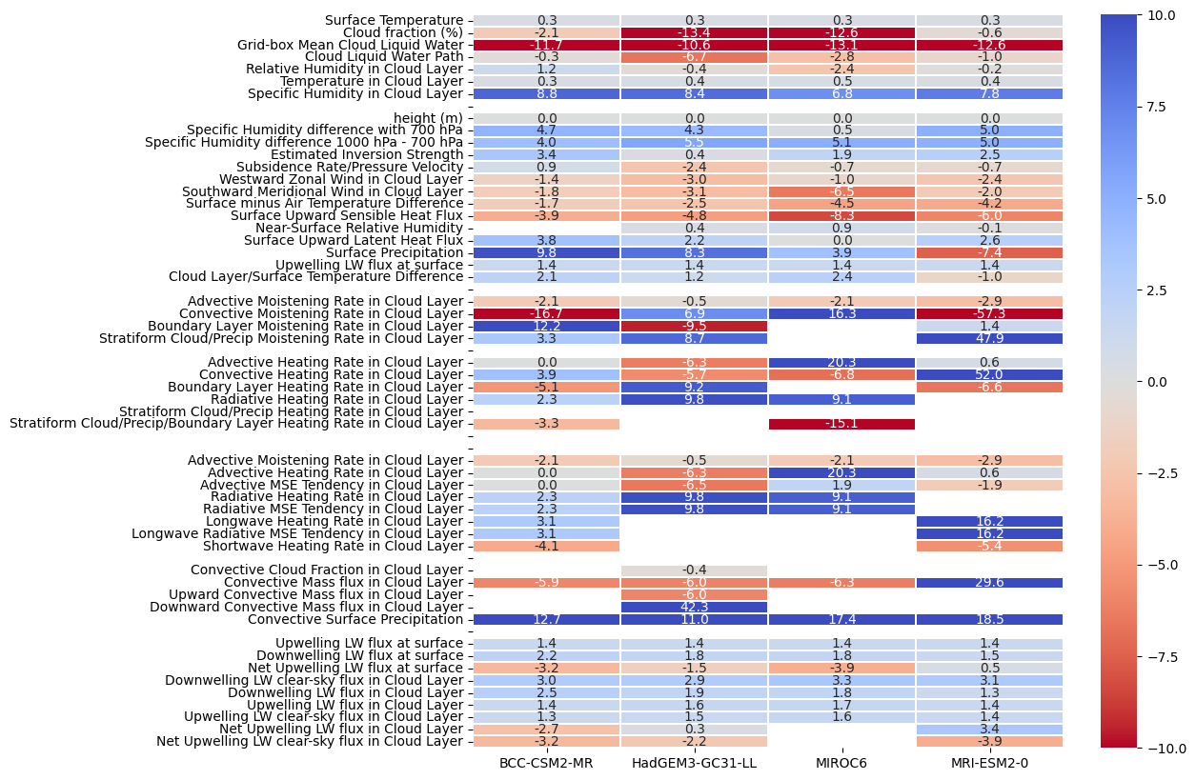
|
HadGEM3-GC3.1-LL Moistening / drying rate responses

Slide 19
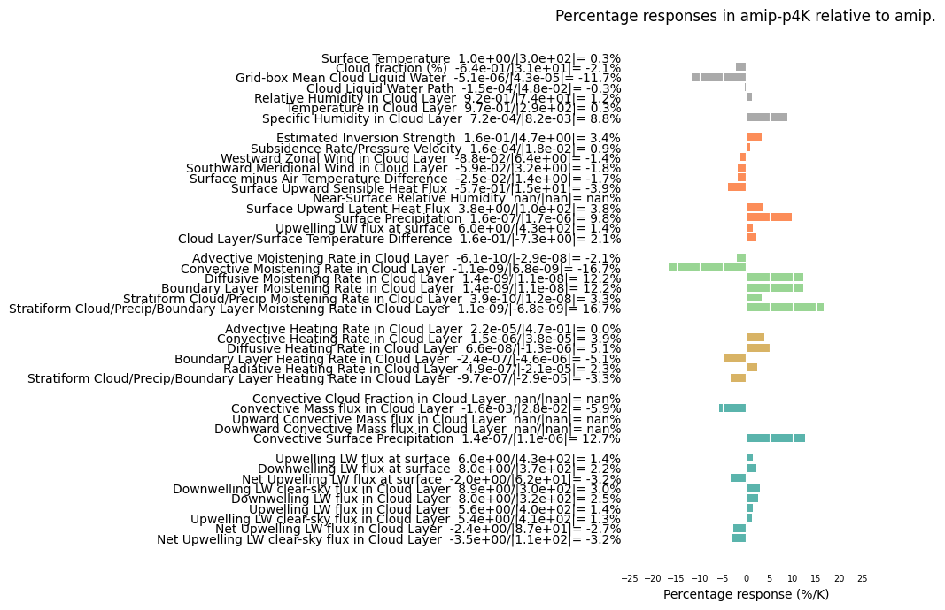
amip+4K percentage responses [137°W, 26°N]
BCC-CSM2-MR

Slide 20
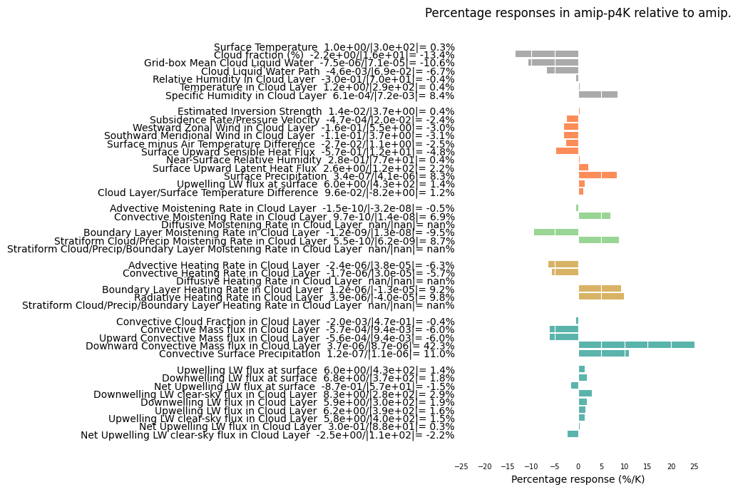
HadGEM3-GC3.1-LL
amip+4K percentage responses [137°W, 26°N]

Slide 21
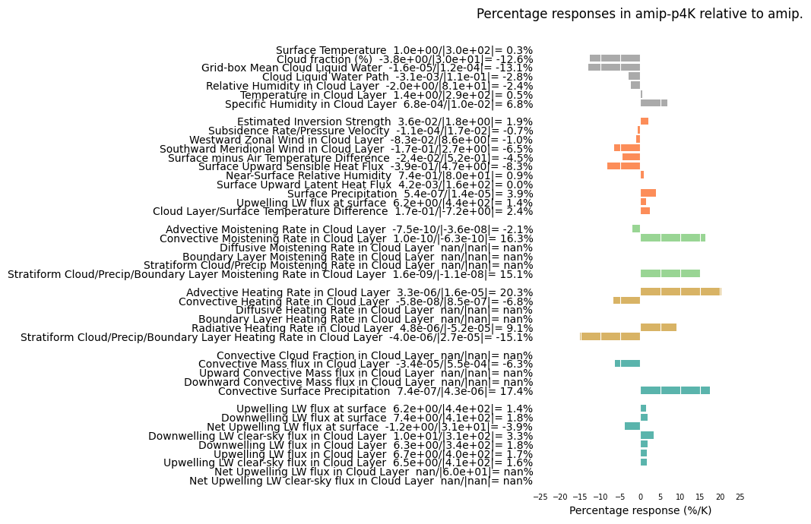
MIROC6
amip+4K percentage responses [137°W, 26°N]

Slide 22
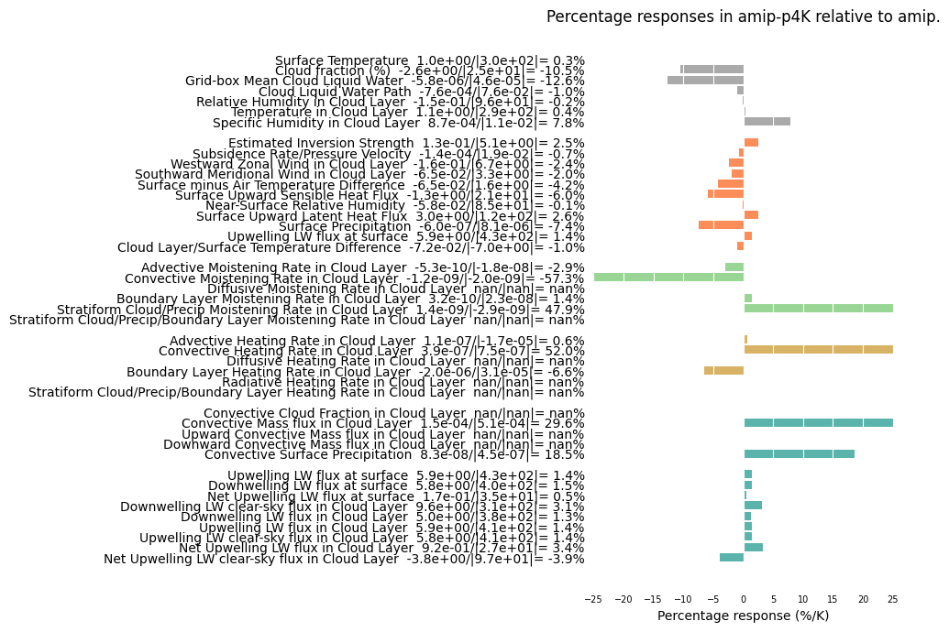
MRI-ESM-2.0
amip+4K percentage responses [137°W, 26°N]

Slide 23
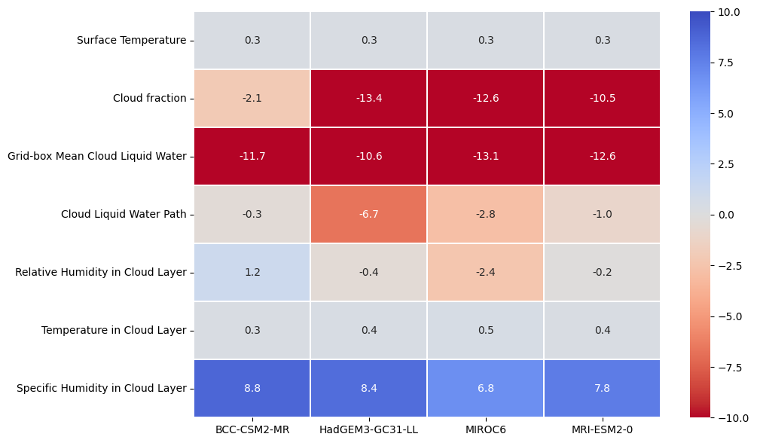
|
Cloud layer properties percentage changes cf control values.
BCC has the largest % increase in q and the smallest % increase in cloud temperature, resulting in a small % increase in RH. Cloud fraction still reduces but the % reduction is smallest across models.
HadGEM3 has the largest % reduction in cloud liquid water path.
MIROC6 has the largest % cloud layer warming and the smallest % increase in cloud layer specific humidity and hence the largest % reduction in RH.
MRI is within the model range for all % responses.
All models except BCC show a drop in cloud-layer RH, consistent with the Ogura and Webb mechanism.

Slide 24
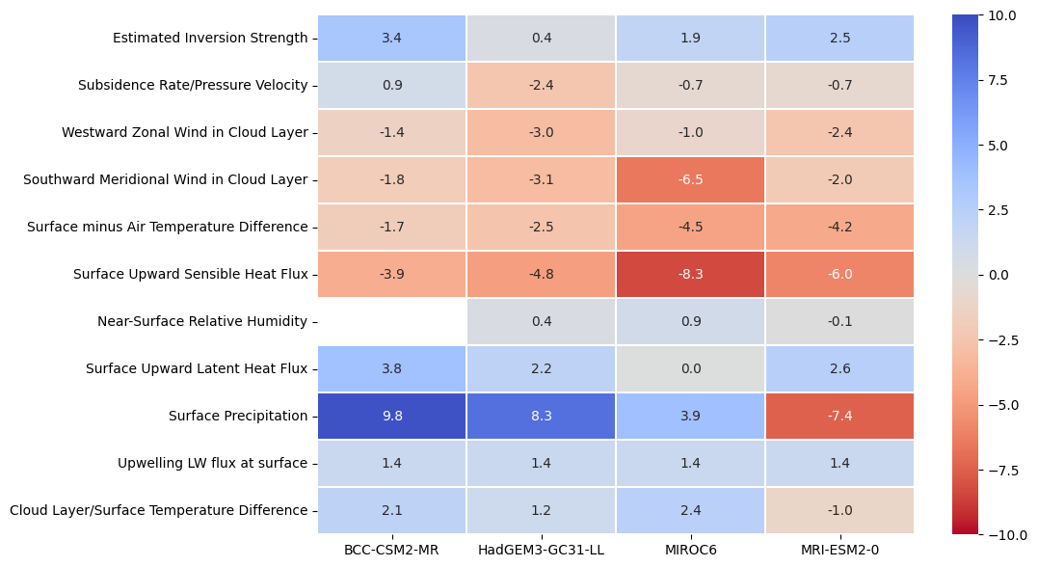
|
Percentage changes relative to control values.
BCC has the largest % increase in EIS and is the only model to show a % increase in subsidence. It has the smallest % reduction in SATD and surface sensible heat flux, and the largest % increases in surface latent heat flux and precipitation.
HadGEM3 has the smallest % increase in EIS, the largest % weakening in subsidence and largest % weakening in westward zonal wind.
MIROC6 has the smallest % reduction in westward zonal wind and the largest % reductions in southward meridional wind, SATD and surface sensible heat flux. It has the largest % increase in near-surface RH and the smallest % increase in surface latent heat flux of zero. It has the largest % increase in cloud/surface temperature difference.
MRI is the only model to show a % reduction in near-surface RH, the only one to show a reduction in surface precipitation and the only one to show a % reduction in cloud/surface temperature difference.
All models except MIROC6 show increasing surface latent heat flux, consistent with Wyant et al deepening warming mechanism.
Show cloud top altitude / boundary layer depth change?

Slide 25
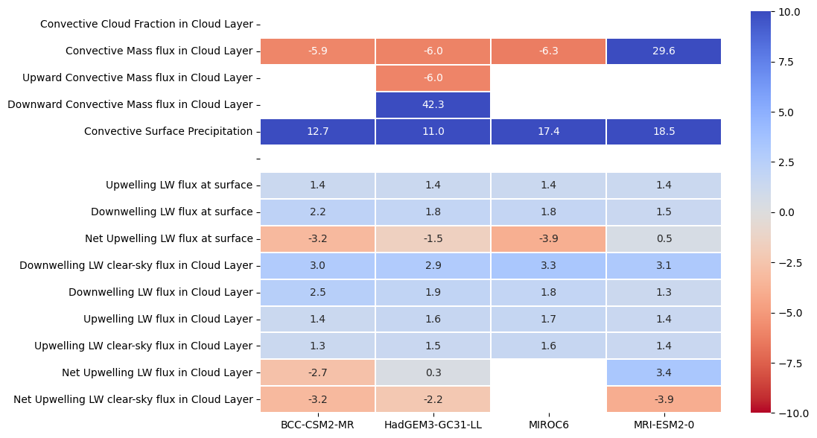
|
Convection & LW flux percentage changes
BCC has the largest % increase downwelling LW flux at the surface and in the cloud layer, and the only reduction in net upwelling LW flux in the cloud layer. It also has the smallest % increase in upwelling clear-sky LW flux in the cloud layer. Enhanced free tropospheric warming?
HadGEM3 has the smallest % increase in convective precipitation. It has the smallest % increase in clear-sky downwelling LW in the cloud layer and the smallest reduction in net upwelling LW clear-sky flux in the cloud layer.
MIROC6 has the largest % reduction in convective mass flux in the cloud layer and the smallest increase in downwelling LW clear-sky flux in the cloud layer. It also has the smallest % reduction in net upwelling LW clear-sky flux in the cloud layer.
MRI is the only model to show an increase in convective mass flux and has the largest increase in convective precipitation. It has the smallest % increase in downwelling LW at the surface and is the only model to show an % increase in net upwelling LW flux at the surface. It has the smallest % increase in downwelling LW flux in the cloud layer and largest % reduction in net upwelling LW clear-sky flux in the cloud layer. Also it has the largest % reduction in net upwelling LW clear-sky flux in the cloud layer.
All models show increasing upwelling LW clear-sky fluxes at the surface and in the cloud layer, consistent with the Ogura and Webb mechanism.
All models show increasing downwelling LW clear-sky fluxes in the cloud layer, consistent with Bretherton et al. TBC

Slide 26
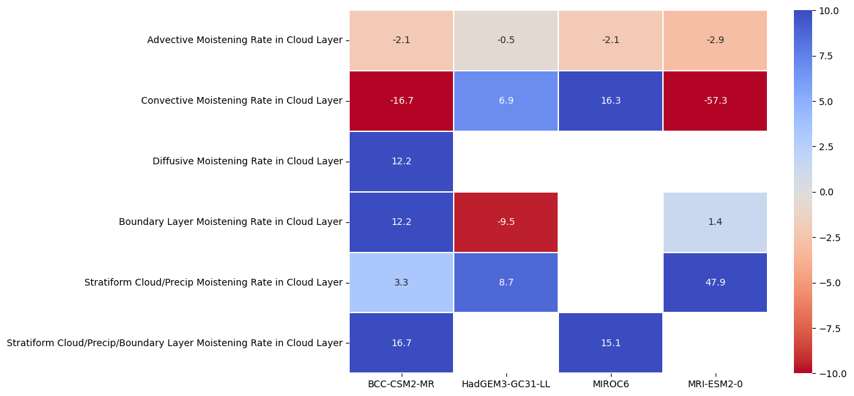
|
Specific humidity tendencies percentage changes
Advective drying increases in all models but other terms look to be important as well.
BCC has the largest % increase in boundary layer moistening. It's largest % drying change is from convection.
HadGEM3 has the smallest % increase in advective drying and the largest % increase in boundary layer drying.
MIROC6 has the largest % increase in convective moistening. It's largest % drying term is the advection term.
MRI has the largest % increase in convective drying.
Would total rather than percentage changes be more informative for the budget terms?
All models show increasing advective drying, consistent with Brient & Bony 2012 mechanism.

Slide 27
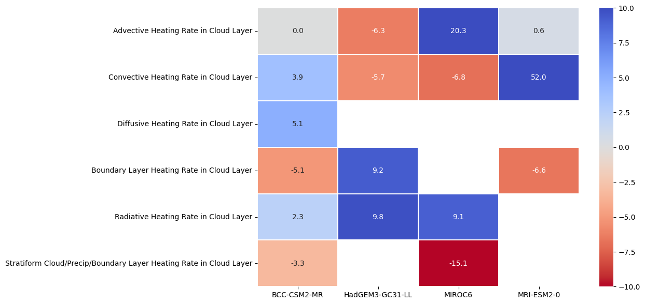
|
Temperature tendencies percentage changes
BCC has the smallest % increase in radiative cooling in the cloud layer, consistent with smallest cloud reduction.
HadGEM3 has the largest % decrease in advective heating in the cloud layer, consistent with largest reduction in subsidence. Also the only model to show an increase in cloud layer heating by the boundary layer scheme. It has the largest % increase in radiative heating of the cloud layer, consistent with having the largest % cloud fraction reduction.
MIROC6 has the largest % reduction in stratiform cloud / precip / boundary layer heating.
MRI has the largest % reduction in convective heating of the cloud layer.
Would total rather than percentage changes be more informative for the budget terms?

Slide 28
|
MRI amip+4K percentage responses [137°W, 26°N]
Responses per K surface warming are expressed as percentages of the absolute magnitudes of their control values.
Responses in heating and moistening rates are relative to the absolute magnitude of control values for the total physics.
+/- symbols indicate the signs of control values.
TEXT BELOW FOR HADGEM3 TBU
Relative humidity in cloud layer increases slightly.
Cloud layer warms more than the surface.
Specific humidity increases at 8%/K surface warming.
EIS increases.
Subsidence and zonal/meridional winds weaken.
Surface SH flux reduces because of weaker winds/air-sea temp difference.
Sfc evap increases < 7%/K due to weaker wind / increased near surface RH.
Surface precip increases by 13%/K.
PBL stabilises.
Advective drying increases due to increased horizontal humidity gradient?
Less moistening by PBL due to reduced LW driven mixing?
Less moistening from evaporating precip.
Less cloud radiative cooling.
Less cooling from evaporating precip.

Slide 29
|
HadGEM3-GC3.1-LL amip+4K percentage responses [137°W, 26°N]
Responses per K surface warming are expressed as percentages of the absolute magnitudes of their control values.
Responses in heating and moistening rates are relative to the absolute magnitude of control values for the total physics.
+/- symbols indicate the signs of control values.
Cloud amount/water reduces.
Relative humidity in cloud layer drops slightly.
Cloud layer warms more than the surface.
Specific humidity increases at 8%/K surface warming.
EIS increases.
Subsidence and zonal/meridional winds weaken.
Surface SH flux reduces because of weaker winds/air-sea temp difference.
PBL stabilises.
Sfc evap increases < 7%/K due to weaker wind / increased near surface RH.
Surface precip increases by 13%/K.
Advective drying increases due to increased horizontal humidity gradient?
Less moistening by PBL due to reduced LW driven mixing?
Less moistening from evaporating precip.
Less cloud radiative cooling.
Less cooling from evaporating precip.

Slide 30
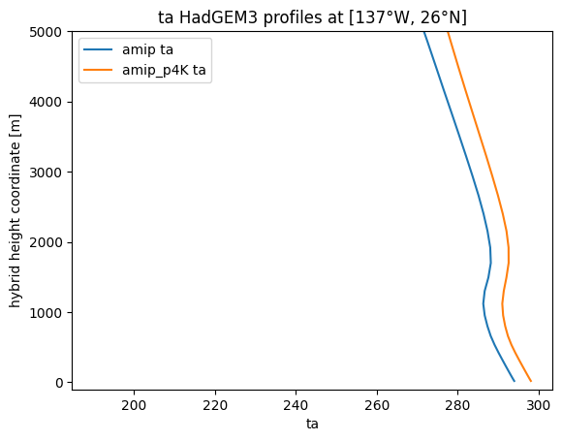
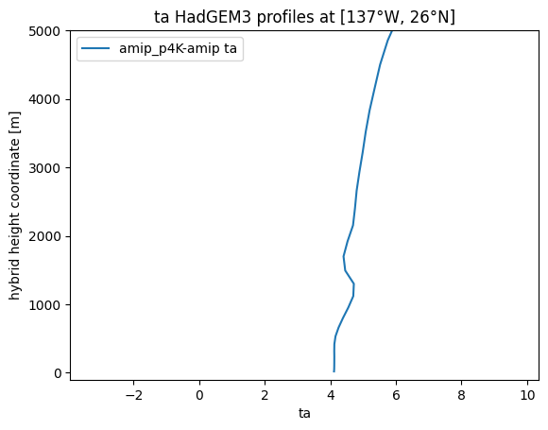
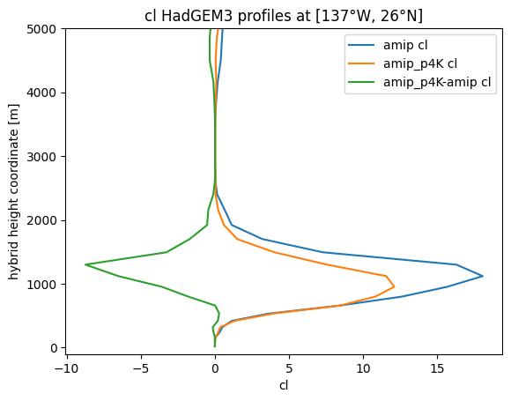
|
Atmospheric Temperature [137°W, 26°N] JJA
www.metoffice.gov.uk
© Crown Copyright, Met Office 2021

Slide 31
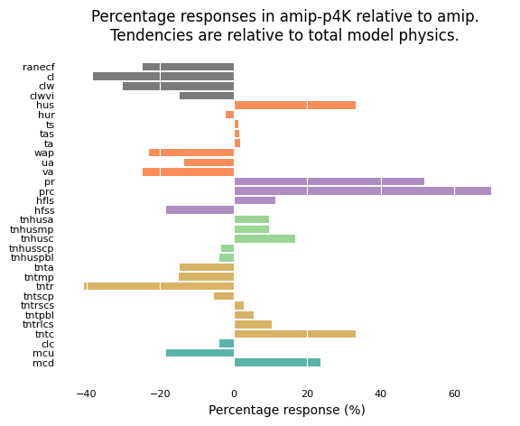
|
HadGEM3-GC3.1-LL amip+4K percentage responses
Californian Stratocumulus / Trade cumulus transition region [137°W, 26°N]
Cloud layer warms more than surface / more stable.
Grid-box mean cloud water decreases less than cloud fraction => increasing in-cloud water.
Relative humidity in cloud layer drops – T or q?
Subsidence and horizonal winds weaken.
Surface evaporation increases / sensible heat flux decreases.
Precip increases faster than surface latent heat flux and specific humidity – increased specific humidity gradients ?
More advective drying / physics moistening.
Additional moistening comes from convection.
Less advective heating in cloud layer likely due to weaker subsidence.
Less cooling in cloud layer by model physics, mainly due to reduced cloud radiative cooling but some reduction in cooling from evaporating precipitation.
Reduced convective cloud fraction/mass flux but increased convective precipitation.
www.metoffice.gov.uk
© Crown Copyright, Met Office 2021

Slide 32
|
HadGEM3-GC3.1-LL amip+4K percentage responses [137°W, 26°N]
Responses per K surface warming are expressed as percentages of the absolute magnitudes of their control values.
Responses in heating and moistening rates are relative to the absolute magnitude of control values for the total physics.
+/- symbols indicate the signs of control values.
Cloud amount/water reduces.
Relative humidity in cloud layer drops slightly.
Cloud layer warms more than the surface.
Specific humidity increases at 8%/K surface warming.
EIS increases.
Subsidence and zonal/meridional winds weaken.
Surface SH flux reduces because of weaker winds/air-sea temp difference.
PBL stabilises.
Sfc evap increases < 7%/K due to weaker wind / increased near surface RH.
Surface precip increases by 13%/K.
Advective drying increases due to increased horizontal humidity gradient?
Less moistening by PBL due to reduced LW driven mixing?
Less moistening from evaporating precip.
Less cloud radiative cooling.
Less cooling from evaporating precip.

Slide 33
|
MIROC6 amip+4K percentage responses [145°W, 20°N]
Responses per K surface warming are expressed as percentages of the absolute magnitudes of their control values.
Responses in heating and moistening rates are relative to the absolute magnitude of control values for the total physics.
+/- symbols indicate the signs of control values.
Cloud amount/water reduces.
Relative humidity in cloud layer drops slightly.
Cloud layer warms less than than the surface.
Specific humidity increases at 7%/K surface warming.
EIS increases.
Subsidence weakens less than in hadgem3
zonal/meridional winds weaken.
Surface SH flux reduces because of weaker winds/air-sea temp difference.
Sfc evap increases <<< 7%/K due to weaker wind / increased near surface RH.
Surface precip increases by < 7%/K.
PBL destabilises.
Advective drying increases due to increased horizontal humidity gradient?
V little change in convection
More moistening by PBL
Big increase in advective heating b/c subs doesn’t weaken much?
Less cloud radiative cooling.
Much less heating from SCP/PBL

Slide 34
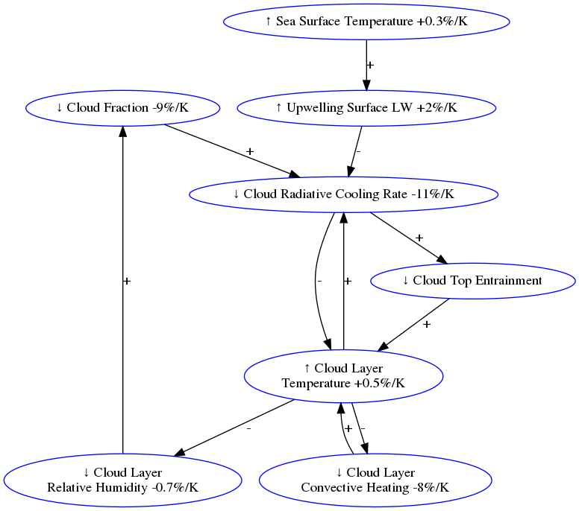
|
Hypothesised positive low cloud feedback mechanism
The specific humidity budget in the cloud layer suggests that the cloud feedback would be negative if the cloud layer warmed at the same rate as the surface.
The cloud layer warms more than the surface, leading to a drop in relative humidity and hence cloud fraction.
We suggest that the cloud layer may be heated initially by increased radiative heating from the surface as proposed by Ogura and Webb (submitted) - see Tomoo Ogura's poster.
The temperature budget for the cloud layer suggests a positive feedback between LW cooling, cloud layer temperature and RH and cloud fraction.
This positive feedback may be damped by negative feedbacks due to Newtonian cooling of the cloud layer, LW driven cloud top entrainment and convective heating.
This hypothesis could be tested in future work by perturbing various quantities in turn or fixing them to break causal links.
www.metoffice.gov.uk
© Crown Copyright, Met Office 2021

Slide 35
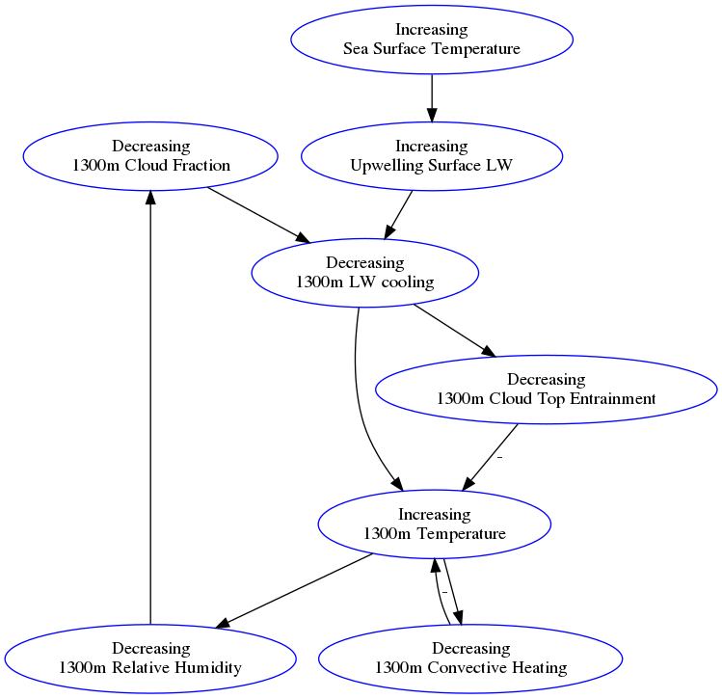
|
Hypothesised positive low cloud feedback mechanism
The cloud layer warms more than the surface, leading to a drop in relative humidity and hence cloud fraction.
The specific humidity budget in the cloud layer suggests that the cloud feedback would be negative if the cloud layer warmed at the same rate as the surface.
We suggest that the cloud layer may be heated initially by increased radiative heating from the surface as proposed by Ogura and Webb (submitted) - see Tomoo Ogura's poster.
The temperature budget for the cloud layer suggests a positive feedback between LW cooling, cloud layer temperature and RH and cloud fraction.
This positive feedback may be damped by negative feedbacks due to LW driven cloud top entrainment and convective heating.
This hypothesis could be tested in future work by perturbing various quantities in turn or fixing them break causal links.
www.metoffice.gov.uk
© Crown Copyright, Met Office 2021

