Slide 1


Model spread in the tropical low cloud feedback tied to overturning circulation response to warming
Photo: Will Tomanek
Kathleen Schiro
University of Virginia
In collaboration with Hui Su (JPL/UCLA), Fiaz Ahmed (UCLA), Clare Singer (Caltech), Ni Dai (UCLA), Greg Elsaesser (GISS), Pierre Gentine (Columbia), Jonathan Jiang (JPL), David Neelin (UCLA)
We gratefully acknowledge the funding support from NASA-MAP, NASA-TASNPP, NOAA-MAPP, and DOE-RGMA programs.

Slide 2
Photo: Discover Magazine
Tropical low cloud feedbacks are known to be a root cause of uncertainty in the strength of the total cloud feedback parameter and the intermodel spread in equilibrium climate sensitivity (ECS) (Bony and Dufresne, 2005; Webb et al., 2006; Medeiros et al., 2008; Vial et al., 2013).
Notes:
Feedbacks from clouds in the planetary boundary layer over oceans (Fig. 1), which make one of the largest contributions to intermodel spread in climate sensitivity, seem to be driven largely by mixing of the lower troposphere by shallow convection^{2,15,16,17}; in a warmer climate, these processes are expected to dry the marine boundary layer over the vast expanse of the tropical oceans, reducing the low-cloud amount and the Earth's albedo in a way that amplifies warming.

Slide 3
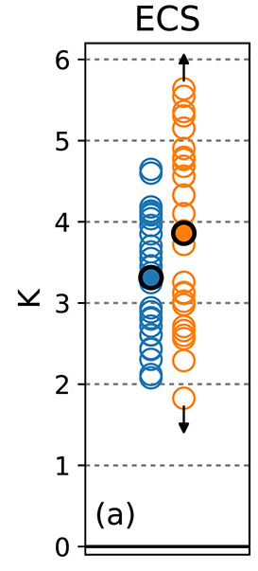
Zelinka et al. (2020)
Photo: Discover Magazine
CMIP6
CMIP5
Tropical low cloud feedbacks are known to be a root cause of uncertainty in the strength of the total cloud feedback parameter and the intermodel spread in equilibrium climate sensitivity (ECS) (Bony and Dufresne, 2005; Webb et al., 2006; Medeiros et al., 2008; Vial et al., 2013).
Notes:
Feedbacks from clouds in the planetary boundary layer over oceans (Fig. 1), which make one of the largest contributions to intermodel spread in climate sensitivity, seem to be driven largely by mixing of the lower troposphere by shallow convection^{2,15,16,17}; in a warmer climate, these processes are expected to dry the marine boundary layer over the vast expanse of the tropical oceans, reducing the low-cloud amount and the Earth's albedo in a way that amplifies warming.
The 1.5–4.5 K spread in model ECS has remained fairly constant since the first multimodel assessment²⁶. However, the new generation of GCMs includes a number of models with even greater ECS²⁷, which is largely attributed to contributions from low-cloud feedbacks, mostly at mid-latitudes and partly in the tropics. A simple comparison of the relationship between low-cloud feedbacks and ECS of the previous and current generations of GCMs suggests that an increase in tropical low-cloud feedbacks explains up to one-third of the ECS increase (Supplementary Fig. 11), consistent with a more detailed analysis (referencing Zelinka et al. (2020))

Slide 4
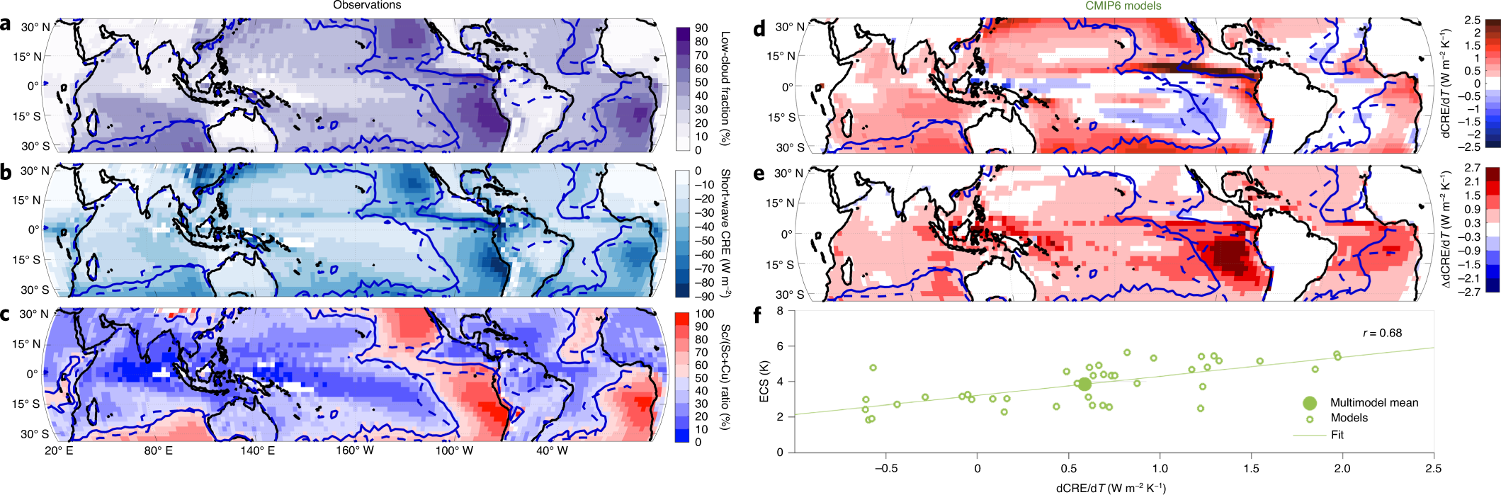
Zelinka et al. (2020)
Photo: Discover Magazine
Cesana and Del Genio (2021)
CMIP6
CMIP5
Tropical low cloud feedbacks are known to be a root cause of uncertainty in the strength of the total cloud feedback parameter and the intermodel spread in equilibrium climate sensitivity (ECS) (Bony and Dufresne, 2005; Webb et al., 2006; Medeiros et al., 2008; Vial et al., 2013).
Notes:
Feedbacks from clouds in the planetary boundary layer over oceans (Fig. 1), which make one of the largest contributions to intermodel spread in climate sensitivity, seem to be driven largely by mixing of the lower troposphere by shallow convection^{2,15,16,17}; in a warmer climate, these processes are expected to dry the marine boundary layer over the vast expanse of the tropical oceans, reducing the low-cloud amount and the Earth's albedo in a way that amplifies warming.
The 1.5–4.5 K spread in model ECS has remained fairly constant since the first multimodel assessment²⁶. However, the new generation of GCMs includes a number of models with even greater ECS²⁷, which is largely attributed to contributions from low-cloud feedbacks, mostly at mid-latitudes and partly in the tropics. A simple comparison of the relationship between low-cloud feedbacks and ECS of the previous and current generations of GCMs suggests that an increase in tropical low-cloud feedbacks explains up to one-third of the ECS increase (Supplementary Fig. 11), consistent with a more detailed analysis (referencing Zelinka et al. (2020))

Slide 5
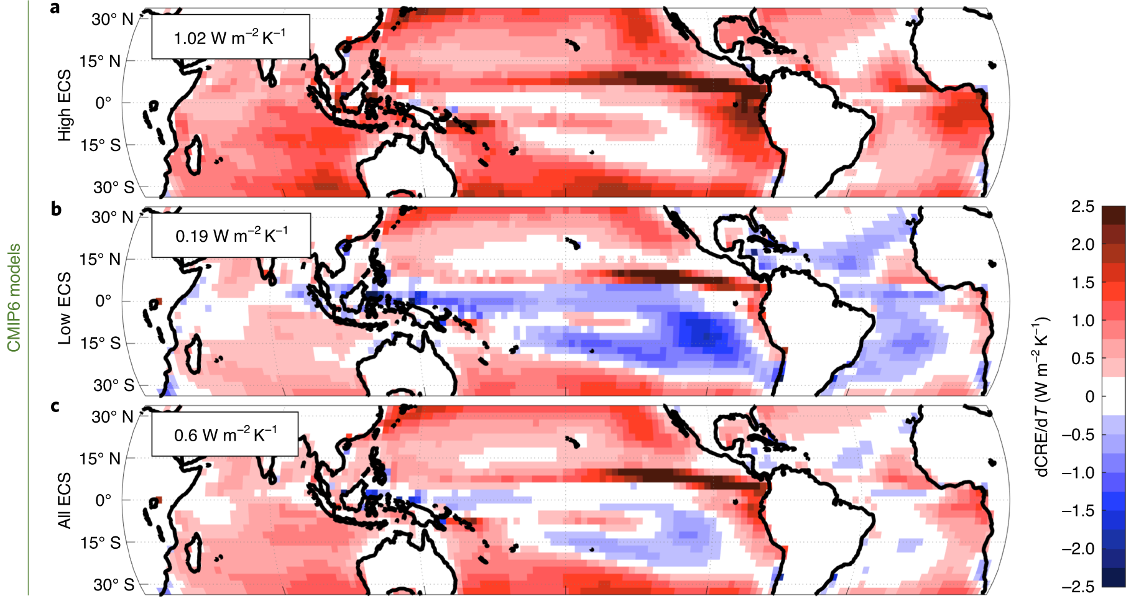
Large intermodel differences in dSWCRE/dTs among high vs. low ECS models
Cesana and Del Genio (2021)

Slide 6
Large intermodel differences in dSWCRE/dTs among high vs. low ECS models
Cesana and Del Genio (2021)

Slide 7
Large intermodel differences in dSWCRE/dTs in stratocumulus regions
Cesana and Del Genio (2021)

Slide 8
Large intermodel differences in dSWCRE/dTs also along convective margins
Cesana and Del Genio (2021)

Slide 9
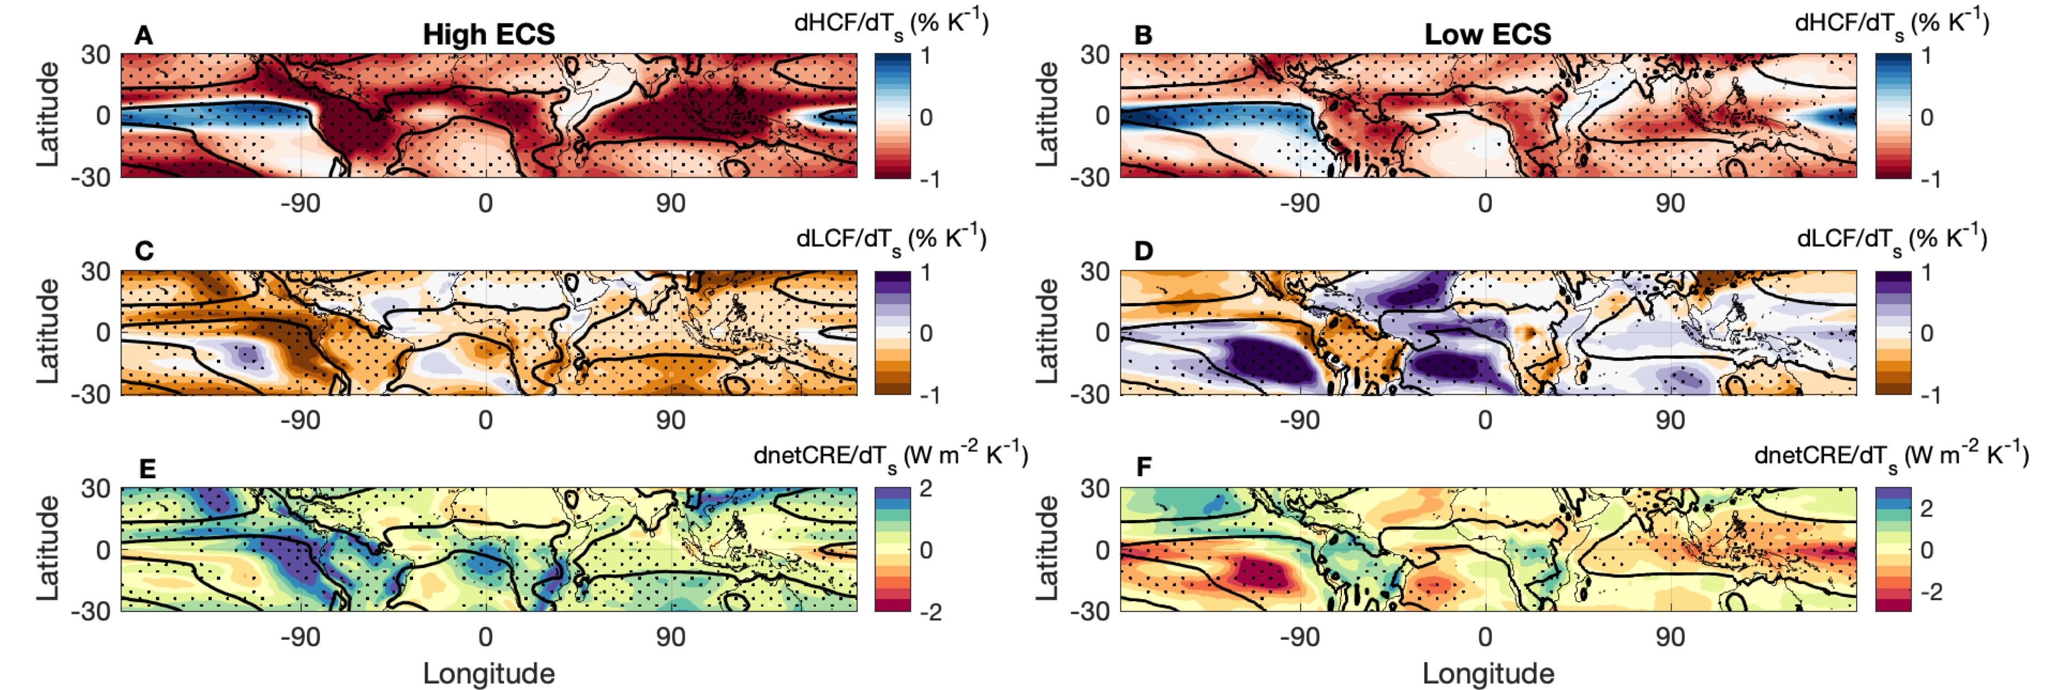
Large intermodel differences in dHCF/dTs and dLCF/dTs among high vs. low ECS models.
How interrelated are high and low cloud changes?
Schiro et al. (2022), Nat. Comm. in revision

Slide 10
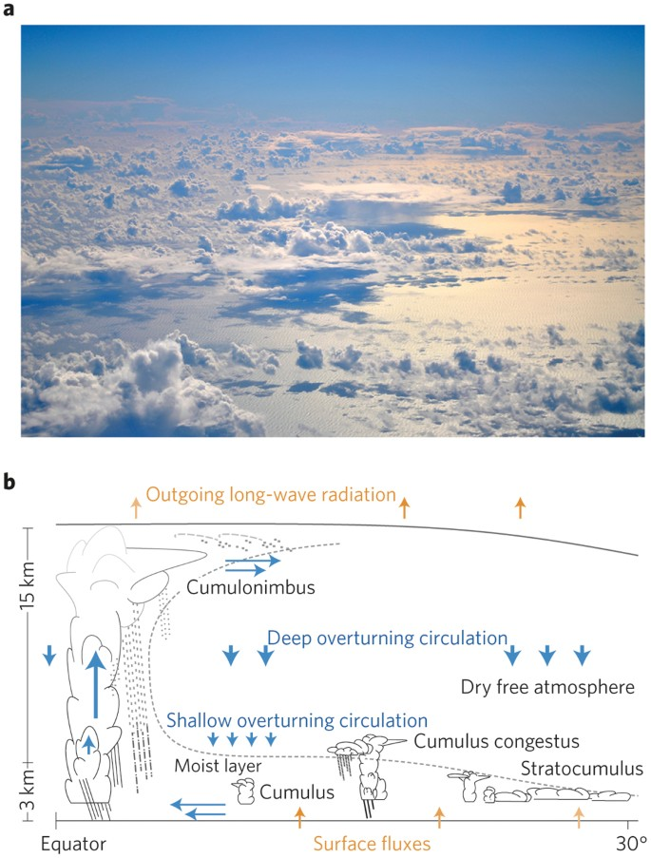
Simulation of climate and climate sensitivity has been shown to be sensitive to deep convective processes and process representation in GCMs (e.g. Sherwood et al. 2014; Zhao 2014; Tomassini et al. 2014; Zhao et al. 2016, Wang and Zhang 2016).
Bony et al. (2015)
How do deep convective processes in the ascent region affect dynamic and thermodynamic factors controlling low cloud populations across the tropics?
Notes:
Feedbacks from clouds in the planetary boundary layer over oceans (Fig. 1), which make one of the largest contributions to intermodel spread in climate sensitivity, seem to be driven largely by mixing of the lower troposphere by shallow convection^{2,15,16,17}; in a warmer climate, these processes are expected to dry the marine boundary layer over the vast expanse of the tropical oceans, reducing the low-cloud amount and the Earth's albedo in a way that amplifies warming.

Slide 11
How is the tropical ascent region changing under anthropogenic warming?

Slide 12
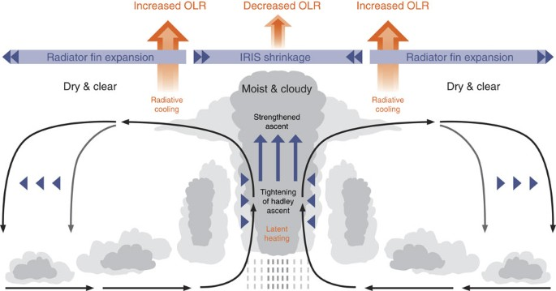
The tropical ascent area (Aa) is reducing.
Su et al. (2017)
Notes:
The differences in SWCRE in the deep tropics in the trade cumulus regime among high and low ECS models made us wonder about possible linkages to changing ITCZ dynamics. We know that the ITCZ is supposed to narrow in a warmer world, and to what extent this change modifies low cloud fraction in both the trade cumulus and subtropical stratocumulus regimes became of great interest to us. (Explain Figure)

Slide 13
The frequency of heavy precipitation is increasing.
Su et al. (2017)
Notes:
The differences in SWCRE in the deep tropics in the trade cumulus regime among high and low ECS models made us wonder about possible linkages to changing ITCZ dynamics. We know that the ITCZ is supposed to narrow in a warmer world, and to what extent this change modifies low cloud fraction in both the trade cumulus and subtropical stratocumulus regimes became of great interest to us. (Explain Figure)

Slide 14
These changes to deep convection result in less detrainment of water vapor and condensate.
The intermodel spread in ascent area changes linked to intermodel spread in high cloud fraction changes.
The intermodel spread in heavy precipitation frequency linked to intermodel spread in UT RH.

Slide 15
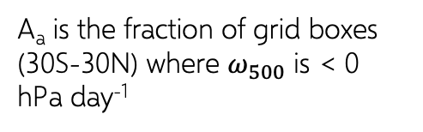
A smaller tropical ascent area (fewer high clouds) is seen in models with higher ECS.
Data: CMIP6 SSP5-8.5, future (2086-2100) minus historical (2000-2014), land + ocean
A_{a} is the fraction of grid boxes (30S-30N) where $ω_{500}$ is < 0 hPa day⁻¹
Schiro et al. (2022), Nat. Comm. in revision

Slide 16
More frequent heavy precipitation (lower UT RH) in models with higher ECS.
Data: CMIP6 SSP5-8.5, future (2086-2100) minus historical (2000-2014), land + ocean
F_{p>10} is the fraction of grid boxes (30S-30N) where precipitation exceeds 10 mm day⁻¹ in monthly averaged output.
Schiro et al. (2022), Nat. Comm. in revision

Slide 17
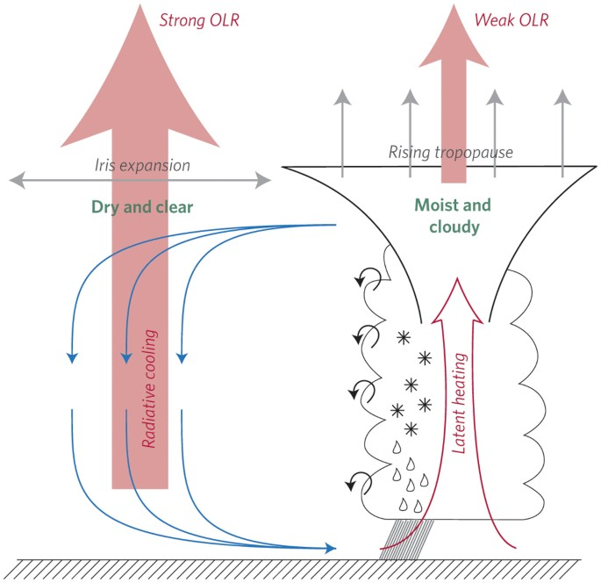

Schematic: Mauritsen and Stevens (2015)
But shouldn’t reduced HCF and UT RH lead to a negative longwave cloud feedback and promote lower ECS, not higher ECS?
“Iris Hypothesis” – Lindzen et al. (2001)

Slide 18
How is the overturning circulation changing under anthropogenic warming?

Slide 19
Subsidence weakening in subtropical regions is generally more pronounced in low ECS models than high ECS models.
Schiro et al. (2022), Nat. Comm. in revision

Slide 20
East Pacific
East Atlantic
Stippling is where more than ¾ of the models agree on the sign of the change
Schiro et al. (2022), Nat. Comm. in revision

Slide 21
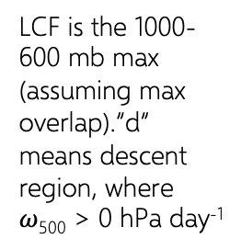
Stronger subsidence generally disfavors low cloudiness in the presence of a strong inversion (Myers and Norris 2013).
When stronger subsidence is preserved in the future (less weakening) this promotes a greater reduction of low cloudiness.
Data: CMIP6 SSP5-8.5, future (2086-2100) minus historical (2000-2014), land + ocean.
LCF is the 1000-600 mb max (assuming max overlap).”d” means descent region, where $ω$₅₀₀ > 0 hPa day⁻¹
Schiro et al. (2022), Nat. Comm. in revision

Slide 22
What controls the subsidence rate and its changes under warming?

Slide 23
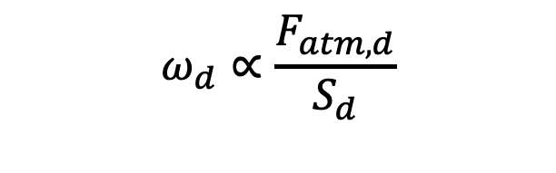
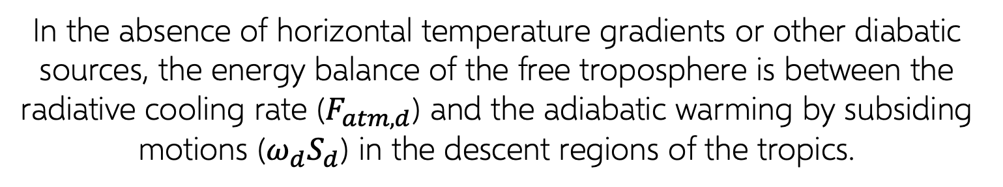
In the absence of horizontal temperature gradients or other diabatic sources, the energy balance of the free troposphere is between the radiative cooling rate ($F_{atm,d}$) and the adiabatic warming by subsiding motions ($ω_{d}S_{d}$) in the descent regions of the tropics.
$$ω_{d}∝\frac{F_{atm,d}}{S_{d}}$$

Slide 24
In the absence of horizontal temperature gradients or other diabatic sources, the energy balance of the free troposphere is between the radiative cooling rate ($F_{atm,d}$) and the adiabatic warming by subsiding motions ($ω_{d}S_{d}$) in the descent regions of the tropics.
$$ω_{d}∝\frac{F_{atm,d}}{S_{d}}$$
Increase radiative cooling, increase subsidence.
Decrease tropospheric stability, increase subsidence.

Slide 25
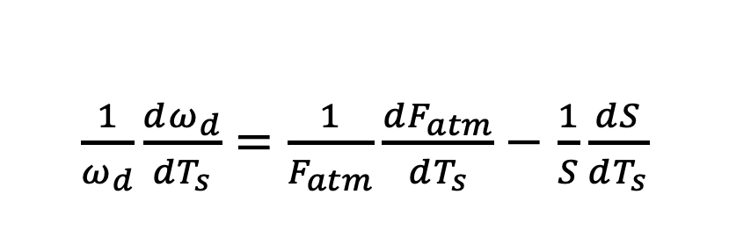
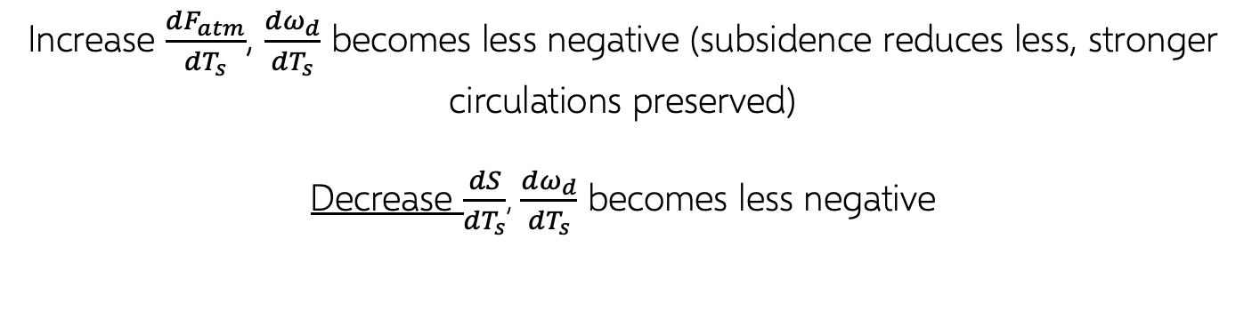
In the absence of horizontal temperature gradients or other diabatic sources, the energy balance of the free troposphere is between the radiative cooling rate ($F_{atm,d}$) and the adiabatic warming by subsiding motions ($ω_{d}S_{d}$) in the descent regions of the tropics.
$\frac{1}{ω_{d}}\frac{dω_{d}}{dT_{s}}=$ $\frac{1}{F_{atm}}\frac{dF_{atm}}{dT_{s}}−$ $\frac{1}{S}\frac{dS}{dT_{s}}$
negative
Increase $\frac{dF_{atm}}{dT_{s}}$, $\frac{dω_{d}}{dT_{s}}$ becomes less negative (subsidence reduces less, stronger circulations preserved)
Decrease $\frac{dS}{dT_{s}}$, $\frac{dω_{d}}{dT_{s}}$ becomes less negative

Slide 26
What controls the subsidence rate and its changes under warming?
Part 1: Radiative Cooling

Slide 27
The intermodel spread in subsidence rate changes strongly linked to the intermodel spread in changing OLR_{d}
Intermodel spread in OLR_{d} explained by changes in high cloudiness, which relates to ascent area changes
… and UT RH changes, which relates to changes in the frequency of heavy precipitation
Schiro et al. (2022), Nat. Comm. in revision

Slide 28
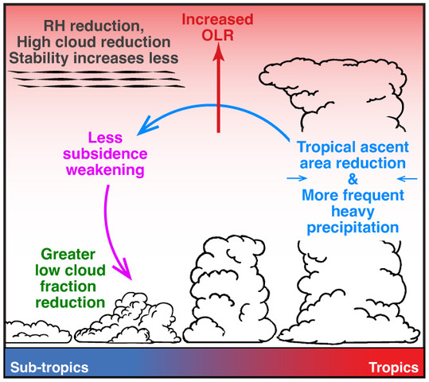
“Radiation-Subsidence Pathway”
Schiro et al. (2022), Nat. Comm. in revision

Slide 29
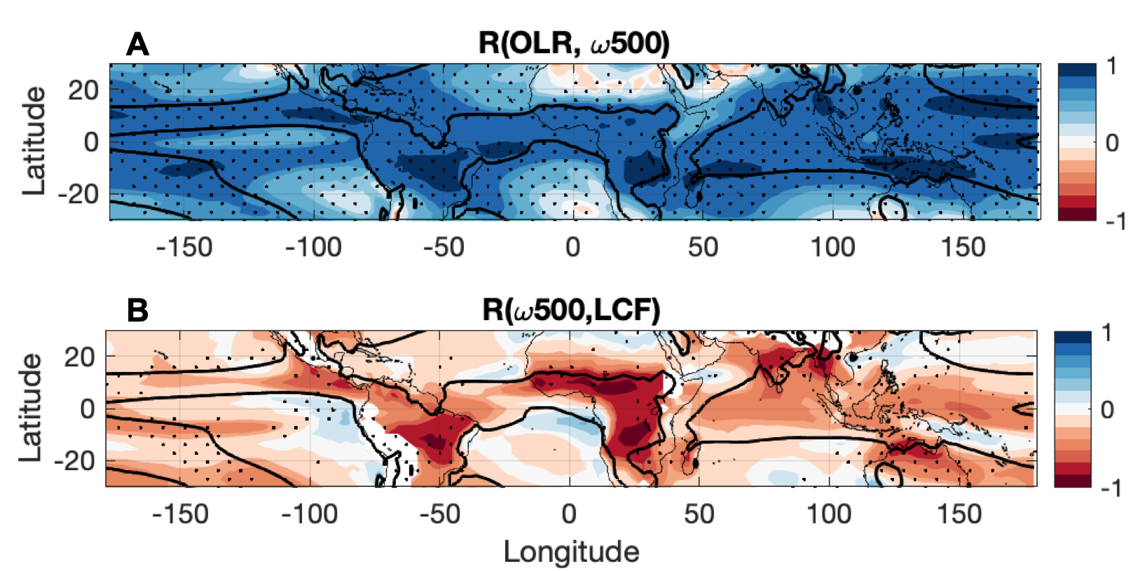
Radiation-Subsidence Pathway likely acting most strongly along convective margins.
Relationships between OLR and $ω$₅₀₀ are most significant along convective margins (dark blue), which correspond to the areas where $ω$₅₀₀ and LCF relate most closely.
Schiro et al. (2022), Nat. Comm. in revision

Slide 30
What controls the subsidence rate and its changes under warming?
Part 2: Stability

Slide 31
The intermodel spread in upper tropospheric stability tied very closely to the intermodel spread in subsidence rate.
Changes to stability are not independent of OLR and are likely driven in large part by the changes in radiative heating.
Schiro et al. (2022), Nat. Comm. in revision

Slide 32
“Stability-Subsidence Pathway”
Schiro et al. (2022), Nat. Comm. in revision

Slide 33
The intermodel spread in mean-state stability also tied very closely to the intermodel spread in subsidence rate.
Changes to mean-state stability are driven less by radiative processes (OLR) and more by diabatic processes (our proxy here: F_{p>10})
Schiro et al. (2022), Nat. Comm. in revision

Slide 34
What could control mean-state static stability differences among models?
A
B
Static stability higher in climates with lower entrainment
Less stable = stronger subsidence
Stronger subsidence = fewer low clouds
Increasing entrainment
Increasing entrainment
1-5 are tropical mean climatologies in CAM5.3 simulated with increasing entrainment
Schiro et al. (2022), Nat. Comm. in revision

Slide 35
Higher entrainment means convection needs a more unstable environment in order to fire due to the enhanced sensitivity of convection to lower tropospheric (LT) moisture.
In order to maintain energy balance, the system shifts towards a more unstable state.
Schiro et al. (2022), Nat. Comm. in revision

Slide 36
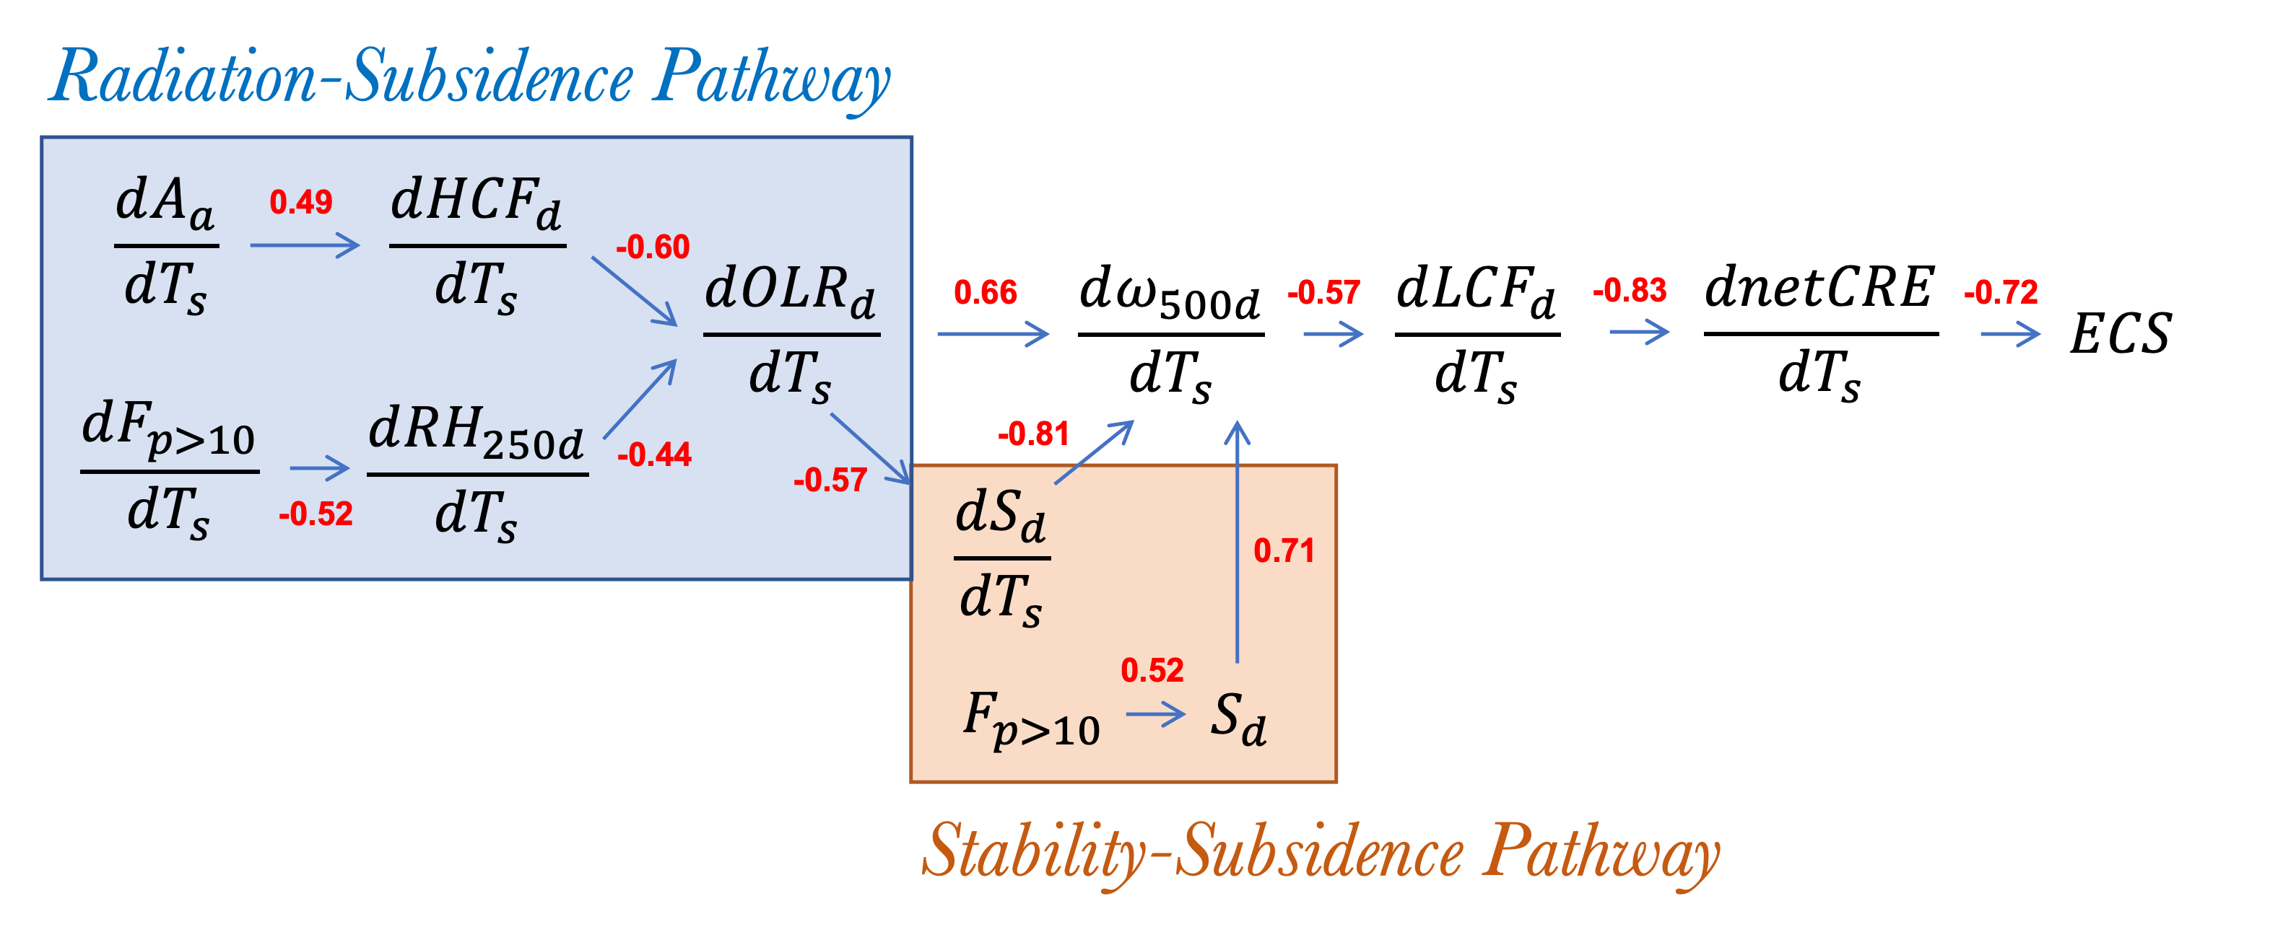
Summary

Slide 37
Summary
A reduction of high cloudiness and enhanced free tropospheric drying (negative longwave feedback) due to ascent area reduction and an increase in frequency of heavy precipitation under anthropogenic warming leads to a net positive cloud feedback in CMIP6 models by contributing to a reduction in low cloudiness (positive shortwave feedback).
Two pathways linking changes to deep convection and low cloudiness through changes to subsidence rate:
  Radiation-Subsidence Pathway
  Stability Pathway
Varying pathway strengths contribute considerably to the intermodel spread in climate sensitivity.
Thank you!

Slide 39
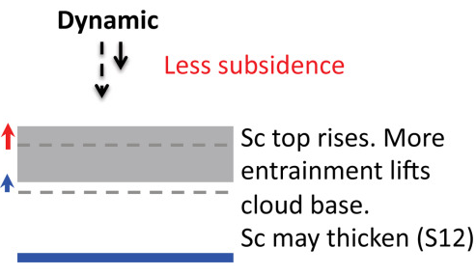
Bretherton et al. (2013)
Weaker subsidence pushes down on the MBL less strongly, allowing clouds to grow higher and thicken, thereby favoring more low-level cloud.
Notes:
a stronger inversion reduces entrainment drying and warming, thus leading to a more humid boundary layer and greater cloud thickness, liquid water path, and cloud fraction

Slide 40
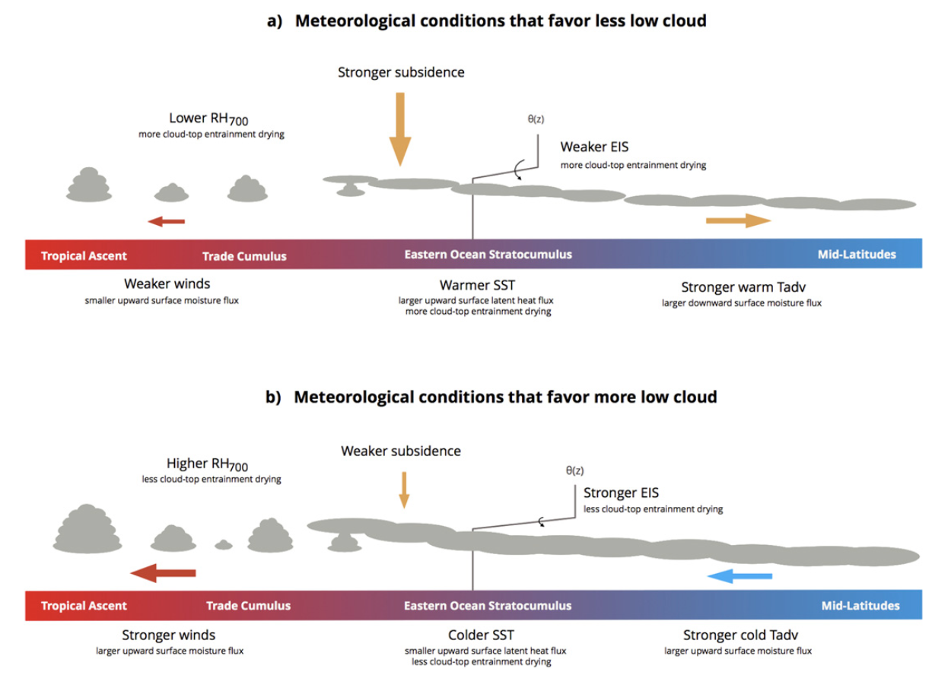
Scott et al. (2020)

Slide 41
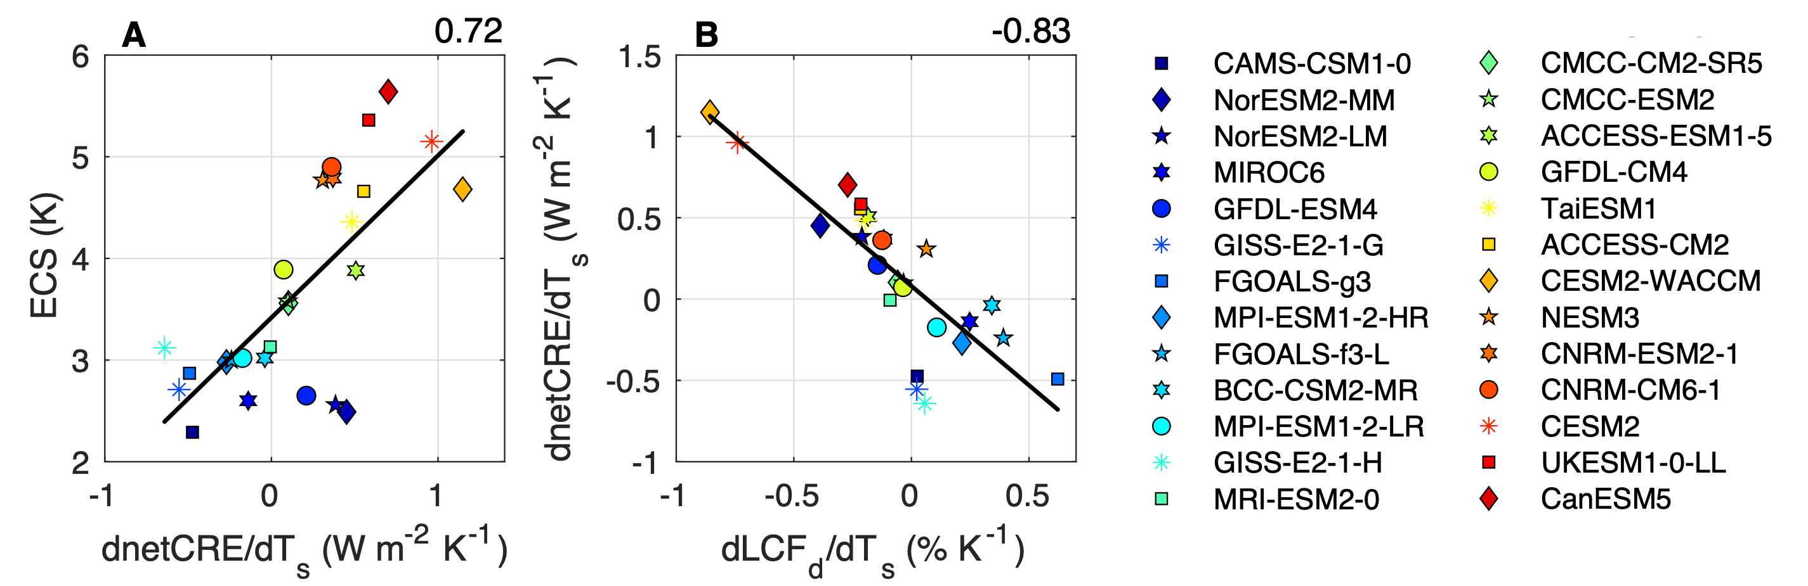

Slide 42
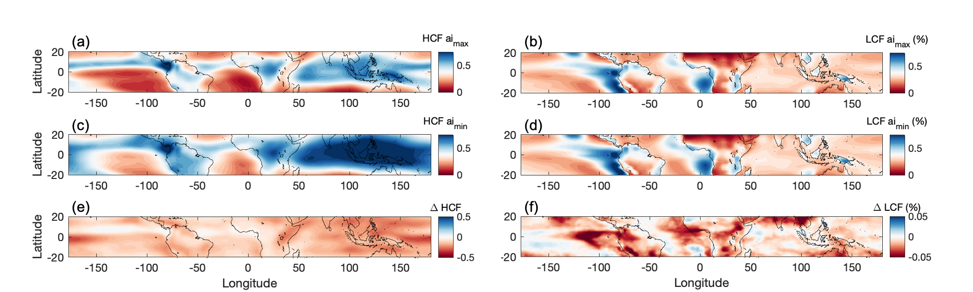
(left column) The mean HCF in CAM5.3 with the fall speed of stratiform ice modified to be (a) 1400 s⁻¹ (double the default value of 700 s⁻¹) and (c) 350 s⁻¹ (half of the default value). The difference between panels a and c is shown in (e). (right column) The mean LCF in CAM5.3 with the fall speed of stratiform ice modified to be (b) 1400 s⁻¹ (double the default value of 700 s⁻¹) and (d) 350 s⁻¹ (half of the default value). The difference between panels b and d is shown in (f).

Slide 43
A
Results from an atmosphere-only experiment in which longwave cloud radiative effects were disabled (lwoff). The control climate (lwon) is subtracted from the lwoff mean climate to reflect changes in (a) OLR, (b) LTS, and (c) LCF across the tropics. OLR units are in W m⁻², LTS units are in K, and LCF units are in %.
B
Latitude
C
Longitude
Notes:
This is for CNRM-CM6-1

Slide 45
A
B
The local Pearson correlation coefficients (R) between (a) RH₇₀₀ and LCF, and (b) dRH₇₀₀/dT_{s} and dLCF/dT_{s}. In (a), each model’s R, calculated for all 180 months at a given grid cell, is averaged together to produce the color shading. In (b), the color shading is the R among the d/dT_{s} values at each point for the 26 models used in this study. Stippling indicates where correlations are statistically significantly correlated at 95% (p < 0.05).

