Slide 1
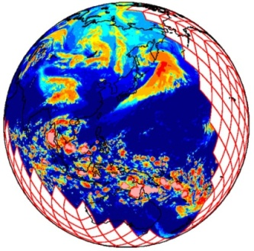
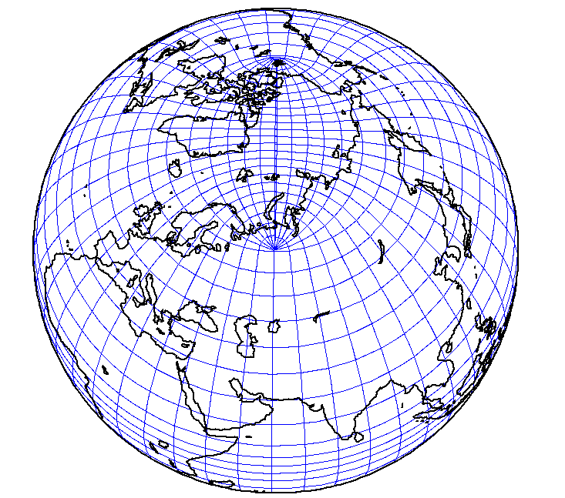


Global storm and ocean-eddy
resolving earth system models
Tomoki Miyakawa and Daniel Klocke

Slide 2
DYAMOND Phase 2
&
some works by NICAM/NICOCO on Fugaku
&
a view into the near future
Tomoki Miyakawa and Daniel Klocke

Slide 3
DYAMOND Phase 2
&
some works by NICAM/NICOCO on Fugaku
&
a view into the near future
Tomoki Miyakawa and Daniel Klocke

Slide 4
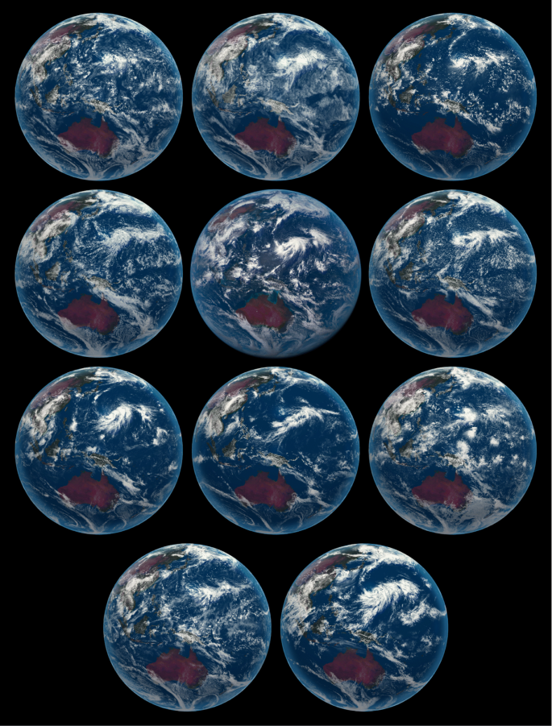
DYAMOND Phase 2
Stevens et al. 2019
Miyakawa and Klocke et al. in preparation, visualized by Flo

Slide 5

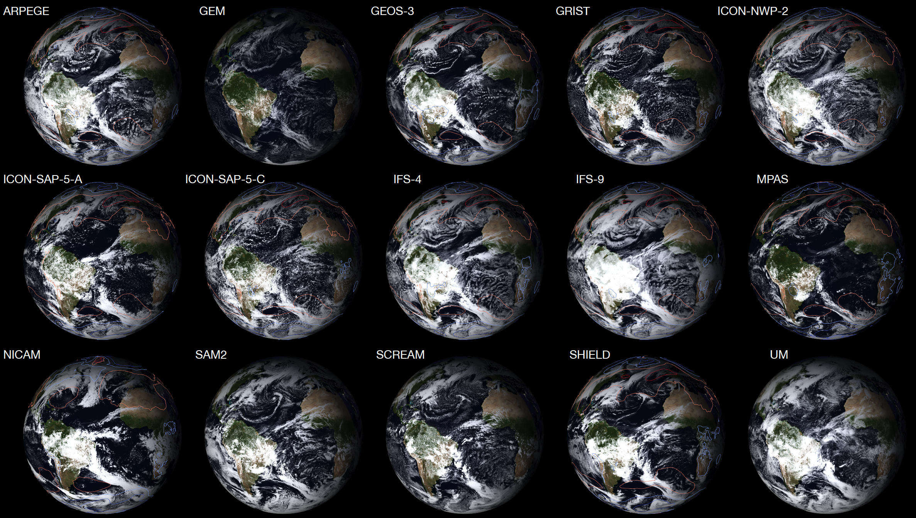
DYAMOND Phase 2
With huge thanks to:
Florian Ziemen as Flo @DKRZ
Stevens et al. 2019
Miyakawa and Klocke et al. in preparation, visualized by Flo

Slide 6
DYAMOND Phase 2
With huge thanks to:
Florian Ziemen as Flo @DKRZ
Stevens et al. 2019
Julia Duras, Ludovic Auger, Ron McTaggart-Cowan, William Putman, Peter Dueben, Thomas Rackow, Falko Judt, Crolyn Reynolds, Tamaki Suematsu, Luca Harris, Marat Khairoutdinov, Peter Caldwell, Pier Luigi Vidale, Nils Wedi, Claudia Stephan, Rene Redler, Christopher Ryutaro Terai, Benoit Vanniere, Jian Li, Yi Zhang, Masaki Satoh, Bjorn Stevens, and hundreds more behind the scenes…
Miyakawa and Klocke et al. in preparation, visualized by Flo

Slide 7
Experiment protocols of phase 2 (DYAMOND-Winter)
Setup: Sub-5 km mesh global models
Period: 40 days starting from Jan 20th, 2020 (EUREC4A)
Initial state: ECMWF operational forecast
Spirit: “Don’t try to be precise, do what you can”

Slide 8
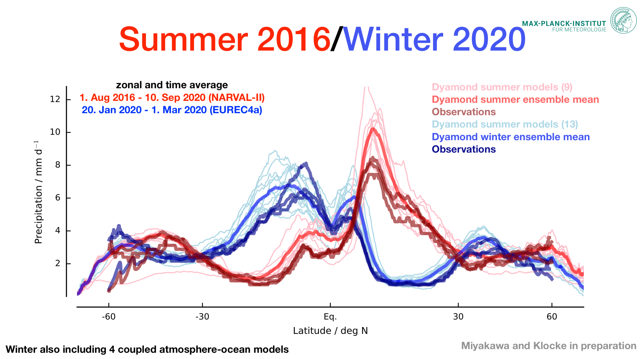
winter
Miyakawa and Klocke et al. in preparation

Slide 9
Diurnal cycles over ocean (solid) and over land (dashed), 20N-20S
mm/h
Precipitation
hrs
Local time

Slide 10
Asian monsoon, pentad #4 (day 16 - 20)
Model A
Model B
Model C
Model D
2m Temperature (colors, anomaly from ensemble mean)
10m U , V (vectors, raw value)
[K]

Slide 11
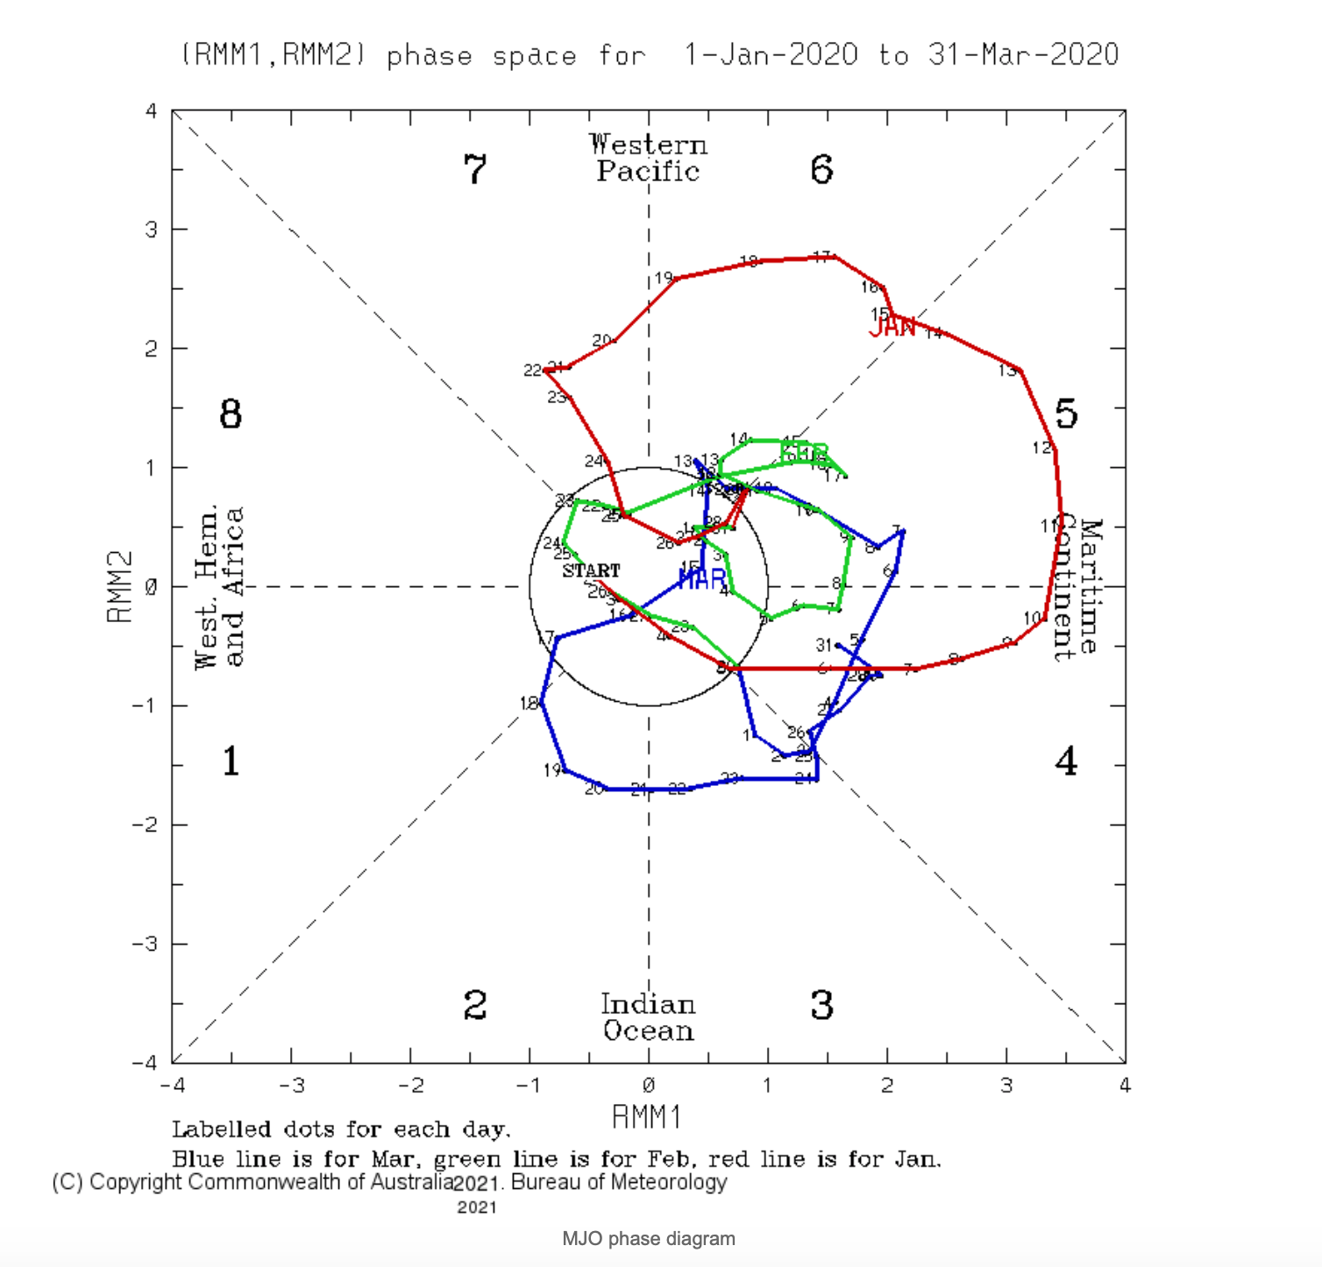
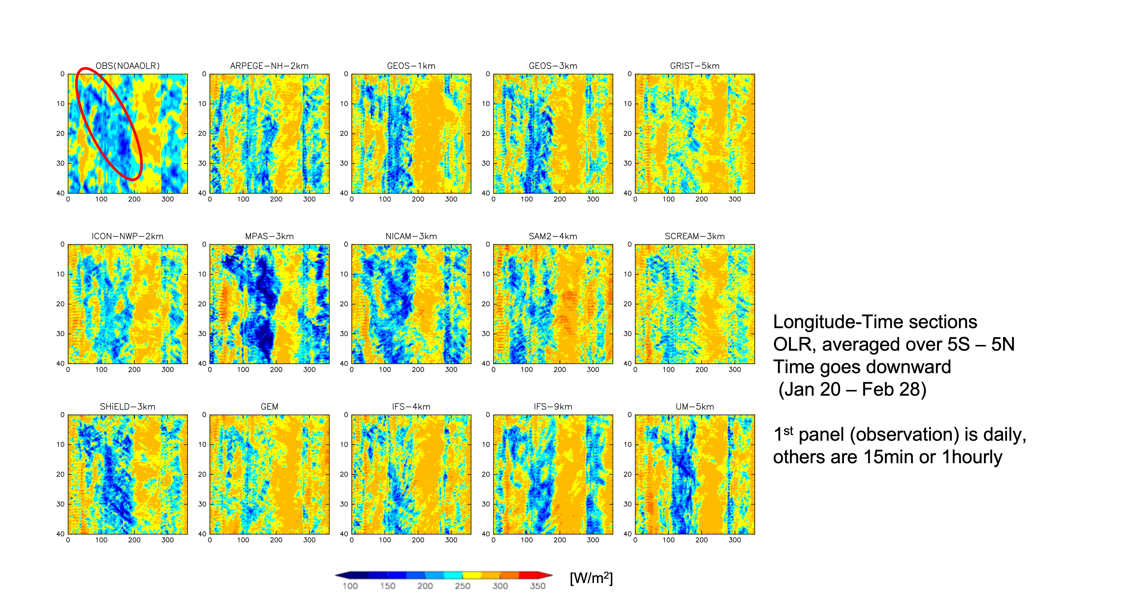
Madden-Julian Oscillation (MJO)
MJO INDEX (real time)
Jan 20
Jan 20
Feb 28
Feb 28
MJO?

Slide 12
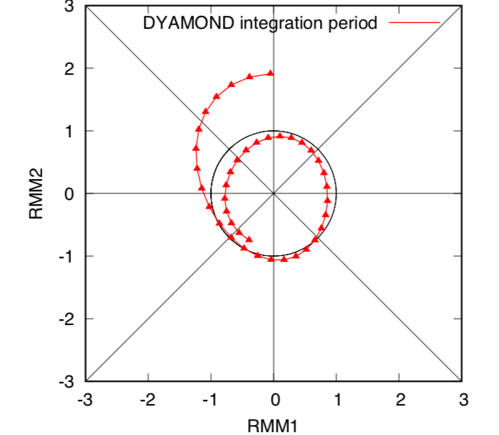

MJO INDEX (real time)
MJO INDEX
(filtered with data after Feb 28 included)
Jan 20
Jan 20
Feb 28
Feb 28
Tamaki Suematsu
U. Tokyo → RIKEN
now visiting MPI
MJO !

Slide 13
Observation
(NOAA OLR)
Jan 20
Model
Model
Model
Model
Feb 28
Jan 20
Model
Model
Model
Model
Model
Feb 28
Jan 20
Model
Model
Model
Model
Model
Longitude-time sections of OLR
Averaged over 5N - 5S
Feb 28
Longitude

Slide 14
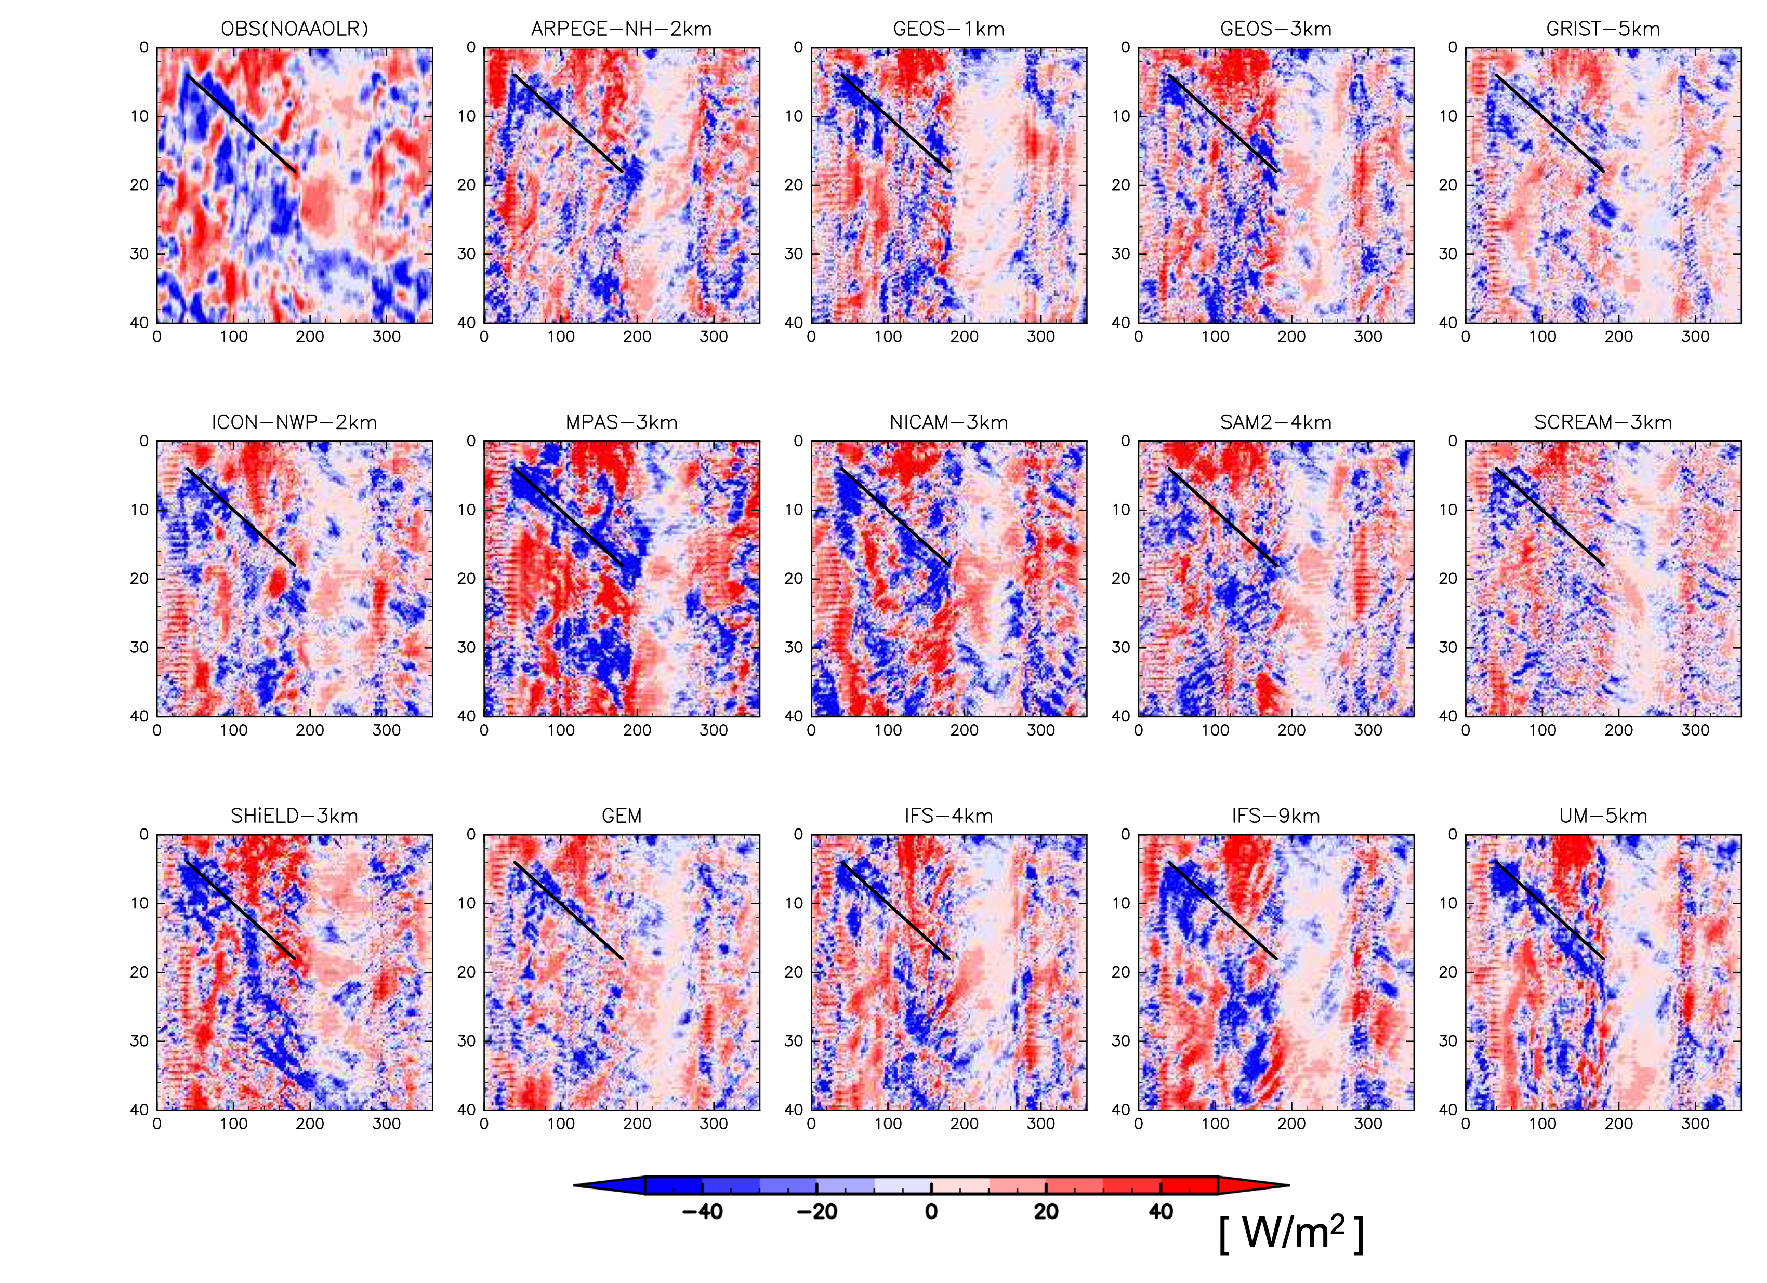
Observation
(NOAA OLR)
Jan 20
Model
Model
Model
Model
Feb 28
Jan 20
Model
Model
Model
Model
Model
Feb 28
Jan 20
Model
Model
Model
Model
Model
Longitude-time sections of OLR anomalies from local 40-day averages
Averaged over 5N - 5S
Feb 28
Longitude

Slide 15
Observation
(NOAA OLR)
Multi-model mean
Jan 20
Feb 28

Slide 16
Observation
(NOAA OLR)
Multi-model mean
exaggerated linearly with time
Multi-model mean
Jan 20
Feb 28

Slide 17
Observation
(NOAA OLR)
Multi-model mean
exaggerated linearly with time
Multi-model mean
Jan 20
Feb 28
Multi model mean appear to do a fairly good job until 〜25 days.

Slide 18
Observation
(NOAA OLR)
Multi-model mean
exaggerated linearly with time
Multi-model mean
Jan 20
Feb 28
Multi model mean appear to do a fairly good job until 〜25 days.

Slide 19
Observation
(NOAA OLR)
Multi-model mean
exaggerated linearly with time
Multi-model mean
Jan 20
Feb 28
Multi model mean appear to do a fairly good job until 〜25 days.
Low OLR near 60W (purple circle). Any value here?

Slide 20
Model to model pattern correlation of column water vapor anomaly
(20N – 20S, ERA5 local 40 day averages subtracted from all models)
1
Pink: Model vs Model
Blue: ERA5 vs Model
Dashed black: Average of Pink
0.5
COR
0
0
10
20
30
40 (day)

Slide 21
Model to model pattern correlation of column water vapor anomaly
(20N – 20S, ERA5 local 40 day averages subtracted from all models)
1
Model skills to predict each other
are lost in about 2 - 3 weeks in terms
of tropical column water vapor
Pink: Model vs Model
Blue: ERA5 vs Model
Dashed black: Average of Pink
0.5
COR
Outlier is …. ERA5
GSRM making common mistakes?
Bias in ERA5 ?
0
0
10
20
30
40 (day)

Slide 22
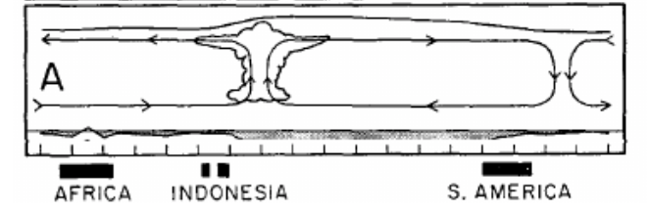
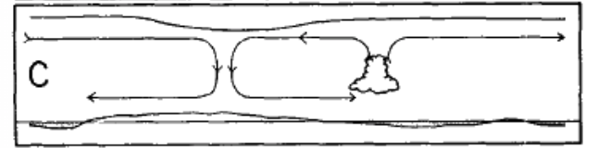
Observation
(NOAA OLR)
Multi-model mean
exaggerated linearly with time
Multi-model mean
Jan 20
Feb 28
Moisture patterns don’t seem to carry predictability in to the 4th week.
Perhaps through a dry dynamical process then?
Maybe?
Slow, convectively coupled
Fast, less coupled
Madden and Julian (1972)

Slide 23
DYAMOND summary
・Zonal mean precipitation in pretty good agreement,
but with peak shifted southward
・Diurnal cycle in good agreement.
Early peak for IFS-9km precipitation over land.
・Monsoon circulations differ a lot.
Topography, land-processe, land-initialization can be issues.
・MJO looking good for 2-3 weeks in OLR.
Predictability lost in column water earlier.
Something else holding the predictability after MJO convection decays?
・GSRMS similar with each other more than with ERA5.

Slide 24
DYAMOND Phase 2
&
some works by NICAM/NICOCO on Fugaku
&
a view into the near future
Program ID: JPMXP1020200305
We used Super computer Fugaku
(hp200128, hp210166, hp220167)

Slide 25
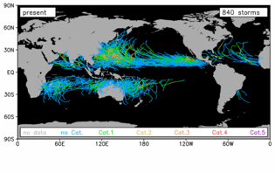
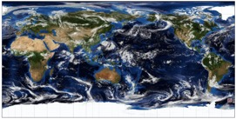

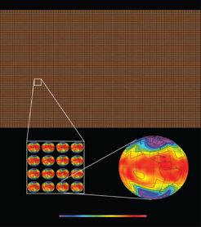
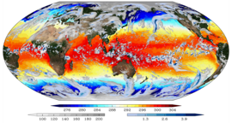
Weather/climate studies with K computer & Fugaku slide by courtesy of Satoh
Kodama et al. (2015 JMSJ; 2020 GMD)
Miyamoto et al.(2013, GRL)
Resolution
Super-high resolution
Global 870m mesh
High resolution climate simulation
NICAM-AMIP 30 years
HighResMIP 100 years
Computer resources
with good computational efficiency
Duration
Complexity
Global cloud & ocean eddy resolving coupled simulation
NICAM+COCO MJO experiment
Large Ensemble
NICAM-LETKF
1000 ensemble
Data assimilation
Ensemble size
Miyoshi et al. (2015, Computer)
Miyakawa et al. (2017, GRL)

Slide 26
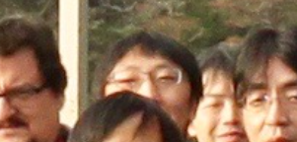
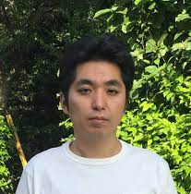
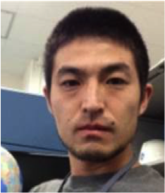
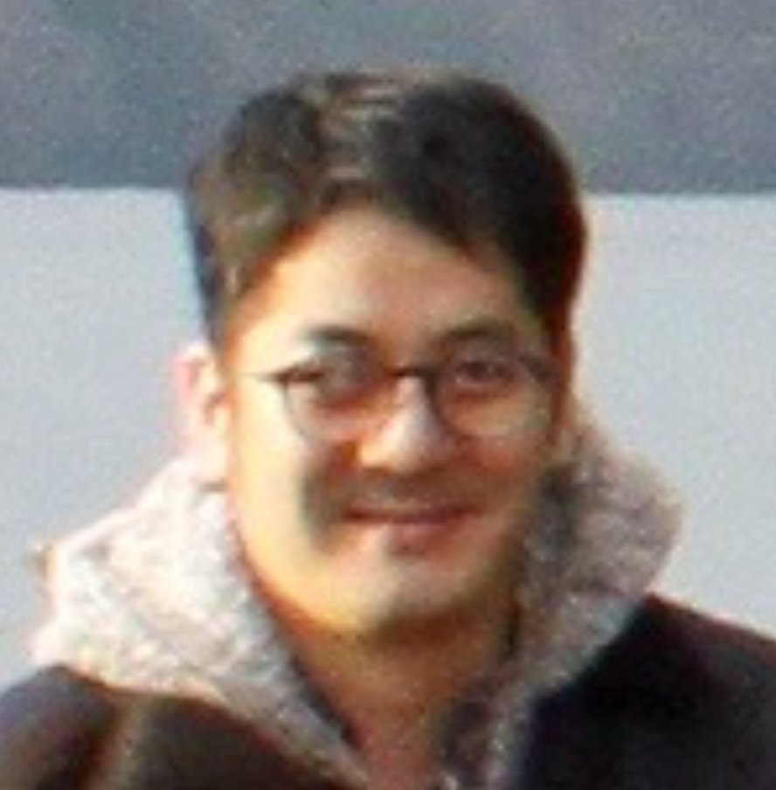
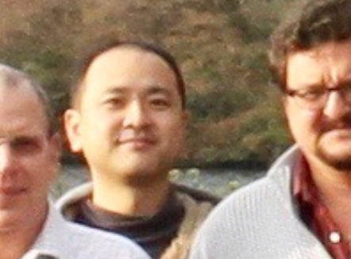


Currently on Fugaku…
Short to seasonal range
NICAM group leaders
Miyakawa, Nakano, Yashiro
Towards Climate
NICAM group leaders
Kodama, Miura

Slide 27
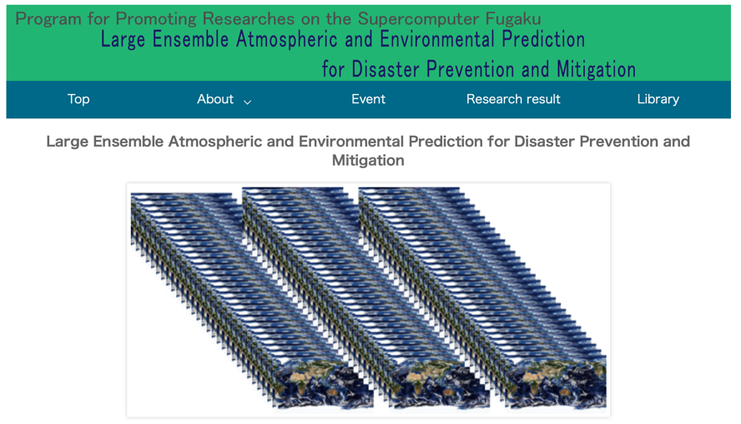
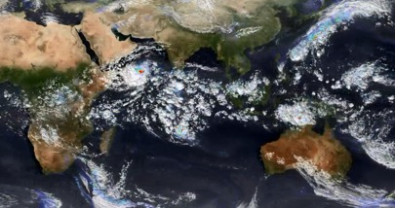
Currently on Fugaku…
“Large ensemble”
at
14 km – 3.5 km resolutions
https://cesd.aori.u-tokyo.ac.jp/fugaku/index_en.html

Slide 28


Specifically…
Components that influence Typhoons
Affection
Jet stream
Target high impact
weather events
Tropical Cyclone (TC)
heat/cold wave
drought・heavy rain
etc.
Warm & moist air
Pacific High
Affection
ISO convection
Sea surface temperature (SST)
SST
TC initiation /
development / route
Affection
Monsoon flow reinforced by ISO
Notes:
本テーマの最重要ターゲットである台風を例に取って、具体的にどのようなことを念頭においているのかを説明いたします。

Slide 29
Major work items
Tropical Cyclones (TCs)
Intra-seasonal oscillations (MJO/BSISO)
Ocean

Slide 30
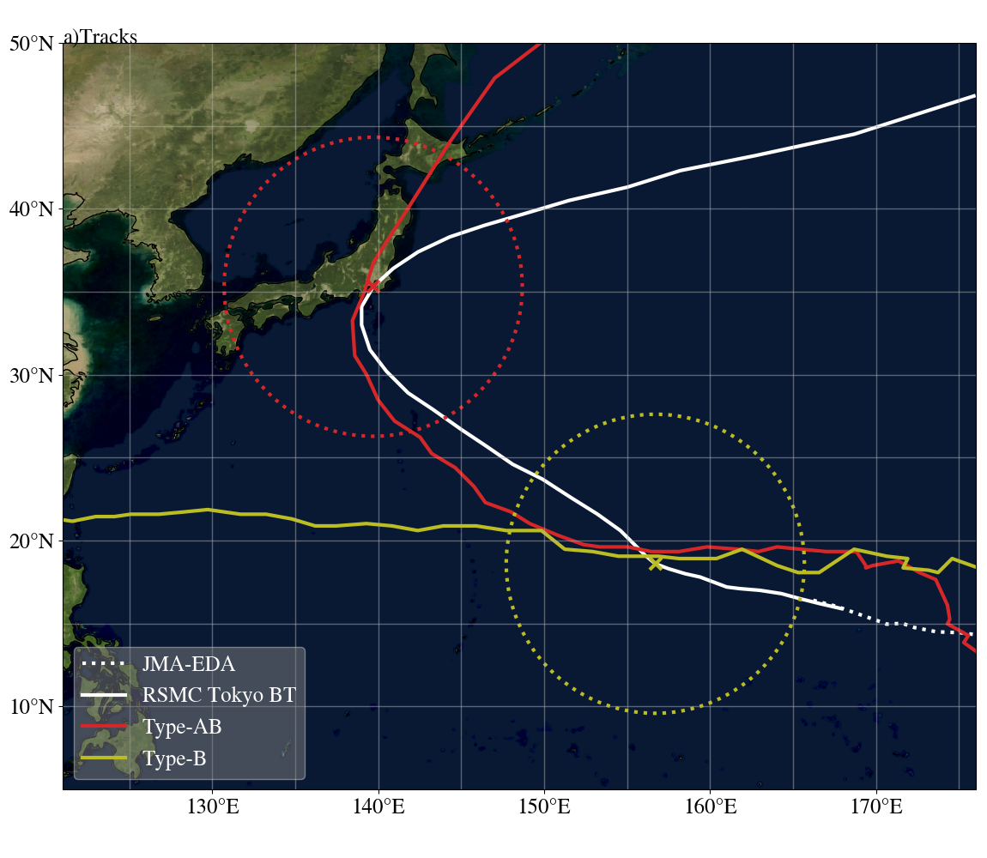
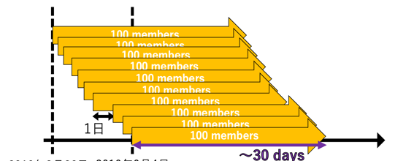

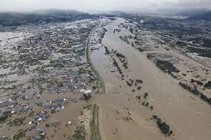
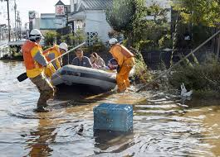
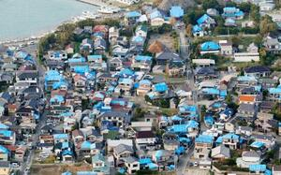
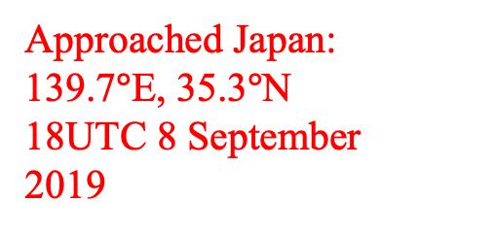
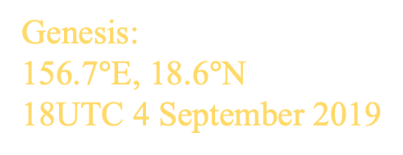
Large ensemble study on Typhoons:
1600 member ensemble experiment
8/31 [80(16)]
Approached Japan:
139.7$°$E, 35.3$°$N
18UTC 8 September
2019
Genesis:
156.7$°$E, 18.6$°$N
18UTC 4 September 2019
1 day
Aug 25
Sep 4
Typhoon Faxai (2019) initiated on Sep. 5, hit Eastern Japan on Sep. 9,
and caused severe damage.
Yohei Yamada (山田洋平)@JAMSTEC
Notes:
富岳が早く使えたからスイッチを押せばいい、というのものではありませんで、担当研究員が相当な労力をかけて富岳に、、、

Slide 31
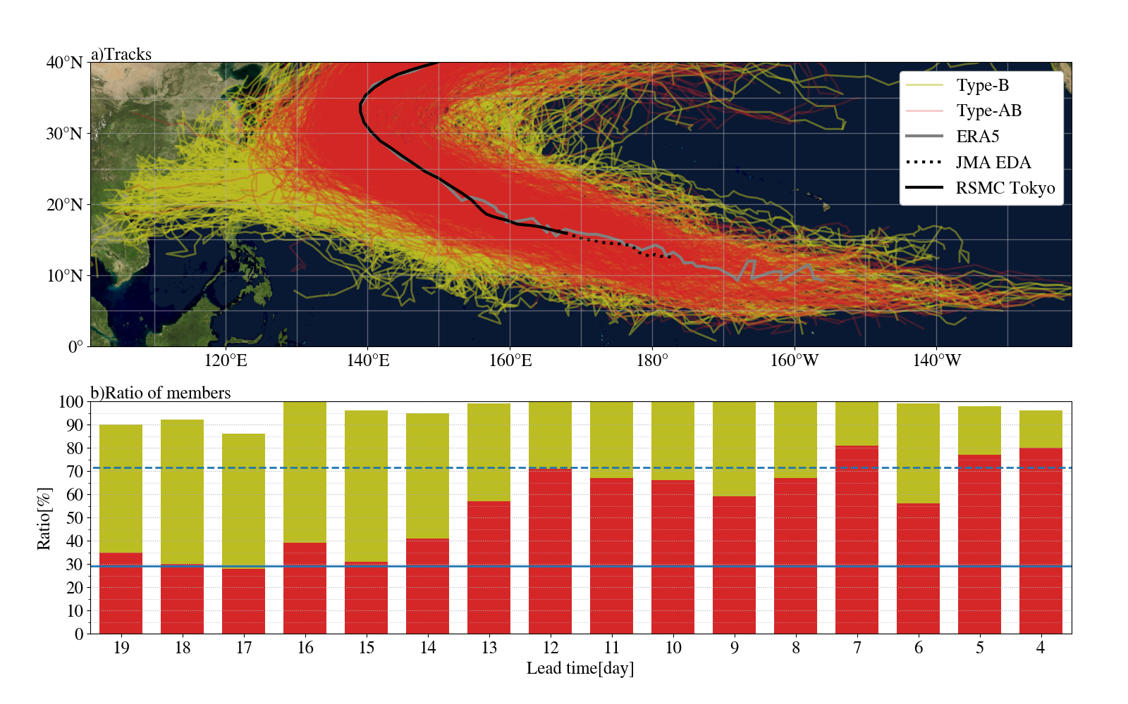
Simulated tracks of Faxai-like vortex in 1600-member ensemble simulations
Faxai-like vortex (Type-AB or Type-B vortices) was generated in 97% of total members (1551/1600).
Type-AB vortex was generated in 55% of total members (885/1600).

Slide 32
Ratio of the ensemble members reproducing Faxai-like vortex to respective 100 members for each lead time
Generated nearly 100% after initial vortex appears in the East Pacific
Type-B
Type-AB
Rises after upper
trough becomes
predictable
Dashed line is the mean rate of the ensemble members reproducing Faxai-like vortex in model climatology.
Solid line is same as the solid line but for type-AB vortex.
NICAM could predict with high accuracy two weeks before landfall that the vortex was likely to head toward Japan.

Slide 33
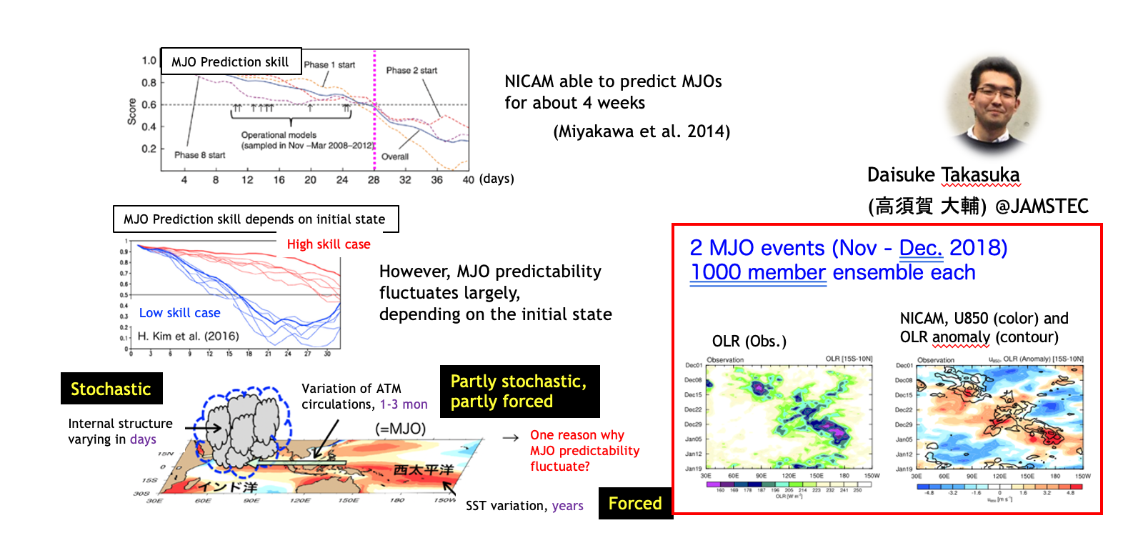
Large ensemble study on MJOs:

Slide 34
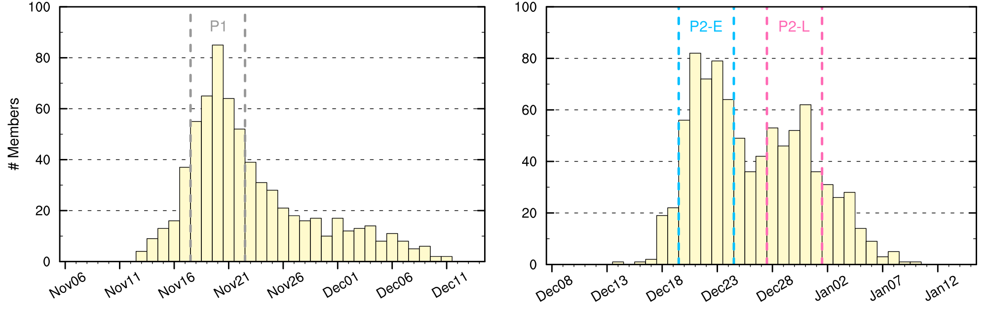
Timing of MJO prop. among the members
The timing of MJO propagation into the WP can be divided into two
cases: Almost uniquely determined or NOT (= multi. solutions).
Histogram of the date when MJO convection has reached “Phase 7”
MJO1 (Nov)
MJO2 (Dec)
Single peak (11/18)
Double peaks
(12/22 or 31)
Early
Late
Questions:
• What physical differences exist b/w the earlier and later propagation for MJO2?
• What can separate b/w unique and multiple solutions for MJO prop.?

Slide 35
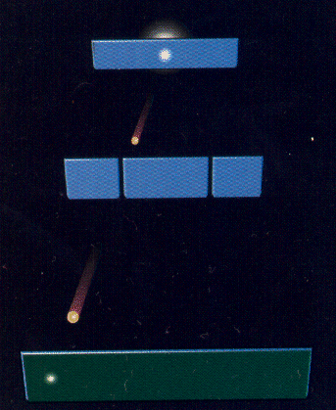
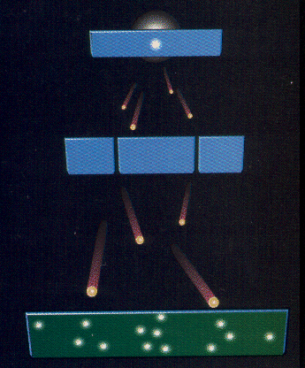
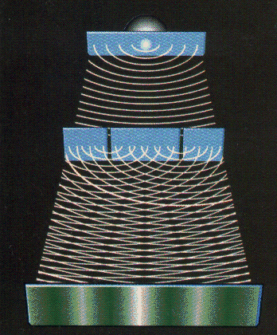
Think about Thomas Young’s double slit experiment
One photon → One member Numerous photons → Large ensemble
http://abyss.uoregon.edu/~js/21st_century_science/lectures/lec13.html
Information is limited in a
deterministic simulation
but with a large ensemble…

Slide 36
Think about Thomas Young’s double slit experiment
One photon → One member Numerous photons → Large ensemble
http://abyss.uoregon.edu/~js/21st_century_science/lectures/lec13.html
Information is limited in a
deterministic simulation
but with a large ensemble…
Highly probable locations of the MJO appears

Slide 37
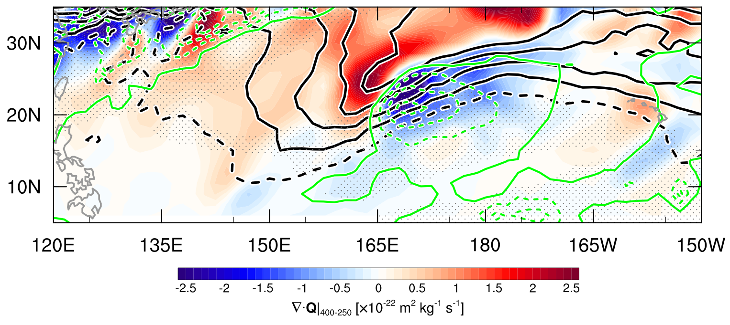
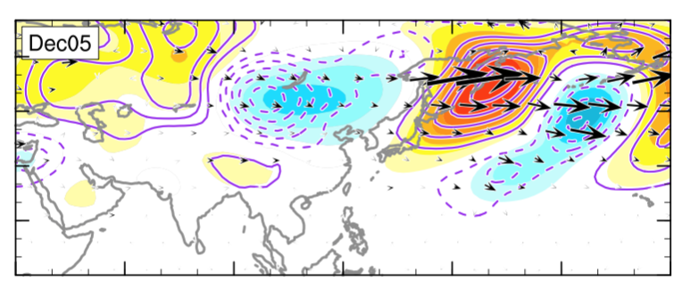
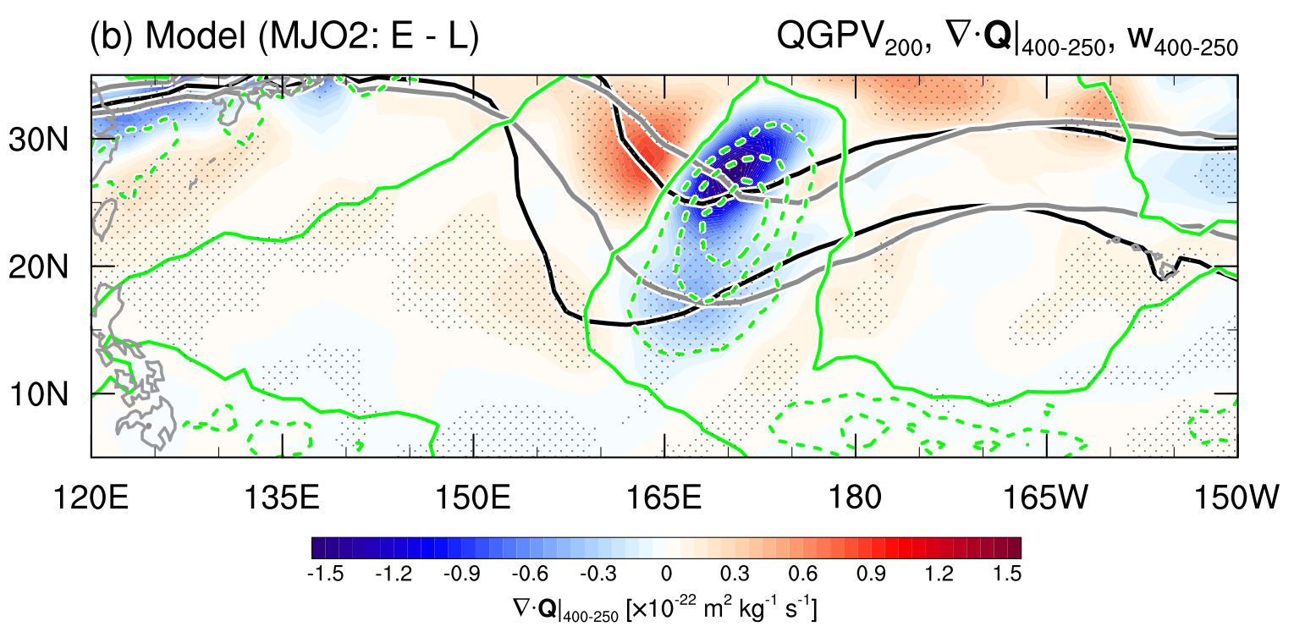

Why is there a difference in wave-conv. coupling?
Trough intrusion from the extratropics is clearly detected for “Early”.
Forced upward motions help moistening in the mid-to-upper layer.
QGPV (200hPa), ∇ • Q, ω (400-250hPa), CWV anom. > 0
WAF (300hPa), stream func. (200hPa)
Obs. (ERAI)
Dec03–07
Early & Diff. (cont.)
WAF: Takaya & Nakamura (2001)
Early – Late
Early – Late
Mid-latitude Rossby wave trains appear
to be refracted toward the tropical WP.
“Early”
“Late”
Wave prop.
MJO with skewed stochasticity found and explained using the large ensemble approach
∇ • Q [x10⁻²² m² kg⁻¹ s⁻¹]

Slide 38
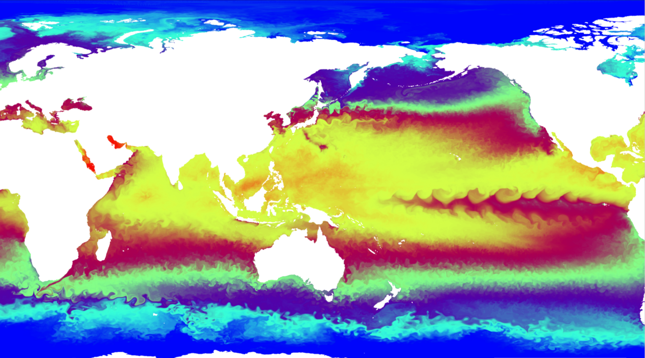

Ryusuke Masunaga
Univ. Tokyo → JAMSTEC
SST from 0.1 deg Ocean

Slide 39
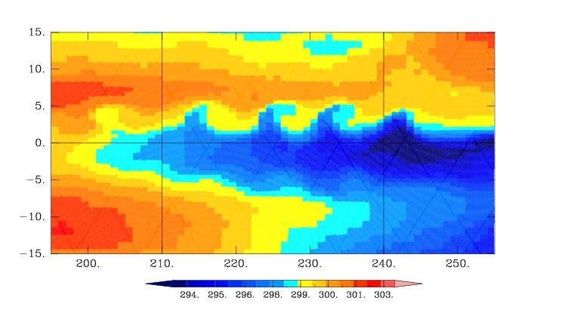
Ryusuke Masunaga
Univ. Tokyo → JAMSTEC
SST from 1.0 deg Ocean
SST from 0.1 deg Ocean

Slide 40
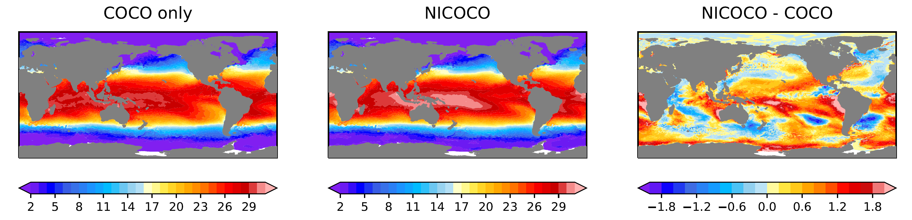
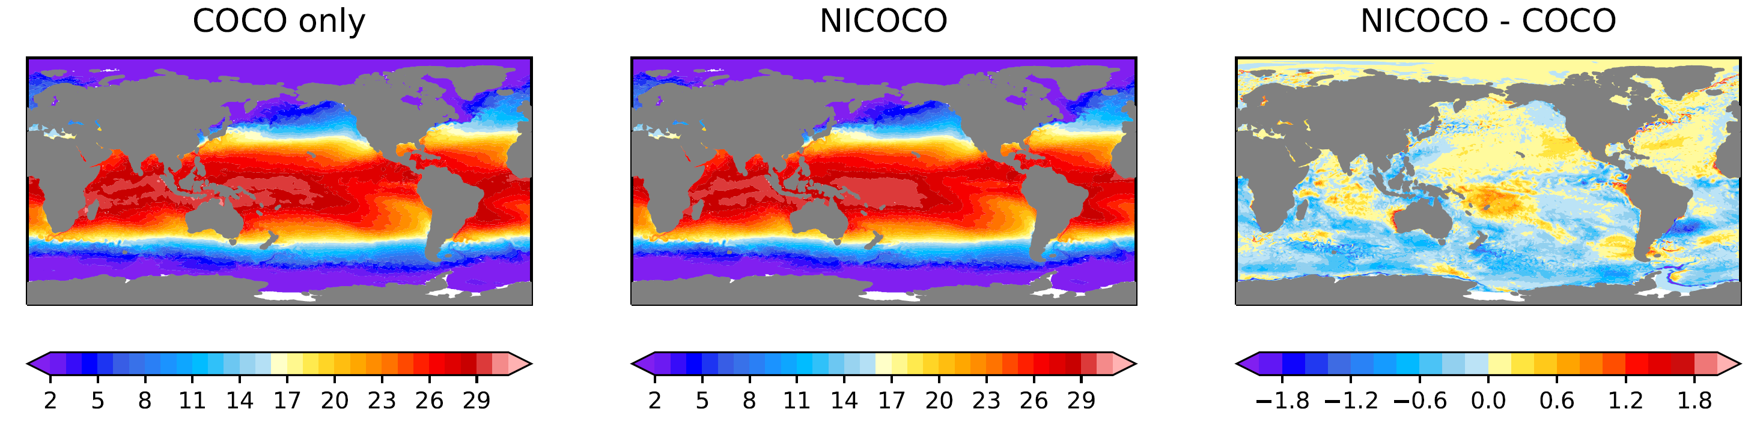
Suppressing ocean drift for a seasonal prediction
Feb.13, 2010 SST
（above）Free with out correction（below）flux corrected
  Flux correction applied for suppressing SST drift, without strongly affecting oceanic internal variability.

Slide 41
Major work items
Tropical Cyclones (TCs)
Intra-seasonal oscillations (MJO/BSISO)
Ocean
All progressing nicely, towards good seasonal TC prediction

Slide 42
DYAMOND Phase 2
&
some works by NICAM/NICOCO on Fugaku
&
a view into the near future

Slide 43
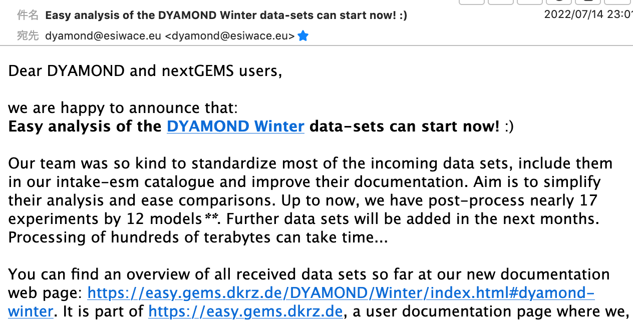
You’ve got mail?
(July 14, 2022)

Slide 44

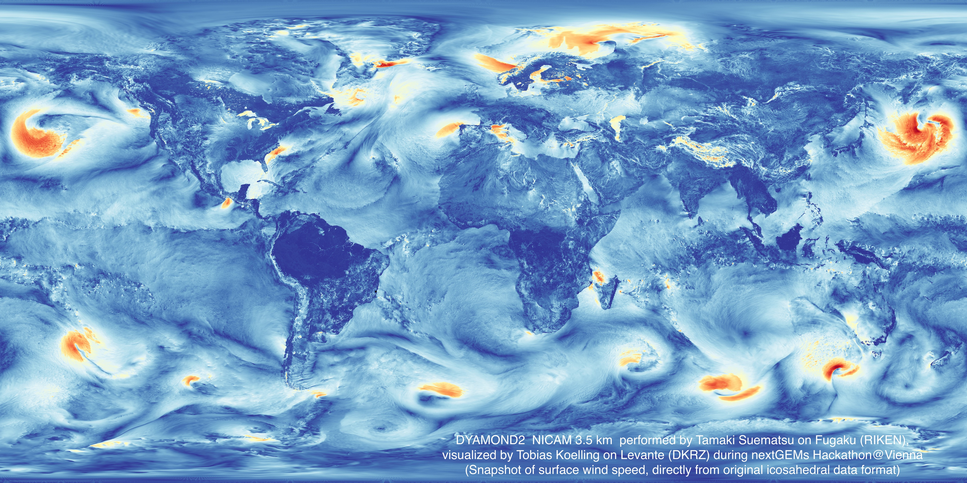
A product from Hackathon@Vienna last month…
Tobi and Tamaki

Slide 45

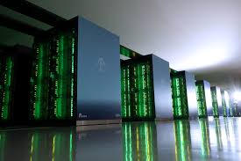

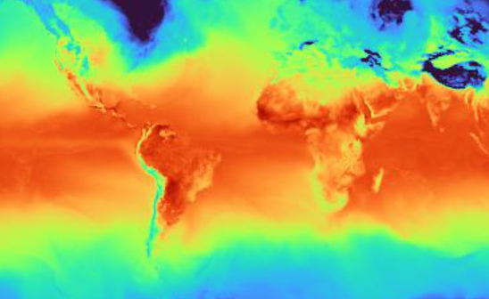

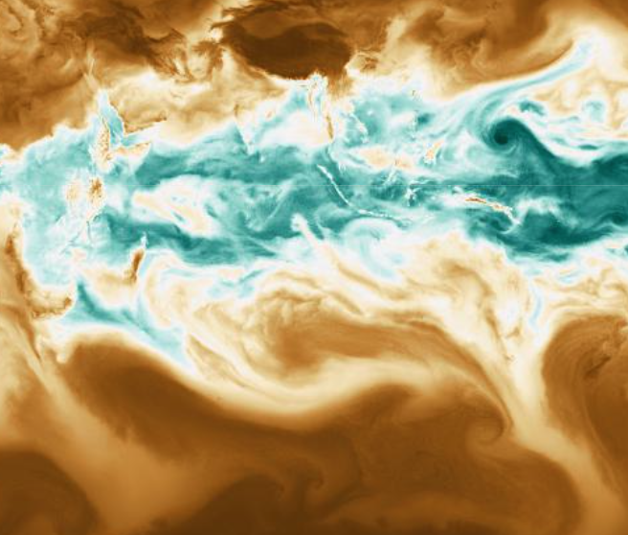


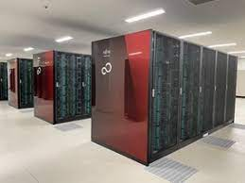
Earth figure by Flo

Slide 46
Hop on the wagon!!
take home message:
DYAMOND2 data open and easier to access now
A lot of efficient new techniques to share and compare different datasets being installed and shared at DKRZ.
Supercomputers including Fugaku can be applied from abroad.
A call for special edition of JMSJ on HPC/DYAMOND will be announced soon.
Guest editors include Daniel Klocke, Pier-Luigi Vidale, Thomas Rackow, Falko Judt, Andreas Prein
Thank you.

Slide 49
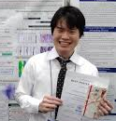



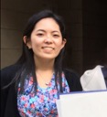


Currently on Fugaku…
Short to seasonal range
NICAM group leaders
Miyakawa, Nakano, Yashiro
Towards Climate
NICAM group leaders
Kodama, Miura

