Slide 1
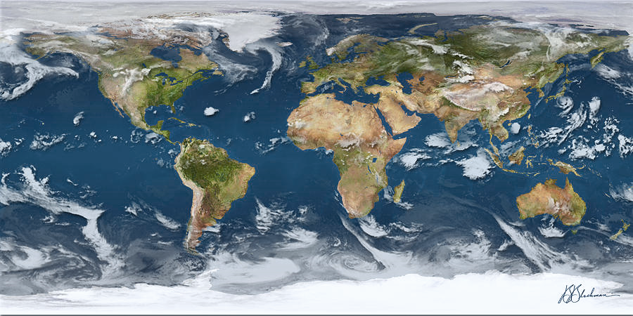
Compounding extreme rainfall and heatwaves: how important are large scale dynamics in generating extreme floods?
Hayley J. Fowler
Professor of Climate Change Impacts
School of Engineering
Newcastle University, UK
Contributions from Christoph Sauter, Chris White, Seth Westra, Haider Ali, Nadav Peleg, Jen Catto

Slide 2
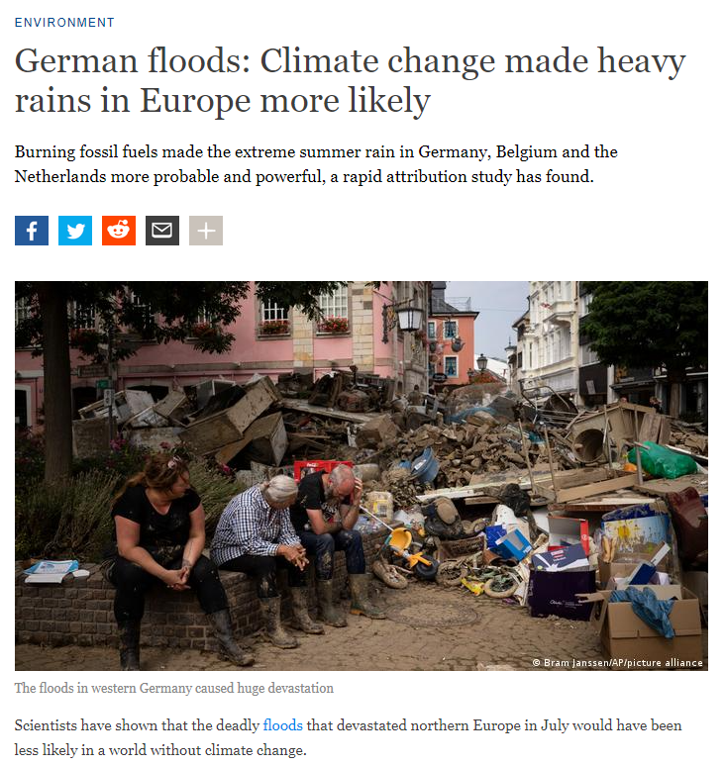
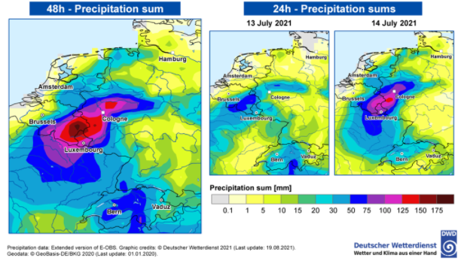
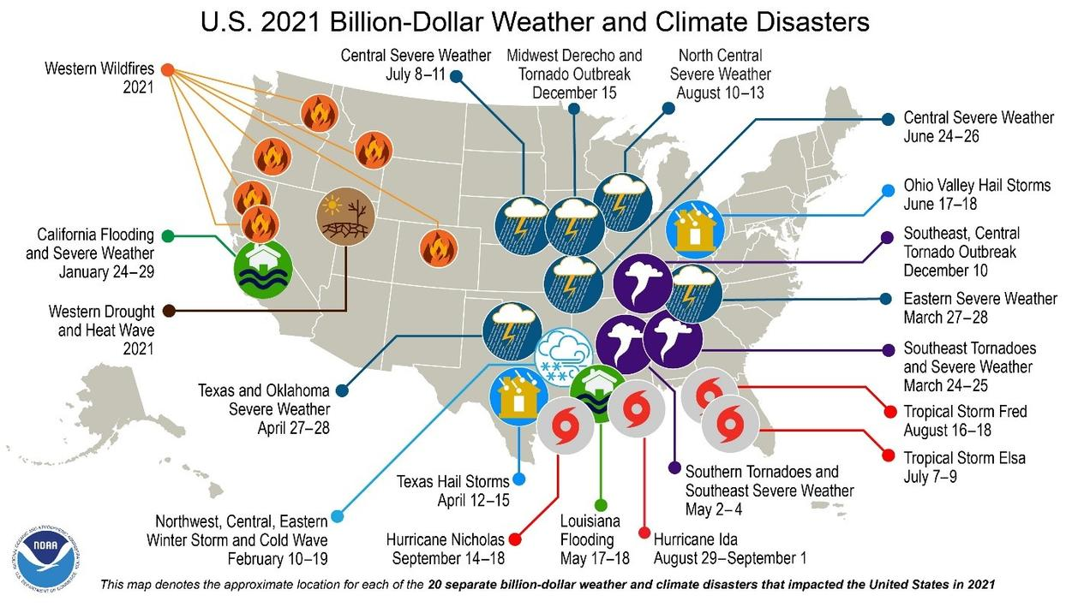
Extreme events and the summer of 2021
GERMAN FLOODS 2021: Global warming made the heavy summer rainfall between 3% and 19% stronger, and 1.2 to nine times more likely

Slide 3
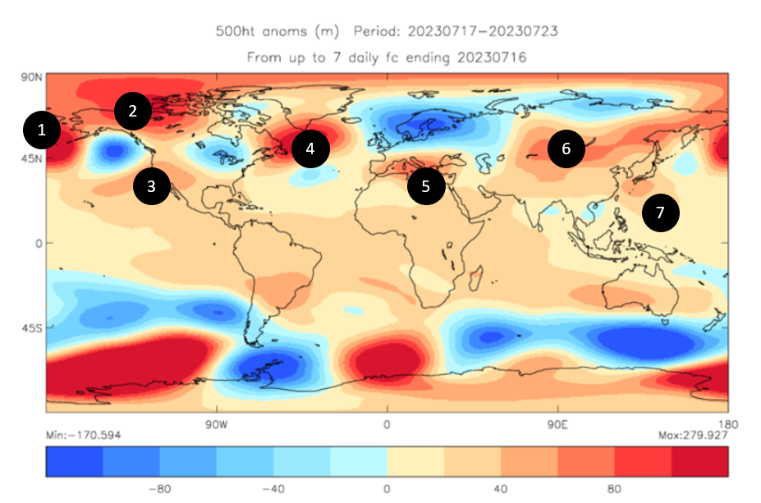
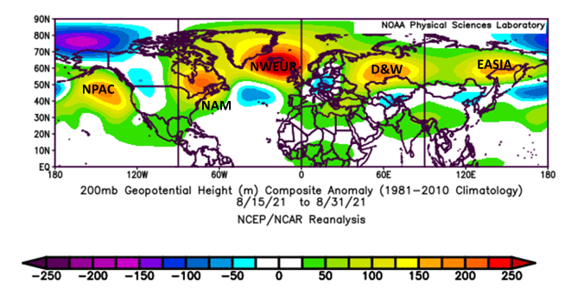
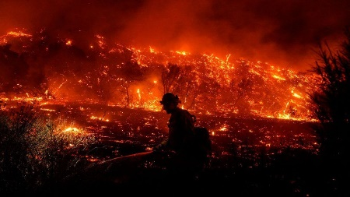
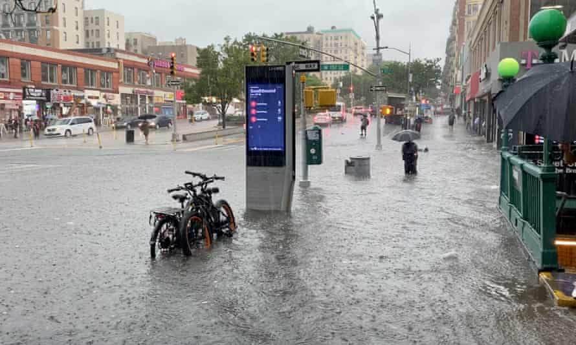
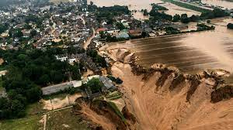
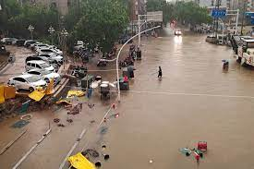
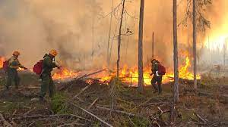
Summer of 2021
Blocked Pattern causing persistent weather extremes
US/Canadian
Heat Dome
New York Floods
Germany floods
Zhengzhou floods
Siberian wildfires
New York Floods
Courtesy Paul Davies

Slide 4
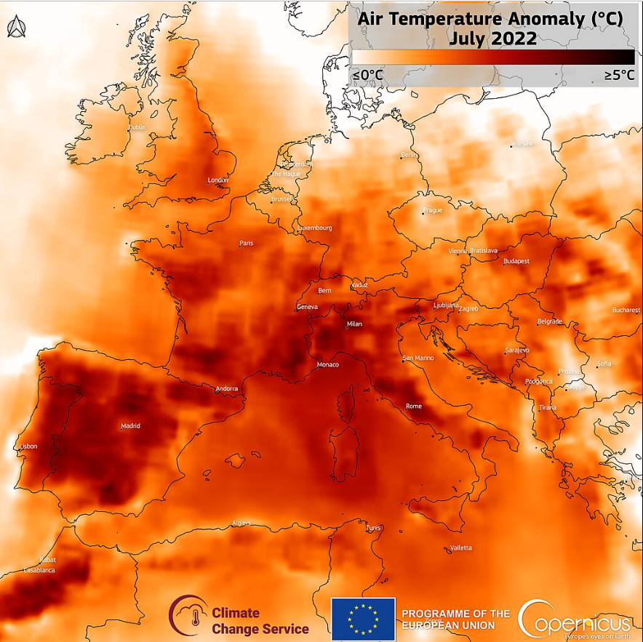
Summer of 2022
Same blocked conditions led to a ‘heatdome’ over Europe
40degC in the UK!
Records broken in many locations
And again in 2023!

Slide 5
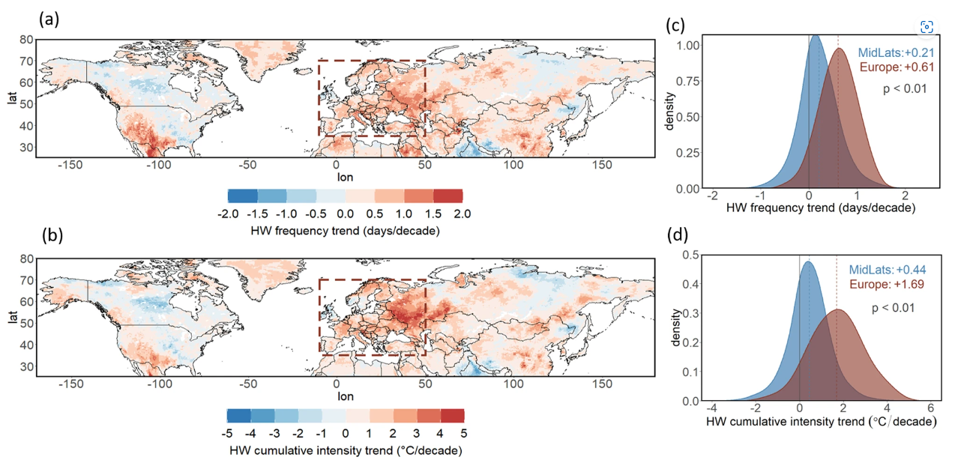
Increasing heatwave trends over the midlatitudes and Europe
Rousi et al. 2022 Nat Comms https://doi.org/10.1038/s41467-022-31432-y

Slide 6
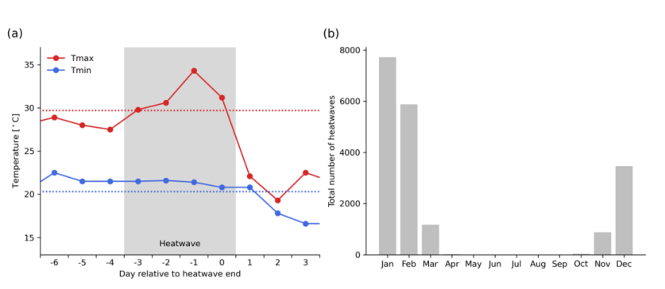
Defining Heatwaves
For a given location, a heatwave is identified if:
The daily Tmax lies above its yearly 95th percentile value for at least three consecutive days, and
The daily Tmin lies above its yearly 95th percentile for at least the second and third day.
A heatwave ends when either Tmax or Tmin drop below their respective 95th percentile thresholds. The last day where the criteria above are still fulfilled is referred to as 'day 0'

Slide 7
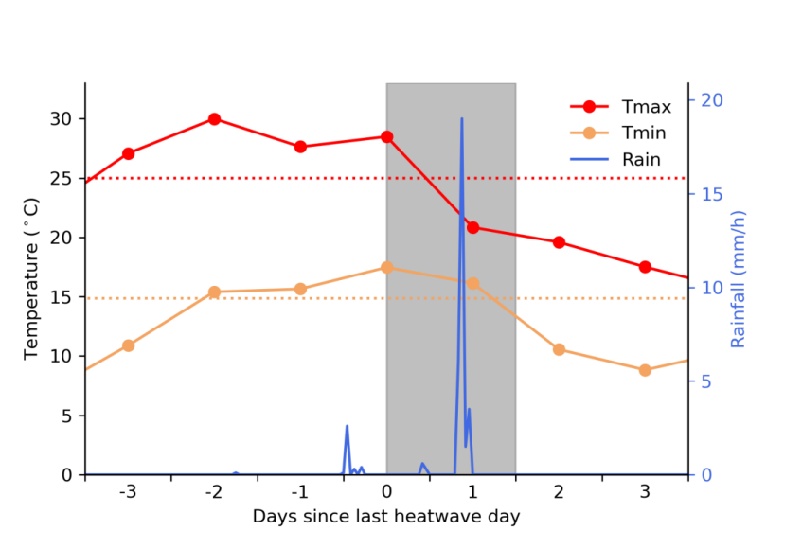
An example of a heatwave followed by extreme hourly rainfall from a station in Germany
Rainfall is defined as extreme if is exceeds the 95th percentile for hourly wet amounts.
Quality-controlled rainfall observations at an hourly scale from the Global Sub-Daily Rainfall Dataset (GSDR) (Lewis et al., 2019). Daily Tmax and Tmin from ERA5 reanalysis dataset
Sauter et al., 2023, Weather and Climate Extremes, DOI: 10.1016/j.wace.2023.100563

Slide 8
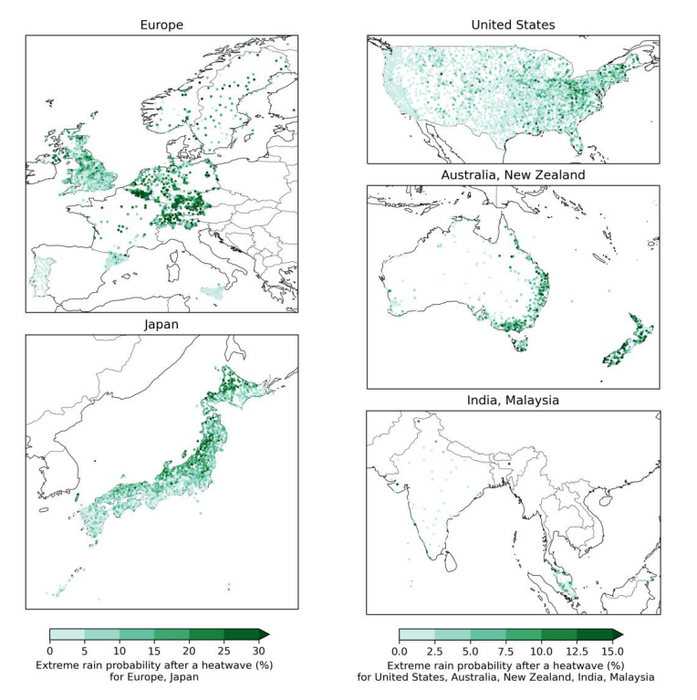
Probability of at least one hour of extreme rainfall occurring within 36 hours from noon on the last heatwave day for stations in Europe, Japan, the contiguous United States, Australia, India, and Malaysia

Slide 9
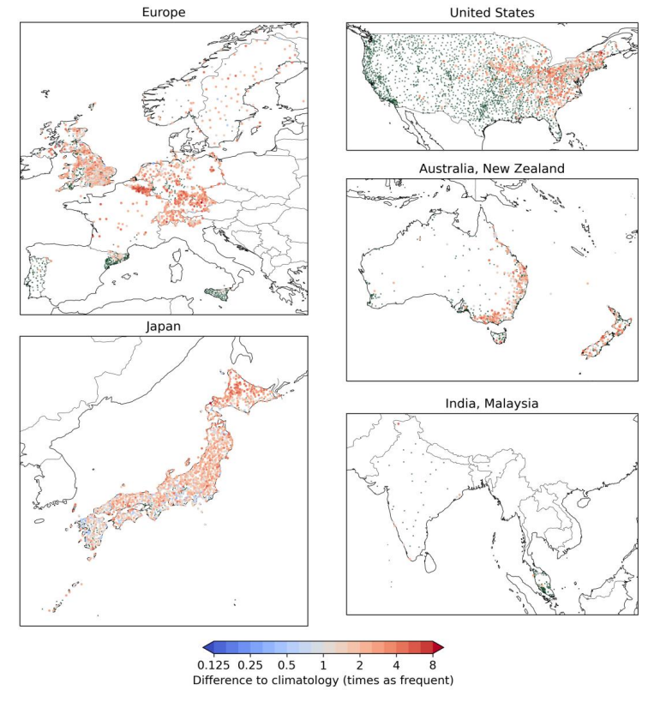
The difference in probability of extreme rainfall after a heatwave from expected probabilities from rainfall climatology.
Values >1 indicate that hourly extreme rainfall is more likely after a heatwave than for climatology.

Slide 10
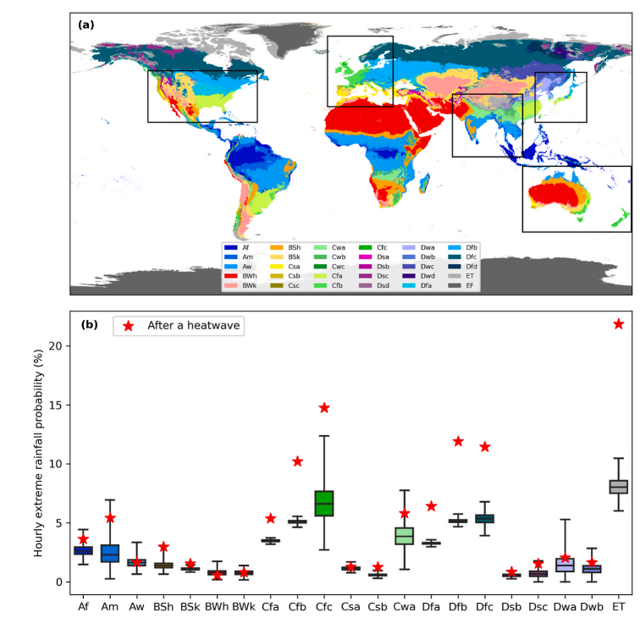
Division by Koppen-Geiger climate zones
Compound heatwave-extreme rainfall events are most likely in temperate or colder climates (‘C’, ‘D’, ‘E’), provided there is no ‘dry season’ (‘f’ sub-climate); in some parts of mid-latitudes 40% of heatwaves followed by hourly extreme rainfall
Sauter et al., 2023, Weather and Climate Extremes, DOI: 10.1016/j.wace.2023.100563

Slide 11
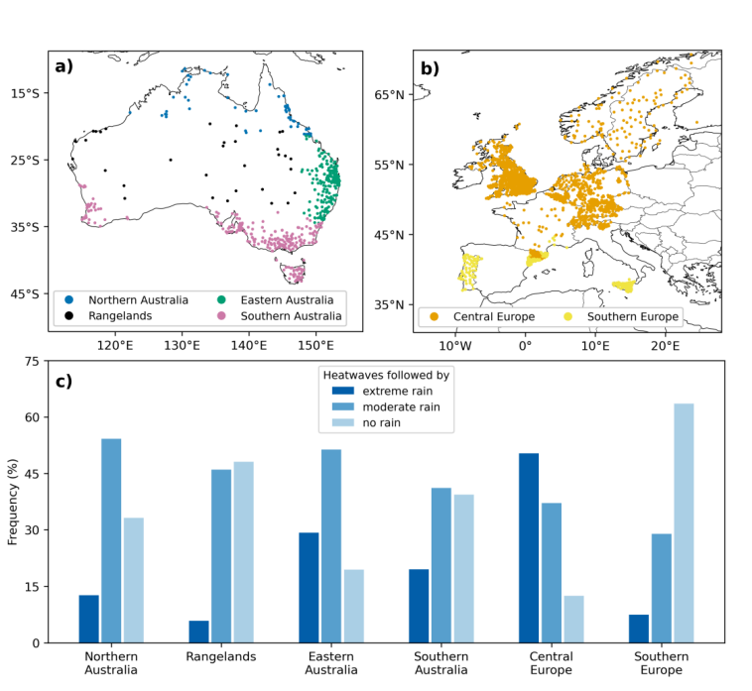
Analysis of Europe and Australia to examine mechanisms
Stations used and percentage of heatwaves ended by rainfall in each region
Sauter et al., in press,

Slide 12
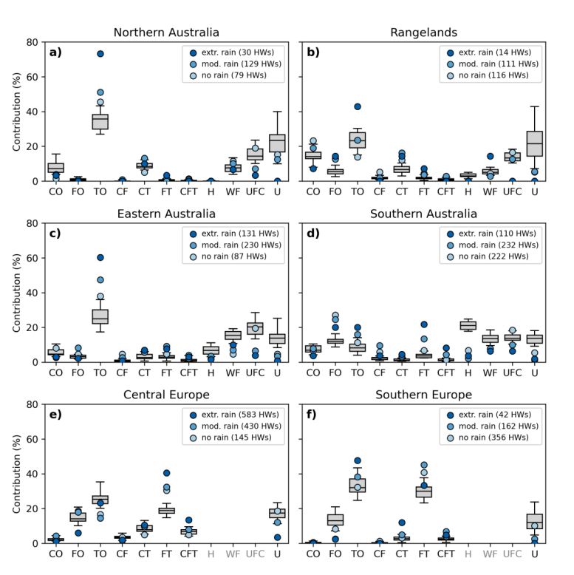
Weather types
Cyclone Only (CO),
Front Only (FO), Thunderstorm Only (TO), Cyclone-Front (CF), CycloneThunderstorm (CT), Front-Thunderstorm (FT), Cyclone-Front-Thunderstorm (CFT),
and Undefined (U).

Slide 13
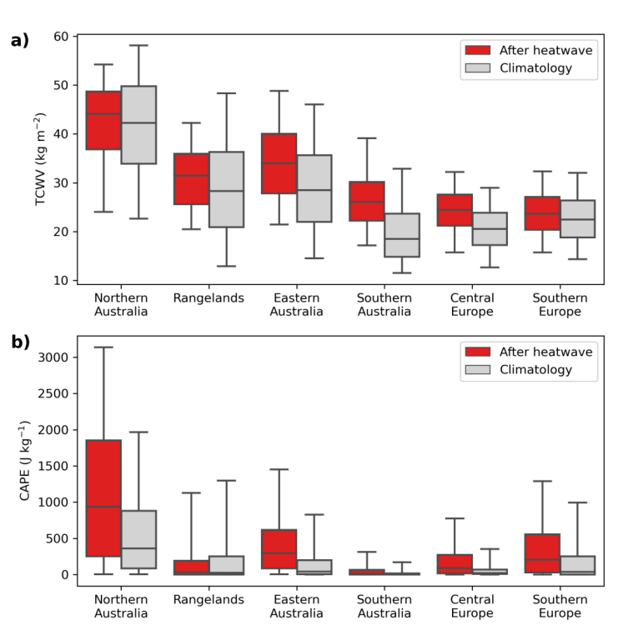
Distribution of TCWV (a) and CAPE (b) on the last day of the heatwave (red) and for climatology (grey) for the six regions used in this study. The boxplot whiskers extend from the 5th to 95th percentile

Slide 14
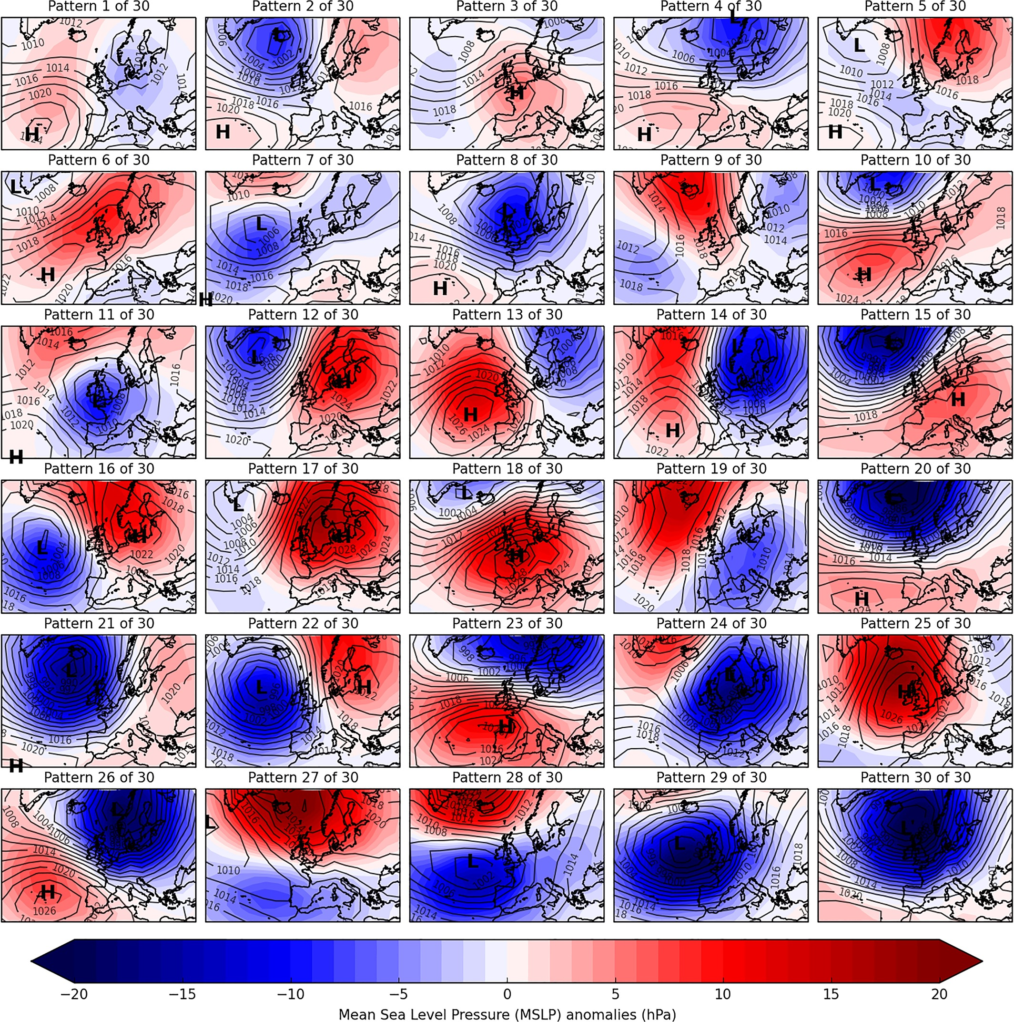
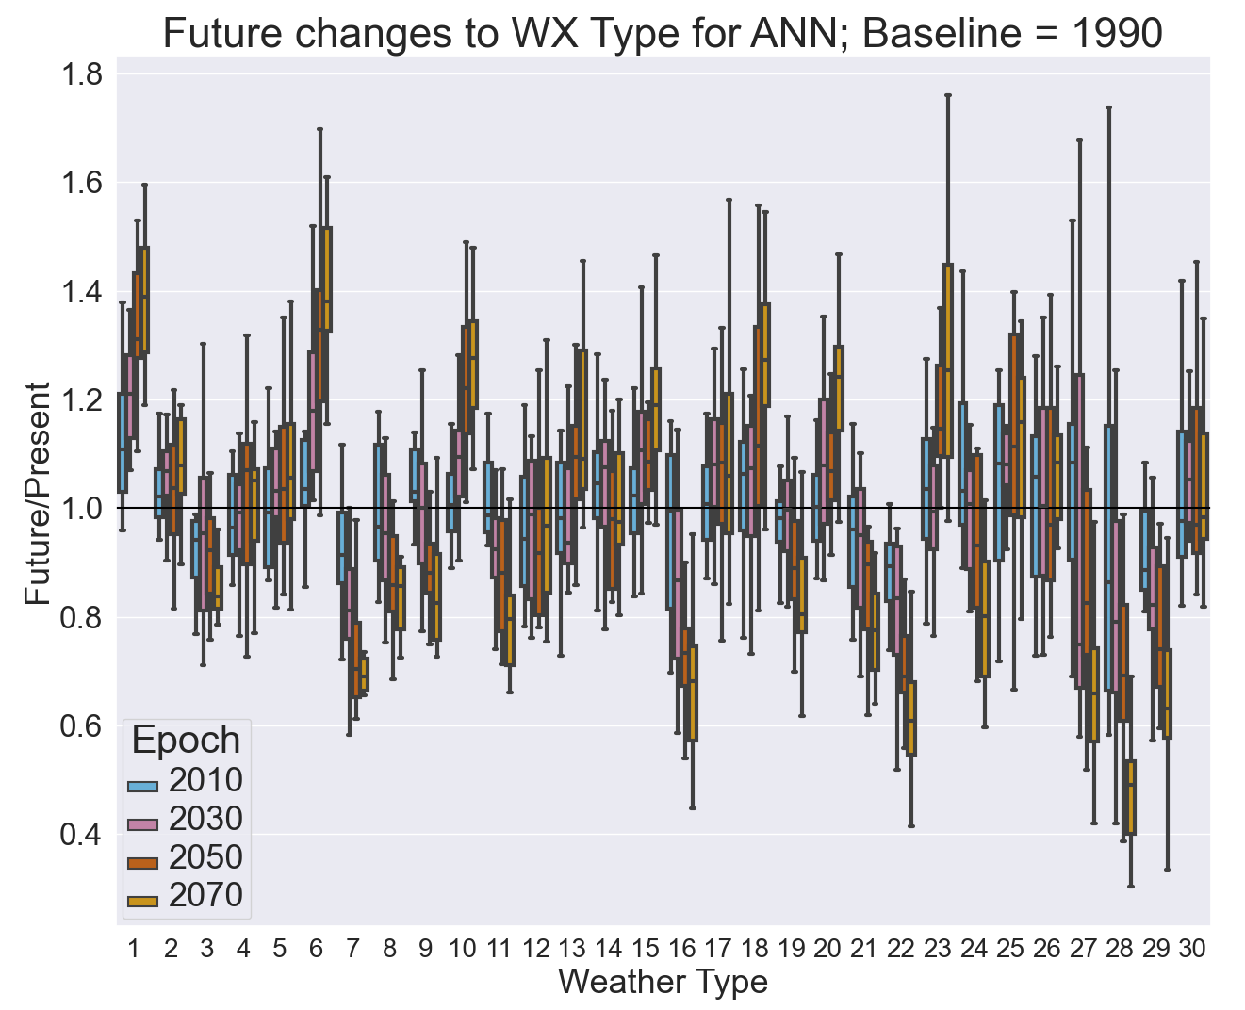
Future Changes to Synoptic Variability
30 European weather regimes (Neal et al., 2016)
Future Changes of Weather Types in UKCP18 (Pope et al., 2022)
Chan et al.in prep
Notes:
BLANK SLIDE
To duplicate slide, select copy on tool bar and then duplicate on drop down menu.

Slide 16
Summary thoughts
Compound extremes are important for impacts and may change more than individual extremes with warming. Often they are connected by physical processes in sequences that might be important for impacts.
Dynamical changes to the atmosphere are important for changing characteristics of extreme weather, but GCMs appear to be underestimating the changes we are seeing in the real world, esp.the persistence of blocked conditions important for heatwaves and extreme rainfall
We need to take a hybrid approach – combining information from regional and global climate models with observations, including sensitivity studies.
Transitions between WP sequences are crucially important in producing extremes, particularly compound extremes

