Slide 1
Assessment of the Water Balance Components Using Energy and Mass Balance Models in Small Glaciated Catchments of the Central Tian-Shan, Kyrgyzstan.
Sanjar Sadyrov
Mountain Societies Research Institute, University of Central Asia
GEWEX 3rd Workshop on Central Asia
29 April 2024

Slide 2
Background
Study Area
Methodology
Conclusion
Results
Goals of the study:
The main goal of our study is to assess the capabilities of a combination of models in solving various hydrological problems.
One of the most important aspects in hydrological modeling of mountain ecosystems is determining the source of runoff.
Since glaciers are fragile ecosystems undergoing unique dynamic changes, the model should also include a comprehensive representation of the processes occurring in the glacier zone.
By identifying the glacier component in the water balance of a specific basin, we can accurately predict the changes that will occur when this component changes.

Slide 3
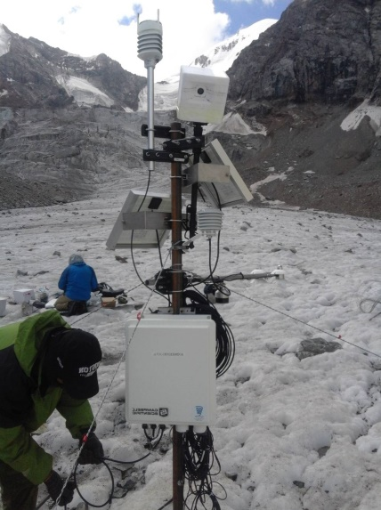
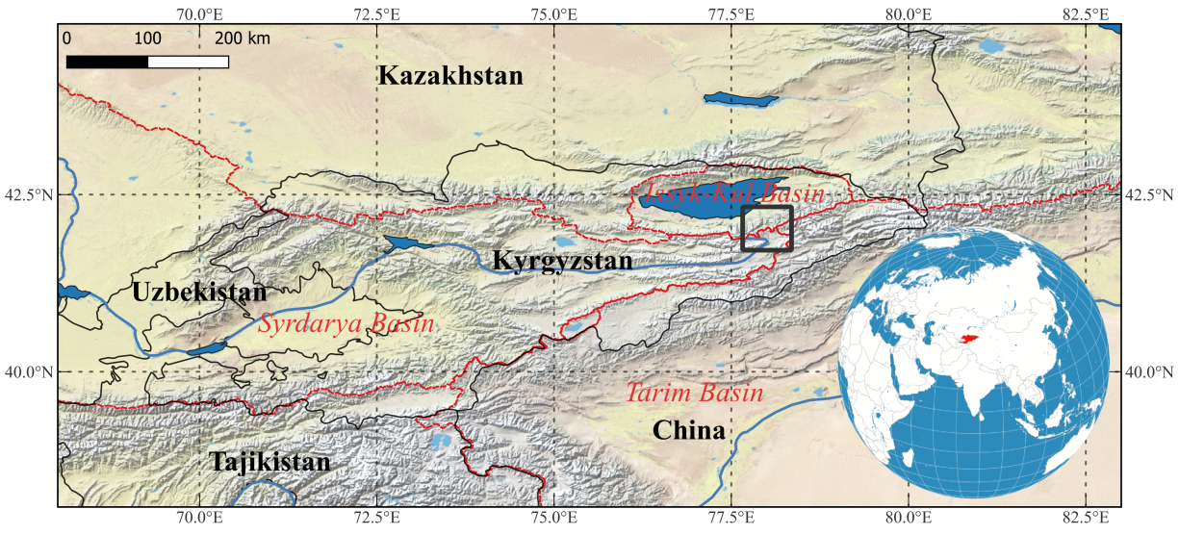
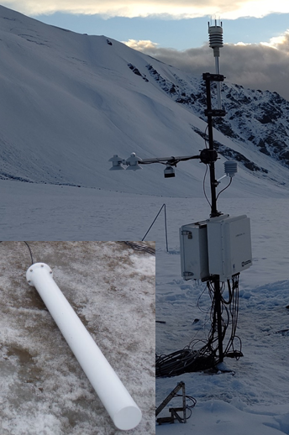
Background
Study Area
Methodology
Conclusion
Results
Measures snow water equivalent (SWE)
3

Slide 4
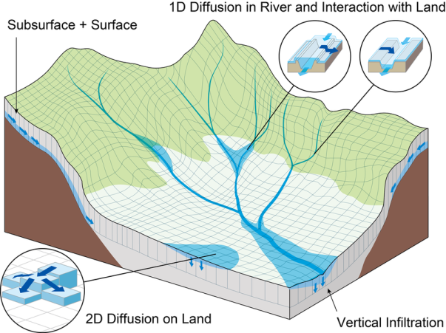
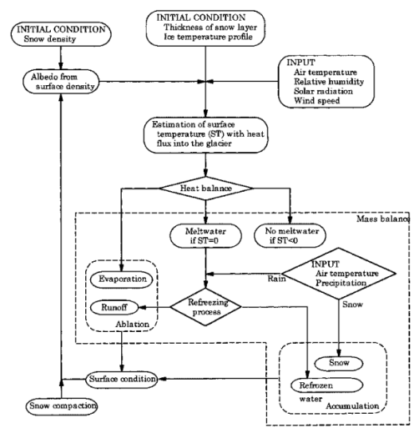
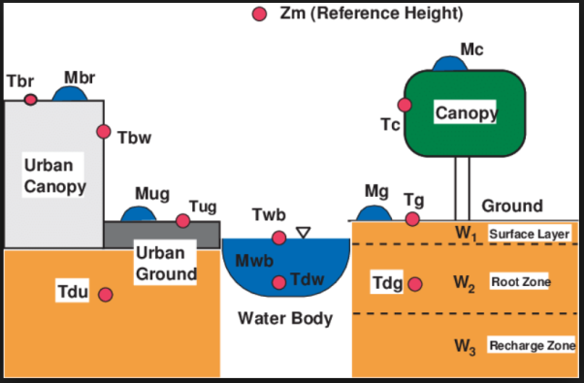
Background
Study Area
Methodology
Conclusion
Results
Input data
Correction:
Topography(30m 1km) ASTER GDEM
Cloud (0.25⁰) ERA5
Reanalysis products:
ERA5 (0.25⁰)
Incoming shortwave radiation
Incoming longwave radiation
Windspeed
Air pressure
Humidity
Air temperature
GPM-IMERG (0.1⁰)
Precipitation
RGI 6.0
Glacier mask (100m res.)
(Tanaka, 2005)
(Sayama et al., 2012)
(Fujita et al., 2000)
Modeling(1km)
Output
SiBUC
Ground/Water/Urban
Daily discharge
Mass balance
Runoff
EvapT
RRI
River Routing
+
GLIMB
Glacier
Annual
4

Slide 5
Background
Study Area
Methodology
Glacier model
Conclusion
Results
Mass balance models
A meta-analysis based review of glacio-hydrological studies estimated that about 94% used the temperature-index method for modeling purposes, and only 6% used the energy-balance approach (He et al., 2021).
Energy-balance approach
Temperature-index
$$Q_{s}=\left(1−a_{s}\right)H_{SR}+H_{LR}−εσ{\left(T_{s}+273.15\right)}^{4}+H_{S}+H_{L}−G_{g}$$
$$M= \left\{\begin{aligned}{DDF}_{snow/ice}T T>Tt \\ 0 T ≤Tt\end{aligned}\right.$$
(GLIMB model, Fujita and Ageta, 2000)
(Pellicciotti et al., 2005)
In high mountainous areas, establishing an observation network with a wide spectrum of measurements is labour-intensive, and in most cases, air temperature is the only available data metric.

Slide 6
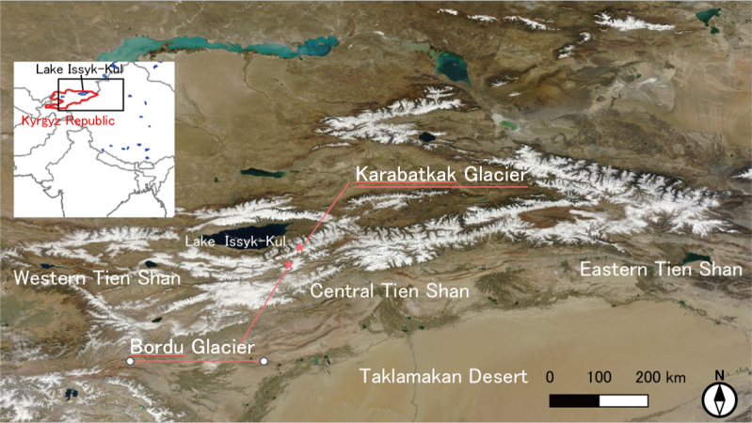
Background
Study Area
Methodology
Data
Conclusion
Results
Kyoto University’s (in collaboration with Academy of Sciences of KR, University of Central Asia) monitoring network in Kyrgyzstan.
Measurements | Equipment | Series
Weather sensor (Psfc, Tair, RH, Prec, Wind) Radiation (SWup, SWdown, LWup, LWdown) Snow depth & Glacier surface height Snow water equivalent Soil (Ice) heat flux x 2 Soil (Ice) temperature x 4 | Vaisala Hukseflux Campbell Hydroinnova Hukseflux | WXT536 NR01 SR50A Snowfox HFP01 Pt100 (JIS A grade)
2017 July Karabatkak Basecamp SWE Karabatkak Glacier (ice) melting zone Energy Balance
2018 August Bordu Glacier (ice) melting zone Energy Balance + SWE
Karabatkak Glacier (debris) melting zone Radiation Balance
2019 August Karabatkak Glacier (debris) melting zone Raingauge (with LPH)
Bordu Glacier (ice) melting zone Raingauge (with LPH)
2022 July Karabatkak Glacier (ice) near fall Solar Radiation
Karabatkak Glacier (ice) upper zone Energy Balance
2022 August Grigoriev Glacier (ice) melting zone Energy Balance Raingauge (with LPH)
2023 August Karabatkak Glacier (ice) upper zone Raingauge (with LPH)
Grigoriev Glacier
Installation
timeline

Slide 7
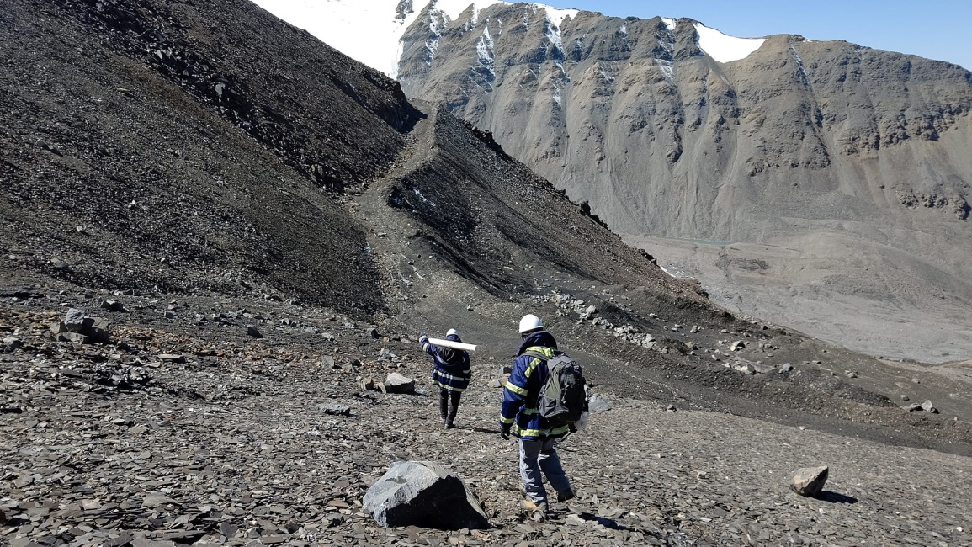
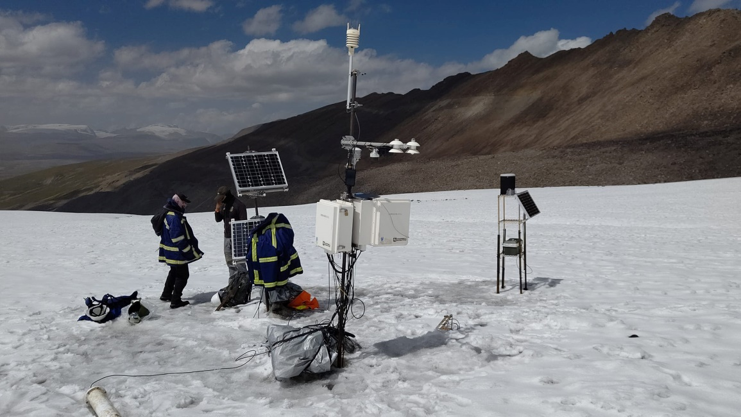
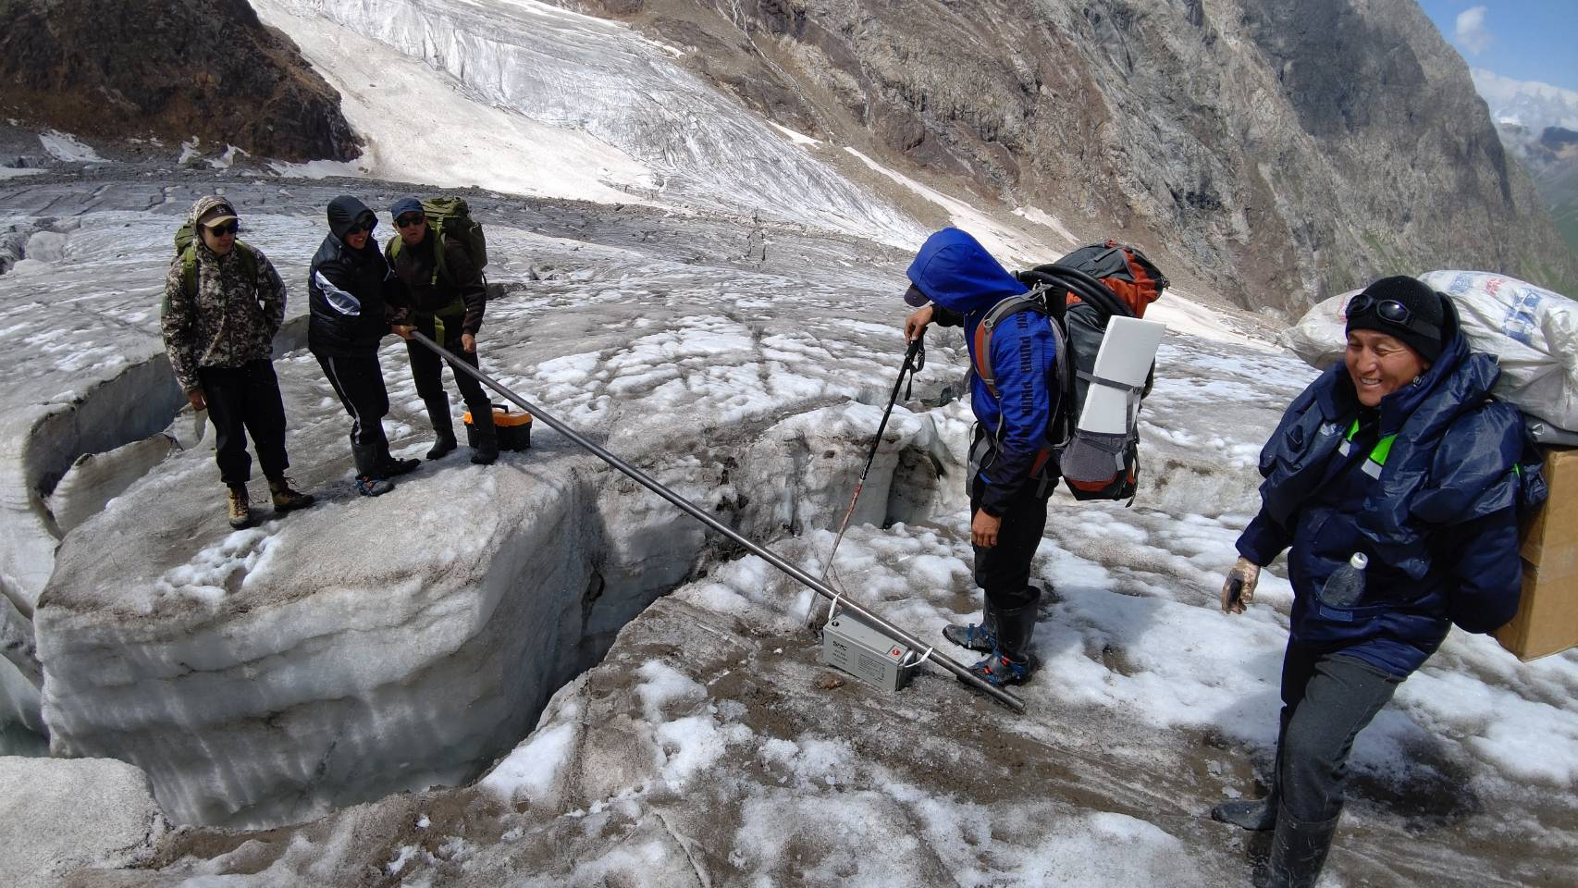
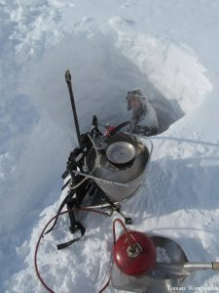
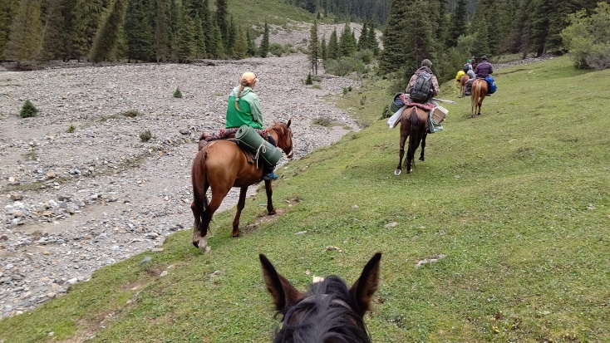
Background
Study Area
Methodology
Data
Conclusion
Results
Hot
Vapor
Drilling
Machine

Slide 8
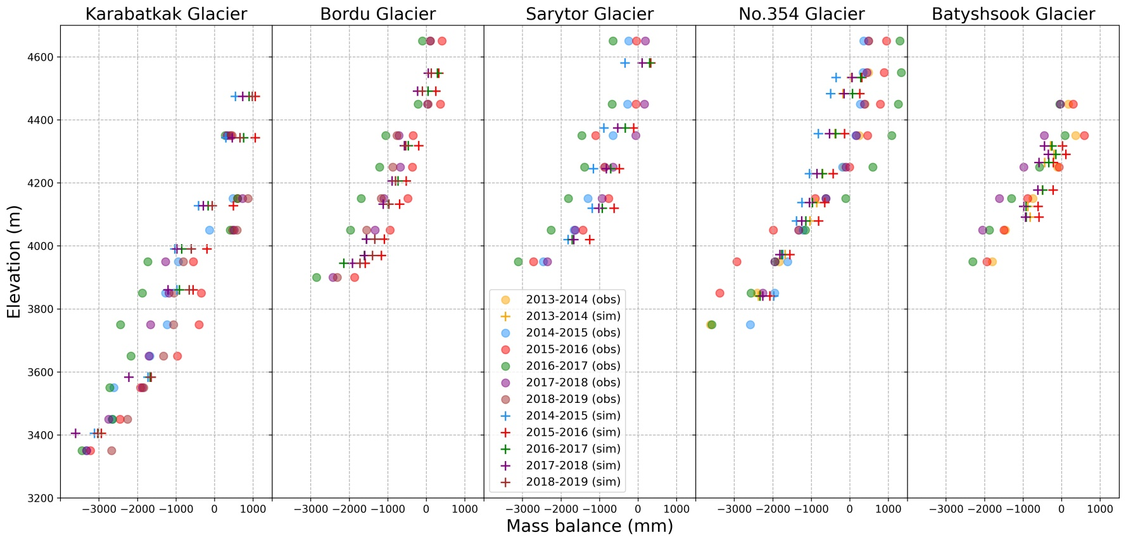
Background
Study Area
Methodology
Conclusion
Results
Glacier Mass Balance Comparison
<Mass balance — is the total of accumulated snow – melted ice on the glacier during the year (October-September)>
The results can be improved with additional data included in downscaling/correction.
8

Slide 9
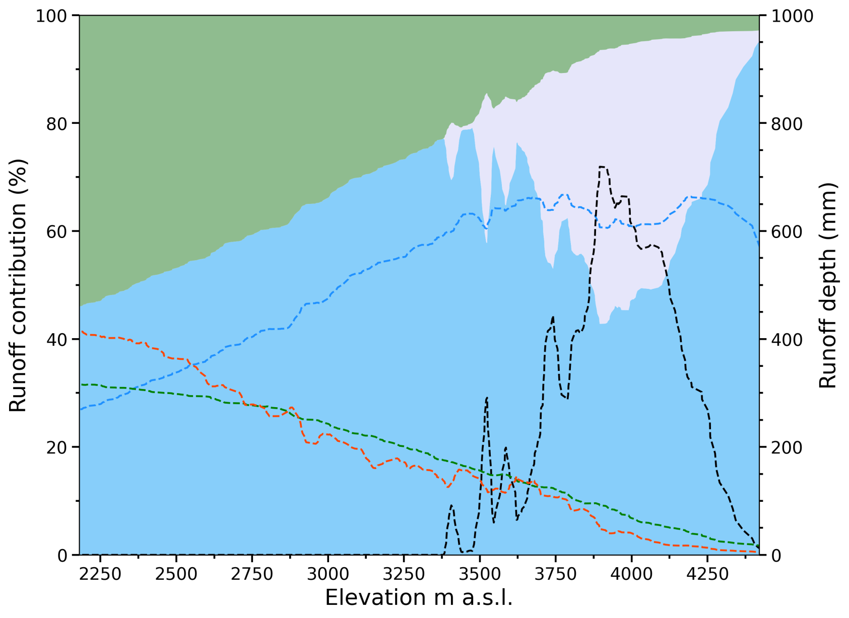
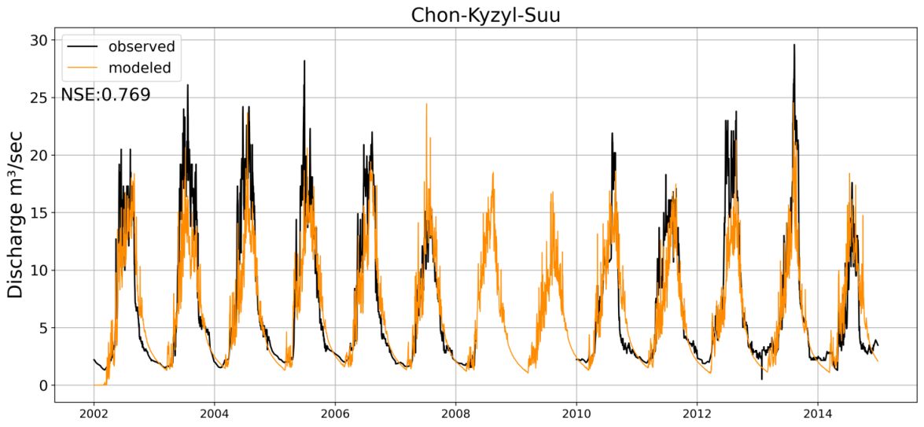
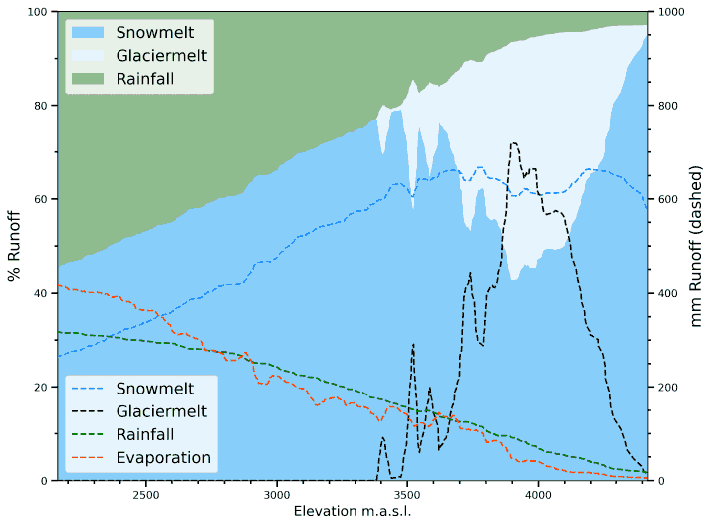
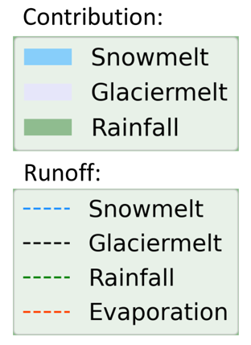
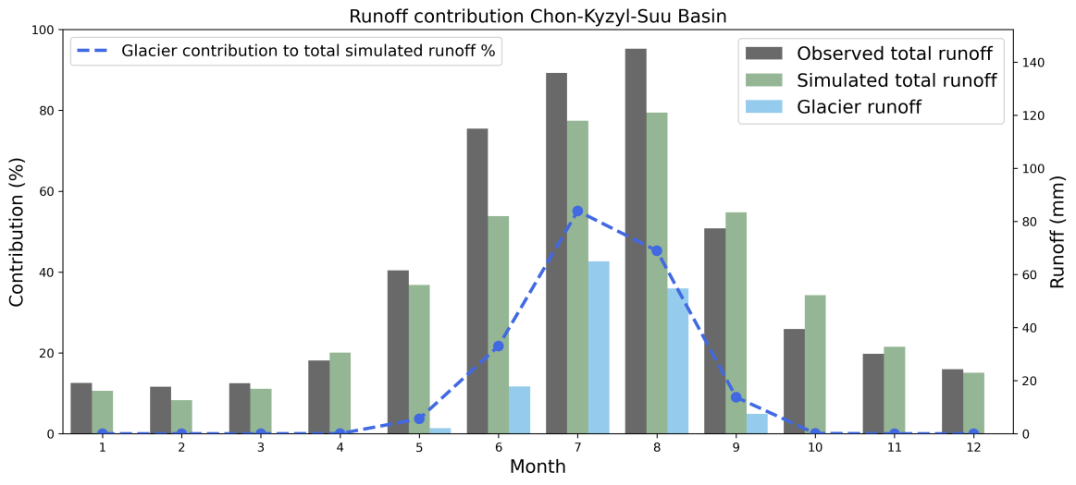
Background
Study Area
Methodology
Conclusion
Results
Runoff contribution by elevation band
Glacier contribution in Chon-Kyzyl-Suu Basin (11.4% glaciated) can reach about 50% in July-August and 20% annual.
9

Slide 10
Background
Study Area
Methodology
Conclusion
Results
Sadyrov, S., Tanaka, K., Satylkanov, R., Khujanazarov, T., Touge, Y., & Fujita, K. (2024). Modelling runoff components and hydrological processes in glaciated catchments of the inner Tien-Shan, Kyrgyzstan. Frontiers in Earth Science, 11, 1306476.
Conclusion
Global products are very useful for ungauged basins and its accuracy can be improved by inclusion of in-situ data.
Energy and water balance models are sensitive to solar radiation data especially in high mountain regions. Therefore, it is essential to consider topography and sometimes clouds for downscaling methods.
Depending on the area of glaciation and precipitation regime, glaciers can contribute to annual runoff from 2.4 % in basins with less glaciation up to 31.2% in highly glaciated basins of the study area.
In dry years, glaciers can significantly reduce the intensity of droughts, but the disappearance of glaciers can break this pattern.
10

Slide 11
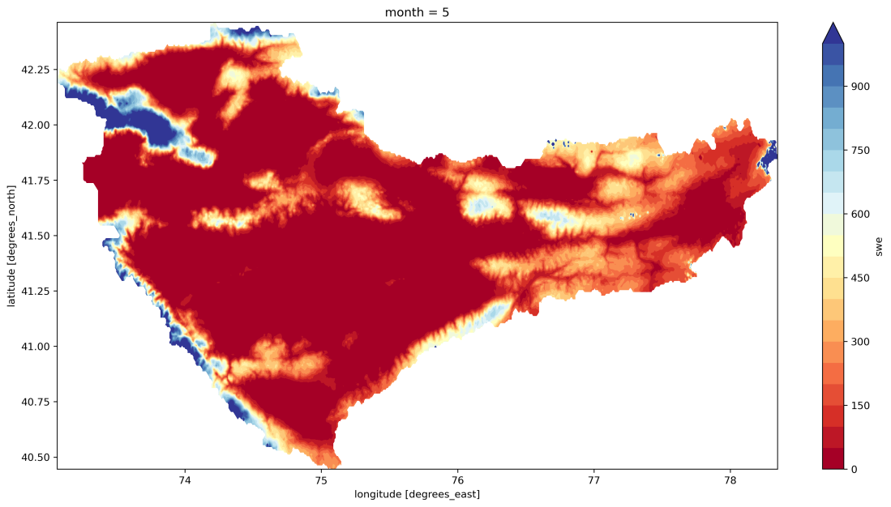
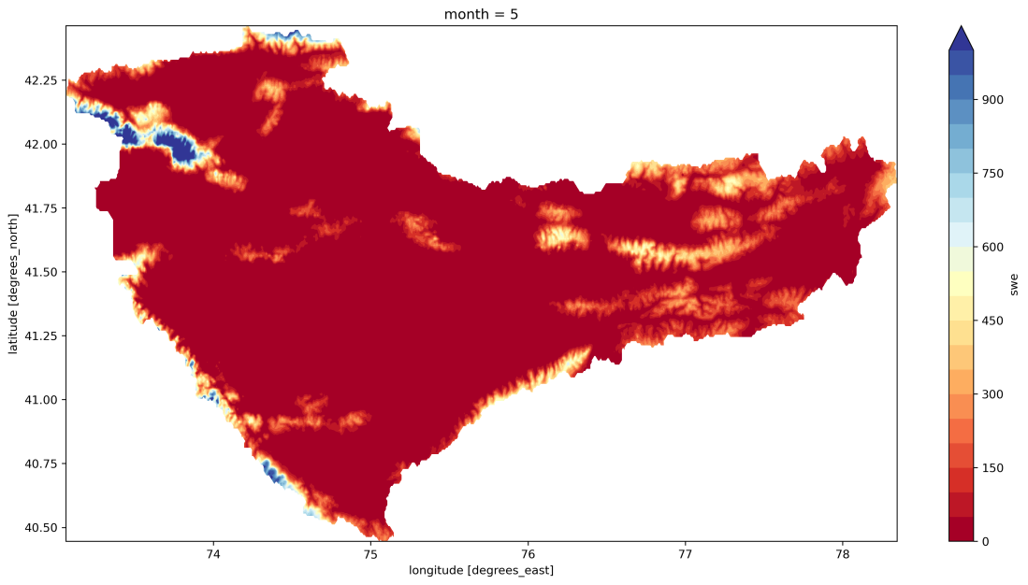
Background
Study Area
Methodology
Conclusion
Results
Naryn River Basin simulation based on high resolution (5 km) NHRCM over Central Asia considering ssp585
1981-1995
2083-2095
Changes in snow water equivalent, mean monthly (May).
11

