Slide 1
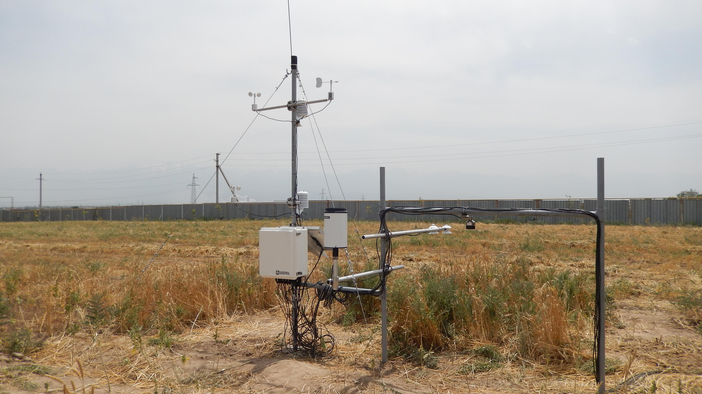
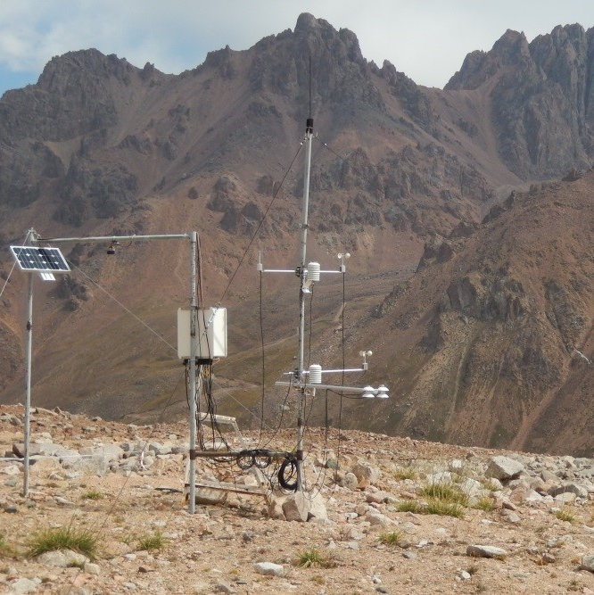
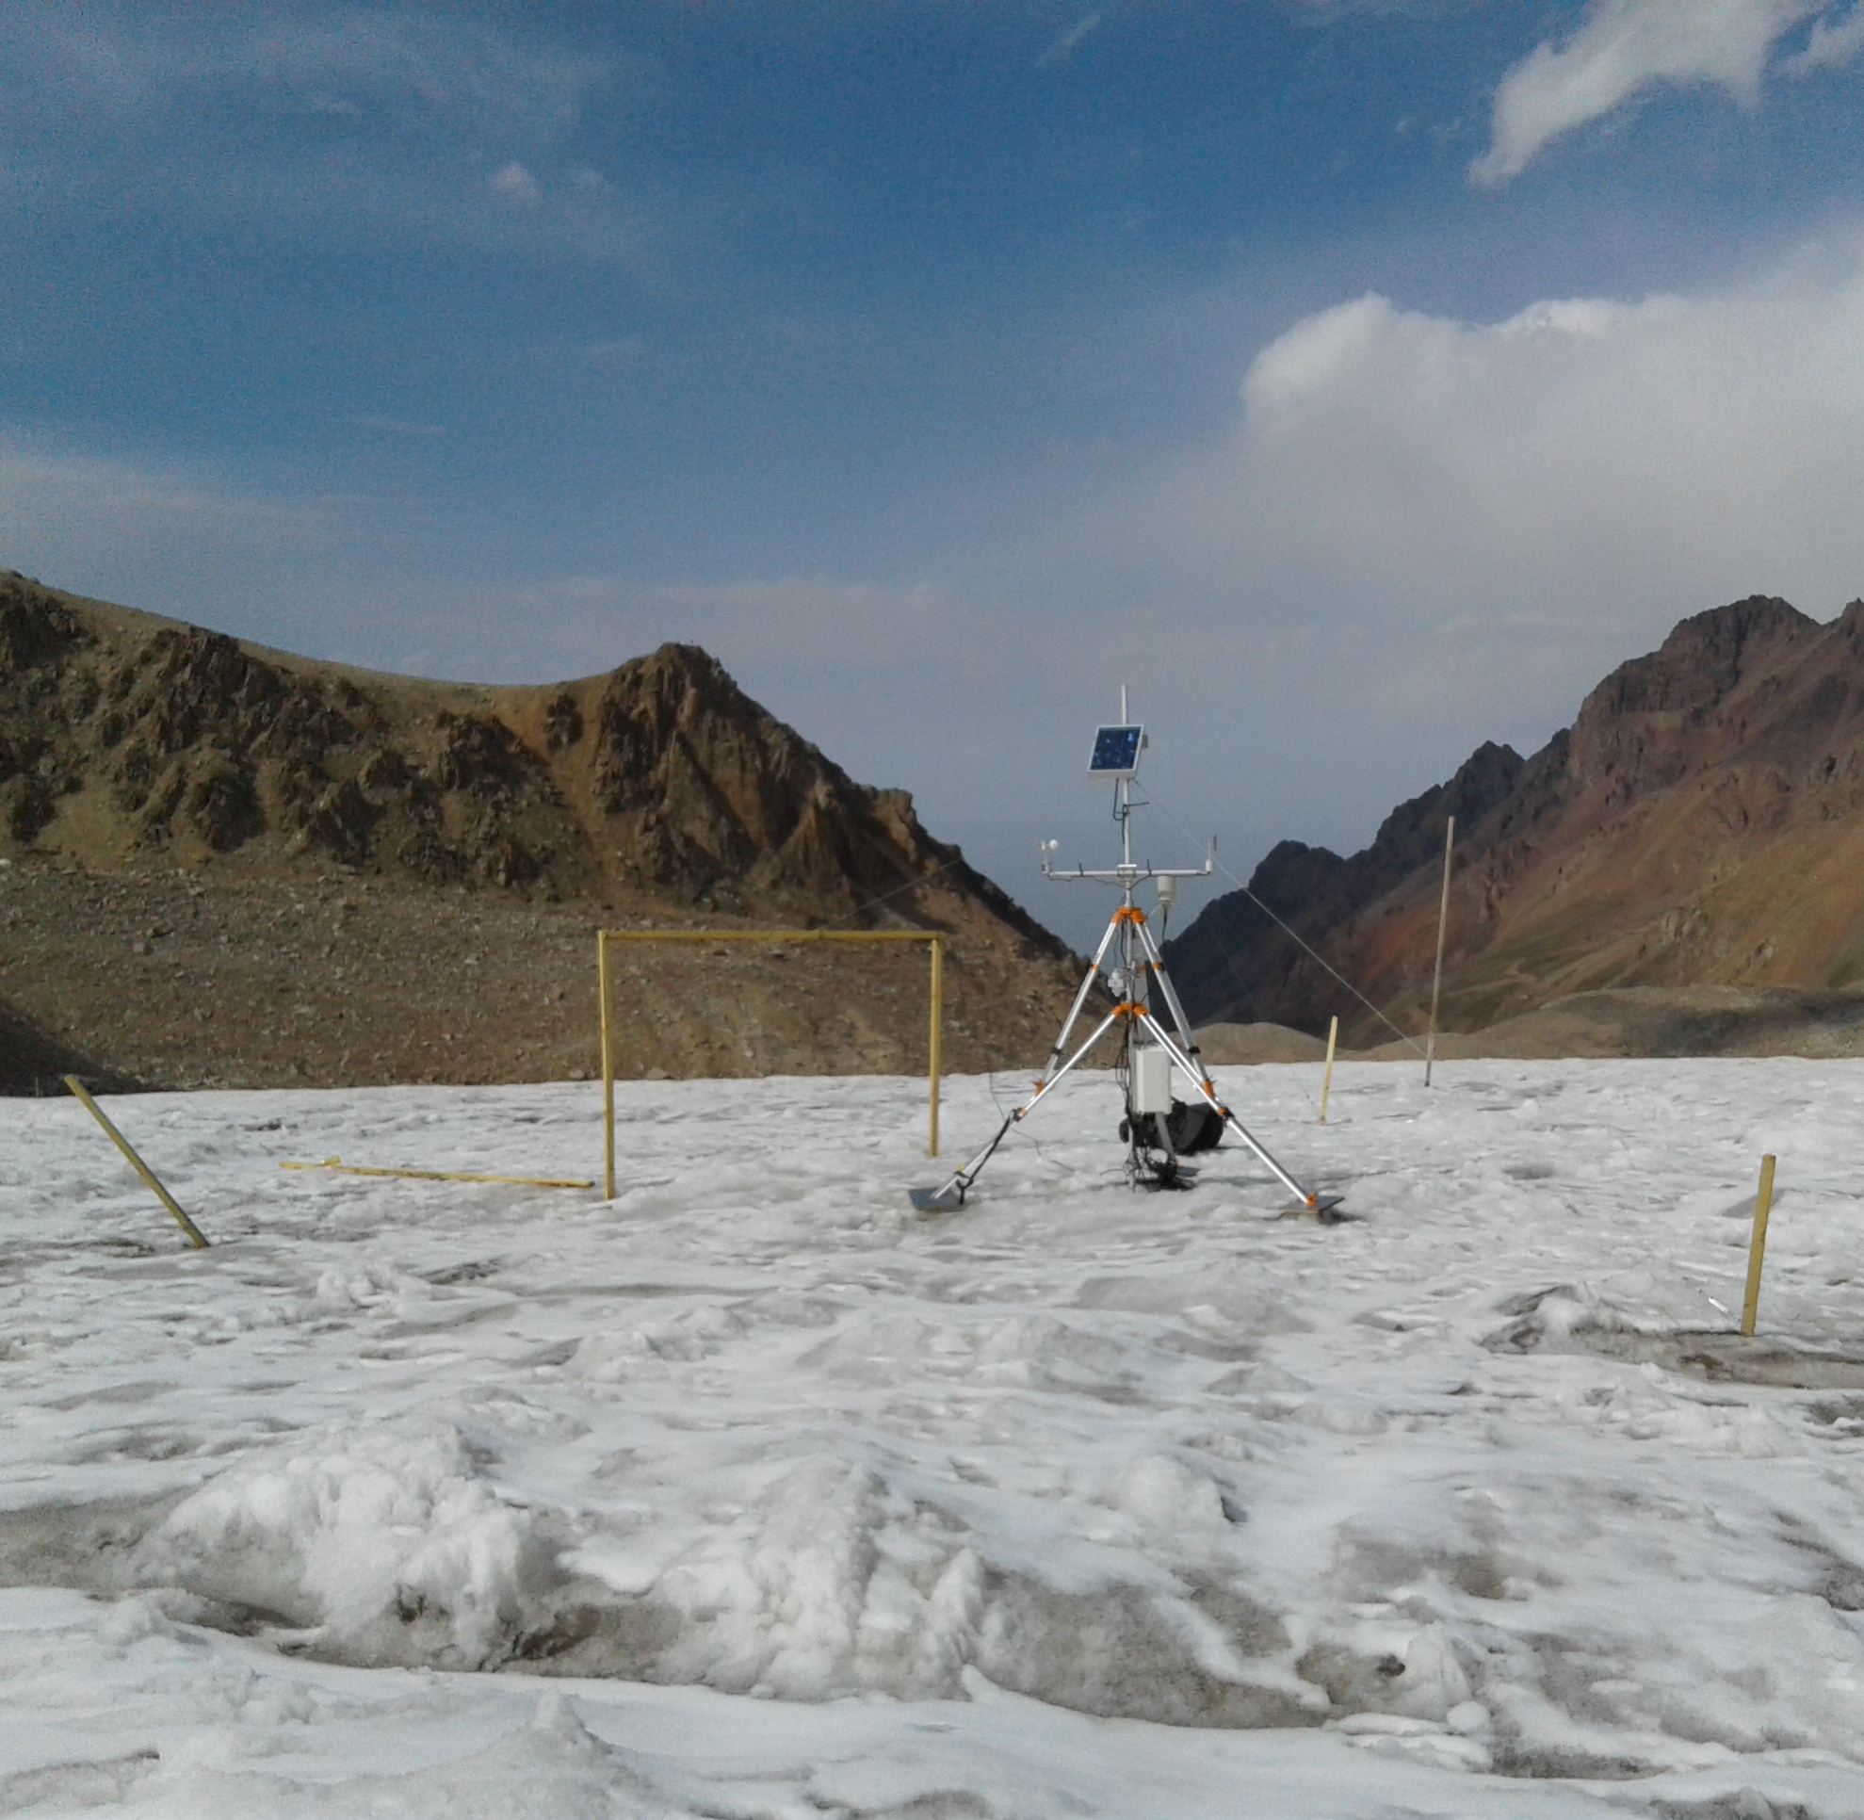
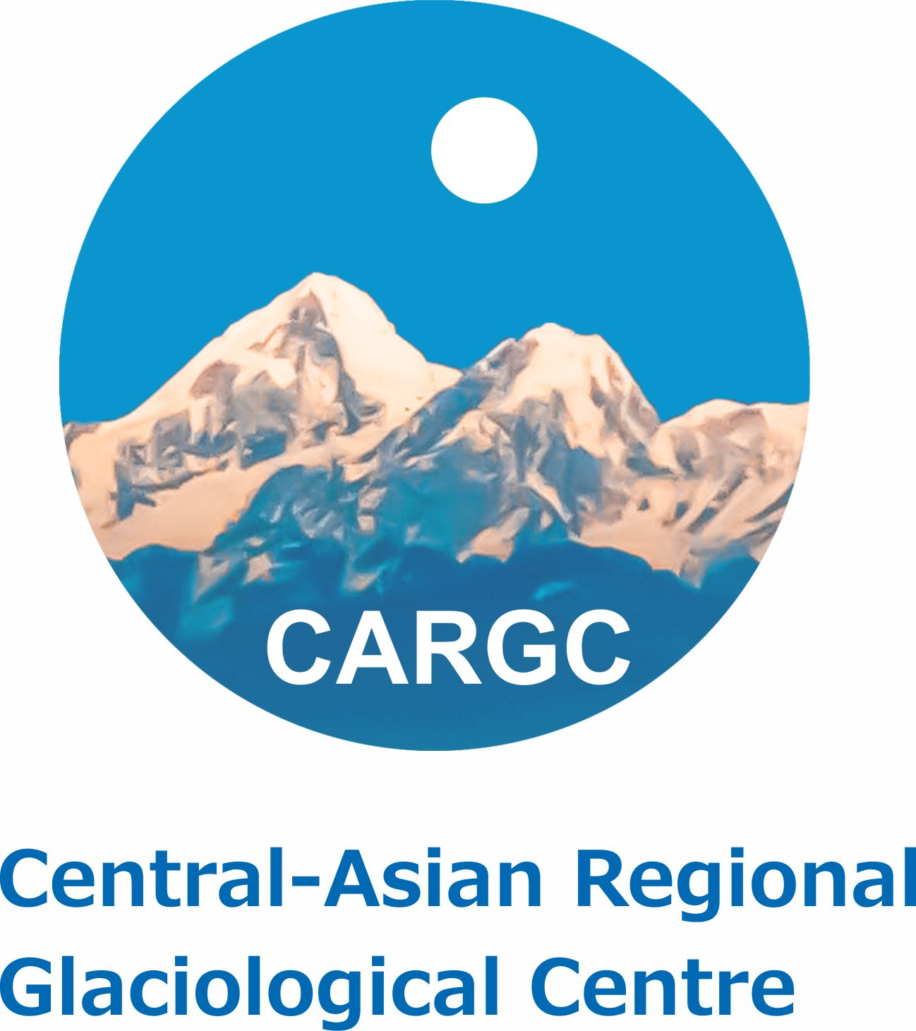
Hydrometeorological and glaciological monitoring in Central Asia: Historical data, new data sets and perspectives
Z. Saidaliyeva, M. Shahgedanova
GEWEX, Osh 2024

Slide 2
Current knowledge and data availability
Mountain Research Initiative (MRI) and Geo Mountains
https://mountainresearchinitiative.org/
Inter- and Transdisciplinary Mountain Across Central Asia: Identifying User Requirements and Access Preferences: https://geomountains.org/news-page-all/138-geo-mountains/2825-inter-and-transdisciplinary-mountain-across-central-asia-identifying-user-requirements-and-access-preferences
CAMON workshop in collaboration with MRI Mountain Observers Working Group: https://research.reading.ac.uk/central-asia-mountain-observatory/
Collaboration with MRI
Elevation Dependant Climate Change working group
Uniform High-Elevation Observing Platform (UHOP) project
Long history of environmental monitoring dating back to 1940s
Research capacity: Central Asian Regional Glaciological Centre, Central Asian Institute for Applied Geosciences, University of Central Asia, etc.
Many national and international projects in collaboration between CA organizations and international partners (e.g. UK, Germany, Switzerland)
New UK Foreign Office research, innovation and development programme in CA
International partners (UNESCO, WMO, Third Pole Regional Climate Change Centre/Forum, IAEA)
Data inventories
GEO Mountains General Inventory
https://geomountains.org/resources/resources-surveys/general-inventory
In Situ Inventory
https://geomountains.org/resources/resources-surveys/inventory-of-in-situ-observational-infrastructure

Slide 3
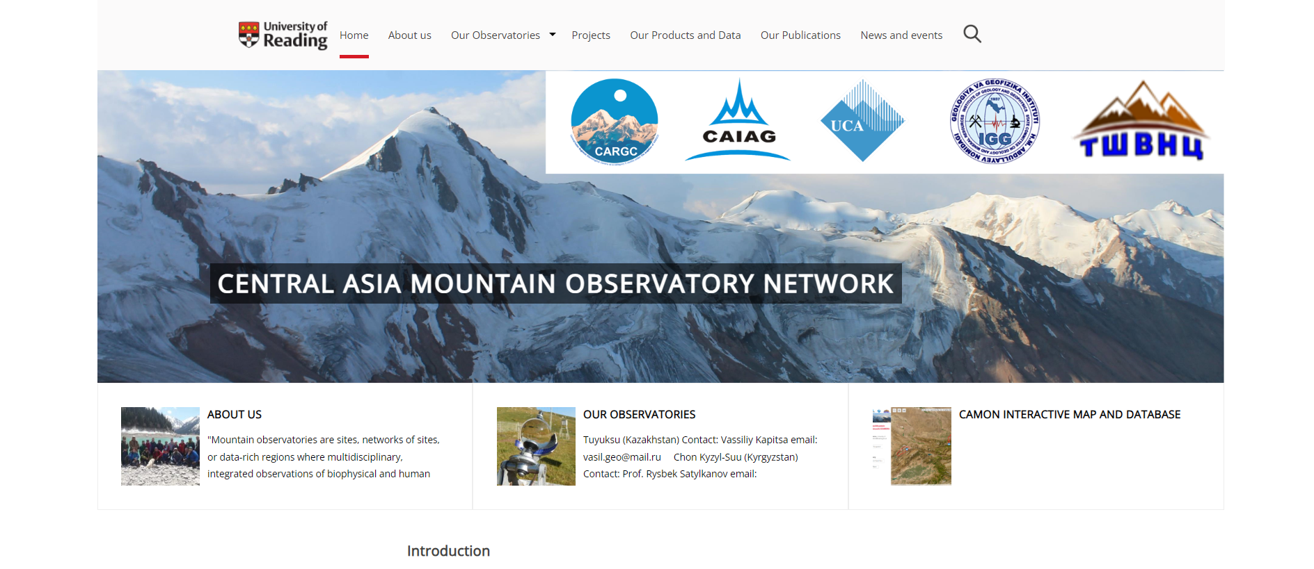
Central Asia Mountain Observatory Network: CAMON
CAMON Open Science project funded by MRI/Geo Mountains 2023-2024: https://research.reading.ac.uk/central-asia-mountain-observatory/
Mountain observatories are sites, networks of sites, or data-rich regions where multidisciplinary, integrated observations of biophysical and human environments are conducted over a lengthy period of time in consistent ways, according to established protocols using both in situ and remote observations” (Shahgedanova et al., 2021; doi.org/10.1659/MRD-JOURNAL-D-20-00054.1).
Five mountain observatories: Tuyuksu (KZ), Ala-Archa (KG), Chon Kyzyl-Suu (KG), Pskem (UZ), Khorog (TJ)
Monitoring commenced in 1940s – 1950s except Khorog
Expanded monitoring and updated equipment in 2010s

Slide 4
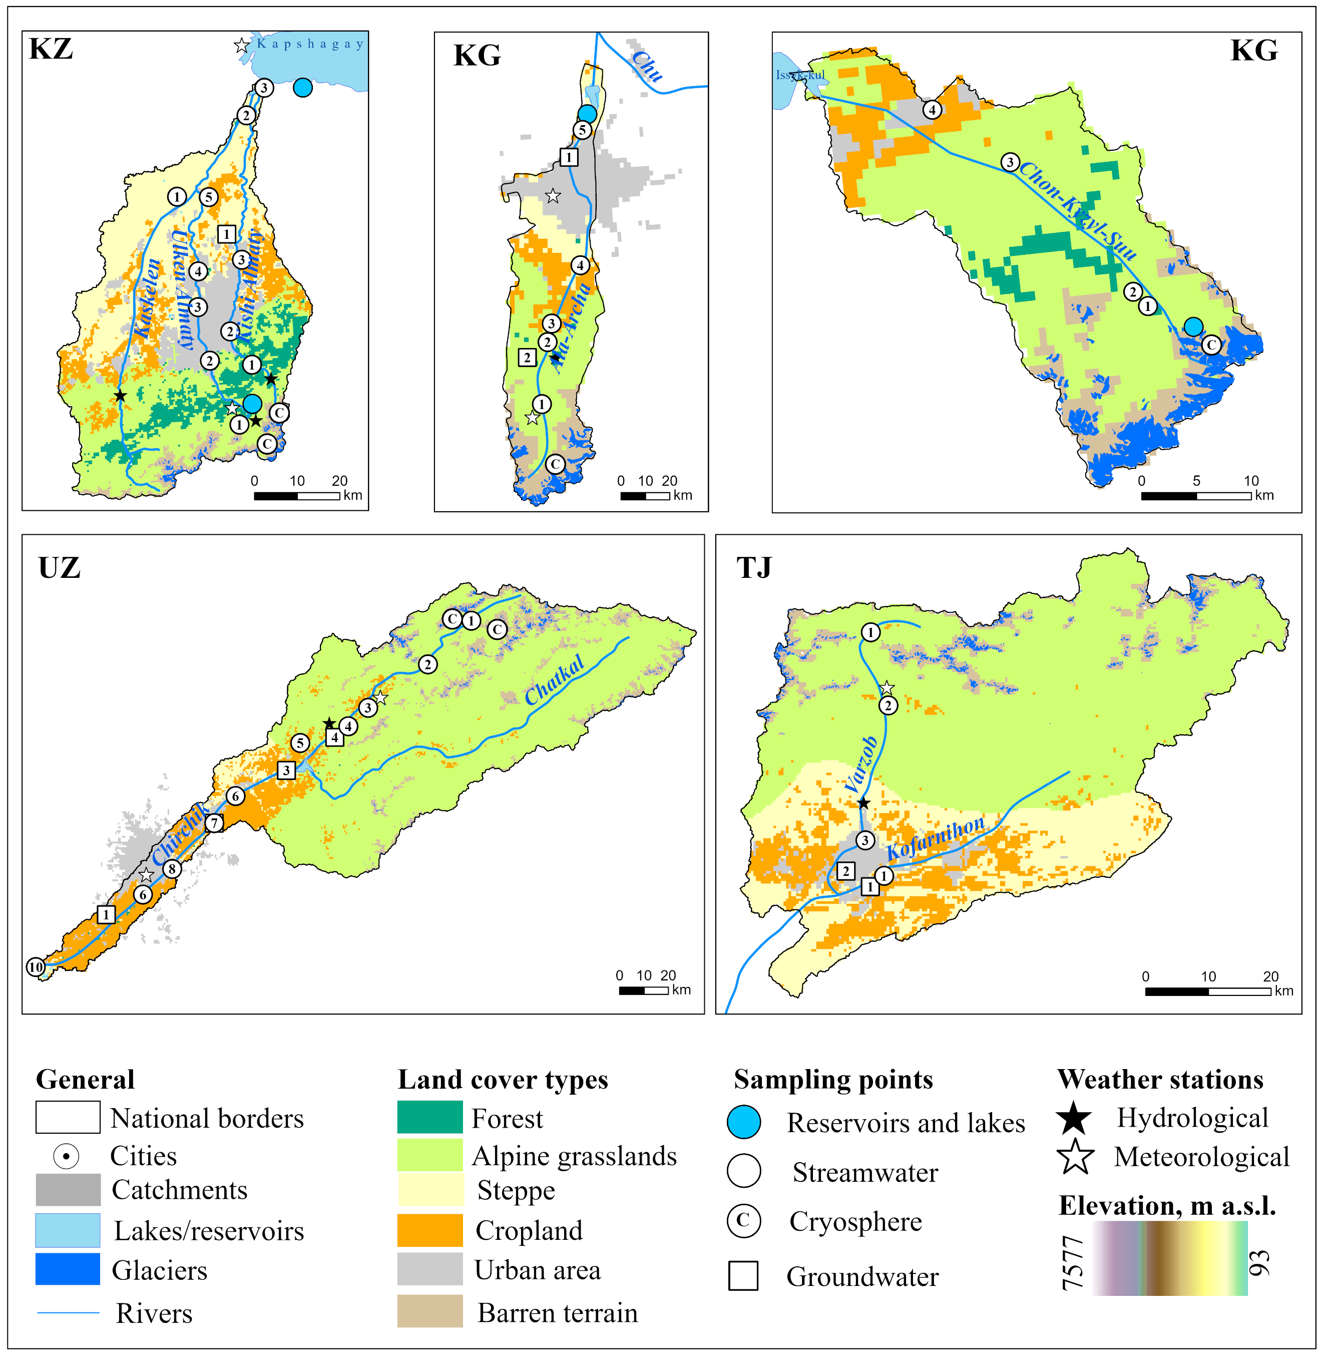
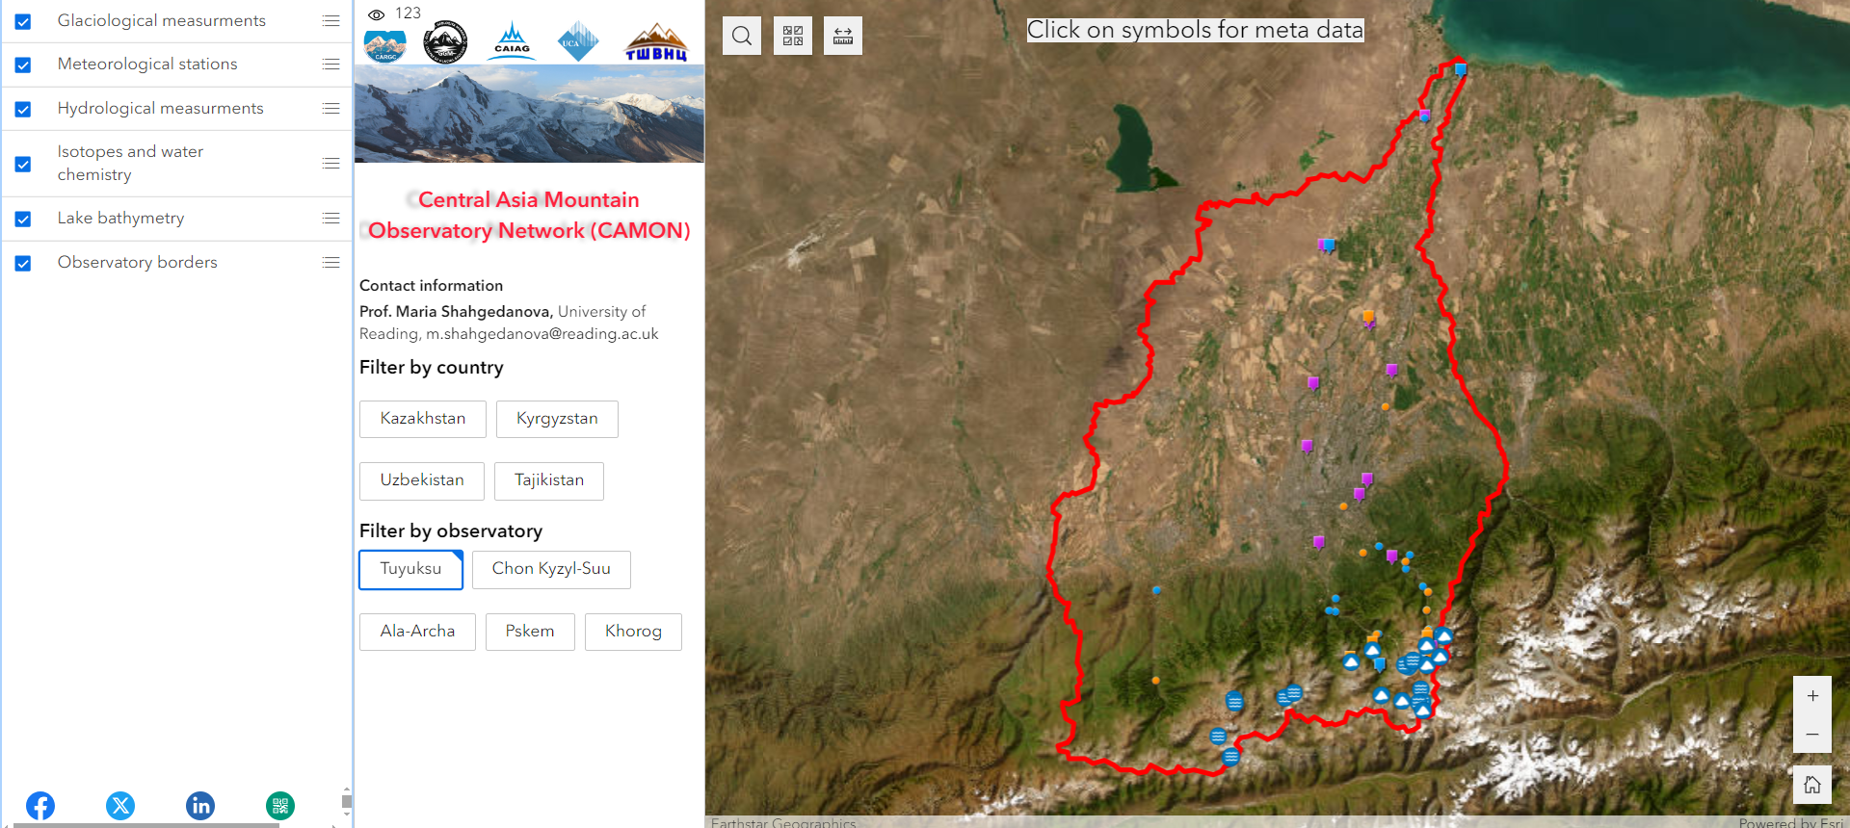
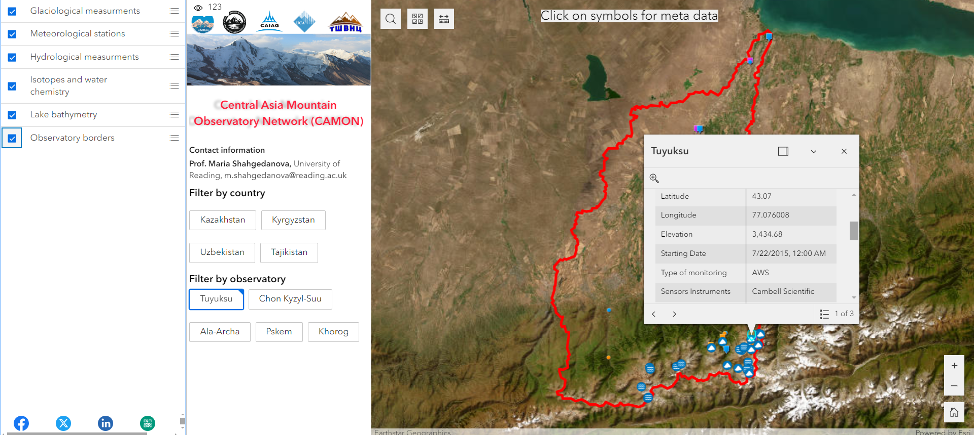
CAMON Metadata
Tuyuksu Observatory
Catchment monitoring approach is used to link mountains and downstream locations
Foci and strengths:
Glaciology: in situ glacier mass balance measurements since 1950s (WGMS reference glaciers); regular glacier inventories across the region (Severskiy et al. 2016; Kapitsa et al., 2020)
Climate, snow cover and streamflow (Shahgedanova et al., 2018)
Hydrochemistry and water quality (Wade et al., 2024; in review)
Water stable isotopes (Saidaliyeva et al., 2023)
Water quality and water stable isotope monitoring networks at four CAMON catchments and in Varzob-Kofarnihon (TJ) catchment

Slide 5
Meteorological and snow monitoring
Long term meteorological and snow depth measurements (since 1930s) from conventional stations
AWS installed along elevation profiles from 400 to 5000 m a.s.l.;
Energy balance measurements including four radiation fluxes and soil heat flux (Tuyuksu (KZ), Chon Kyzyl-Suu (KG))
Eddy covariance system (Chon Kyzyl-Suu (KG) only) but limited measurements of evapotranspiration elsewhere
Lack of soil temperature and moisture measurements (Tuyuksu (KZ) and Chon Kyzyl-Suu KG))
Snow density and SWE measurements (1960s-1990s and since 2010s)
Mean JJA air temperature at three stations: Big Almaty lake (2516 m a.s.l.), Mynzhylki (3017 m a.s.l.), and Tuyuksu (3435 m a.s.l.)
Solar radiation budget at AgroBioCenter station (700 m a.s.l.) and Tuyuksu (3435 m a.s.l.)

Slide 6
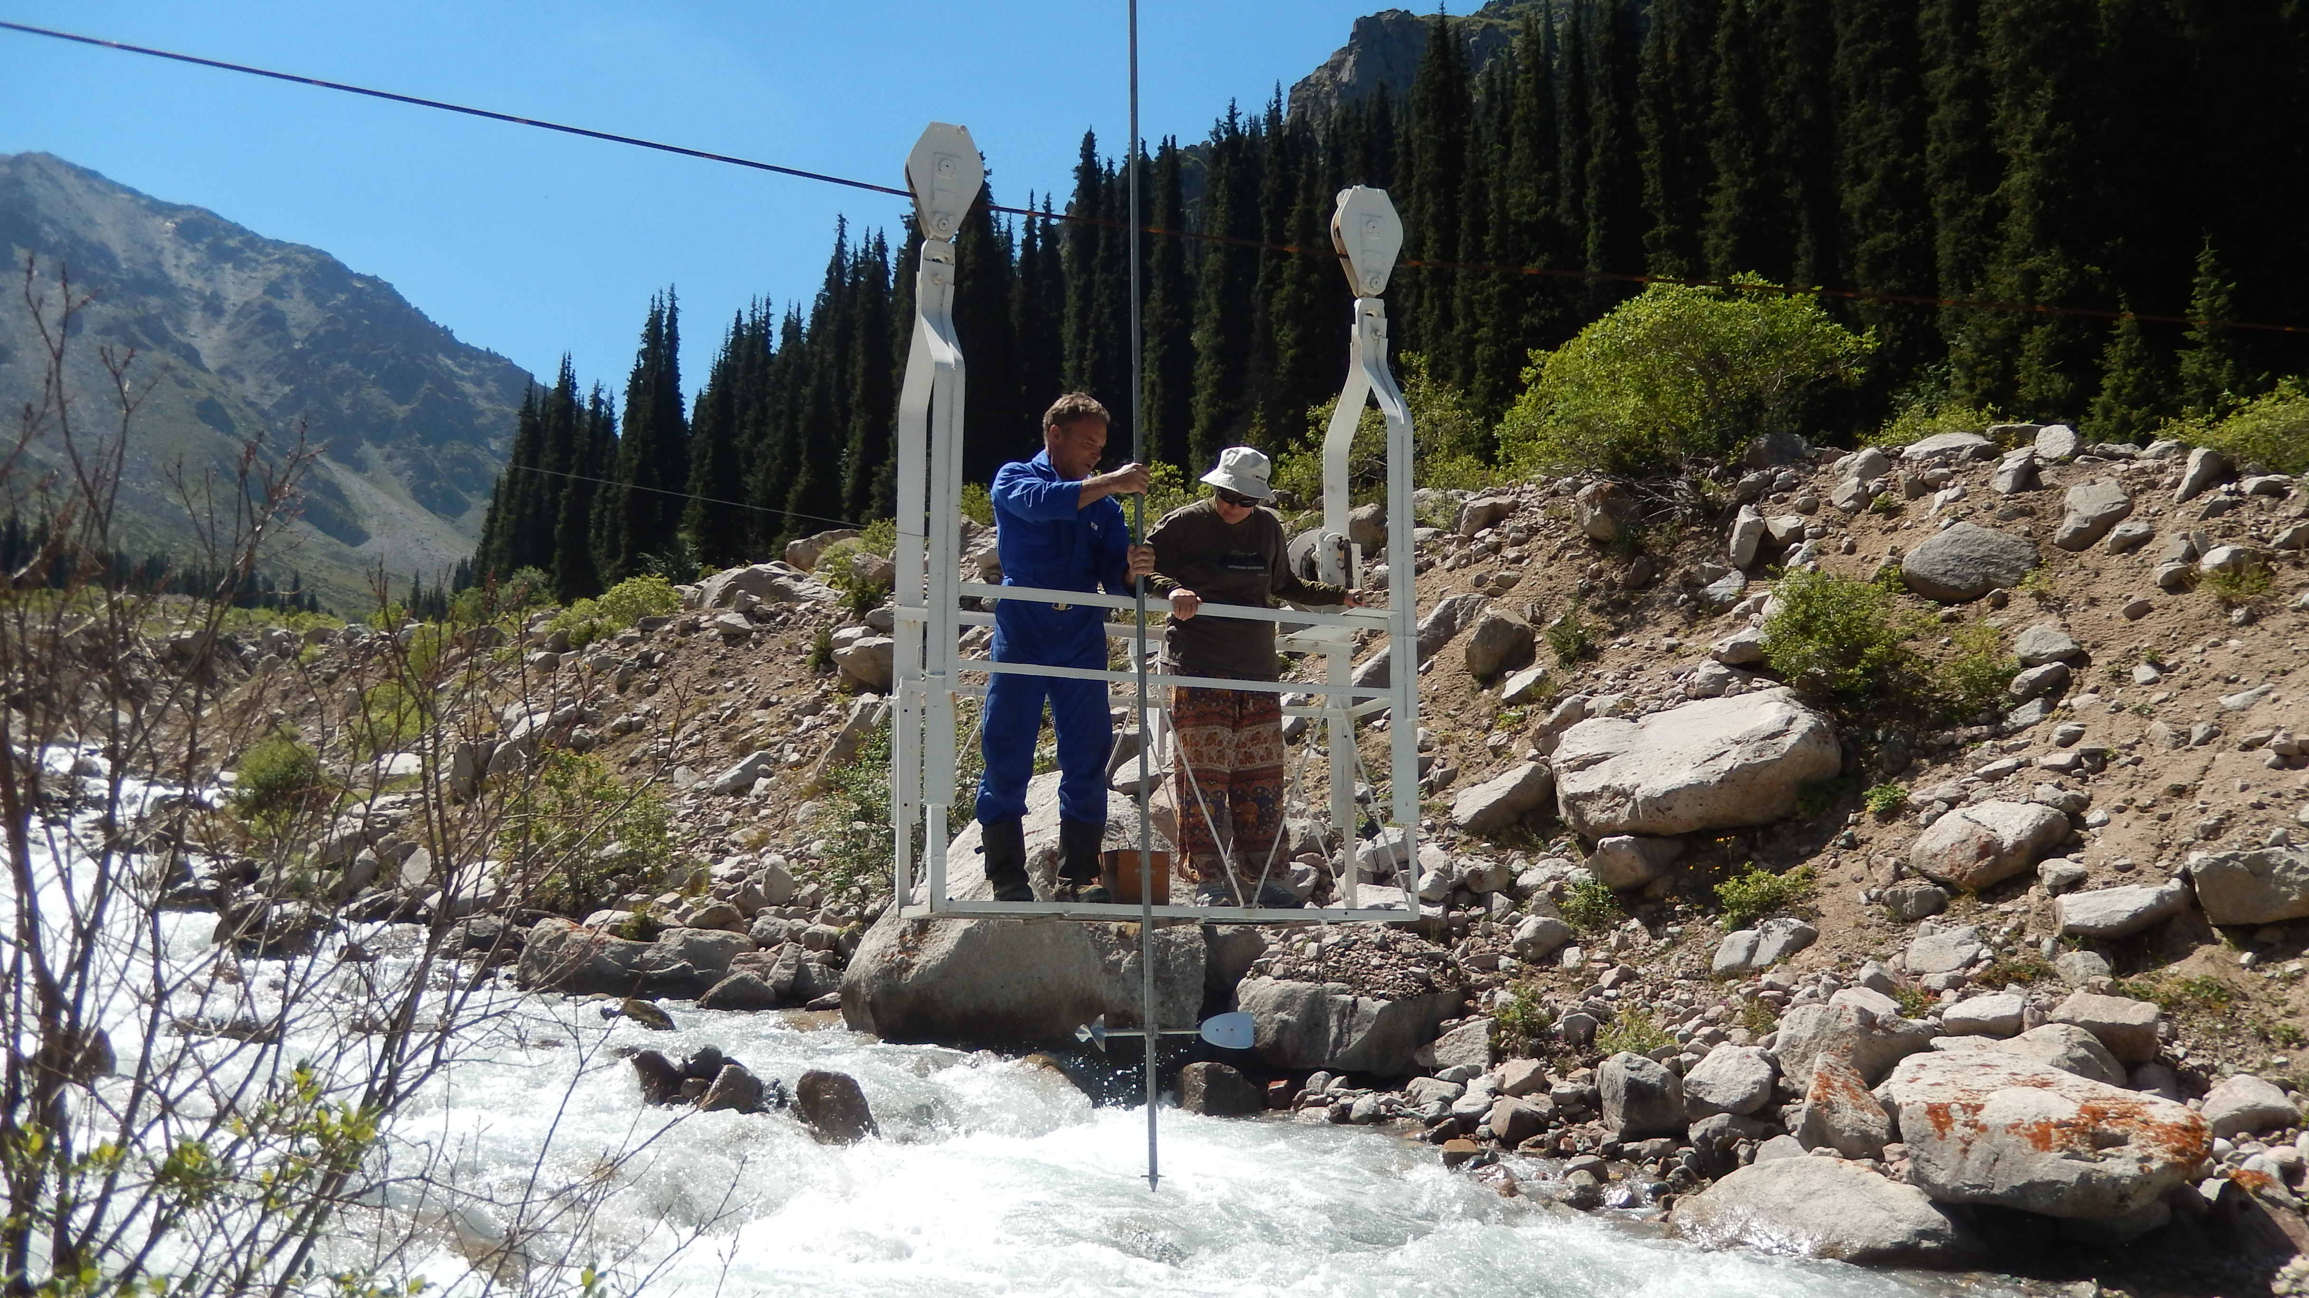
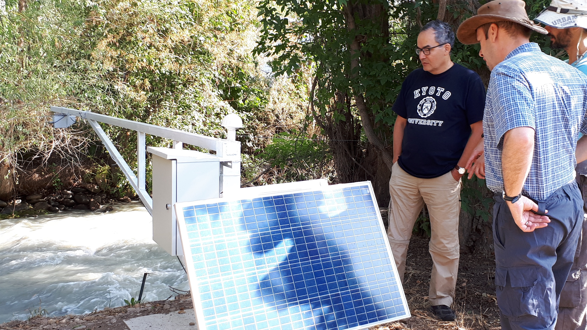
Hydrological and water quality monitoring
Long term water stage and streamflow measurements since 1950s (Shahgedanova et al., 2018)
Very few homogenous records as most rivers are regulated and affected by water abstraction
No reductions in streamflow in natural catchments since the 1950s
Increase in streamflow in catchments with glacierization > ~10%
Expansion of automated measurements but limited coverage still
Lack of groundwater measurements
Q10
Cryosphere water quality: (a) pH, (b) EC, (c) NO₃⁻-N and (d) PO₄^{3—}P (Wade et al., 2024; In Review)
JJA streamflow the Ulken Almaty River (KZ; 11% glacierization)
Water quality monitoring is limited to monthly measurements on few rivers (Yapiyev et al., 2021)
Water quality monitoring at CAMON sites by CARAWAN network since 2019 (Wade et al., 2024; in review)

Slide 7
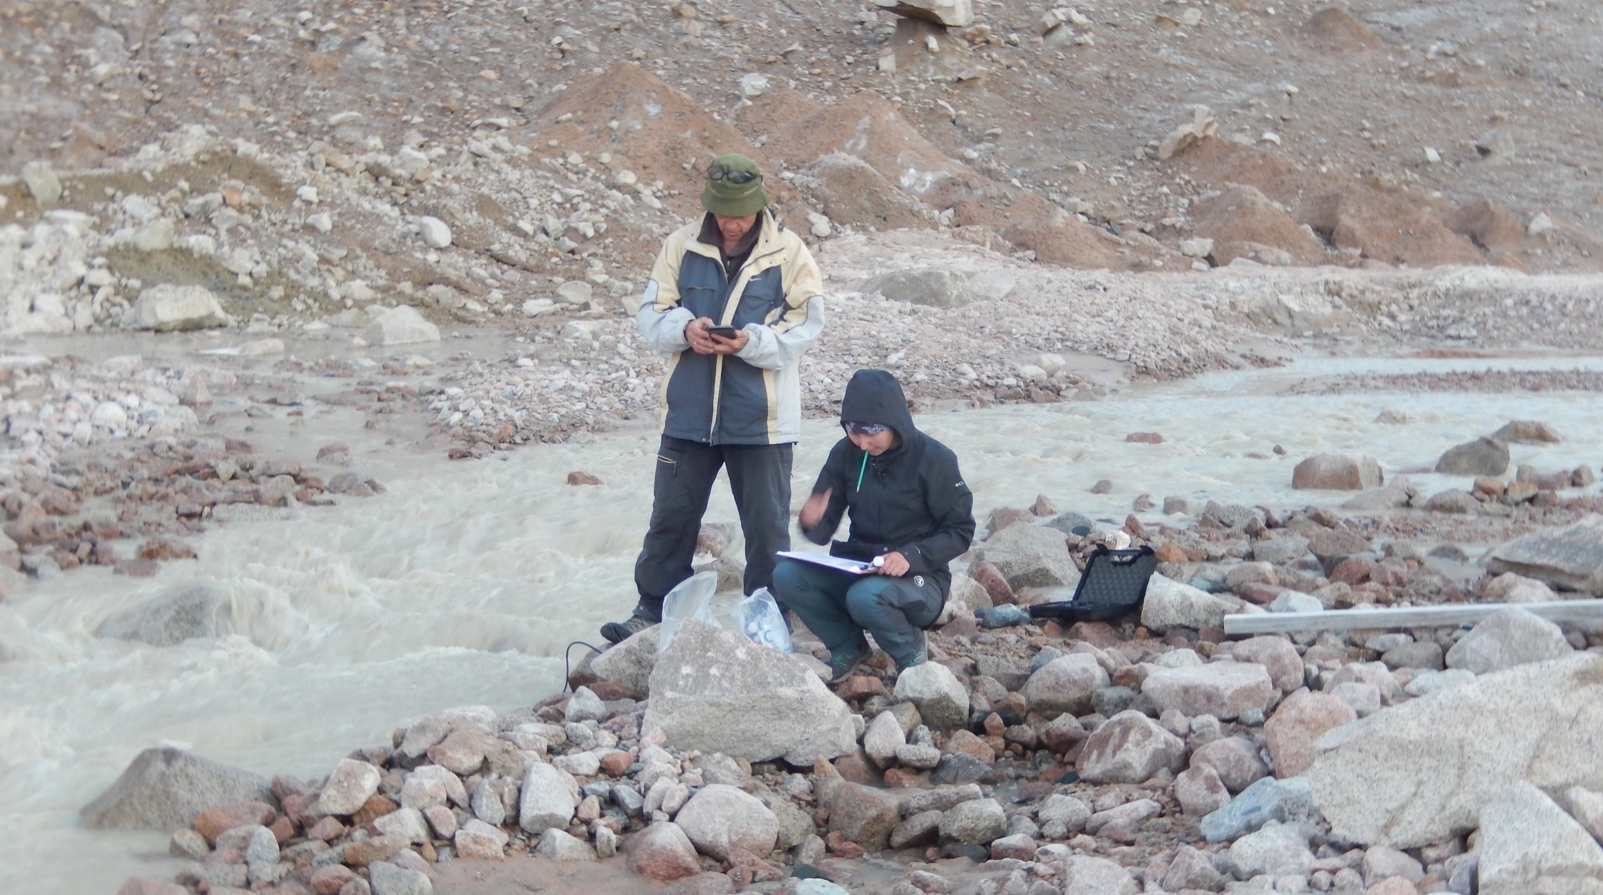
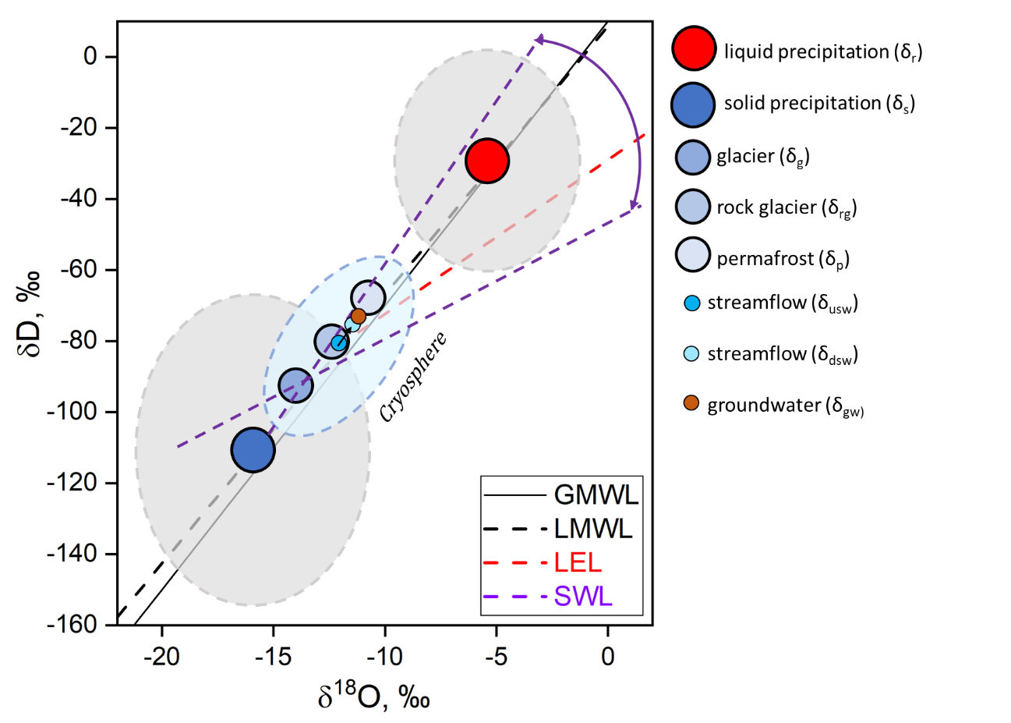
Water Isotope - CARAWAN (Central Asia Research and Adaptation Water Network )
Isotopic and water quality sampling programme was established in 2019 by the University of Reading, in five glacierized catchments.
Kazakhstan: Ulken (UA) and Kishi (KA) Almaty rivers
Kyrgyzstan: Ala-Archa (AA) and Chon Kyzyl-Suu (CKS)
Uzbekistan: Chirchik (CHK)
Tajikistan: Varzob-Kofarnihon (VK)
More recently: Khorog in the western Pamir, Tajikistan
Database of isotopic ratios (~7000) established for the Tien Shan to quantify contributions of different regions to precipitation and water sources to runoff
Even-based precipitation (except Tajikistan)
Daily sampling of streamflow in headwaters (except Tajikistan)
Fortnightly sampling along river courses
End-members (except Tajikistan):
Snow, glacier ice, runoff from glacier surface
Rock glaciers, permafrost, screes, moraines, slopes
Ground water
Axillary measurements (except Tajikistan)
Streamflow, water temperature, electric conductivity, N, P, metals in streamflow
Local Meteoric Water Lines for the mountains of Central Asia. Dual δD and δ¹⁸O plots for (a) the event-based samples for individual catchments, (b) monthly averaged values and seasonal means, and (c) different types of precipitation (Saidaliyeva et al., 2023).
δ_{snow} < δ_{glacier} < δ_{rock glacier} < δ_{permafrost}

Slide 8
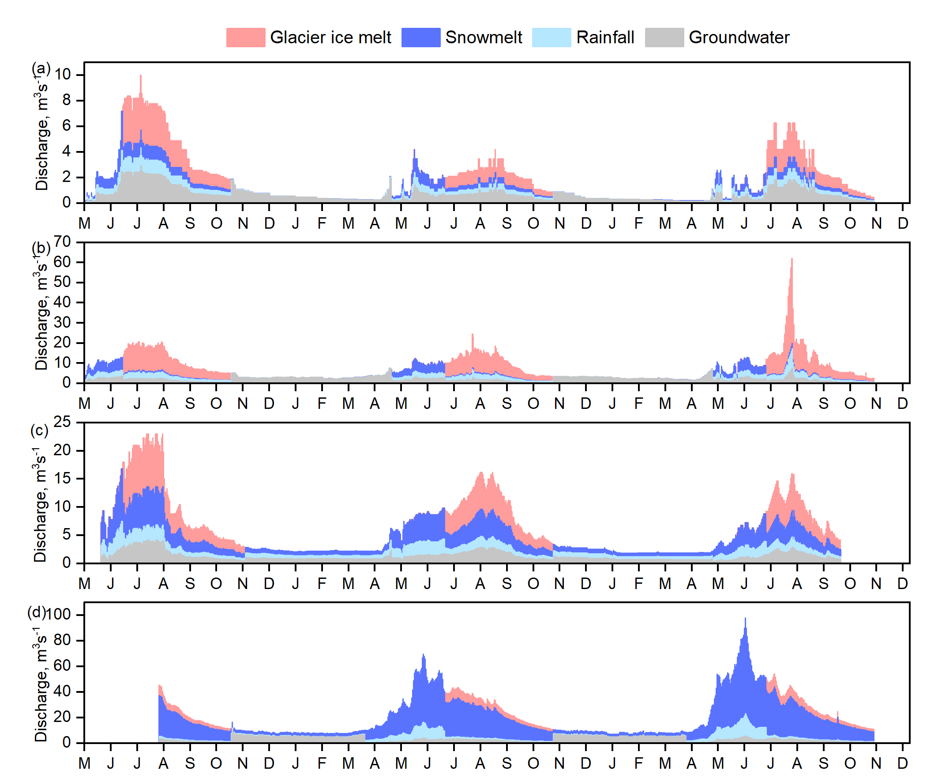
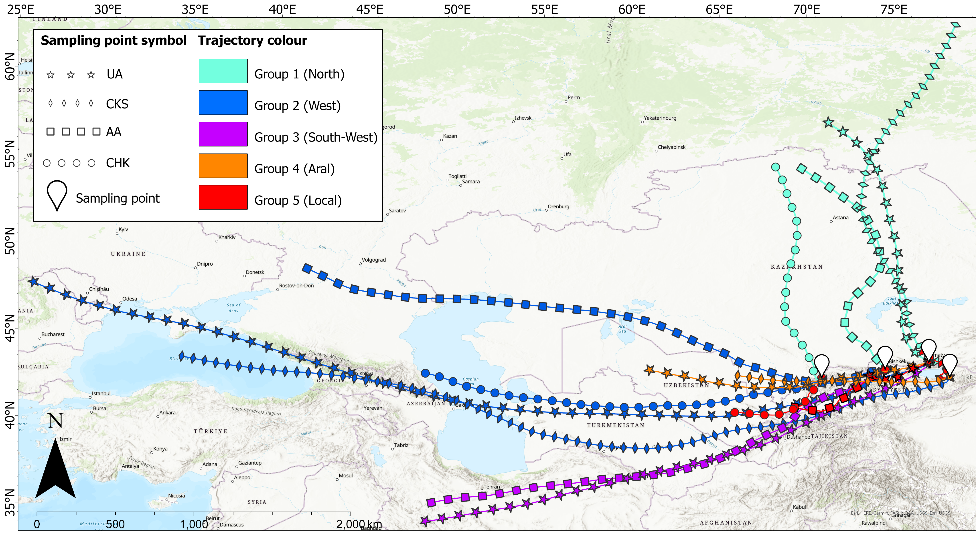
Water Isotope – key findings and further research
Strong contribution of inland moisture from the Aral basin to precipitation (up to 70-80%). Modelling effects on glacier mass balance? (Saidaliyeva et al., 2023)
Groundwater makes significant contribution to discharge in glacierized catchments. Future work: Sources, pathways and links with snow and glacier melt.
Glacier ice makes large contributions (35-45%) to discharge in the high-elevation catchments in Kazakhstan and Kyrgyzstan making them vulnerable to climate change.
Uzbekistan depends primarily on snowmelt (66 %)
Partitioning of daily river discharge between in (a) UA, (b) CKS, (c) AA, and (d) CHK catchments. Mean values, derived from averaging results of the Bayesian (δ¹⁸O; δD), and Bayesian (δ¹⁸O; EC) models, are used. Source: Saidalieyva (2024) Unpublished PhD thesis, University of Reading, UK.
Source regions of the Tien Shan precipitation (Saidalieyva et al., 2023)

Slide 9
Climate and hydrological modelling
Detailed regional climate and hydrological projections are required
25 km grid does not resolve climate (especially precipitation) in the mountains
NASA Global Statistical Downscaling NEX-GDDP-CMIP6 (Trasher et al., 2022) is commonly used but the number of variables is limited
RCM and hydrological projections were developed for Kazakhstan(Shahgedanova et al., 2020) but need updating
Peak flow by 2040s
Reduction of steamflow in July-August in catchments with lower (<10%) glacierization
Spring peak in streamflow
All rivers originate in the mountains and glacier change should be incorporated
Natural catchments: Climate change → snow and glacier change → hydrological projections
Managed catchments: Reservoirs and water abstraction should be included (data on water abstraction are not readily available)
Examples of hydrological projections for the Ile Alatau for snow-dominated (Turgen) and glacier-ice- dominated (Ulken Almaty) catchments (Shahgedanova et al. 2020).

Slide 10
Synthesis and Conclusions
Impacts of climate change in Central Asia
One of the hot-spots of climate change
Glacier retreat except the eastern Pamir
Water supply depends on mountain snow cover and glacier ice
Data availability and monitoring
Well-established continuous monitoring at the CAMON sites but expansion is required
Focus on mountains but a lack of observations on the plains supplying data for agricultural studies
Climate and hydrological modelling
High-resolution regional climate projections are required to resolve processes in the mountains
Wider application of distributed or semi-distributed hydrological models in combination with modelling glacier retreat (desirably taking glacier dynamics into account)
Data on water stable isotopes permits the use of isotope-enabled models
Impacts on agriculture and food security
Crop modelling is limited: Two projects at the University of Reading on modelling responses of maize and soya to climate change using Aqua Crop and SALTMED models in south-eastern Kazakhstan (supported by Tuyuksu Observatory)
Expansion of crop modelling is required

Slide 11
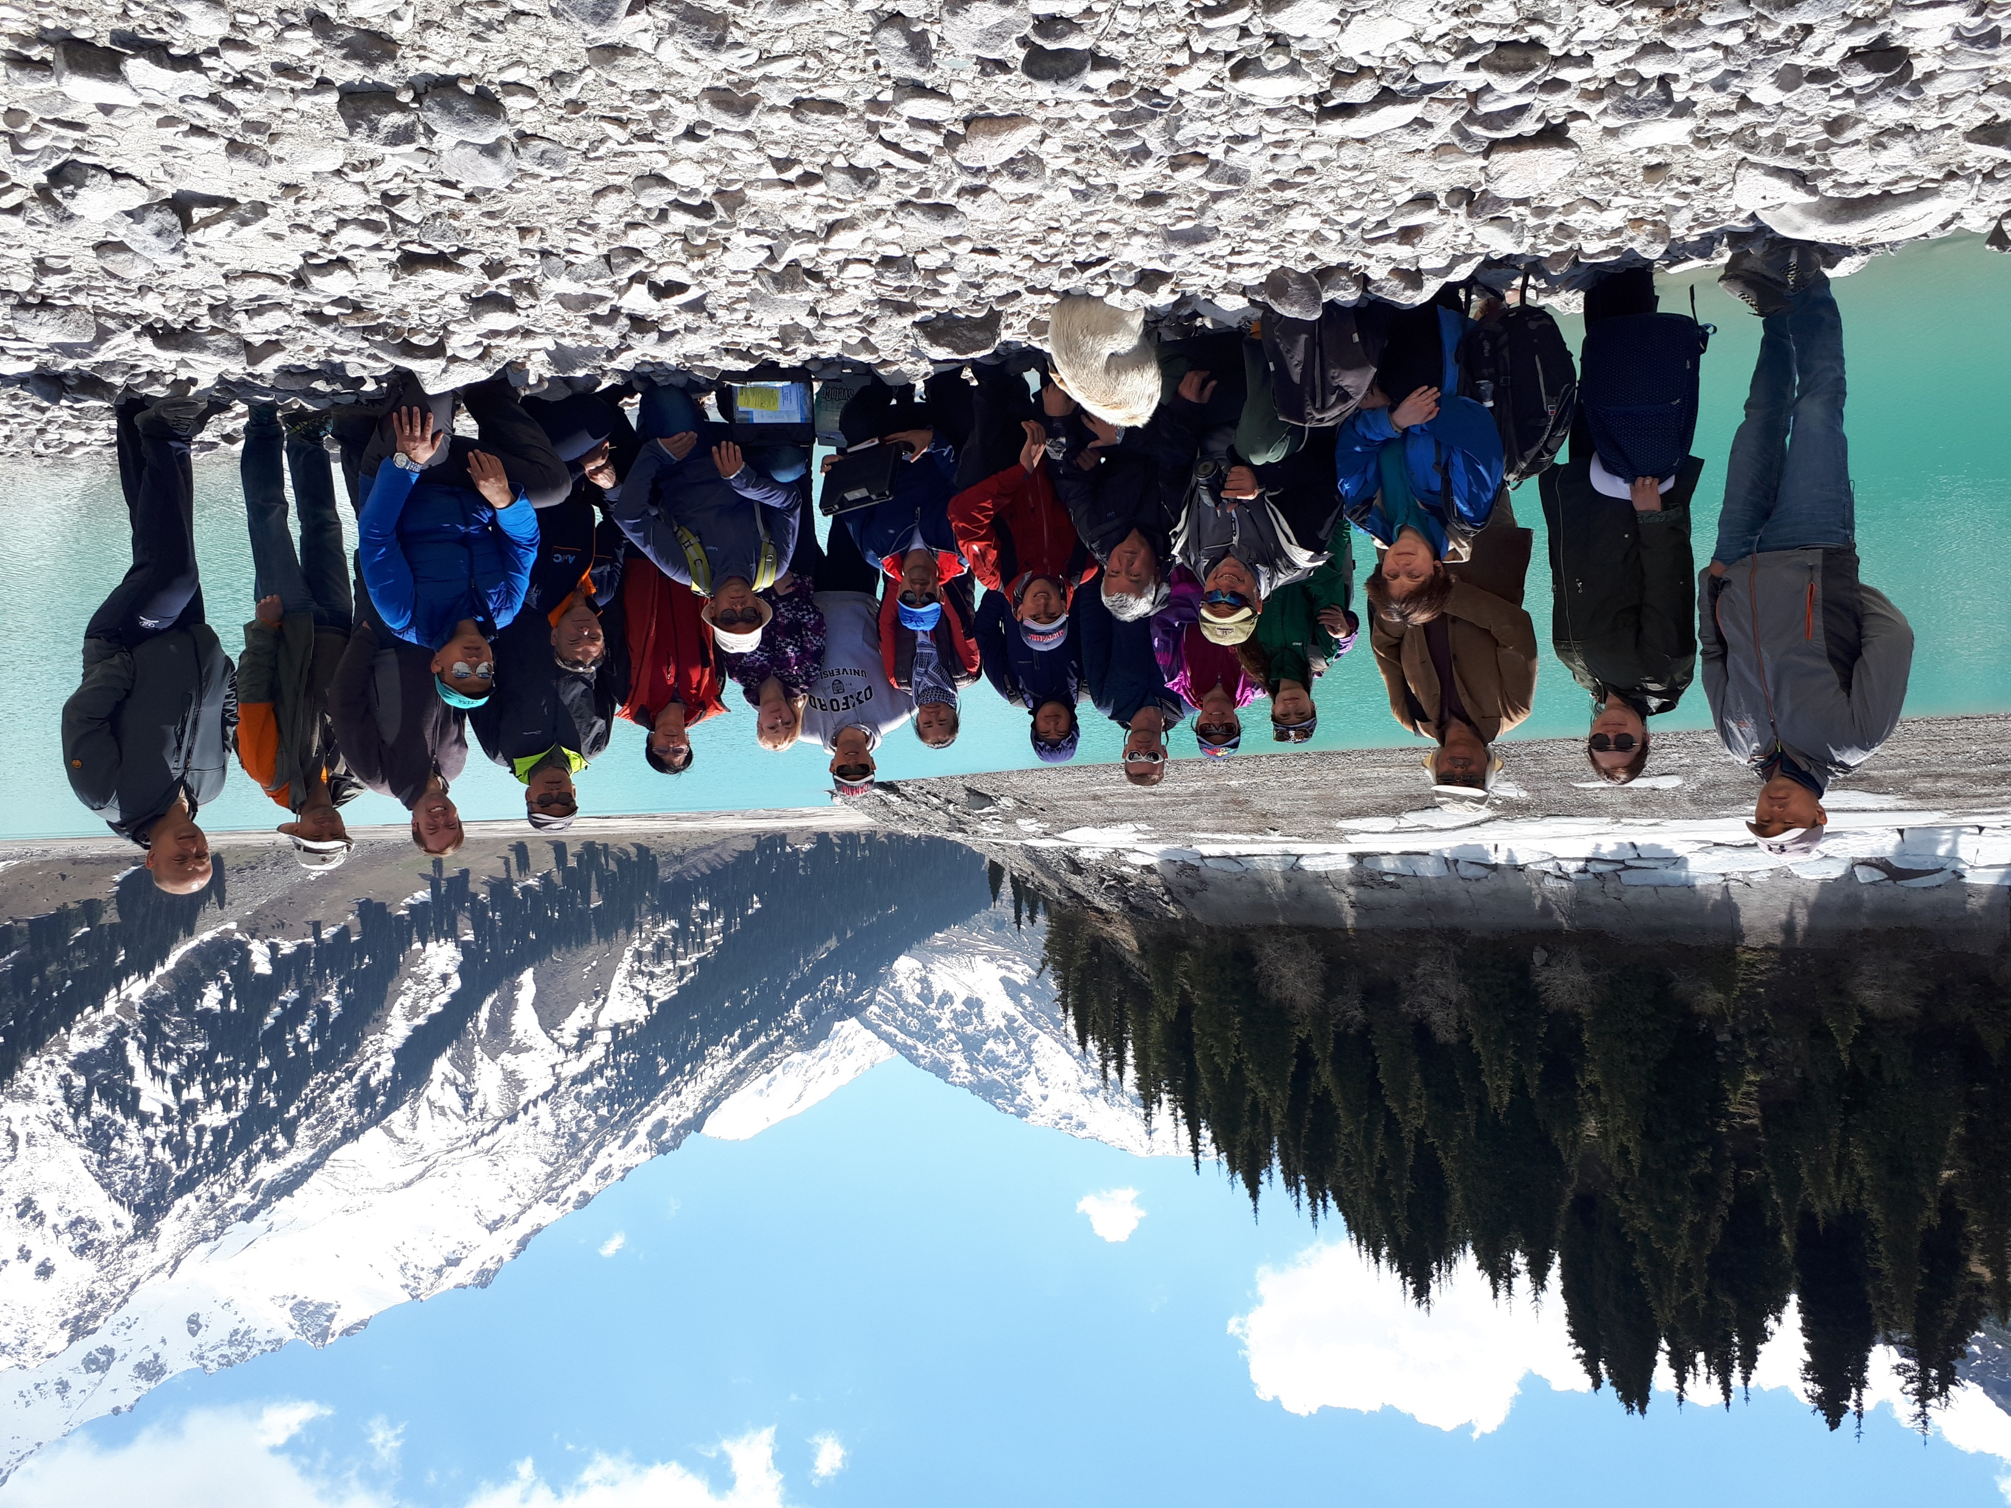
Contacts:
Zarina Saidaliyeva (z.saidaliyeva@reading.ac.uk), Prof. Maria Shahgedanova (m.shahgedanova@reading.ac.uk)
With special thanks to
CARAWAN/CAMON including Central Asia Regional Glaciological Centre under the Auspices of UNESCO (Kazakhstan), Central Asia Institute for Applied Geosciences (Kyrgyzstan), Tien Shan High Elevation Research Centre (Kyrgyzstan), Institute of Geology and Geophysics and National University of Uzbekistan (Uzbekistan), Institute of Water Problems and Centre Research of Glaciers (Tajikistan), Central Asia University (Tajikistan).

