Slide 1
The Spacetime Variability of Flood Frequency in a Warming Climate
Daniel Wright
Associate Professor
Civil and Environmental Engineering
University of Wisconsin-Madison
Olympus Dam
Oil on Canvas
X. Gonzalez (1898-1993)

Slide 2
Flood Frequency Analysis: Where flood science meets flood practice—and where a lot more work is needed!
1% Annual Exceedance Prob.
or 100-Year Flood
Q₁₀₀ or 100-year Magnitude
Example “Flood Frequency Curve”
Annual Recurrence Interval or Return Period

Slide 3
How can we use conceptual, observational, and modeling advances to bring flood frequency analysis into the 21st century?

Slide 4
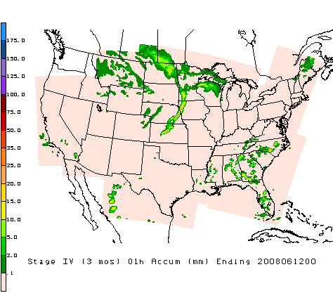
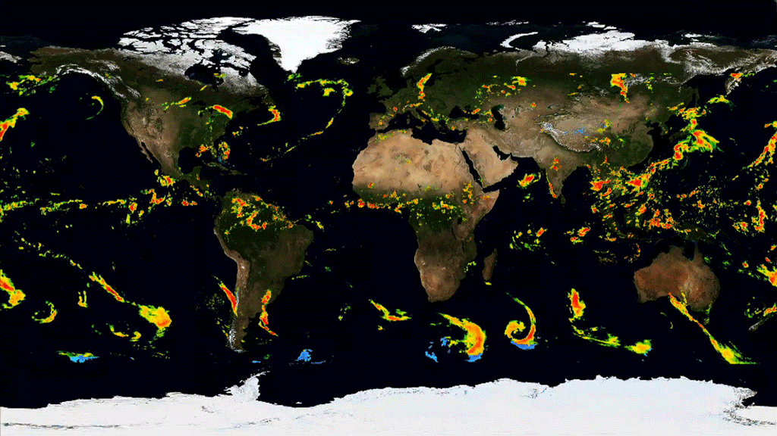
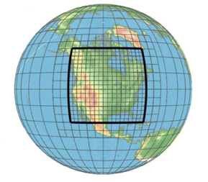
Gridded Precipitation Data→critical spacetime information
1. Weather Radar and/or Rain Gages
2. Satellites
3. High-resolution regional/global climate models

Slide 5
Our Approach: Process-Based Flood Frequency Analysis via “Flood Recipes”
Step 1
Step 2
Step 3
Stochastically generate lots of flood recipes: rainfall + other ingredients
Lots of Monte Carlo simulations using physics-based models
Analyze model outputs for flood frequency and physical drivers
Stochastic Storm Transposition (SST): resampling from storm catalogs created from gridded rainfall
Image: http://www.berries.com

Slide 6
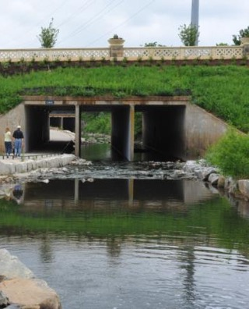
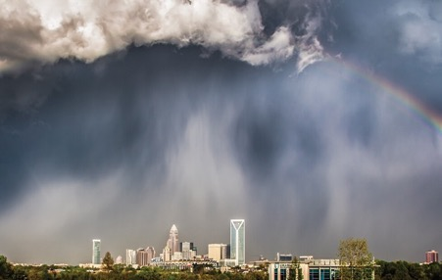
Two Examples
Example 1: Little Sugar Creek in Charlotte, North Carolina
Example 2: Turkey River, Iowa

Slide 7
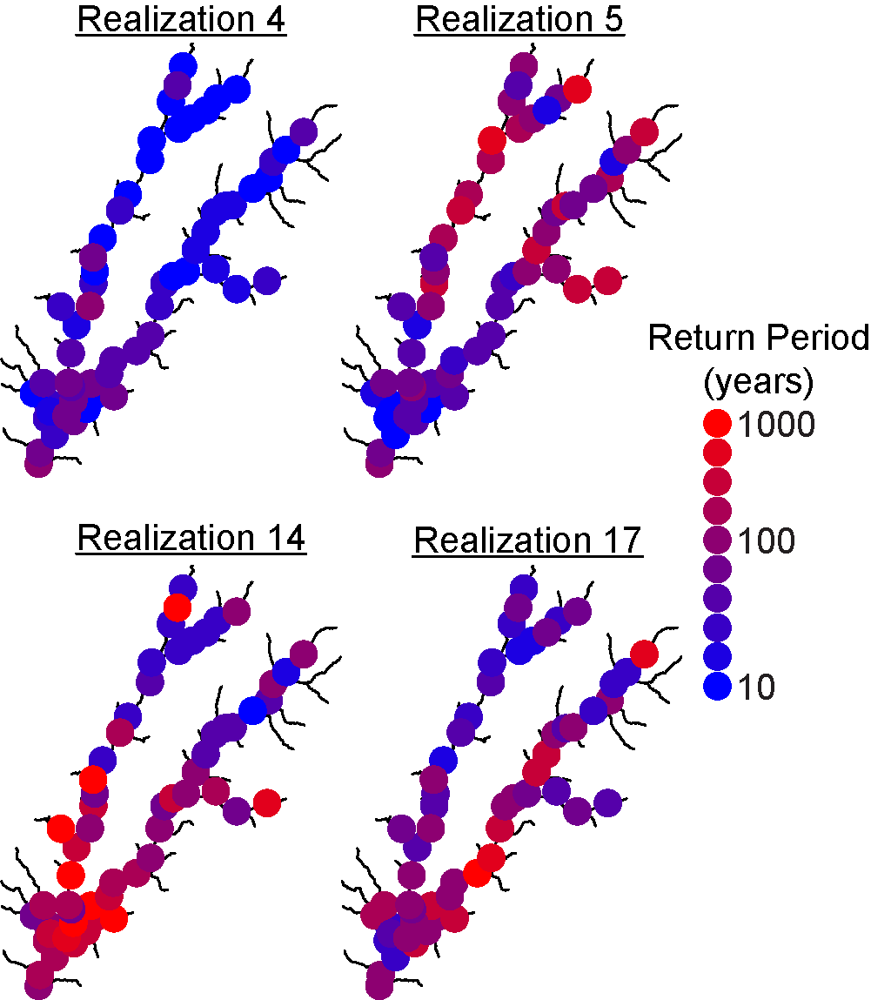
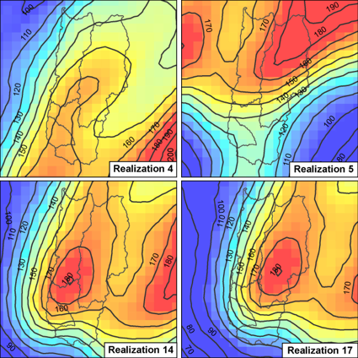
Example 1: Little Sugar Creek (110 km²)—Centrality of Rainfall Spatiotemporal Variability
Four randomly-generated floods that each produced 100-year discharge at the outlet:
Transposed hi-res bias-corrected radar rainfall
Wright et al., Flood Frequency Using Radar Rainfall Fields and Stochastic Storm Transposition. WRR, 2014.

Slide 8
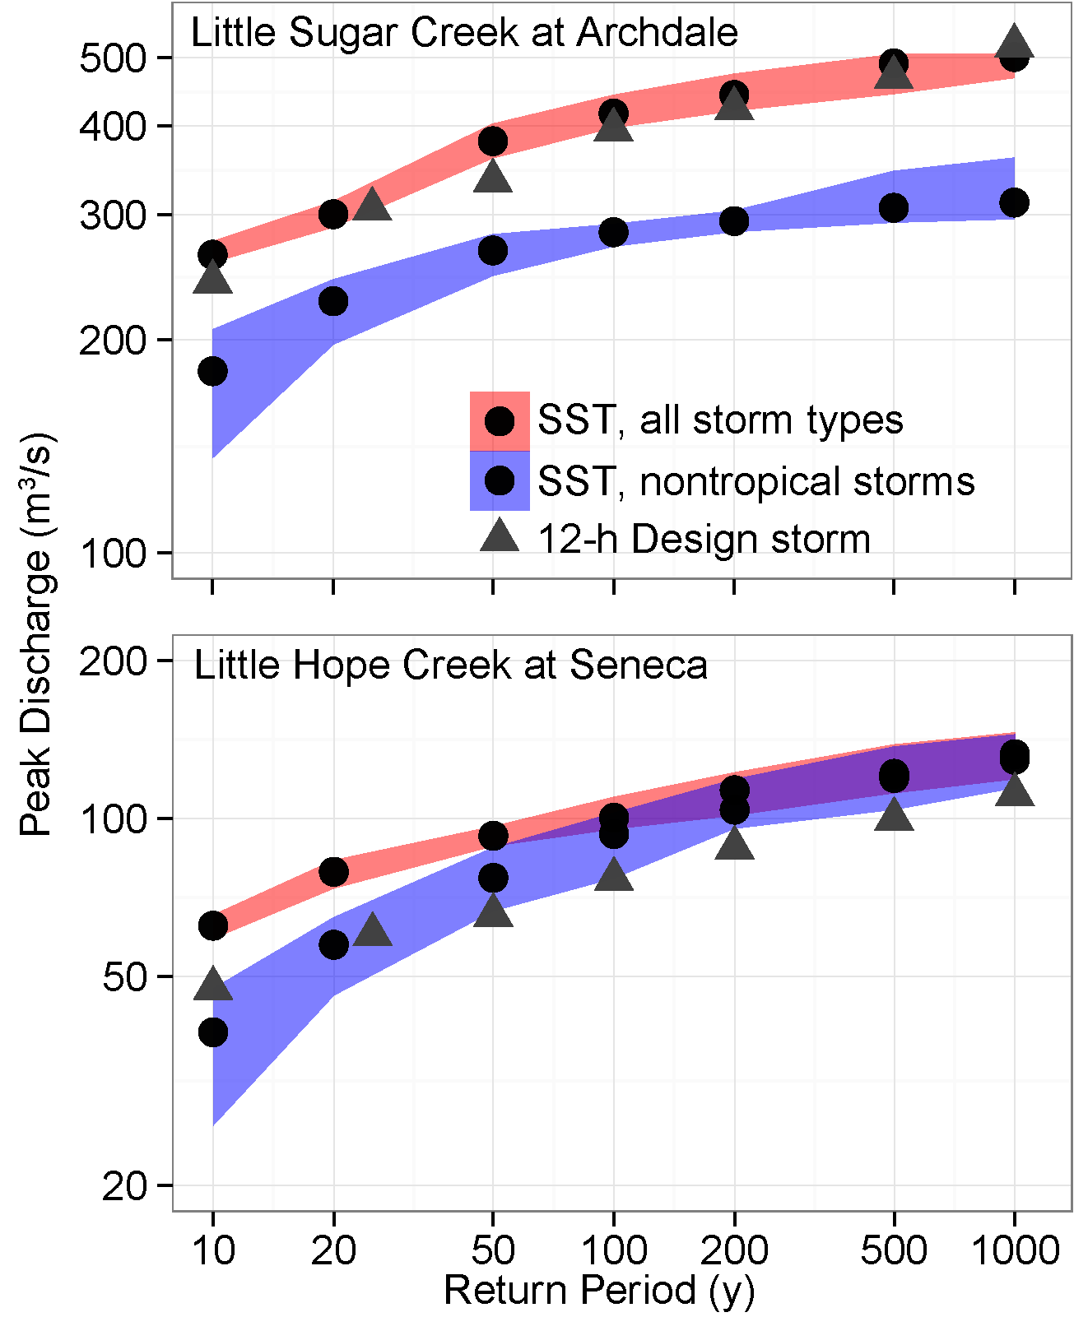
Example 1: Little Sugar Creek (110 km²)—Centrality of Rainfall Spatiotemporal Variability
Key Question #1:
How do different types of rainfall-producing storm systems change—in frequency, intensity, structure, and location—in a warming world?
110 km²
7 km²
Wright et al., Flood Frequency Using Radar Rainfall Fields and Stochastic Storm Transposition. WRR, 2014.

Slide 9
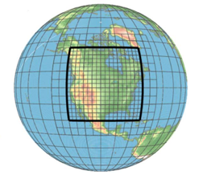
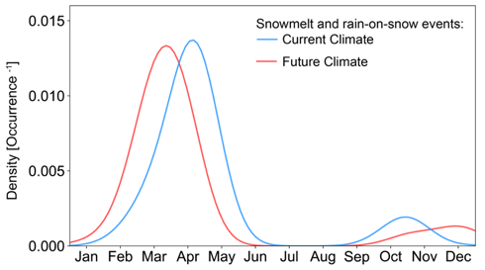
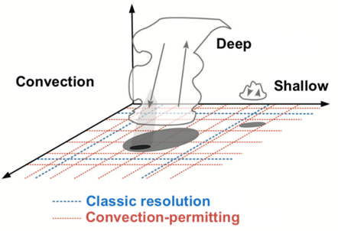
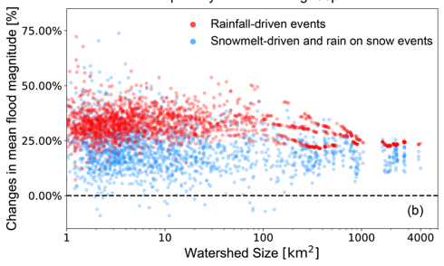
Example 2: Process-based FFA + CPM in Turkey River
Yu et al., The Upper Tail of Precipitation in Convection-Permitting Regional Climate Models and Their Utility in Nonstationary Rainfall and Flood Frequency Analysis, Earth's Future, 2020
NCAR “CONUS-I”
13 years: present day; end-of-century

Slide 10
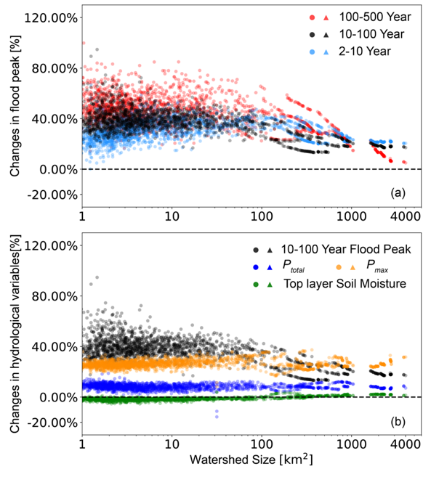
Example 2: Process-based FFA + CPM in Turkey River
Key Question #2:
What are the right roles for CPMs, ESM ensembles, and observations in modeling future changes in flood frequency across scales and geographies?
Yu et al., The Upper Tail of Precipitation in Convection-Permitting Regional Climate Models and Their Utility in Nonstationary Rainfall and Flood Frequency Analysis, Earth's Future, 2020

Slide 11
Flood frequency analysis is useful for studying flood changes; it is essential for decisionmaking
Process-based methods give us an alternative way to estimate flood frequency—and to understand what drives it
There’s much to be done to understand spatiotemporal flood frequency across scales, which requires integration of different types of models and observations—and at least in the USA, the clock is ticking: FEMA will deploy the approach very soon in practice!
Acknowledgements/Collaborators
Jim Smith & Mary Lynn Baeck (Princeton University), Witold Krajewski & Nicolas Velasquez (University of Iowa), Ricardo Mantilla (University of Manitoba), Christa Peters-Lidard (NASA), Amanda Stone & Kathleen Holman (Bureau of Reclamation), Eric Booth & Ken Potter (University of Wisconsin-Madison); Zhe Li & Frances Davenport (Colorado State University), Guo Yu (Desert Research Institute), Mike Fienen & Jeremy White (USGS), Fred Ogden & Luciana Cunha (NOAA), Zhengzheng Zhou & Qi Zhuang (Tongji University), Zhihua Zhu (Sun-Yat Sen University), Soren Thorndahl & Christoffer Andersen (Aalborg University), Nadav Peleg (University of Laussane), Gabriel Perez Mesa (Vanderbilt University); Greg Karlovitz (US Army Corps of Engineers); Seth Lawler & Alyssa Dietrich (Dewberry)

Slide 12
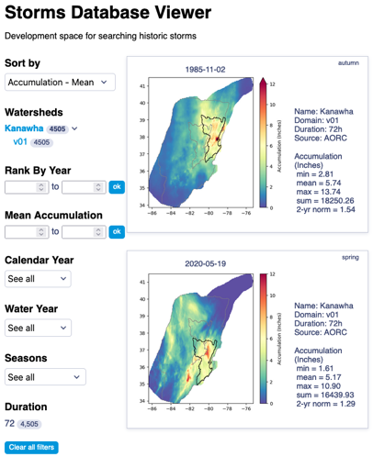
Process-Based FFA is coming!
FEMA’s Future of Flood Risk Data (FFRD) initiative: $2 billion USD for new floodplain mapping
Stochastic storm transposition in HEC-HMS
Storm typing, seasonality, etc.
Starting with present climate; will eventually include future climate projections
https://storms.dewberryanalytics.com/

